Slide 1
Lesson 47.2
The Importance of Biodiversity to Human Life

Slide 2
Objectives
Identify chemical diversity benefits to humans.
Identify biodiversity components that support human agriculture.
Describe ecosystem services.

Slide 3
Importance of Biodiversity
The loss of a particular individual species
May appear to be emotional from a human perspective
Is often unimportant from the perspective of evolution and ecology
Is disastrous is the species is a keystone species
Extinction is a normal part of macroevolution.
The current accelerated extinction rate resulting in the loss of tens of thousands of species within our lifetimes is likely to have a dramatic effect:
Through the collapse of ecosystems
In added costs to maintain food production, clean air and water, and human health

Slide 4
Humans Are Part of Ecosystems
While humans have transitioned from hunter-gatherers to heavily modifying their environments, they are still:
Embedded in ecosystems
Dependent on them
While agriculture and technology have smoothed out the extremes of existence, humans still require a supportive ecosystem.

Slide 5
Importance of Biodiversity to Human Health₁
Humans have been using plants for medicinal uses for thousands of years.
A Chinese document from 2800 BCE is thought to be the first written account of herbal remedies.
Contemporary indigenous societies often have broad knowledge of the medicinal uses of local plants.
Most plants produce secondary plant compounds (metabolites), which are toxins that:
Protect the plant from insects and other animals that eat them
Often work as medications

Slide 6
Importance of Biodiversity to Human Health₂
Examples of significant medicines derived from plant compounds include:
Aspirin
Codeine
Digoxin
Atropine
Vincristine
Many drugs that were once derived from plant extracts are now synthesized.
At one time, 25% of modern drugs contained at least 1 plant extract.
Today, only 10% of modern drugs contain a plant extract because many drugs are synthesized instead.
Antibiotics are largely derived from fungi and bacteria.

Slide 7
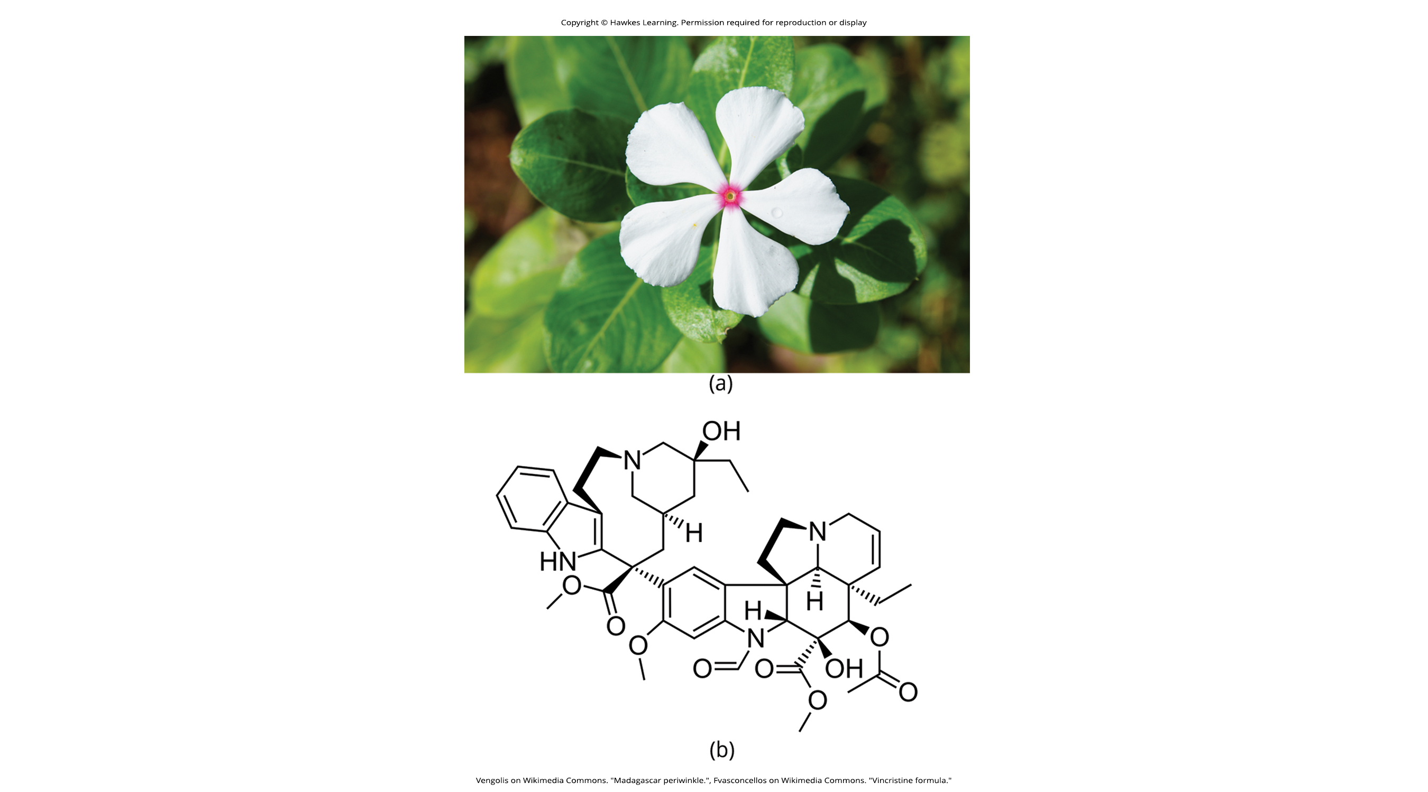
47.2 Figure 1
Vengolis on Wikimedia Commons. "Madagascar periwinkle."
Fvasconcellos on Wikimedia Commons. "Vincristine formula."
Notes:
47.2 Figure 1: (a) Catharanthus roseus, the Madagascar periwinkle, has various medicinal properties. Among other uses, it is a source of (b) vincristine, a complex molecule and drug used in the treatment of lymphomas.

Slide 8
Reflection Question₁
What types of stimulants, drugs, or medicines have you consumed that you think are secondary plant compounds?
Have you gotten these from natural or synthetic sources?
Notes:
The reflection question is included here to use as a talking point or for a think-pair-share activity.

Slide 9
Importance of Biodiversity to Human Health₃
Animal venoms and poisons are currently being studied for their medicinal potential.
As of 2020, the FDA had approved 11 drugs based on animal toxins to treat diseases, such as:
Hypertension
Chronic pain
Diabetes
These include:
1 molecule (ziconotide) from cone snails
2 molecules (exenatide and lixisenatide) from lizards
2 molecules (bivalirudin and desirudin) from leeches
6 molecules (captopril, enalapril, tirofiban, eptifibatide, batroxobin, and cobratide) from snakes
Other toxins being investigated come from mammals, snakes, lizards, amphibians, fish, snails, octopuses, and scorpions.

Slide 10
Importance of Biodiversity to Human Health₄
Medicines derived from natural compounds:
Improve people’s lives
Represent billions of dollars in profits for pharmaceutical companies
Pharmaceutical companies are always looking for new natural products that can function as medicines.
Estimates indicate that ~1/3 of pharmaceutical research and development is spent on natural compounds.
About 35% of new drugs brought to market between 1981–2002 were derived from natural compounds.
The disappearance of species will result in the loss of opportunities for the discovery and development of new medications.

Slide 11
Importance of Biodiversity to Agriculture: Human Influences
Since human agriculture began >10,000 years ago, humans have been breeding and selecting crop varieties.
Crop diversity has often been driven by human needs, as shown by the diversity of varieties of potatoes.
Potatoes were domesticated ~7000 years ago in the central Andes (Peru and Bolivia).
There are 7 species and thousands of varieties found there, each bred to thrive at particular elevations and soil and climate conditions.
Potato diversity is driven by the demands of topography, people’s limited movement, and crop rotation for different varieties that will do well in different fields.

Slide 12
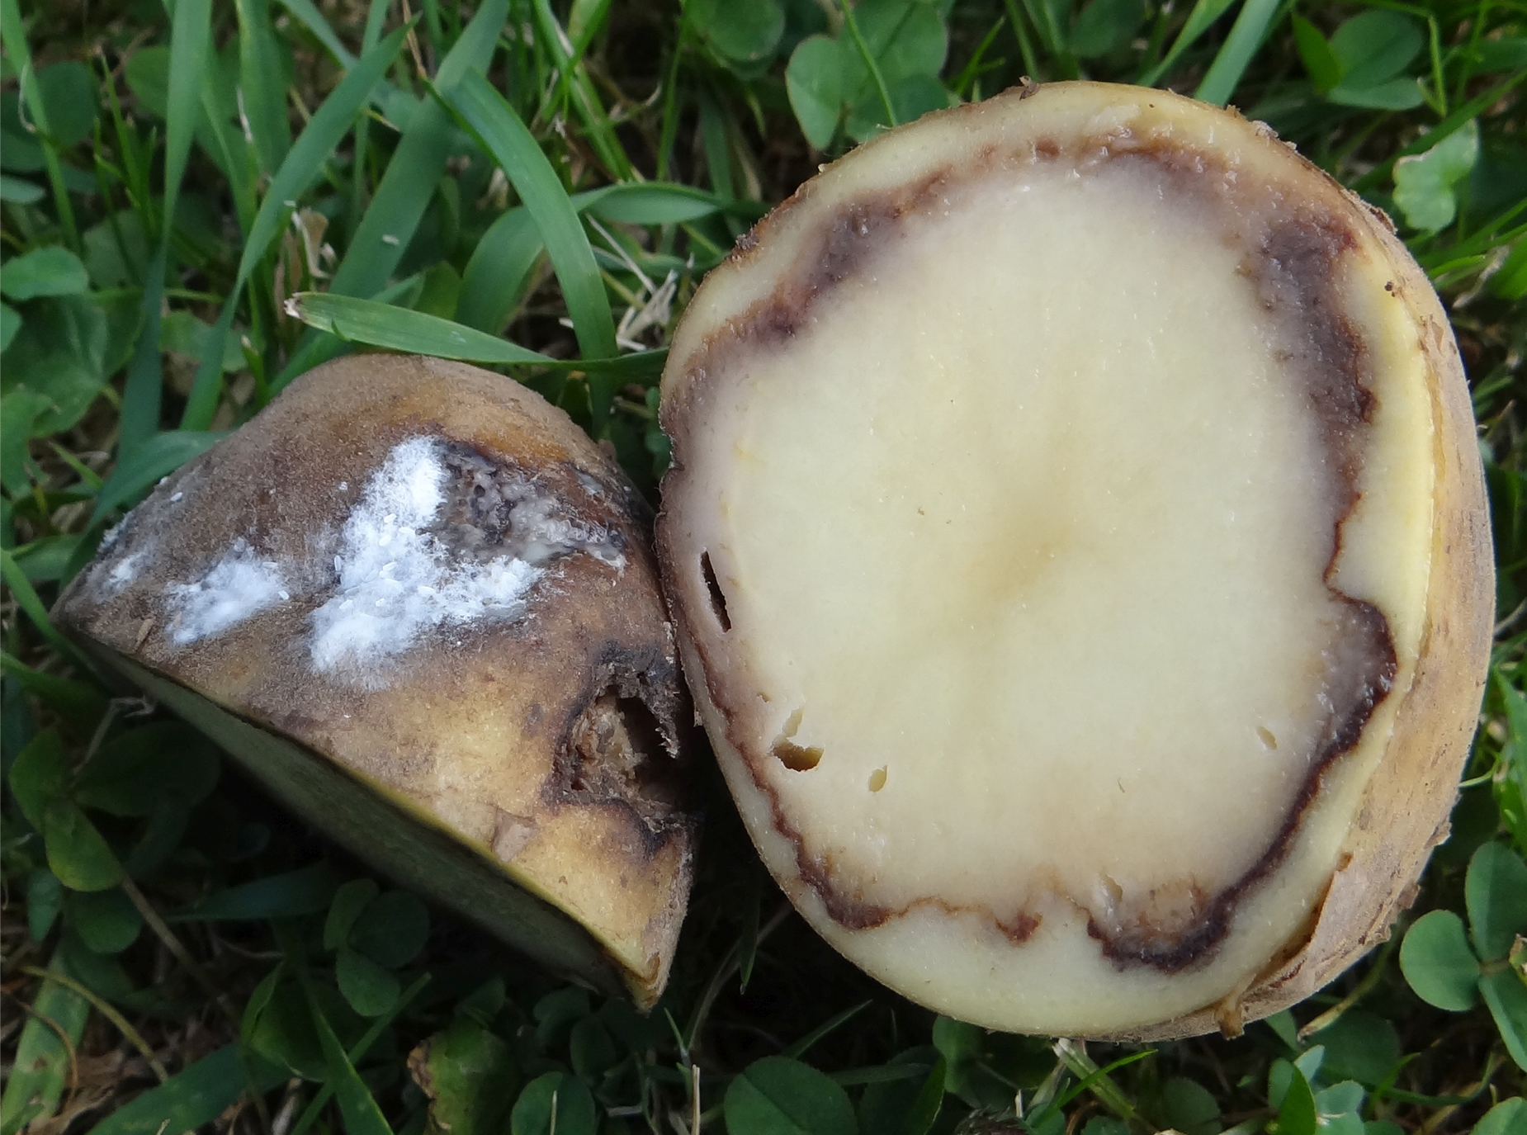
Importance of Biodiversity to Agriculture: Consequences of Low Crop Diversity
Low crop diversity can have catastrophic consequences.
When the single potato variety then available in Ireland became susceptible to potato blight, there was:
Mass famine
Death of >1 million people
Emigration of 2 million people
47.2 Figure 2
Jerzy Opioła on Wikimedia Commons. "Potato with blight."

Slide 13
Importance of Biodiversity to Agriculture: Human Demands
Every plant, animal, and fungus that has been cultivated by humans has been bred from the original wild ancestor species into diverse varieties arising from demands for:
Food value
Adaptation to growing conditions
Pest resistance

Slide 14
Importance of Biodiversity to Agriculture: Disease Resistance and Crop Varieties
Disease resistance is a chief benefit of crop diversity.
Seed companies:
Are the source of most crop varieties in developed countries
Must continually breed new varieties to keep up with evolving pests
Participate in the decline of the number of varieties because they focus on selling fewer varieties in more areas of the world.
The ability to create new crop varieties relies on:
The diversity of varieties available
The accessibility of wild forms related to the crop plant
These wild forms are the source of new gene variants that can be bred with existing varieties to create varieties with new traits, allowing us to have a continued food supply.
The loss of wild species relatives means the loss of potential to improve crops.

Slide 15
Importance of Biodiversity to Agriculture: Seed Banks
Government agriculture departments have maintained regional seed banks of crop varieties as a way to maintain crop diversity since the 1920s.
Seed banks unfortunately can be lost through accidents.
In 2008, the Svalbard Global Seed Vault began storing seeds from around the world as a backup system to regional seed banks.
Vault conditions are maintained at an ideal temperature and humidity for seed survival.
The deep underground arctic vault location means that failure of the vault’s systems will not compromise the vault’s climatic conditions.

Slide 16
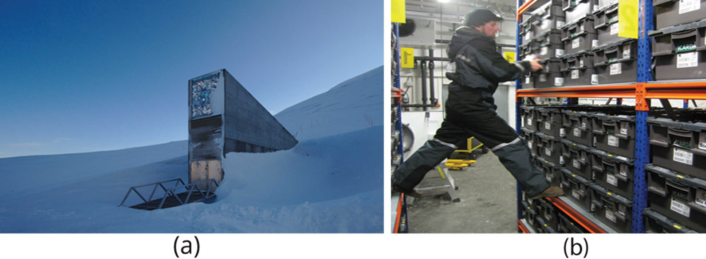
47.2 Figure 3
Einar Jørgen Haraldseid on Wikimedia Commons. "Svalbard Global Seed Vault."
Dag Endresen on Wikimedia Commons. "Seed vault."
Notes:
47.2 Figure 3: The Svalbard Global Seed Vault is a storage facility for seeds of Earth's diverse crops. (a) This remote, small entrance leads to a deep, (b) protected bunker that secures seed varieties.

Slide 17
Reflection Question₂
Genetically modified crops have been developed and used with increasing frequency in recent years. These are breeds of crops that have new genetic material added, sometimes from very different species, that endow them with new abilities (such as pest or drought resistance).
In what ways does the use of genetically modified crops represent a solution to biodiversity problems?
In what ways does it exacerbate the problem?
Notes:
The reflection question is included here to use as a talking point or for a think-pair-share activity.

Slide 18
Think It Through₁
The Svalbard Global Seed Vault is located on Spitsbergen island in Norway, which has an arctic climate.
Why might an arctic climate be good for seed storage?
Notes:
Originally an On Your Own. This is included here to use as a talking point or for a think-pair-share activity.

Slide 19
Think It Through₂
In addition to the Svalbard Global Seed Vault, how else can we preserve a crop variety from extinction?
Notes:
Originally an On Your Own. This is included here to use as a talking point or for a think-pair-share activity.

Slide 20
Importance of Biodiversity to Agriculture: Factors Influencing Crop Success
Crop success is largely dependent on soil quality.
Most soils contain a huge diversity of organisms that maintain:
Nutrient cycles, the breaking down of organic matter into nutrients that crops need
Soil texture, which affects water and oxygen dynamics in the soil that plants need for growth
Note that the need to aerate soils alternatively would be expensive.
These processes are examples of ecosystem services, diverse metabolic activities of resident organisms that provide benefits to:
Human food production
Drinking water availability
Breathable air

Slide 21
Importance of Biodiversity to Agriculture: Plant Pollination
Plant pollination is another key ecosystem service, provided by:
Bees
Other insects
Birds
Honeybees provide the U.S. a $1.6 billion annual benefit.
North American honeybee populations have been suffering losses due to colony collapse disorder.
This may be due to a combination of infections by varroa mites and Nosema gut parasites.
Loss of honeybees would dramatically reduce the ability to grow crops requiring pollination, including grapes, oranges, lemons, peppers, broccoli and cauliflower, and many berries, melons, and nuts.

Slide 22
Importance of Biodiversity to Agriculture: Impacts of Pests
Most crop pests are insects.
While pesticides control these pests:
They are costly.
They lose their effectiveness over time as pest populations adapt and evolve.
They kill non-pest species.
They risk the health of consumers and agricultural workers.
Ecologists suspect that most pest removal results from predators and parasites of the pests.
74% of relevant studies suggest that the greater the landscape complexity, the greater the effect of pest-suppressing organisms in pest control.
An experiment showed that introducing multiple enemies of pea aphids (an important alfalfa pest) increased the yield of alfalfa significantly, indicating that pest diversity is more effective at control than a single pest.

Slide 23
Science and You
Concentrated Animal Feed Operations (CAFOs):
Show how modern industrial agriculture impacts biodiversity
Provide affordable protein and nutrition, reducing the need to overharvest wild animals
Also typically:
Lack animal biodiversity
Contribute to ecological problems like climate change through the fuel needed and emissions produced
Promote pathogen diversity (due to crowded conditions, international livestock trade, and routine subtherapeutic antibiotic use to promote weight gain) which fosters the evolution of new harmful viruses and bacteria (including antibiotic-resistant bacteria)
Notes:
This is included as a relevant application for this topic.

Slide 24
Importance of Biodiversity: Wild Food Sources Like Fish
Humans obtain food from wild populations, primarily fish.
For 1 billion people worldwide, aquatic resources are the main source of animal protein.
Since 1990, global fish production has declined.
Few fisheries are managed to promote sustainability.
Fisheries typically do not lead to extinction of the harvested species, but rather to overharvesting of the species, restructuring the ecosystem and causing:
Loss of a food/protein source, which may be problematic for societies dependent on it but that cannot replace it
Loss of jobs and other negative economic effects
Fisheries now typically harvest smaller species since larger ones are fished to extinction.
The loss of aquatic ecosystems as food sources is a major concern.

Slide 25
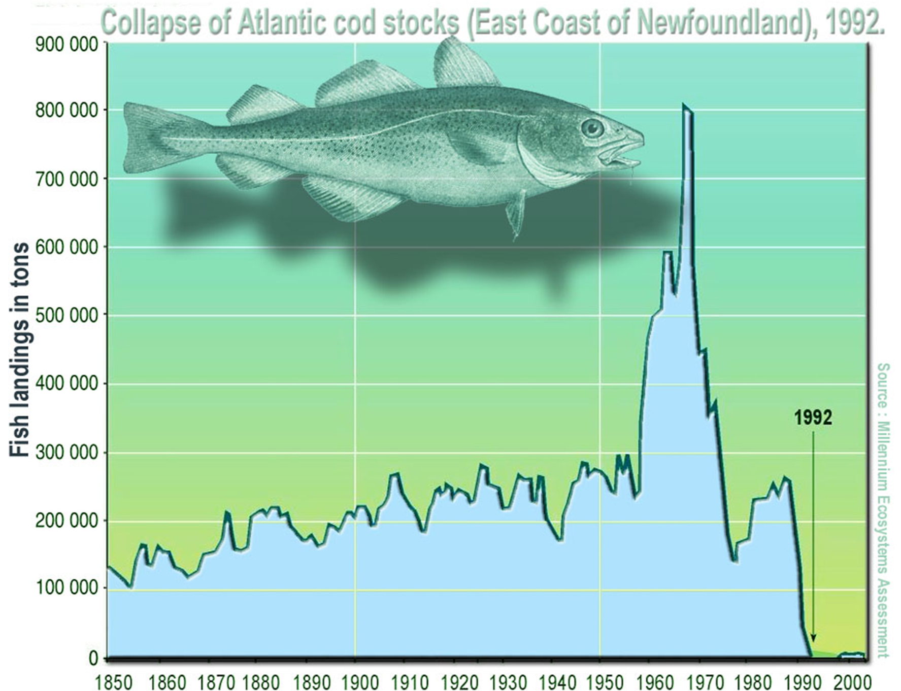
47.2 Figure 4
Lamiot on Wikimedia Commons. "Atlantic cod stocks."
Notes:
47.2 Figure 4: The collapse of Atlantic cod stocks was a result of overfishing and other environmental changes. Beginning in the late 1950s, offshore bottom trawlers began to overfish the stock of fish. Government intervention in the form of fishing quotas led to a decline in the amount of overfishing but did not reverse the collapse of the population.

Slide 26
Importance of Biodiversity: Psychological and Moral Value
Humans benefit psychologically from living in a biodiverse world.
E.O. Wilson (Harvard entomologist) argues that:
Human evolutionary history has adapted us to live in a natural environment
City environments generate psychological stressor that affect human health and well-being
Considerable research into the psychological regenerative benefits of natural landscapes support this.
There is a moral argument that humans have a responsibility to inflict as little harm as possible on other species.

Slide 27
Summary
Humans use many compounds that were first discovered or derived from living organisms as medicines:
Secondary plant compounds
Animal toxins
Antibiotics produced by bacteria and fungi
Future pharmaceuticals will likely be discovered in nature, so loss of biodiversity limits potential new medicines.
Crop diversity is essential for food security and is being lost.
Loss of wild crop relatives threatens breeders' ability to develop new varieties.
Ecosystem services, such as pollination, nutrient cycling, pest control, and soil development, support human agriculture.
Loss of biodiversity threatens these services, risking making food production more expensive or impossible.
Wild food sources, primarily aquatic, are often not sustainably managed, threatening fisheries' ability to supply protein.
Biodiversity provides psychological benefits to humans and has moral significance.

Slide 28

End of Hawkes Learning PowerPoint

