Slide 1
Lesson 47.3
Threats to Biodiversity

Slide 2
Objectives
Identify significant threats to biodiversity.
Explain the effects of habitat loss, the introduction of exotic species, and hunting on biodiversity.
Identify the early and predicted effects of climate change on biodiversity.
Understand organizations that fight for our planet's declining biodiversity.

Slide 3
Threats to Biodiversity
The core threat to the planet's biodiversity and human welfare is the combination of:
  Human population growth
  Resources exploitation
The 3 greatest immediate threats to biodiversity are:
    Habitat loss
    Overharvesting
    Introduction of exotic (invasive) species
  The first 2 threats result directly from human population growth and resource use.
  The third threat results from increased mobility and trade.
A fourth major cause of extinction is anthropogenic (due to human activity) climate change, which is becoming more significant this century.
  This also results from human needs for energy and fossil fuel use to meet those needs.
Environmental issues (including toxic pollution) target specific species but are not considered as large of threats as the others.

Slide 4
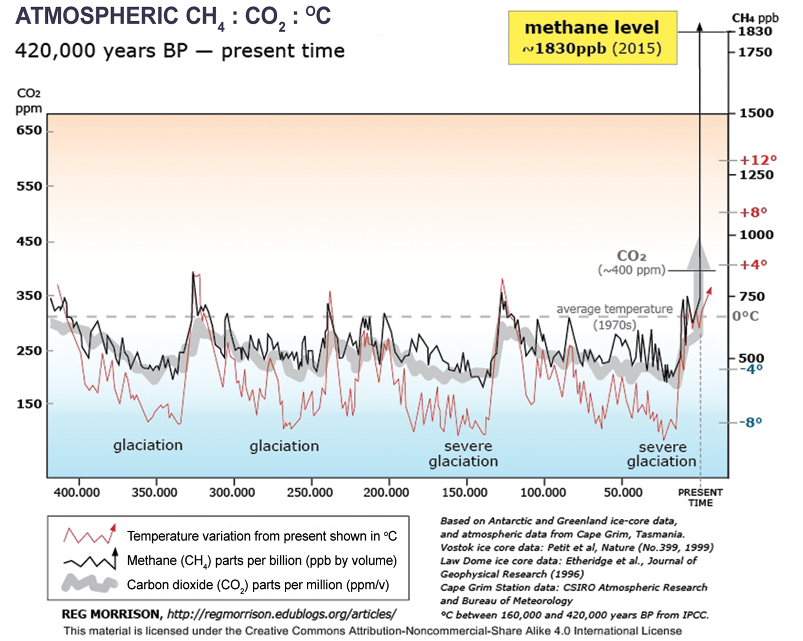
47.3 Figure 1
Reg Morrison on Wikimedia Commons. "Atmospheric carbon dioxide levels."
Notes:
47.3 Figure 1: Atmospheric carbon dioxide (CO2) levels fluctuate in a cyclical manner that correlates well with climate. However, the burning of fossil fuels in recent history has caused a dramatic increase in the levels of carbon dioxide in the Earth's atmosphere, which have now reached levels never before seen in human history. Scientists predict that the addition of this "greenhouse gas" to the atmosphere is resulting in climate change that will significantly impact biodiversity in the coming century.

Slide 5
Habitat Loss
Elimination of the ecosystem (forest, desert, grassland, freshwater estuary, marine environment) will kill individuals belonging to a species living in the ecosystem.
Other species cannot use technology to replace ecosystem functions.
The species will become extinct if the entire habitat within range of the species is removed.
Human destruction of habitats has accelerated in the latter half of the 20th century.

Slide 6
Habitat Loss: Effects on Sumatra and Borneo
Sumatra has exceptional biodiversity that incudes:
  One species of orangutan
  A species of critically endangered elephant
  The Sumatran tiger
Half of Sumatra's forest is now gone.
Borneo (a neighboring island and home to another species of orangutan) has lost a similar amount of forest and continues to do so.
All 3 species of orangutan are listed as endangered by the International Union for Conservation of Nature (IUCN).
  These orangutans are the most visible of thousands of species that will not survive the disappearance of these forests.
Forests are removed for timber and plant palm oil plantations.
  Palm oil is used in many products: food, cosmetics, biodiesel.

Slide 7
Habitat Loss: Global Forests
3.1% of global forest cover was lost between 2000–2005.
In the humid tropics, forest loss is primarily from timber extraction.
  272,000 km² was lost out of a global total of 11,564,000 km² (a 2.4% loss).
  Extinction here is due to a high level of endemism (species that are unique to a defined geographic location and found nowhere else).
Soil erosion after forest removal can remove fertile soil and make rivers toxic.
  Wangari Maathai (Nobel Prize winner) founded the Green Belt Movement in Kenya, which focuses on replanting trees to reverse these effects.

Slide 8
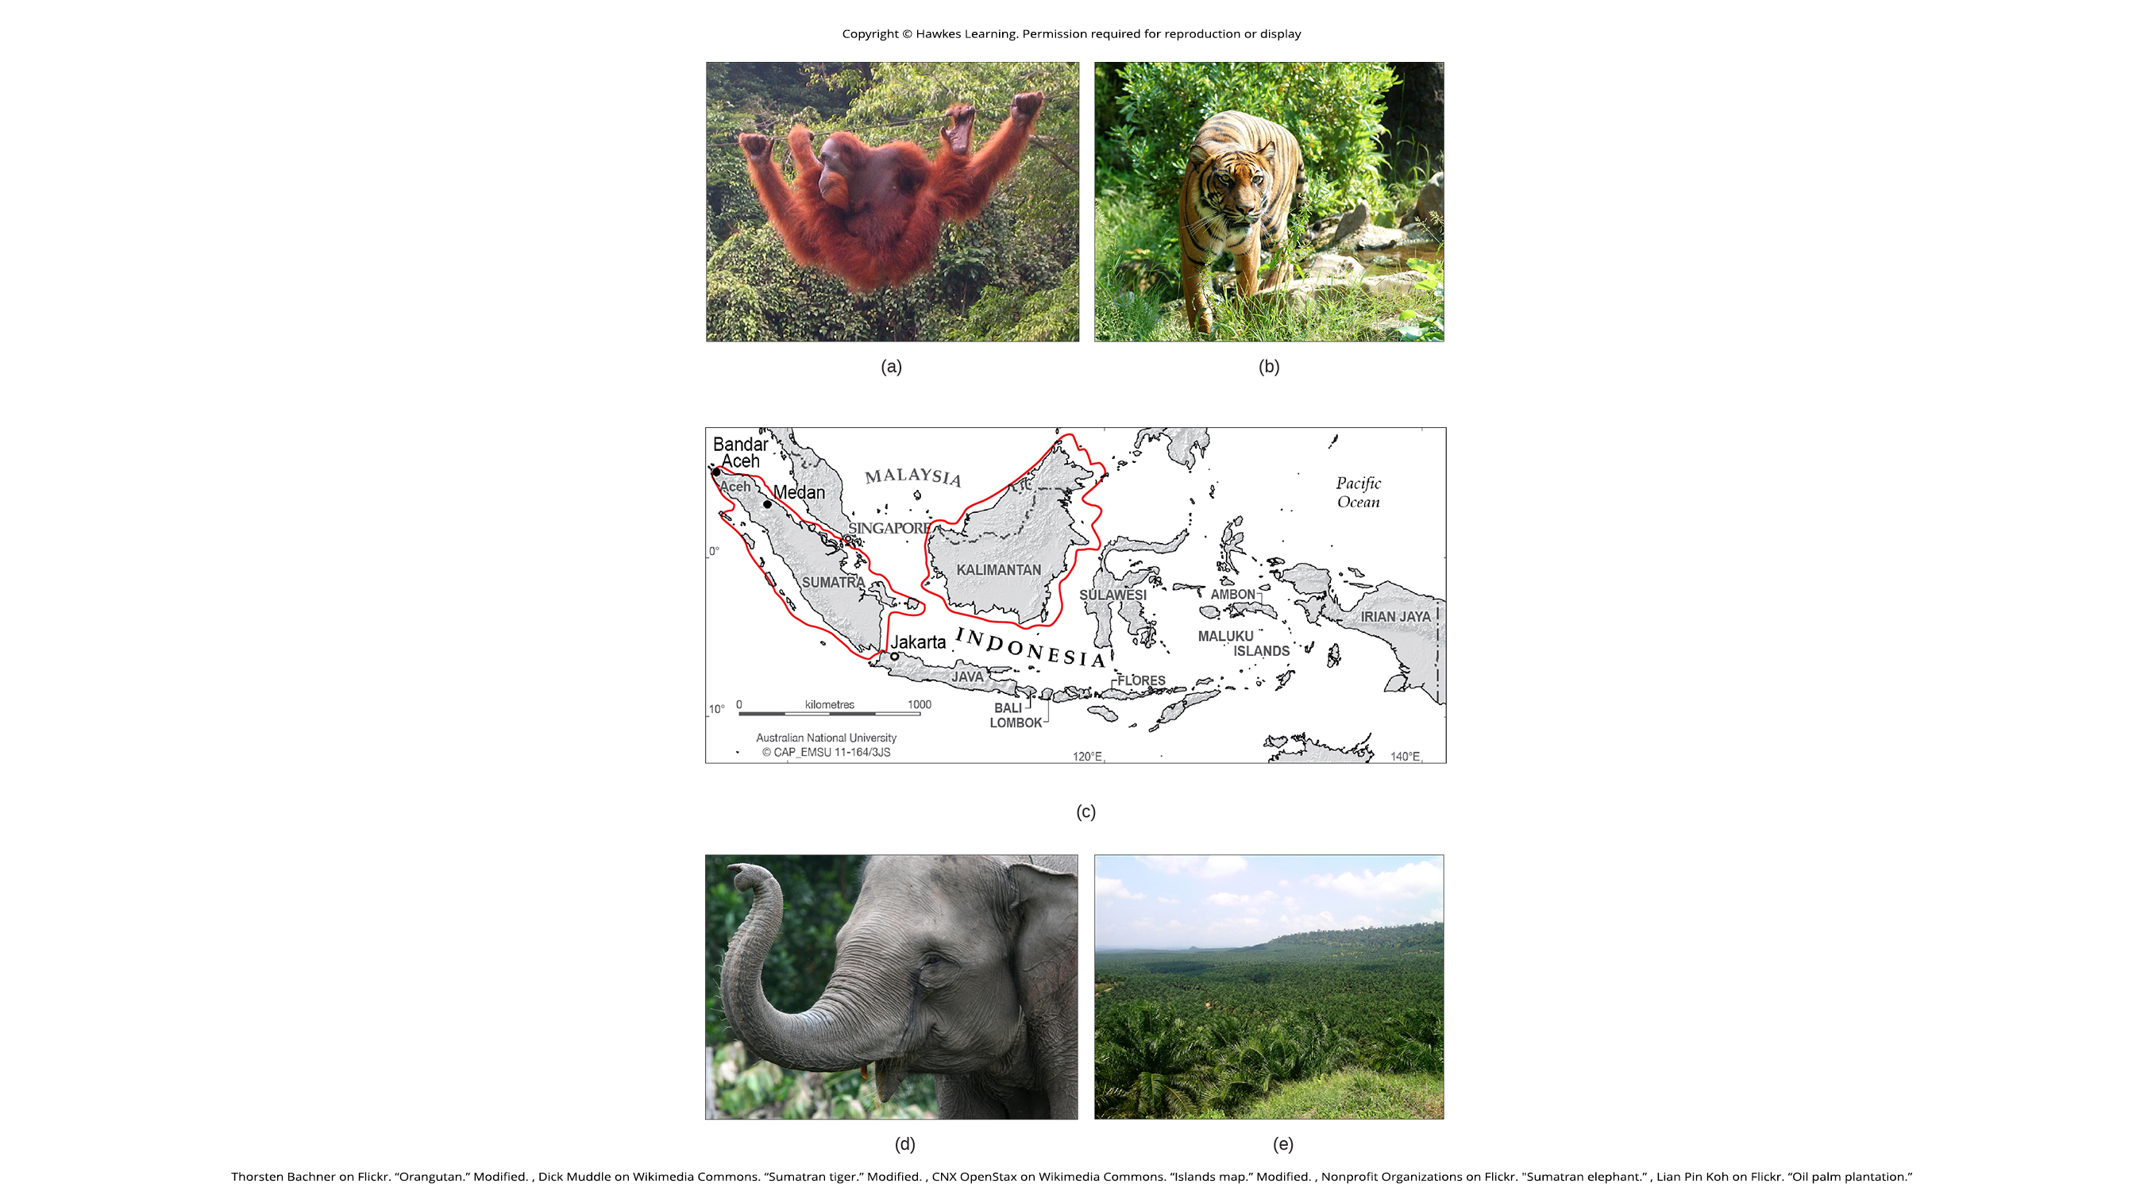
47.3 Figure 2
Thorsten Bachner on Flickr. "Orangutan." Modified.
Dick Muddle on Wikimedia Commons. "Sumatran tiger." Modified.
CNX OpenStax on Wikimedia Commons. "Islands map." Modified.
Nonprofit Organizations on Flickr. "Sumatran elephant."
Lian Pin Koh on Flickr. "Oil palm plantation."
Notes:
47.3 Figure 2: Biodiversity and endangered species in southeast Asia. (a) One of three species of orangutan, Pongo pygmaeus, is found only in the rainforests of Borneo, and another species of orangutan (Pongo abelii) is found only in the rainforests of Sumatra. These animals are examples of the exceptional biodiversity of (c) the islands of Sumatra and Borneo. Other species include the (b) Sumatran tiger (Panthera tigris sumatrae) and the (d) Sumatran elephant (Elephas maximus sumatranus), both critically endangered species. Rainforest habitat is being removed to make way for (e) palm oil plantations, such as this one in the state of Sabah in Borneo.

Slide 9
Science and You₁
Preventing Habitat Destruction with Wise Wood Choices
Consumers often unknowingly buy home improvement products that contribute to habitat loss and extinctions.
  Up to 10% of U.S. imported timber is potentially illegal, amounting to $3.6 billion in 2006.
Consumers can consider the following when making purchases:
  The Forest Stewardship Council (FSC) certifies sustainably harvested wood, so looking for this certification ensures that a consumer product is sustainably and legally harvested.
    Note that FSC certification applies to products, not producers.
  Other certifications may be unreliable.
  Buying domestic wood is a good alternative.
  Logging and forest management laws vary by country, so one should ask about the origin and legality of wood products.
Notes:
This is included as a relevant application for this topic.

Slide 10
Habitat Loss: Rivers and Streams
Rivers and streams are frequently modified through land development, damming, channelizing, or water removal.
~91% of U.S. rivers have been altered in some way, including:
  Damming to create energy or store water
  Levees to prevent flooding
  Dredging or rerouting to create more useful land
Damming affects water flow to all parts of a river, which can reduce or eliminate populations adapted to the natural flow of the river.
  Many fish and amphibian species and freshwater clams in the U.S. have seen declines as a result.

Slide 11
Overharvesting: Fisheries₁
Overharvesting particularly threatens aquatic (marine and freshwater) species.
The collapse of the western Atlantic cod fishery exemplifies this.
  While productive for 400 years, the introduction of modern factory trawlers in the 1980s caused it to become unsustainable.
Fishery collapse results from both economic and political factors.
  Fisheries are considered an international resource even when the fishing territory lies within a single country's territorial waters.
    This leads to tragedy of the commons, whereby no fisher has motivation to exercise restraint when they don’t own it, resulting in overexploitation.
  Overexploitation is exacerbated when the fishery is open and unregulated, and when technology easily allows overfishing.
  In some fisheries, biological growth of the resource is less than the potential growth of profits made from fishing if the time and money is invested elsewhere, leading to fishing the population to extinction.

Slide 12
Overharvesting: Fisheries₂
Fishery extinction is not the same as biological extinction because the last fish of a species is rarely removed.
Fishery extinction is still harmful to fish species and their ecosystems.
True extinction is possible.
  Whales have slow-growing populations due to low reproductive rates and thus are at risk of complete extinction due to hunting.
  Some shark species with restricted distributions are at risk of extinction.
  Groupers are slow-growing that include a number of species in the Caribbean that are at risk of extinction due to overfishing.

Slide 13
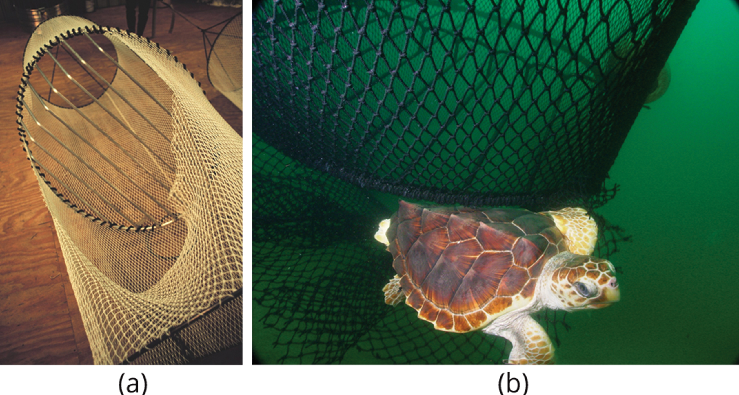
Overharvesting: Fisheries₃
Bycatch is any fish or other marine species that is caught unintentionally while harvesting a target species.
Turtle excluder devices (TEDs) on fishing nets help to reduce the bycatch of species (like the loggerhead seat turtle) because they allow them to swim out.
47.3 Figure 3: (a) Turtle excluder devices, or TEDs, are placed on fishing nets so that species, such as the (b) loggerhead sea turtle (Caretta caretta), can swim freely out of the nets and not become bycatch.
NOAA on Wikimedia Commons. "Loggerhead turtle."
William B. Folsom, NMFS on Wikimedia Commons. "Turtle excluder device."

Slide 14
Overharvesting: The Pet Trade
Most home marine aquaria are stocked with wild-caught organisms.
  Coral reefs are home to ~1/3 of the world's marine species (~4000 species) despite making up only 1% of marine habitat.
  While no species are known to have been driven extinct as a result, some species have declined, suggesting unsustainable harvesting.
There are concerns about the effect of the pet trade on some terrestrial species as well:
  Turtles
  Amphibians
  Birds
  Plants
  Orangutans

Slide 15
Science and You₂
Native Species: Diamond Terrapin
The United States is home to the diamondback terrapin (Malaclemys terrapin), the only turtle species living entirely in brackish water in marsh ecosystems.
Diamondback terrapins inhabit the East Coast and Gulf of Mexico.
Historically harvested for "turtle soup" in the early 1900s, their populations are vulnerable due to slow reproductive maturity (up to 8 years) and low survival rates of young terrapins.
They are still harvested for food and the pet trade in parts of the country.
Protection is state-regulated, with some states increasing regulations to protect them.
Threats include habitat loss and drowning in crab pots, where up to 40 terrapins can drown in a single pot.
Turtle excluder devices (TEDs) on crab pots can prevent the large terrapins from entering while allowing smaller crabs to enter.
Notes:
This is included as a relevant application for this topic.

Slide 16
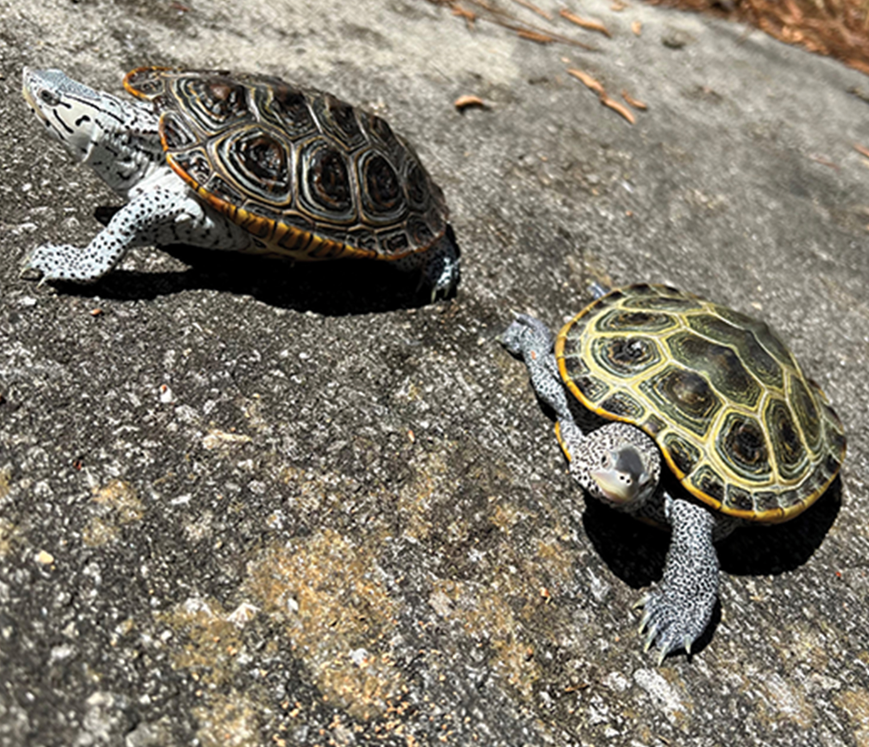
47.3 Figure 4
Notes:
47.3 Figure 4: Pictured are two rescued adult male diamondback terrapins (Malaclemys terrapin). Diamondback terrapins have a variety of skin and shell colors.

Slide 17
Overharvesting: Bush Meat
Bush meat refers to wild animals killed for food.
  Hunting practices, particularly in equatorial Africa and parts of Asia, threaten several species with extinction.
  While bush meat in Africa was traditionally hunted to feed families directly, it is now available in grocery stores, making the harvest rates unsustainable.
  Human population growth has increased the need for protein that is not being met by agriculture.
  Threatened species are mostly mammals, including primates in the Congo basin.

Slide 18
Introduction of Exotic Species
Exotic species are those that have been intentionally or unintentionally introduced into an ecosystem where they did not evolve.
Kudzu (Pueraria lobata):
  Is native to Japan
  Was introduced into the U.S. in 1876
  Is an invasive pest, growing up to 1 foot per day in the southeastern U.S.
  Covers >7 million acres in the southeastern U.S.
Human transportation of people and goods has dramatically increased the introduction of species into new ecosystems, sometimes great distances away and outside the range of natural predators.

Slide 19
Science and You₃
Exotic Species: The Japanese Giant Hornet ("Murder Hornet")
The Asian or Japanese giant hornet (Vespa mandarinia), also known as the "murder hornet," was first reported in the Pacific Northwest in North America in 2019.
Endemic to East and South Asia, it is the world's largest hornet.
The hornet's presence in the Pacific Northwest raises concerns about it becoming an invasive species.
It poses a significant threat to North American honeybees, which lack evolved defenses against it.
Asian giant hornets can decimate beehives, impacting honey production and pollination-dependent agriculture.
Efforts to manage the threat involve local, state, and federal responses in the U.S.
Notes:
This is included as a relevant application for this topic.

Slide 20
Introduction of Exotic Species: Invasive Species
Most introductions of exotic species fail due to either the low number of individuals introduced or poor adaptation to the new ecosystem.
Some species (called invasive species) possess pre-adaptations that make them very successful, allowing for dramatic population increases and threatening existing species.
  Eurasian star thistle (spotted knapweed):
    Has invaded some open prairies of the western states, rendering them useless
    Has great nectar-bearing flowers for producing honey and supporting numerous pollinating insects like migrating monarch butterflies

Slide 21
Introduction of Exotic Species: Lakes and Islands
Lakes and islands:
Contain a disproportionate number of endemic species because of their isolation from mainland ancestors
Are very vulnerable to extinction threats from introduced species
Examples of exotic species introduced to lakes and islands include:
The intentional introduction of the Nile perch to Lake Victoria, resulting in the extinction of ~200 endemic cichlid species
The accidental introduction of the brown tree snake via aircraft from the Solomon Islands to Guam in 1950, resulting in the extinction of 3 bird and 3–5 reptile species endemic to the island
  The brown tree snake is adept at using human transportation.
  A snake was found on an aircraft arriving in Corpus Christi, TX.
  Constant vigilance on the part of airport, military, and commercial aircraft personnel is needed to keep the snake from moving to other Pacific islands like Hawaii.

Slide 22
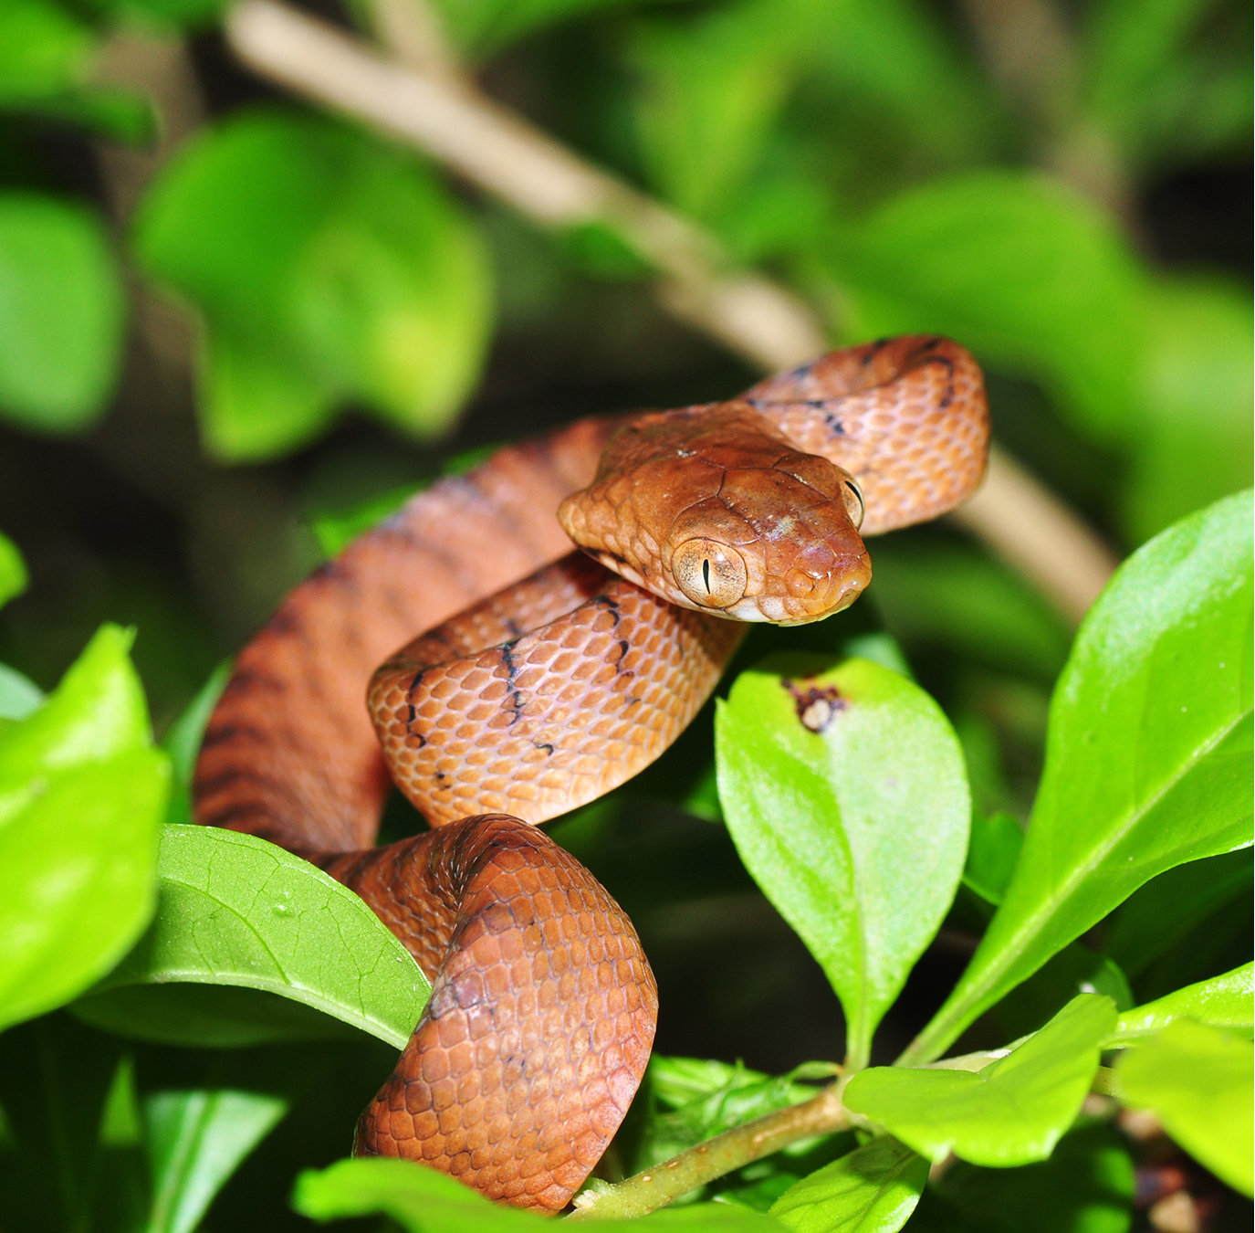
47.3 Figure 5
Pavel Kirillov on Wikimedia Commons. "Brown tree snake."
Notes:
47.3 Figure 5: The brown tree snake, Boiga irregularis, is an invasive species that has caused numerous extinctions on the island of Guam since its accidental introduction in 1950.

Slide 23
Introduction of Exotic Species: Chytridiomycosis
The global decline in amphibians since the 1990s is caused at least in part by chytridiomycosis, a disease caused by infection with the fungus Batrachochytrium dendrobatidis.
The fungus:
  Appears to be native to Africa
  May have been spread by the worldwide transport of the African clawed toad (Xenopus laevis), a laboratory and pet species
The North American bullfrog Rana catesbeiana:
  Has been introduced as a food animal
  Easily escapes captivity
  Survives most fungal infections
  Serves as a reservoir for the fungus
  Is a voracious predator in freshwater lakes

Slide 24
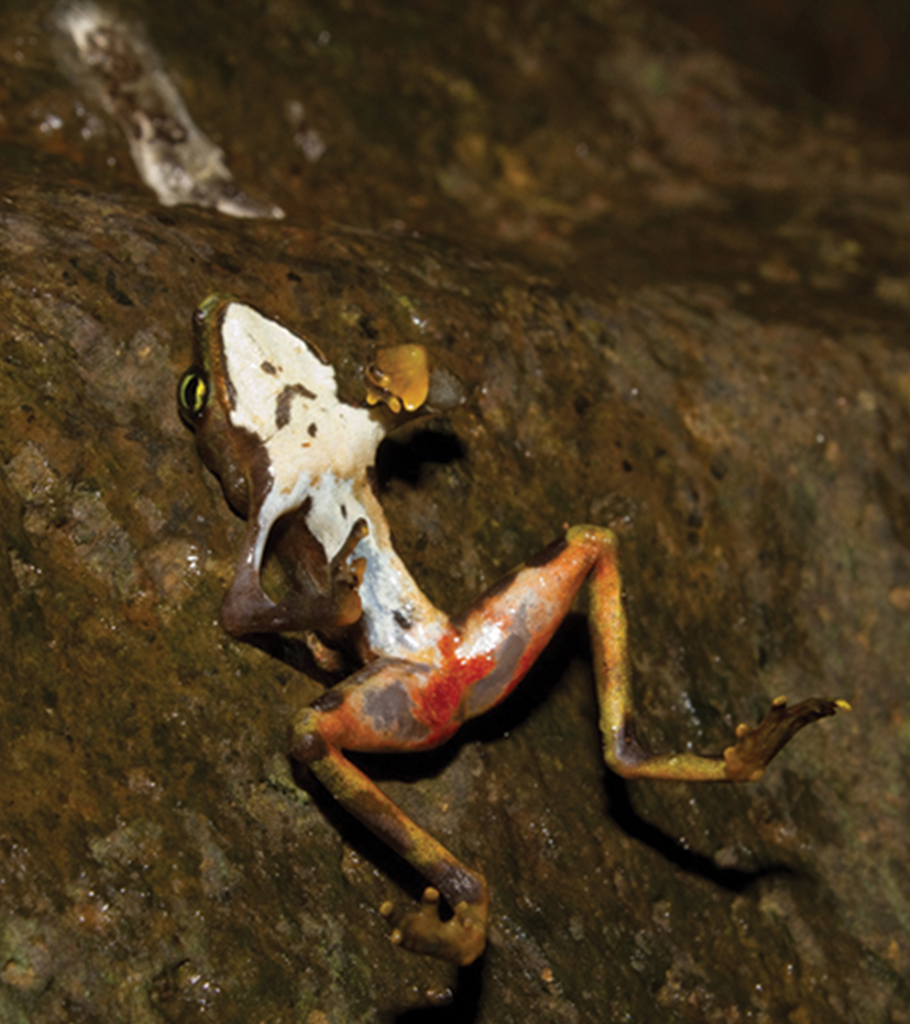
47.3 Figure 6
Brian Gratwicke. "Fungal disease in frog."
Notes:
47.3 Figure 6: This limosa harlequin frog (Atelopus limosus), an endangered species from Panama, died from a fungal disease called chytridiomycosis. The red lesions on its underside are symptomatic of the disease.

Slide 25
Introduction of Exotic Species: White-Nose Syndrome
White-nose syndrome, a disease of cave-hibernating bats in eastern North America, appears to be caused by the fungus Geomyces destructans introduced from Europe.
The disease originated in the U.S. in western New York state.
It has decimated and threatens the extinction of 2 bat species:
  The Indiana bat (Myotis sodalis)
  The Virginia big-eared bat (Corynorhinus townsendii virginianus)
While how the fungus was introduced is unclear, it may have been through the clothes and/or equipment of recreational cavers coming from Europe.

Slide 26
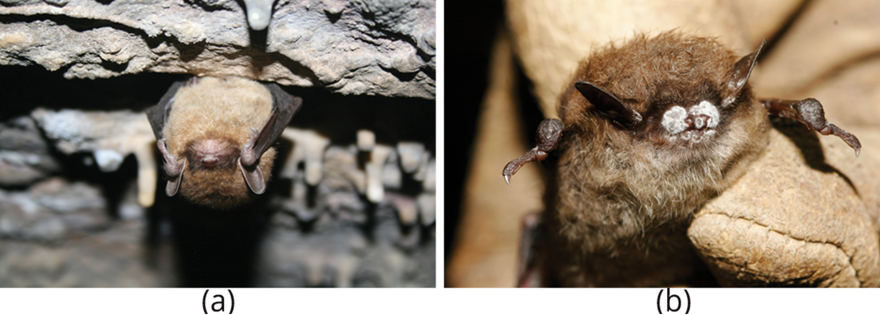
47.3 Figure 7
U.S. Fish and Wildlife Service Headquarters on Wikimedia Commons. "Healthy brown bat and one with white-nose syndrome."
Notes:
47.3 Figure 7: A close-up on (a) a healthy brown bat and one with (b) white-nose syndrome

Slide 27
Climate Change
Climate change, specifically the anthropogenic warming trend currently escalating, is a major extinction threat, especially when combined with other threats (habitat loss, expansion of disease).
Scientists estimate 15–40% of species are destined for extinction by 2050 due to climate change.
Climate change will:
  Alter regional climates (including rainfall and snowfall), making habitats less hospitable for endemic species
  Shift colder climates toward the North and South Poles, forcing species to move, facing habitat gaps along the way
  Cause more competition as species find themselves in contact with species not in their historic ranges (such as grizzly bears being in contact with polar bears)
  Throw off species' delicately timed adaptations to seasonal food resources and breeding times

Slide 28
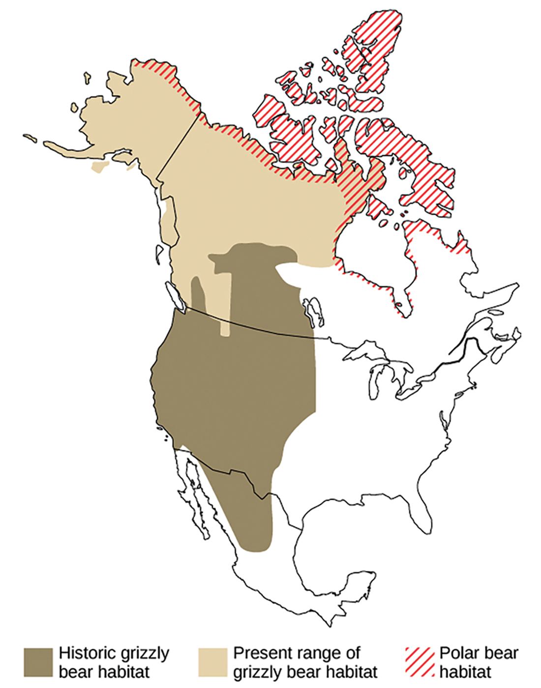
47.3 Figure 8
Maxim187 on Wikimedia Commons. "Grizzly bear habitats."
Notes:
47.3 Figure 8: Since 2008, grizzly bears (Ursus arctos horribilis) have been spotted farther north than their historic range, a possible consequence of climate change. As a result, grizzly bear habitat now overlaps polar bear (Ursus maritimus) habitat, which spans the northern shore of Canada and the Arctic Archipelago. The two species of bears, which are capable of mating and producing viable offspring, are considered separate "ecological" species because, historically, they lived in different habitats and never met. However, in 2006, a hunter shot a wild grizzly-polar bear hybrid, known as a grolar bear—the first wild hybrid ever found.

Slide 29
Climate Change: Range Shifts
Range shifts resulting from climate change are already being seen.
Some European bird species ranges have moved 91 km northward.
  This study also suggested that the optimal shift based on warming trends was 2X this distance, indicating that the populations are not moving fast enough.
Range shifts have also been observed for plants, butterflies, other insects, freshwater fishes, reptiles, and mammals.

Slide 30
Climate Change: Other Effects
Climate gradients will move up mountains, causing:
Crowding of species at higher altitudes
Habitat elimination for those adapted to the highest elevations
Some climates will disappear entirely.
The accelerating warming rate of the arctic will reduce snowfall and sea ice formation.
Species like polar bears will be unable to hunt seals, their only reliable food source.
Sea ice coverage has been decreasing, and the rate of decline has been much greater than earlier predictions.
Ocean levels will rise due to the meltwater from glaciers and the increased volume of warmer water.
Shorelines will be inundated.
Island sizes will be reduced or disappear.
The melting and refreezing cycle of the poles, glaciers, and higher elevation mountains, which has provided freshwater for centuries, will be jeopardized.
There will be an salt water overabundance and a fresh water shortage.

Slide 31
Think It Through
Fill in the blank in the following sentence with the most likely statement or prediction resulting from climate change.
Climate change will [blank].
lead to more tropical disease in North America
lead to more plant biodiversity in North America and arctic regions
increase chances of endotherm extinction, while allowing ectotherms to flourish
not have any effect on biodiversity
Notes:
Originally an On Your Own. This is included here to use as a talking point or for a think-pair-share activity.

Slide 32
Summary
The core threats to biodiversity are:
  Human population growth
  Unsustainable resource use
To date, the most significant causes of extinction are:
  Habitat loss (through deforestation, damming of rivers, and other human activities)
  Introduction of exotic species (especially impacting islands and lakes and due to increased human mobility and trade)
  Overharvesting (particularly of aquatic species and those used as bush meat)
Climate change will be a major cause of extinctions in the coming century.
  It forces range changes that may lead to extinction.
  It affects adaptations to the timing of resource availability.
  Its impacts are greatest in the arctic.
  Sea levels will rise, reducing or eliminating island area.

Slide 33

End of Hawkes Learning PowerPoint

