Slide 1
Lesson 47.4
The Future: Preserving Biodiversity

Slide 2
Objectives
Identify new technologies and methods for describing biodiversity.
Explain the legislative framework for conservation.
Describe principles and challenges of conservation preserve design.
Identify examples of the effects of habitat restoration.
Discuss the role of zoos in biodiversity conservation.

Slide 3
Preserving Biodiversity
Preserving biodiversity requires:
A greater understanding of biodiversity itself
Changes in human behavior and beliefs
Various preservation strategies

Slide 4
Measuring Biodiversity: DNA Barcoding₁
The technologies of molecular genetics and data processing and storage are making cataloguing the planet's species in an accessible way more feasible.
DNA barcoding is a molecular method involving DNA sequencing that takes advantage of the rapid evolution of certain genes in eukaryotic organelles derived from bacterial endosymbiosis.
  Portions of the mitochondrial cytochrome c oxidase 1 gene are used to identify all eukaryotic species except plants, which lack this gene.
  A combination of chloroplast genes are used instead for plant barcoding.
Rapid mass sequencing is fast and cheap.
Computers store and make available lots of data.

Slide 5
Measuring Biodiversity: DNA Barcoding₂
DNA barcoding is being used to catalog museum specimens including:
  Those that have already been named and studied
  Those that are less-studied
As of 2021, the International Barcode of Life (iBOL) had identified and barcoded over 750,000 named species.
The large number of undescribed species that look very similar to sibling species can now be identified using DNA barcoding.
While many computer databases now provide information about named species and a framework for adding new species, it will take ~500 years to complete the catalog of known life at the current rate of species description.
  Many/most species may be extinct by then.

Slide 6
Measuring Biodiversity: Monitoring Extinction Threat
The International Union of Conservation of Nature (IUCN) is a nonprofit that maintains the Red List.
The Red list is an online listing, supported by scientific research, of endangered species categorized by:
  Taxonomy
  Type of threat
  Other criteria
In 2021, the Red List contained:
  138,300 species (all with supporting documentation)
  38,500 species threatened with extinction

Slide 7
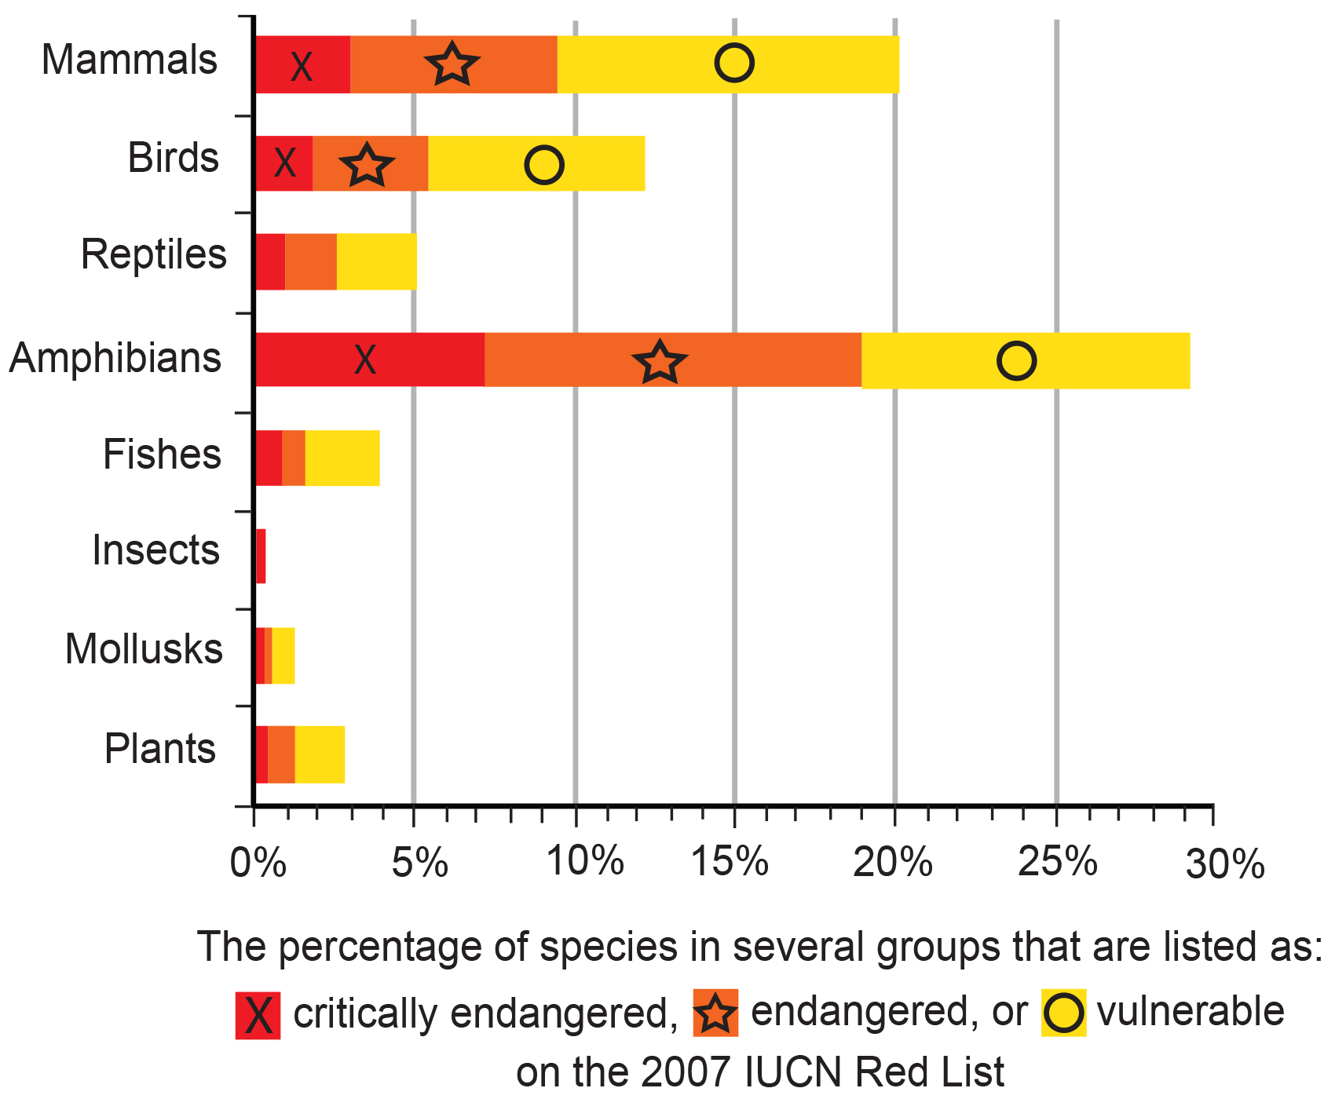
47.4 Figure 1
OpenStax. "IUCN Redlist."
Notes:
47.4 Figure 1: This chart shows the percentage of various animal species, by group, on the IUCN Red List as of 2007.

Slide 8
Think It Through₁
Which of the following statements is not supported by the graph in Figure 1?
There are more vulnerable fishes than critically endangered and endangered fishes combined.
There are more critically endangered amphibians than vulnerable, endangered, and critically endangered reptiles combined.
Within each group, there are more critically endangered species than vulnerable species.
A greater percentage of bird species are critically endangered than mollusk species.
Notes:
Originally an On Your Own. This is included here to use as a talking point or for a think-pair-share activity.

Slide 9
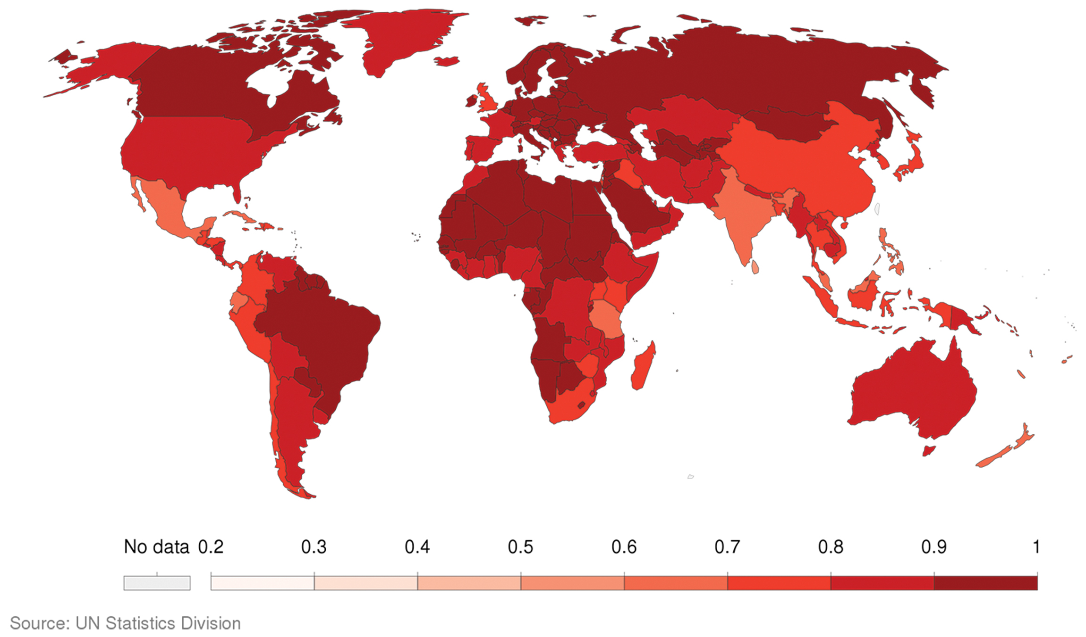
47.4 Figure 2
Our World In Data on Wikimedia Commons. "Red List Index."
Notes:
47.4 Figure 2: The map shows the Red List Index (RLI), or conservation status, of major species groups and the trends in the proportion of species expected to remain in existence without conservation action. An RLI value of 1.0 means that species are of "Least Concern" and not expected to go extinct in the near future. A value of 0.0 would mean all species have gone extinct.

Slide 10
Changing Human Behavior: Legislation₁
Legislation, including international treaties and national and state laws, has been enacted to protect species.
The Convention on International Trade in Endangered Species of Wild Fauna and Flora (CITES) treaty (1975) and supporting legislation prevent the transport of 38,000 listed species across nations' borders, protecting them from being caught and killed for international trade.
  It is limited by:
    Its emphasis on international movement
    Countries' willingness to enforce it
  The nonprofit Trade Records Analysis of Flora and Fauna in Commerce (TRAFFIC) monitors illegal wildlife trade.

Slide 11
Changing Human Behavior: Legislation₂
Many countries have laws to protect endangered species and regulate hunting and fishing.
The Endangered Species Act (ESA), enacted in the U.S. in 1973, lists species at risk that must be protected.
  The U.S. Fish & Wildlife Service is required to develop plans that protect listed species and bring them back to sustainable numbers.
  It is limited by:
    The difficulty of getting a species listed
    The development of an effective management plan once listed
    The ability for species to be controversially taken off the list without having had a change in their situation
    The emphasis on individual (often charismatic) species rather than entire ecosystems
  It does include a habitat restoration provision that can benefit other species besides the one targeted for management.

Slide 12
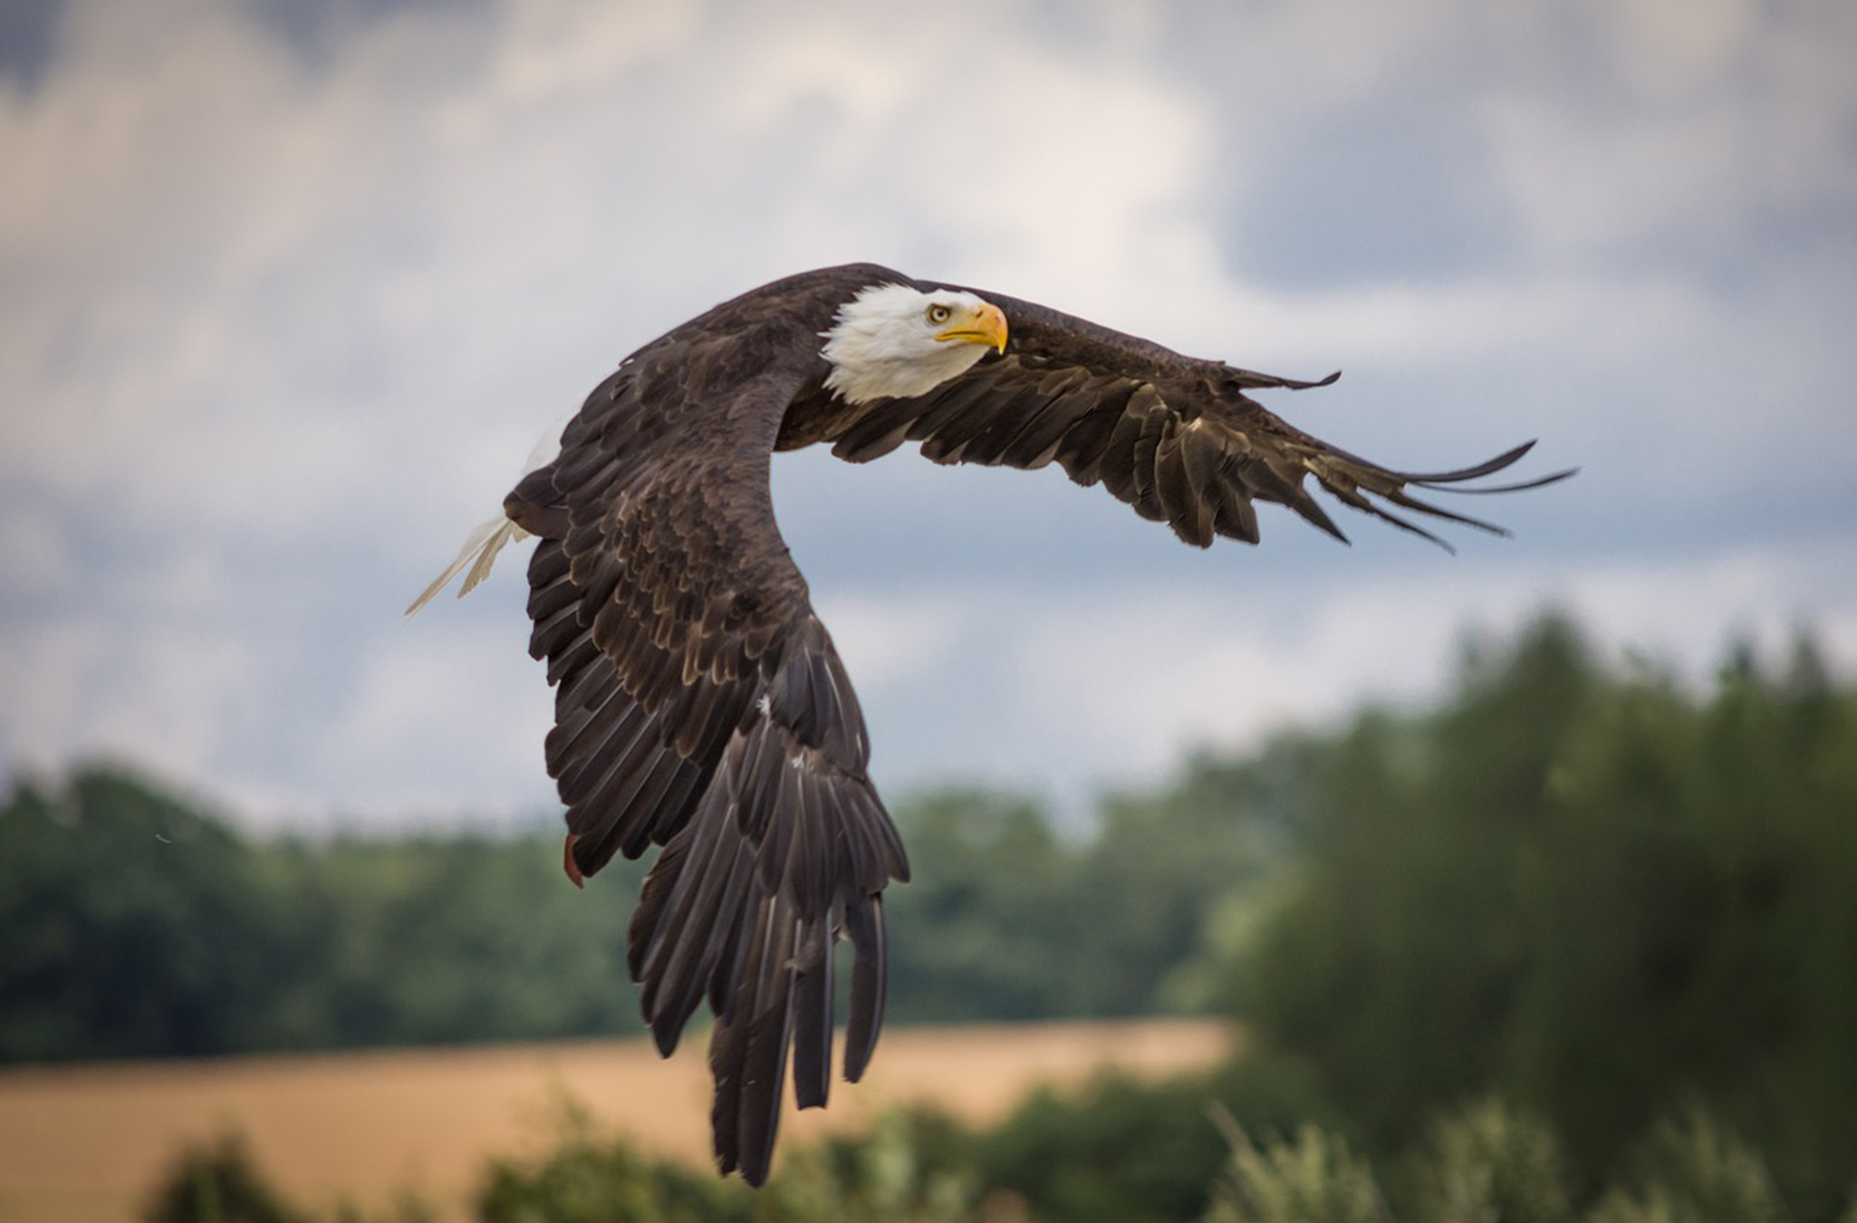
47.4 Figure 3
Sven Lachmann on Pixabay. "Bald eagle."
Notes:
47.4 Figure 3: Bald eagles (Haliaeetus leucocephalus) were one of the first species listed on the ESA in 1973 with approximately 400 wild breeding pairs. They were threatened by pesticides, habitat loss, and hunting. The listing on the ESA aided in the ban of the pesticide DDT and habitat protection. Bald eagles were removed from the list in 2007 and now have more than 10,000 breeding pairs in the United States.

Slide 13
Changing Human Behavior: Legislation₃
There are examples of countries working together.
The Migratory Bird Treaty Act (MBTA):
  Is an agreement between the U.S. and Canada
  Was signed into law in 1918 in response to declines in North American bird species due to hunting
  Lists over 1,000 protected species (2021), making it illegal to:
    Disturb or kill protected species
    Distribute their parts (much hunting historically was for their feathers)
The Paris Climate Agreement:
  Has been signed by over 194 countries
  Is a unified effort to reduce greenhouse gas emissions, embrace alternative energy sources, and ease climate pressures on ecosystems
  Will be monitored over time for implementation and effectiveness
  Has great potential to benefit species negatively affected by climate change

Slide 14
Changing Human Behavior: Nonprofits
The private nonprofit sector plays a large role in conservation in both North America and globally.
Some are species-specific.
Others are broadly focused like IUCN and TRAFFIC.
The Nature Conservancy purchases land and protects it in an effort to preserve ecosystems.

Slide 15
Think It Through₂
Name the legislation or organization that matches each description.
This is an agreement between the United States and Canada to protect migratory bird numbers from declining due to hunting.
This list requires the U.S. Fish & Wildlife Service, by law, to develop plans that protect the listed species and bring them back to sustainable numbers.
This treaty protects species from international trade and provides legal guidelines for transport of species across national borders.
This nonprofit contains the Red List—an online listing of endangered species categorized by taxonomy, type of threat, and other criteria.
This nonprofit enforces the rules and regulations around illegal wildlife trade.
Notes:
Originally an On Your Own. This is included here to use as a talking point or for a think-pair-share activity.

Slide 16
Conservation in Preserves
Establishment of wildlife and ecosystem preserves is a key tool of conservation efforts.
A preserve is an area of land set aside with varying levels of protection for the organisms that exist within the preserve's boundaries.
Preserves:
  Can be effective in the short term for protecting species and ecosystems
  Face challenges that scientists are studying to make them better long-term solutions to preserving biodiversity and preventing extinction

Slide 17
Conservation in Preserves: Preserve Size
It is difficult to determine how much land or marine habitat should be protected.
The Protected Planet Report (2020):
  Was released by IUCN and the United Nations Environmental Program (UNEP)
  Reported that 16.64% Earth's land ecosystems and 7.74% of marine/coastal ecosystems are currently protected
Individual animals are not equally represented on preserves.
  High-quality preserves include only ~50% of threatened amphibian species.
To ensure preservation of all threatened species:
  The protected areas must increase in size.
  The percentage of high-quality preserves must increase.
  Preserves must be targeted with more attention to protect biodiversity, something that researchers say is needed.

Slide 18
Conservation in Preserves: Preserve Design Based Upon Island Biogeography₁
The fundamental principle behind much research into preserve design comes from seminal theoretical work on island biogeography published in 1967 by R.H. MacArthur and E.O. Wilson, who concluded that biodiversity on an island was a function of:
The origin of species through migration
  The greater the distance from the mainland, the lower the migration and the equilibrium number of species.
  Because smaller islands are harder to find, fewer new species will immigrate to them.
The origin of species through speciation
  Within island populations, the number of species gradually increases to be similar to the numbers on the mainland from which the species is suspected to have migrated.
  Smaller islands are geographically less diverse, so there are fewer niches to promote speciation.
Extinction
  Smaller islands support smaller populations, so the probability of extinction is higher.

Slide 19
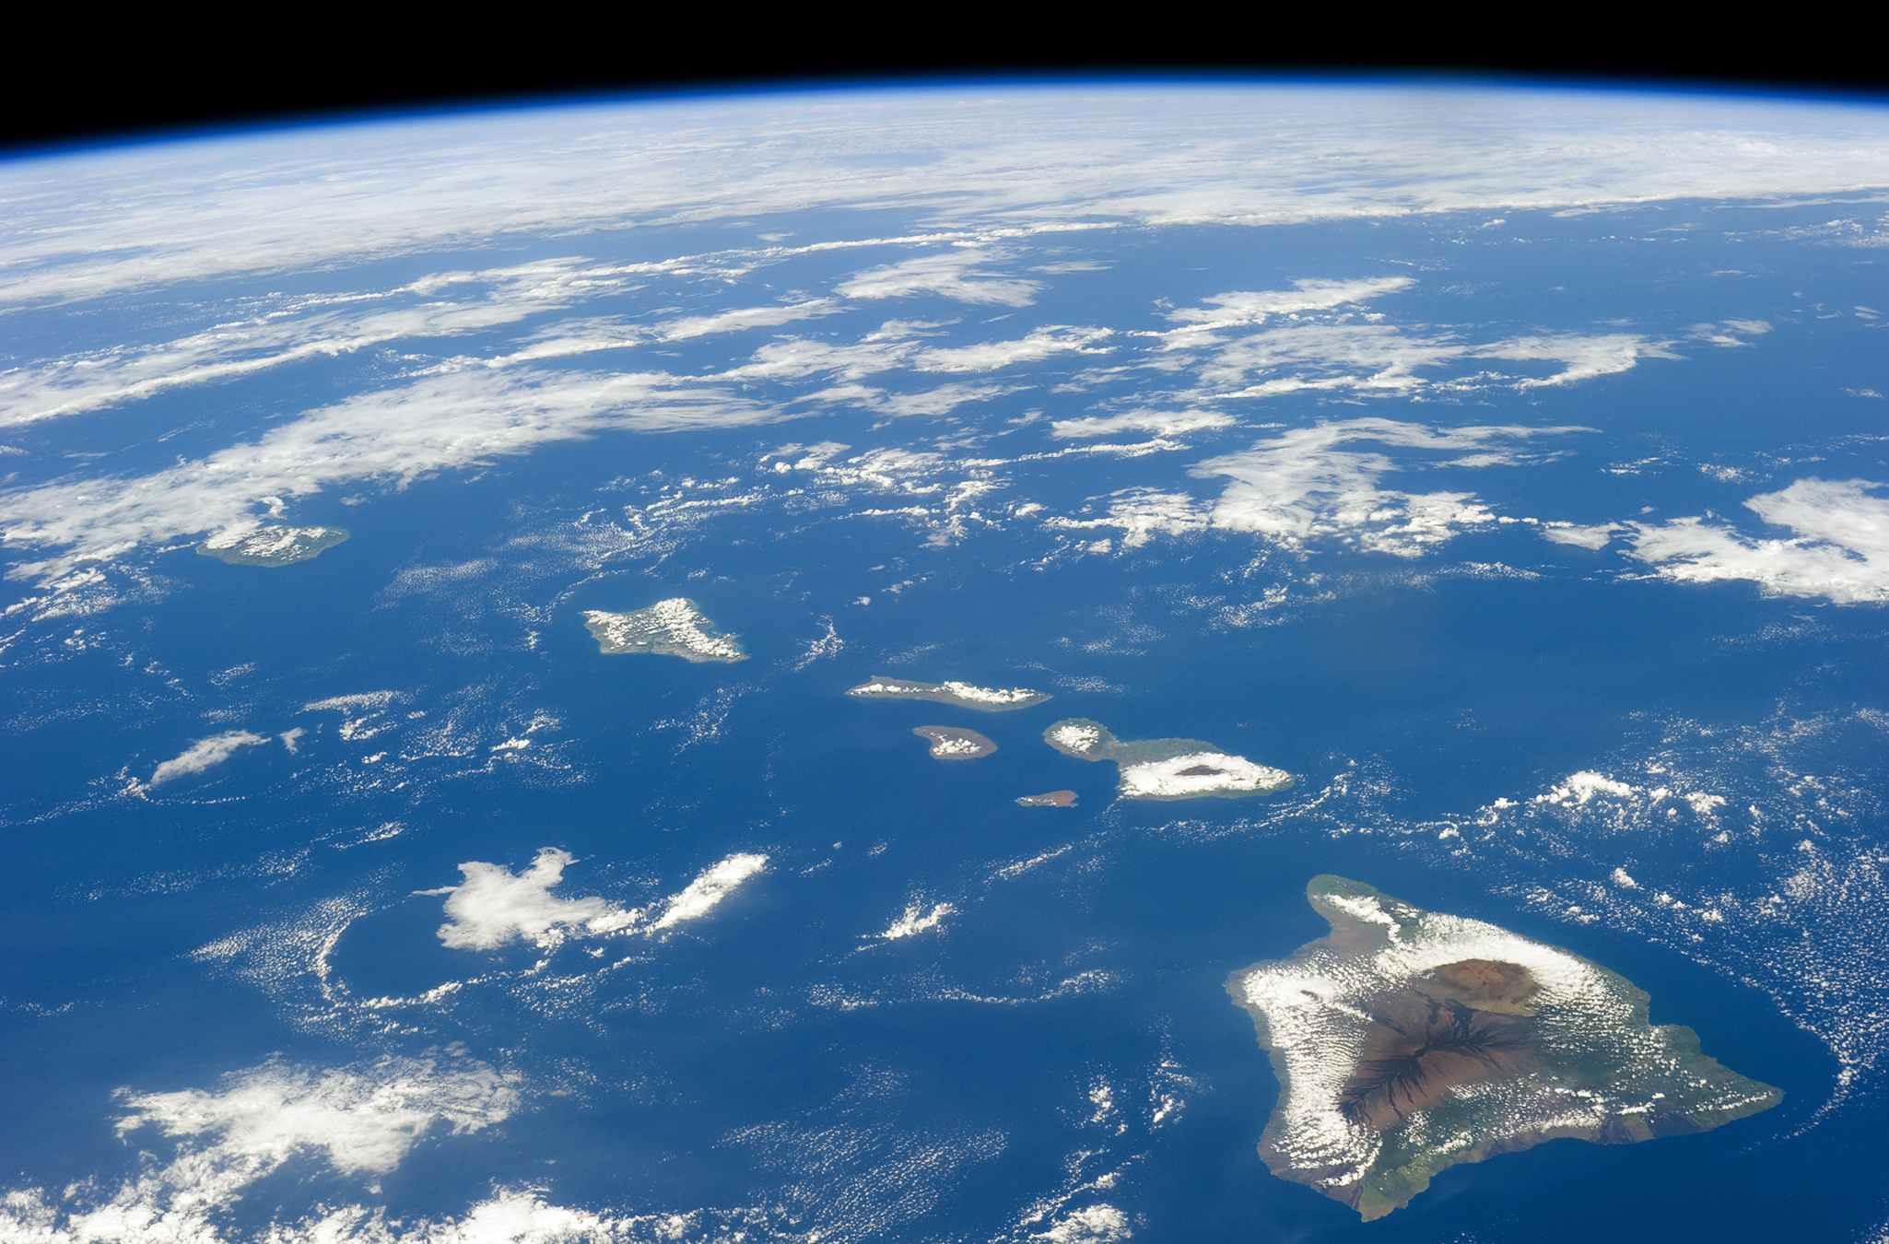
47.4 Figure 4
NASA on Wikimedia Commons. "Hawaiian islands."
Notes:
47.4 Figure 4: The Hawaiian Islands represent only 6.7% of the Earth's land surface area, but they harbor approximately 20% of Earth's biodiversity (Fernández-Palacios et al., 2021).

Slide 20
Conservation in Preserves: Preserve Design Based Upon Island Biogeography₂
According to island biogeography, as islands get larger, the number of species able to colonize and find suitable niches increases (although there is not a direct correlation between island area and species number).
Conservation preserves can be seen as "islands" of habitat within "oceans" of non-habitat.
  For a species to persist, a preserve mut be large enough to support it.
  The critical size depends in part on the characteristic home range for the species.
    Wolves need a large preserve because they range hundreds of kilometers.
    Butterflies can have a smaller preserve because they range within 10 km during their lifetimes.
  A larger preserve:
    Has more core area of optimal habitat for individual species
    Has more niches to support more species
    Attracts more species since it is more easily found and reached

Slide 21
Conservation in Preserves: Buffer Zones and Wildlife Corridors
Preserves perform better when they have buffer zones of suboptimal habitat around them.
Buffer zones allow organisms to exit preserve boundaries without predation or lack of resources.
One large preserve is better than the same area of smaller ones because there is more core habitat unaffected by edges.
A preserve in the shape of a square or circle performs better than a preserve with many thin "arms."
Smaller preserves should have wildlife corridors connecting them so that individuals and their genes can move between them.
Wildlife corridors make a group of smaller preserves act more like a larger one.

Slide 22
Conservation in Preserves: Policies, Legislation, and Enforcement
There are many policy, legislative, and enforcement specifications that affect species protection in preserves, including the possible use of preserves for:
  Timber extraction
  Mineral extraction
  Regulated hunting
  Human habitation
  Nondestructive human recreation
Many decisions on use are based on political pressures.
In some cases, wildlife protection policies have forced subsistence-living native peoples from ancestral lands.
In other cases, lack of enforcement promotes illegal poaching and timber extraction, especially in the tropics.

Slide 23
Conservation in Preserves: Limitations
Political and economic pressures result in preserves being small, so setting aside large enough areas with sufficient buffer zones is difficult.
Strong enforcement of protections is needed to prevent poaching and illegal resource extraction.
Climate change is problematic for the location of preserves.
  While scientists are planning for habitat changes and species migration to higher latitudes, this is all based upon prediction.
Conservation preserves suggest that humans are growing more separate from nature and that they only damage biodiversity.
  This may reduce the pressure on humans outside the preserve to act sustainably and without damage to biodiversity.
  Conversely, properly managed, high-quality preserves present ways to allow humans to witness nature in a less damaging way and may present local economic benefits.
Ultimately, humans will need to alter their activities to preserve biodiversity.

Slide 24
Habitat Restoration
Habitat restoration can restore and maintain biodiversity:
Extinct species cannot be restored, but degraded ecosystems can benefit.
The reintroduction of wolves into Yellowstone National Park (1995) led to dramatic changes in the ecosystem that increased biodiversity.
Wolves reduced elk and coyote populations.
This provided more resources for carrion eaters.
This allowed riparian areas (along the banks of rivers and streams) to revegetate, boosting their species diversity.
This increased populations of species previously eaten by coyotes.
The wolf is a keystone species in this habitat.

Slide 25
Habitat Restoration: Keystone Species
A keystone species is essential for maintaining ecosystem diversity.
Removing them can collapse ecosystem diversity.
Restoring keystone species restores biodiversity.
Ecologists argue for identifying keystone species, focusing protection efforts on them, and reintroducing them to eco systems if they have been removed.

Slide 26
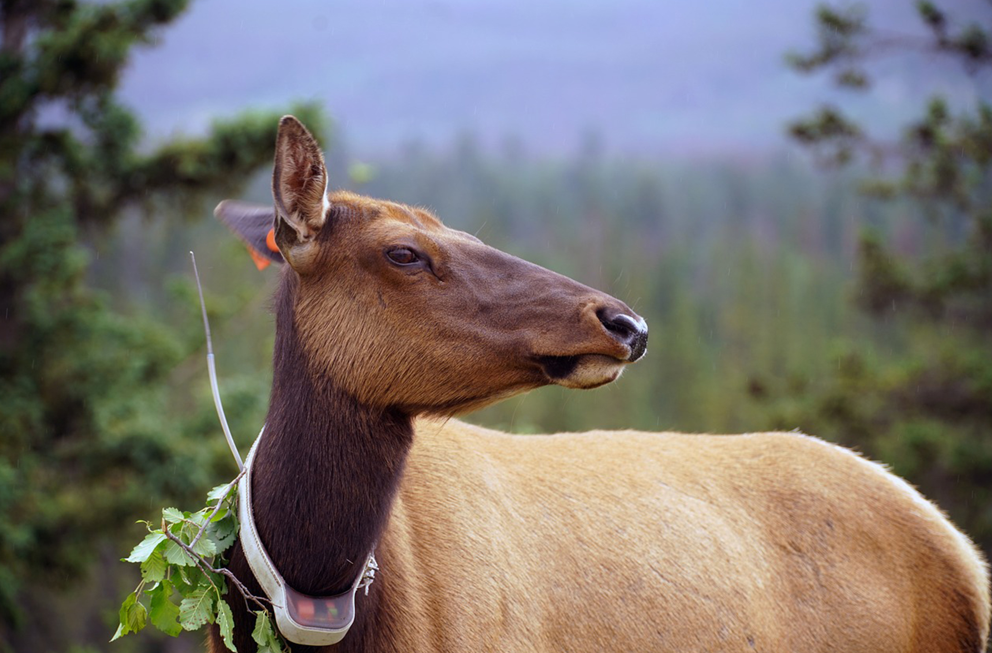
47.4 Figure 5
gayleenfroese2 on Pixabay. "Elk."
Notes:
47.4 Figure 5: Wildlife researchers sometimes will track animals using satellite technology, like the collar you see on this elk. This allows experts to track the movements of wild animals and better understand their habitat, territory, and social interactions.

Slide 27
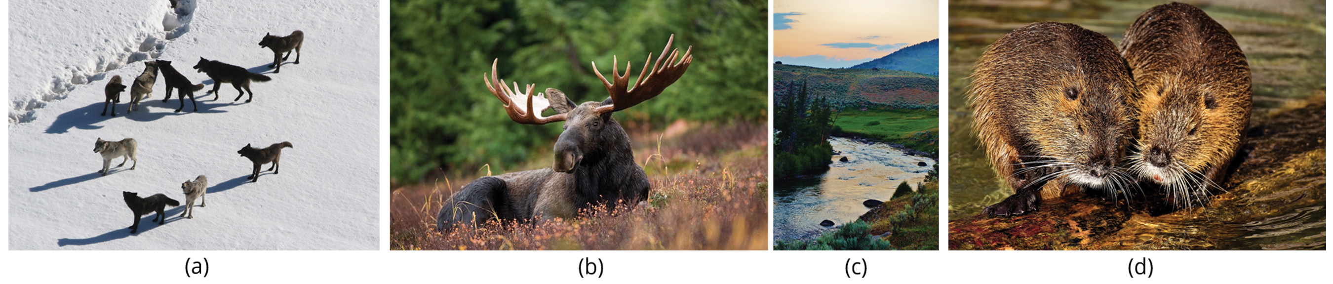
47.4 Figure 6
WikiImages on Pixabay. "Wolf pack."
MikeGoad on Pixabay. "Elk."
Abhardphoto on Pixabay. "Yellowstone."
Alexas_Fotos on Pixabay. "Beavers."
Notes:
47.4 Figure 6: (a) The Gibbon wolf pack in Yellowstone National Park, March 1, 2007, represents a keystone species. The reintroduction of wolves into Yellowstone National Park in 1995 led to a change in the grazing behavior of (b) elk. To avoid predation, the elk no longer grazed exposed streams and riverbeds, such as (c) the Lamar Riverbed in Yellowstone. This allowed willow and cottonwood seedlings to grow and recolonized large areas. The seedlings decreased erosion and provided shading to the creek, which improved fish habitat. A new colony of (d) beaver may also have benefited from the habitat change.

Slide 28
Habitat Restoration: Dam Removal₁
The national movement to remove dams in the U.S. has been accelerating.
Since the mid-1980s, many aging dams have been considered for removal rather than replacement:
  Due to shifting belief about the ecological value of free-flowing rivers
  Because dams no longer provide the benefits and functions they did when first built
The measured benefits of dam removal include:
  Restoration of naturally fluctuating water levels
  Increased fish diversity
  Improved water quality

Slide 29
Habitat Restoration: Dam Removal₂
Many dam removal projects have had significant impacts.
In the Pacific Northwest, dam removal projects are expected to increase in salmon populations.
  Salmon is a keystone species because it transports key nutrients to inland ecosystems during its annual spawning migrations.
On the Atlantic coast, dam removal has allowed the return of spawning anadromous fish species (those born in fresh water, live most of their lives in salt water, then return to fresh water to spawn).
Ongoing and upcoming dam removal projects will provide large-scaled ecological data to inform future dam removal or construction projects.

Slide 30
Conservation Strategies
Conservation and management strategies aim to increase the population size of a targeted species facing decline in the wild.
Strategies are often unique to the target species and population.
Strategies may include:
  Catch limits
  Habitat restoration
  Management
  Protection
  Stock enhancements from captive breeding programs
Mark-recapture studies are a way to estimate population size and decline.
  This method tags wild animals to track their recapture or sightings.
  These studies provide insight into various population dynamics: territory size, survival rates, life span, recruitment, and population growth.
  Understanding population parameters helps wildlife managers make informed conservation decisions.

Slide 31
Captivity and Education₁
Zoos are increasingly focusing on conservation through captive breeding programs and education.
  The shift from collection and exhibition to conservation-focused missions is gaining momentum.
Captive breeding programs for endangered species are often inefficient, but there are success stories:
  The California condor's reintroduction to the Grand Canyon
  The whooping crane's re-establishment along the Midwest flyway
Head-starting, a common conservation management tool, is the captive rearing of vulnerable young individuals to reduce early-life mortality.
  Individuals may be obtained from captive breeding programs or taken from the wild as juveniles.
  Individuals are released once they reach a larger size less susceptible to predation.
  In some cases, juveniles are raised in educational institutions like zoos and aquariums to allow the public access and involvement.

Slide 32
Captivity and Education₂
Zoos are too limited to handle captive breeding for the numerous species at risk.
Education in zoos can positively impact conservation efforts, especially as urbanization reduces human-wildlife contact.
Studies on zoos' effectiveness in changing conservation attitudes and actions show mixed results.
Zoos often engage in ongoing research and citizen science, involving the public in data collection.
Zoos and aquariums may still be important in bridging the worlds of conservation and education to unite the public to work towards saving threatened species.

Slide 33
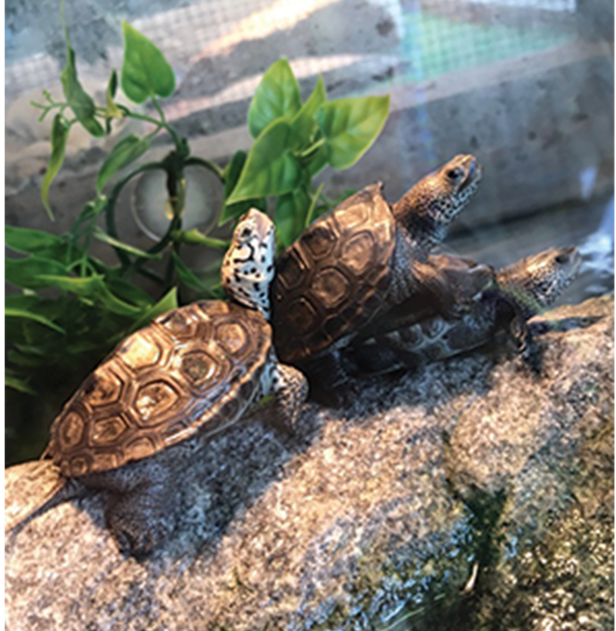
47.4 Figure 7
Notes:
47.4 Figure 7: Diamondback terrapins (Malaclemys terrapin) are North America's only brackish water turtle and are selected for head-starting due to declining wild populations. In some studies, eggs are collected from females that have been killed by cars and are raised in captivity until they are a larger size. Then, they are released.

Slide 34
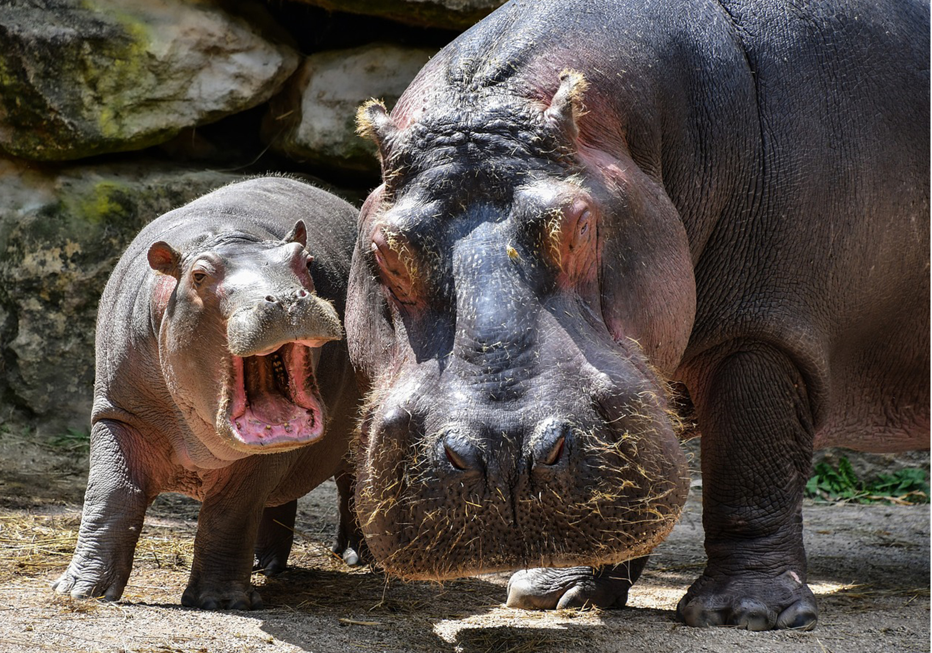
47.4 Figure 8
Christel SAGNIEZ on Pixabay. "Nile hippos."
Notes:
47.4 Figure 8: The Nile hippo is one species that is considered vulnerable by the IUCN. In 2017, a baby hippo named Fiona was born six weeks premature at the Cincinnati Zoo and Botanical Gardens in Ohio. Weighing only 29 lbs. at birth, Fiona was 25 lbs. lighter than the lowest recorded birth weight for this species. Incredibly, Fiona survived and now weighs over 1,600 lbs. and could one day weigh over 3,000 lbs. like her mother, Bibi!

Slide 35
Summary
New technologies (DNA barcoding and better information processing) aid in cataloging the planet's biodiversity.
International treaties, such as CITES, regulate the transport of endangered species.
National legislation and global agreements aim to protect biodiversity and address climate change, with limited success.
  Examples include the Endangered Species Act (U.S.) and the Migratory Bird Act (U.S. and Canada).
  The Paris Climate Accords aim to reduce global climate change.
Nonprofit organizations play an active role in conservation efforts.
Conservation preserves protect 11% of Earth's land surface, informed by island biogeography, but face political, economic, and climate challenges.
Habitat restoration can restore ecosystems, with examples including keystone species reintroduction and dam removal.
Zoos aid conservation through limited captive breeding programs and education efforts.

Slide 36

End of Hawkes Learning PowerPoint

