Slide 1
Lesson 5.1
Plasma Membrane Components and Structure

Slide 2
Objectives
Describe phospholipid, protein, and carbohydrate functions in the membrane.
Discuss membrane fluidity.
Understand the cell membrane fluid mosaic model.

Slide 3

Structure and Function of Membranes
The plasma membrane, or cell membrane, defines the borders of the cell and keeps it functional.
It is semipermeable, allowing some materials to freely cross while restricting others.
Certain materials require specialized structures to cross the membrane and sometimes even energy investment.
5.1 Figure 1: Despite its hustle and bustle, Grand Central Station functions with a high level of organization, as does the plasma membrane.
ollguna on Pixabay. "Grand Central Station."

Slide 4
Plasma Membrane Components and Structure
The plasma membrane defines the cell's borders and regulates interaction with the environment by controlling what enters or exits.
It is flexible so that cells, like red and white blood cells, can change shape to squeeze through narrow capillaries.
Surface markers allow cells to recognize each other, which is vital for tissue and organ formation and immune system responses.
Membrane receptor proteins transmit signals by receiving external inputs and activating internal response cascades.

Slide 5
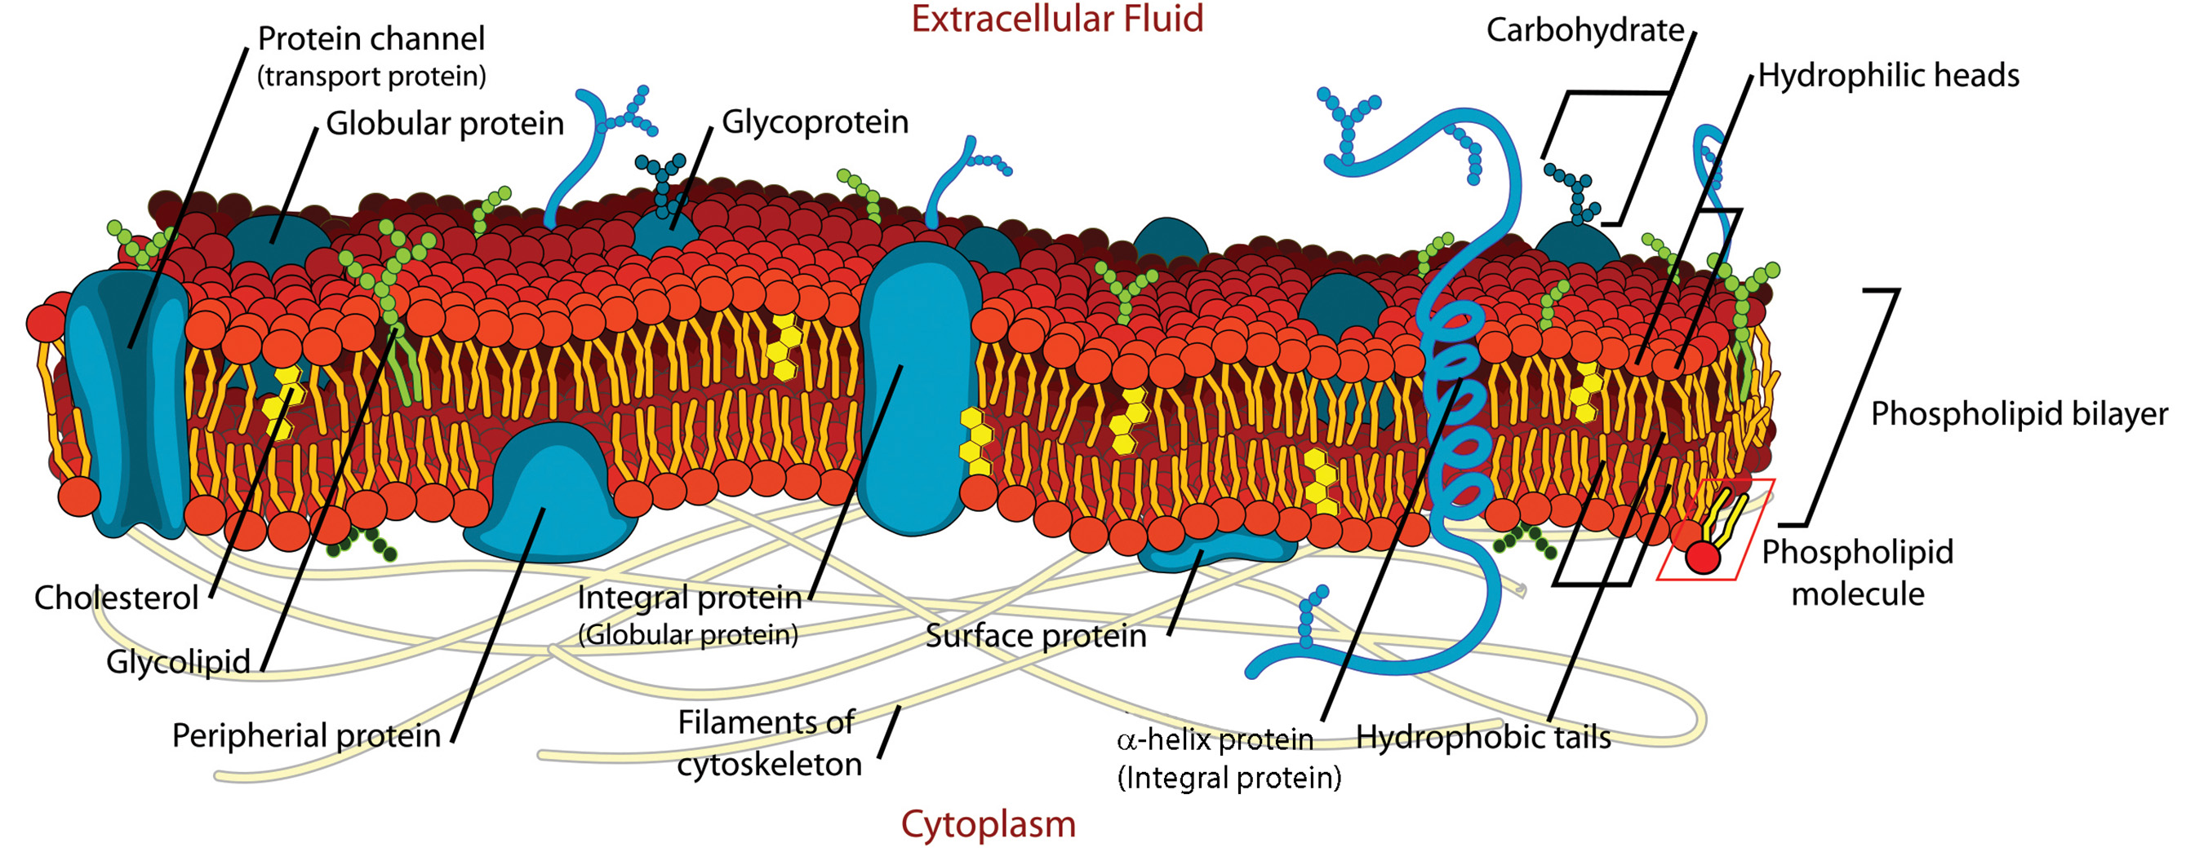
Fluid Mosaic Model₁
Early models in the 1930s viewed the plasma membrane as railroad track or "sandwich" with protein "bread" surrounding lipids.
Advances in microscopy in the 1950s showed the membrane's core is a double lipid layer, not single layer.
In 1972, the fluid mosaic model proposed the membrane as a fluid mixture of lipids, proteins, and carbohydrates.
Best explains the plasma membrane's structure and function
5.1 Figure 2
Mariana Ruiz Villarreal on Wikimedia Commons. "Cell membrane diagram."

Slide 6
Fluid Mosaic Model₂
The principal plasma membrane components are lipids (phospholipids, cholesterol), proteins, and carbohydrates.
Phospholipids have a phosphate-linked head group, glycerol, and two fatty acid tails.
Cholesterol has four fused carbon rings.
Typical composition is 50% protein, 40% lipids, 10% carbohydrates, though this varies by cell type.
Carbohydrates are only on the exterior surface, attached to proteins (glycoproteins) and lipids (glycolipids).

Slide 7
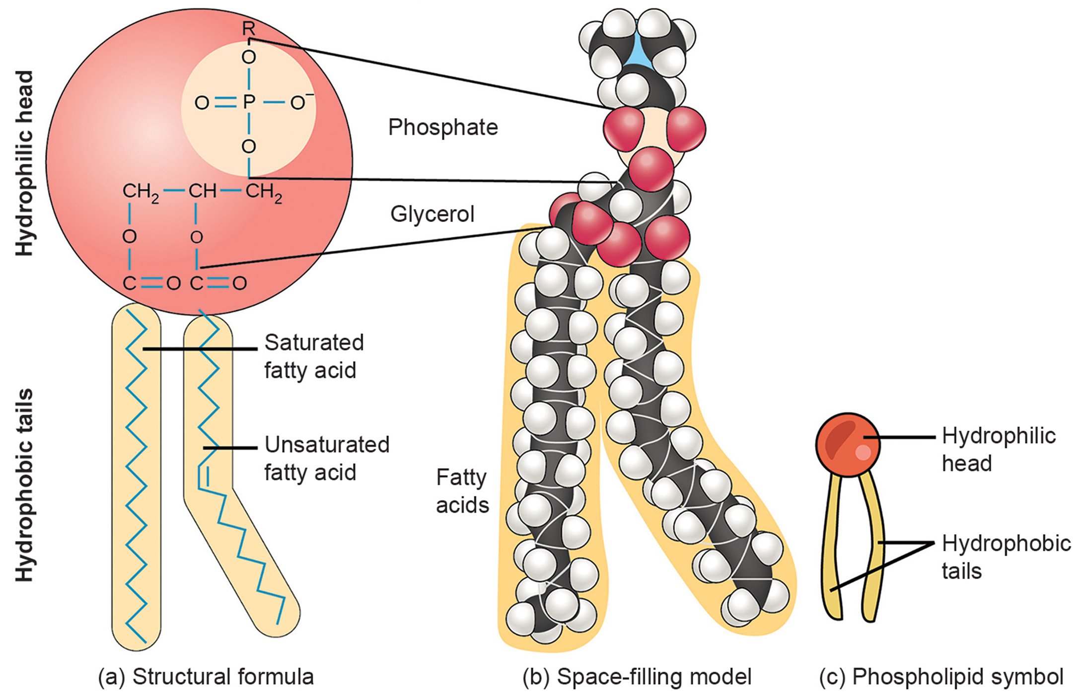
Phospholipids₁
The membrane's is made of amphipathic (polar and nonpolar) phospholipid molecules.
The hydrophilic (water-loving) phosphate-linked head regions interact with aqueous fluids inside and outside the cell.
The fatty acid tails are hydrophobic (water-fearing).
This allows phospholipids to form a bilayer separating the interior from the exterior aqueous environment.
5.1 Figure 3
Mariana Ruiz Villarreal on Wikimedia Commons. "Cell membrane." Modified.

Slide 8
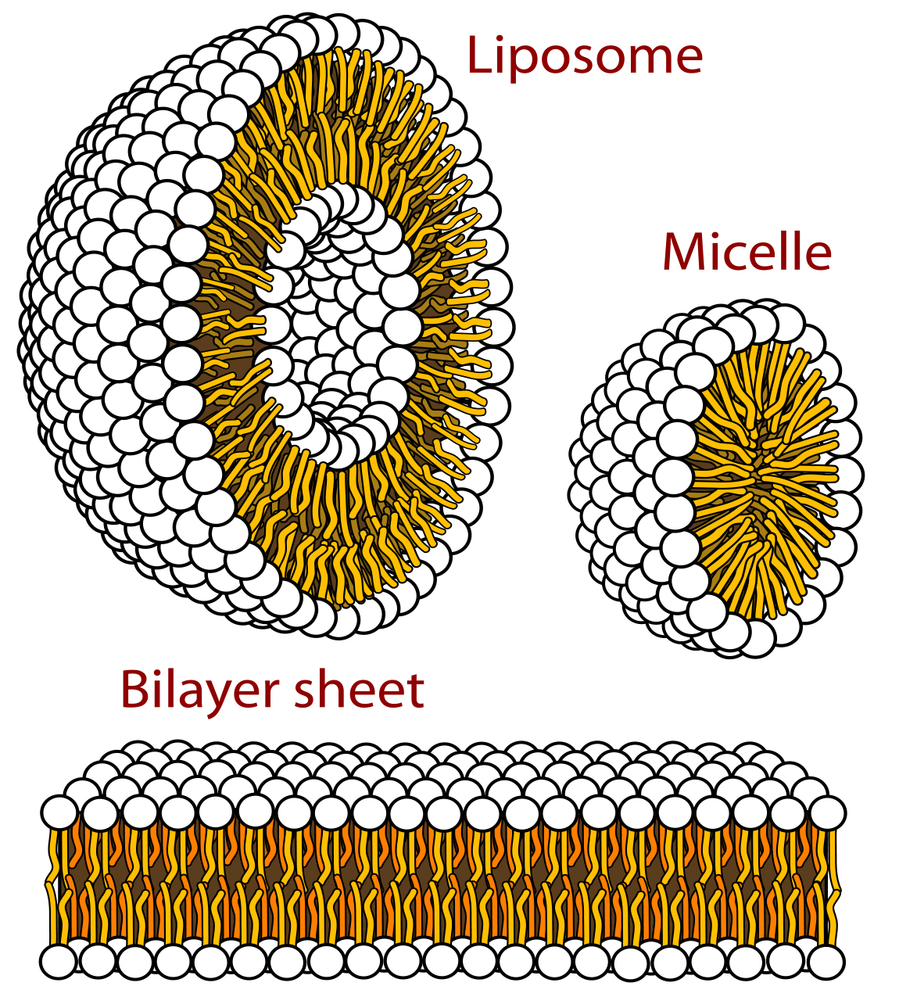
Phospholipids₂
The lipid bilayer has hydrophobic tails facing inward and hydrophilic heads facing outward.
When heated in water, phospholipids can spontaneously form micelles (single layer) or liposomes (bilayer surrounding an inner aqueous compartment).
5.1 Figure 4
Mariana Ruiz Villarreal on Wikimedia Commons. "Phospholipid."

Slide 9
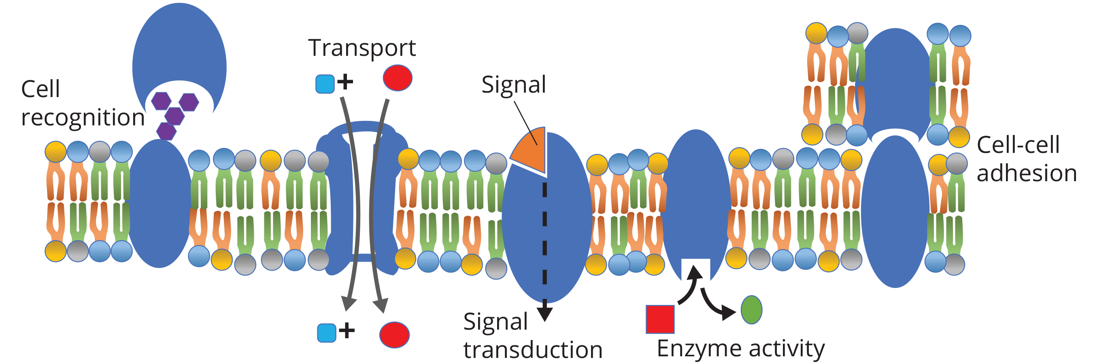
Proteins₁
Proteins are the second major component of plasma membranes and serve various important functions.
They can be integral (embedded in the membrane) or peripheral (temporarily attached).
Integral proteins span the membrane partially or fully, with hydrophobic regions embedded in the lipid bilayer and hydrophilic regions protruding from the membrane.
5.1 Figure 5
Connectivid-D on Wikimedia Commons. "Proteins."

Slide 10
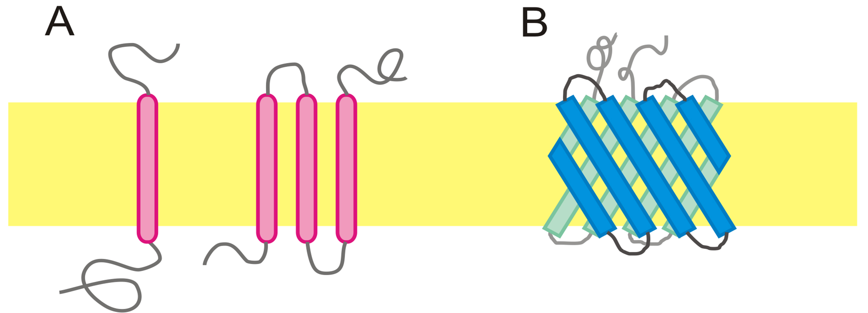
Proteins₂
A peripheral protein is attached to the exterior or interior surface (periphery) of the membrane.
They can attach to either integral proteins or phospholipids in the membrane.
Peripheral and integral proteins can function as enzymes, as attachments for the cytoskeleton, or act as cell recognition sites.
5.1 Figure 6
Danielle Keller on Wikimedia Commons. "Integral membrane proteins."

Slide 11
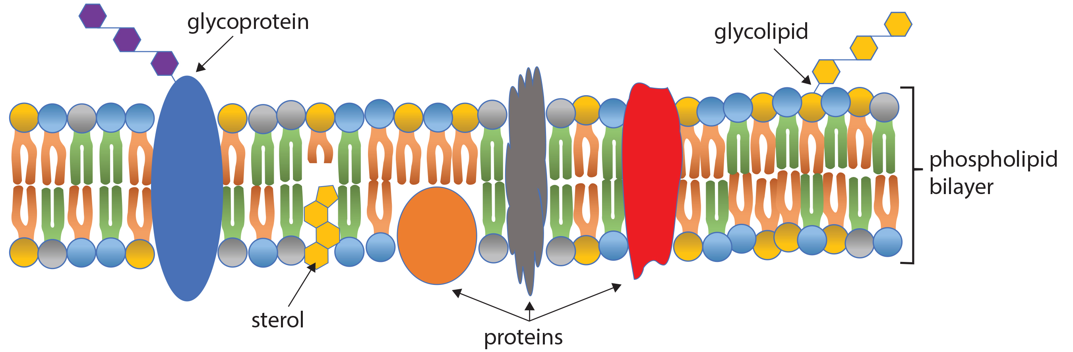
Carbohydrates
Carbohydrates are always found on the exterior surface of the plasma membrane.
Bound to proteins (glycoproteins) or lipids (glycolipids) in straight or branched chains
Form the glycocalyx, which attracts water to the cell surface, aids in cell recognition, embryonic development, and in cell-to-cell attachments
5.1 Figure 7
Connectivid-D on Wikimedia Commons. "Fluid mosaic model."

Slide 12
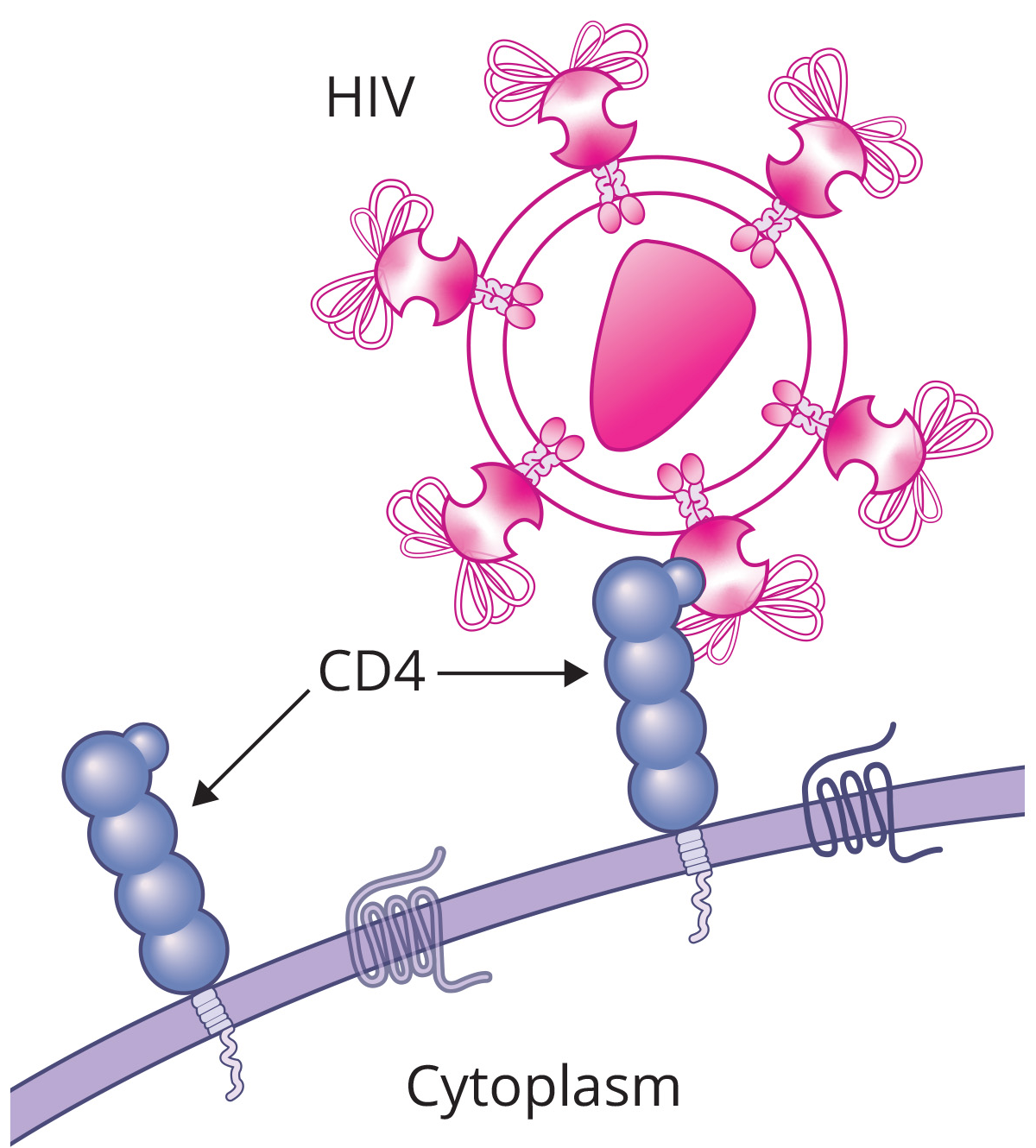
How Viruses Infect Specific Organs
HIV can penetrate the plasma membranes of helper T cells and monocytes, while hepatitis attacks liver cells.
Viruses like HIV can invade cells by binding to specific surface receptors, while other viral surface proteins interact with the immune system to induce antibody production against the viral antigens.
A major challenge with HIV is that the viral surface recognition sites mutate rapidly, generating new viral variants that existing antibodies cannot effectively recognize and bind to.
HIV compounds this problem by specifically infecting and destroying immune cells involved in the body's response, further weakening the host's ability to combat the rapidly evolving virus.
5.1 Figure 8
NIH, NIAID on Wikimedia Commons. "HIV."

Slide 13
Science and You
Career: Immunologist
The cell surface protein and carbohydrate variations that form recognition sites are researched by immunologists for vaccine development against diseases.
What Does an Immunologist Study?
Immunologists study and treat immune system disorders, develop vaccines, and investigate immunity's role in health, in diseases like cancer, and the environmental impacts on natural immunity.
How Does One Become an Immunologist?
Immunologists need a PhD or MD, extensive accredited training, board certification, and comprehensive knowledge of immunology, human biology, pharmacology, and medical technologies and procedures.
Notes:
This is included as a relevant application for this topic.

Slide 14
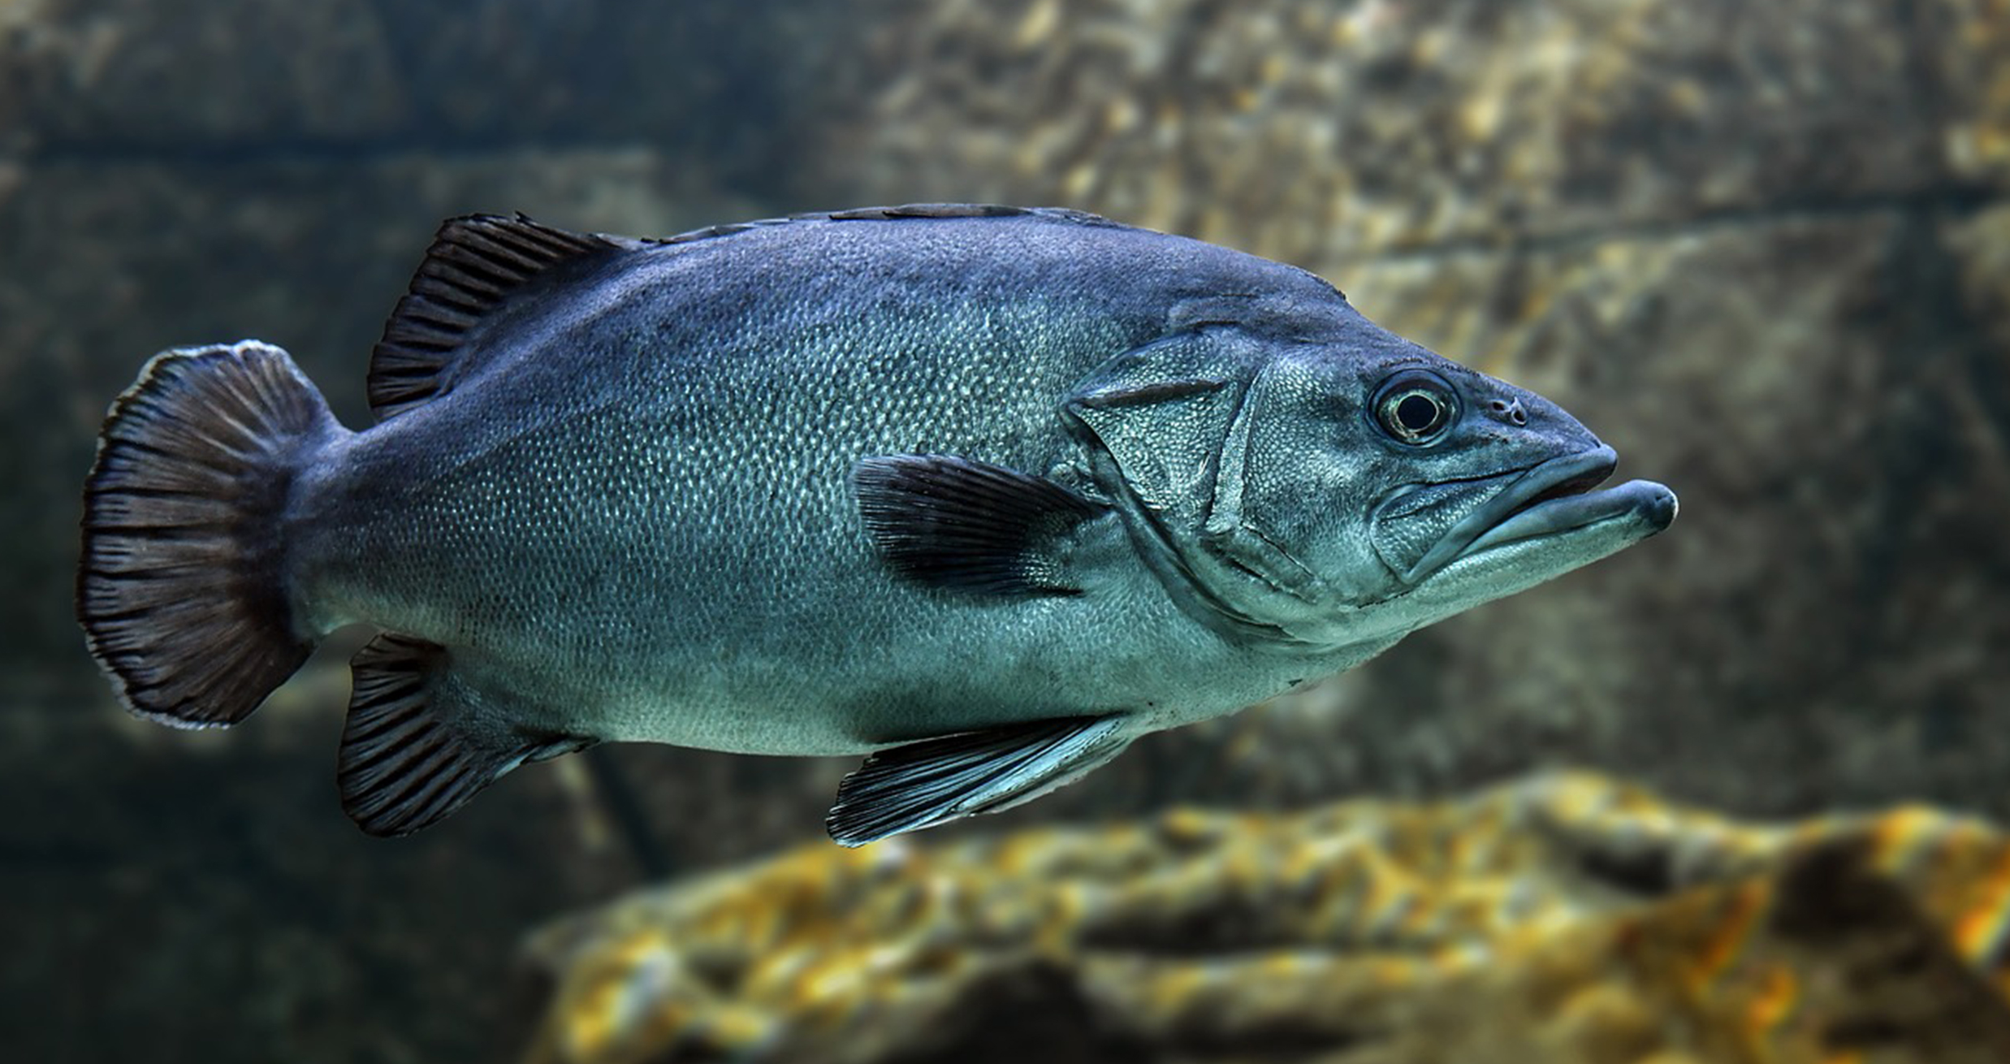
Membrane Fluidity₁
The plasma membrane's structure allows fluidity with integral proteins and lipids moving relative to each other.
Will burst if penetrated or if it takes on too much water
Phospholipids have either saturated fatty acid tails that pack tightly together or unsaturated tails with kinks that create fluidity.
Colder temps solidify membranes with more saturated fats.
Organisms adapt to the cold by adjusting the unsaturated to saturated fatty acid ratio to maintain membrane fluidity.
5.1 Figure 9: Organisms, like fish, that live in cold environments can increase the proportion of unsaturated fatty acids in the phospholipids in their membrane in order to increase membrane fluidity at lower temperatures.
Christel SAGNIEZ on Pixabay. "Fish."

Slide 15
Think It Through
How does cell membrane composition differ between organisms living in warm versus cold temperatures?
Notes:
Originally an On Your Own. This is included here to use as a talking point or for a think-pair-share activity.

Slide 16
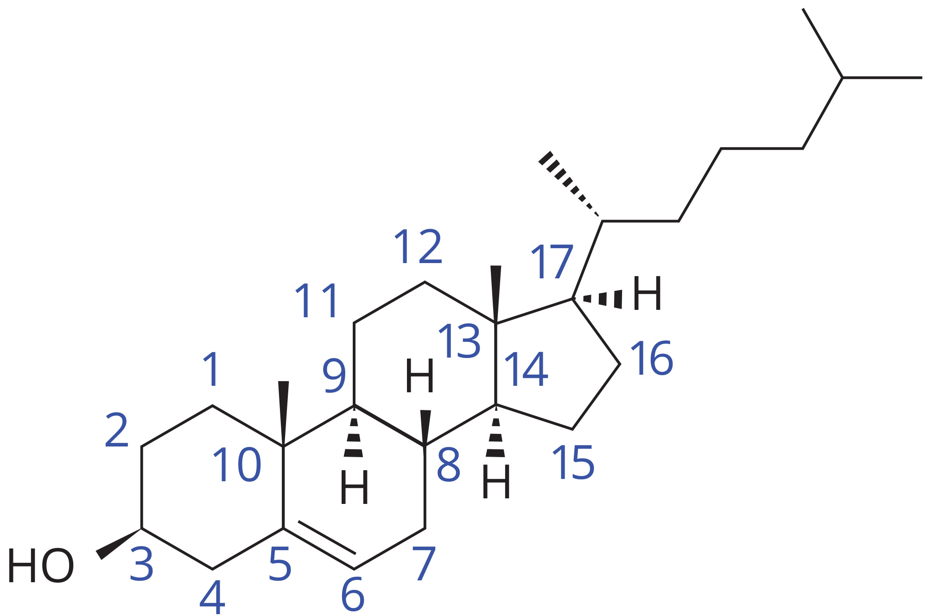
Membrane Fluidity₂
Cholesterol helps maintain membrane fluidity across a range of temperatures.
It acts as a buffer, preventing low temperatures from inhibiting fluidity and high temperatures from increasing it excessively.
Cholesterol organizes transmembrane proteins into lipid rafts within the membrane.
Lipid rafts compartmentalize processes like signal reception and relay by grouping together related components.
5.1 Figure 10
Calvero on Wikimedia Commons. "Cholesterol."

Slide 17
Table 1: Plasma Membrane Components and Functions
Component | Location
phospholipid | main membrane fabric
cholesterol | attached between phospholipids and between the two phospholipid layers
integral proteins (for example, integrins) | embedded within the phospholipid layer(s); may or may not penetrate through both layers
peripheral proteins | on the phospholipid bilayer's inner or outer surface; not embedded within the phospholipids
carbohydrates (components of glycoproteins and glycolipids) | generally attached to proteins on the outside membrane layer

Slide 18
Reflection Question
We hear a lot in the news about cholesterol and its negative effects on our health. Do you think that cholesterol fully deserves its negative reputation? Why or why not?
Notes:
The reflection question is included here to use as a talking point or for a think-pair-share activity.

Slide 19
Summary
The plasma membrane is a fluid mosaic model comprised of a phospholipid bilayer with embedded proteins and cholesterol.
Some membrane proteins span the membrane and transport materials in and out of the cell.
Carbohydrates attach to some membrane proteins and lipids forming complexes that identify the cell.
The membrane's fluidity results from temperature, fatty acid tail configurations, cholesterol abundance, and the mosaic arrangement of proteins and carbohydrates.

Slide 20


End of Hawkes Learning PowerPoint

