Slide 1
Lesson 5.2
Passive Transport and Diffusion

Slide 2
Objectives
Define tonicity and its relevance to passive transport.
Explain why and how passive transport occurs.
Understand the osmosis and diffusion processes.

Slide 3
Passive Transport and Diffusion₁
Plasma membranes are:
Semipermeable, allowing some substances but not others based on their molecular size
Selectively permeable, blocking some substances while permitting others

Slide 4
Passive Transport and Diffusion₂
Passive transport moves substances from an area of high concentration to an area of low concentration without using energy.
A concentration gradient drives passive transport of a substance between locations.

Slide 5
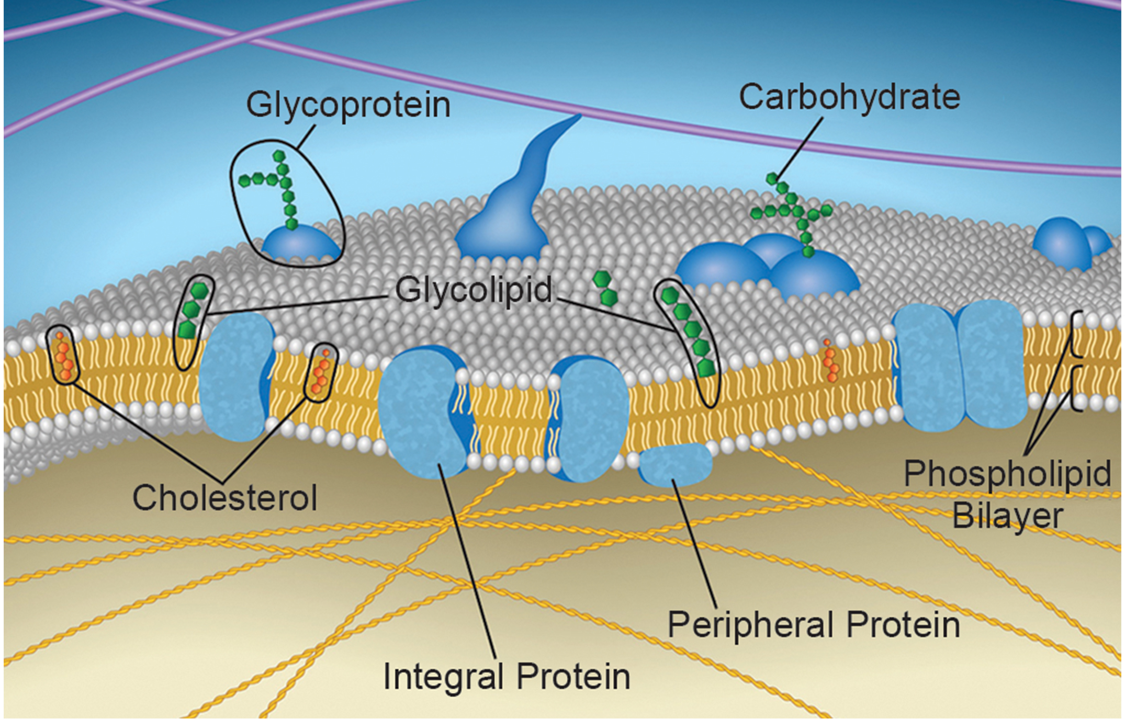
Selective Permeability₁
Plasma membranes are asymmetrical; the interior does not match the exterior
Some interior proteins anchor the membrane to the cytoskeleton.
Exterior peripheral proteins bind to extracellular matrix elements.
Carbohydrates on the exterior surface bind required substances in the extracellular fluid.
5.2 Figure 1
Rao, A., Ryan, K., Fletcher, S., Hawkins, A. and Tag, A. Department of Biology, Texas A&M University. "Plasma membrane."

Slide 6
Selective Permeability₂
The plasma membrane is amphipathic.
Nonpolar and lipid-soluble materials can move through the hydrophobic core.
  Vitamins A, D, E, and K as well as oxygen and carbon dioxide
Polar substances and ions can interact with the hydrophilic membrane exterior but cannot pass through the lipid core.
  Ions such as sodium (Na⁺), potassium (K⁺), calcium (Ca²⁺), and chloride (Cl⁻)

Slide 7
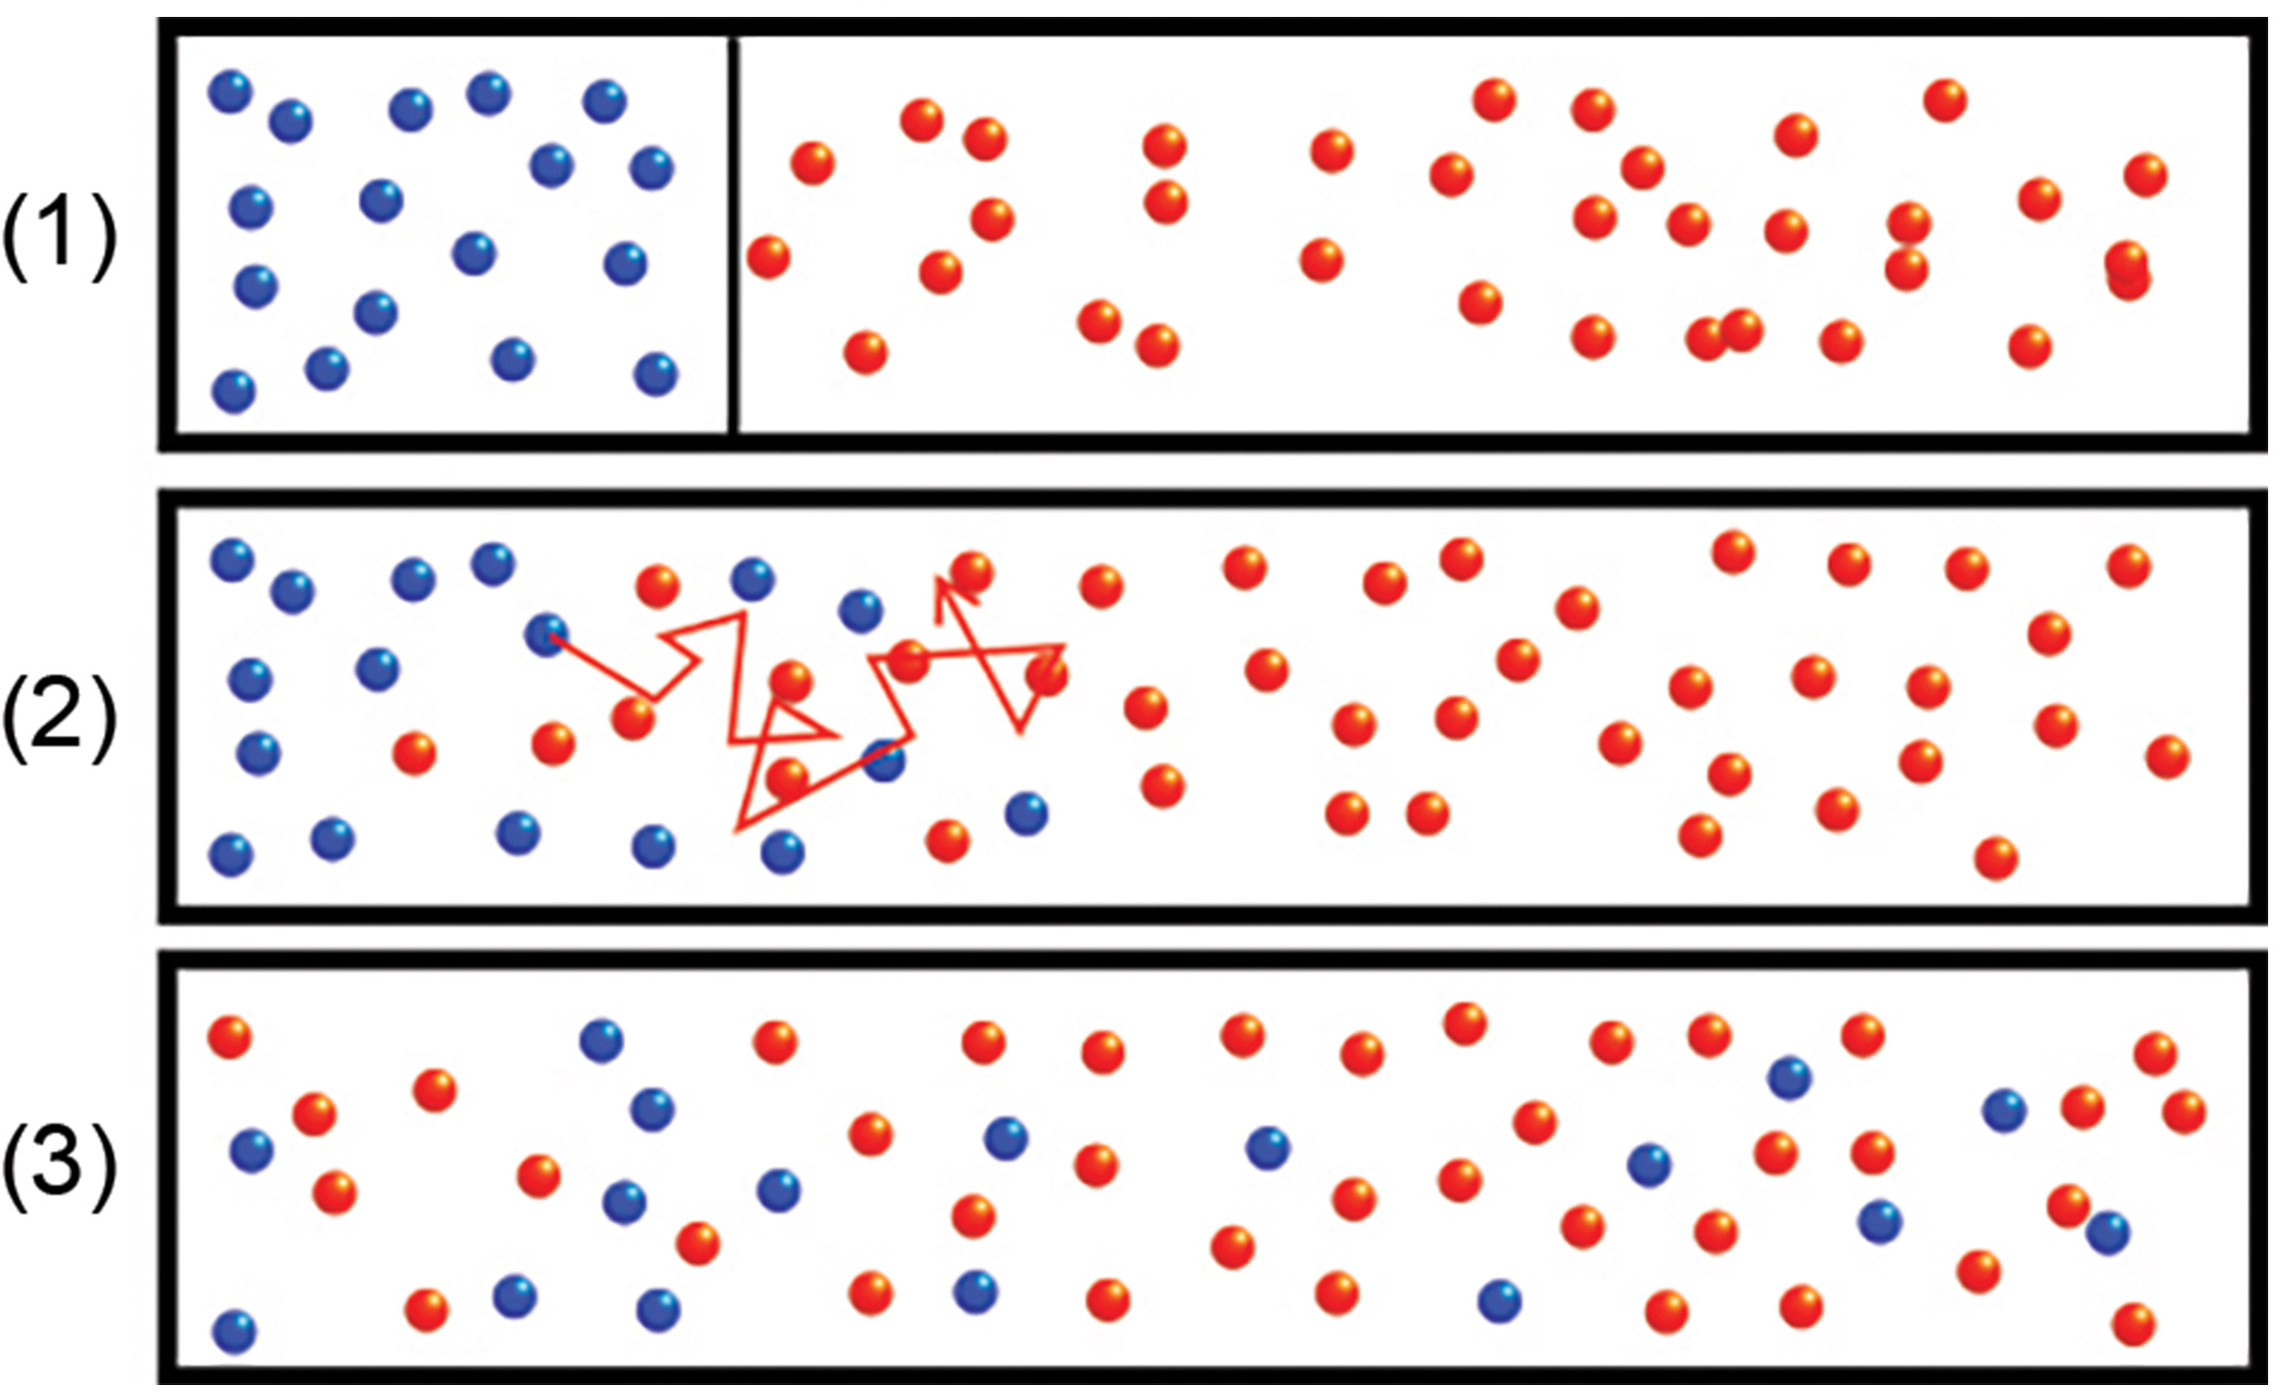
Diffusion₁
Diffusion: passive transport process of a low-molecular weight material along its concentration gradient from an area of higher concentration to an area of lower concentration
Continues until equilibrium is reached
5.2 Figure 2: In panel 1, a black line barrier separates the different molecules. The barrier is removed in panel 2, allowing molecules to move from areas of higher concentration to areas of lower concentration. After some time, the concentrations each molecule will be the same throughout the solution (panel 3).
Adam Rędzikowski on Wikimedia Commons. "Diffusion."

Slide 8
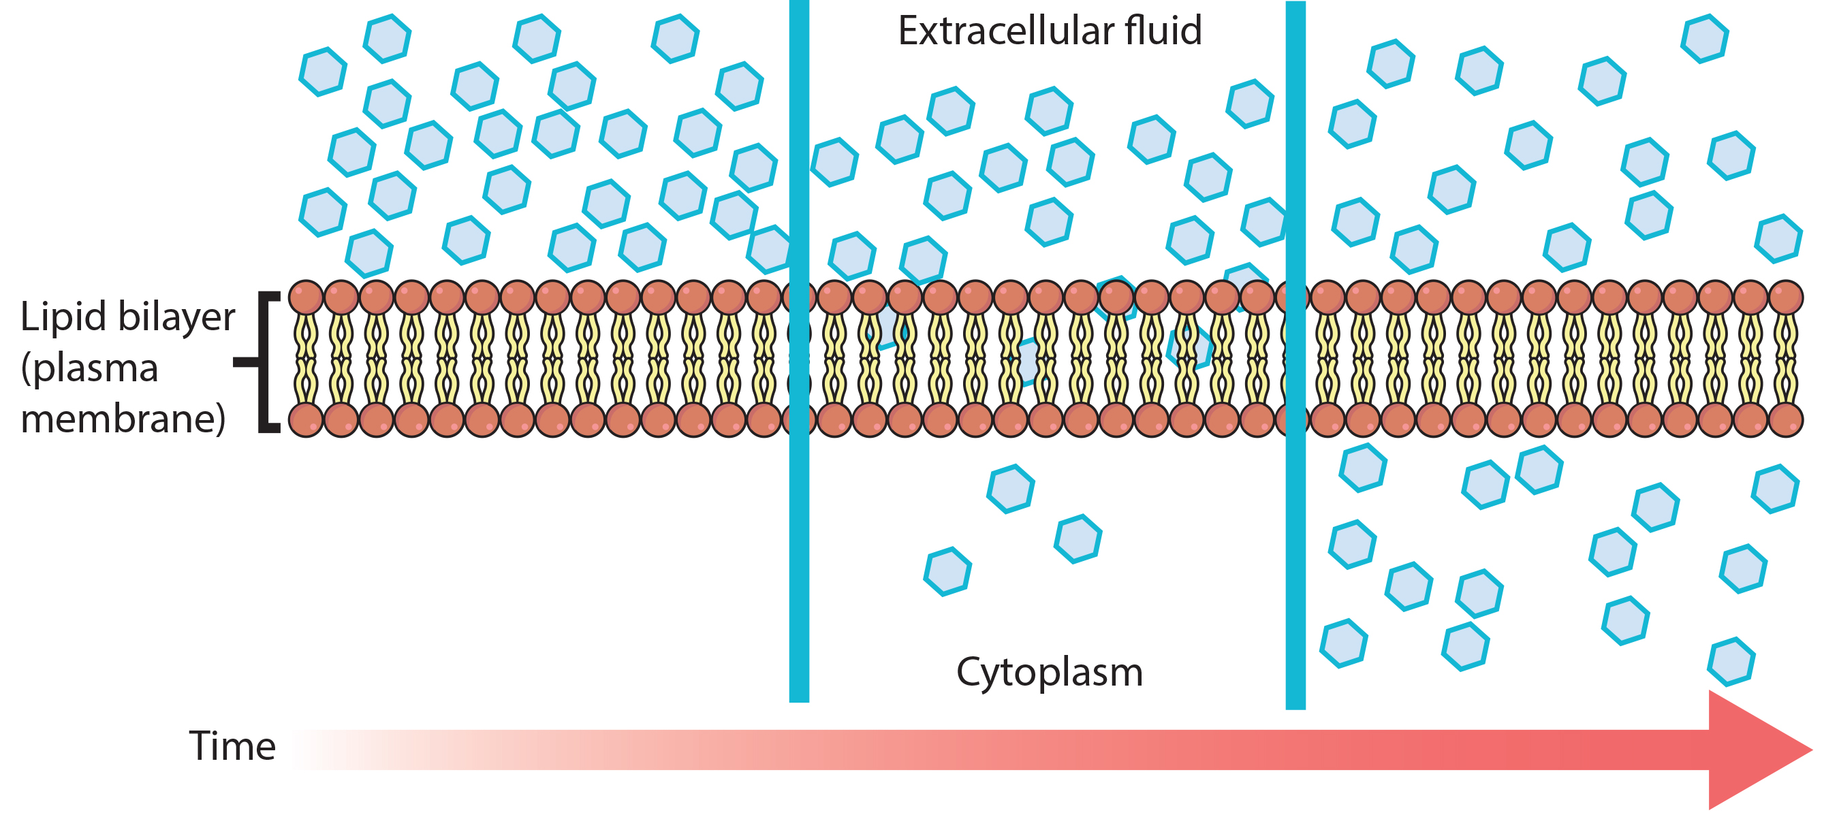
Diffusion₂
Diffusion allows material movement within cytosol and through membrane.
Concentration gradients are a form of potential energy that dissipates as the gradient is eliminated.
5.2 Figure 3
Mariana Ruiz Villarreal on Wikimedia Commons. "Diffusion."

Slide 9
Factors That Affect Diffusion
Molecules move randomly, but the rate of movement depends on the molecule's mass, the environment, and the temperature.
At dynamic equilibrium, there is no net movement of molecules despite constant motion.

Slide 10
Table 1: Factors That Affect Diffusion Rate
 | Increases Diffusion Rate | Decreases Diffusion Rate
Size of Concentration Gradient | a larger concentration gradient | a smaller concentration gradient
Mass of Molecules Diffusing | smaller molecules due to faster movement | heavier molecules due to slower movement
Temperature | higher temperatures due to increased molecular movement | lower temperatures due to decreased molecular movement
Solvent Density | lower solvent density because molecules can more easily move through it | higher solvent density because molecules have more difficulty moving through it

Slide 11
Table 1: Factors That Affect Diffusion Rate (Continued)
 | Increases Diffusion Rate | Decreases Diffusion Rate
Solubility | nonpolar and lipid-soluble molecules through a plasma membrane | polar molecules and ions through a plasma membrane
Surface Area or Plasma Membrane Thickness | increased surface area or decreased plasma membrane thickness | decreased surface area or increased plasma membrane thickness
Distance Traveled and Relationship to Cell Size | decreased distance, diffusion is more effective at dispersing molecules in smaller cells (like prokaryotes) or flattened cells (like many single-celled eukaryotes) | increased distance, diffusion is less effective at dispersing molecules in larger spherical cells like typical eukaryotic cells because nutrients or waste cannot reach or leave the cell's center, respectively

Slide 12
Science and You₁
Dehydration is related to solvent density affecting diffusion across cell membranes.
As solvent density increases, the diffusion rate decreases due to molecular slowing.
In less dense solvents, diffusion increases.
Dehydration decreases diffusion in the cytoplasm, impairing cellular functioning.
Neurons are sensitive to dehydration which can lead to unconsciousness and even a coma.
Notes:
This is included as a relevant application for this topic.

Slide 13
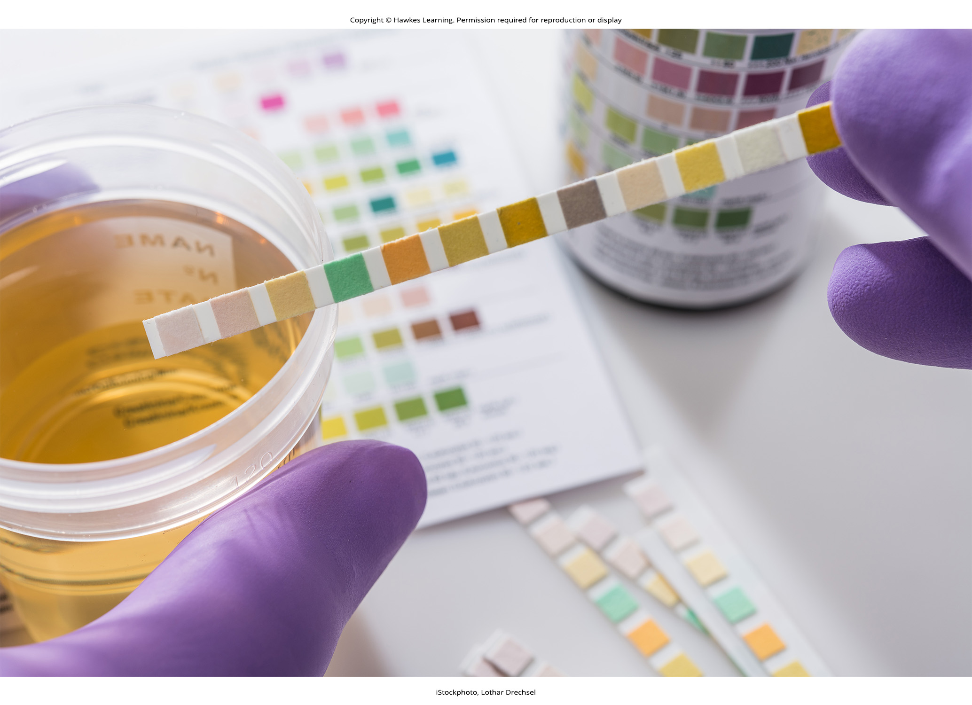
Diffusion By Filtration
Filtration is diffusion through a membrane, sometimes using pressure to increase the diffusion rate.
In the kidneys, blood pressure forces water and solutes (dissolved substances) out of the blood.
High blood pressure can force too many proteins into the urine.
5.2 Figure 4: Excess protein in urine can be detected using a urine dipstick test. The presence of protein in urine may be due to one of several reasons, including high blood pressure, heart failure, infection, dehydration, or kidney dysfunction.

Slide 14
Facilitated Transport
Facilitated transport is the process by which material moves down a concentration gradient using integral membrane proteins and no energy.
The hydrophobic interior blocks independent crossing of polar materials, but proteins them, allowing diffusion.
Materials first bind to exterior receptors, enabling removal from extracellular fluid.

Slide 15
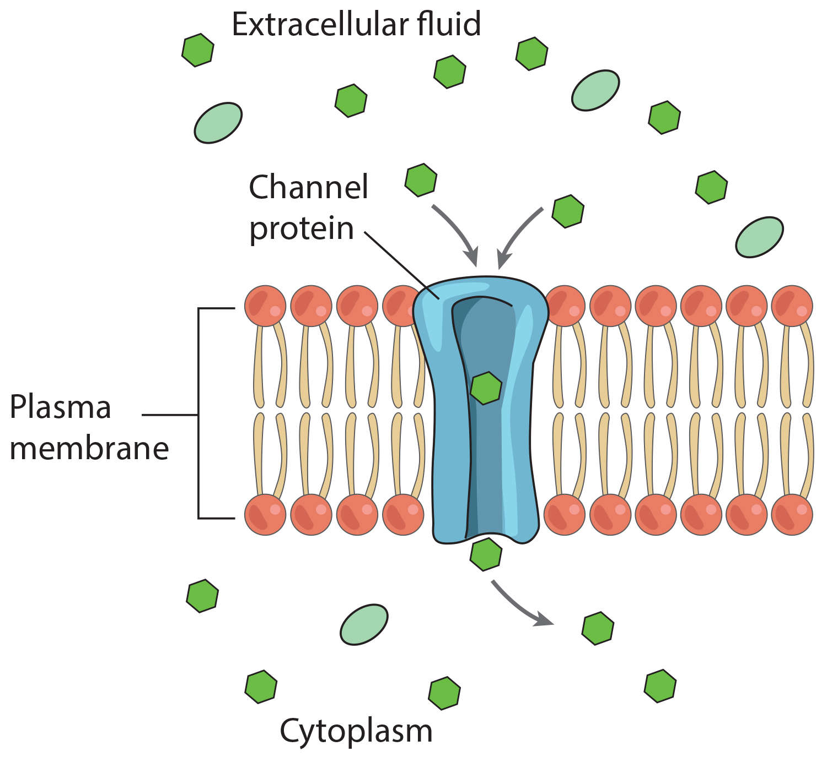
Channels
Transport proteins facilitate material movement across the membrane.
Can be channel or carrier protein
Channels have higher diffusion rates.
Channel proteins are membrane proteins that allow a substance to pass through its hallow, hydrophilic core.
Allow polar compounds to enter the cell
Are always open or gated
Aquaporins are channel proteins that allow rapid water transport.
5.2 Figure 5
OpenStax on Wikimedia Commons. "Facilitated diffusion."

Slide 16
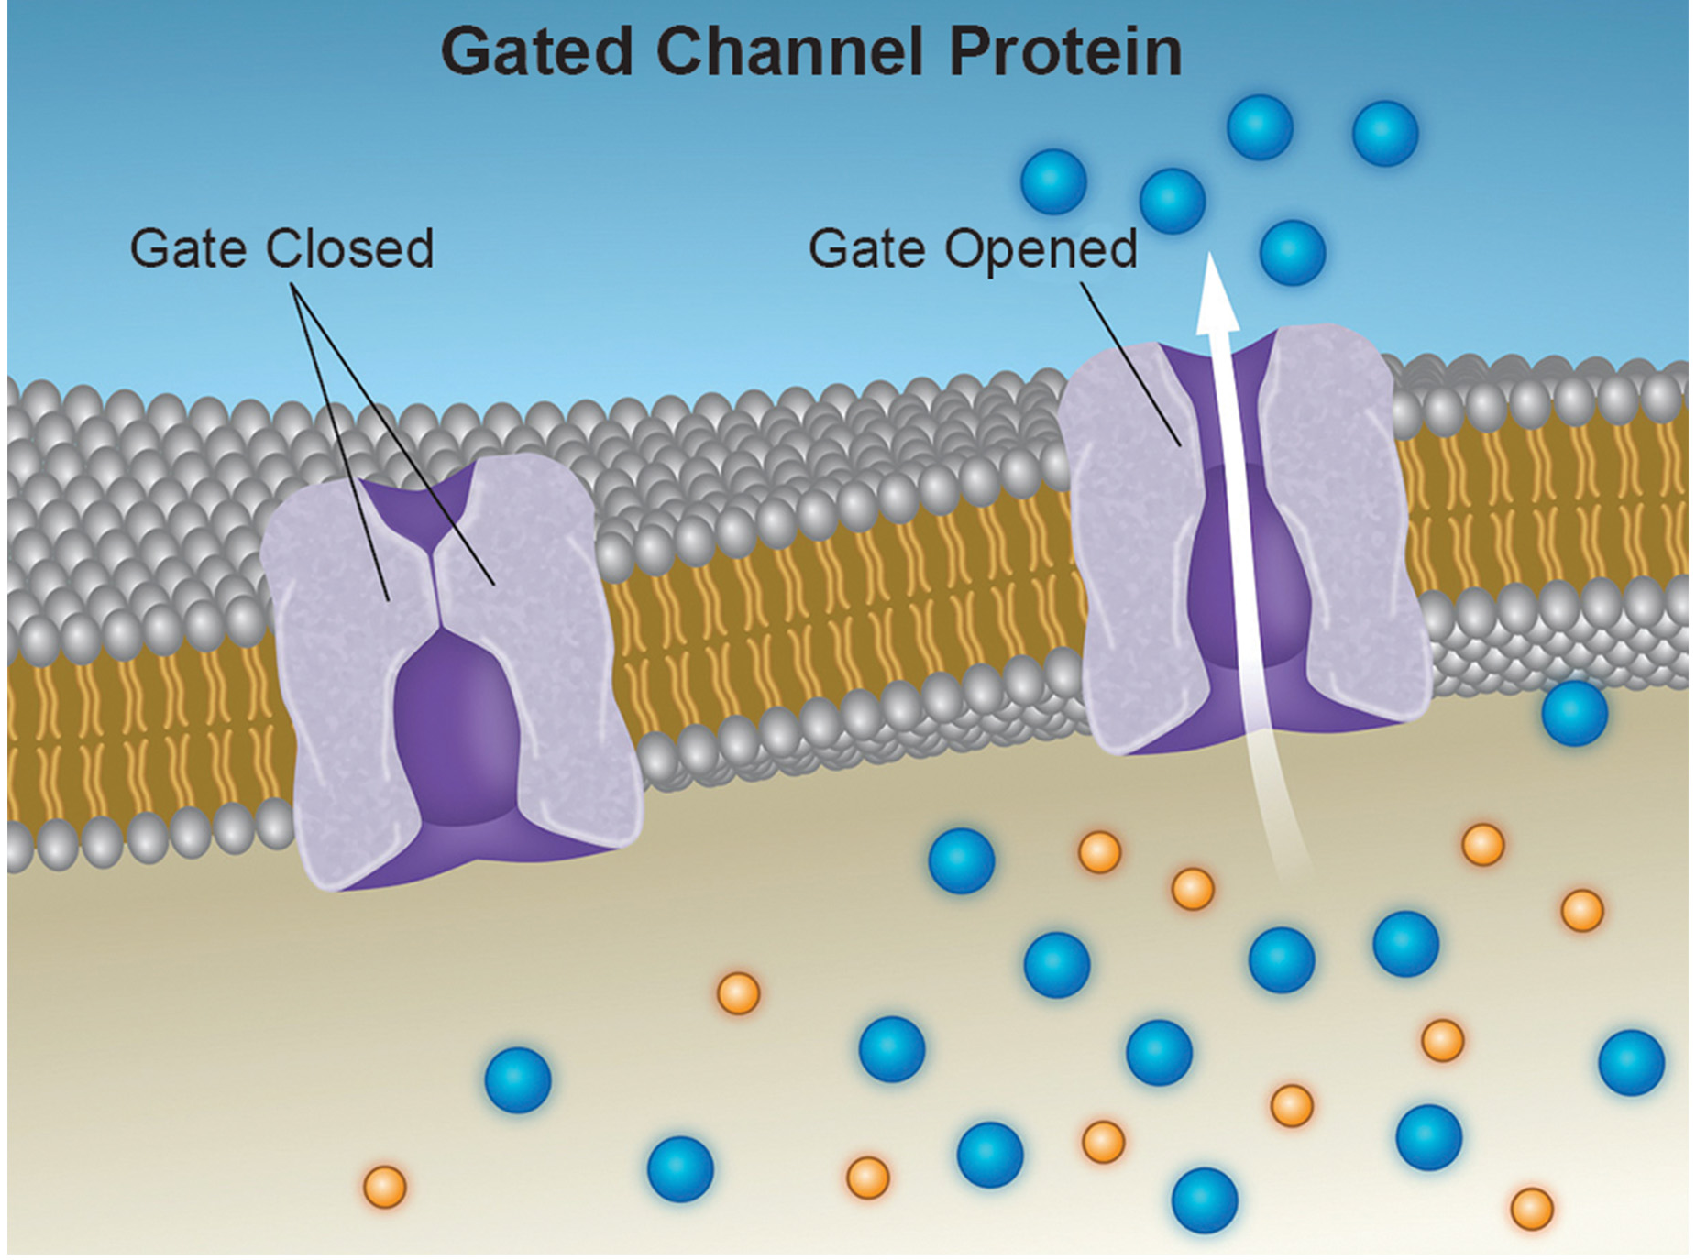
Gated Channels
Gated ion channels open by the attachment of an ion or ligand (molecule), or voltage change.
Kidneys have both gated and open channels for ions.
Neurons have gated sodium, potassium, and calcium channels that maintain the concentrations needed for electrical signals.
5.2 Figure 6
Rao, A., Ryan, K., Tag, A. and Fletcher, S. Department of Biology, Texas A&M University. "Ion channel proteins."

Slide 17
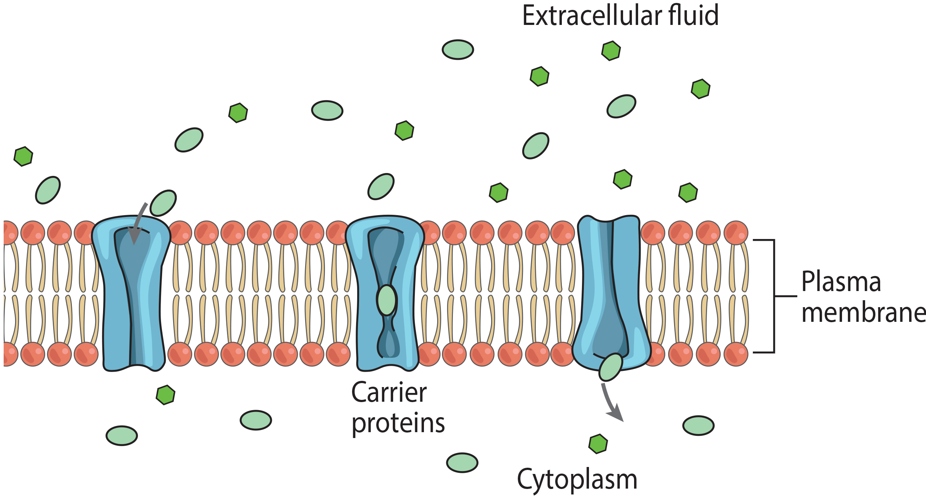
Carrier Proteins
Carrier proteins bind and facilitate the movement of specific molecules across the plasma membrane by changing shape.
Specify for a single substance
Move substances in or out of the cell
Finite number of each carrier proteins limiting transport
Glucose transporters in the kidneys transport glucose back into the blood, but due to a finite number of transporters, excess glucose is excreted in the urine.
5.2 Figure 7
CNX OpenStax on Wikimedia Commons. "Carrier proteins."

Slide 18
Reflection Question
Why do you think channel proteins can transport substances much more quickly than carrier proteins can?
Notes:
The reflection question is included here to use as a talking point or for a think-pair-share activity.

Slide 19
Osmosis
Osmosis is the movement of water across a semipermeable membrane driven by the concentration gradient of water.
The water concentration gradient is inversely proportional to the solute concentration gradient.
The aquaporins that facilitate water transport play a major role in osmosis in red blood cells and kidney tubules.

Slide 20
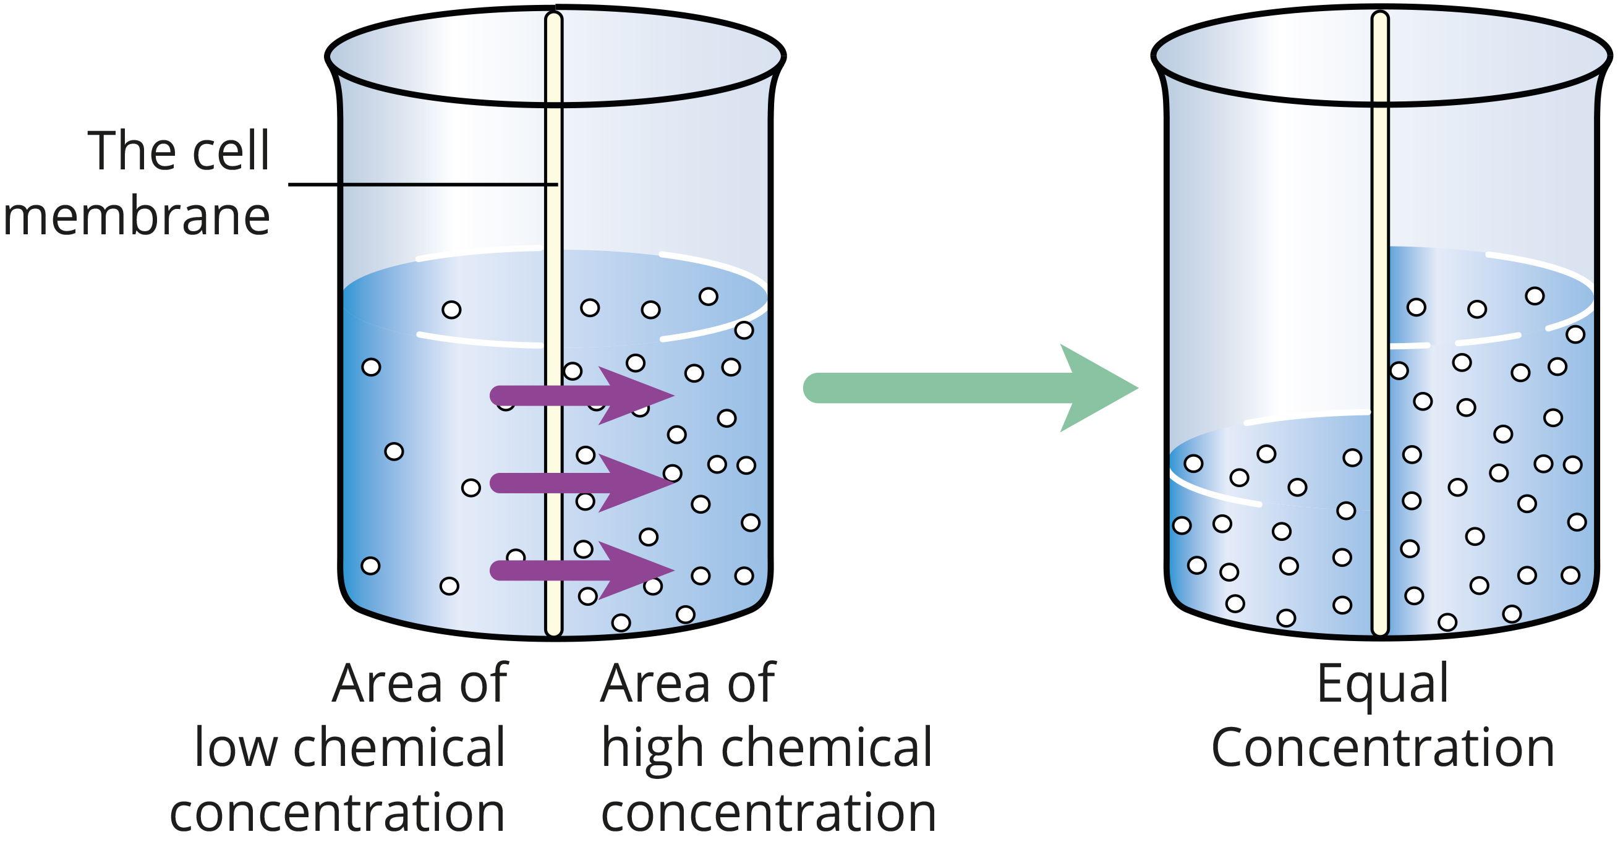
Mechanism of Osmosis
The solute cannot cross the semipermeable membrane, but water can, creating a concentration gradient that drives osmosis.
Osmosis will continue until the water concentrations are equal on both sides of the membrane, or until opposing forces reach equilibrium.
5.2 Figure 8

Slide 21
Tonicity
Tonicity is a measure of the effective osmotic pressure gradient, or the difference in water potential of two solutions.
Osmolarity describes the solution's total solute concentration.
  Low osmolarity has a high water concentration and low solute concentration
  High osmolarity means a high solute concentration and low water concentration.

Slide 22
Hypotonic and Hypertonic Solutions
Hypotonic solution: situation in which extracellular fluid has a lower osmolarity than the fluid inside the cell, resulting in water moving into the cell
Hypertonic solution: situation in which extracellular fluid has a higher osmolarity than the fluid inside the cell, resulting in water moving out of the cell

Slide 23
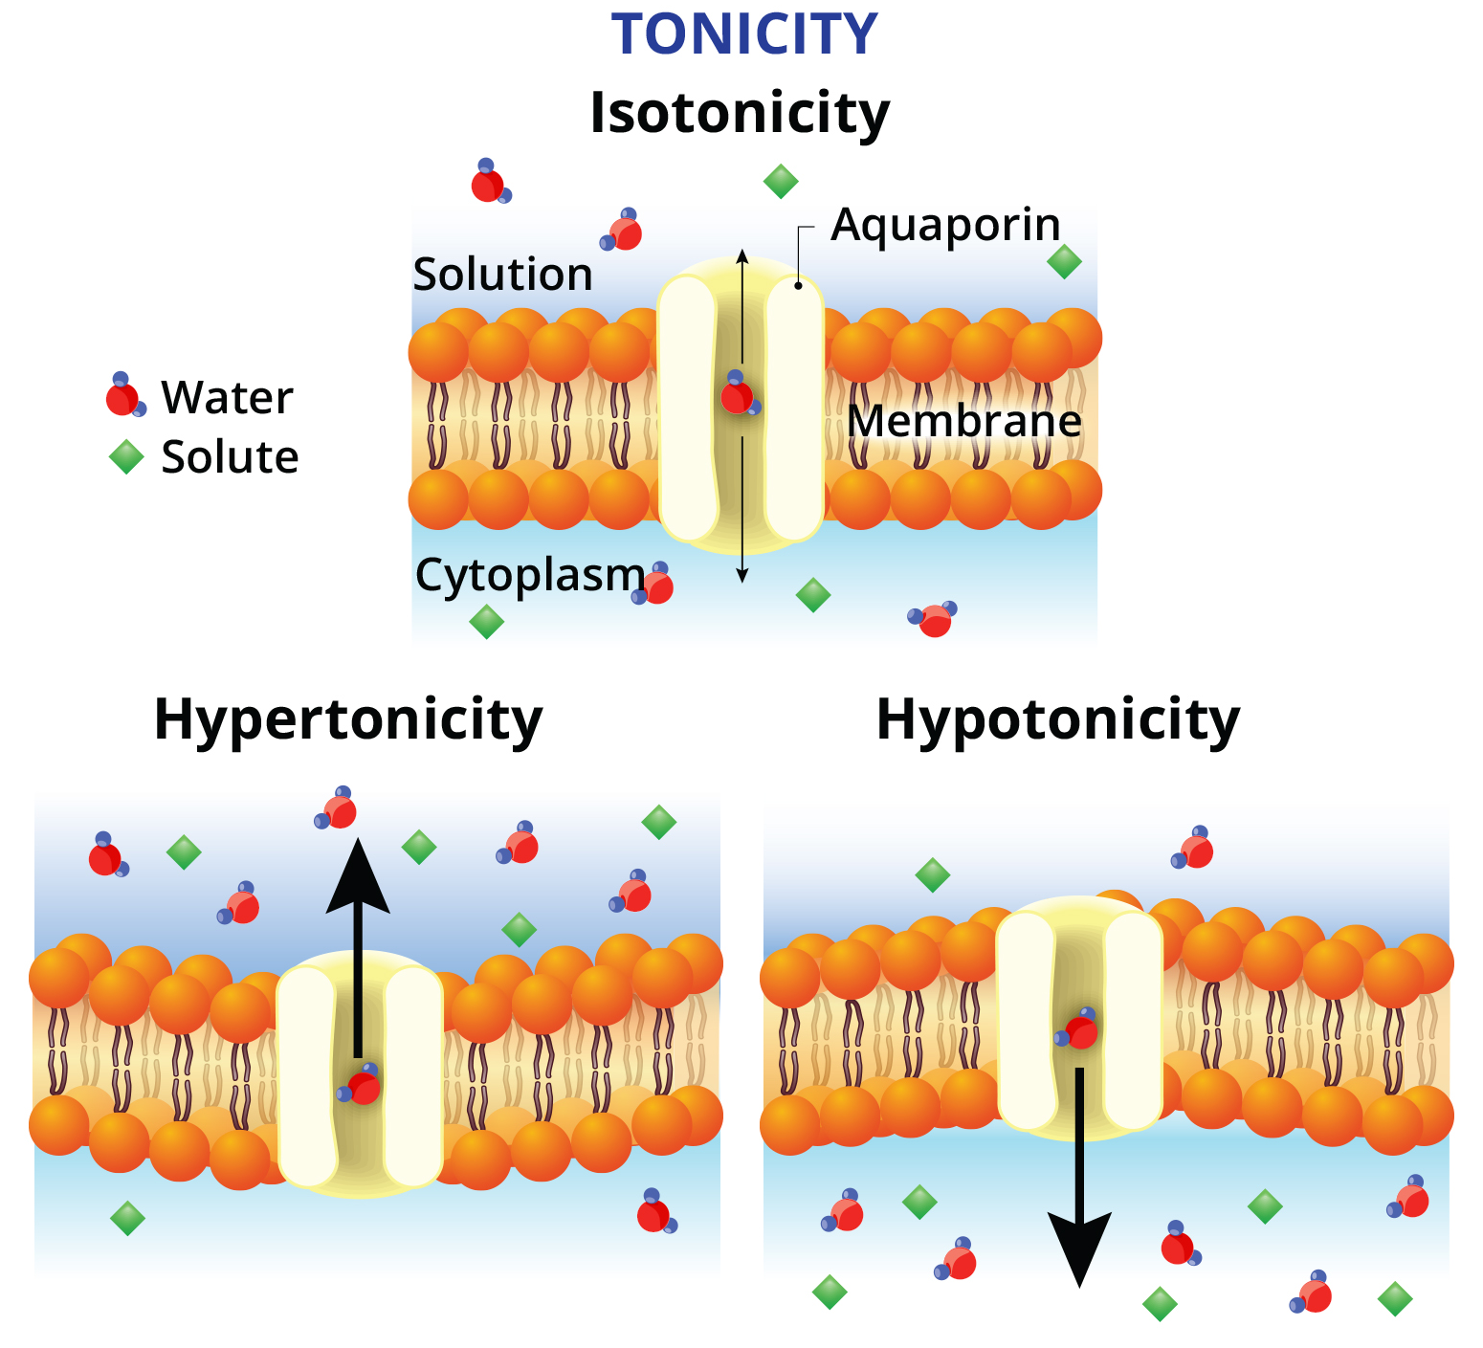
Isotonic Solutions
5.2 Figure 9
An isotonic solution has the same osmolarity inside and outside the cell.
In an isotonic environment, there is no net movement of water into or out of the cell.
However, water is still able to move across the cell membrane in both directions.

Slide 24
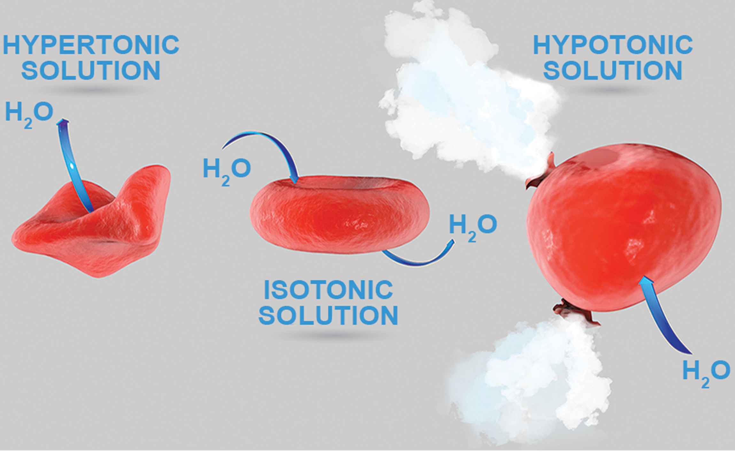
Think It Through₁
The tonicity of an extracellular solution affects the direction that water flows across the membrane of cells. Figure 10 shows the flow of water across the membrane of red blood cells and the resulting affects on the cell in hypertonic, isotonic, and hypotonic solutions.
A doctor injects a patient with what the doctor thinks is an isotonic saline solution (a solution of sodium chloride). The patient dies, and an autopsy reveals that many red blood cells have burst. Do you think the solution the doctor injected was isotonic? Why or why not?
5.2 Figure 10
Notes:
Originally an On Your Own. This is included here to use as a talking point or for a think-pair-share activity.

Slide 25
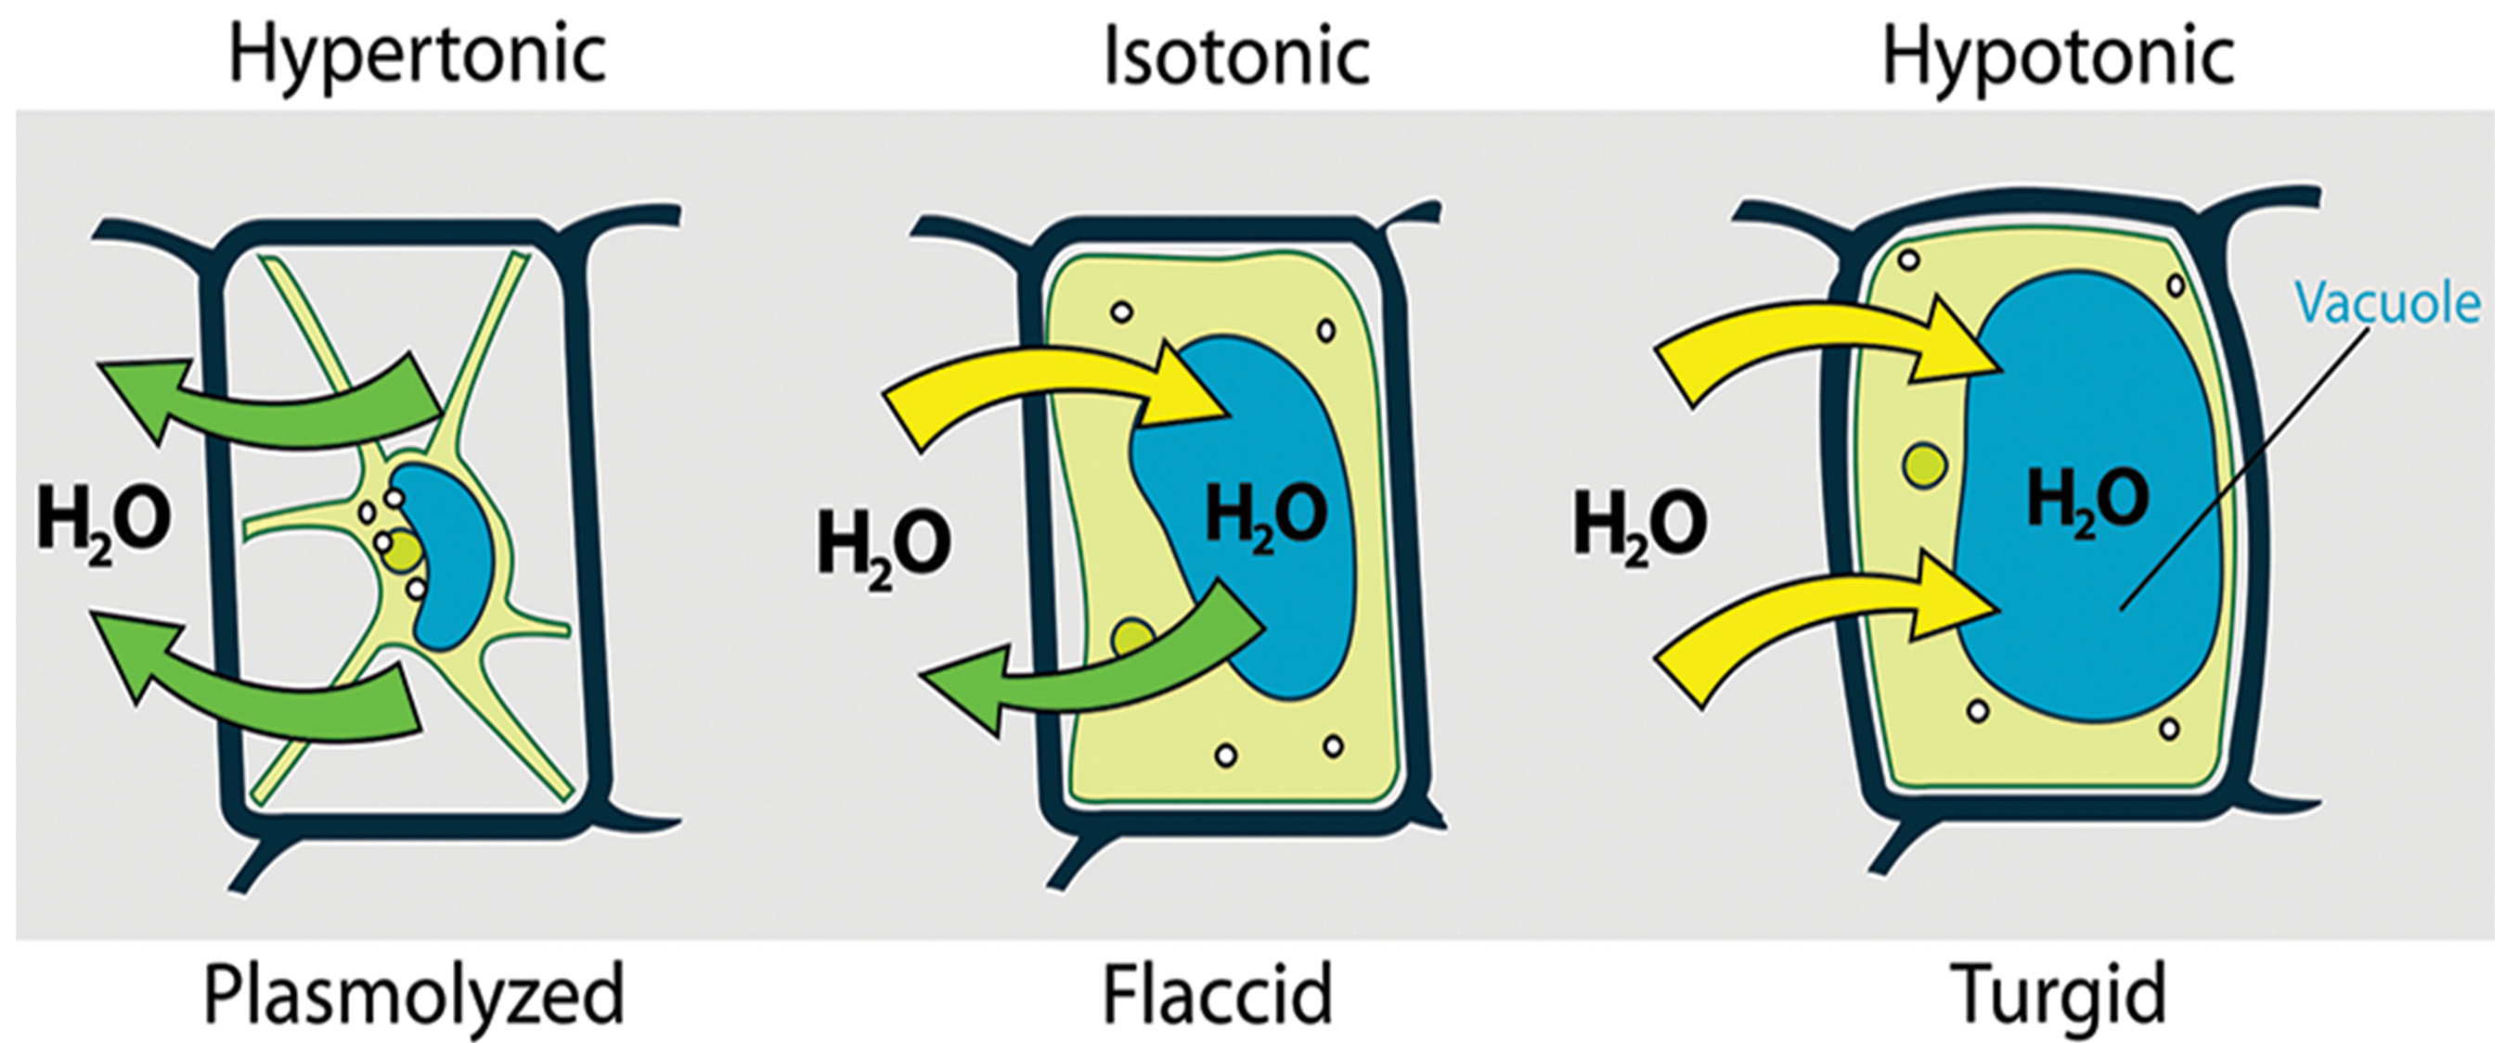
Tonicity in Living Systems₁
Osmotic Effects on Cells:
Hypotonic: Water enters the cell and excessive swelling causes lysis (bursting).
Isotonic: No net water movement and no change in cell size.
Hypertonic: Water leaves the cell and excessive shrinking concentrates solutes, compromising the cell’s functioning and survival.
5.2 Figure 11
Mariana Ruiz Villarreal on Wikimedia Commons. "Tonicity."

Slide 26
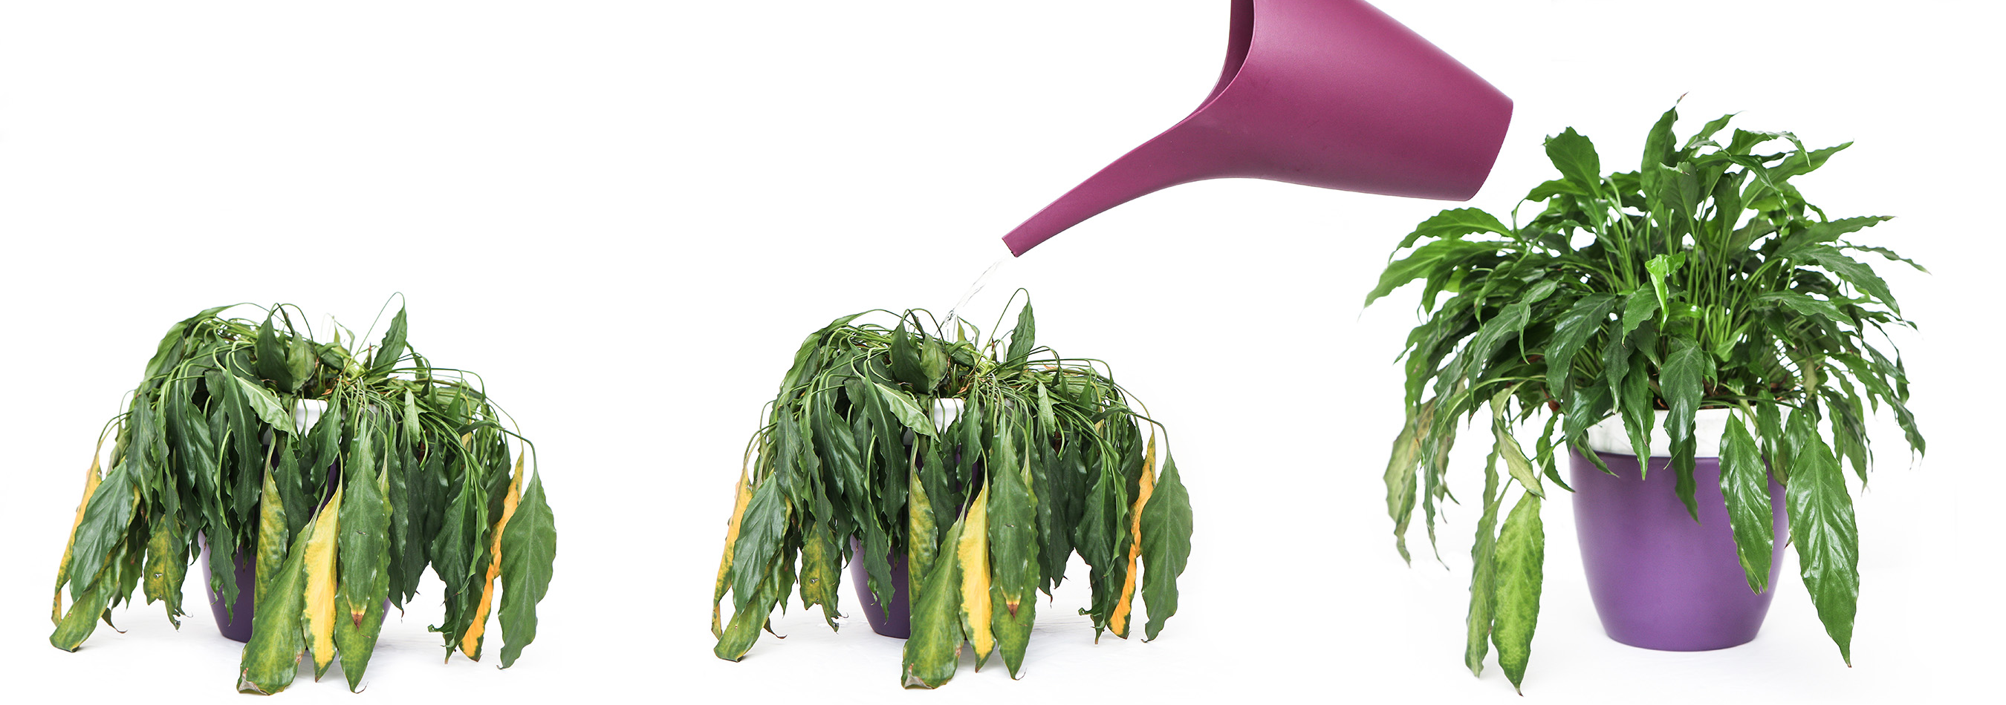
Tonicity in Living Systems₂
Plants have cell walls to prevent lysis.
A hypotonic external environment creates turgor pressure in plants, stiffening the plant’s cell walls.
A hypertonic external environment causes plasmolysis, where the cell membrane detaches from the cell wall.
Plasmolysis leads to wilting due to lost turgor pressure.
5.2 Figure 12: Without adequate water, the plant loses turgor pressure and wilts. Watering restores the turgor pressure.

Slide 27
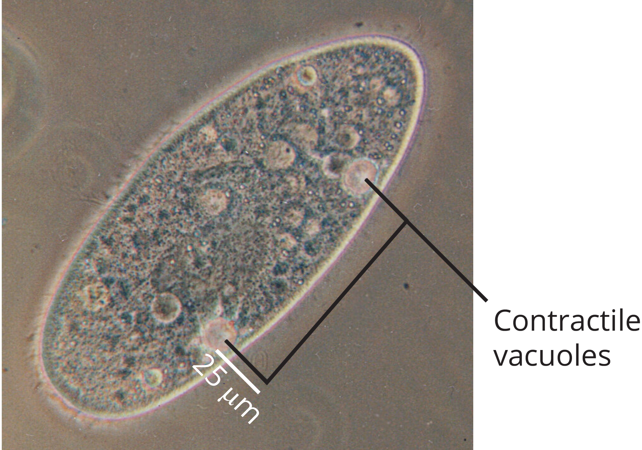
Tonicity in Living Systems₃
Protists like paramecia and amoebas lack cell walls and have contractile vacuoles that:
Collect excess water from the cell's interior
Pump out collected water from the cell
Prevent cell lysis from taking in too much water
5.2 Figure 13
Olaf Studt on Wikimedia Commons. "Paramecium contractile vacuoles."

Slide 28
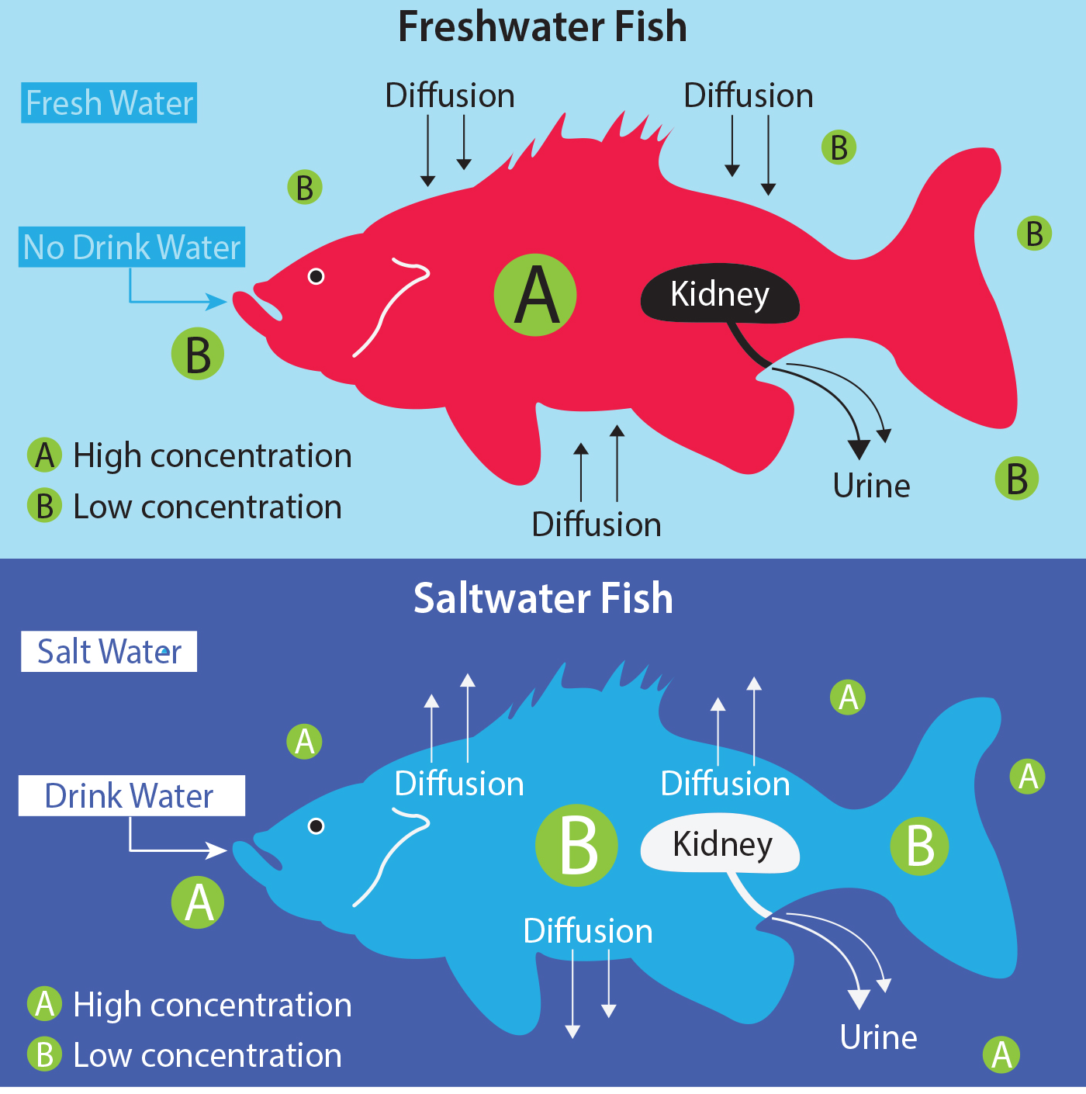
Tonicity in Living Systems₄
5.2 Figure 14
Freshwater fish live in an environment that is hypotonic to their cells.
Saltwater fish live in an environment that is hypertonic to their cells.

Slide 29
Tonicity in Living Systems₅
In vertebrates, kidneys regulate the amount of water in the body.
Osmoreceptors in the brain monitor the blood's solute concentration.
  If solutes increase beyond normal range, a hormone is released to slow water loss through the kidney to dilute the blood.
High albumin protein concentration in the blood helps to control the osmotic pressure and prevent fluid leakage into the tissues.

Slide 30
Think It Through₂
What would happen if plants were watered using seawater?
Notes:
Originally an On Your Own. This is included here to use as a talking point or for a think-pair-share activity.

Slide 31
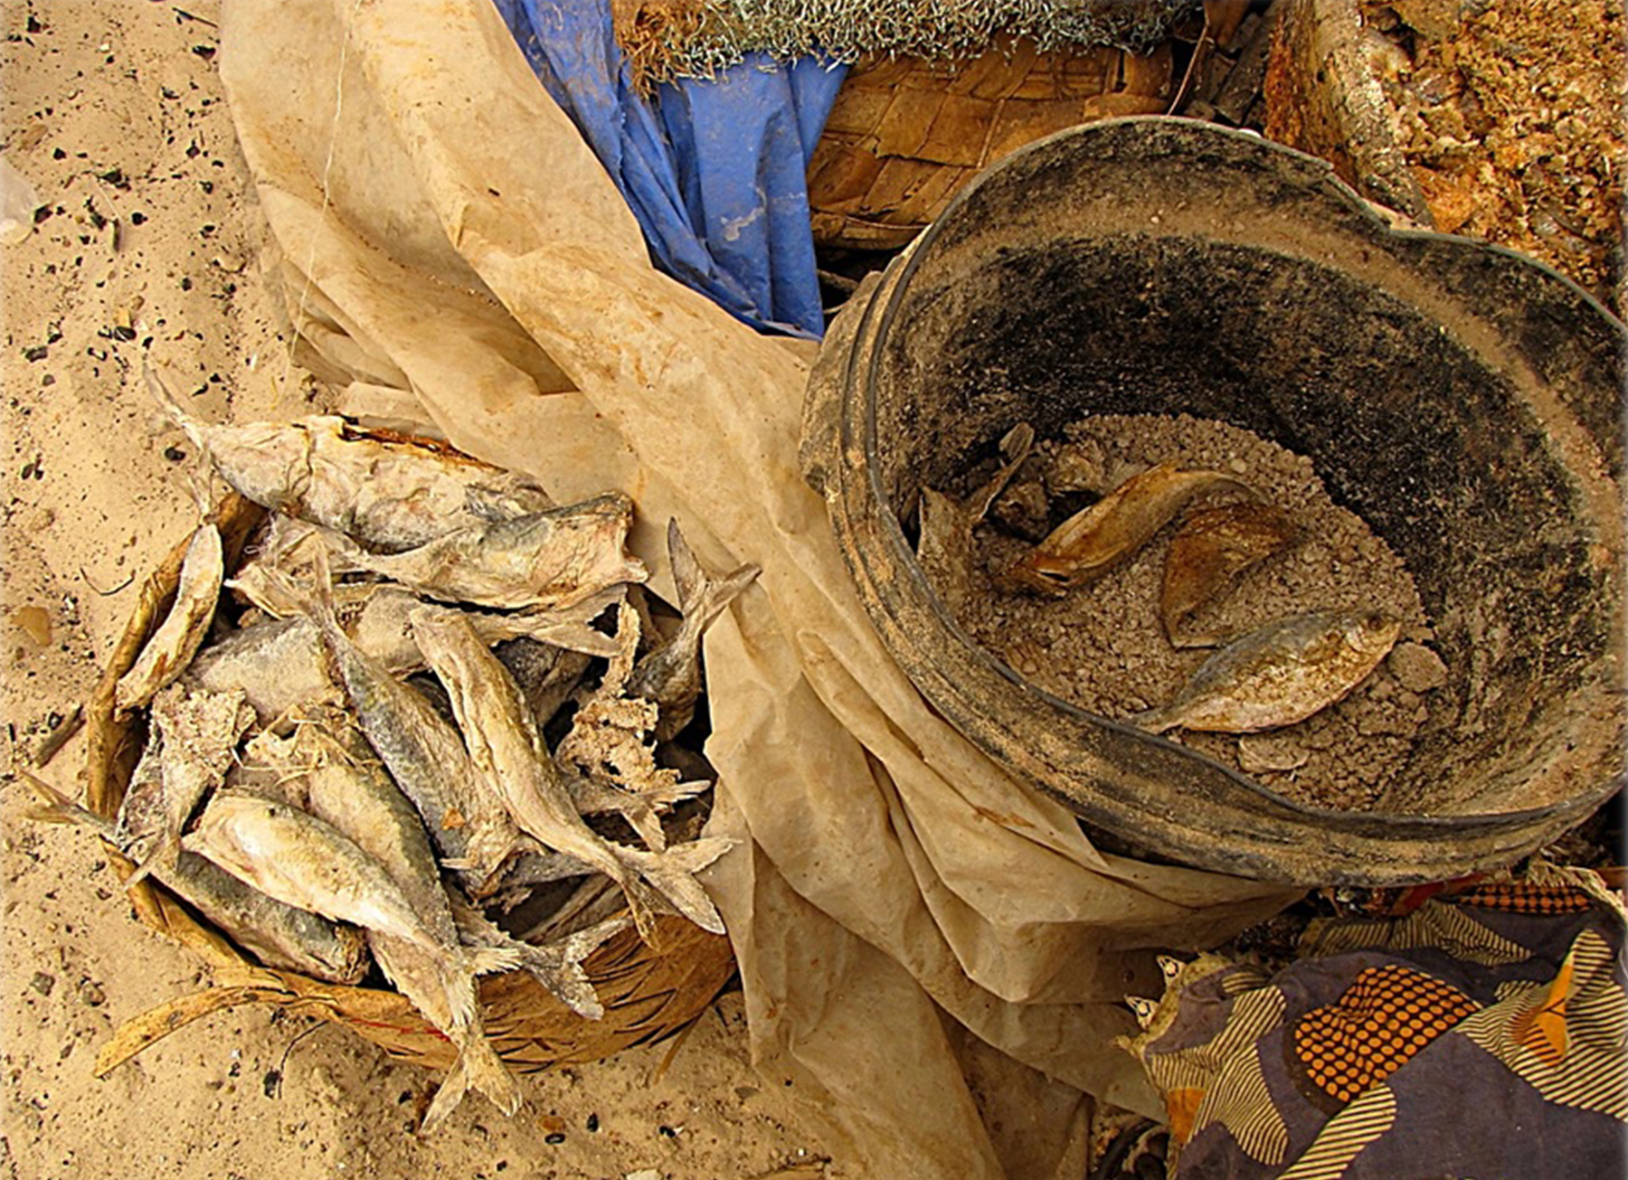
Science and You₂
Prior to the development of refrigeration technology, common food preservation techniques included salting, adding sugars, and drying food.
This creates a hypertonic environment and causes water to leave the microbial cells through osmosis.
Drying directly removes water from foods and dehydrates the microbes present.
5.2 Figure 15
T.K. Naliaka on Wikimedia Commons. "Salt-cured fish."
Notes:
This is included as a relevant application for this topic.

Slide 32
Summary
Diffusion and osmosis move small molecules across membranes from areas of high to areas of low concentration.
Each substance diffuses independently based on its own concentration gradient.
Diffusion rates depend on factors like concentration gradient, particle size, and temperature.
The plasma membrane controls substances diffusing into and out of cells.
Membrane proteins like channels and transporters facilitate diffusion of some materials in living systems.

Slide 33


End of Hawkes Learning PowerPoint

