Slide 1
Lesson 5.3
Active Transport and the Sodium-Potassium Pump

Slide 2
Objectives
Distinguish between primary active transport and secondary active transport.
Understand how electrochemical gradients affect ions.
Describe the sodium-potassium pump as a primary active transport mechanism.

Slide 3
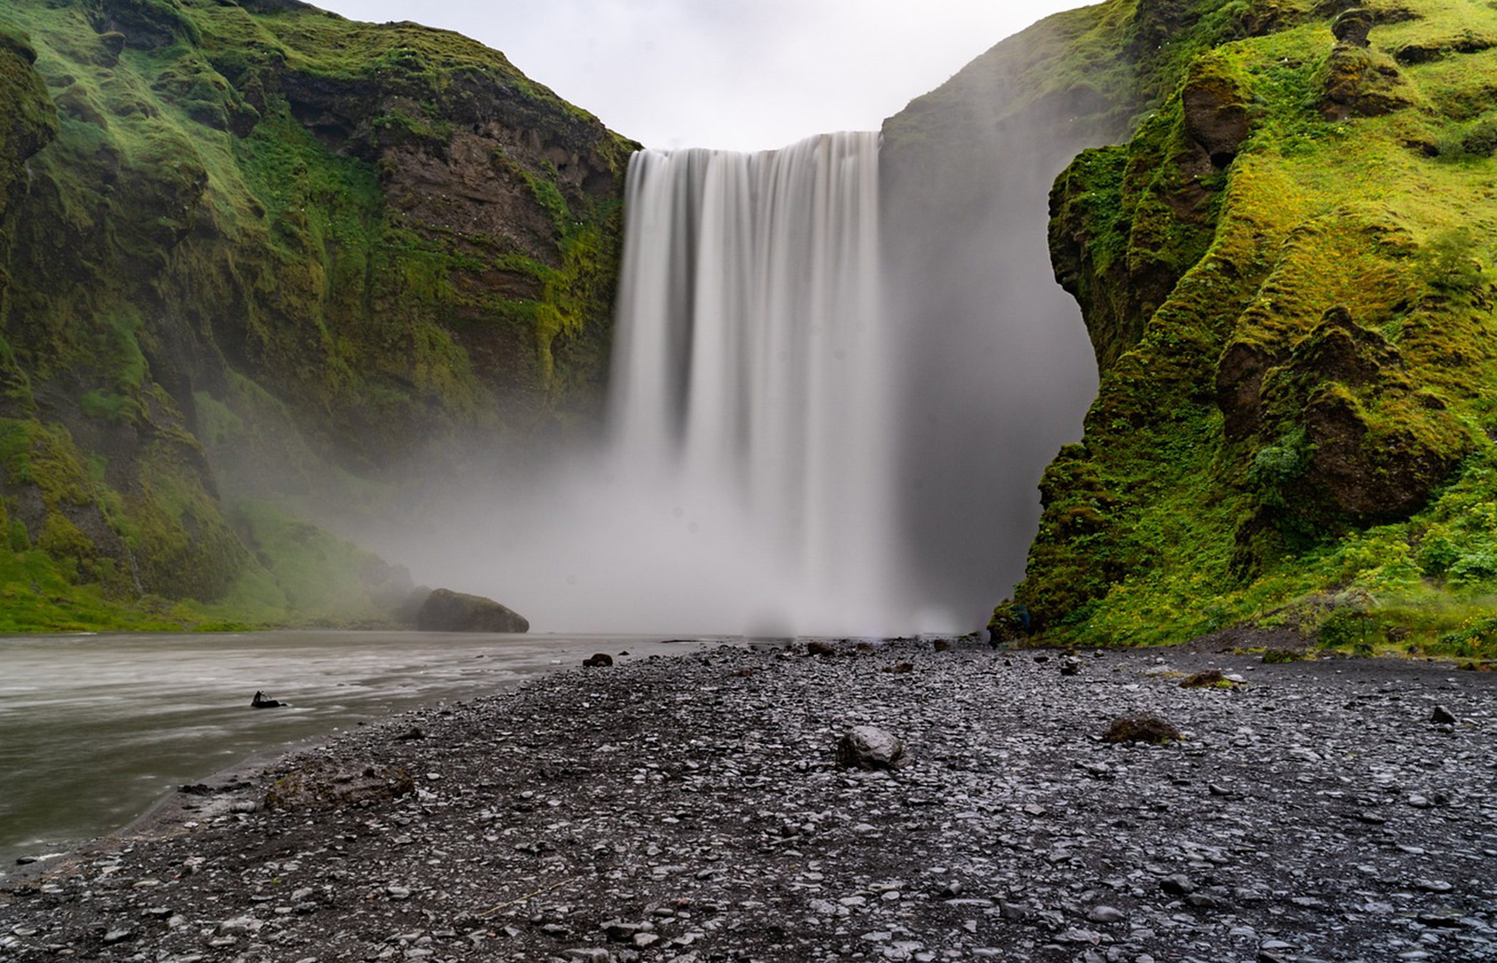
Active Transport
Active transport requires energy, often ATP, to move substances against their concentration gradients.
Passive transport is like the movement of water down a waterfall, while active transport is like the movement of water up a waterfall, it would require energy.
Some mechanisms transport small ions and molecules, while others move larger molecules through the membrane.
5.3 Figure 1
ReneGossner on Pixabay. "Waterfall."

Slide 4
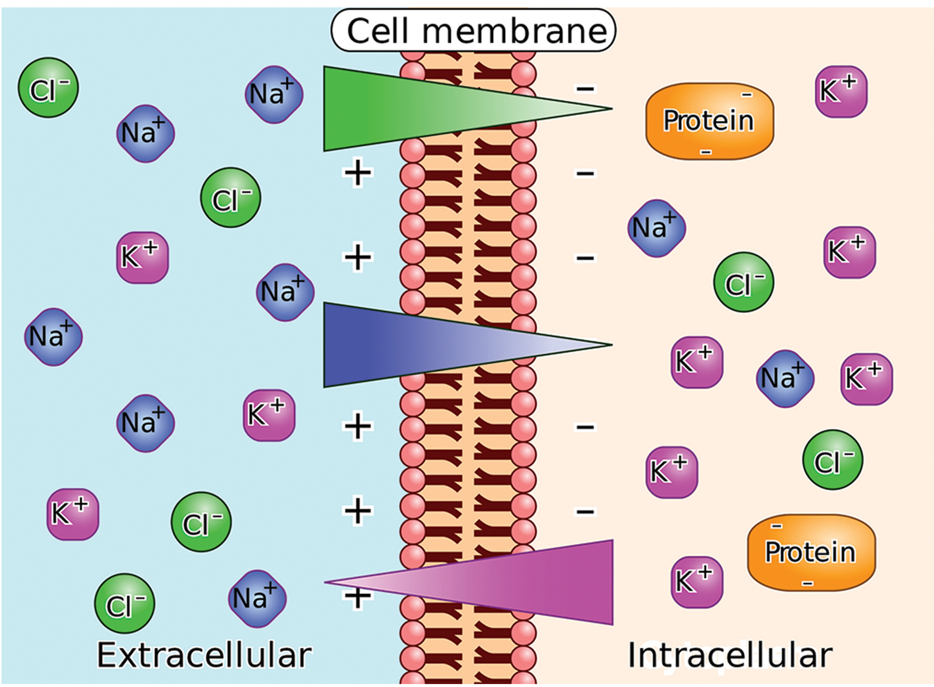
Electrochemical Gradient
Living cells have complex electrochemical gradients across their membranes due to different ion concentrations and electrical charges on each side of the membrane.
The cell's interior is negatively charged relative to the extracellular fluid, with higher potassium (K⁺) but lower sodium (Na⁺) concentrations.
An ion's electrochemical gradient combines its concentration gradient and the electrical force driving it based on charge.
5.3 Figure 2
CNX OpenStax on Wikimedia Commons. "Electrochemical gradient." Modified.

Slide 5
Think It Through₁
Injecting a potassium solution into a person's blood is lethal, which is why the administration of a potassium solution is the method commonly used for capital punishment and euthanasia. Why do you think a potassium solution injection is lethal?
Notes:
Originally an On Your Own. This is included here to use as a talking point or for a think-pair-share activity.

Slide 6
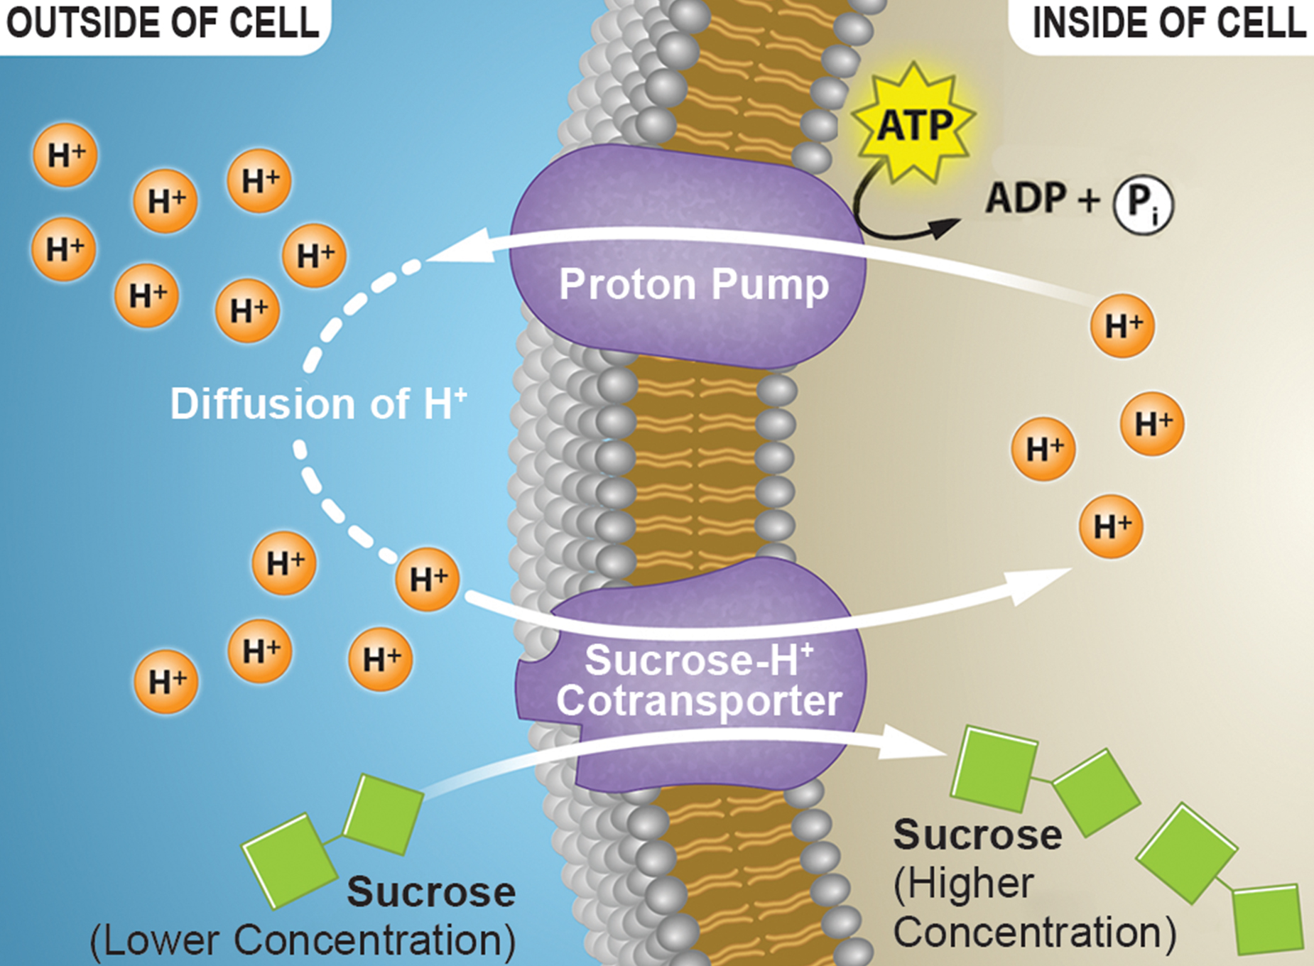
Moving Against a Gradient
Active transport pumps move substances against gradients using energy.
Pumps maintain the electrochemical gradient, by moving critical ion and small molecules that can passively diffuse down their concentrations.
Primary active transport directly uses ATP to pump substances.
Secondary active transport uses cotransporters (pumps that move two substances at once) to couple the movement of a substance down its gradient with the movement of another against its gradient.
5.3 Figure 3
Rao, A. Tag, A. and Ryan, K. Department of Biology, Texas A&M University. "Proton gradient."

Slide 7
Group Activity
As a group, think about different types of cells, including human cells, plant cells, and bacterial cells.
What types of molecules might each type of cell like to accumulate?
What types of molecules might each type of cell try to avoid accumulating?
Discuss your reasons why as a group.

Slide 8
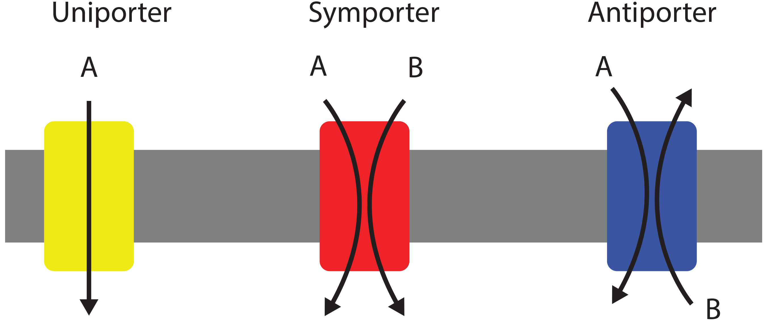
Carrier Proteins for Active Transport
Transporters, or ATPases) are membrane proteins that facilitate active transport.
Uniporters transport a single ion or molecule across the membrane.
Symporters carry two different ions or molecules in the same direction.
Antiporters transport two ions or molecules in opposite directions across the membrane, such as the sodium-potassium pump.
5.3 Figure 4
Lupask on Wikimedia Commons. "Uniporter, symporter, and antiporter."

Slide 9
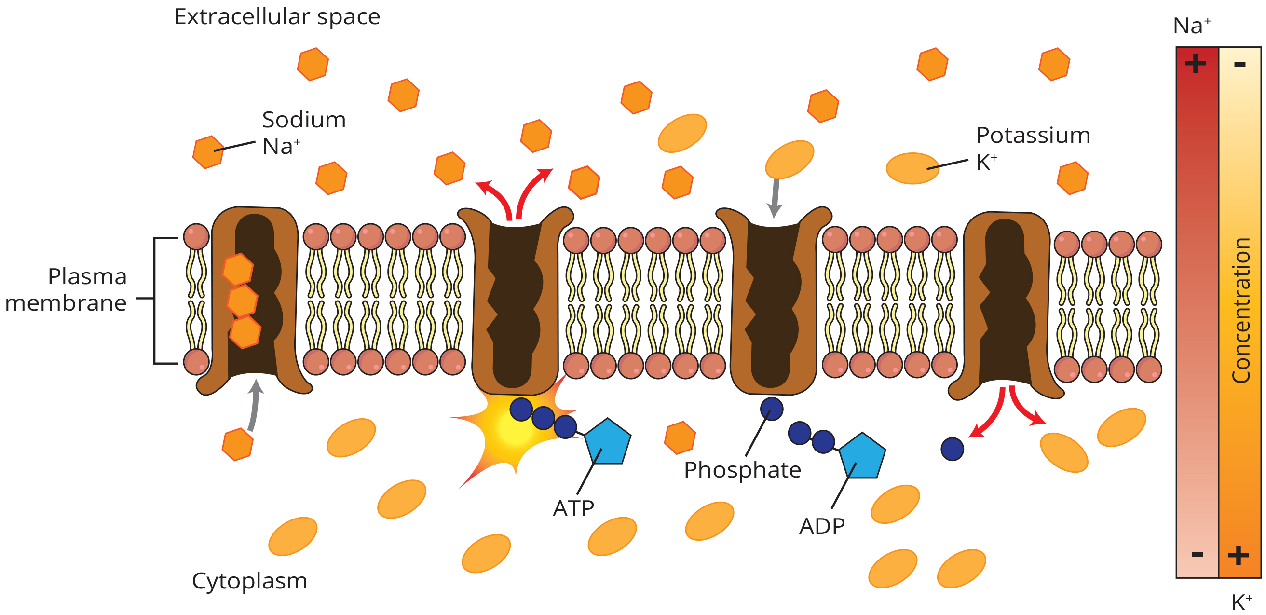
Primary Active Transport
Primary active transport of the sodium-potassium pump establishes electrochemical gradients that drive secondary active transport.
5.3 Figure 5
Mariana Ruiz Villarreal on Wikimedia Commons. "Sodium-potassium pump."

Slide 10
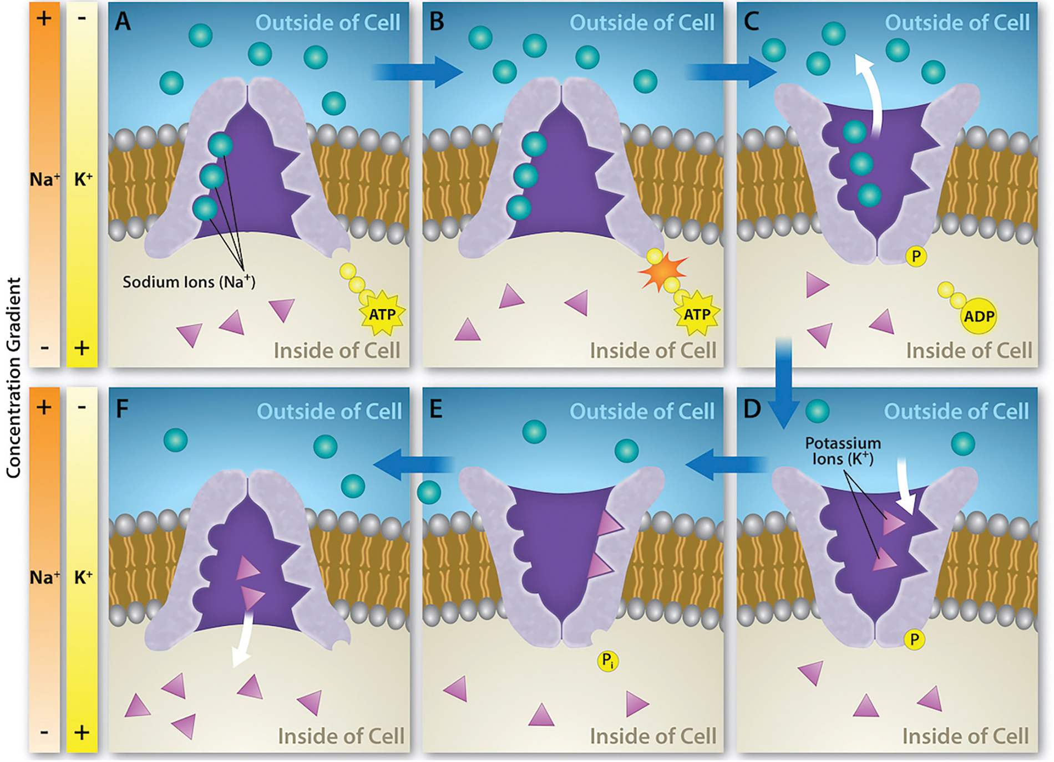
The Sodium-Potassium Pump
Sodium-potassium pump moves 3 Na⁺ out for every 2 K+ into the cell.
Creates a chemical gradient with more Na⁺ outside the cell and K⁺ inside.
Establishes a membrane potential by making the cell interior negatively charged and the exterior positively charged
5.3 Figure 6
Rao, A., Ryan, K. and Fletcher, S. Department of Biology, Texas A&M University. "Sodium-potassium pump."

Slide 11
Steps of a Sodium-Potassium Pump
Steps 1–3 are primary active transport, 4–6 are secondary active transport.
With the enzyme oriented towards the cell's interior, the carrier has a high affinity for sodium ions. Three ions bind to the protein.
The protein carrier hydrolyzes ATP, and the released phosphate group attaches to the carrier.
Once the phosphate group attaches, the carrier changes shape and reorients itself towards the membrane's exterior. The protein's affinity for sodium decreases, and the three sodium ions leave the carrier.
The shape change increases the carrier's affinity for potassium ions, and two such ions attach to the protein. Subsequently, the low-energy phosphate group detaches from the carrier.
With the phosphate group removed and potassium ions attached, the carrier protein repositions itself towards the cell's interior.
The carrier protein, in its new configuration, has a decreased affinity for potassium, and the two ions move into the cytoplasm. The protein now has a higher affinity for sodium ions, and the process starts again.

Slide 12
Secondary Active Transport (Cotransport)₁
Secondary active transport uses the kinetic energy of one substance (such as sodium ions) moving down its concentration or electrochemical gradient to transport another substance against its concentration or electrochemical gradient.
For example, sodium ions move down their electrochemical gradient providing the energy to transport glucose against its concentration gradient.
Glucose and amino acids enter cells this way.

Slide 13
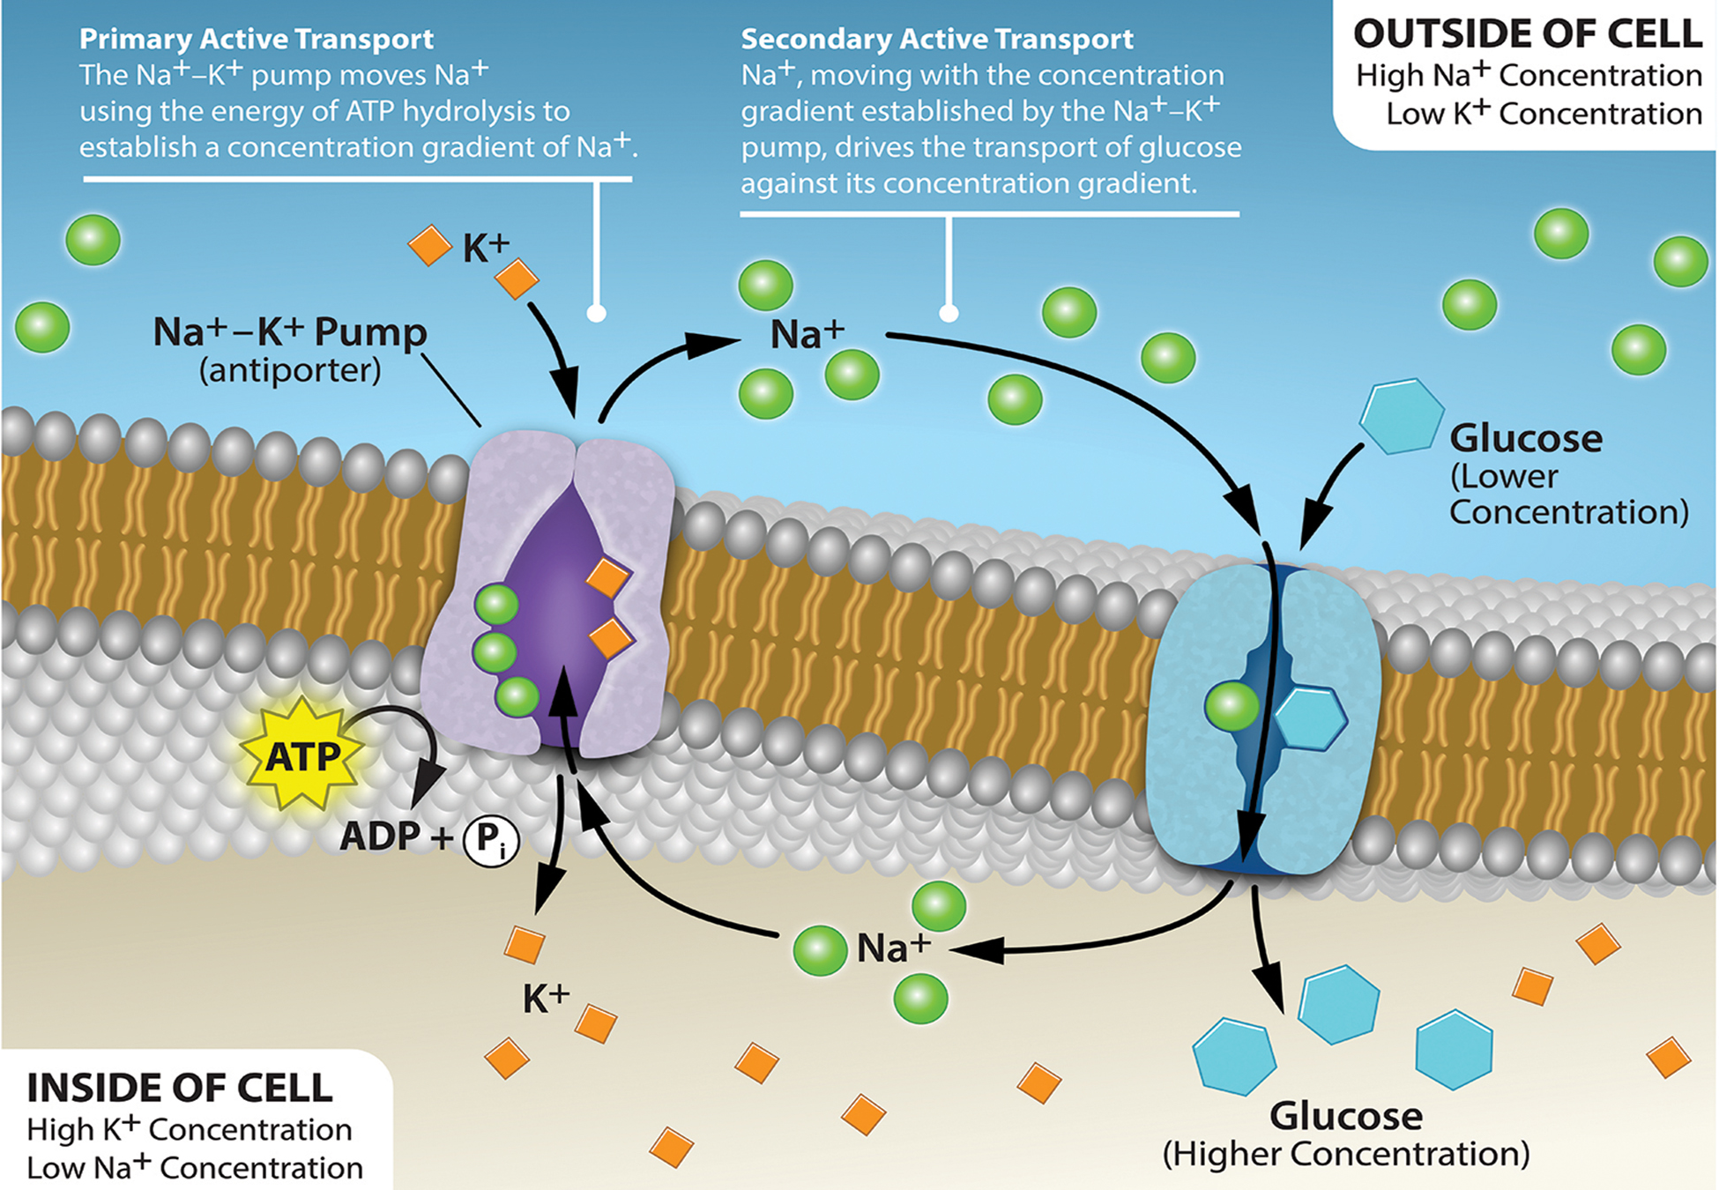
5.3 Figure 7
Rao, A., Ryan, K. and Fletcher, S. Department of Biology, Texas A&M University. "Electrochemical gradient."

Slide 14
Think It Through₂
Consider the cotransport mechanism shown in Figure 7. If the concentration of sodium ions outside the cell increases, how will the amount of glucose transported into the cell be affected?
5.3 Figure 7
Rao, A., Ryan, K. and Fletcher, S. Department of Biology, Texas A&M University. "Electrochemical gradient."
Notes:
Originally an On Your Own. This is included here to use as a talking point or for a think-pair-share activity.

Slide 15
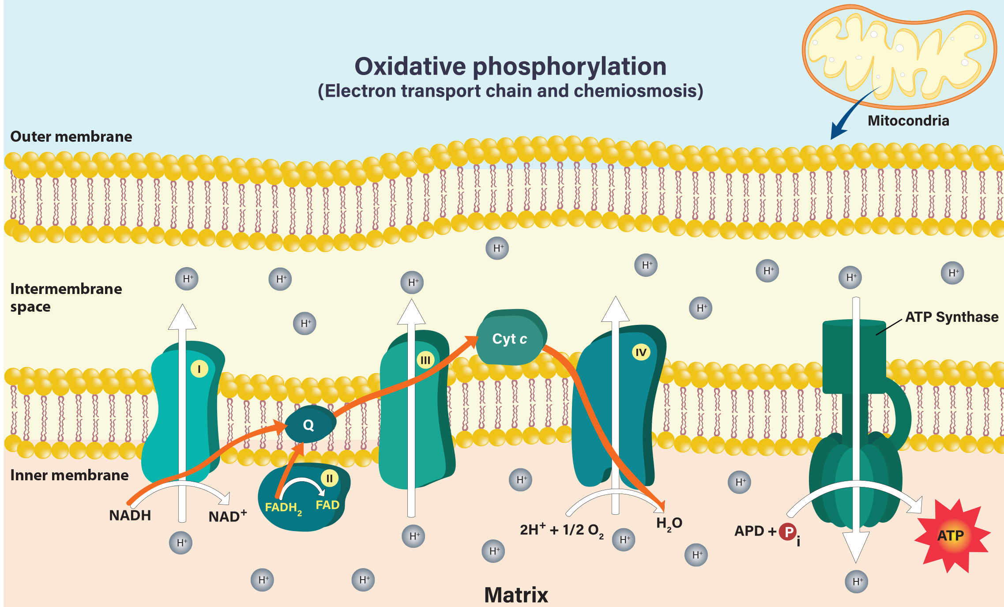
Secondary Active Transport (Cotransport)₂
The electrochemical gradient of hydrogen ions (protons) across the inner mitochondrial membrane provides the energy to make ATP during oxidative phosphorylation.
Protons move through the channel protein, ATP synthase, releasing energy that drives the phosphorylation of ADP into ATP.
5.3 Figure 8

Slide 16
Summary
The combined gradient that affects an ion includes its concentration gradient and its electrical gradient.
For example, positive ions may face concentration gradients favoring diffusion but electrical gradient hindering it.
In aqueous solutions, both electrochemical and concentration gradients need to be considered.
Cells require some substances at higher internal concentrations than external.
Moving substances against electrochemical gradients requires energy (ATP) via active transport (primary or secondary).

Slide 17


End of Hawkes Learning PowerPoint

