Slide 1
Lesson 5.4
Transport of Living Molecules

Slide 2
Objectives
Describe endocytosis, including phagocytosis, pinocytosis, and receptor-mediated endocytosis.
Understand the process of exocytosis.
Compare and contrast endocytosis and exocytosis.

Slide 3
Transport of Multiple Molecules
Eukaryotic cells need to remove and take in larger molecules and particles.
  The transport of large molecules, particles or cells across the cell membrane is called bulk transport.
  Bulk transport requires energy.

Slide 4
Types of Bulk Transport
Endocytosis: a type of active transport that moves particles into a cell.
  Phagocytosis
  Receptor mediated endocytosis
  Pinocytosis
Exocytosis: a type of active transport that expels material

Slide 5
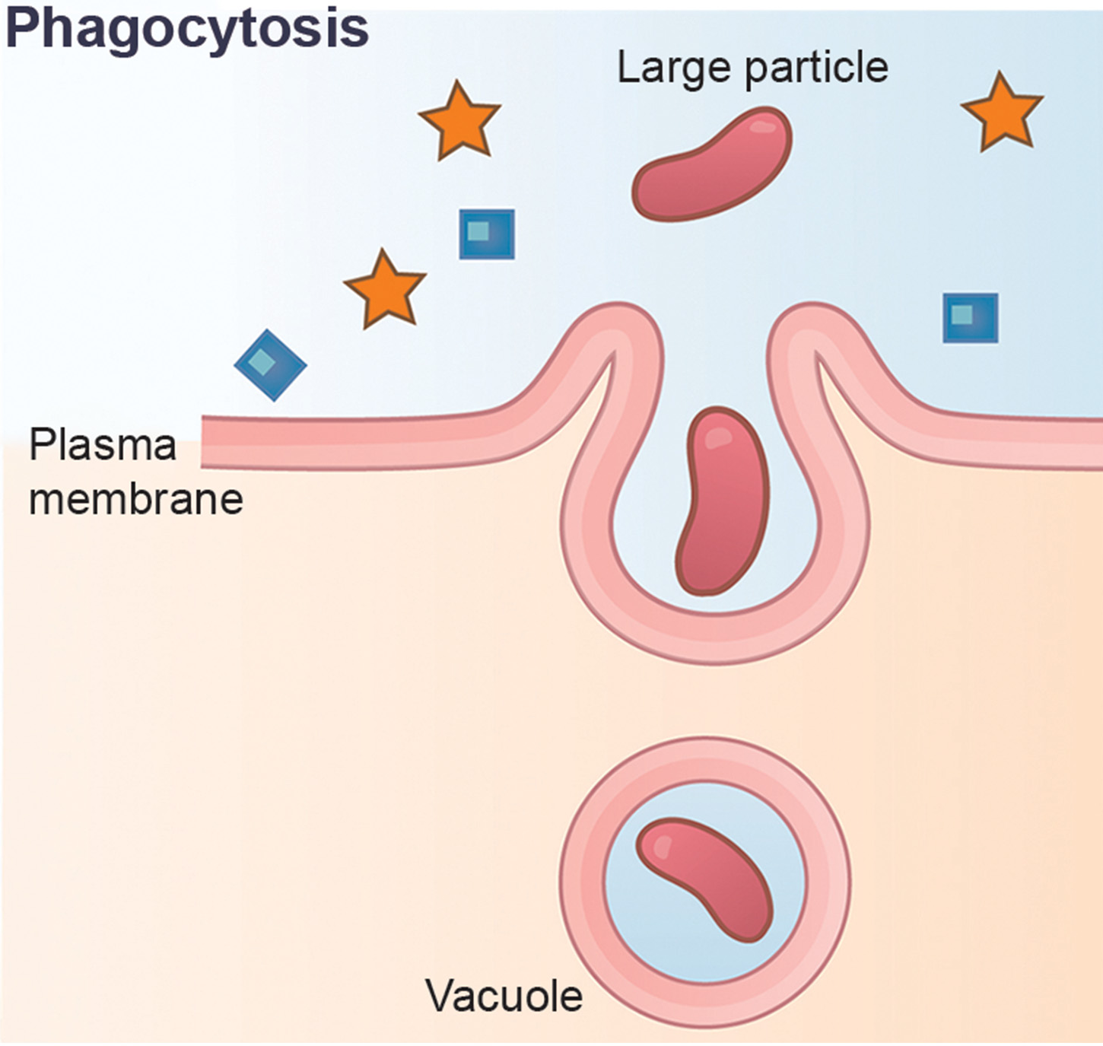
Phagocytosis
Phagocytosis: (cell eating) is the process by which a cell takes in larger particles, including other cells or cell debris.
Neutrophils (a type of white blood cell) remove microorganisms from the body using phagocytosis.
  The neutrophil uses pseudopods (membrane extensions ) to surround and engulf the microorganism.
5.4 Figure 1
Mariana Ruiz Villareal on Wikimedia Commons. "Phagocytosis." Modified.
Notes:
Figure 1

Slide 6
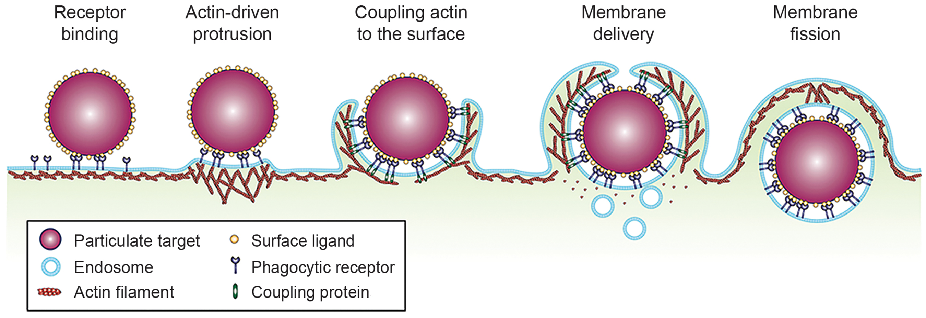
Lesson 5.4 Figure 2
Frontiers. "Phagocytosis."
Notes:
Phagocytosis is stimulated by the binding of certain molecules (ligands) on the target particle to receptors on the phagocytotic cell. This binding stimulates the polymerization of actin, which causes the membrane to protrude out and around the particle. Proteins that couple the cell membrane receptors to actin help ensure that the membrane fully surrounds, and remains around, the particle. Once the membrane protrusions have connected, the membrane of the forming vesicle undergoes fission (splits off from) the cell membrane and the actin disconnects from the receptors.

Slide 7
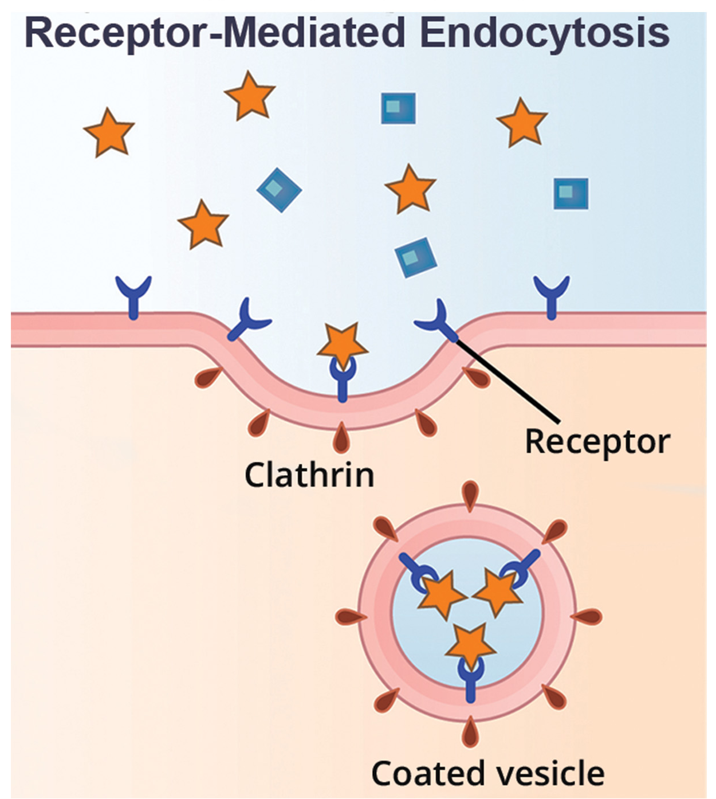
Receptor-Mediated Endocytosis
5.4 Figure 3
Cells use receptor- mediated endocytosis to bring in small particles proteins, hormones and metabolites) with the help of cell-surface receptors
Clathrin: a protein which helps stabilizes the cell membrane is often used.
Example: Receptor-mediated endocytosis is used to remove low density lipoprotein (LDL) from the blood.
Mariana Ruiz Villarreal on Wikimedia Commons. "Phagocytosis." Modified.

Slide 8
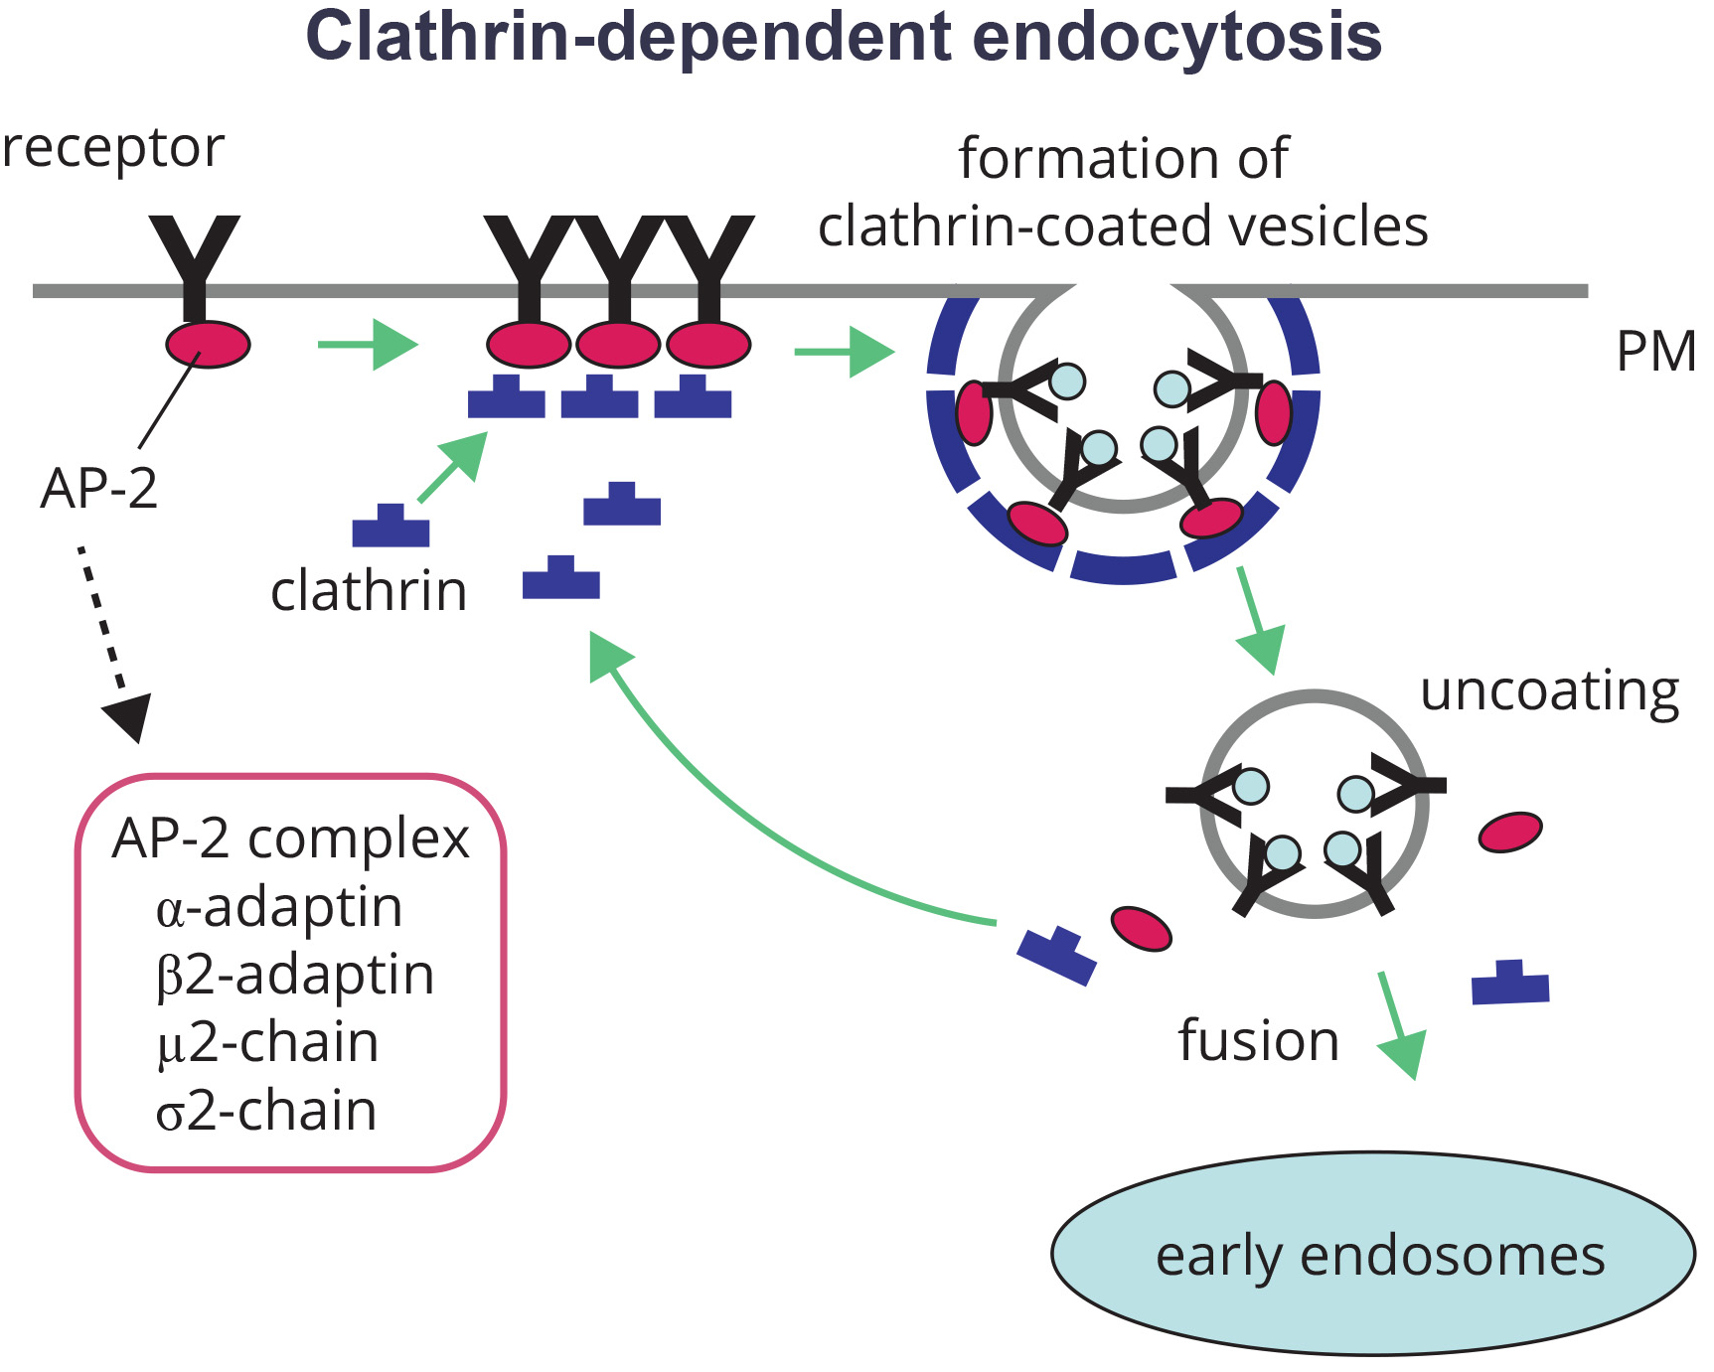
Lesson 5.4 Figure 4
Grant, B. D. and Sato, M on Wikimedia Commons. "Clathrin-dependent endocytosis."
Notes:
During clathrin-dependent endocytosis, clathrin proteins assemble on the inside of the plasma membrane, where the membrane receptors (black Y's) that attach to specific substances are located. Proteins of the AP-2 complex help in the assembly of these clathrin molecules. The plasma membrane invaginates, resulting in the formation of a vesicle containing the target substance. The vesicle then fuses with an endosome.

Slide 9
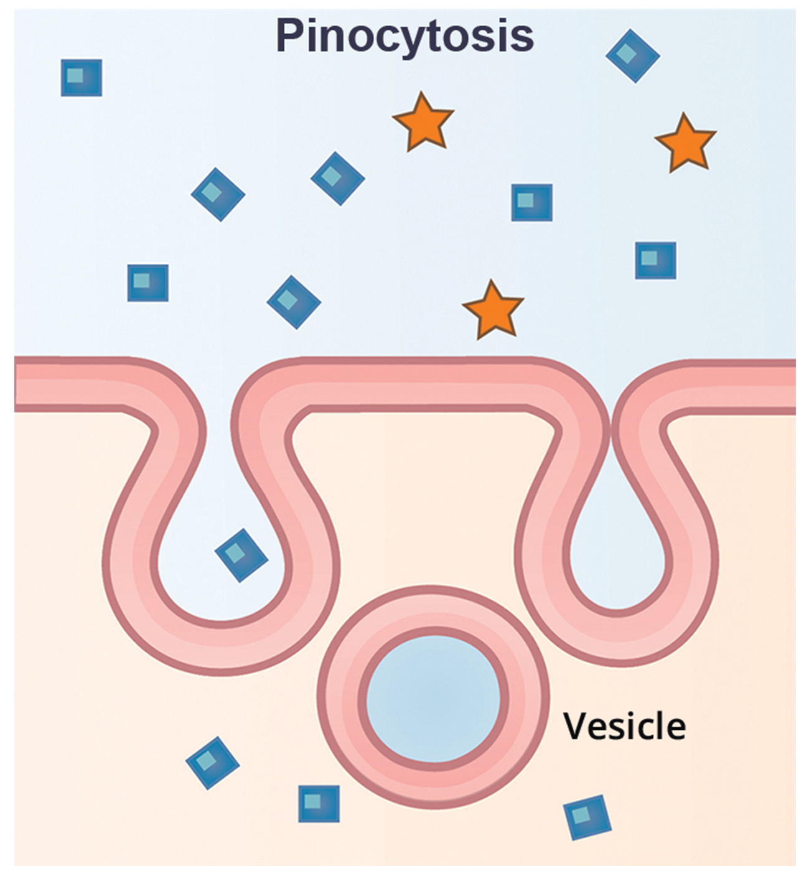
Pinocytosis
A variation of endocytosis where the cell takes in small molecules ( such as water) from the extracellular fluid.
Pinocytosis results in smaller vesicles than phagocytosis.
The vesicle does not merge with the lysosome.
5.4 Figure 5
Mariana Ruiz Villarreal on Wikimedia Commons. "Pinocytosis." Modified.

Slide 10
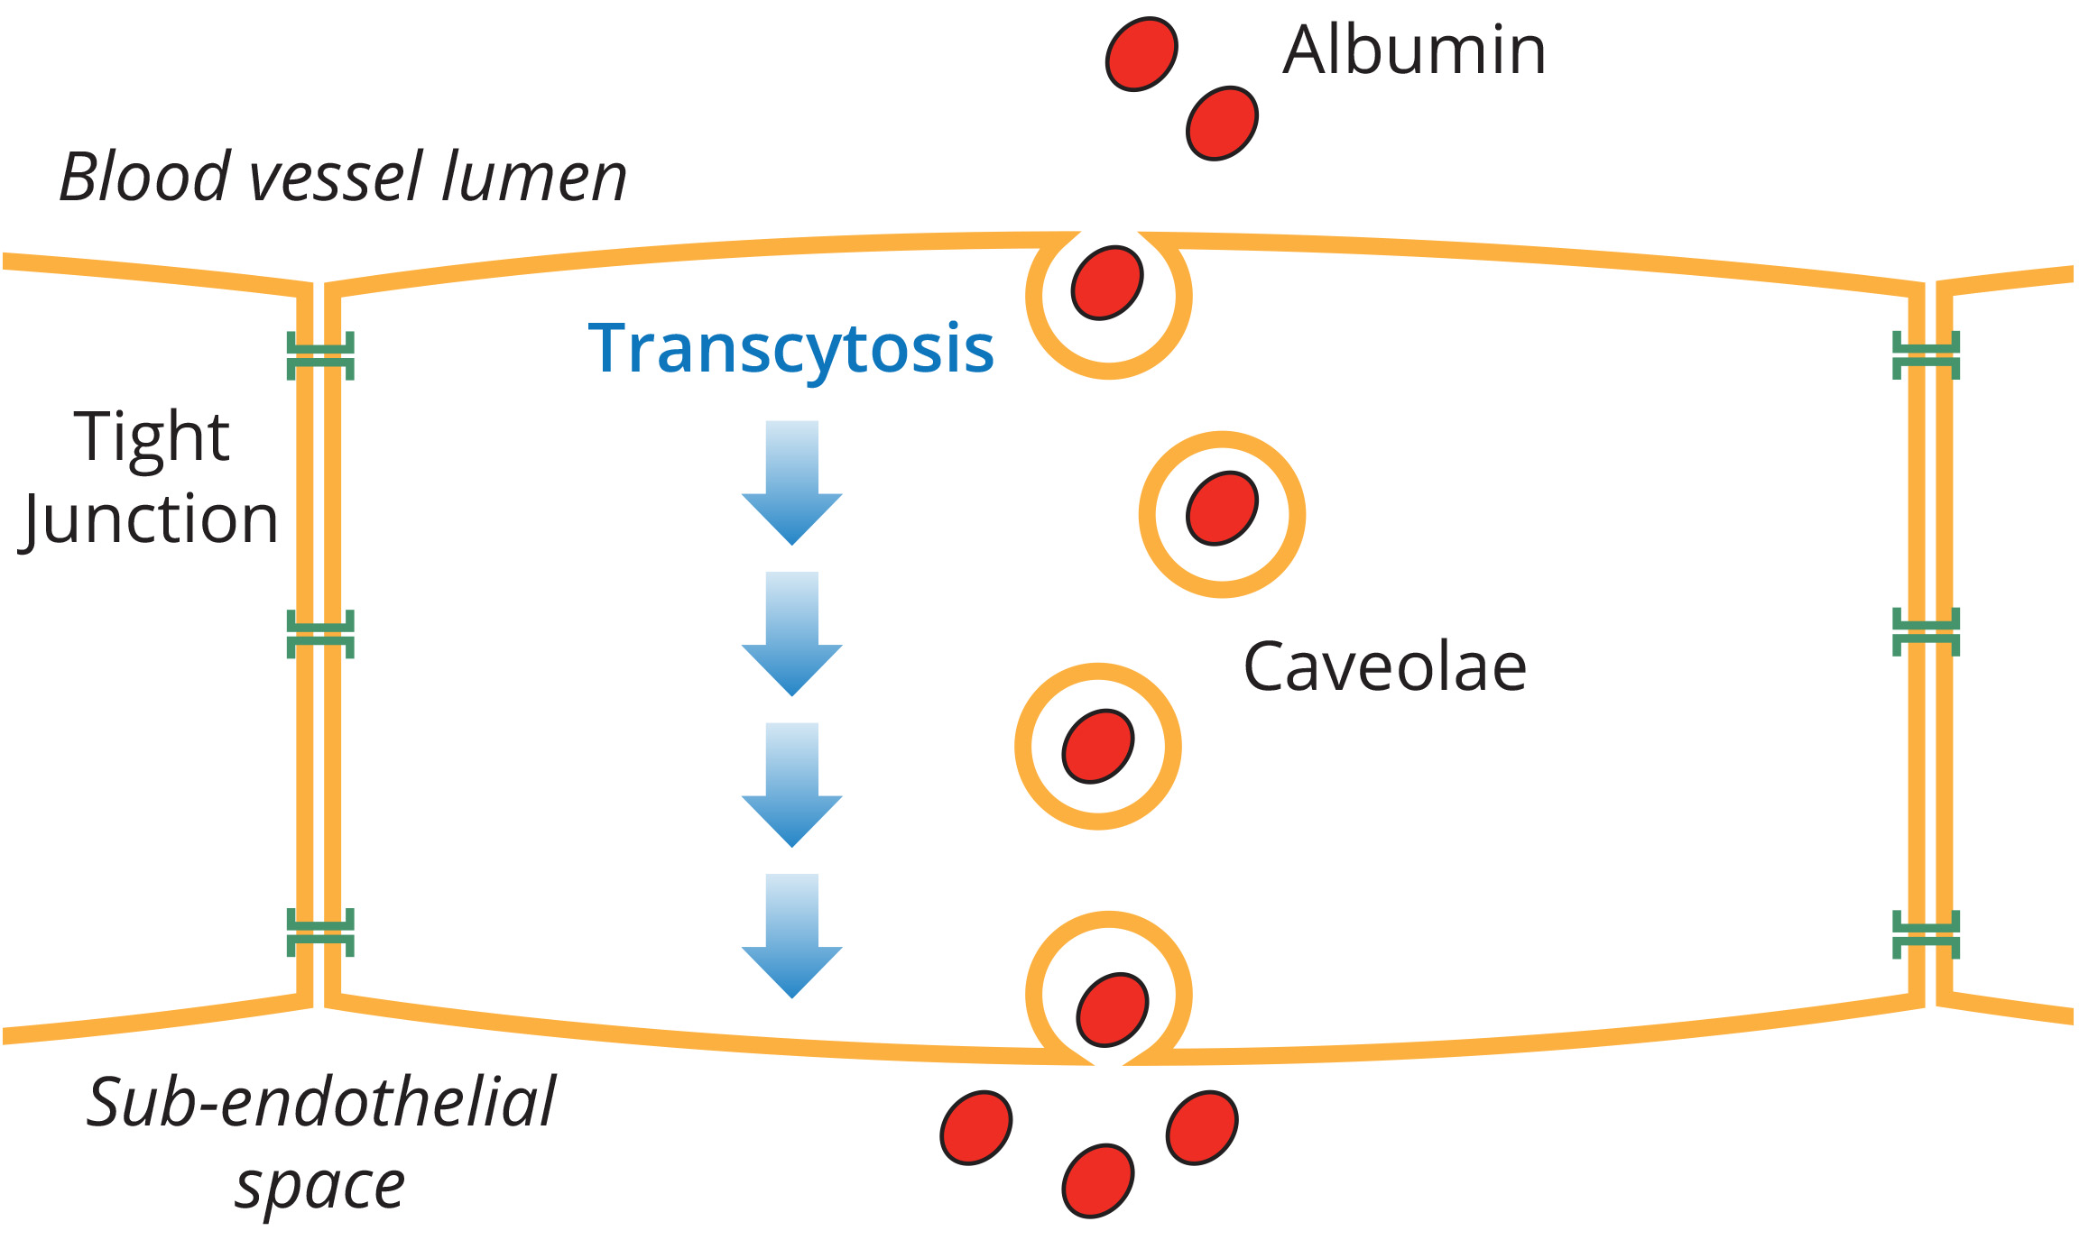
Potocytosis
Small molecules and ions are taken up by vesicles and deposited directly into the cytoplasm.
Uses caveolin: a coating protein with a similar function the clathrin.
5.4 Figure 6
Robert Vink on ResearchGate. "Transcytosis." Modified.
Notes:
Figure 6: Potocytosis is also used for transcytosis, where small molecules are taken up on one side of a cell and released on the other. Here, the protein albumin is taken up by a capillary wall endothelial cell from the bloodstream (which travels through the blood vessel lumen, or interior of the blood vessel) and deposited on the other side (the sub-endothelial space), outside of the capillary.

Slide 11
Think It Through
How does clathrin-dependent endocytosis differ from potocytosis?

Slide 12
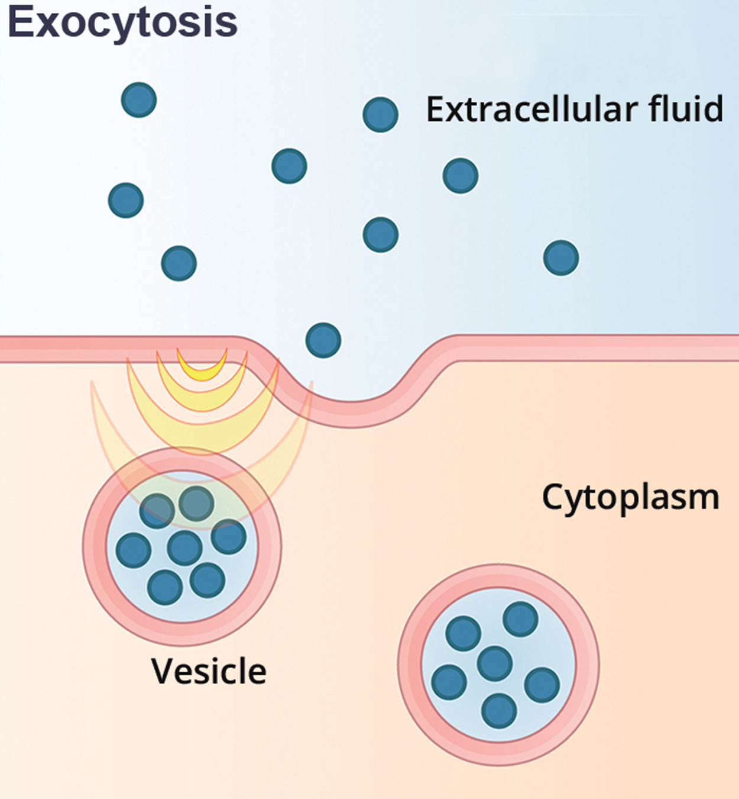
Exocytosis
The purpose of exocytosis is to expel material, such as waste.
Cells also use exocytosis to secrete products such as signaling molecules that need to be received by other cells
  Hormones
  Neurotransmitters
5.4 Figure 7
OpenStax on Wikimedia Commons. "Exocytosis." Modified.

Slide 13
Table 1: Methods of Transport, Energy Requirements, and Types of Material Transported
Transport Method | Active/Passive | Material Transported
diffusion | passive | small-molecular-weight material
osmosis | passive | water
facilitated transport/diffusion | passive | sodium, potassium, calcium, glucose
primary active transport | active | sodium, potassium, calcium
secondary active transport | active | amino acids, lactose
phagocytosis | active | large macromolecules
receptor-mediated endocytosis | active | large macromolecules
pinocytosis and potocytosis | active | small molecules, ions (liquids/water)

Slide 14
Group Activity
As a group, consider the structural and size differences between typical prokaryotes and eukaryotes as well as the difference between animal and plant cells.
Why are the bulk transport mechanisms discussed in this section limited to eukaryotic cells?
Based on what you know about animal verse plant cell structure, what eukaryotic cells type is more likely to use bulk transport mechanisms? Why?
Discuss your reasoning.

Slide 15
Summary
The cell moves large molecules into and out of the cell using bulk transport, which requires energy.
Materials are moved into the cell using one of the forms of endocytosis, based on the material being transported.
Materials are transported out of the cell using exocytosis.

Slide 16


End of Hawkes Learning PowerPoint

