Slide 1
Lesson 5.5
Cell Surface and
Interaction

Slide 2
Objectives
Describe the extracellular matrix.
List examples of the ways that plant cells and animal cells communicate with adjacent cells.
Summarize the roles of tight junctions, desmosomes, gap junctions, and plasmodesmata.

Slide 3
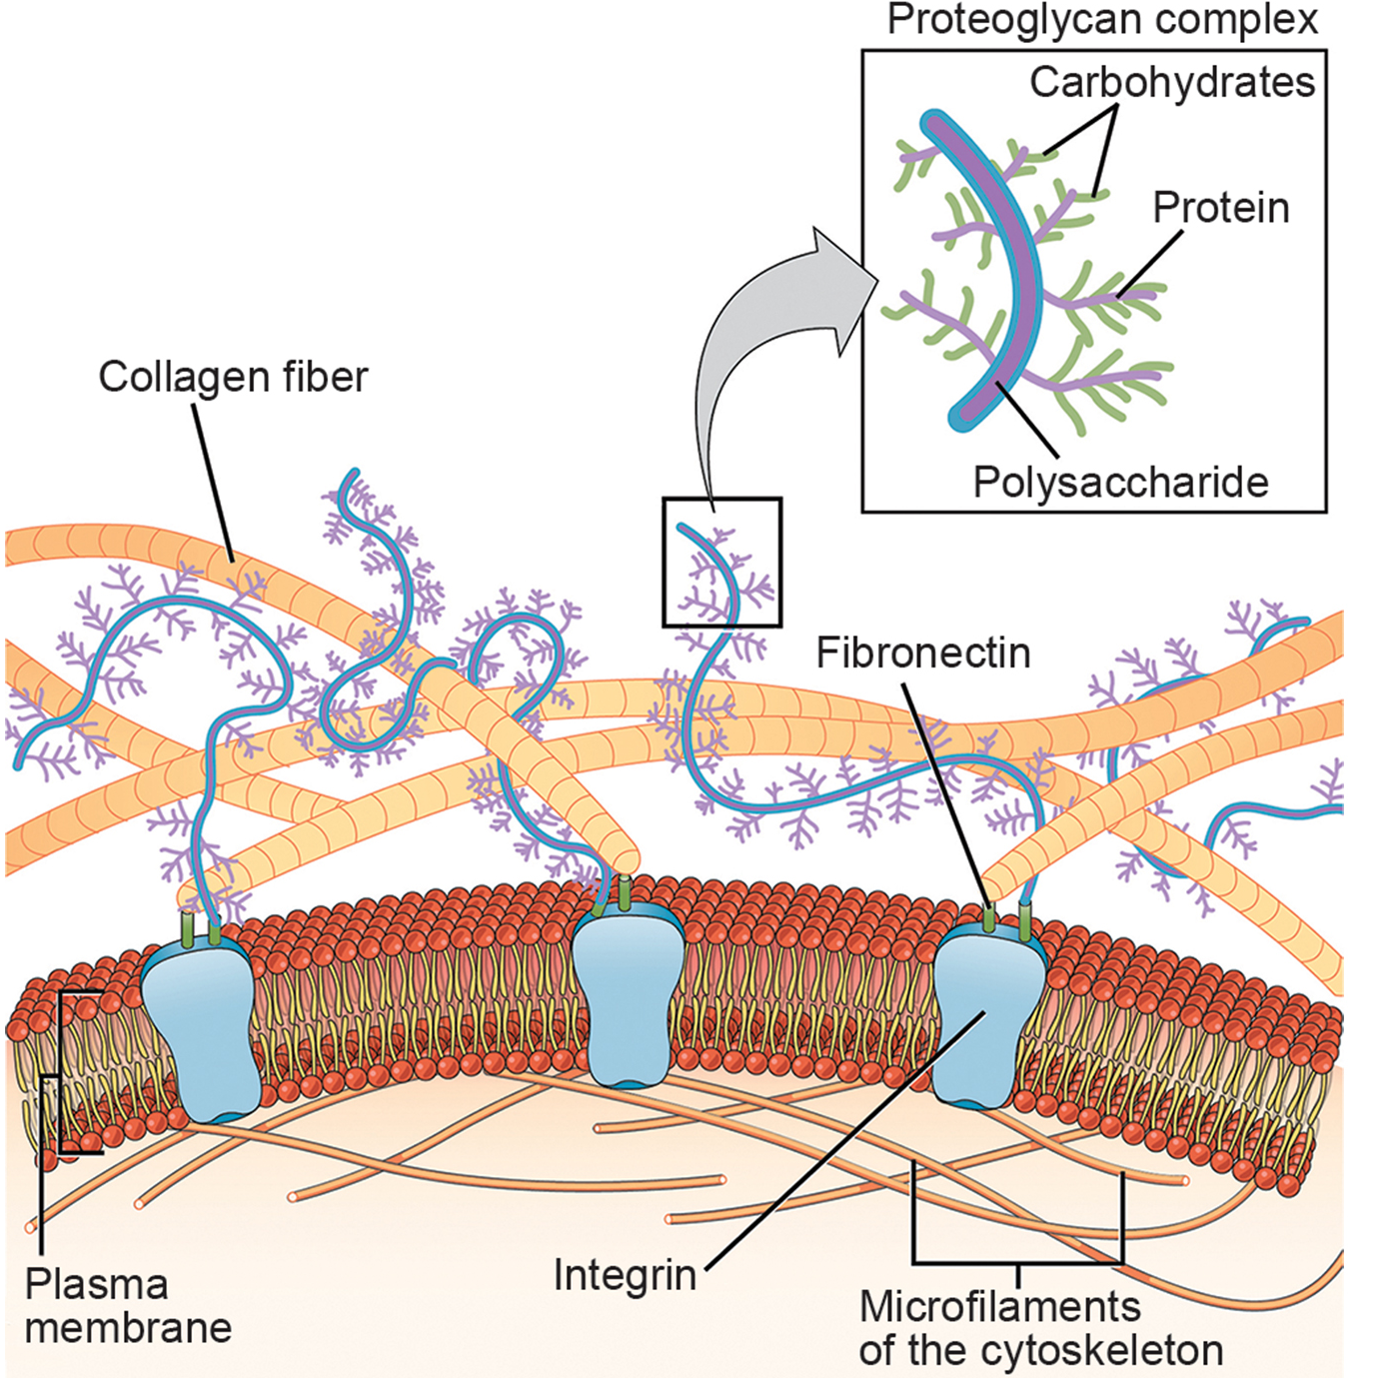
Extracellular Matrix of Animal Cells: Composition
5.5 Figure 1
Extracellular matrix is the collection of materials found in the extracellular space surrounding animal cells in a multicellular organism.
Collagen is the most abundant protein and forms fibers.
Proteoglycans, carbohydrate-containing proteins, are interwoven with collagen.
CNX OpenStax on Wikimedia Commons. "Extracellular matrix."

Slide 4
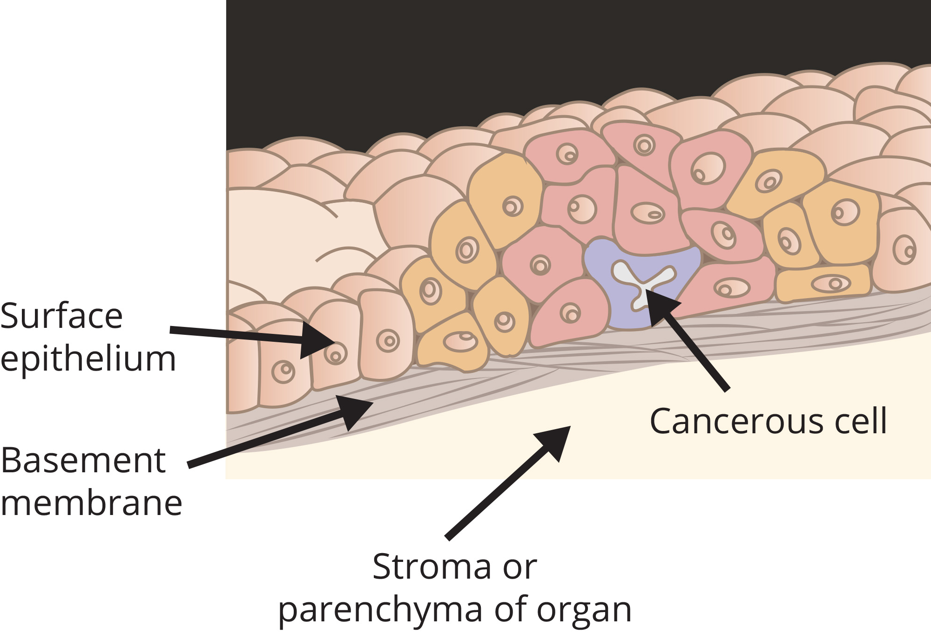
Extracellular Matrix of Animal Cells: Function
Matrix molecules connect to the extracellular surface of cells.
The extracellular matrix:
Holds cells together to form a tissue
Allows cells within a tissue to communicate with each other
5.5 Figure 2
NCI on Wikimedia Commons. "In situ carcinoma."

Slide 5
Extracellular Matrix of Animal Cells: Effects on Cells
Binding of matrix molecules to cell receptors causes changes in the cell's activities through a sequence of events:
Matrix molecules bind to protein receptors on the extracellular surfaces of cells.
The receptor changes the shape of the actin filaments just inside the plasma membrane.
The conformational changes induce chemical signals inside the cell that reach the nucleus.
The transcription of specific DNA sections is turned "on" or "off."
Which proteins are made by the cell changes.
The cell's activities change.

Slide 6
Extracellular Matrix of Animal Cells: Blood Clotting
Blood clotting results from a sequence of events:
Cells lining a blood vessel are damaged.
Damaged cells display a protein receptor called tissue factor.
Tissue factor binds a factor within the extracellular matrix.
This binding causes platelets to adhere to the damaged vessel's wall.
This stimulates the contraction of adjacent smooth muscle cells in the blood vessel.
The blood vessel constricts.
The platelets produce clotting factors.

Slide 7
Science and You₁
The extracellular matrix is important to the development of cancer.
Non-cancerous epithelial cells have a greater propensity for cell division.
Non-cancerous epithelial cells cannot cross the basement membrane of the epithelium.
Mutation of epithelial cells may cause them to divide uncontrollably.
Continued mutation of epithelial cells causes them to act like fibroblasts, which modify the matrix, allowing tumor cells to cross the basement membrane and spread (a hallmark of metastasis).
Notes:
This is included as a relevant application for this topic.

Slide 8
Intercellular Junctions
Cells can also communicate with each other via direct contact, or intercellular junctions.
Plants have one type of junction:
Plasmodesmata
Animals have three different types of junctions:
Tight junctions
Gap junctions
Desmosomes

Slide 9
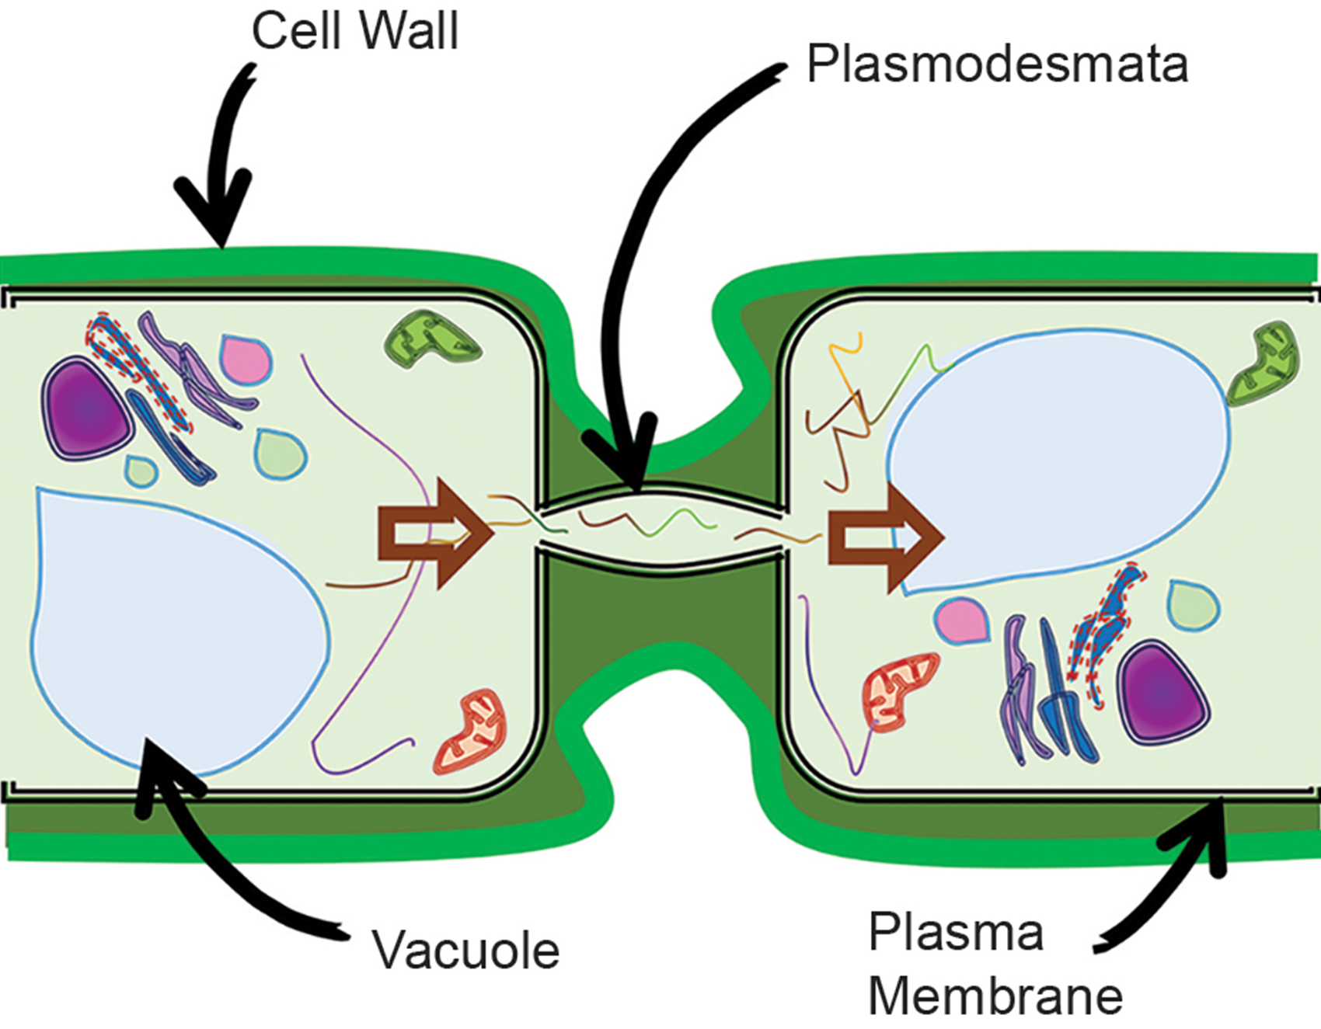
Intercellular Junctions in Plants: Plasmodesmata
Plasmodesmata are channels between the cell walls of adjacent plant cells that connect their cytoplasms, allowing for:
Direct communication via the transport of signaling molecules
The transport of materials (like water, minerals, and nutrients) from cell to cell throughout the plant
5.5 Figure 3
CNX OpenStax on Wikimedia Commons. "Plasmodesmata." Modified.

Slide 10
Evolution Connection
Plasmodesmata have evolved independently in different lineages of plants and algae.
They evolved repeatedly against the selective pressure of the cell wall to allow plant cells to form effective multicellular organisms.
Plasmodesmata have also affected plant virus evolution.
Some viruses are small enough to pass through plasmodesmata to infect and spread.
Plants have evolved new ways to regulate and defend these openings.
Viruses have evolved ways to continue to infect plants.

Slide 11
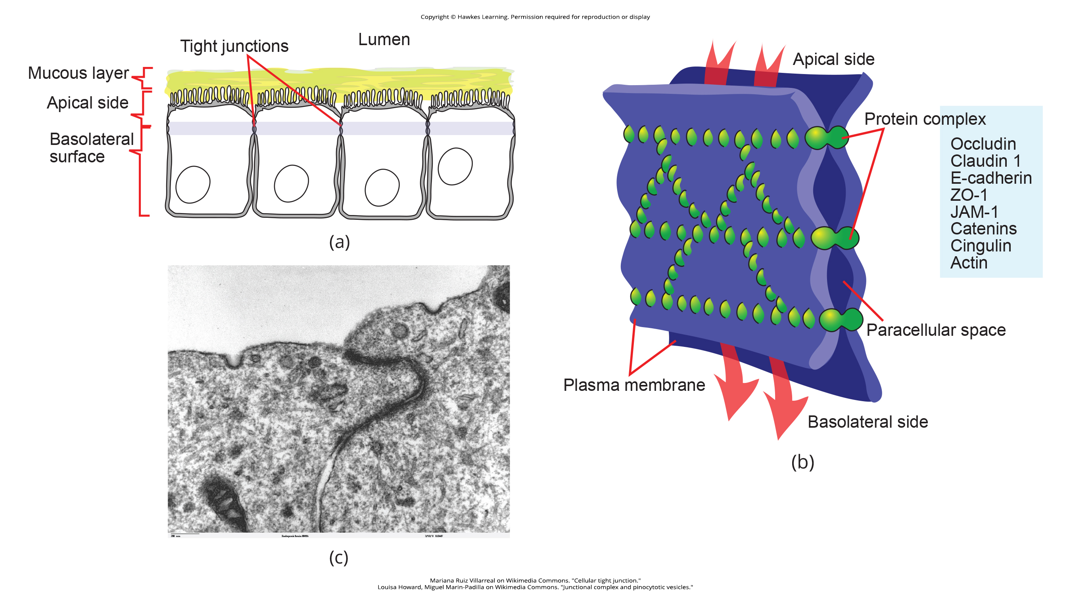
Intercellular Junctions in Animals: Tight Junctions₁
A tight junction is a watertight seal between two adjacent animal cells that prevents materials from leaking between the cells.
5.5 Figure 4 (a)
Mariana Ruiz Villarreal on Wikimedia Commons. "Cellular tight junction."

Slide 12
Intercellular Junctions in Animals: Tight Junctions₂
Proteins, including claudins and occludins, within tight junctions hold the cells together.
5.5 Figure 4 (b)
Mariana Ruiz Villarreal on Wikimedia Commons. "Cellular tight junction."

Slide 13
Intercellular Junctions in Animals: Tight Junctions₃
Tight junctions are common in epithelial tissues that line internal organs and cavities and comprise most of the skin.
They line the urinary bladder and prevent urine leakage into the extracellular space.
5.5 Figure 4 (c)
Louisa Howard, Miguel Marin-Padilla on Wikimedia Commons. "Junctional complex and pinocytotic vesicles."

Slide 14
Science and You₂
Some pathogenic bacteria (Vibrio cholerae) and viruses (Rotavirus) damage tight junctions.
This increases the pathogens' abilities to cross tissues.
This may lead to severe diarrhea and subsequent dehydration in infected individuals.
Notes:
This is included as a relevant application for this topic.

Slide 15
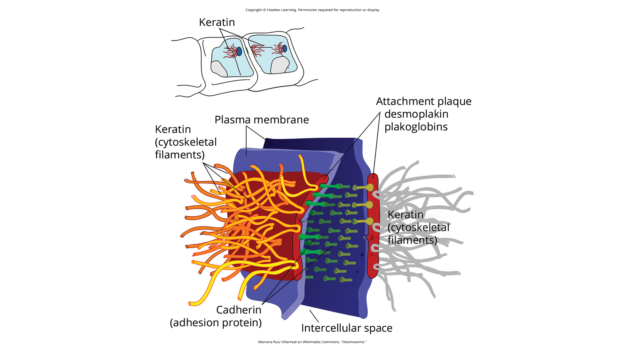
Intercellular Junctions in Animals: Desmosomes₁
Desmosomes act like spot welds between adjacent epithelial cells.
These junctions maintain cells in a sheetlike formation in stretchable organs and tissues (like the skin, heart, and muscles).
5.5 Figure 5
Mariana Ruiz Villarreal on Wikimedia Commons. "Desmosome."

Slide 16
Intercellular Junctions in Animals: Desmosomes₂
Plasma membrane proteins called cadherins connect to keratin (a type of cytoskeletal filament) to create desmosomes.
5.5 Figure 5
Mariana Ruiz Villarreal on Wikimedia Commons. "Desmosome."

Slide 17
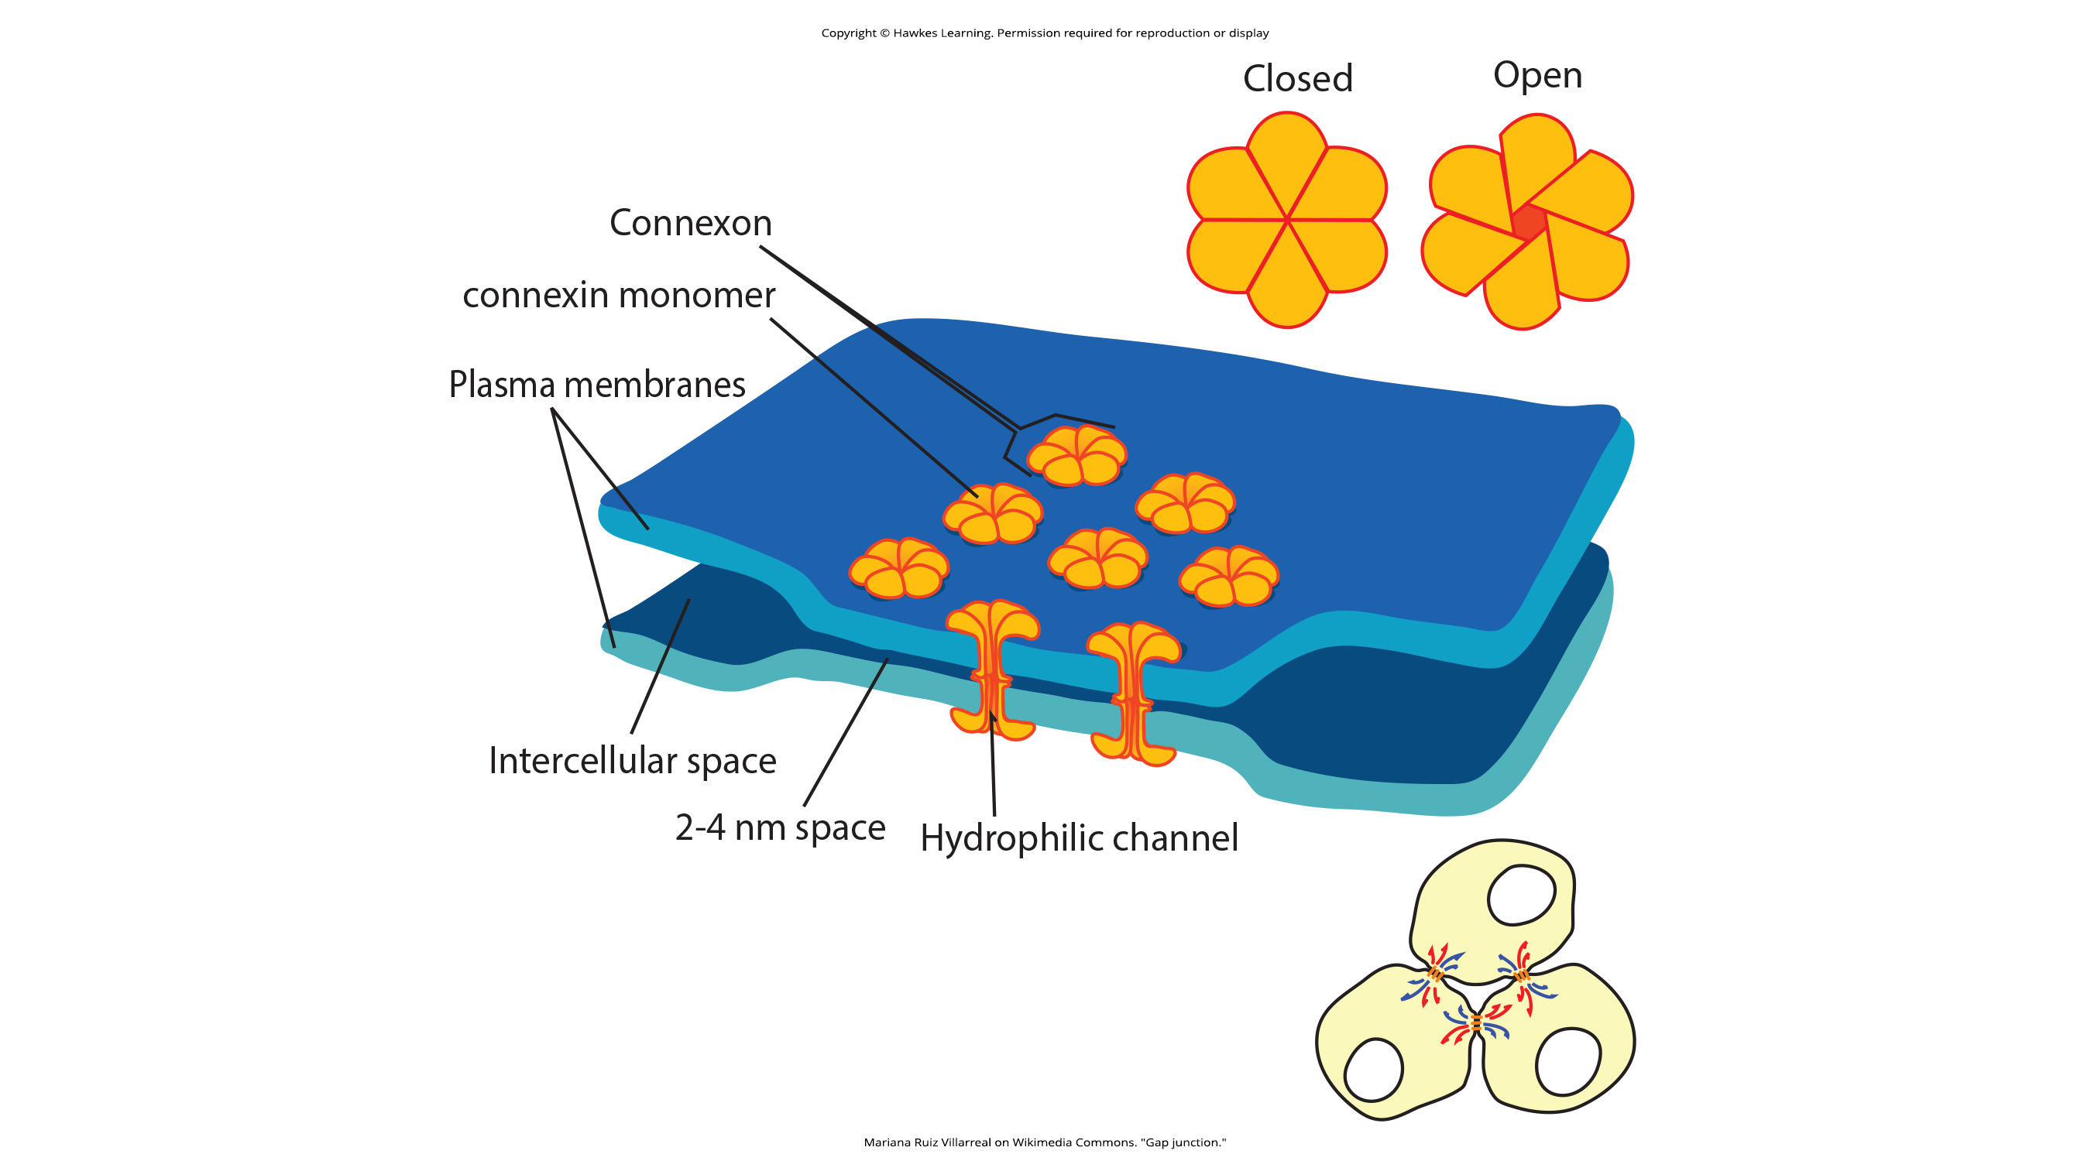
Intercellular Junctions in Animals: Gap Junctions₁
Gap junctions are protein-lined channels between adjacent cells that allow for the transport of ions, nutrients, and other substances that allow cells to communicate.
They are functionally like plasmodesmata in plant cells.
5.5 Figure 6
Mariana Ruiz Villarreal on Wikimedia Commons. "Gap junction."

Slide 18
Intercellular Junctions in Animals: Gap Junctions₂
A gap junction forms when:
Six connexin proteins in the plasma membrane on one cell form a connexon.
A connexon in one cell aligns with a connexon in an adjacent cell.
5.5 Figure 6
Mariana Ruiz Villarreal on Wikimedia Commons. "Gap junction."

Slide 19
Think It Through₁
What would be the consequence if you switched the types of connections in your cells? For example, what if you converted every gap junction into a tight junction?
Notes:
Originally an On Your Own. This is included here to use as a talking point or for a think-pair-share activity.

Slide 20
Think It Through₂
For each tissue or cell description, provide the best type of intercellular connection:
Cells share materials through a polysaccharide cell wall.
Epithelial cells need to be strongly anchored to each other.
Cells share materials in the absence of a cell wall.
Epithelial cells need to regulate the degree to which the tissue is porous, controlling how much fluid can cross the tissue.
Cells need to be contained or scaffolded within a certain region of the tissue.
Notes:
Originally an On Your Own. This is included here to use as a talking point or for a think-pair-share activity.

Slide 21
Summary
Animal cells communicate via their extracellular matrices.
When protein receptors on an animal cell's membrane surface binds to an extracellular matrix substance, this results in changes in the cell's internal activities.
Animal cells may be connected to each other via tight junctions, desmosomes, and gap junctions.
A tight junction is a watertight seal between two adjacent cells.
A desmosome acts like a spot weld.
A gap junction is a channel between adjacent animal cells.
Plant cells are connected and communicate with each other via plasmodesmata.
While gap junctions and plasmodesmata are functionally similar their structures are quite different.

Slide 22


End of Hawkes Learning PowerPoint

