Slide 1
Lesson 6.1
Energy and Metabolism

Slide 2
Objectives
Discuss how chemical reactions play a role in energy transfer.
Explain metabolic pathways and describe the two major types.

Slide 3
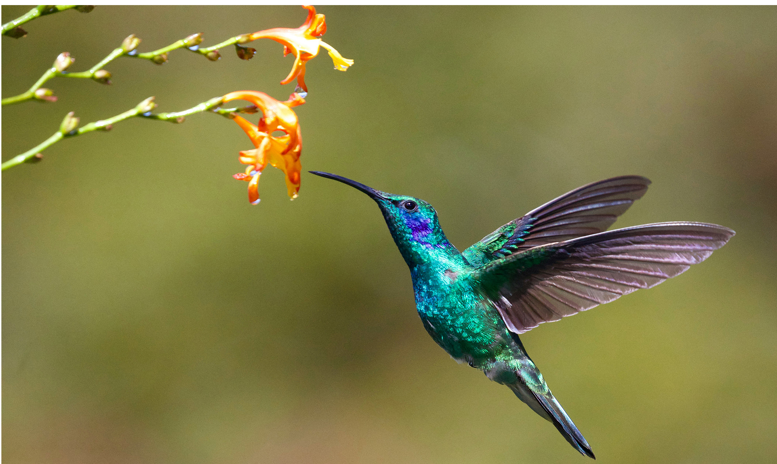
Bioenergetics
Bioenergetics is the study of how living organisms obtain, use, and transfer energy.
Living organisms require energy for all cellular processes.
Examples: nutrient acquisition, metabolism, molecule synthesis, modification, and transport, as well as cell locomotion and waste removal
6.1 Figure 1: Hummingbirds need energy for flight.
James Wainscoat on Unsplash. "Hummingbird."

Slide 4
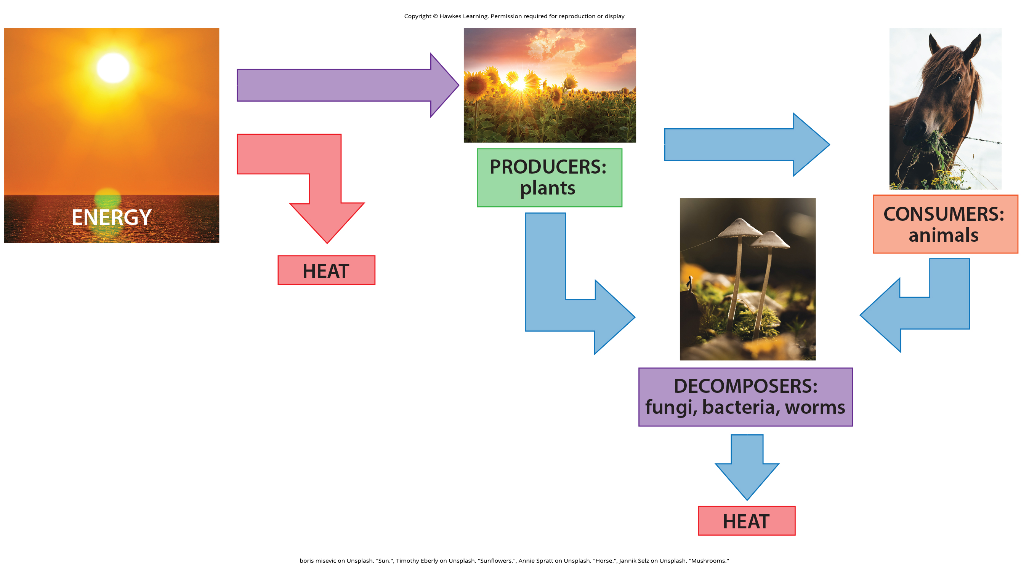
Energy and Metabolism
Energy is obtained from food molecules like carbohydrates through metabolic pathways.
All the chemical reactions that transpire inside cells are the cell’s metabolism.
6.1 Figure 2
"boris misevic on Unsplash. ""Sun.""Timothy Eberly on Unsplash. ""Sunflowers.""Annie Spratt on Unsplash. ""Horse.""Jannik Selz on Unsplash. ""Mushrooms."""

Slide 5
Reflection Question
What do you think of when you consider the word metabolism as it's used in everyday language? In what ways does the biological definition align with the word's common usage? In what ways are the meanings different?

Slide 6
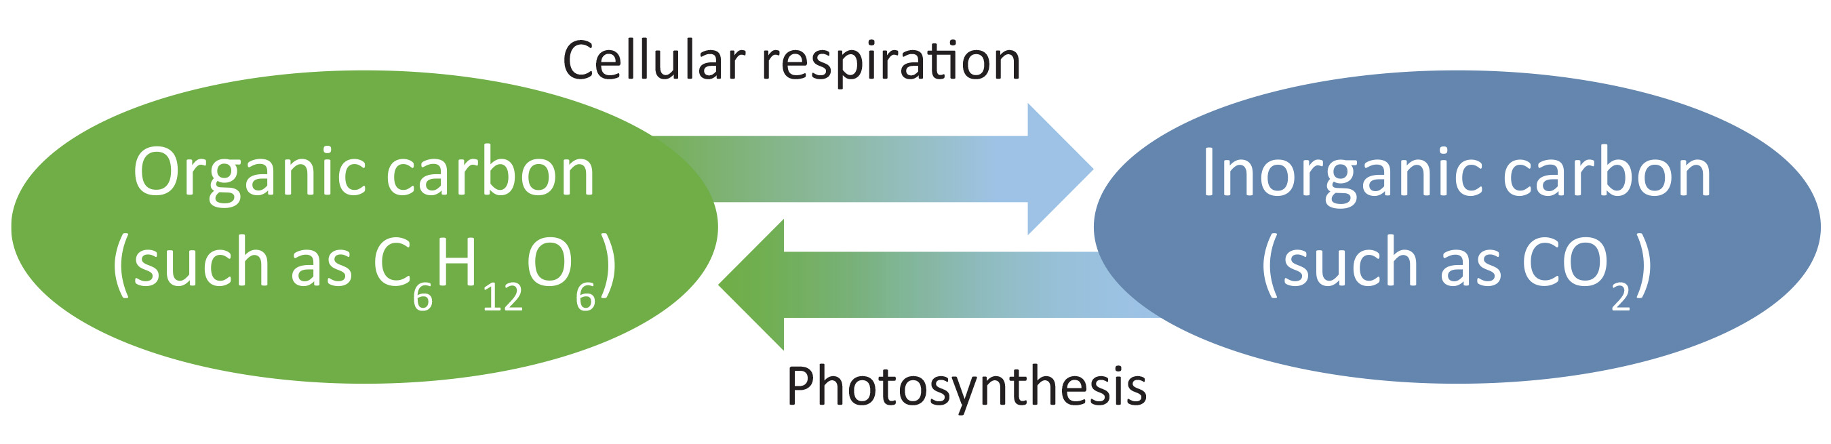
Carbohydrate Metabolism₁
Sugar, such as glucose, is a main energy source.
Photosynthesis converts CO₂ and H₂O into glucose using solar energy.
6.1 Figure 3

Slide 7

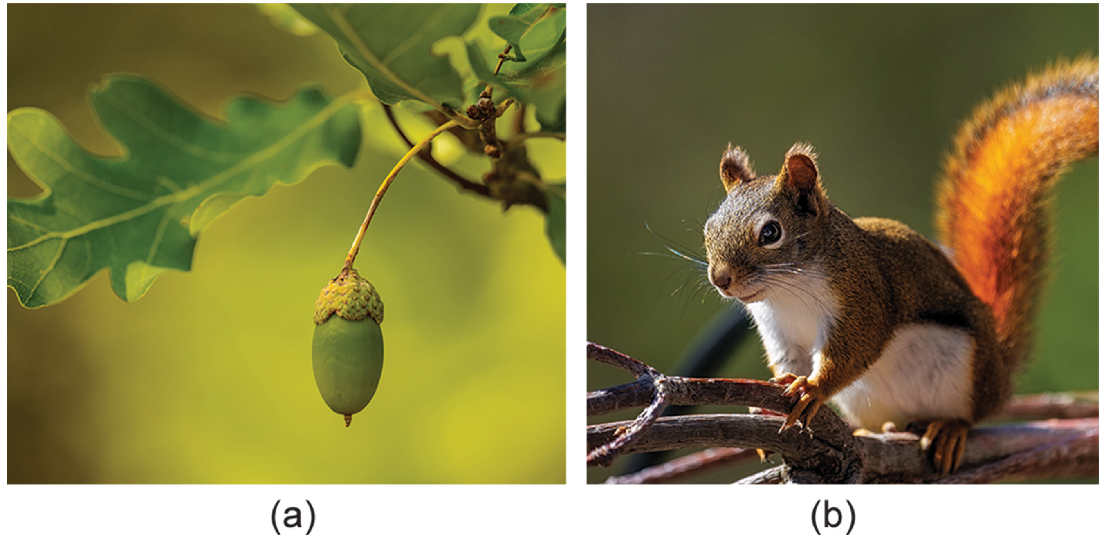
Carbohydrate Metabolism₂
Photosynthesis stores energy as ATP and then uses it to produce glucose.
18 ATP + 12 NADPH = 1 glucose
Glucose is stored as starch, cellulose, and other polymers.
Cellular respiration breaks down glucose to release stored energy in ATP.
6.1 Figure 4: The cellulose in clover is made of glucose.
Pixabay on Pexels. "Rabbit with clover."
6.1 Figure 5: (a) Oak trees photosynthesize to make glucose. (b )Both plants and animals, like squirrels, use cellular respiration.
Petr Ganaj on Pexels. "Acorn."
Skyler Ewing on Pexels. "Squirrel."

Slide 8
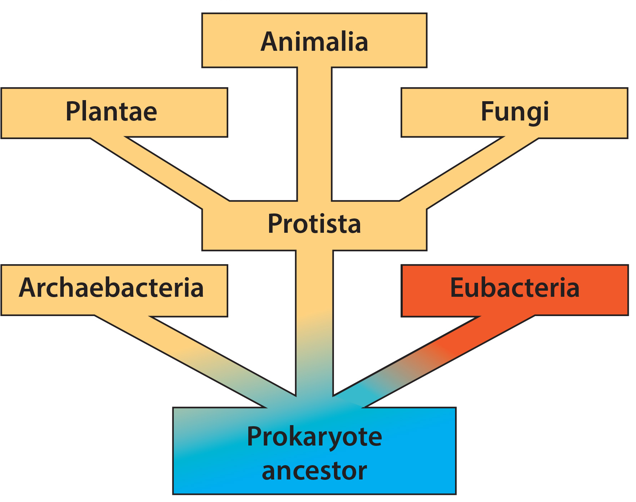
Metabolic Pathways
Metabolic pathway: a series of interconnected biochemical reactions that convert a substrate into intermediates and finally to a product
Anabolic (building) pathways require energy to synthesize molecules.
Catabolic (breaking down) pathways release energy by breaking down molecules.
6.1 Figure 6: All forms of life require energy and have a metabolism.
CNX OpenStax on Wikimedia Commons. "Prokaryote ancestor."

Slide 9
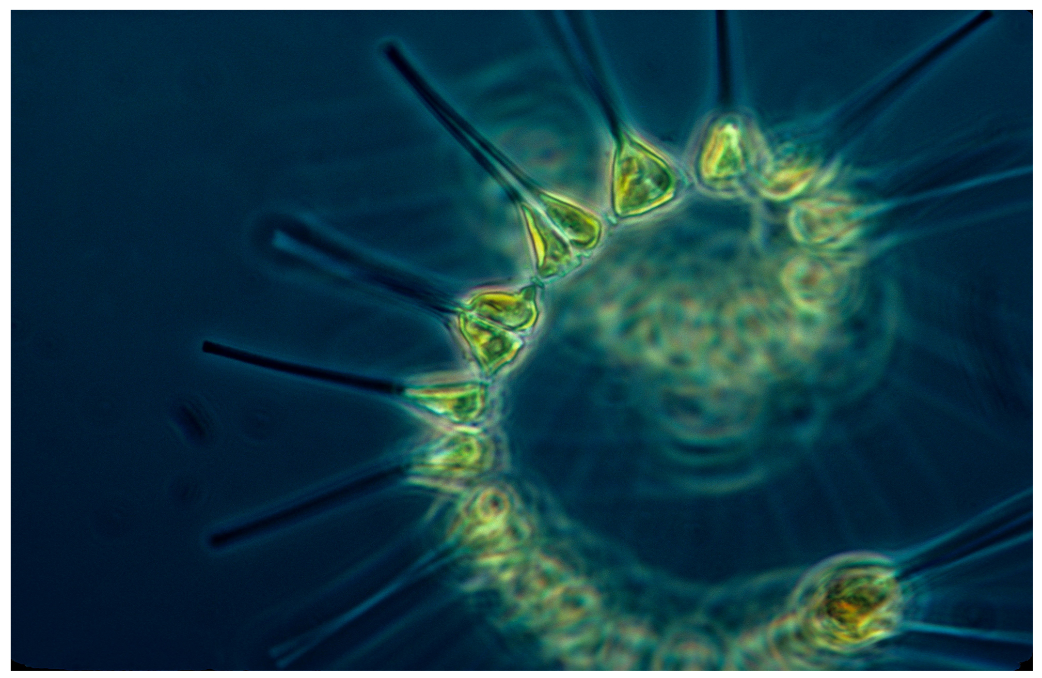
Evolution of Metabolic Pathways
• Metabolic complexity varies across organisms, involving photosynthesis, aerobic respiration, and anaerobic fermentation.
• All life shares core metabolic pathways from a common ancestor, with later pathway divergence for environmental adaptation.
• Organisms must harvest environmental energy and convert it to ATP to power cellular processes.
6.1 Figure 7: Phytoplankton perform photosynthesis.
NOAA on Unsplash. "Phytoplankton."

Slide 10
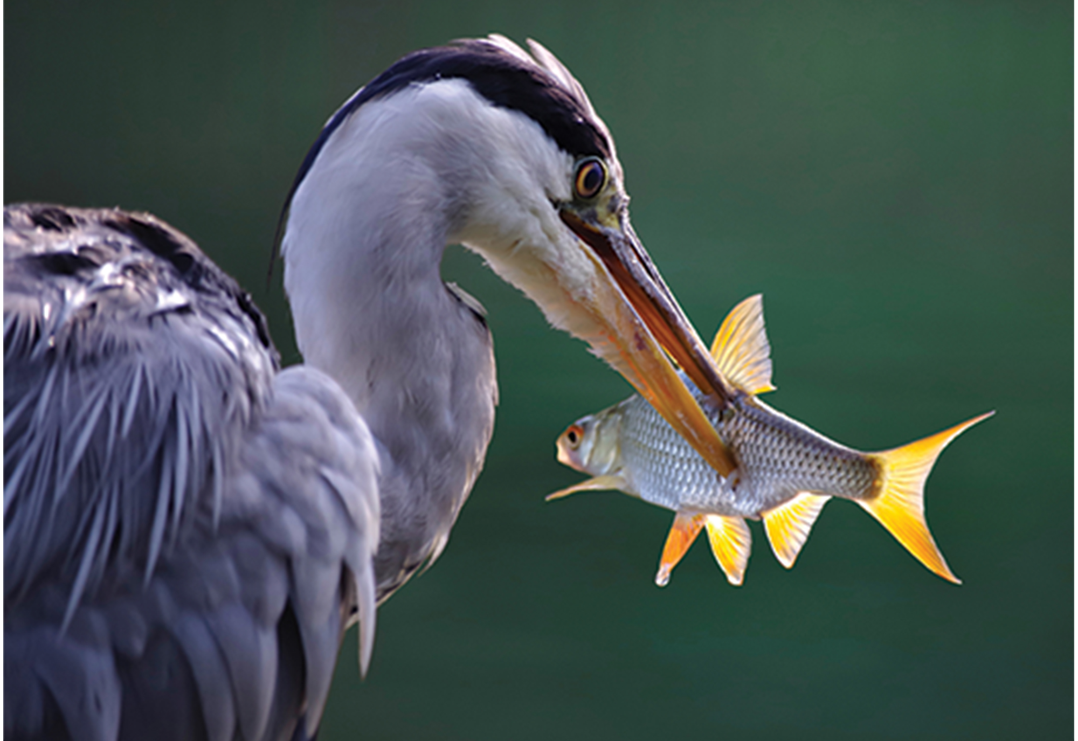
Anabolic and Catabolic Pathways
Anabolic pathways: synthesis of complex molecules from simpler ones using energy
Photosynthesis, protein and DNA synthesis
Catabolic pathways: Breakdown of complex molecules into simpler ones, releasing energy (ATP)
Cellular respiration
Both pathways are critical for life and metabolism
6.1 Figure 8: Catabolic reactions turn food into energy.
wal_172619 on Pixabay. "Heron with fish."

Slide 11
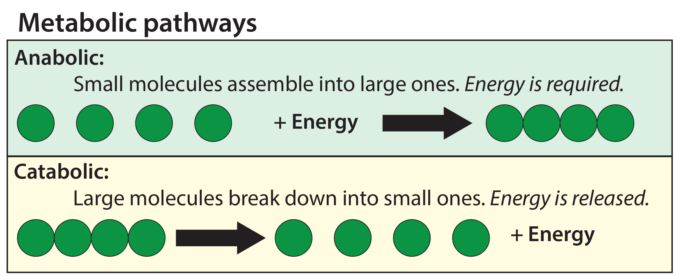
6.1 Figure 9
CNX OpenStax on Wikimedia Commons. "Metabolic pathways."

Slide 12
Science & You
The Danger of Anabolic Steroid Abuse
Anabolic steroids mimic testosterone, promoting muscle building.
Steroids are sometimes abused by athletes, leading to psychological issues.
Long-term steroid abuse can damage organs like the kidneys, liver, and heart.
Notes:
This is included as a relevant application for this topic.

Slide 13
Summary
Metabolism refers to all the chemical reactions occurring within a cell to carry out life's processes.
Catabolic reactions break down complex molecules into simpler ones, releasing energy.
Anabolic reactions build complex molecules (synthesis) from simpler precursors, requiring an input of energy.

Slide 14


End of Hawkes Learning PowerPoint

