Slide 1
Lesson 6.2
Potential, Kinetic, Free, and Activation Energy

Slide 2
Objectives
Define "energy."
Describe endergonic and exergonic reactions.
Discuss the concepts of free energy and activation energy.
Explain the difference between kinetic and potential energy.

Slide 3
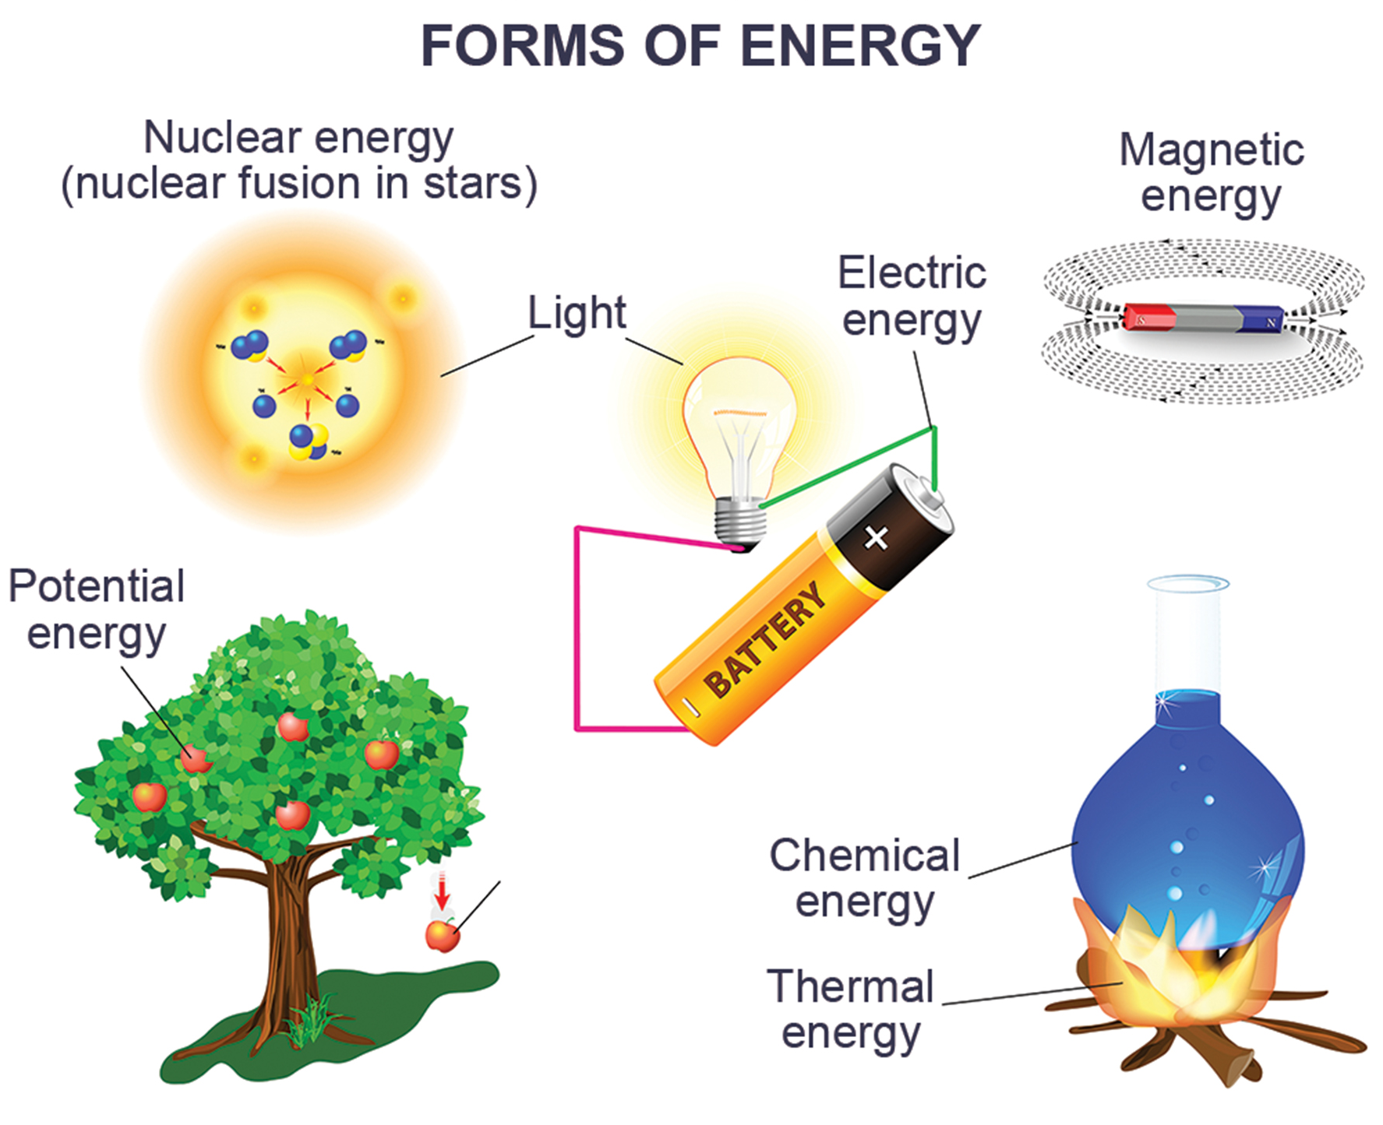
Potential, Kinetic, Free, and Activation Energy
Energy is the ability to do work, existing in different forms like electrical, light, kinetic, potential, and heat energy.
6.2 Figure 1

Slide 4
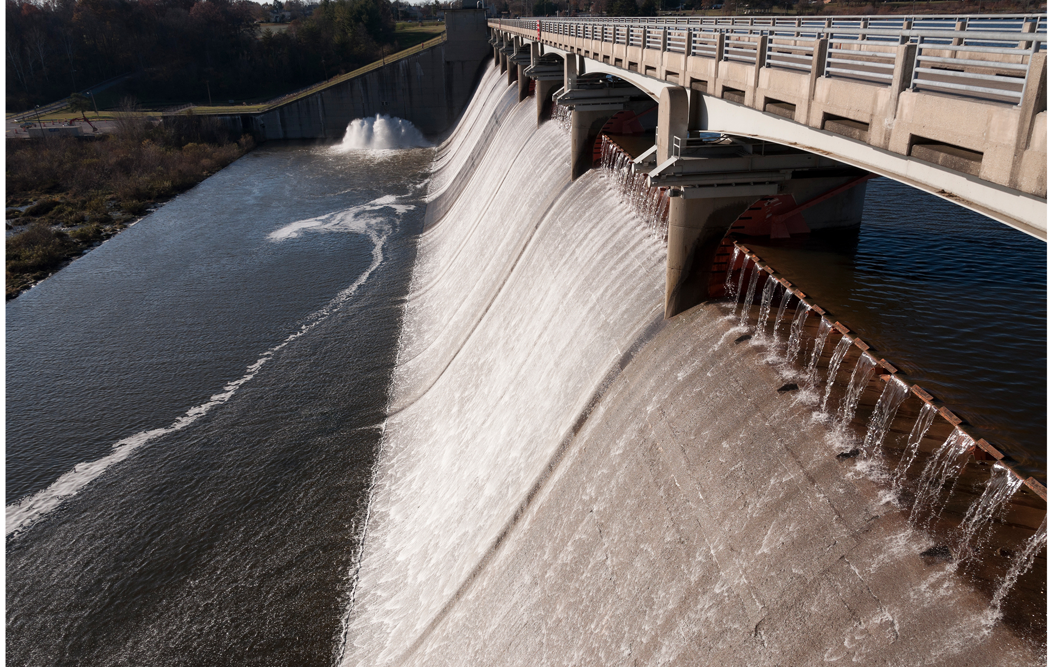
Energy Types₁
Kinetic energy is the energy of moving objects, like a speeding train or electromagnetic radiation.
Potential energy is stored energy with the potential to do work, like a compressed spring.
6.2 Figure 2: Water behind a dam has potential energy. Moving water has kinetic energy.
Sixflashphoto on Wikimedia Commons. "Hoover Dam."

Slide 5
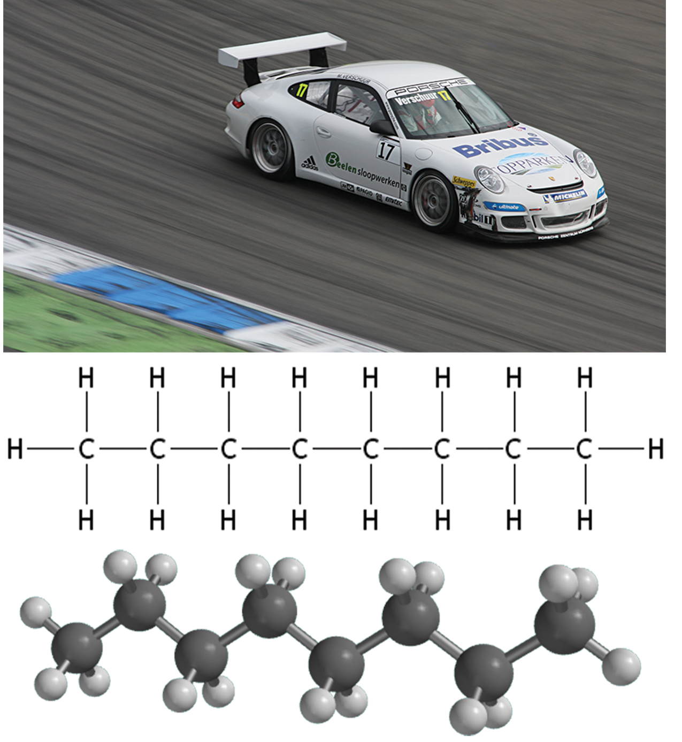
Energy Types₂
Potential energy depends on an object's location and structure
Motionless wrecking ball vs. a suspended one
Stretched rubber band
Chemical bonds in a molecule
Chemical energy: the energy released when chemical bonds are broken
6.2 Figure 3: The chemical bonds gasoline contain chemical energy. This energy transforms into kinetic energy that moves a car.
AngMoKio on Wikimedia Commons. "Porsche racing car."
UCLA. "3-D octane molecule."

Slide 6
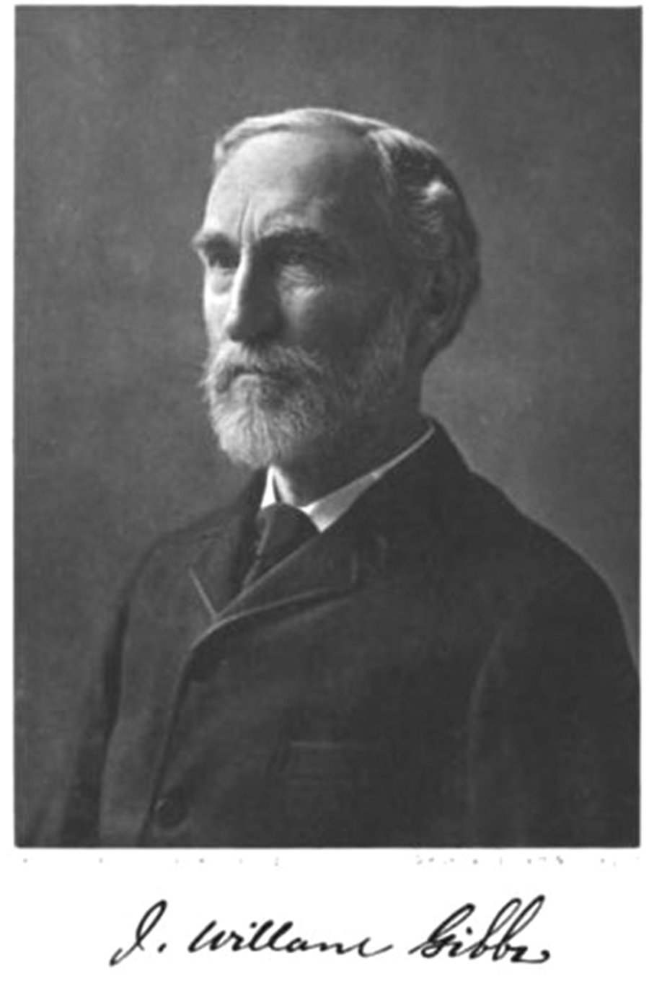
Free Energy
Gibbs free energy (ΔG): the usable energy or energy available to do work after accounting for entropy
Entropy is the amount of that becomes unusable, such as heat, during an energy transfer.
ΔG = ΔH – TΔS
Where ΔH is enthalpy, ΔS is entropy, and T is temperature in Kelvin
Express ΔG in kilojoules (kJ/mol) or kilocalories (kcal/mol)
6.2 Figure 4: Josiah Willard Gibbs introduced the concept of entropy.
J. Willard Gibbs on Wikimedia Commons. "Josiah Willard Gibbs."

Slide 7
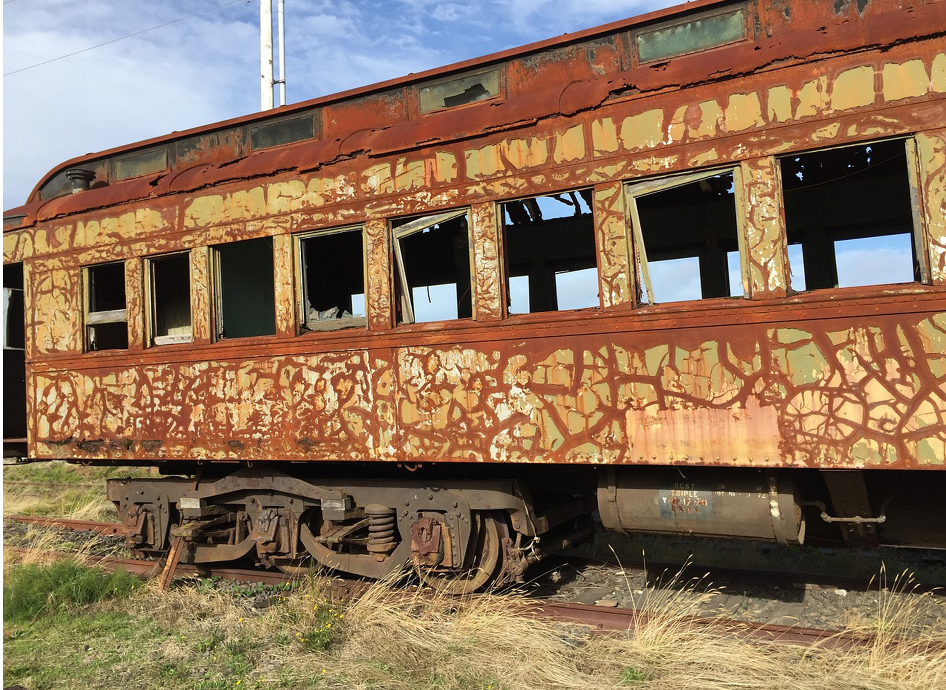
Endergonic Reactions and Exergonic Reactions₁
Exergonic reaction: a reaction with a negative ΔG meaning it releases energy
Like catabolic reactions breaking down glucose
These spontaneous reactions occur without energy input, but may be very slow, like iron rusting over time.
Endergonic reaction: a reaction with a positive ΔG meaning it requires energy input
Like anabolic reactions synthesizing molecules
6.2 Figure 6
Laura Ramirez on Pixabay. "Rusting train."

Slide 8
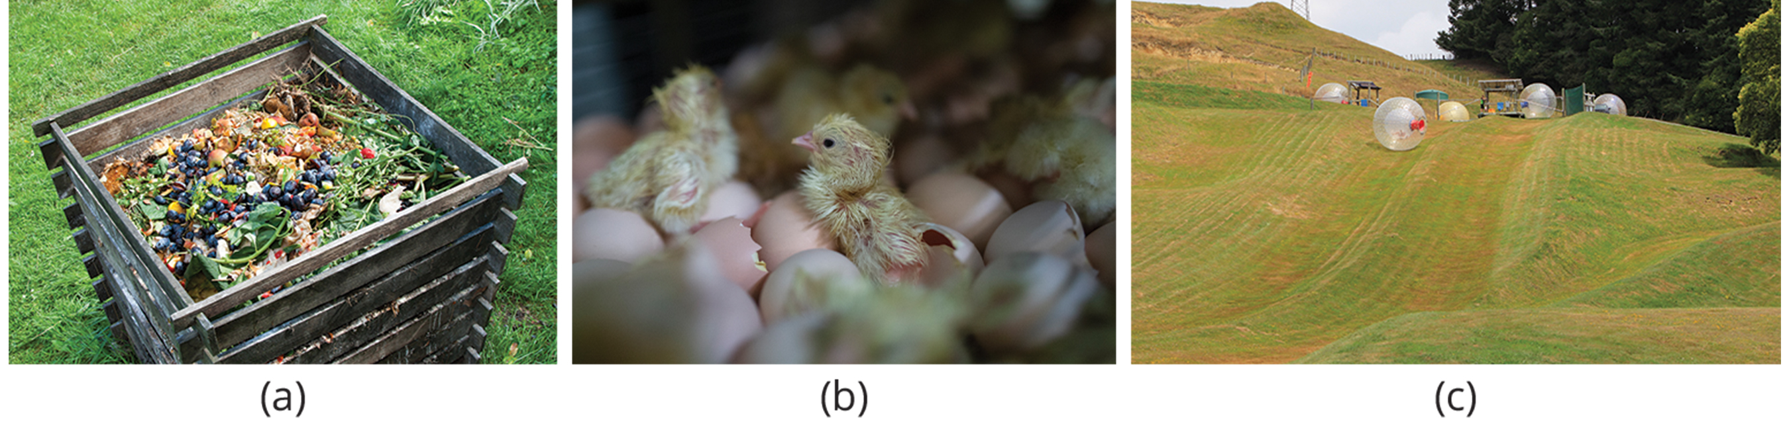
Think It Through₁
Consider each of the processes in the figure below and decide if it is endergonic or exergonic. In each case, does enthalpy increase or decrease, and does entropy increase or decrease?
6.2 Figure 5: his figure shows some examples of endergonic processes (ones that require energy) and exergonic processes (ones that release energy). These include (a) a compost pile decomposing, (b) a chick developing from a fertilized egg, and (c) a ball rolling down a hill.
Otwarte Klatki on Wikimedia Commons via Flickr. "Baby chick."
Notes:
Originally an On Your Own. This is included here to use as a talking point or for a think-pair-share activity.

Slide 9
Think It Through₂
ATP provides the cell with energy to perform its functions. The hydrolysis of ATP is represented by the following equation:
ATP → ADP + P_{i}
Here, ΔG = −7.3 kcal/mol of energy. Based on this reaction, can you determine whether this reaction is exergonic or endergonic?
Notes:
Originally an On Your Own. This is included here to use as a talking point or for a think-pair-share activity.

Slide 10
Endergonic Reactions and Exergonic Reactions₂
Most chemical reactions are reversible and can proceed in both directions.
In a closed system, a cell's reactions would reach equilibrium, depleting the resources and free energy required for life processes.
Living cells are open systems constantly moving materials into the cell and recycling products in other reactions.
Constantly energy requiring to avoid equilibrium and entropy

Slide 11
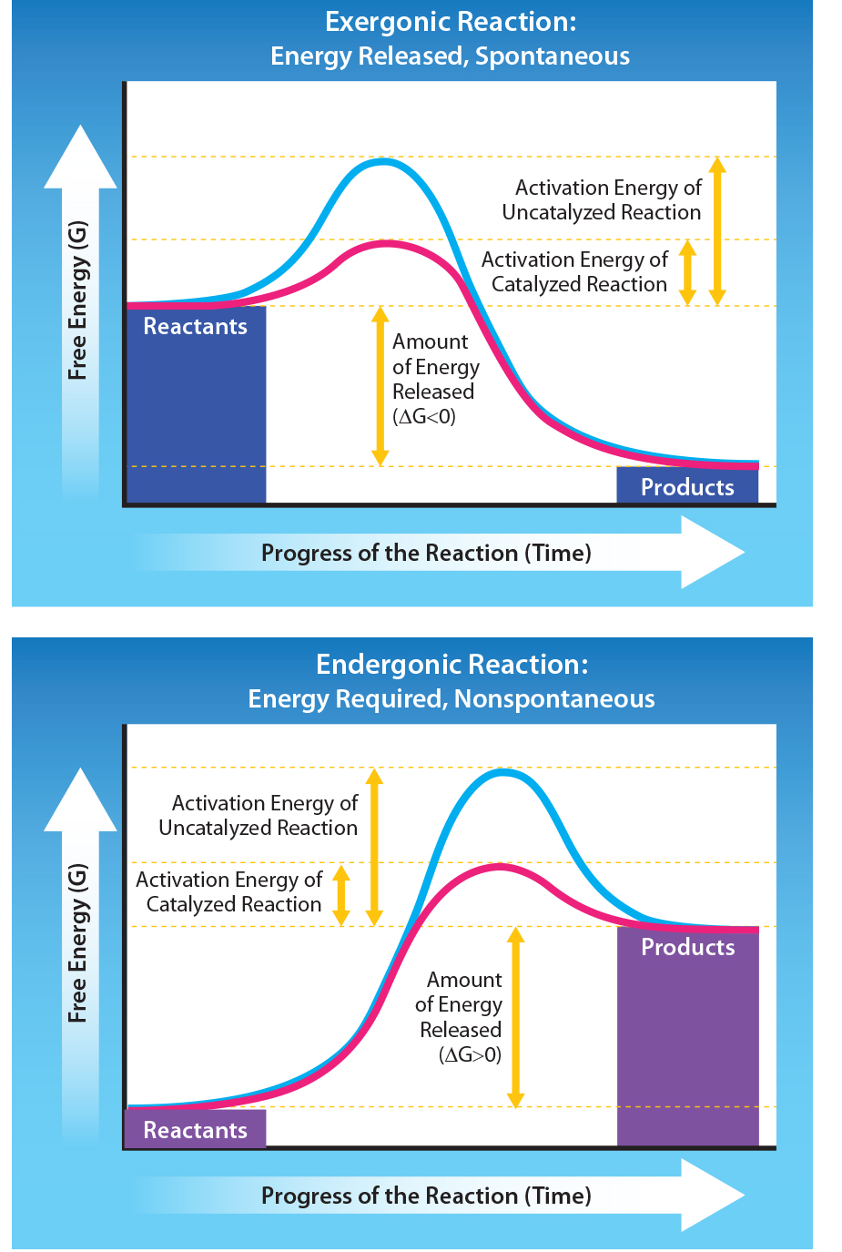
6.2 Figure 7
Tag, A., Rao, A., Fletcher, S. and Ryan, A. Department of Biology, Texas A&M University. "Exergonic and endergonic reactions."

Slide 12
Activation Energy₁
Activation energy (E_{A}): the energy required to initiate a chemical reaction by overcoming the energy barrier to reach the transition state
Transition state: a high-energy, unstable state (intermediate)
Even exergonic (energy-releasing) reactions require a small E_{A}.
E_{A} typically comes from heat energy in the surroundings.
Heat energy: the total bond energy of reactions or products in a chemical reaction
Increases molecules’ speeds to start the reaction
Higher E_{A} means a slower reaction rate, requiring more heat energy input.

Slide 13

Activation Energy₂
Higher E_{A} means a slower reaction rate, requiring more heat energy input.
Cells need more than heat as an E_{A} for efficient reaction rates.
Catalysts can lower E_{A}.
6.2 Figure 8: Once an oil fire starts, it provides enough activation energy to continue burning fuel, making it a hard fire to put out.

Slide 14
Think It Through₃
If no activation energy were required to break down sucrose (table sugar), would you be able to store it in a sugar bowl?
Notes:
Originally an On Your Own. This is included here to use as a talking point or for a think-pair-share activity.

Slide 15
Summary
Energy exists in different forms, including kinetic energy of moving objects and potential energy of objects' positions or bonds.
Living cells harvest potential energy from breaking molecular bonds to perform work.
Free energy (ΔG) measures the energy available to do work in a system during transfers like chemical reactions.
Exergonic reactions (ΔG < 0) release energy, while endergonic reactions (ΔG > 0) require energy input.
All reactions require an initial activation energy input to reach the transition state, which enzymes lower without affecting ΔG.

Slide 16


End of Hawkes Learning PowerPoint

