Slide 1
Lesson 6.3
The Laws of Thermodynamics

Slide 2
Objectives
Discuss the concept of entropy.
Explain the first and second laws of thermodynamics.

Slide 3

The Laws of Thermodynamics
Thermodynamics: the study of energy and energy transfer involving physical matter, including the system and surroundings
System: physical environment relevant to the energy transfer, can be open, closed, or isolated
Surroundings: everything outside of the system
6.3 Figure 1
NoName_13 on Pixabay. "Sunlit forest."

Slide 4
Table 1: The Three Types of Systems and Whether They Exchange Matter or Energy with Their Surroundings
System | Matter Transferred | Energy Transferred | Example
open | yes | yes | humans
closed | no | yes | an iced coffee with a lid
isolated | no | no | vacuum-sealed thermos

Slide 5
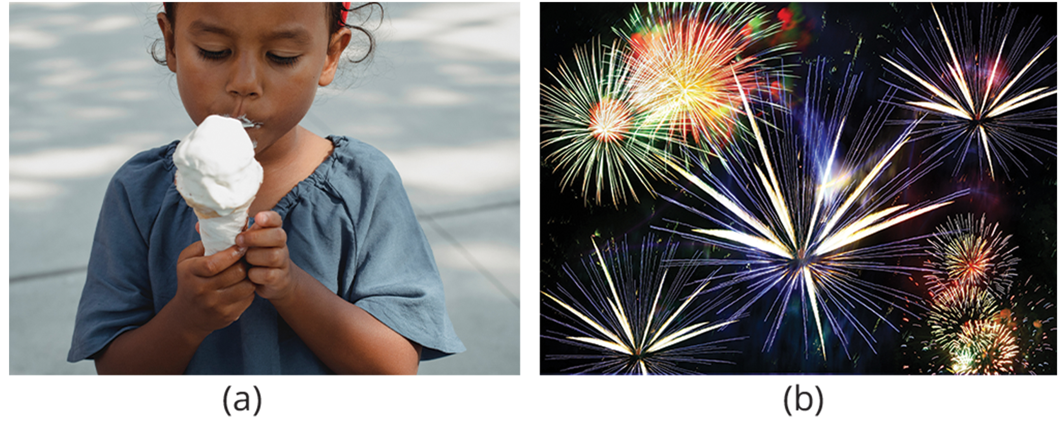
The First Law of Thermodynamics
The total amount of energy in the universe is constant and cannot be created or destroyed.
Energy can only be transferred or transformed from one form to another, such as photosynthesis converting light energy to chemical energy.
Living cells transform chemical energy from molecules like sugars into ATP to do work.
Build molecules, transport materials, power cilia or flagella, contract muscle fibers, and facilitate reproduction
6.3 Figure 2: (a) Humans can convert the chemical energy in food. (b) During a firework display, chemical energy is converted into kinetic, heat, light, and sound energy.
"Kamaji Ogino on Pexels. ""Girl eating ice cream.""Gerd Altmann on Pixabay. ""Fireworks."""

Slide 6
Think It Through₁
We all listen to music, audiobooks, or podcasts. Consider which form(s) of energy is/are input into the system and which form(s) of converted energy emerge as an output.
Notes:
Originally an On Your Own. This is included here to use as a talking point or for a think-pair-share activity.

Slide 7
The Second Law of Thermodynamics
In every energy transfer, some energy is lost in an unusable form (nothing is 100% efficient).
The more energy a system loses to the surroundings, the less ordered and more random the system.
Entropy: the measure of disorder or randomness in a system — higher entropy means more disorder

Slide 8
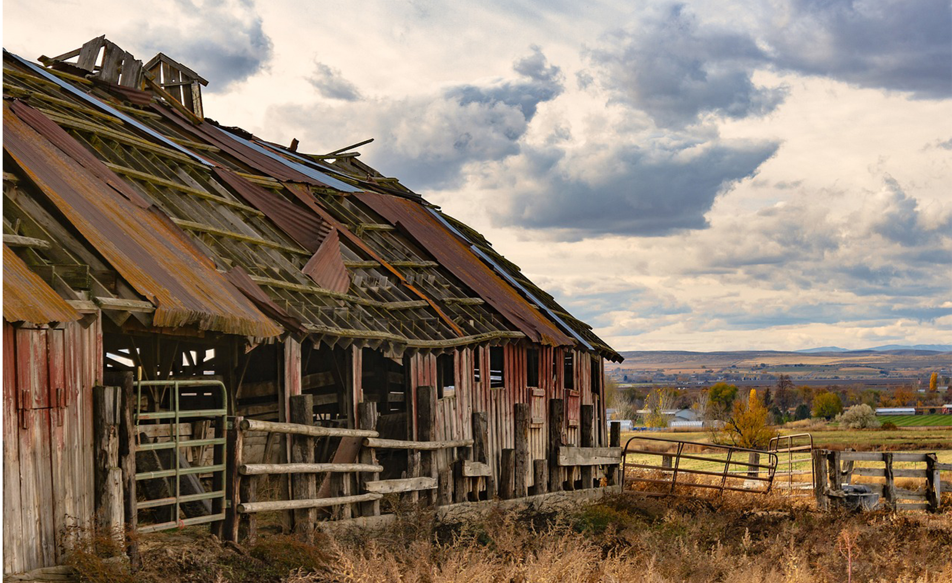
Heat and Entropy
Heat: energy that transfers from one system to another that isn’t doing work
Disordered, high entropy systems like a messy room require energy input to increase order.
As chemical reactions proceed to equilibrium and molecules diffuse, entropy increases.
6.3 Figure 3: A barn without maintenance disintegrates over time due to entropy.
themevnack on Pixabay. "Collapsing barn."

Slide 9
Universal Entropy Increases
Living systems are highly ordered, requiring constant energy to maintain low entropy states.
Waste from energy transformations in life increases entropy of the surroundings.
Example: as chemical reactions reach a state of equilibrium, entropy increases

Slide 10
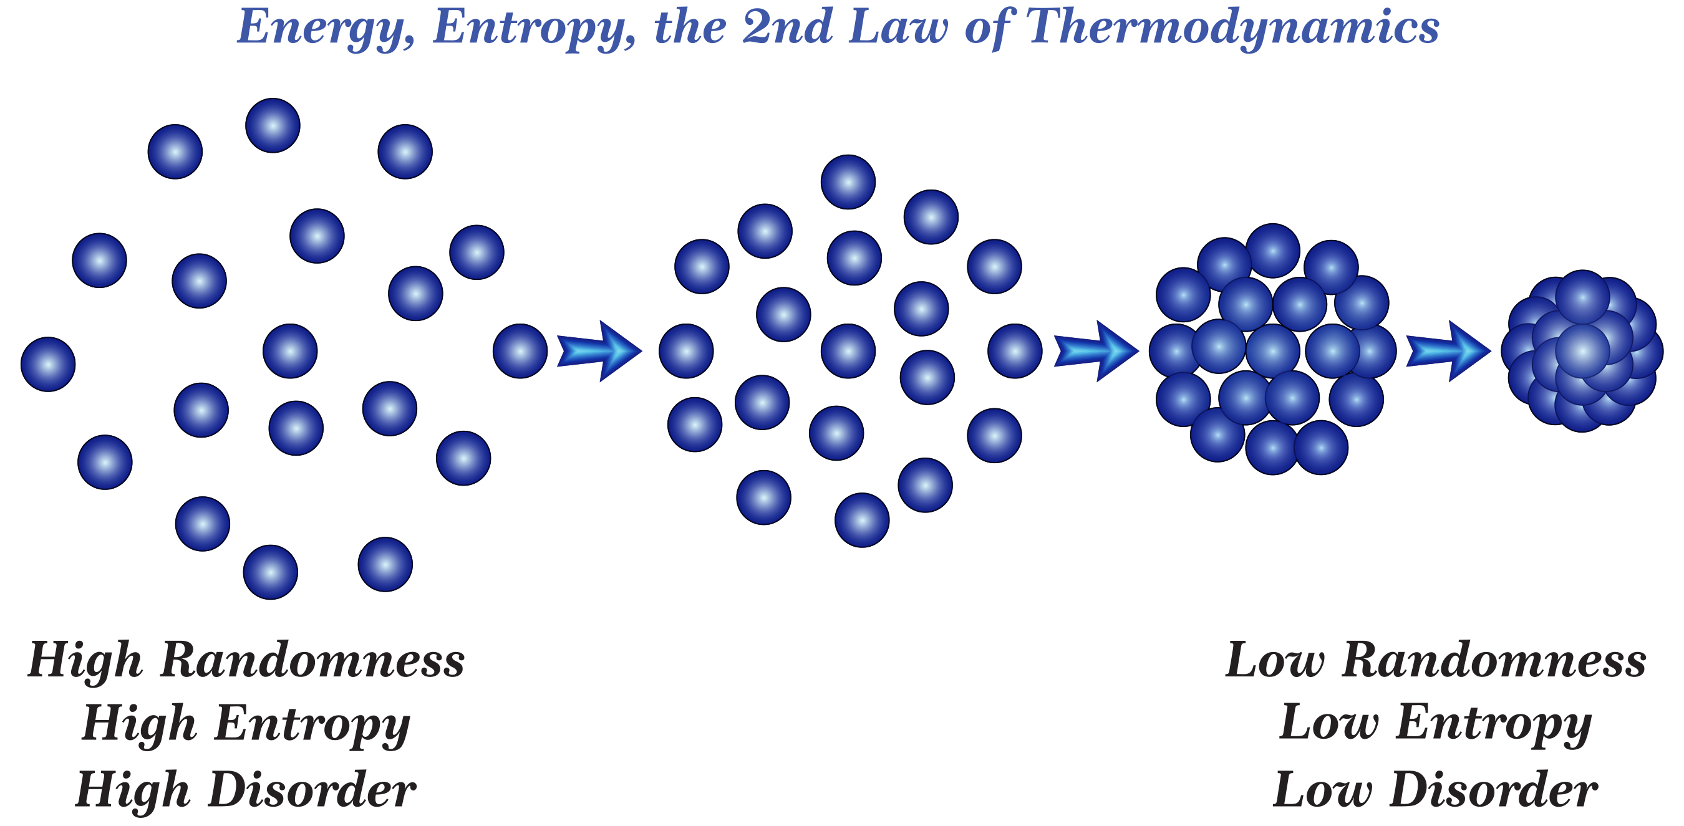
6.3 Figure 4

Slide 11
Group Activity
Set up a simple experiment to understand how energy transfers and how it results in a change in entropy.
Take a block of ice. This is water in solid form, so it has a high structural order. This means that the molecules cannot move very much and are in a fixed position. The ice's temperature is 0℃. As a result, the system's entropy is low.
Allow the ice to melt at room temperature. What is the state of molecules in the liquid water now? How did the energy transfer take place? Is the system's entropy higher or lower? Why?
Heat the water to its boiling point. What happens to the system's entropy when the water is heated?

Slide 12
Think It Through₂
While car engines are more efficient now than ever before, they still generate approximately a third of the energy available in gasoline. Based on what we have discussed in this chapter, explain this inefficiency.
Notes:
Originally an On Your Own. This is included here to use as a talking point or for a think-pair-share activity.

Slide 13


End of Hawkes Learning PowerPoint

