Slide 1
Lesson 6.4
ATP: Adenosine Triphosphate

Slide 2
Objectives
Describe how energy releases through ATP hydrolysis.
Explain ATP's role as the cellular energy currency.

Slide 3
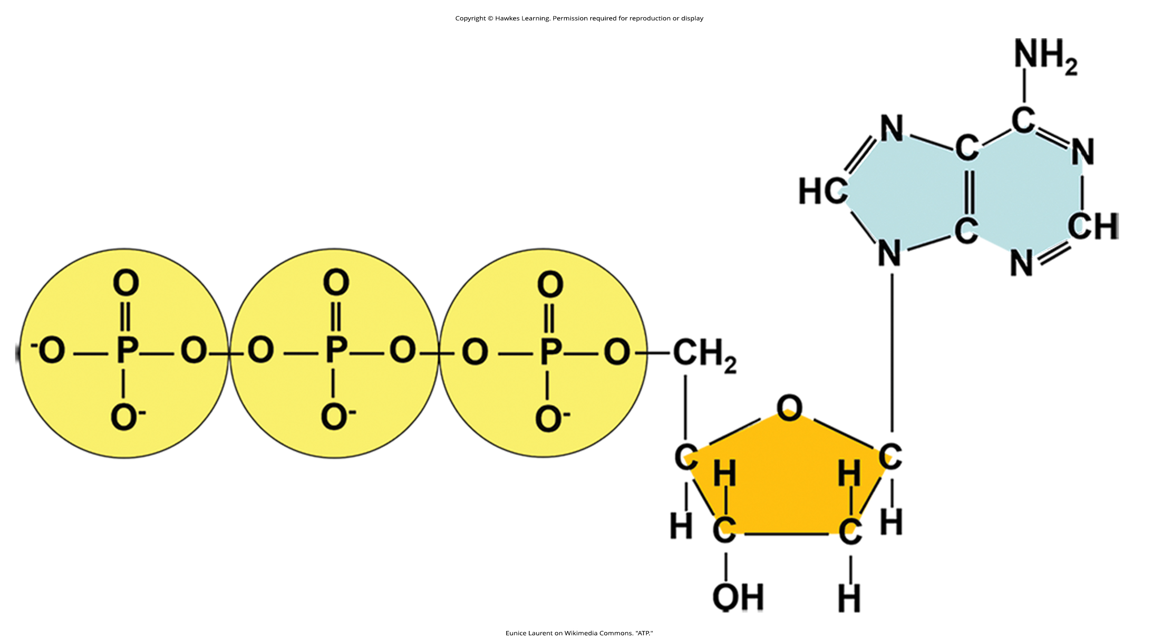
Adenosine Triphosphate₁
Adenosine triphosphate (ATP): a small, energy-supplying molecule that powers most cellular reactions through the release of energy from its high-energy phosphate bonds
Composed of an adenosine molecule (nitrogenous base adenine + ribose sugar) and three phosphate groups (alpha, beta, and gamma).
6.4 Figure 1
Eunice Laurent on Wikimedia Commons. "ATP."

Slide 4

Adenosine Triphosphate₂
Phosphoanhydride bond: high energy bond between each of the phosphates in ATP
The hydrolysis of ATP into ADP and inorganic phosphate (P_{i}) releases energy:
ATP + H₂O → ADP + P_{i} + free energy
Regeneration of ATP from ADP and Pi requires an input of free energy:
ADP + P_{i} + free energy → ATP + H₂O
6.4 Figure 2: Like all cells, muscle cells demand ATP.
Ketut Subiyanto on Pexels. "Yoga."

Slide 5

ATP Hydrolysis₁
The ΔG for 1 mole ATP hydrolysis under standard conditions is -7.3 kcal/mol (-30.5 kJ/mol).
In living cells, it's -14 kcal/mol (-57 kJ/mol).
ATP is highly unstable and will spontaneously dissociate if not used quickly.
6.4 Figure 3: This firefly must spend ATP constantly to generate this bioluminescent effect.

Slide 6
Think It Through₁
Describe ATP in terms of stability and energy yield. Explain the process of ATP usage and ATP regeneration.
Notes:
Originally an On Your Own. This is included here to use as a talking point or for a think-pair-share activity.

Slide 7
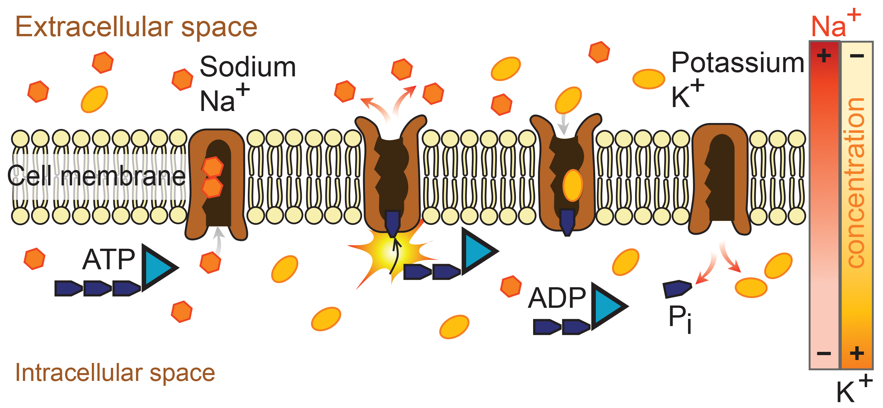
ATP Hydrolysis₂
Energy coupling: cells couple the exergonic reaction of ATP hydrolysis to endergonic reactions to provide them with the necessary energy.
Examples: Sodium-potassium pump and reactions within glycolysis
6.4 Figure 4: The sodium-potassium pump is an example of energy coupling. The energy derived from exergonic ATP hydrolysis pumps sodium and potassium ions across the cell membrane.
Mariana Ruiz Villarreal on Wikimedia Commons. "Sodium-potassium pump."

Slide 8
Think It Through₂
One ATP molecule's hydrolysis releases 7.3 kcal/mol of energy (ΔG = −7.3 kcal/mol of energy). If it takes 2.1 kcal/mol of energy to move one Na+ across the membrane (ΔG = +2.1 kcal/mol of energy), how many sodium ions could one ATP molecule's hydrolysis move?
Notes:
Originally an On Your Own. This is included here to use as a talking point or for a think-pair-share activity.

Slide 9
ATP Hydrolysis₃
Phosphorylation: when ATP hydrolysis results in the transfer of the gamma phosphate to another molecule or protein often causing conformational (shape) changes
The phosphorylation of the sodium-potassium pump gives it the necessary energy to pump ions.
Glucose is phosphorylated in the first step of glycolysis to create fructose.

Slide 10
Group Activity
As a group, consider different types of cells in a human body and their ATP needs. Come up with some cell types that likely go through more ATP than average. If you had to guess, what are some cell types that likely use less ATP than average? Discuss as a group why you think so.

Slide 11
Science and You
Why Do Your Cells Use ATP Energy Rather Than Using Energy Directly from the Bonds in Your Food?
ATP is the cell's "energy currency" and is more efficient than a hypothetical alternative.
Does the Extra Step to Convert Food Energy into ATP Waste Energy?
Akin to appliances running solely on transformed electricity, cells run on the single energy currency of ATP for efficiency despite some losses.
A centralized energy system has transformation losses but is vastly more efficient than accommodating multiple direct energy sources and forms for each process.
Notes:
This is included as a relevant application for this topic.

Slide 12
Summary
ATP (adenosine triphosphate) is the primary energy-supplying molecule for living cells, comprised of adenosine, a 5-carbon sugar, and three phosphate groups.
The high energy phosphoanhydride bonds connect the phosphate groups in ATP.
The energy released from ATP hydrolysis performs cellular work by coupling this exergonic reaction with endergonic (energy-requiring) reactions.
Energy coupling uses phosphorylation, where ATP donates its phosphate group to another molecule, increasing its energy and instability to undergo the necessary endergonic change.

Slide 13


End of Hawkes Learning PowerPoint

