Slide 1
Lesson 6.5
Metabolic Pathways and Enzymes

Slide 2
Objectives
Describe the role of enzymes in metabolic pathways.
Discuss enzyme regulation by various factors.
Explain how enzymes function as molecular catalysts.
Identify enzymes and coenzymes.

Slide 3
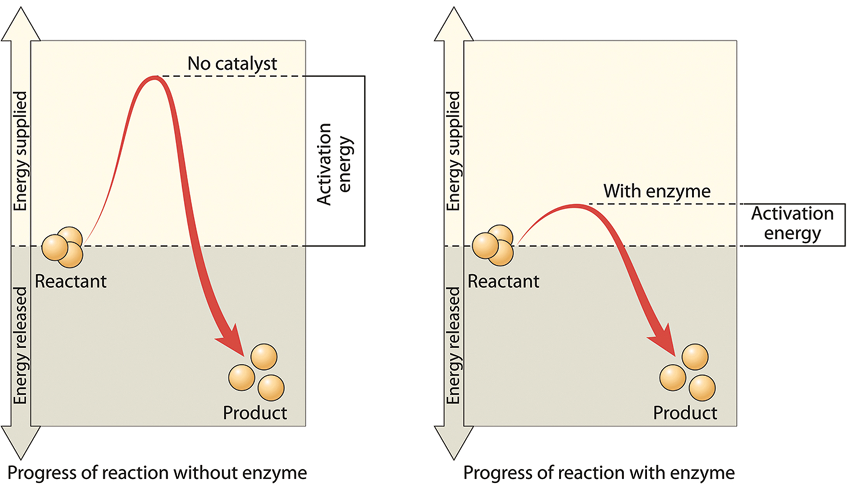
Metabolic Pathways and Enzymes
Enzymes: proteins that catalyze biochemical reactions by lowering the activation energy required for the reaction
Enzymes do not change the ΔG (free energy) of a reaction, only the activation energy required to reach the transition state.
6.5 Figure 1

Slide 4
Enzyme Active Site and Substrate Specificity₁
Enzymes are specific to the substrates they bind and the reactions they catalyze due to their unique active site environment.
Substrate: the chemical reactants that bind to an enzyme's active site, which is where the catalytic action occurs
Active site: the location within the enzyme where the substrate binds
The specific arrangement of amino acid residues in an enzyme's active site creates a chemical environment suited for binding specific substrates.

Slide 5
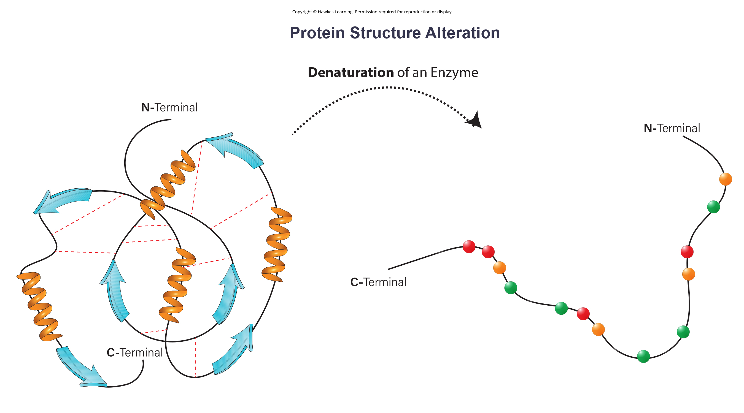
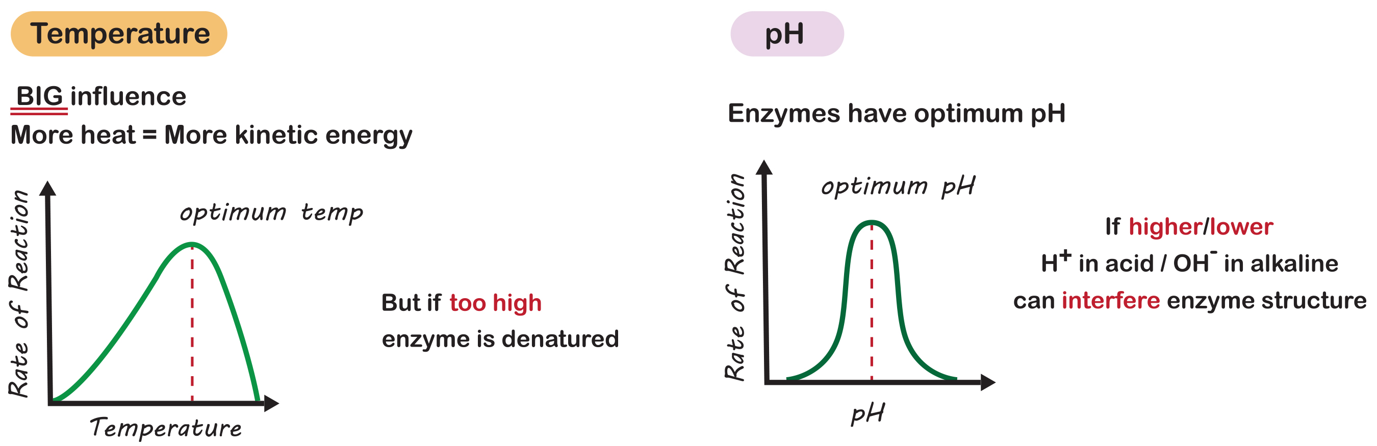
Enzyme Active Site and Substrate Specificity₂
Environmental factors like temperature and pH can affect the binding of substrates to the active site and enzyme function and may even cause enzymes to denature (change protein structure).
6.5 Figure 2
6.5 Figure 3

Slide 6
Think It Through
A gene-encoded enzyme is mutated such that an acidic amino acid found within the active site is changed to a hydrophobic amino acid. What effect might this change have on the enzyme's activity?
Notes:
Originally an On Your Own. This is included here to use as a talking point or for a think-pair-share activity.

Slide 7
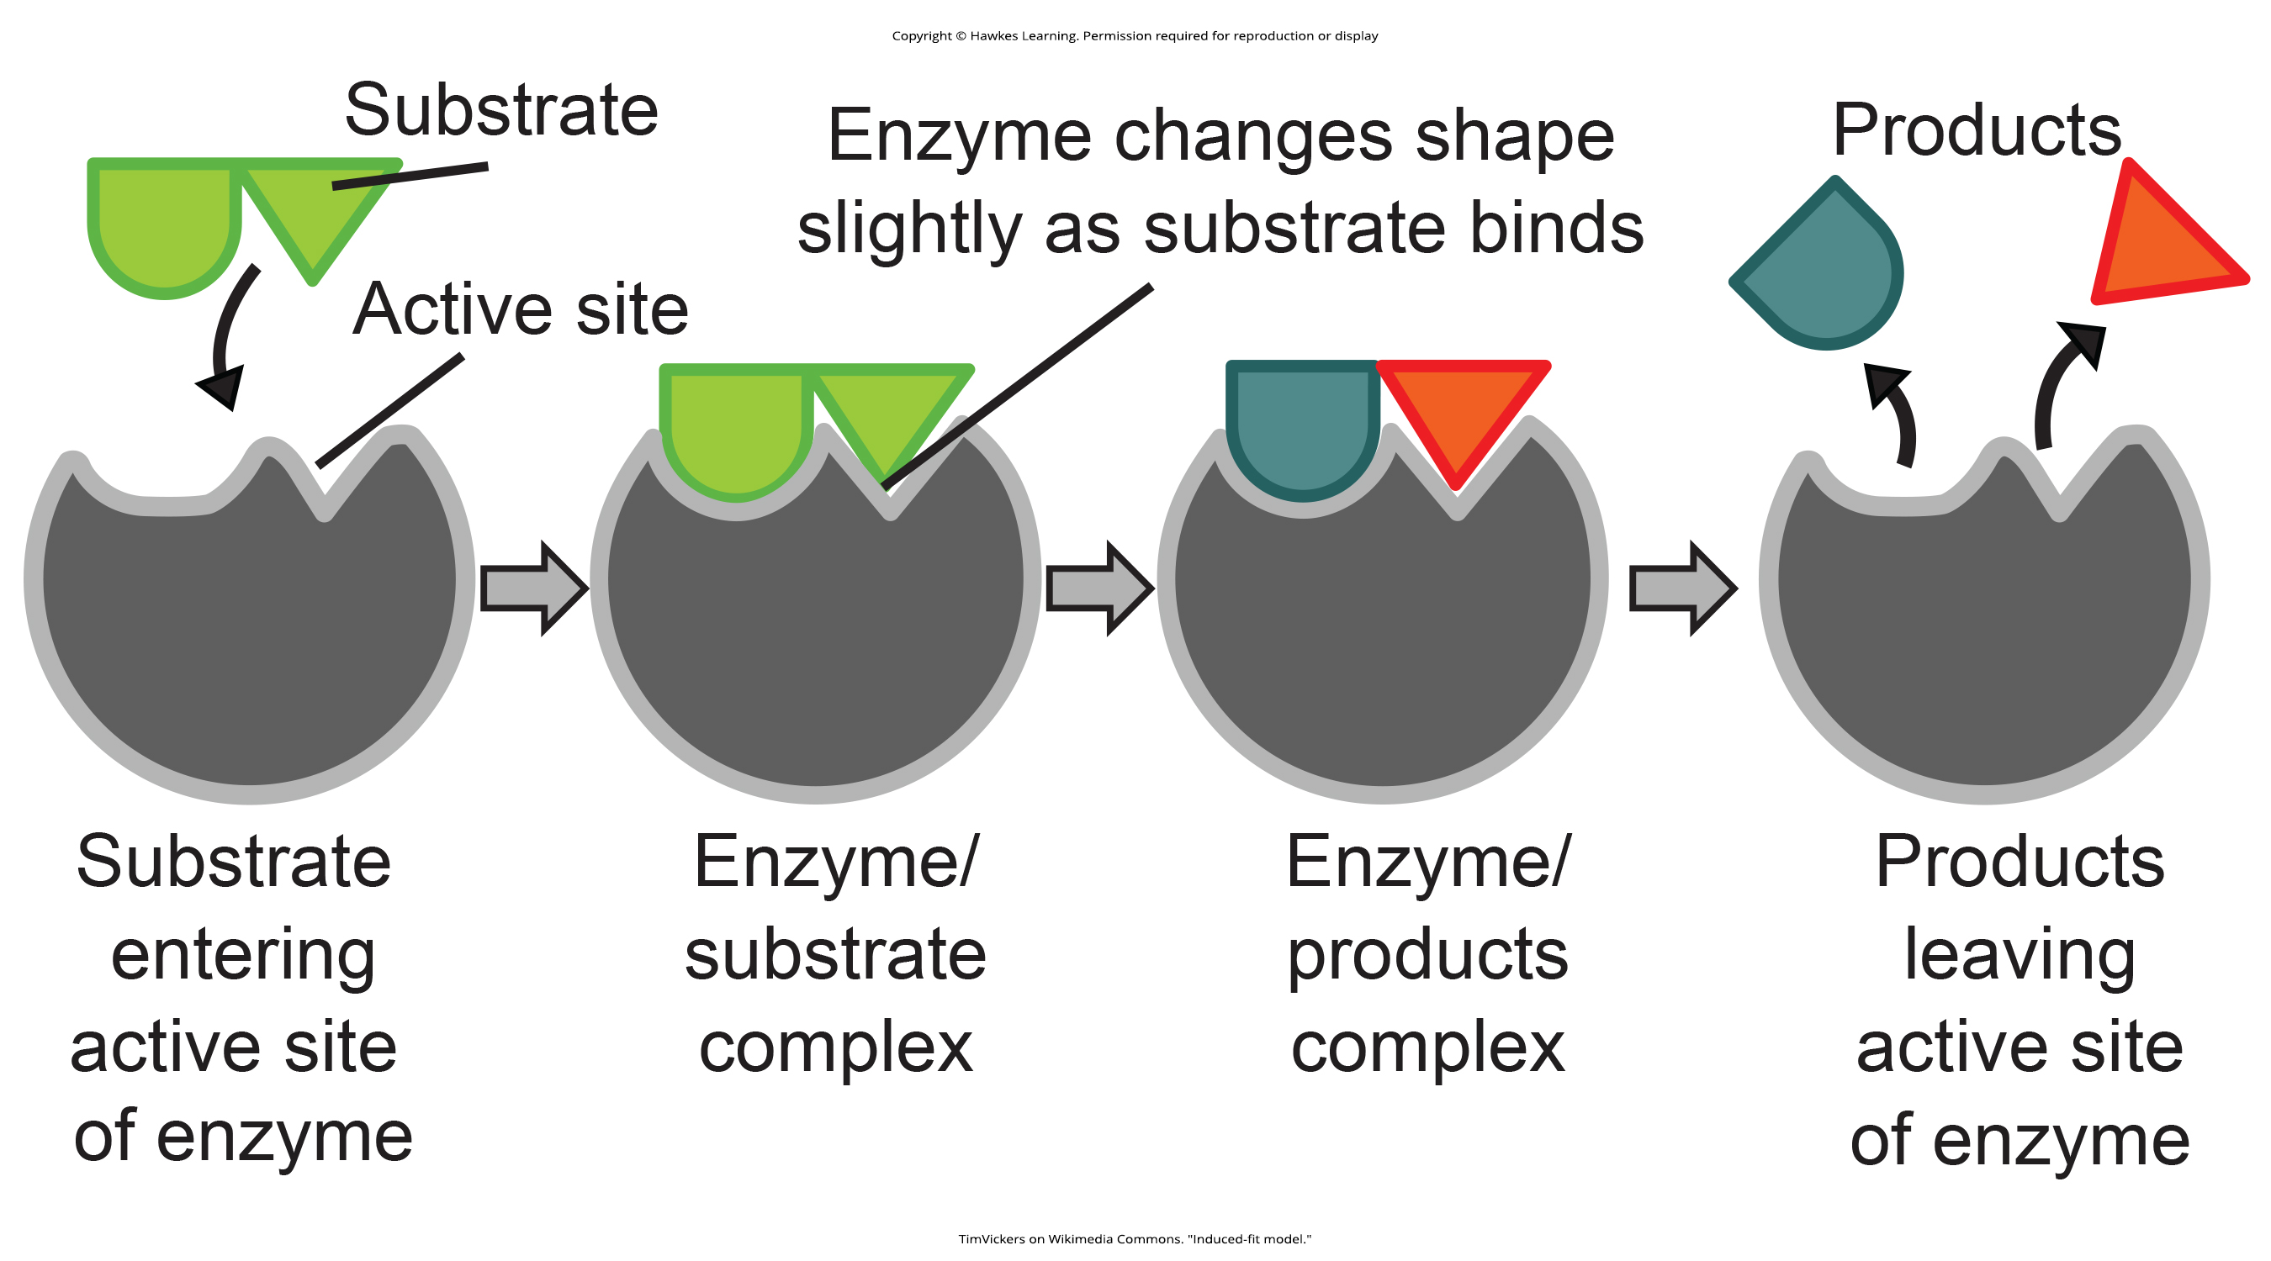
Induced Fit and Enzyme Function₁
The induced fit model describes a dynamic interaction where enzyme and substrate binding causes a mild shift in the enzyme’s structure for optimal binding.
6.5 Figure 4: The induced fit model
TimVickers on Wikimedia Commons. "Induced-fit model."

Slide 8
Induced Fit and Enzyme Function₂
Enzymes promote reactions by:
Bringing substrates together
Creating an optimal environment
Lowering the activation energy required
Enzymes are not consumed or altered by the reactions.

Slide 9
Metabolism Control through Enzyme Regulation
Enzyme number and activity vary based on cellular conditions and needs.
Enzyme requirements for stomach cells are different from fat storage cells, skin cells, blood cells, and nerve cells.
Environmental factors like pH and temperature partly control enzyme activity, but cells also regulate enzymes through various mechanisms.

Slide 10
Molecular Regulation of Enzymes₁
Enzymes can be regulated in ways that either promote or reduce their activity.
Competitive inhibition: inhibitor molecules bind to the active site, blocking the substrate from binding and inhibiting the enzyme.
Noncompetitive inhibition: inhibitor molecules bind to an allosteric site, inducing a conformational change that prevents substrate binding.
This is a form of allosteric regulation.

Slide 11
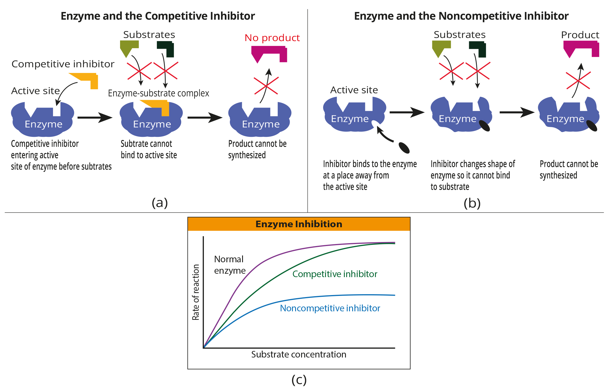
6.5 Figure 5
Notes:
(a) Competitive inhibition and (b) noncompetitive inhibition affect (c) the reaction's rate differently. Competitive inhibitors affect the initial rate but do not affect the maximal rate of reaction, while noncompetitive inhibitors lower the maximal rate of reaction.

Slide 12
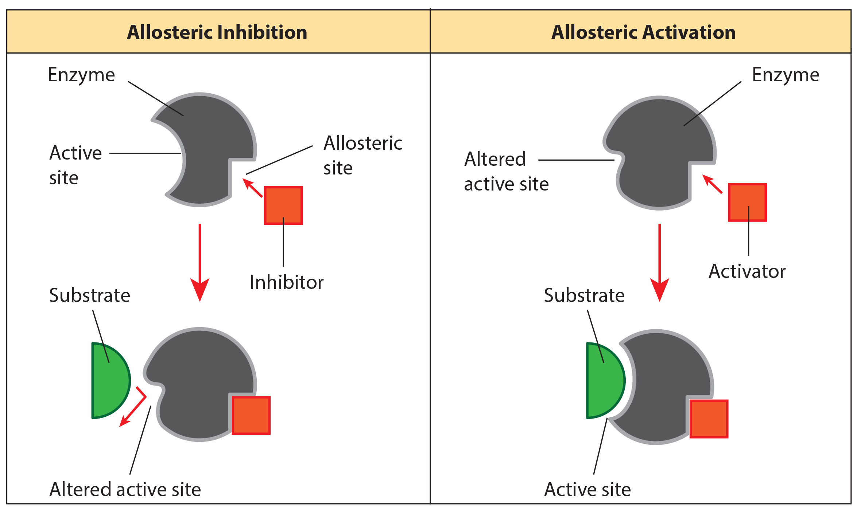
Allosteric Regulation
Allosteric regulation: binding event at a site different from the active site inducing a conformational change that changes the enzyme's affinity for its substrate
Can activate or inhibit an enzyme
6.5 Figure 6
CNX OpenStax on Wikimedia Commons. "Allosteric inhibitors." Modified.

Slide 13
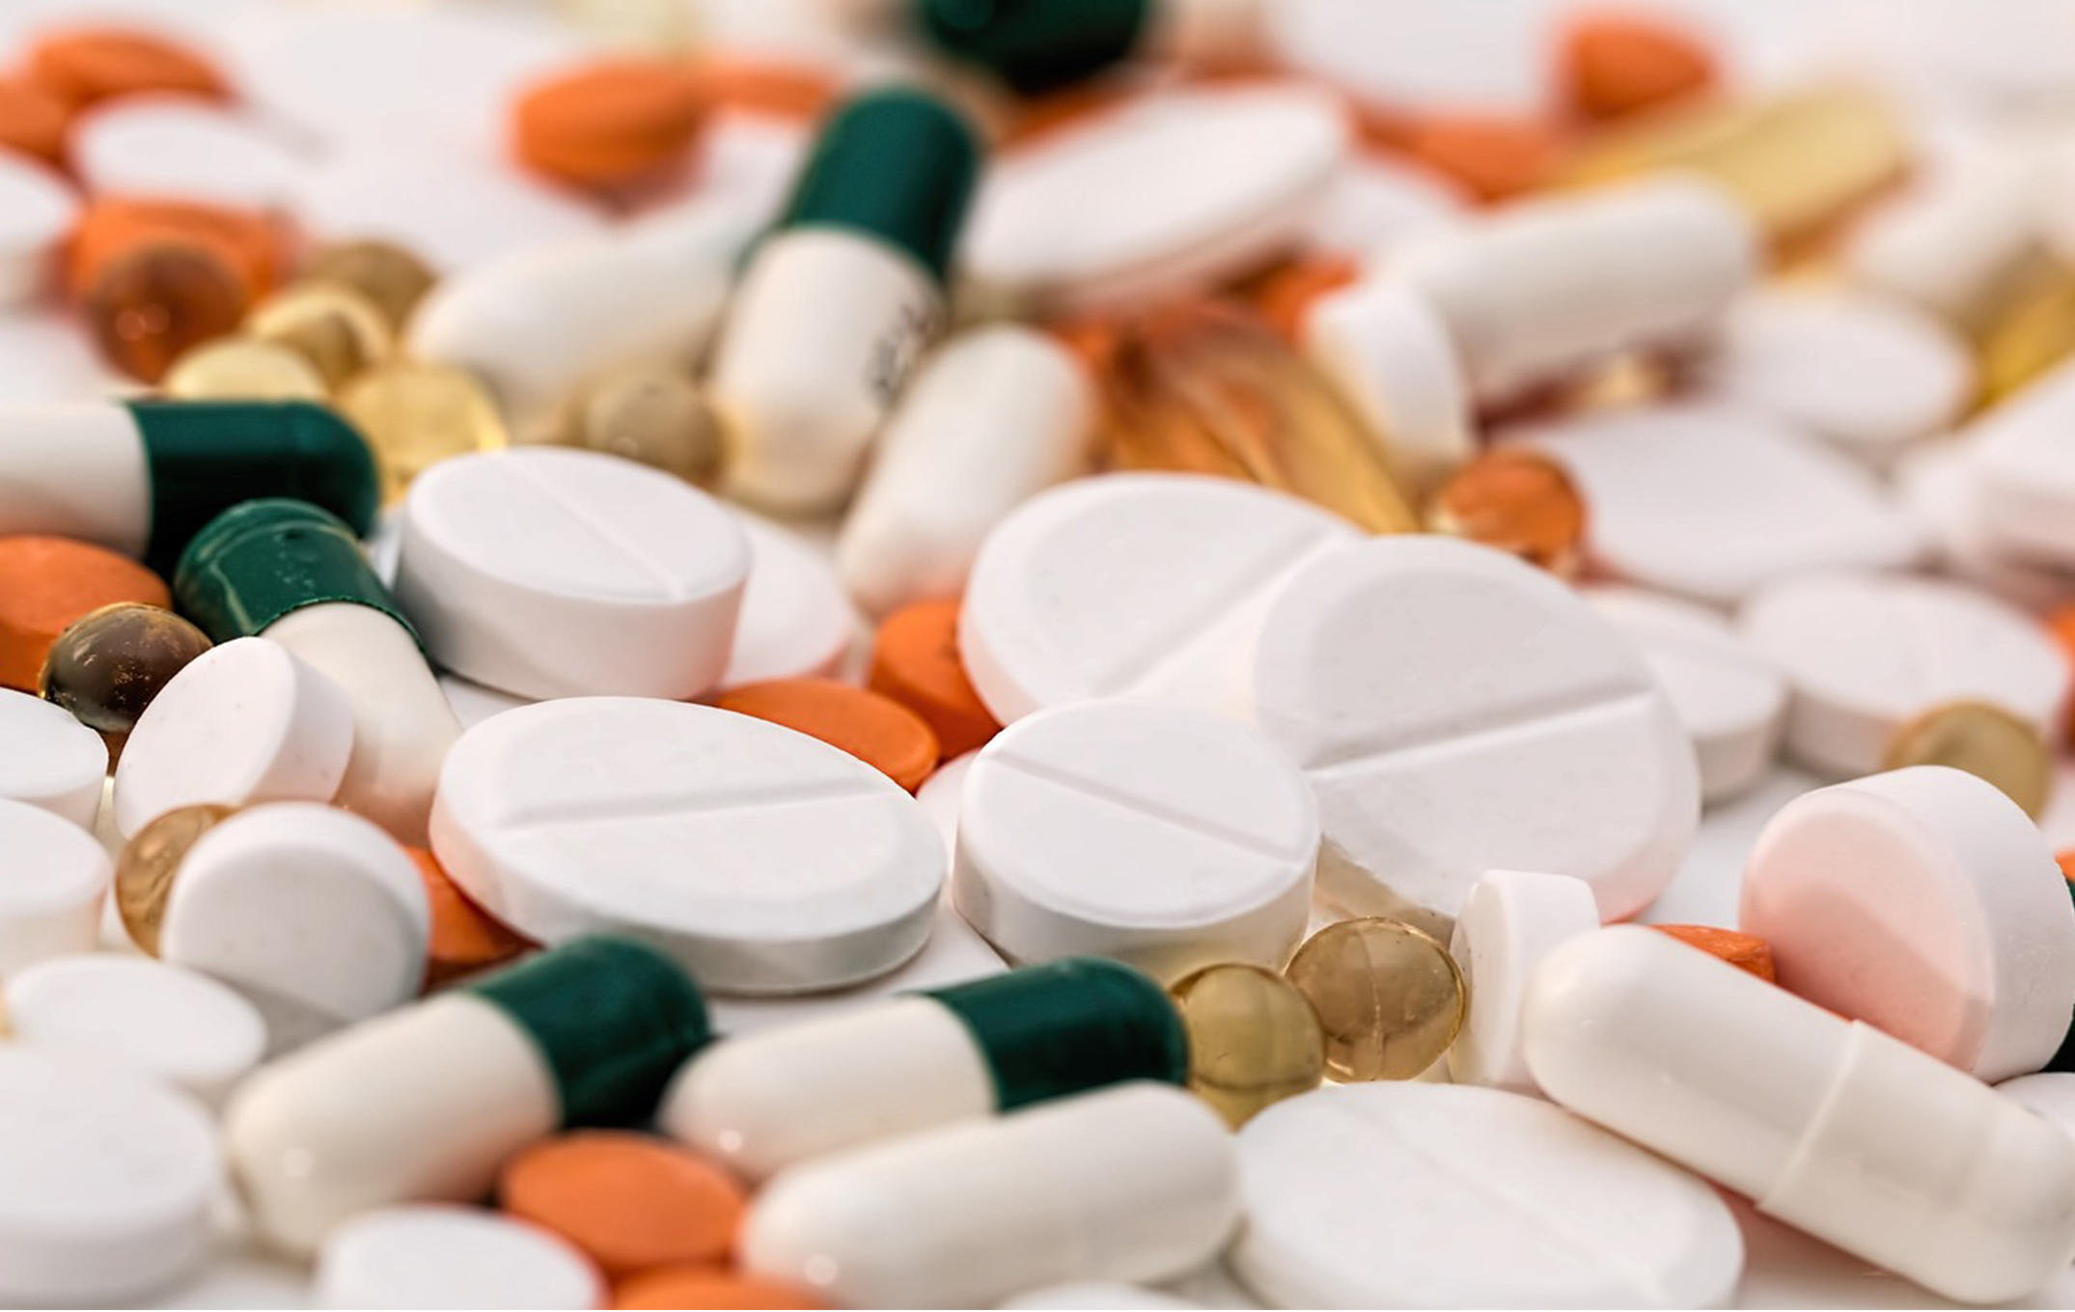
Science and You
Drug Discovery: Looking for Inhibitors of Key Enzymes in Specific Pathways
Enzymes are crucial components of metabolic pathways and understanding them is key to developing many pharmaceutical drugs.
Drug development involves identifying enzyme targets, understanding their roles in pathways and disease states, designing molecules to inhibit or activate the target enzyme, and undergoing extensive testing before market use.
Examples: statins inhibiting HMG-CoA reductase to reduce cholesterol, and acetaminophen (Tylenol) inhibiting cyclooxygenase for fever and pain relief
6.5 Figure 7
Steve Buissinne on Pixabay. "Pills."
Notes:
This is included as a relevant application for this topic.

Slide 14
Molecular Regulation of Enzymes₂
Many enzymes don't work optimally unless bound to other specific non-protein helper molecules.
Cofactors (inorganic ions) and coenzymes (organic molecules) are required helper molecules for optimal enzyme function.
Cofactors examples: Fe²⁺, Mg²⁺, and Zn²⁺ (DNA polymerase)
Dietary vitamins can be coenzymes or coenzyme precursors.

Slide 15
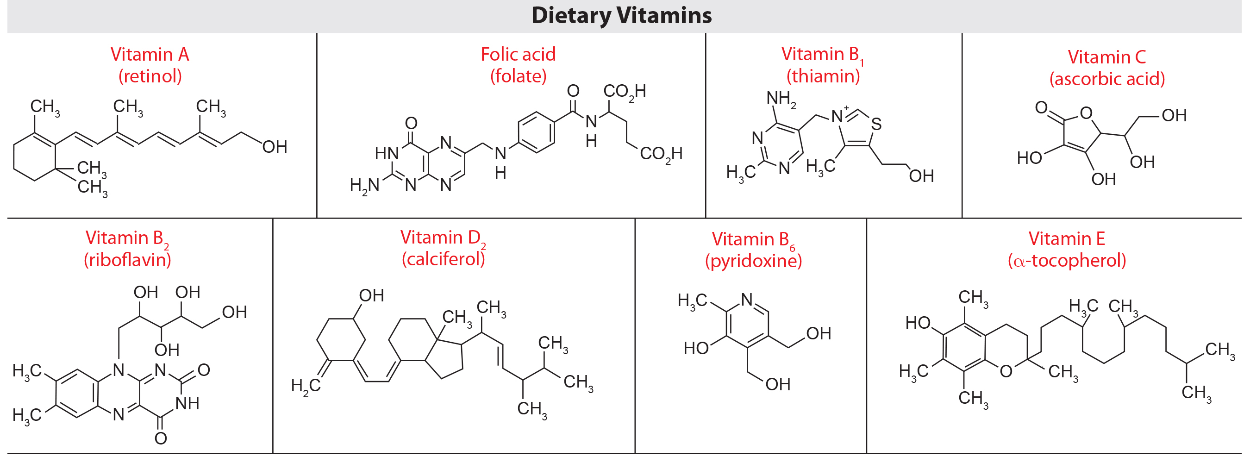
Molecular Regulation of Enzymes₃
In glycolysis the enzyme pyruvate dehydrogenase requires a magnesium ion and five different organic coenzymes to catalyze its specific chemical reaction.
6.5 Figure 8
OpenStax. "Dietary vitamins." Modified.

Slide 16
Reflection Question
Think about both the medications and the dietary supplements that you take or have taken. For the medications, what metabolic pathway is affected by each? For the dietary supplements, are they coenzymes? Cofactors? What enzymes or metabolic pathways do they each affect? Use the internet to research each medication and dietary supplement.
Notes:
The reflection question is included here to use as a talking point or for a think-pair-share activity.

Slide 17
Enzyme Compartmentalization
In eukaryotic cells, enzymes are often compartmentalized into different organelles for regulation and efficiency of specific processes.
Later stages of cellular respiration are housed in the mitochondria.

Slide 18
Feedback Inhibition in Metabolic Pathways
Feedback inhibition: a product's effect of a reaction sequence to decrease its further production by inhibiting the first enzyme's activity in the pathway that produces it
ATP inhibits some catabolic enzymes that produce it, while ADP activates them when ATP levels are low.

Slide 19
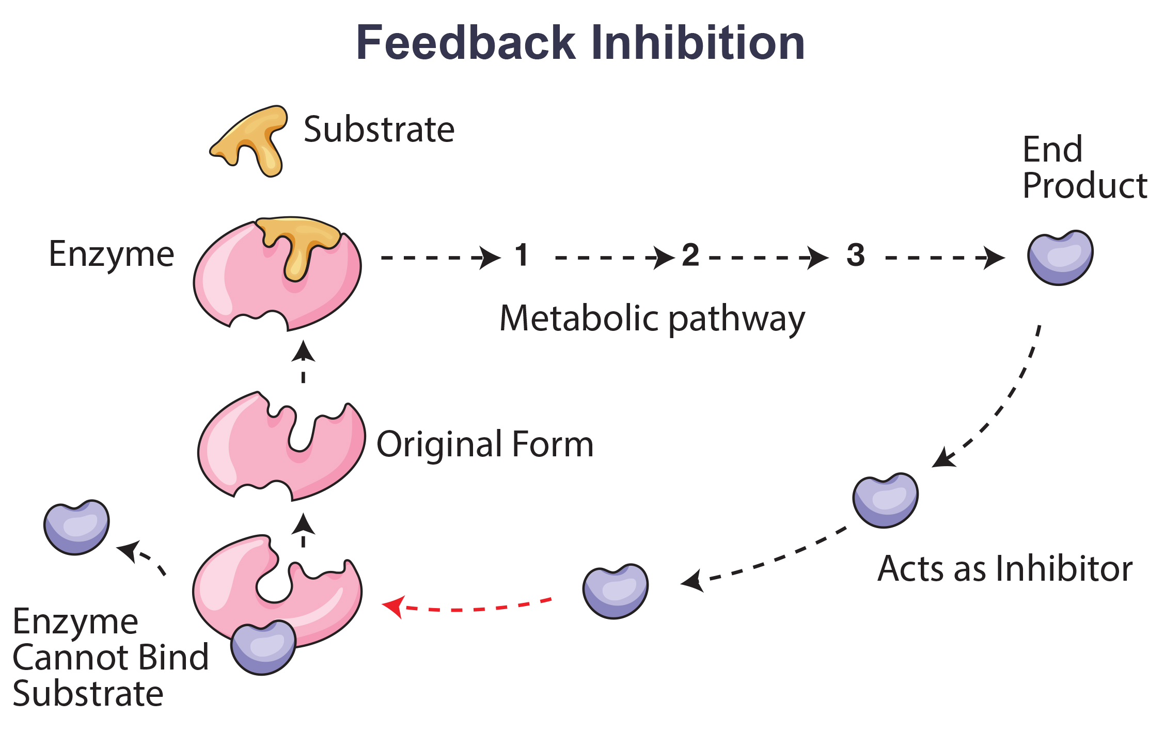
6.5 Figure 9

Slide 20
Summary
Enzymes are protein catalysts that lower activation energy of reactions by providing an optimal active site environment to bind substrates and stabilize transition states through induced fit binding.
Enzymes catalyze by substrate orientation, bond strain, favorable environments, or direct covalent participation.
Regulation occurs via conditions, localization, inhibitors (competitive, allosteric), and activators (allosteric).
Feedback inhibition involves pathway products allosterically inhibiting their production enzymes.

Slide 21


End of Hawkes Learning PowerPoint

