Slide 1
Lesson 7.1
Energy in Living Systems

Slide 2
Objectives
Discuss the importance of electrons in the transfer of energy in living systems.
Explain how ATP is used by cells as an energy source.

Slide 3
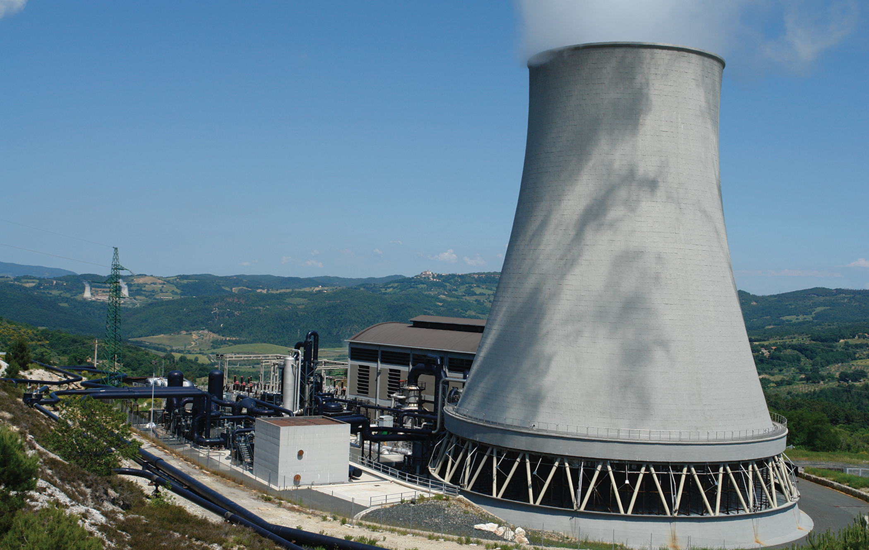
Cellular Respiration
Plants and animals convert energy from food into energy cells can use (ATP).
Cellular respiration: extracts energy from glucose bonds and converts it to ATP
7.1 Figure 1: This geothermal power plant transforms thermal energy from deep in the ground into electrical energy, which can be easily used.
T. AGEMAR on Wikimedia Commons. "Geothermal power plant."

Slide 4
Energy in Living Systems
Involves oxidation-reduction reactions (called redox reactions)
  Oxidation strips electrons
  Reduction adds electrons
Transfers energy via these electron shifts

Slide 5
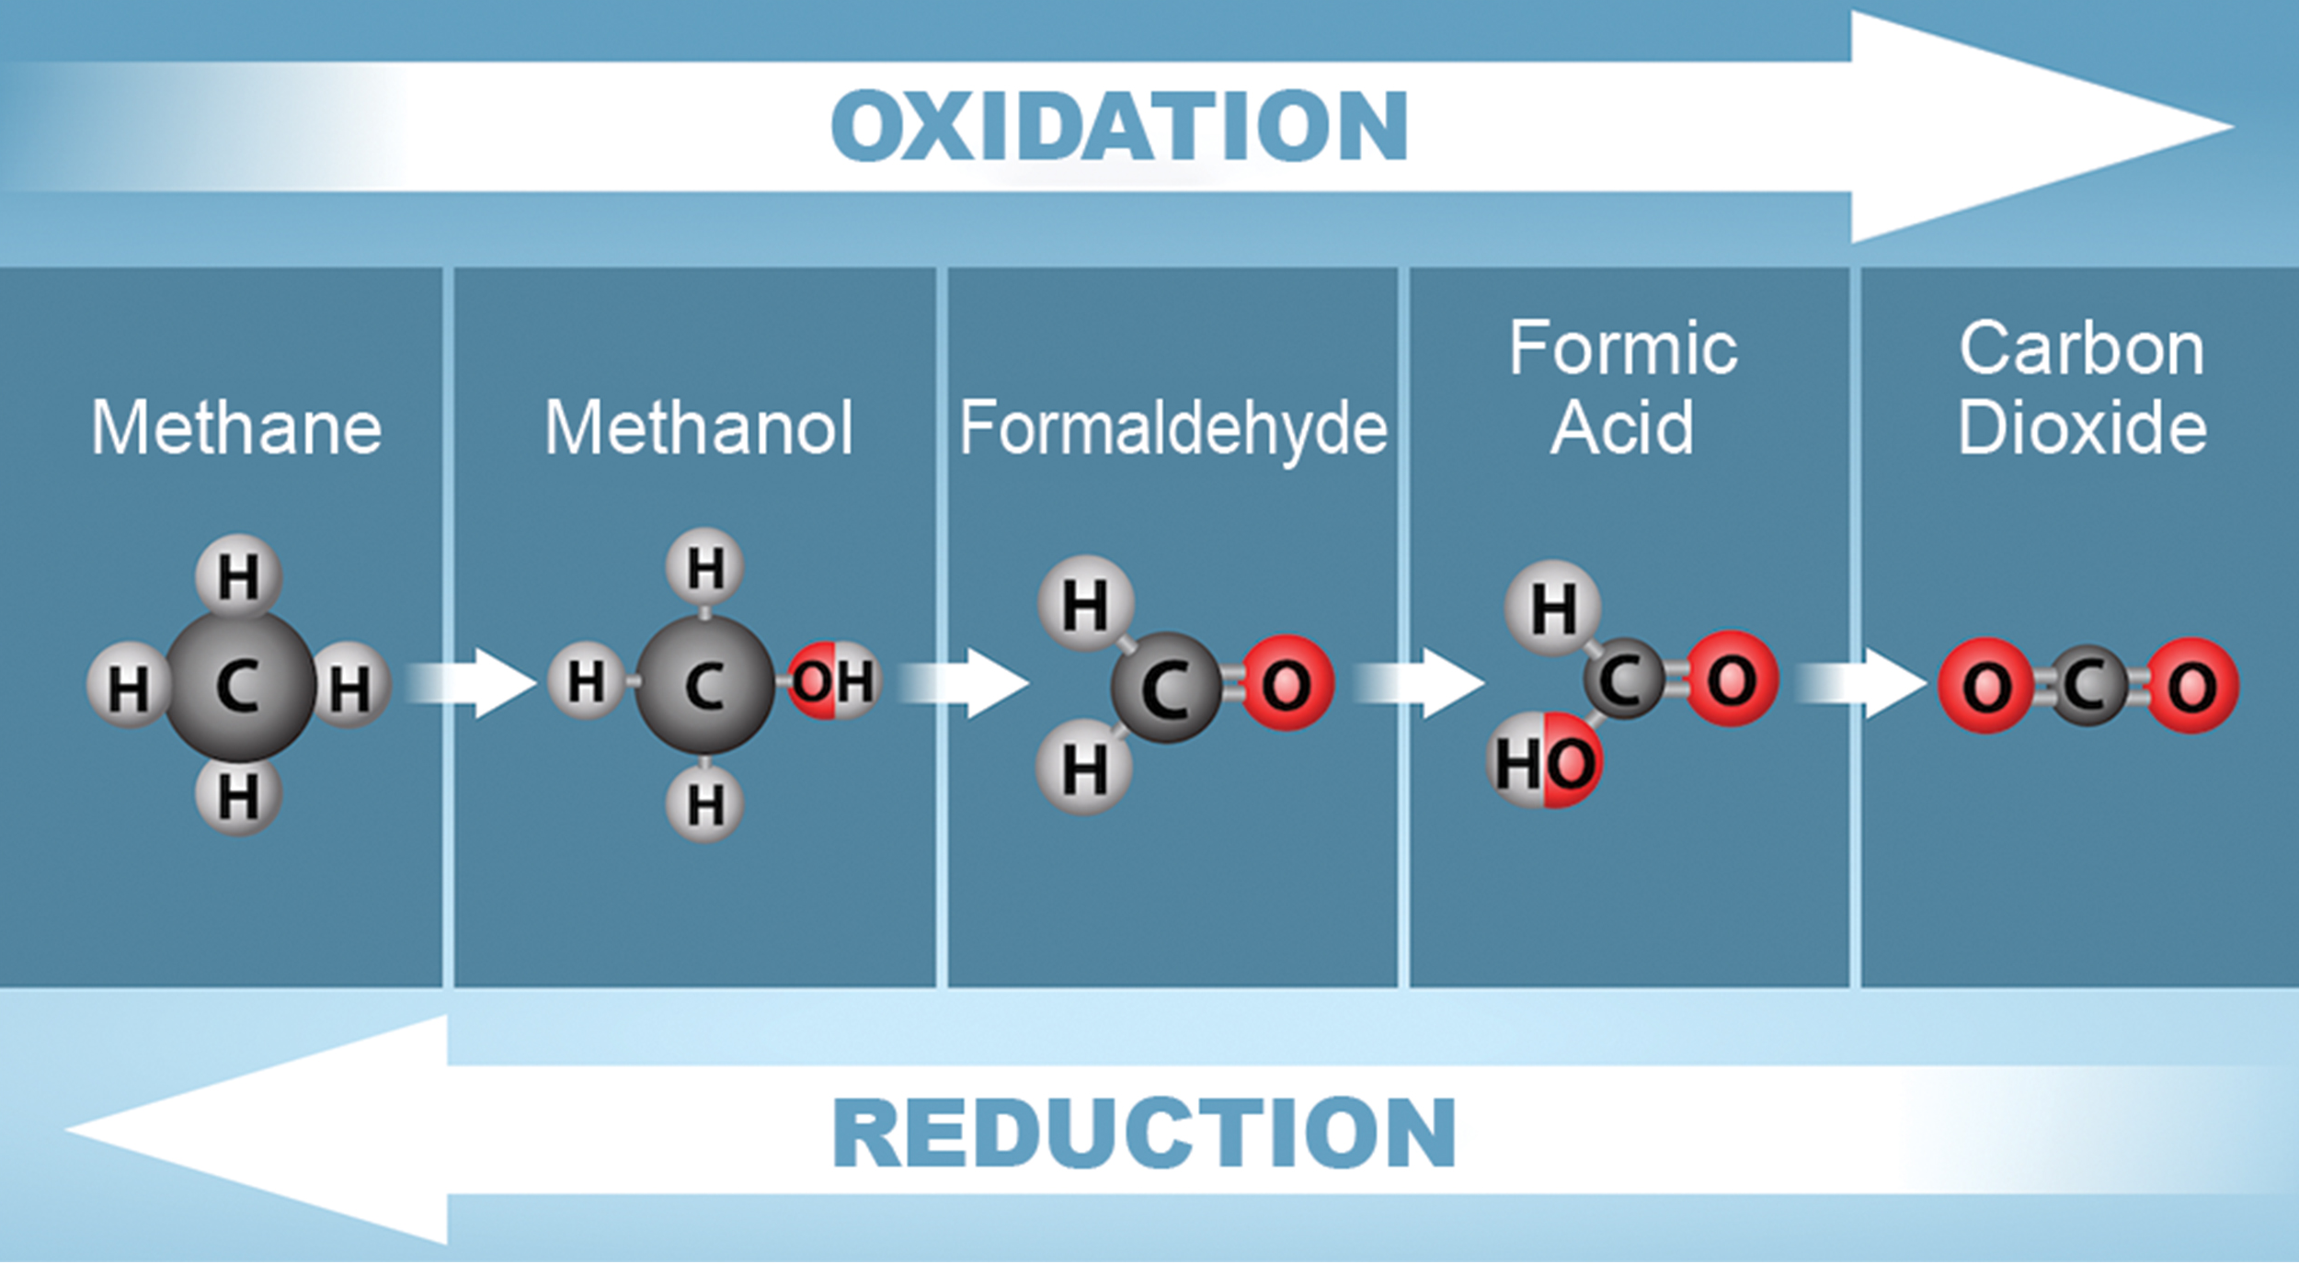
7.1 Figure 2
Ryan, K., Rao, A. and Fletcher, S. Department of Biology, Texas A&M University. "Redox reactions."
Notes:
Figure 2: These are the stages of oxidation/reduction of a single carbon. Electrons are lost from carbon as methane (CH4) is oxidized to carbon dioxide (CO2). The loss of electrons is also accompanied by the loss of energy. Electrons are gained during the reduction of carbon dioxide to methane. The gain of an electron is accompanied by a gain in potential energy and often by the addition of a proton (H+).

Slide 6
Electrons and Energy
The removal of electrons (oxidation) results in a decrease in potential energy in the oxidized compound.
The addition of electrons (reduction) results in an increase of potential energy in the reduced compound.
High-energy electrons fuel cells.
Cells use high-energy electrons to incrementally transfer energy.

Slide 7
Think It Through
Why do you think it necessary for the cell to extract energy in small packages instead of one large step?
Notes:
Originally an On Your Own. This is included here to use as a talking point or for a think-pair-share activity.

Slide 8
Electron Carriers
Electron shuttles bind and carry high-energy electrons
  Examples: NAD⁺/NADH and FAD⁺/FADH₂
RH (reducing agent) + NAD⁺ (oxidizing agent)
→
NADH (reduced) + R (oxidized)
Electrons added, compound reduced (becomes a reducing agent)
Electrons removed; compound oxidized (becomes an oxidizing agent)

Slide 9
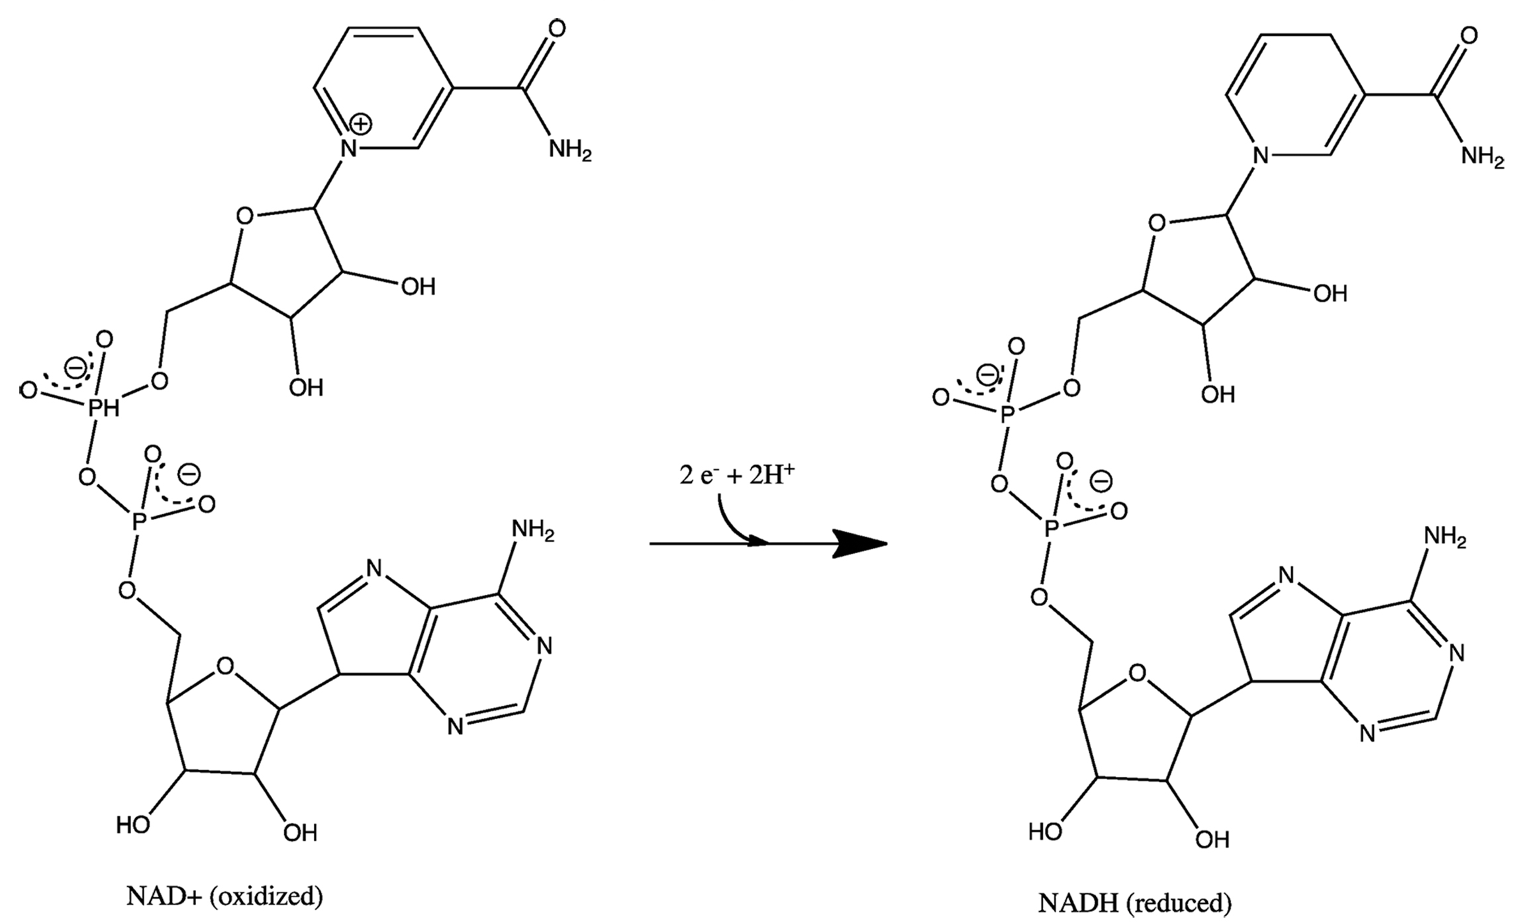
7.1 Figure 3
Alejandro Porto on Wikimedia Commons. "NAD⁺ and NADH."
Notes:
Figure 3: The oxidized form of the electron carrier (NAD+) is converted to the reduced form (NADH). The nitrogenous base in NADH has one more hydrogen ion and two more electrons than in NAD+.

Slide 10
ATP in Living Systems
ATP is "energy currency."
  Stores/transfers energy
Removing the last phosphate group from ATP releases energy.
Phosphate binding to another molecule activates energy.
Example: Sodium-potassium (Na-K) pump
  ATP alters the structure of the integral protein that works as a pump, changing its affinity for Na and K. This is how the cell performs work—pumping ions against their electrochemical gradients.

Slide 11
ATP Structure and Function
AMP is part of ATP.
  Adding a phosphate group to AMP produces ADP.
  Adding a phosphate group to ADP produces ATP.
Adding a phosphate group requires energy.
Dephosphorylation: releasing a phosphate group from ATP to release energy
Phosphate groups are removed through hydrolysis (adding H₂O).

Slide 12
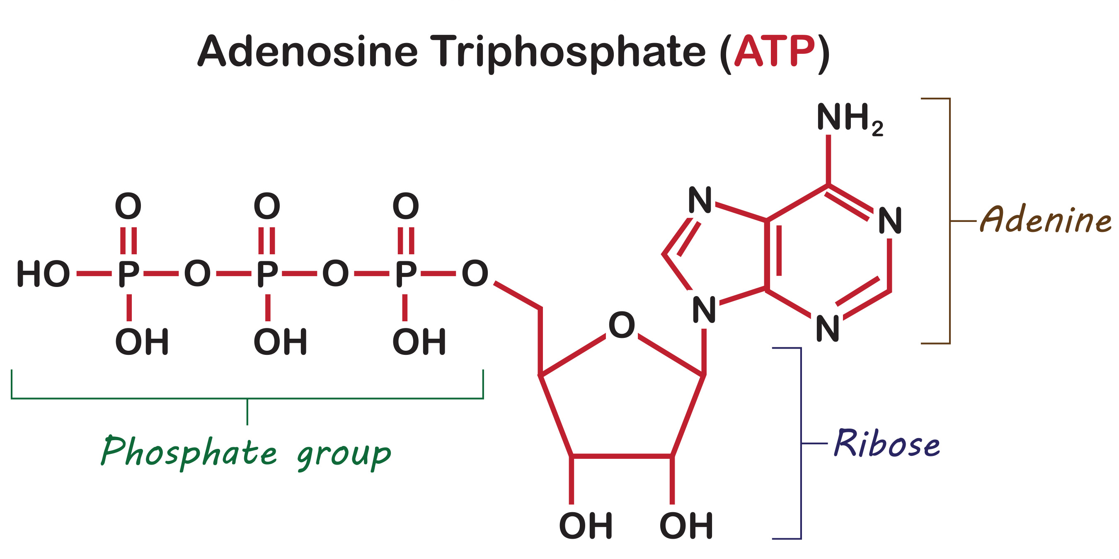
7.1 Figure 4
Notes:
Figure 4: ATP (adenosine triphosphate) has three phosphate groups that can be removed by hydrolysis (the addition of H2O) to form ADP (adenosine diphosphate) or AMP (adenosine monophosphate). The negative charges on the phosphate group naturally repel each other, requiring energy to bond them together and releasing energy when these bonds are broken.

Slide 13
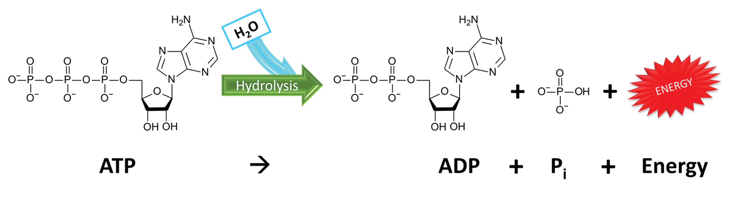
Energy from ATP
Hydrolysis breaks down complex macromolecules.
Hydrolysis of ATP produces ADP and P_{i} (release of free energy).
ATP is regenerated by adding phosphate to ADP.
ATP links catabolism to anabolic pathways.
7.1 Figure 5: The hydrolysis of ATP generates energy by breaking one of the chemical bonds within an ATP molecule.
SrKellyOP on Wikimedia Commons. "ATP hydrolysis."

Slide 14
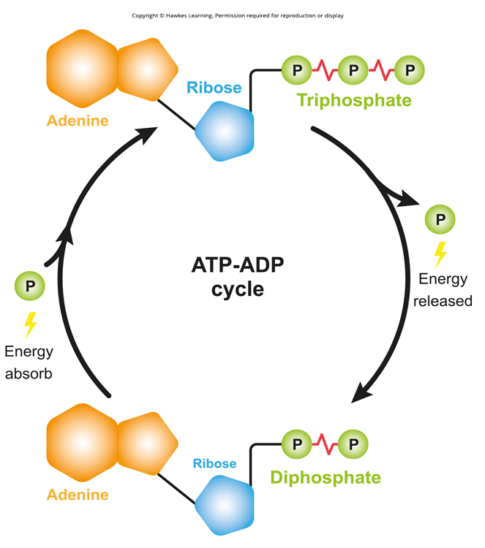
7.1 Figure 6
Notes:
Figure 6: To meet the energy needs of living organisms, ATP is constantly dephosphorylated into ADP and then phosphorylated into ATP. This is known as the ATP-ADP cycle.

Slide 15
Phosphorylation
Enzymes form intermediate complexes to allow substrates and ATP to interact during reactions.
Phosphorylation:
  Adding a phosphate (~P) by using intermediate complex to transfer ATP's third phosphate group to substrate
  Driving force for turning cellular processes on and off
A + enzyme + ATP → [A – enzyme – ~P] → B + enzyme + ADP + P_{i}

Slide 16
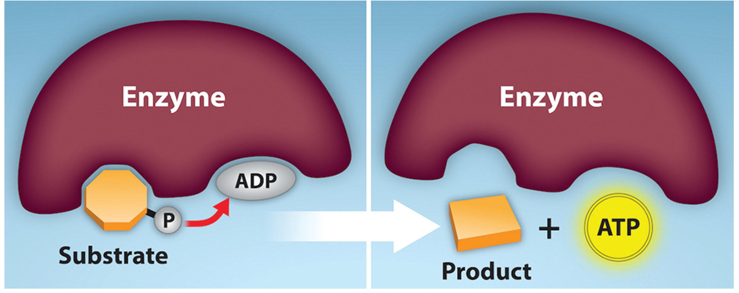
Substrate-Level Phosphorylation
Chemical reactions of ADP produce ATP through catabolic reactions.
Substrate-level phosphorylation: phosphate group removed from intermediate reactant and attached to ADP, producing ATP
7.1 Figure 7
Rao, A., Ryan, K. and Fletcher, S. Department of Biology, Texas A&M University. "Phosphorylation reactions."
Notes:
Figure 7: In a substrate-level phosphorylation reaction, a phosphate group is removed from an intermediate reactant and is attached to ADP, forming a molecule of ATP.

Slide 17
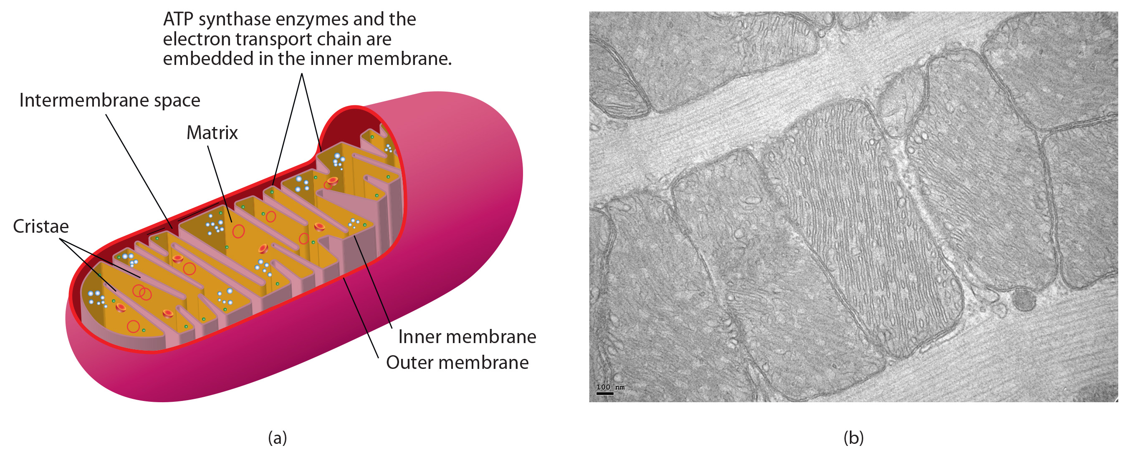
Oxidative Phosphorylation
Most of ATP is generated from chemiosmosis.
Chemiosmosis: process of ATP production in cellular metabolism
Oxidative phosphorylation: production of ATP using chemiosmosis
7.1 Figure 8: Mitochondria are membrane-bound organelles that are the site of oxidative phosphorylation in eukaryotic cells. Mitochondria have two membranes, an outer membrane and inner membrane; the inner membrane is highly folded into many projections called cristae.
Mariana Ruiz Villarreal on Wikimedia Commons. "Mitochondria."

Slide 18
Science and You
Career: Mitochondrial Disease Physician
Mitochondrial diseases impair cellular respiration/ATP production.
  Caused by nuclear/mitochondrial DNA mutations
  Symptoms: muscle weakness, coordination issues, stroke-like episodes, sensory loss
  Most childhood diagnoses, some adult-onset
Specialized medical training is required.
  Path: college, med school, medical genetics
  Board certification in medical genetics
  Professional mitochondrial disease associations
Notes:
This is included as a relevant application for this topic.

Slide 19
Summary
ATP is the energy currency of cells.
  Stores energy, transports it for endergonic reactions
  Loses phosphates to become ADP/AMP when used
ADP is regenerated to ATP using glucose catabolism energy.
Phosphates are attached to substrates in phosphorylation.
Two ATP regeneration processes:
  Substrate-level phosphorylation
  Oxidative phosphorylation/chemiosmosis

Slide 20


End of Hawkes Learning PowerPoint

