Slide 1
Lesson 7.2
Glycolysis

Slide 2
Objectives
Identify components of each step in the energy-requiring phase of glycolysis.
Identify components of the second half of glycolysis.
Identify the enzymes (and their functions) for each step of glycolysis.
Compare the output of glycolysis in terms of ATP molecules and NADH molecules produced.
Describe the overall result in terms of molecules produced during the chemical breakdown of glucose by glycolysis.

Slide 3
Glycolysis₁
Glycolysis: the first step in breaking down glucose to extract energy for cellular metabolism
An anaerobic (without oxygen) process that occurs in the cytoplasm of all cells
Glucose enters cells via:
Secondary active transport (transport takes place against the glucose concentration gradient)
Glucose transporter (GLUT) proteins: group of integral proteins that assist in facilitated diffusion of glucose

Slide 4
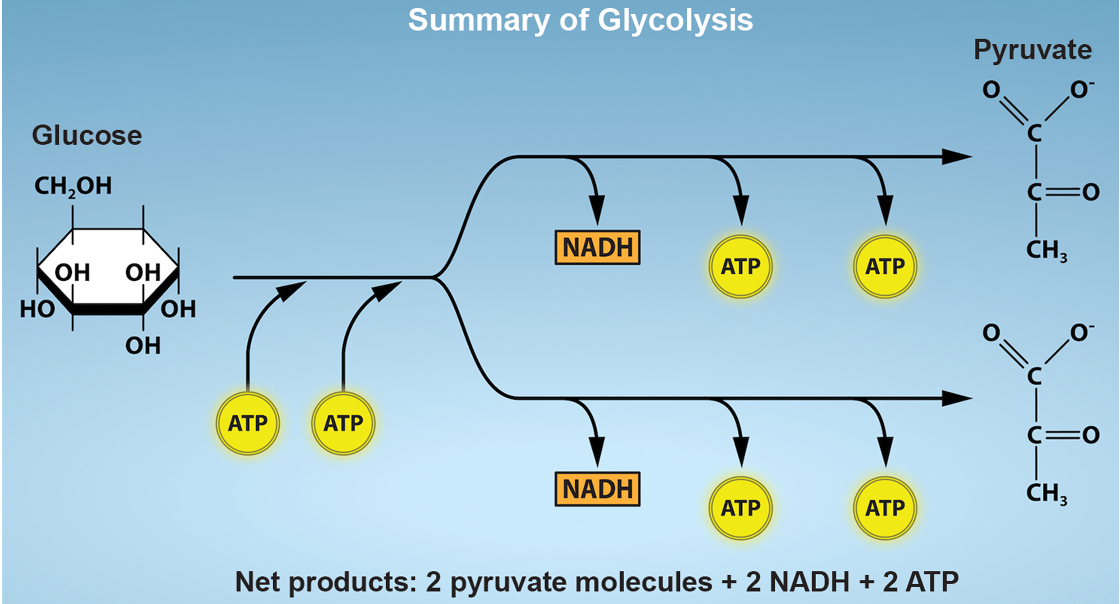
7.2 Figure 1
Rao, A. and Ryan, K. Department of Biology, Texas A&M University. "Glycolysis."
Notes:
Figure 1: Glycolysis begins with an energy investment phase which requires two ATP molecules to phosphorylate the starting glucose molecule. The 6-carbon intermediate is then split into two 3-carbon sugar molecules. In the energy recovery phase, each 3-carbon sugar is then oxidized to pyruvate with the energy transferred to form NADH and 2 ATP.

Slide 5
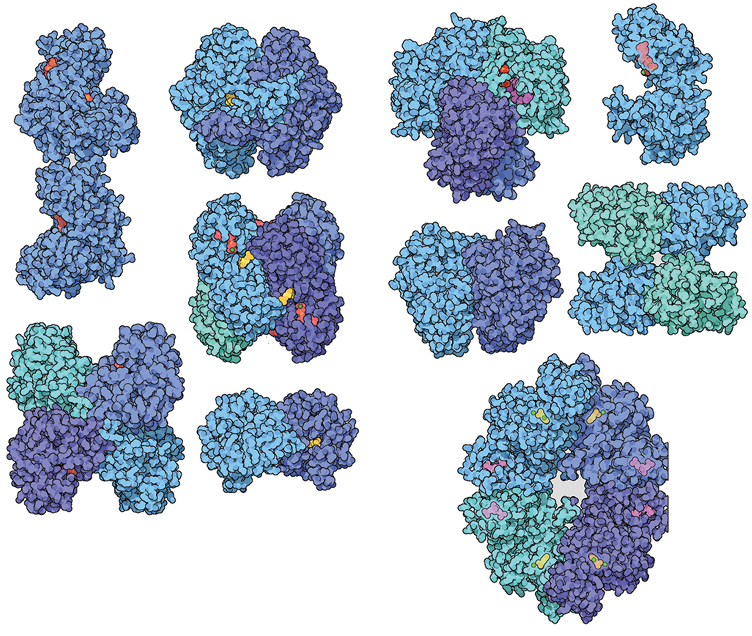
Glycolysis₂
Two distinct phases:
Traps glucose in the cell and uses energy to modify it so that the 6-carbon sugar molecule can split into two 3-carbon molecules
Extracts energy from molecules and stores it in ATP and NADH
Each step catalyzed by different enzyme
7.2 Figure 2: This is a model of unique enzymes that catalyze each step of the glycolysis pathway. Each enzyme binds to a different intermediate within the glycolytic pathway, each with its own unique shape.
David Goodsell on Wikimedia Commons. "Glycolytic enzymes."

Slide 6
First Half of Glycolysis (Energy-Requiring Steps)₁
Step 1
Catalyzed by hexokinase enzyme
Phosphorylates glucose to glucose-6-phosphate using ATP
Prevents phosphorylated glucose molecule from continuing to interact with GLUT proteins, trapping it in the cell
Negatively charged phosphate will not allow it to cross hydrophobic plasma membrane interior
Step 2
Catalyzed by an isomerase enzyme
Isomerase: enzyme that catalyzes the conversion of a molecule into one of its isomers
Converts glucose-6-phosphate to fructose-6-phosphate
Allows split into two 3-carbon molecules

Slide 7
Think It Through
Why does the cell phosphorylate the glucose molecule during the process of glycolysis?
Notes:
Originally an On Your Own. This is included here to use as a talking point or for a think-pair-share activity.

Slide 8
First Half of Glycolysis (Energy-Requiring Steps)₂
Step 3
Catalyzed by phosphofructokinase (rate-limiting enzyme)
Phosphorylates fructose-6-phosphate to fructose-1,6-bisphosphate using ATP
Inhibited by high ATP levels; stimulated by high ADP levels (end-product inhibition)
Step 4
High-energy phosphates destabilize fructose-1,6-bisphosphate
Catalyzed by aldolase enzyme that cleaves fructose-1,6-bisphosphate into two 3-carbon molecules: DHAP and G3P
Step 5
Catalyzed by isomerase that transforms DHAP to G3P
Investment of 2 ATP molecules to breakdown 1 glucose molecule

Slide 9
Second Half of Glycolysis (Energy-Releasing Steps)₁
So far, glycolysis costs 2 ATP and produces 2 G3P.
Now, energy will be extracted from 2 G3P molecules to produce 4 ATP and 2 NADH.
The initial investment of 2 ATP is "paid back."
The end result is a net energy profit of 2 ATP and 2 NADH molecules.

Slide 10
Second Half of Glycolysis (Energy-Releasing Steps)₂
Step 6
Oxidizes G3P by transferring electrons to NAD⁺ to form NADH
Phosphorylates the oxidized sugar to 1,3-bisphosphoglycerate
Depends on the availability of NAD⁺, so NADH must be continually oxidized back into NAD⁺
If NAD⁺ not available, process slows down or stops
Step 7
Catalyzed by phosphoglycerate kinase
1,3-biophosphoglycerate donates a high-energy phosphate to ADP to form 1 ATP (substrate-level phosphorylation)
Forms 3-phosphoglycerate

Slide 11
Second Half of Glycolysis (Energy-Releasing Steps)₃
Step 8
Remaining phosphate group moves from third carbon to second carbon, producing 2-phosphoglycerate
Catalyzed by phosphoglycerate mutase (type of isomerase that catalyzes the movement of a functional group from one position to another in same molecule)
Step 9
Catalyzed by enolase enzyme
Dehydration reaction produces phosphoenolpyruvate (PEP)
Step 10
Catalyzed by pyruvate kinase (rate-limiting enzyme)
Substrate-level phosphorylation produces a second ATP from PEP
PEP converted into pyruvic acid
Pyruvate: salt form of pyruvic acid

Slide 12
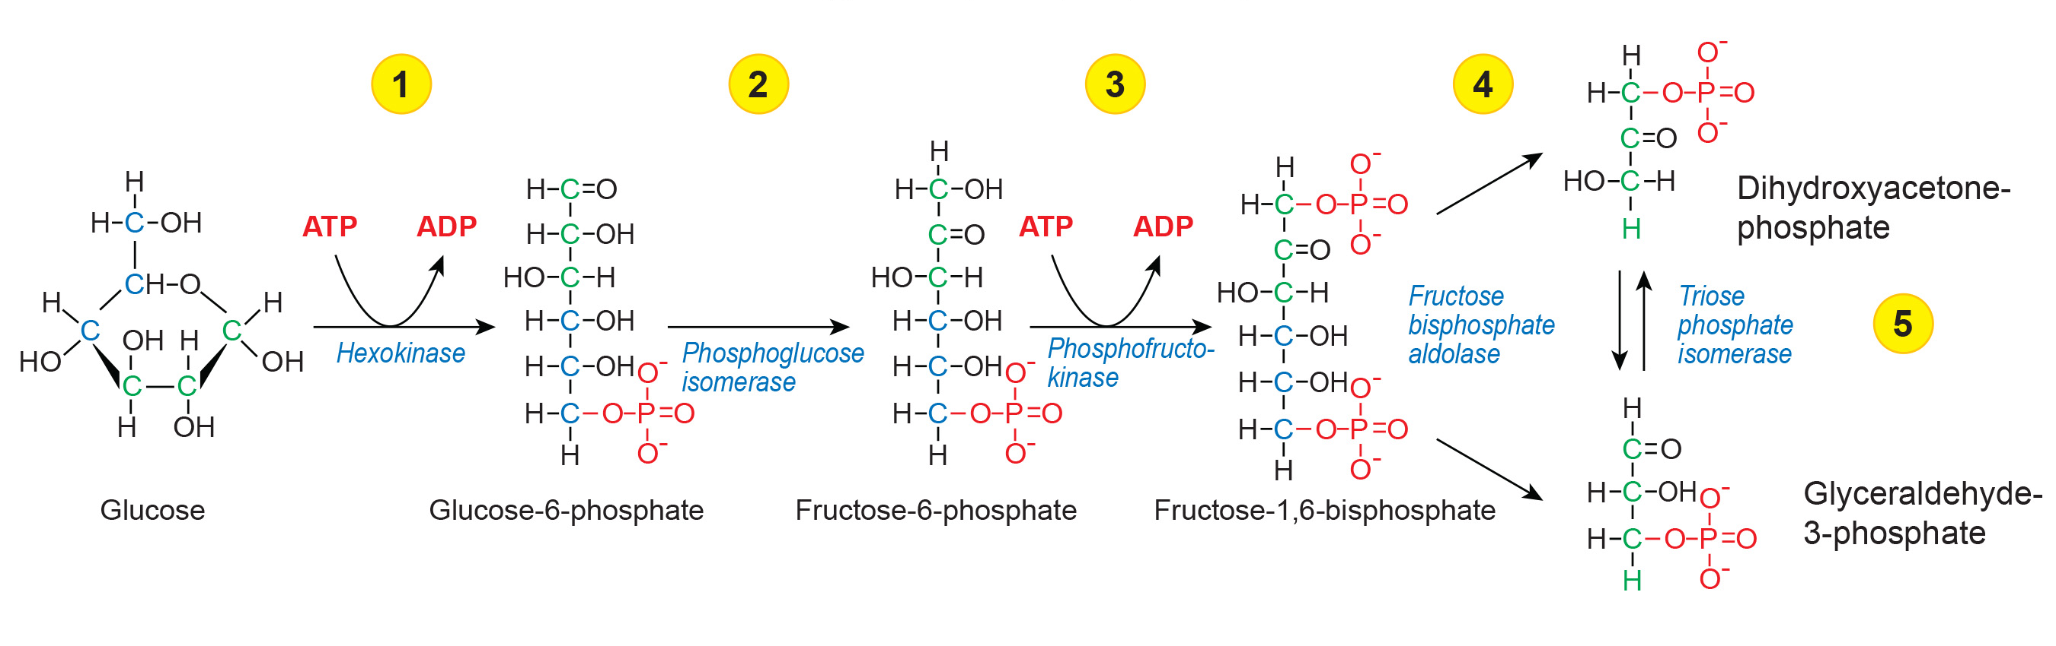
7.2 Figure 3
Eunice Laurent on Wikimedia Commons. "Glycolysis pathway." Modified.
Notes:
Figure 3: The first half of glycolysis uses two ATP molecules in the phosphorylation of glucose, which is then split into two 3-carbon molecules.

Slide 13
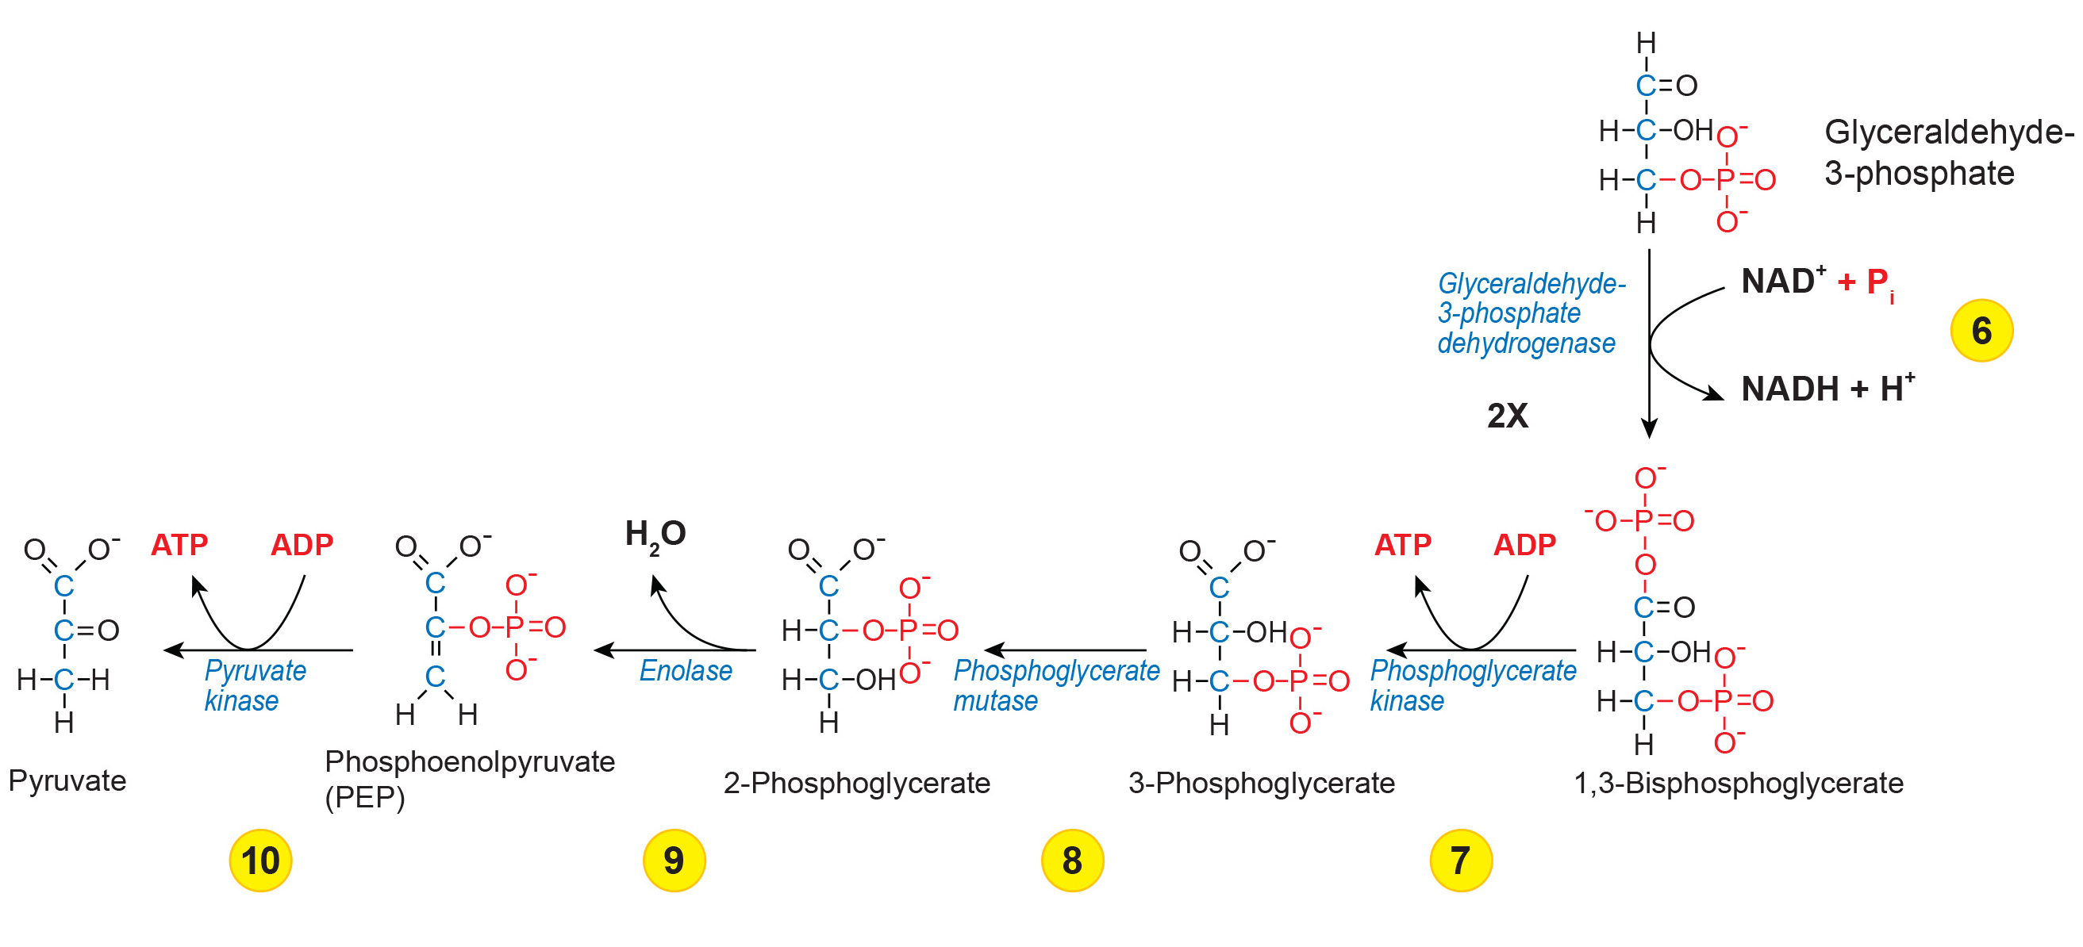
7.2 Figure 4
Eunice Laurent on Wikimedia Commons. "Glycolysis pathway." Modified.
Notes:
Figure 4: The second half of glycolysis involves phosphorylation without ATP investment (step 6) and produces two NADH and four ATP molecules per glucose.

Slide 14
Outcomes of Glycolysis
Produces 2 pyruvate, 4 ATP, and 2 NADH from 1 glucose
Net gain of 2 ATP and 2 NADH after investment phase (first half of glycolysis)
Example: Critical ATP source for anaerobic red blood cells that cannot perform aerobic respiration
Aerobic respiration: converting energy in the presence of oxygen
If no glycolysis, cells cannot maintain Na-K pumps and die
Last step will not occur if pyruvate kinase is insufficient
Entire pathway will proceed but only produce 2 ATP in second half
Making pyruvate kinase a rate-limiting enzyme

Slide 15
Summary
Glycolysis was the first pathway used to break down glucose and extract energy.
An ancient metabolic pathway found in nearly all organisms
Consists of two parts:
First part breaks down the 6-carbon glucose into 2 3-carbon sugars, investing 2 ATP
Second part extracts energy and produces 4 ATP and 2 NADH
The ATP is generated by substrate-level phosphorylation reactions.
Overall, there is a net gain of 2 ATP and 2 NADH molecules per glucose.

Slide 16


End of Hawkes Learning PowerPoint

