Slide 1
Lesson 7.3
Oxidation of Pyruvate and the Citric Acid Cycle

Slide 2
Objectives
Describe how pyruvate, the product of glycolysis, is prepared for entry into the citric acid cycle.
Explain how a circular pathway, such as the citric acid cycle, fundamentally differs from a linear biochemical pathway, such as glycolysis.
Discuss the relationship between the citric acid cycle intermediates and its products.
State the role of oxidizing and reducing agents in the citric acid cycle.

Slide 3
Oxidation of Pyruvate and the Citric Acid Cycle
Occurs in the mitochondria of eukaryotic cells under aerobic conditions
Pyruvate from glycolysis is converted into an acetyl group (small molecule made of 2 carbons, 3 hydrogens, and 1 oxygen)
Acetyl group then picked up and activated by coenzyme A (CoA)
  Result is acetyl CoA: combination of an acetyl group from pyruvic acid and coenzyme A

Slide 4
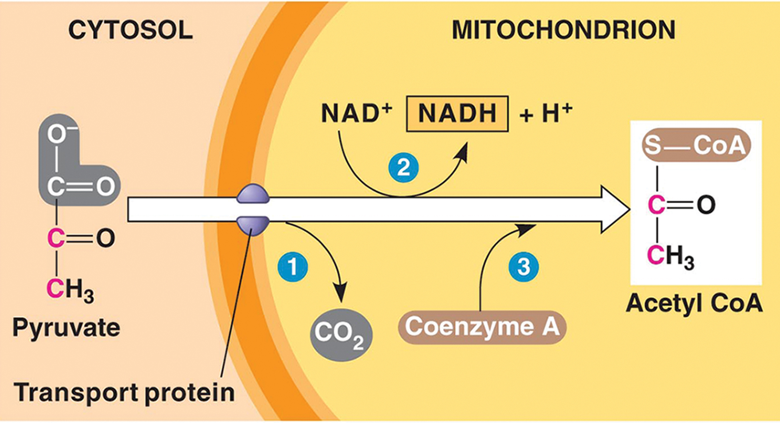
Breakdown of Pyruvate₁
Pyruvate (the product of glycolysis) must go through a three-step process to convert to acetyl CoA.
7.3 Figure 1: The conversion of pyruvate to acetyl CoA occurs while pyruvate is translocated across the mitochondrial membrane.
Campbell and Reece on Wikimedia Commons. "Conversion of pyruvate."

Slide 5
Breakdown of Pyruvate₂
Step 1
Carboxyl group (COOH) removed from pyruvate, releasing CO₂
  Creates 2-carbon hydroxyethyl group (C₂H₅O) bound to pyruvate dehydrogenase: a multi-subunit enzyme embedded in mitochondrial membrane that catalyzes the conversion of pyruvate to acetyl CoA
Step happens twice to remove 2 of the 6 carbons
Step 2
Hydroxyethyl group oxidized to an acetyl group
Electrons transferred to NAD⁺ to form NADH
  High-energy electrons from NADH used later to generate ATP
Step 3
Enzyme-bound acetyl group transferred to coenzyme A, forming acetyl CoA

Slide 6
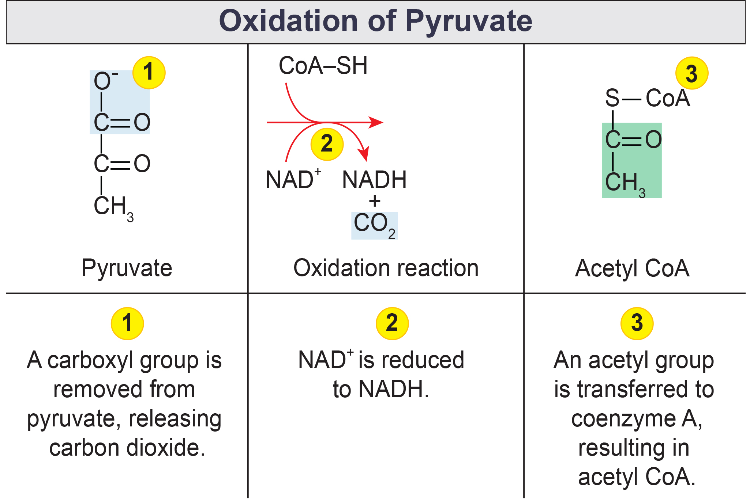
7.3 Figure 2
OpenStax. "Oxidation of pyruvate." Modified.
Notes:
Figure 2: Upon entering the mitochondrial matrix, a multienzyme complex converts pyruvate into acetyl CoA. In the process, carbon dioxide is released, and one molecule of NADH is formed.

Slide 7
Acetyl CoA to CO₂
Acetyl CoA delivers its acetyl group to the 4-carbon oxaloacetate to form citrate (6-carbon molecule with 3 carboxyl groups).
This initiates the citric acid cycle to extract the remaining energy and release CO₂.
  Citric acid cycle: series of enzyme-catalyzed chemical reactions of importance in all living cells for extraction of energy from carbohydrates (also, TCA cycle and Krebs cycle)

Slide 8
Citric Acid Cycle
Takes place in mitochondria
A closed loop with the last part regenerating compounds used in first step
8 steps total
  Includes:
    Redox
    Dehydration
    Hydration
    Decarboxylation
Produces 2 CO₂, 1 GTP/ATP, and reduced electron carriers NADH and FADH₂
Aerobic pathway that produces little ATP and does not consume oxygen directly

Slide 9
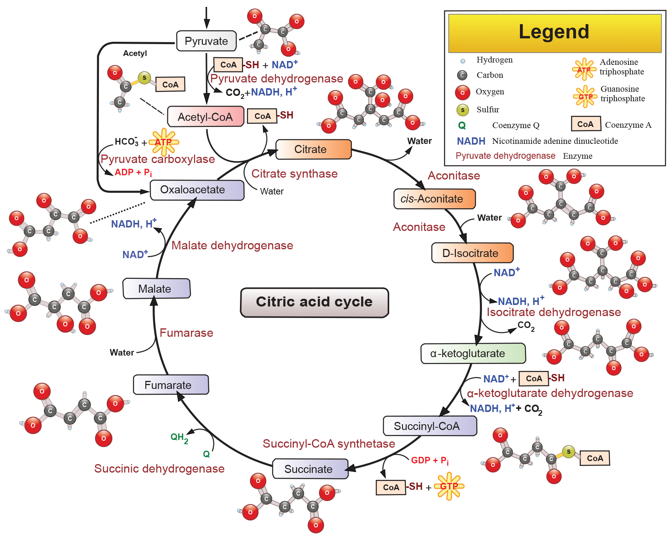
7.3 Figure 3
Narayanese on Wikimedia Commons. "Citric acid cycle."
Notes:
Figure 3: In the citric acid cycle, the acetyl group from acetyl CoA is attached to a 4-carbon oxaloacetate molecule to form a 6-carbon citrate molecule. Through a series of steps, citrate is oxidized, releasing two carbon dioxide molecules for each acetyl group fed into the cycle. In the process, three NAD+ molecules are reduced to NADH, one FAD molecule is reduced to FADH2, and one ATP or GTP (depending on the cell type) is produced (by substrate-level phosphorylation). Because the final product of the citric acid cycle is also the first reactant, the cycle runs continuously in the presence of sufficient reactants.

Slide 10
Steps in the Citric Acid Cycle₁
Step 1
Prior to this step: pyruvic acid converted to acetyl CoA
Condensation: combines 2-carbon acetyl group with 4-carbon oxaloacetate to form 6-carbon citrate
Irreversible, highly exergonic, rate controlled by ATP levels
  Negative feedback: ATP ↑ then rate of reaction ↓
Step 2
Citrate loses 1 H₂O (becoming cis-Aconitate) and gains another to become isomer (D-isocitrate)
Step 3
D-isocitrate oxidizes to produce 5-carbon α-ketoglutarate, releasing CO₂ and 2 electrons (reducing to NAD⁺ and NADH)
  Negative feedback: ATP and NADH ↑ then rate of reaction ↓
  Positive effect: ADP ↑ then rate of reaction ↑

Slide 11
Reflection Question
ATP is an excellent energy currency for the cell. Can you come up with reasons why GTP is also made and used by the cell?
Notes:
The reflection question is included here to use as a talking point or for a think-pair-share activity.

Slide 12
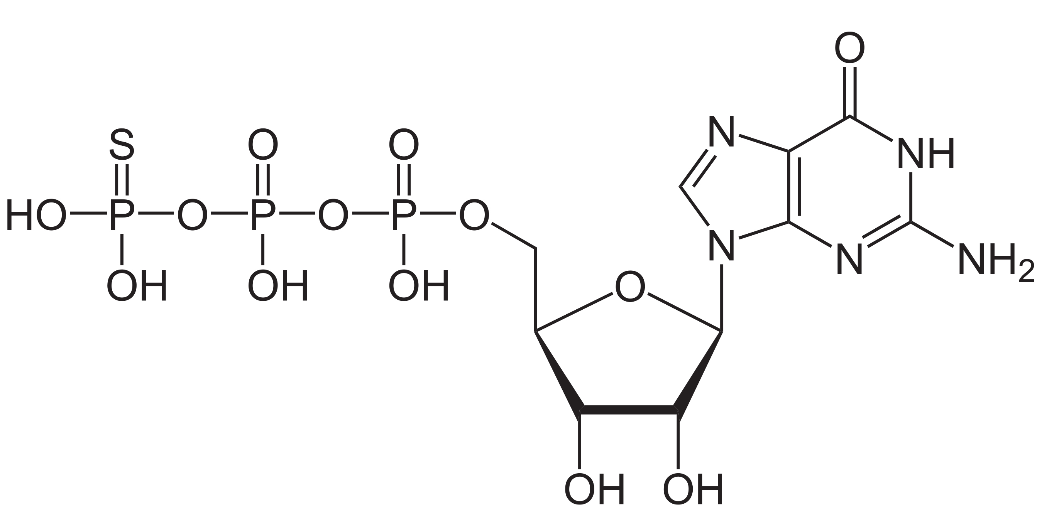
Steps in the Citric Acid Cycle₂
Step 4
Alpha-ketoglutarate is oxidized to succinyl CoA, releasing CO₂ and NADH
Negative feedback by ATP, succinyl CoA, and NADH
Step 5
Substrate-level phosphorylation: succinyl CoA is converted to succinate, producing GTP or ATP
Examples:
  Tissues (like heart and skeletal muscle) that use a large amount of ATP produce ATP.
  Protein synthesis and activation (high number of anabolic pathways) use GTP instead of ATP.
7.3 Figure 4: The structure of GTP is like ATP. GTP, generated during the citric acid cycle, is used to power metabolic processes, such as the activation of specialized cell proteins called G proteins.

Slide 13
Steps in the Citric Acid Cycle₃
Step 6
Dehydration converts succinate into fumarate, reducing FAD to FADH₂
Step 7
Hydrolysis converts fumarate to 4-carbon malate
NADH produced

Slide 14
Products of the Citric Acid Cycle
2 CO₂ molecules released per turn of the cycle
3 NADH and 1 FADH₂ molecules as electron carriers
  Connect with last portion of aerobic respiration (electron transport chain) to produce ATP
1 GTP or ATP molecule
Intermediates can be used in synthesizing amino acids
  Making cycle amphibolic: both catabolic and anabolic

Slide 15
Think It Through
How many ATP, FADH₂, and NADH molecules are generated during the citric acid cycle from a single acetyl CoA molecule?
Notes:
Originally an On Your Own. This is included here to use as a talking point or for a think-pair-share activity.

Slide 16
Summary
In the presence of oxygen, pyruvate from glycolysis is converted to acetyl CoA:
  The acetyl group attaches to coenzyme A, forming acetyl CoA
  CO₂ released, accounting for 2 of the 6 carbons from glucose
  High-energy electrons transferred to NAD⁺ to form NADH
The cycle is a series of redox and decarboxylation reactions that removes CO₂ and high-energy electrons.
Products of the citric acid cycle include:
  NADH and FADH₂ as electron carriers for ATP production
  1 molecule of GTP or ATP from substrate-level phosphorylation per cycle
  Complete oxidation of the original glucose molecule

Slide 17


End of Hawkes Learning PowerPoint

