Slide 1
Lesson 7.4
The Electron Transport Chain and Oxidative Phosphorylation

Slide 2
Objectives
Discuss chemiosmosis and ATP formation.
Discuss factors that affect ATP yield.
Describe how electrons move through the electron transport chain and explain what happens to their energy levels during this process.
Explain how a proton (H⁺) gradient is established and maintained by the electron transport chain.

Slide 3
The Electron Transport Chain and Oxidative Phosphorylation
ATP from glycolysis and citric acid cycle derived by moving electrons
Electrons move through electron carriers in redox reactions
H⁺ accumulate in mitochondria and pass through ATP synthase
ATP synthase: enzyme that uses the energy released by H⁺ moving down concentration gradient to produce ATP
ATP synthase phosphorylates ADP to produce ATP

Slide 4
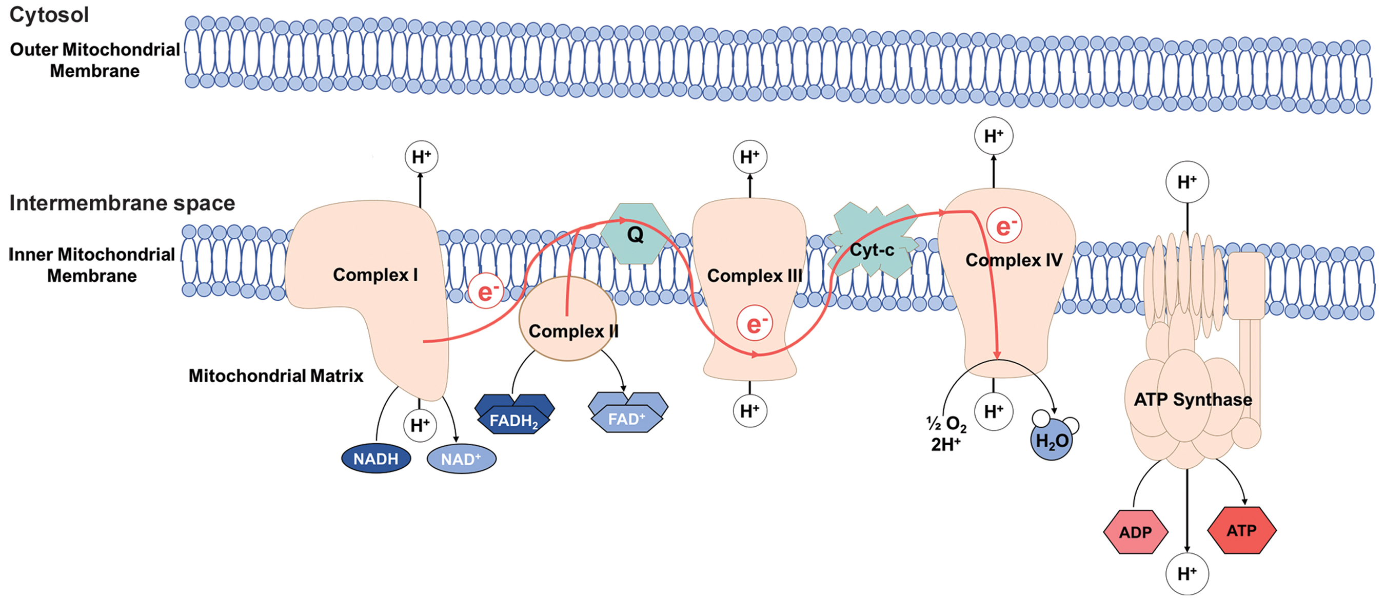
7.4 Figure 1
Dw001 on Wikimedia Commons. "Electron transport chain."
Notes:
Figure 1: The electron transport chain is a series of electron transporters embedded in the inner mitochondrial membrane that shuttles electrons from NADH and FADH2 to molecular oxygen. In the process, protons are pumped from the mitochondrial matrix to the intermembrane space, and oxygen is reduced to form water.

Slide 5
Electron Transport Chain (ETC)
Last component of aerobic respiration
Only part of glucose metabolism that requires atmospheric oxygen
Series of redox reactions that reduce oxygen to produce water
Made up of 4 protein complexes and mobile electron carriers
Present in the inner mitochondrial membrane of eukaryotes and the plasma membrane of prokaryotes
Electron transport chain: series of protein complexes and other molecules embedded in a membrane that couple the transfer of electrons via successive redox reactions with the transfer of protons across the membrane to generate an electrochemical gradient

Slide 6
Complex I
2 electrons carried to complex I via NADH
Composed of flavin mononucleotide (FMN) and iron-sulfur (Fe-S) proteins
FMN is one of several prosthetic groups/cofactors
Prosthetic group: a nonprotein molecule (like a lipid, sugar, or vitamin) that is bound to a protein and facilitates its biological function
Example: Prosthetic groups of enzymes include coenzymes (molecules necessary for enzymes to function).
Enzyme: NADH dehydrogenase and composed of 44 polypeptide chains
Can pump four hydrogen ions across the membrane

Slide 7
Q and Complex II
Complex II receives FADH₂, which bypasses complex I.
Ubiquinone B connects I and II to III.
Ubiquinone (Q): delivers electrons to next complex in ETC
Receives electrons from NADH (complex I) and FADH₂ (complex II)
Q and FADH₂ deliver electrons to ETC, skipping complex I
Fewer ATP molecules made from FADH₂ electrons because of this
Number of ATP obtained is proportional to number of protons pumped across inner mitochondrial membrane

Slide 8
Complex III
Composed of cytochrome bc1, containing cytochrome b, a Rieske center (2Fe-2S center), and cytochrome c proteins
Also called cytochrome oxidoreductase
Cytochrome c has prosthetic group of heme (which carries electrons)
Result is iron ion is reduced or oxidized as it passes electrons, fluctuating between reduced (Fe⁺⁺) and oxidized (Fe⁺⁺⁺)
Pumps protons and passes electrons to cytochrome c for transport to complex IV

Slide 9
Complex IV
Composed of cytochromes c, a, and a₃, with heme groups (one in a and one in a₃) and copper (Cu) ions
Cytochromes hold oxygen molecule between iron and copper ions until oxygen is reduced by gaining 2 electrons
Reduced oxygen picks up 2 hydrogen to make water (H₂O)
Removal of hydrogen ions contributes to ion gradient for the foundation of chemiosmosis

Slide 10
Group Activity
As a group, assign a complex within the electron transport chain to each person. Each person is tasked with learning the processes that occur within each complex and then explaining them to the rest of the group. Keep in mind the following:
What electron carrier is involved in this complex?
What enzymes are involved in this complex?
What proteins are involved in this complex?

Slide 11
Chemiosmosis
Chemiosmosis: where the free energy from redox reactions is used to pump hydrogen ions across mitochondrial membrane
Creates an electrochemical gradient, with a higher concentration of protons on one side of the membrane
ATP synthase allows protons to diffuse back through, using the energy to phosphorylate ADP to form ATP
Used to generate 90% of ATP made during aerobic glucose catabolism
Also used in light reactions of photosynthesis (called photophosporylation)

Slide 12
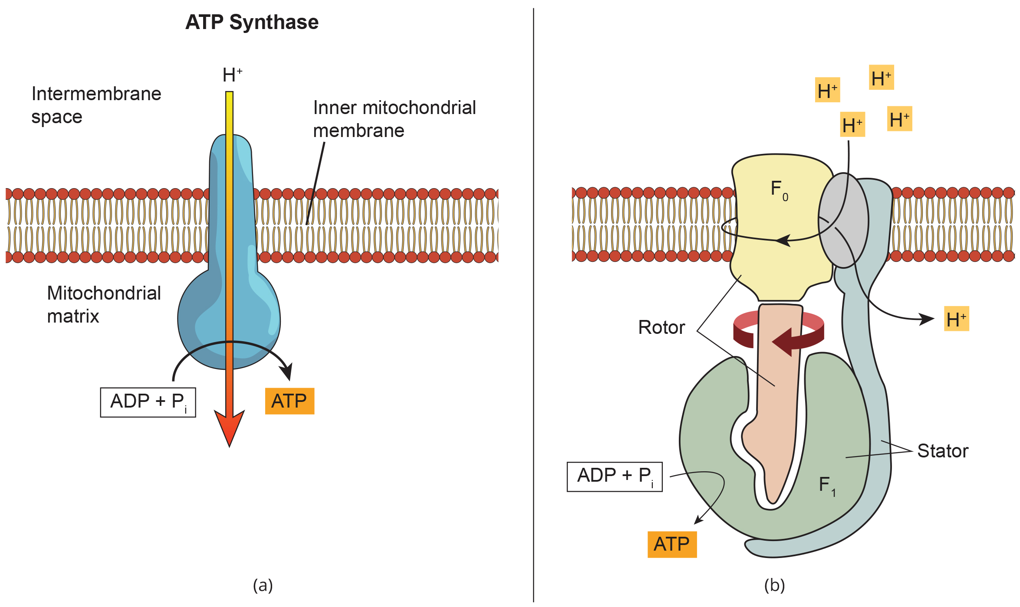
7.4 Figure 2
Klaus Hoffmeier on Wikimedia Commons. "ATP synthase."
Notes:
Figure 2: (a) ATP synthase is a complex, molecular machine that uses a proton (H+) gradient to form ATP from ADP and inorganic phosphate (Pi). (b) ATP synthase is made up of multiple subunits, with each serving a unique role. The F0 subunit is the component that allows the movement of protons across the inner mitochondrial membrane. The F1 subunit contains subunits that can convert ADP to ATP via conformation changes that are powered by rotation of the entire complex via the movement of protons through the F0 subunit.

Slide 13
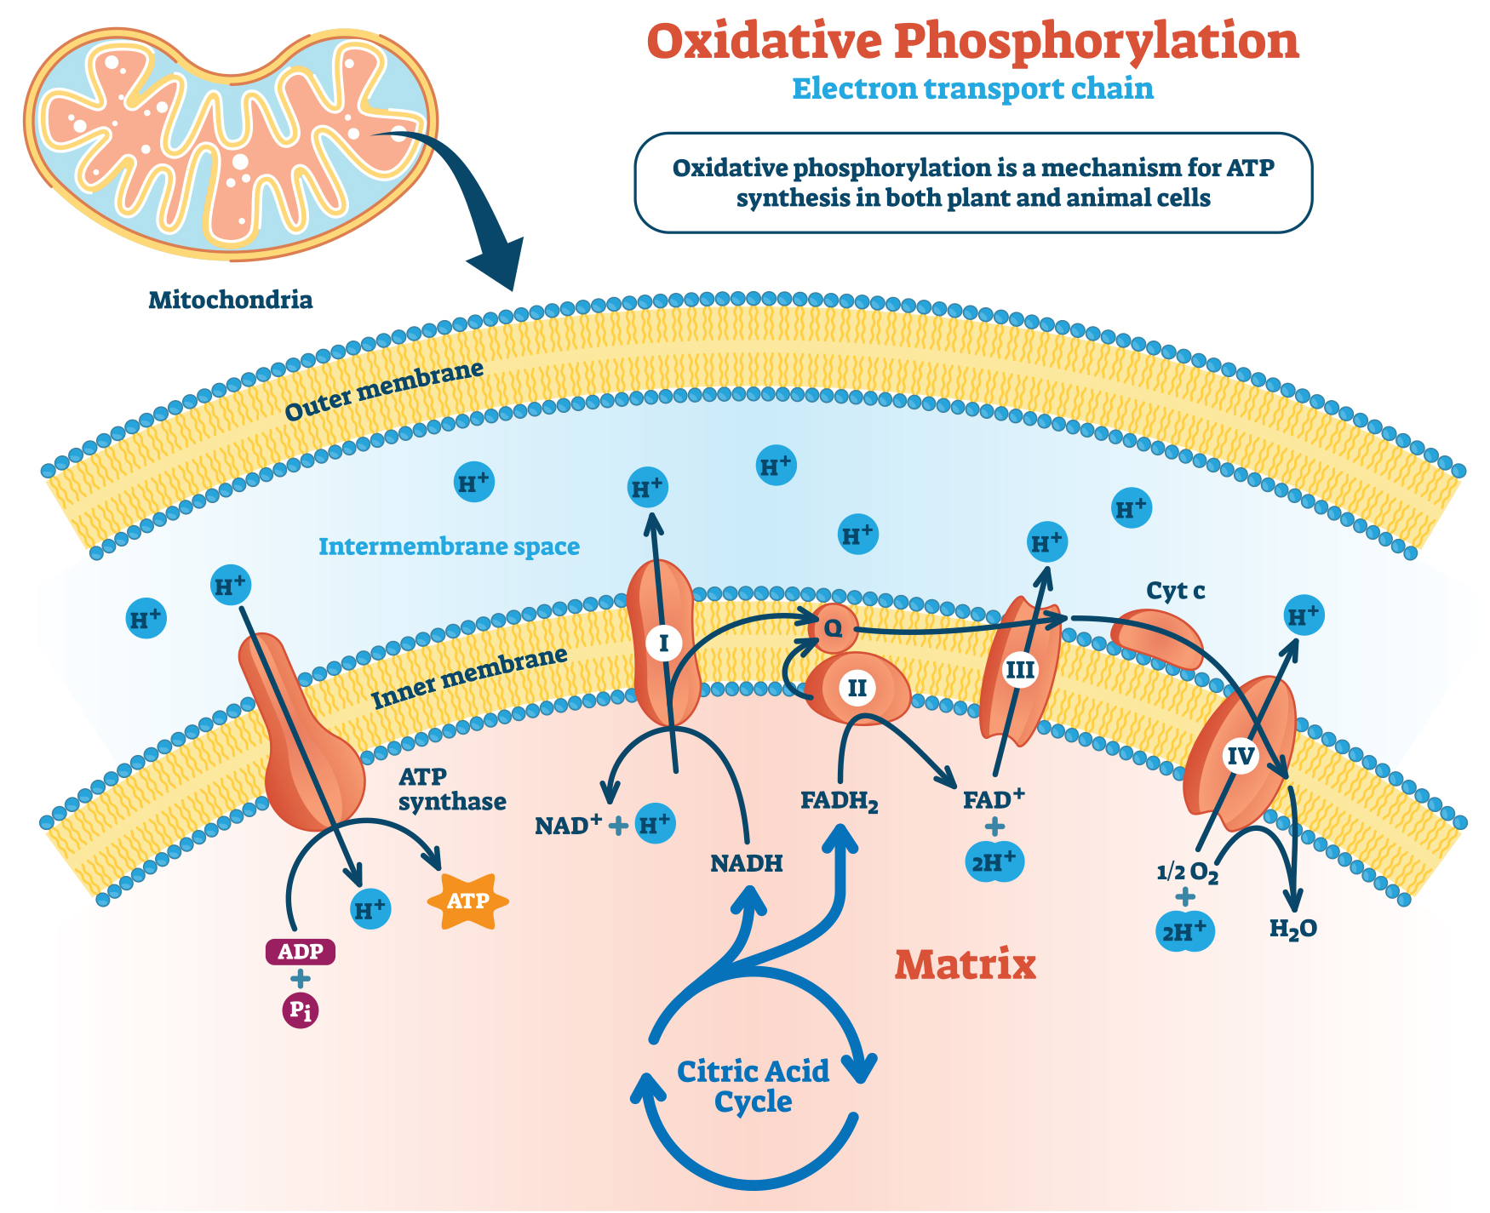
Think It Through
Cyanide inhibits cytochrome c oxidase, a component of the electron transport chain. If cyanide poisoning occurs, would you expect the pH of the intermembrane space to increase or decrease? What effect would cyanide have on ATP synthesis?
7.4 Figure 3: In oxidative phosphorylation, the pH gradient formed by the electron transport chain is used by ATP synthase to form ATP.
Notes:
Originally an On Your Own. This is included here to use as a talking point or for a think-pair-share activity.

Slide 14
ATP Yield
The number of ATP molecules generated varies based on factors like species, electron shuttles, and uncoupling proteins.
Intermediate compounds are also used for other purposes, reducing the overall ATP yield.
Example: Sugars other than glucose are fed into the glycolytic pathway. Pentose sugars, nonessential amino acids, and lipids are made from intermediates in glycolysis and/or the citric acid cycle.
In living systems, glycolysis and the citric acid cycle extract about 34% of the energy from glucose, with the remainder released as heat.

Slide 15
Summary
ETC is the portion of aerobic respiration that uses oxygen as the final electron acceptor.
ETC is composed of four large protein complexes embedded in the inner mitochondrial membrane and two small electron carrier molecules that shuttle electrons between them.
NADH and FADH₂ donate high-energy electrons that pass through a series of redox reactions, with some energy used to pump protons across the membrane to establish a gradient that contributes to chemiosmosis.
The electrons gradually lose energy as they are passed down the chain until they reduce oxygen to form water as the final electron acceptor.
The end products of ETC are water and ATP.

Slide 16


End of Hawkes Learning PowerPoint

