Slide 1
Lesson 7.5
Fermentation

Slide 2
Objectives
Describe the type of fermentation that readily occurs in animal cells and the conditions that initiate that fermentation.
Discuss the fundamental difference between anaerobic cellular respiration and fermentation.

Slide 3
Fermentation
Fermentation: processes that use an organic molecule to regenerate NAD⁺ from NADH
Only ATP-generating process is glycolysis
Anaerobic process: occurs in the absence of oxygen

Slide 4
Think It Through₁
What is the overall goal of fermentation?
Notes:
Originally an On Your Own. This is included here to use as a talking point or for a think-pair-share activity.

Slide 5
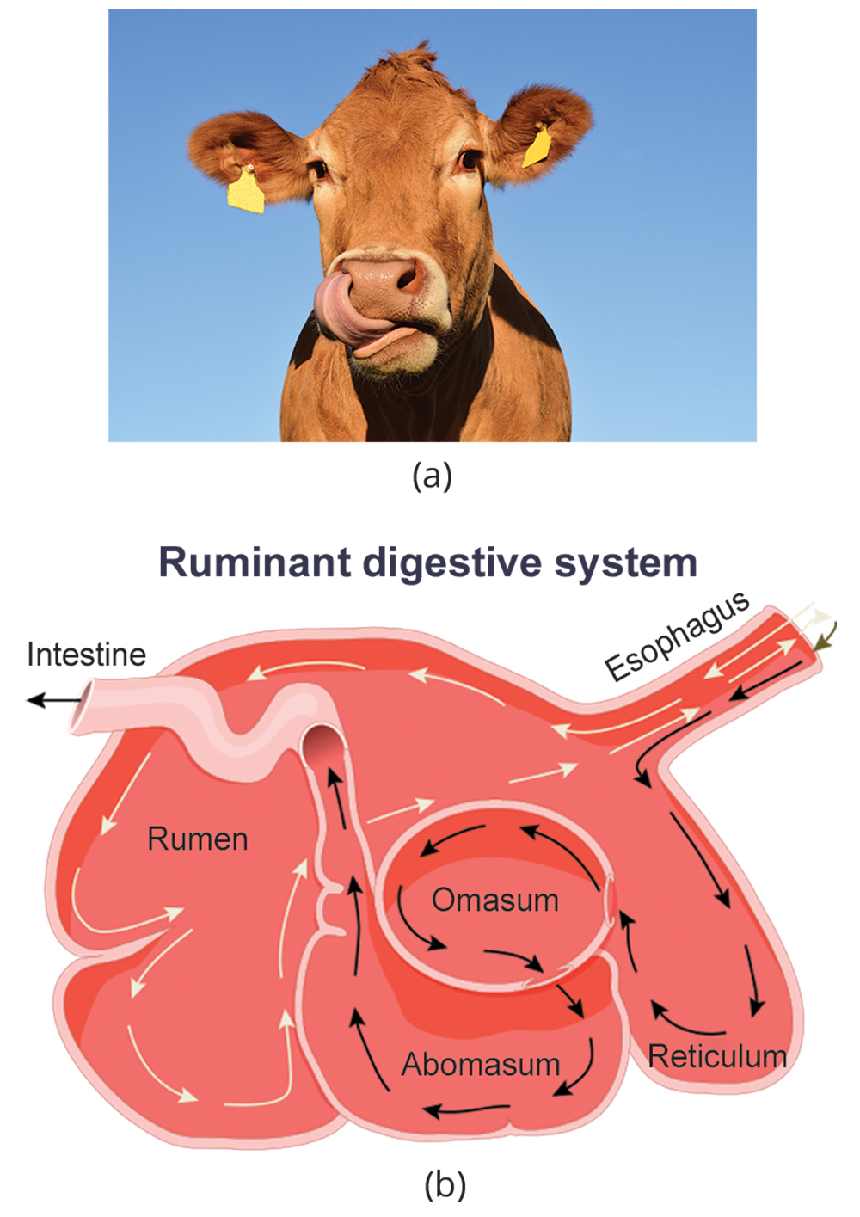
Anaerobic Cellular Respiration
Anaerobic cellular respiration: a molecule other than oxygen serves as the final electron acceptor in an ETC that produces ATP
Occurs in certain prokaryotes (Bacteria and Archaea)
Example: A group of archaeans called methanogens reduces carbon dioxide (CO₂) to methane (CH₄) to produce ATP. They are found in soil and digestive tracts of ruminants.
7.5 Figure 1: (a) Cows are examples of ruminant animals. (b) Their ruminant stomachs contain bacteria that help break down cellulose present in grass.
Ulrike Leone on Pixabay. "Cow."

Slide 6
Reflection Question
Why do you think different approaches to respiration (aerobic and different types of anaerobic) evolved across the natural world?
Notes:
The reflection question is included here to use as a talking point or for a think-pair-share activity.

Slide 7
Lactic Acid Fermentation₁
Used by animals and certain bacteria (e.g., in yogurt and cheese)
Pyruvic acid (product of glycolysis) accepts electrons from NADH to form lactic acid and regenerate NAD⁺
Example: It occurs in mammalian red blood cells (which do not have mitochondria) and in skeletal muscles that have an insufficient oxygen supply.
Lactic acid produced from this process must be removed by the blood and transported to the liver for further metabolism.
pyruvic acid + NADH ↔ lactic acid + NAD⁺

Slide 8
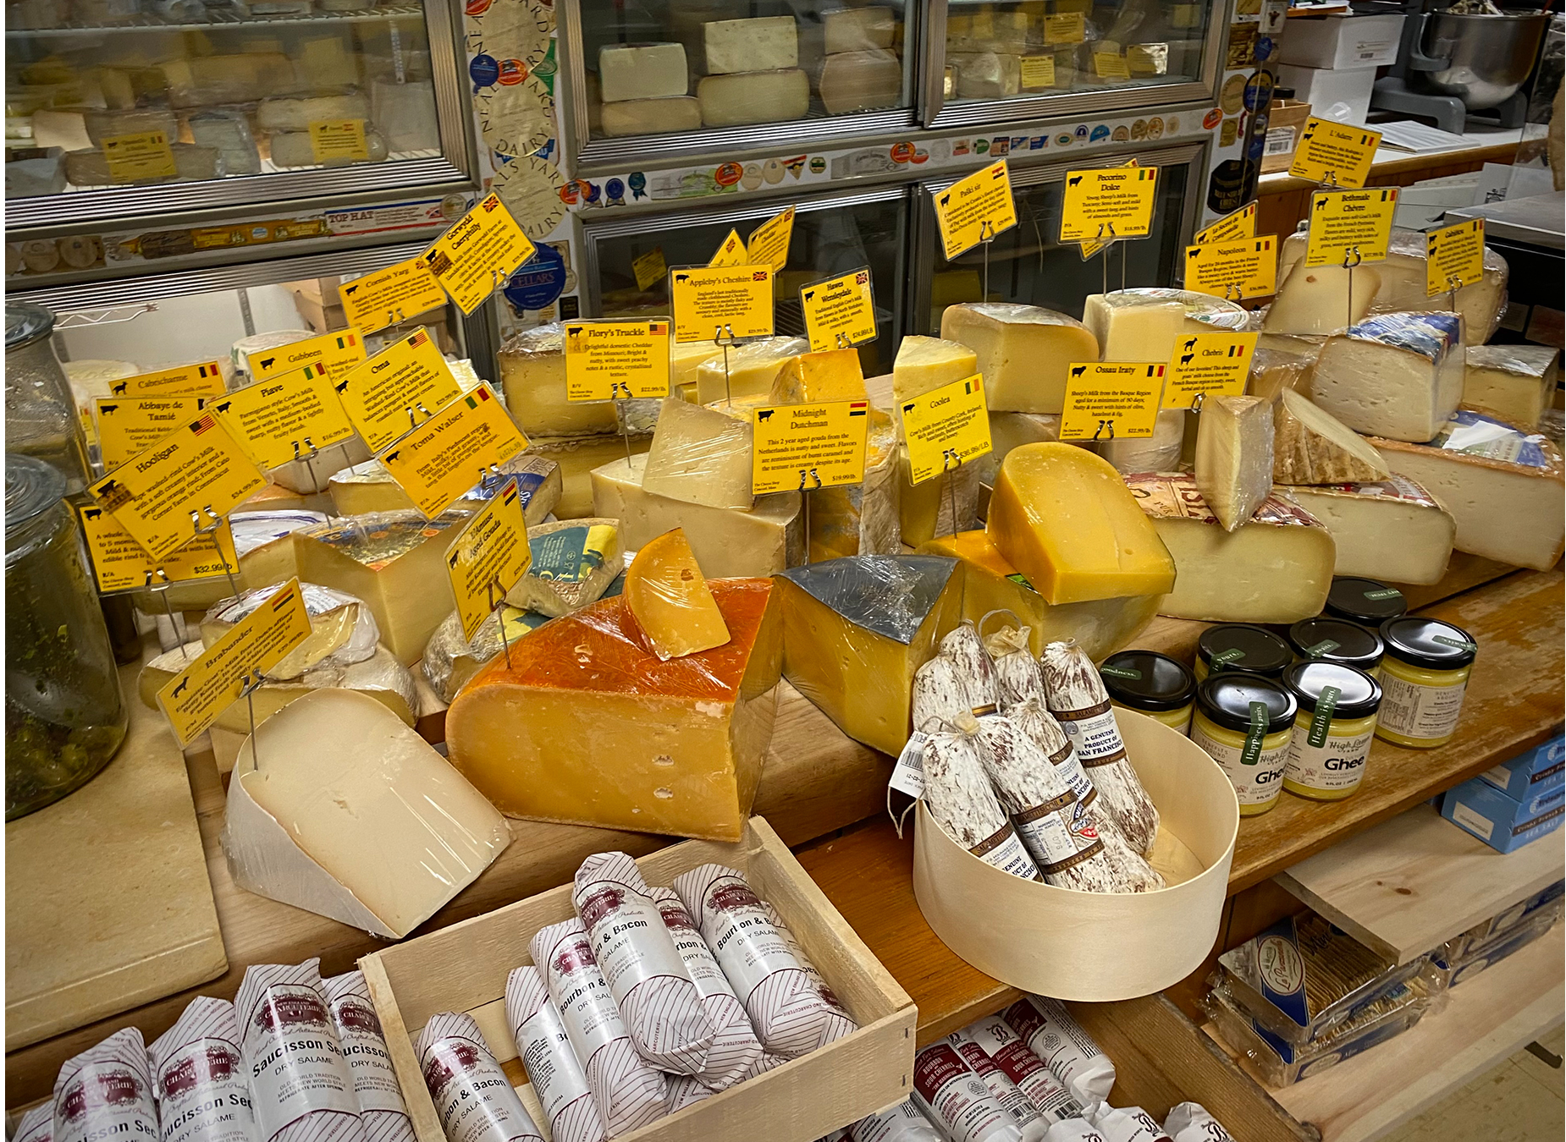
Lactic Acid Fermentation₂
Catalyzed by the enzyme lactate dehydrogenase (LDH)
Can catalyze in both directions
When oxygen is low, LDH converts pyruvic acid to lactic acid, producing NAD⁺.
When there is a high lactic acid concentration (like lactic acid in muscles), the lactic acid inhibits the reaction. LDH experiences feedback inhibition.
Once lactic acid is removed from the muscle and makes it way to the liver, LDH converts lactic acid to pyruvic acid, which can then be catabolized for energy.
7.5 Figure 2: Cheese is another useful byproduct of fermentation.
Sharon Hahn Darlin on Wikimedia Commons. "Cheese."

Slide 9
Think It Through₂
If you were to apply a drug that inhibited the function of lactate dehydrogenase, which critical cellular respiration process would be impaired?
Notes:
Originally an On Your Own. This is included here to use as a talking point or for a think-pair-share activity.

Slide 10
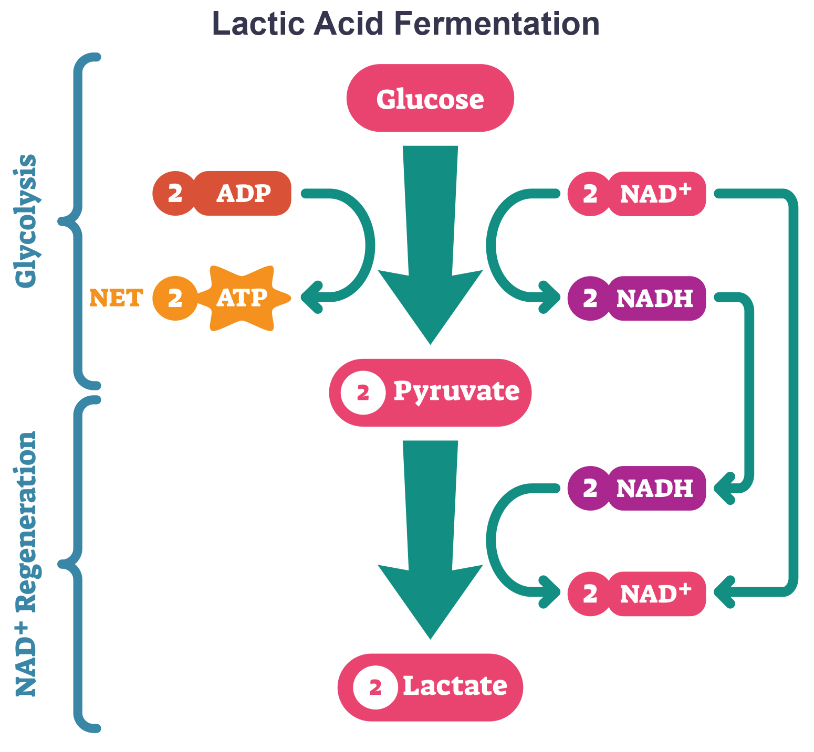
Think It Through₃
Tremetol, a metabolic poison found in the white snakeroot plant, prevents the metabolism of lactate. When cows eat this plant, tremetol is concentrated in the milk they produce. Humans who consume the milk can become seriously ill. Symptoms of this disease, which include vomiting, abdominal pain, and tremors, become worse after exercise.
Why do you think this is the case?
7.5 Figure 3
Notes:
Originally an On Your Own. This is included here to use as a talking point or for a think-pair-share activity.

Slide 11
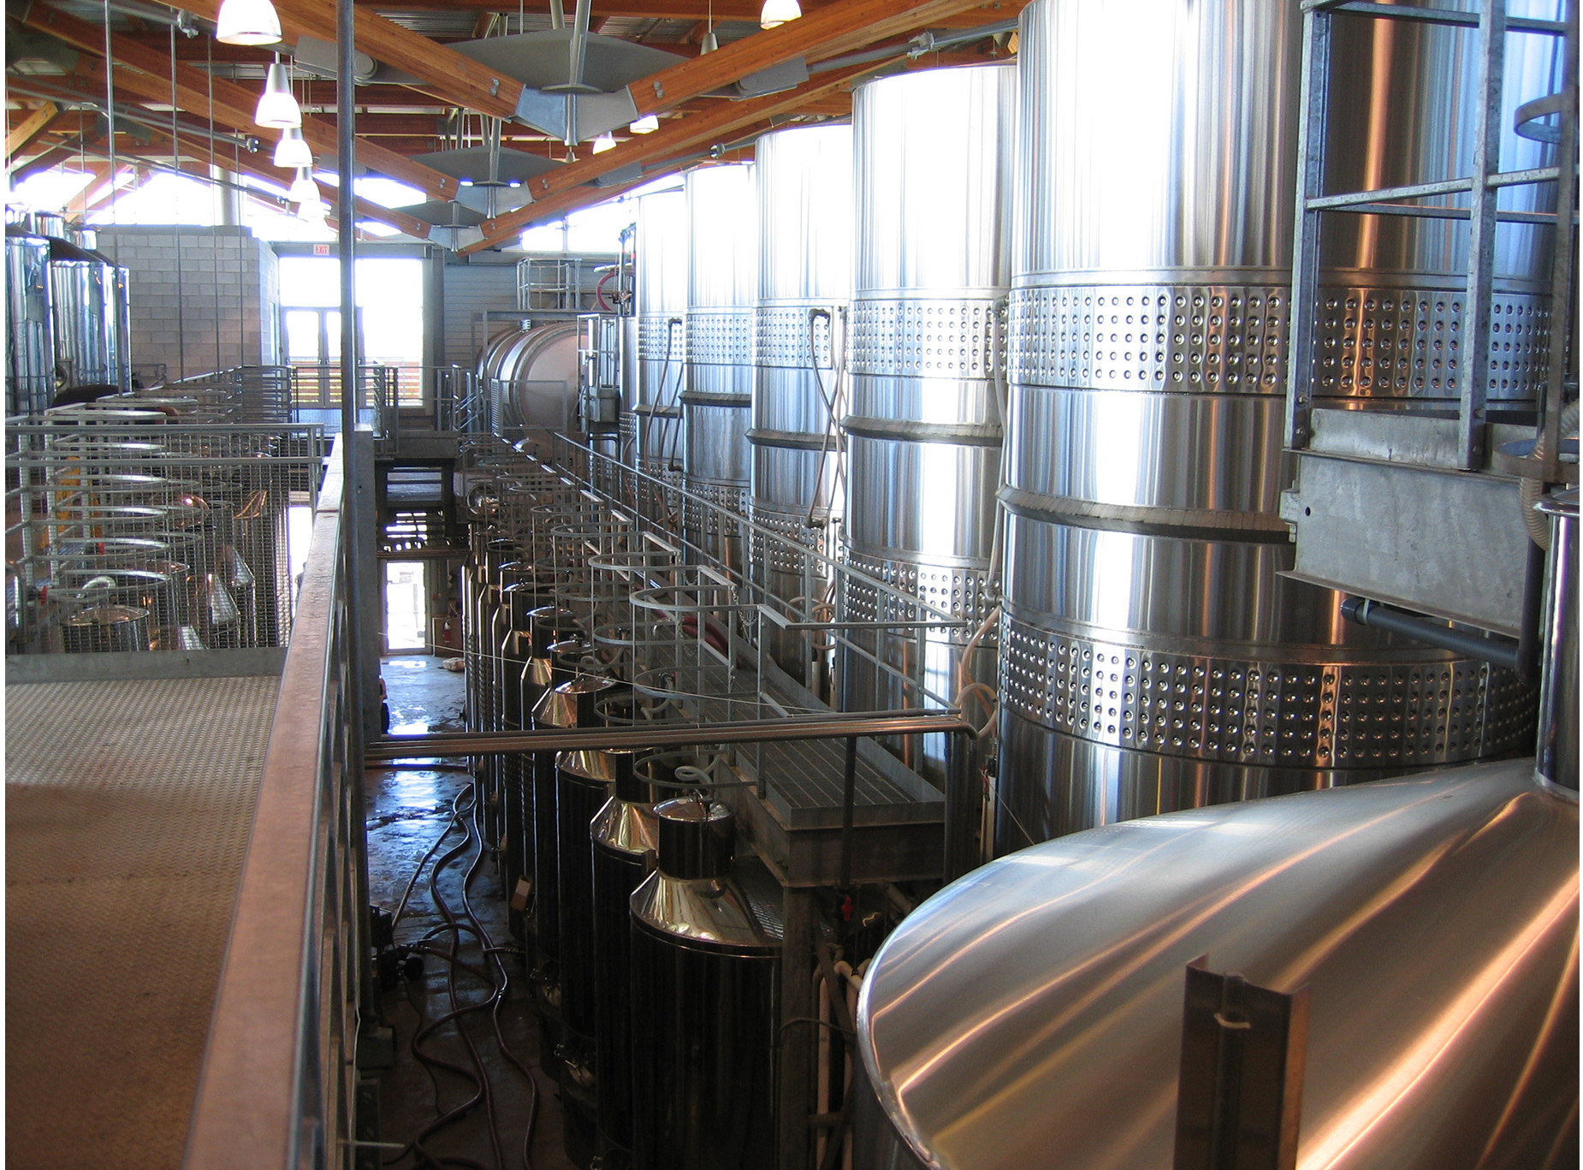
Alcohol Fermentation
Produces ethanol (used in commercial applications like fuel and alcohol)
Pyruvate converts to ethanol and carbon dioxide (CO₂)
NADH oxidizes to NAD⁺
pyruvic acid + H⁺ →
CO₂ + acetaldehyde + NADH + H⁺ →
ethanol + NAD⁺
Catalyzed by 1) pyruvate decarboxylase with a coenzyme of thiamine pyrophosphate (TPP) and 2) alcohol dehydrogenase enzymes
7.5 Figure 4: Fermentation of grape juice into wine produces CO₂ as a byproduct. Fermentation tanks have valves so that the pressure inside the tanks created by the carbon dioxide produced can be released.
Tomas Eriksson on Wikimedia Common. "Fermentation tanks."

Slide 12
Other Types of Fermentation
Occur in bacteria
Facultative anaerobes: prokaryotes that can switch between aerobic respiration and fermentation
Obligate anaerobes: anaerobes that live and grow in the absence of molecular oxygen (e.g., Clostridia)
All types, except lactic acid fermentation, produce gases as byproducts
Gas production used as an indicator for identifying specific bacteria
Provides a mechanism for regenerating NAD⁺ for glycolysis to continue

Slide 13
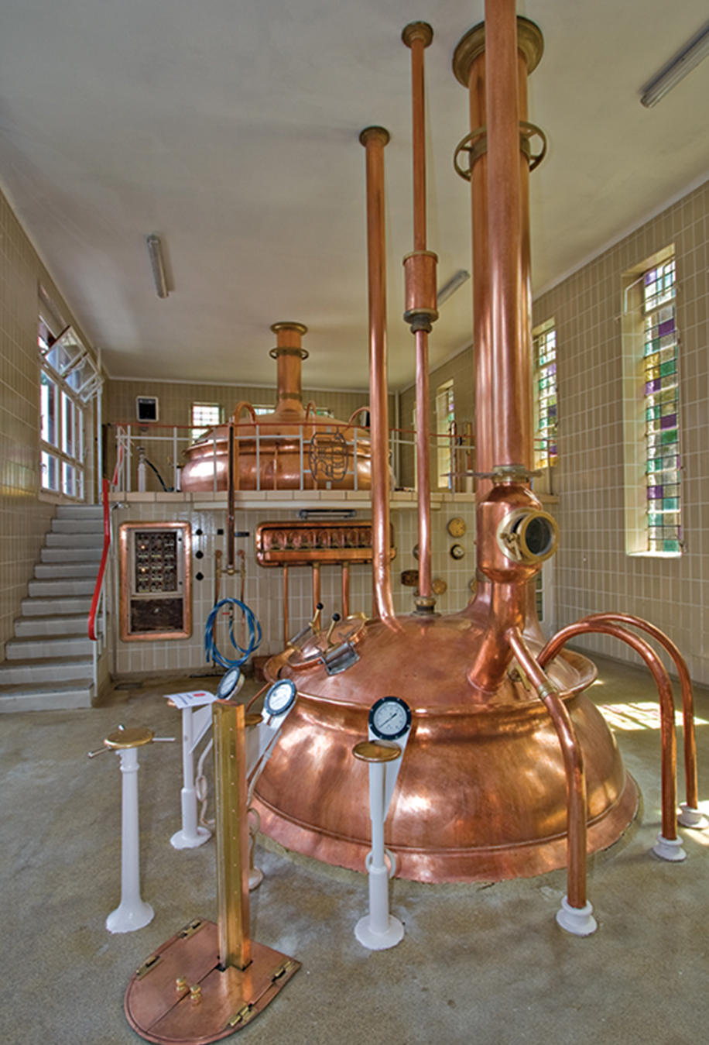
Science and You
If you have ever visited a brewery, you may have noticed that all the "brewing" is occurring in air-tight containers, such as in Figure 5. These containers are air-tight to prevent the entry of oxygen. In the absence of oxygen, the bacteria revert to anaerobic respiration and fermentation and, thereby, generate the ethanol needed for brewing beer.
7.5 Figure 5
Luca Galuzzi on Wikimedia Commons. "Brewery."
Notes:
This is included as a relevant application for this topic.

Slide 14
Summary
Organisms employ different strategies (anaerobic respiration or fermentation) to produce ATP in the absence of oxygen, based on their metabolic capabilities.
Anaerobic cellular respiration involves using compounds/molecules other than oxygen as the terminal electron acceptor in the ETC to generate ATP.
Fermentation is a set of metabolic reactions that regenerates NAD⁺ from NADH, allowing glycolysis to continue.
It does not directly generate ATP, as the regeneration of NAD⁺ is not accompanied by ATP production.
The potential of NADH to produce ATP through an ETC is not utilized.

Slide 15


End of Hawkes Learning PowerPoint

