Slide 1
Lesson 7.6
Carbohydrate, Protein, and Lipid Metabolic Pathways

Slide 2
Objectives
Discuss the ways in which carbohydrate metabolic pathways, glycolysis, and the citric acid cycle interrelate with protein and lipid metabolic pathways.
Explain why metabolic pathways are not considered closed systems.

Slide 3
Carbohydrate, Protein, and Lipid Metabolic Pathways
All catabolic pathways for carbohydrates, proteins, and lipids eventually connect into glycolysis and the citric acid cycle pathways.
Metabolic pathways are interconnected, with substances entering and intermediates leaving for other pathways.
These pathways are not closed systems.

Slide 4
Connections of Other Sugars to Glucose Metabolism₁
Glycogen: branched glucose storage polymer
  Used for energy storage in animals
  Excess stored as glycogen in liver and muscle cells
  Hydrolyzed into glucose-1-phosphate (G-1-P) and converted to glucose-6-phosphate (G-6-P) to enter glycolytic pathway

Slide 5
Think It Through₁
Which branched polysaccharide serves as a body reservoir of glucose, and where in the body is it found?
Notes:
Originally an On Your Own. This is included here to use as a talking point or for a think-pair-share activity.

Slide 6
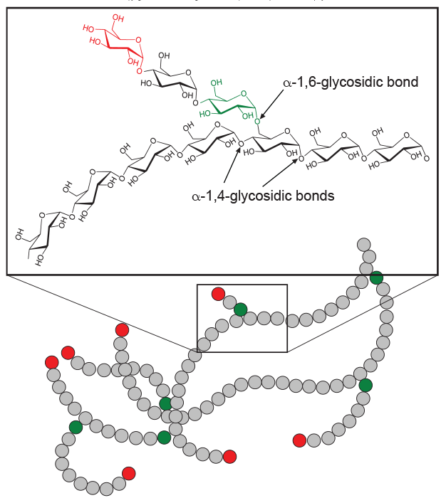
7.6 Figure 1
GKFX on Wikimedia Commons. "Glycogen."

Slide 7
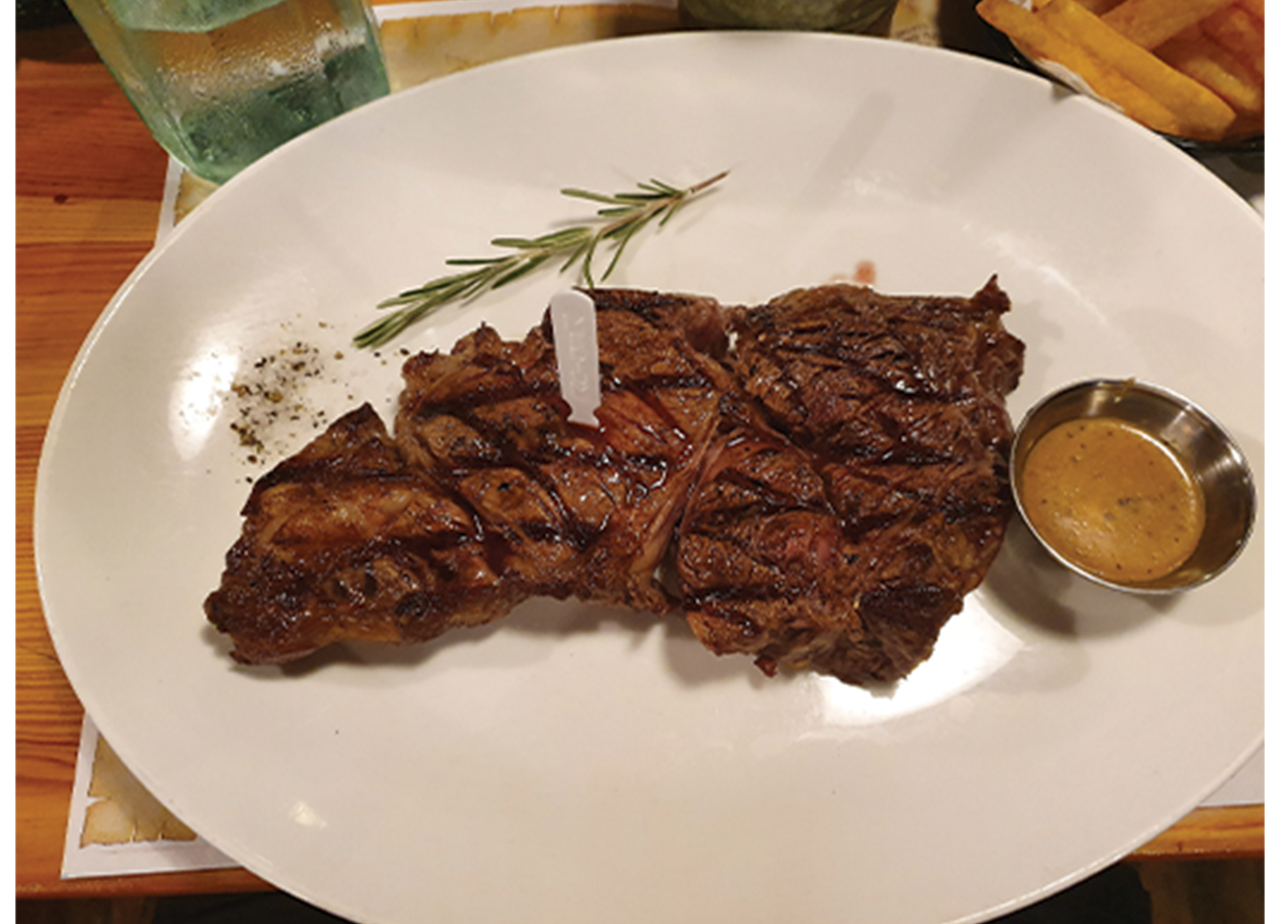
Connections of Other Sugars to Glucose Metabolism₂
Sucrose is a disaccharide of glucose and fructose.
  Fructose, glucose, and galactose is directly absorbed into the bloodstream.
  The catabolism of fructose and galactose produces the same number of ATP as glucose.
7.6 Figure 2: The protein and fat contained in steak can be digested by enzymes and subsequently converted into forms that can be inserted into various steps of cellular metabolism.
Yotam Nachum on Wikimedia Commons. "Steak."

Slide 8
Connections of Proteins to Glucose Metabolism
Proteins digested and hydrolyzed to be recycled into new proteins
Excess amino acids from protein digestion can enter glucose catabolism pathways
Amino acid must have amino group removed before entry
  Amino group converts into ammonia (NH₃)
  Ammonia excreted as urea
Amino acids can be synthesized from intermediates and reactants in cellular respiration cycle

Slide 9
Reflection Question
Why do you think groups of amino acids enter or exit the respiration pathway at certain steps and not at other steps?
Notes:
The reflection question is included here to use as a talking point or for a think-pair-share activity.

Slide 10
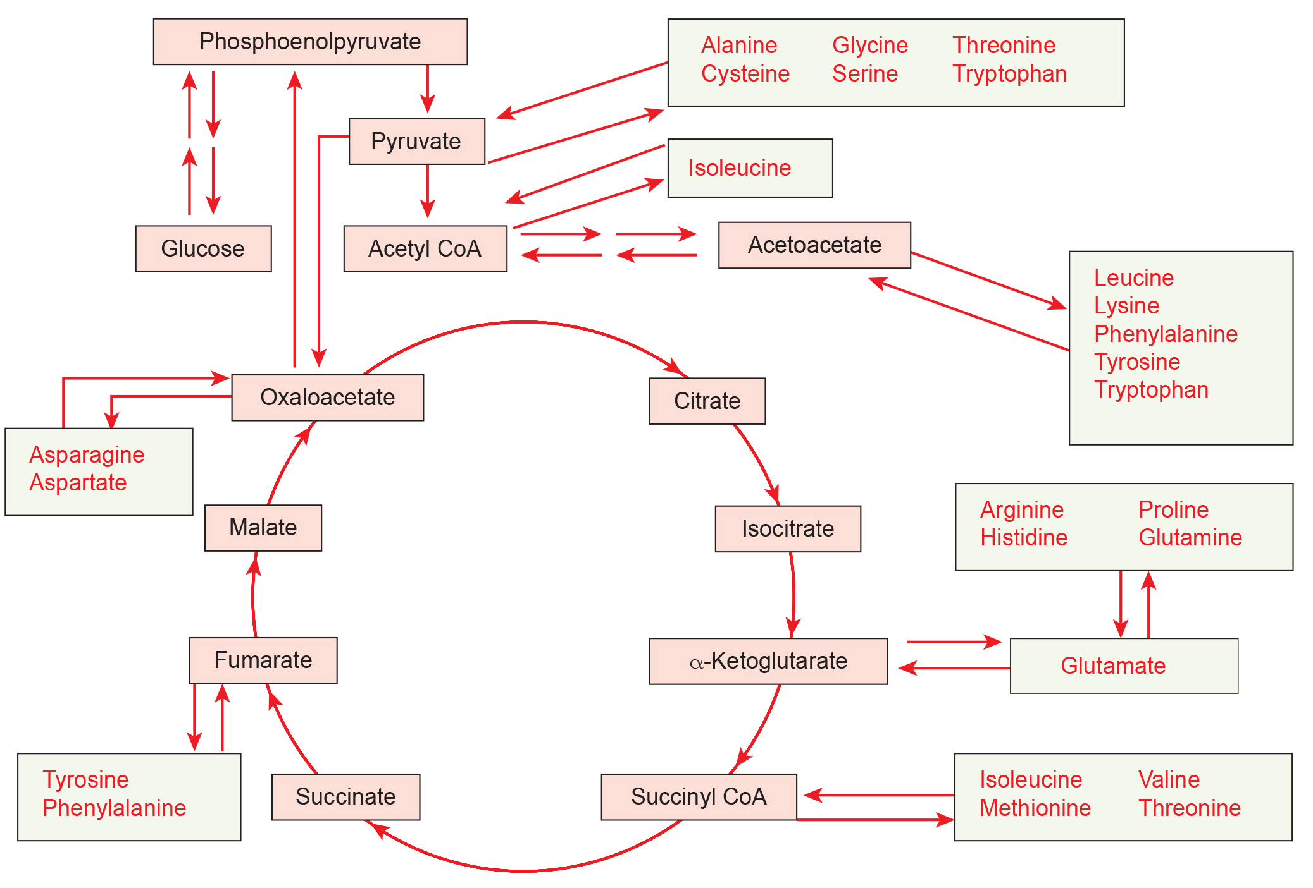
7.6 Figure 3
Mikael Häggström on Wikimedia Commons. "Amino acids in citric acid cycle." Modified.

Slide 11
Connections of Lipids and Glucose Metabolism
Includes cholesterol and triglycerides
  Cholesterol contributes to cell membrane flexibility and precursor to steroid hormones
    Starts with acetyl groups and only goes in one direction
  Triglycerides (glycerol and 3 fatty acids) are a long-term energy storage form
    Made and broken down through glucose metabolism
    Glycerol can be phosphorylated to enter glycolysis
    Fatty acids undergo β-oxidation to acetyl-CoA, which enters the citric acid cycle

Slide 12
Think It Through₂
Eating food high in cholesterol puts you at a high risk for heart disease due to the clogging of arteries. Yet, eliminating cholesterol entirely from your diet is also not advisable. Explain why.
Notes:
Originally an On Your Own. This is included here to use as a talking point or for a think-pair-share activity.

Slide 13
Evolution Connection₁
Pathways of Photosynthesis and Cellular Metabolism
Early cells (with depleted nutrients) likely arose in aqueous, nutrient-rich environment
  Natural selection favored organisms that could extract energy from surrounding nutrients
Early anoxygenic (non-oxygen producing) form of photosynthesis developed
  Used water as a hydrogen source but did not produce free oxygen

Slide 14
Evolution Connection₂
Glycolysis likely predated oxygenic photosynthesis
  Allowed use of simple sugars accumulating in the environment
  Later form of oxygenic photosynthesis using water evolved
    Generated free oxygen and led to an oxygenated atmosphere over time
    Oxygenated atmosphere allowed aerobic respiration through the citric acid cycle and oxidative phosphorylation

Slide 15
Summary
Breakdown and synthesis of carbohydrates, proteins, and lipids connect with glucose catabolism
Simple sugars catabolized during glycolysis:
  Galactose
  Fructose
  Glycogen
  Pentose
Amino acids from proteins connect with glucose catabolism through:
  Pyruvate
  Acetyl CoA
  Components of citric acid cycle
Cholesterol synthesis starts with acetyl groups
Triglycerides formed from glycerol-3-phosphate from glycolysis and acetyl groups produced in mitochondria from pyruvate

Slide 16


End of Hawkes Learning PowerPoint

