Slide 1
Lesson 7.7
Regulation of Cellular Respiration

Slide 2
Objectives
Describe how feedback inhibition would affect the production of an intermediate or product in a pathway.
Identify the mechanism that controls the rate of the transport of electrons through the electron transport chain.

Slide 3
Regulation of Cellular Respiration
Needed to provide balanced amounts of energy in the form of ATP
Cell must generate intermediates for anabolism and catabolism of macromolecules
Without controls, metabolic reactions reach equilibrium, resources used inappropriately
Cell needs to control its metabolism

Slide 4
Regulatory Mechanisms
Cell's glucose access can be regulated used GLUT protein
GLUT protein: integral proteins that facilitate the uptake of glucose from the outside to the inside of the cell
Reversible reactions controlled by different enzymes for each direction
Enzymes are controlled by allosteric effectors like ATP, ADP, AMP, NAD⁺, and NADH
Allosteric effectors bind to enzymes and alter their structure, affecting substrate affinity
Feedback control is effective as long as the effector is bound to the enzyme

Slide 5
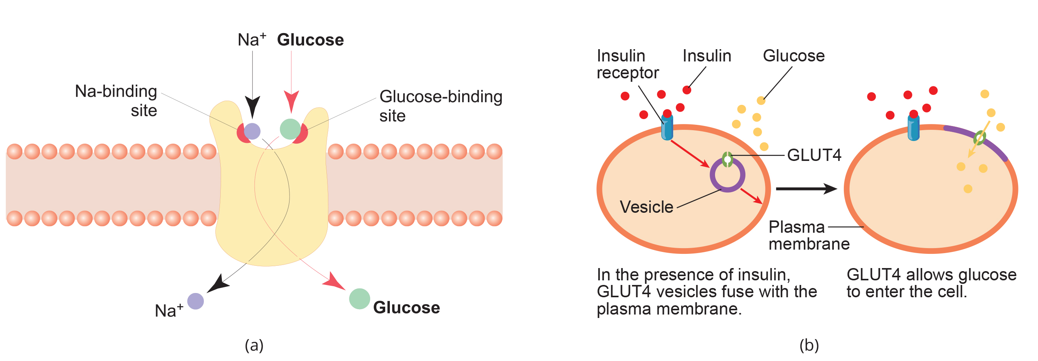
7.7 Figure 1
Notes:
Figure 1: (a) Glucose transporters allow movement of glucose along their concentration gradients. Occasionally, they require the simultaneous transport of another molecule, such as sodium, in a process called cotransport. (b) GLUT4 is a glucose transporter that is stored in vesicles. A cascade of events that occurs upon insulin binding to a receptor in the plasma membrane causes GLUT4-containing vesicles to fuse with the plasma membrane so that glucose may be transported into the cell.

Slide 6
Think It Through
Why do cells need a glucose transporter, given that glucose is a nonpolar molecule and could diffuse across the plasma membrane?
Notes:
Originally an On Your Own. This is included here to use as a talking point or for a think-pair-share activity.

Slide 7
Science and You
What Would Cause Your Body to Synthesize Fat Molecules?
Fat is synthesized in the body when more food is consumed than is necessary for metabolic processes. Fat is how our body can store that extra energy so that it can be used later, if needed!
Notes:
This is included as a relevant application for this topic.

Slide 8
Control of Catabolic Pathways
Enzymes in glycolysis, citric acid cycle, and ETC catalyze non-reversible reactions
Meaning if initial reaction takes place, pathway is committed to proceeding
Enzyme activity is released based on the energy needs of the cell (ATP, ADP, and AMP levels)

Slide 9
Glycolysis₁
Begins with hexokinase
Catalyzes the phosphorylation of glucose, which helps prepare for cleavage
When inhibited, glucose diffuses out of the cell and does not become a substrate for respiration
Product is glucose-6-phosphate, which accumulates when phosphofructokinase is inhibited
Phosphofructokinase is main enzyme controlled in glycolysis

Slide 10
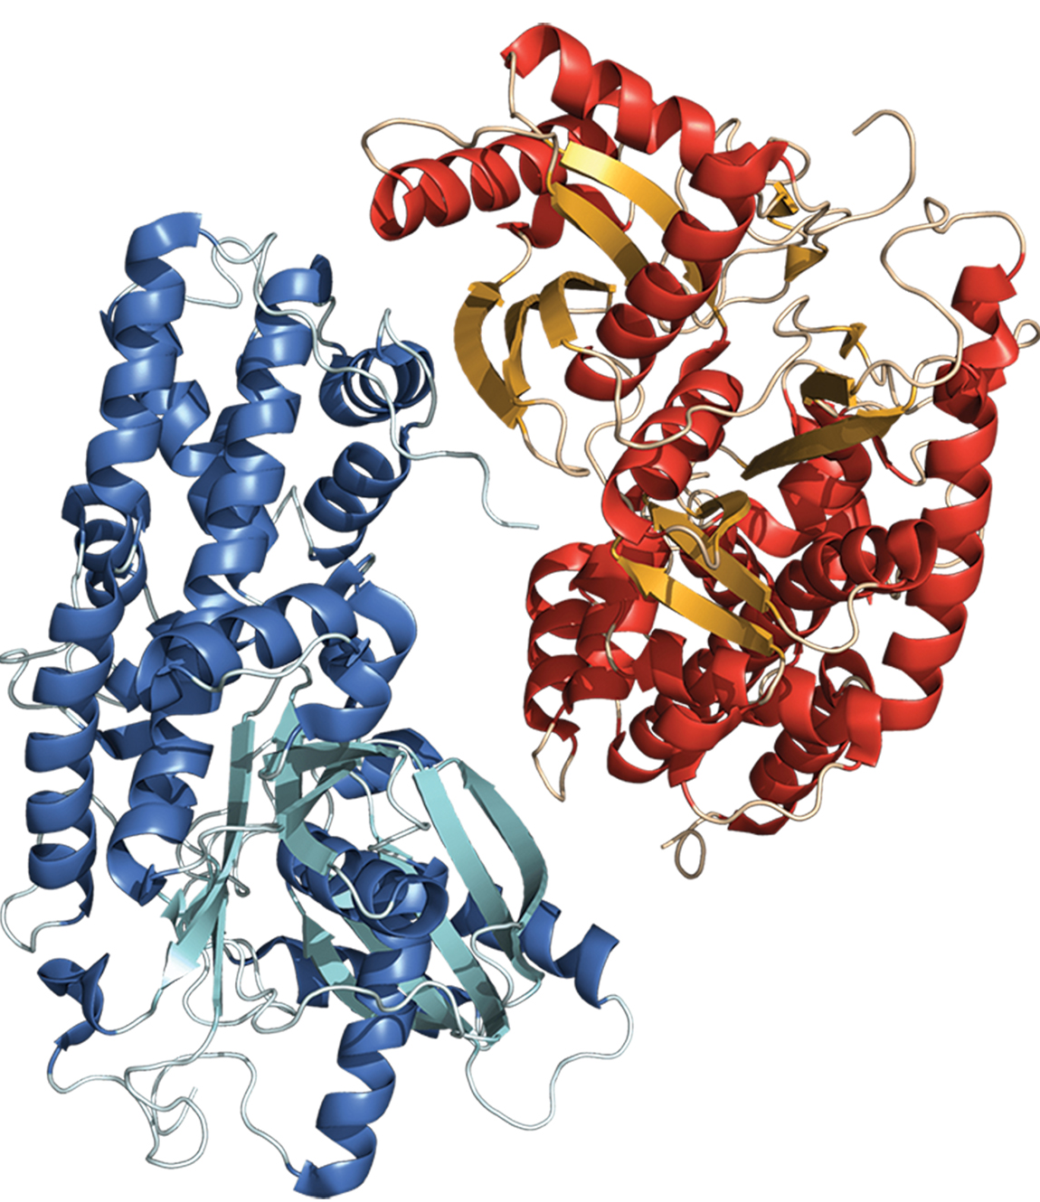
Glycolysis₂
Last step is catalyzation by pyruvate kinase
Product (pyruvate) proceeds to be catabolized or converted into alanine
Is inhibited if no more energy is needed and converted into acetyl CoA by pyruvate dehydrogenase (which is regulated by phosphorylation)
Is increased when fructose-1,6-bisphosphate levels increase
7.7 Figure 2: Hexokinase is the first enzyme in the glycolysis pathway. This enzyme phosphorylates the glucose molecule, preventing its efflux (exit) out of the cell, and makes the molecule more reactive for subsequent breakdown.
Ігор Пєтков on Wikimedia Commons. "Hexokinase."

Slide 11
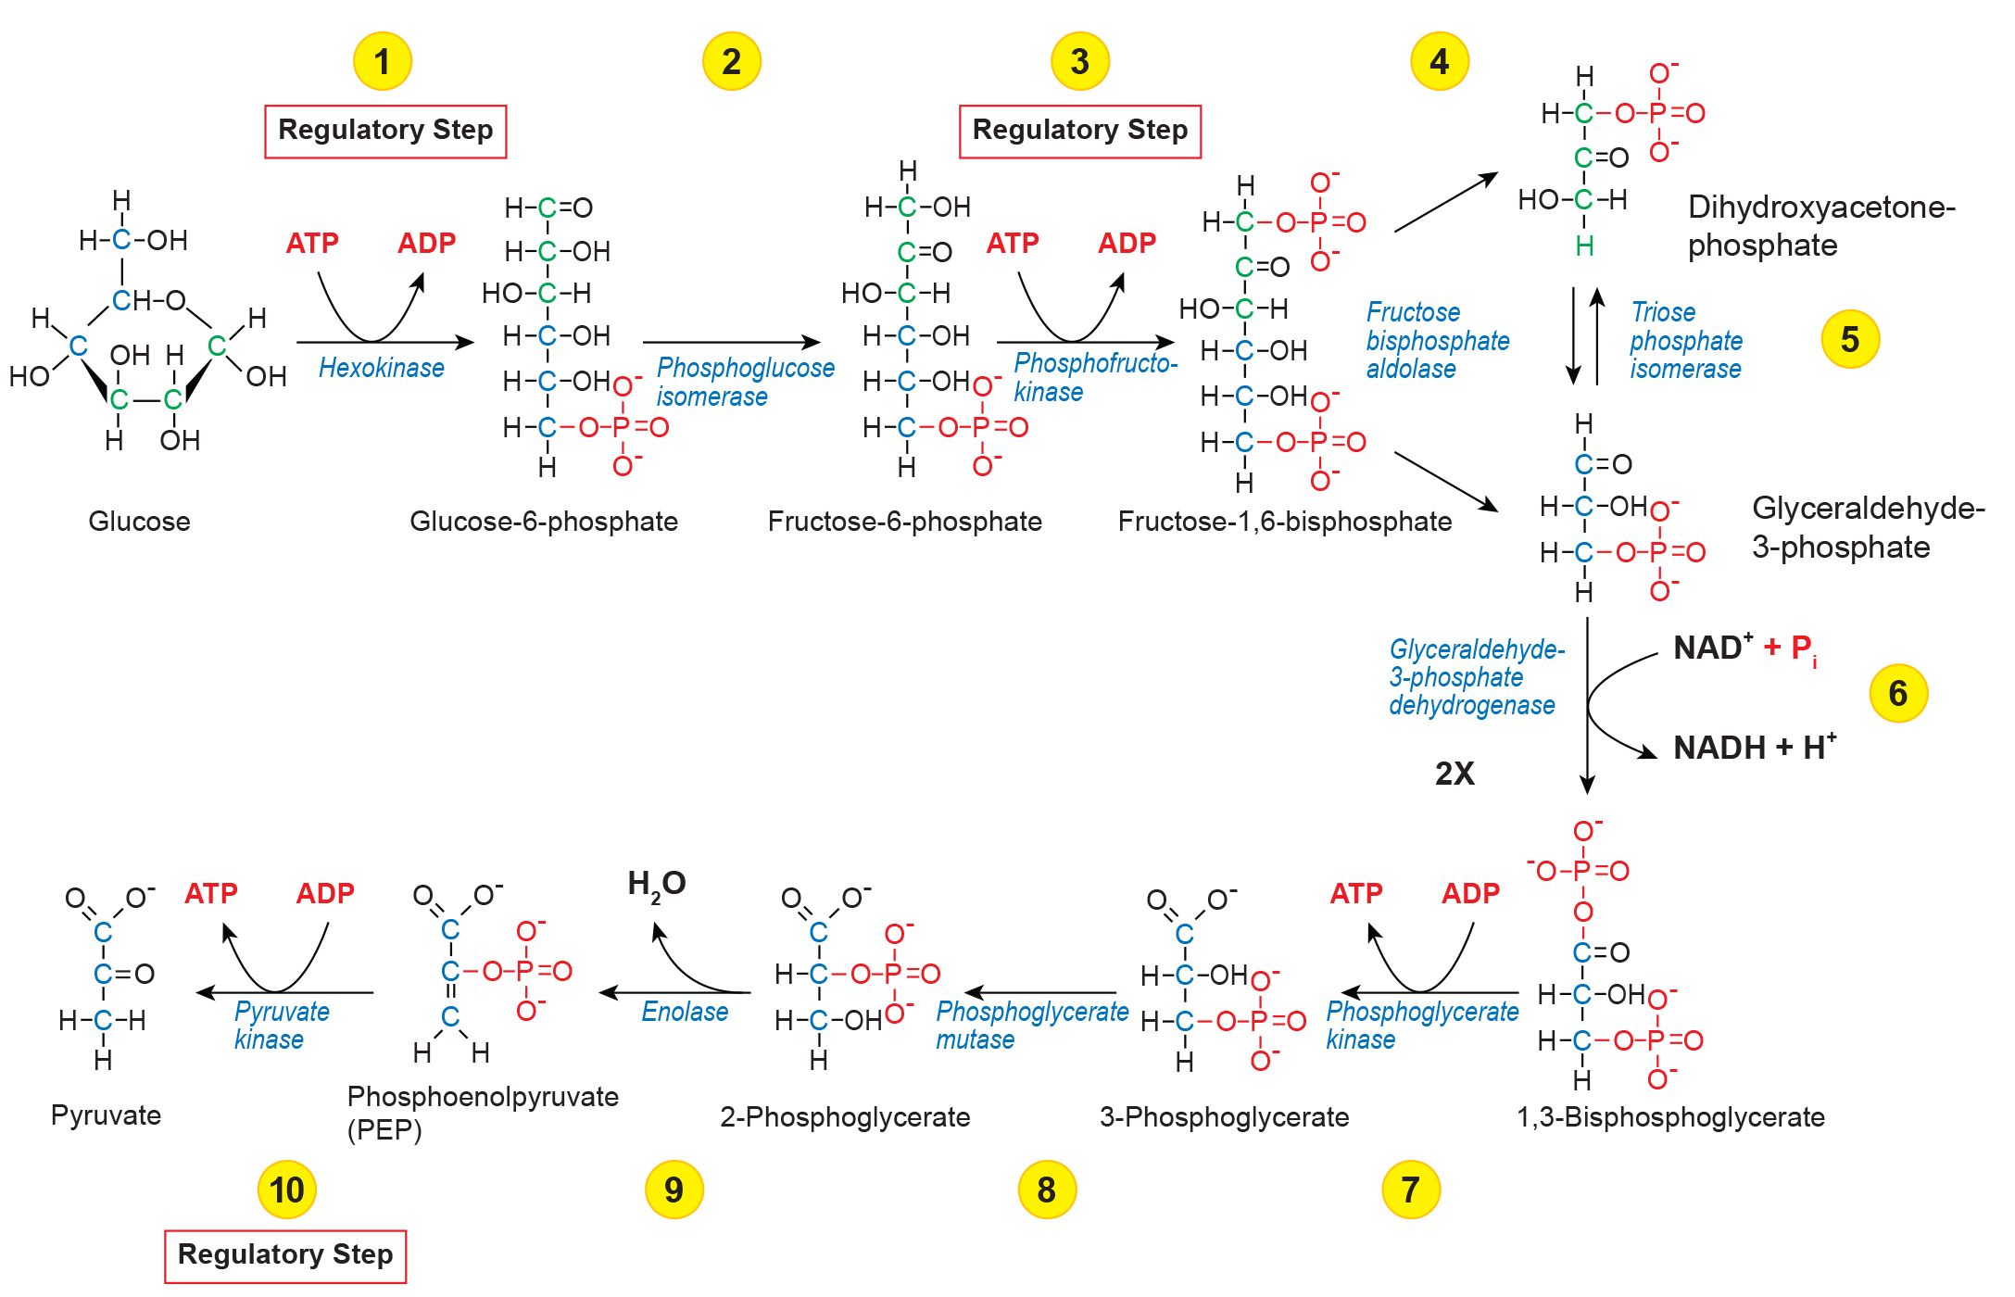
7.7 Figure 3
Rozzychan on Wikimedia Commons. "Glycolysis." Modified.
Notes:
Figure 3: The glycolysis pathway is primarily regulated at the three key enzymatic steps (1, 3, and 10), as indicated. Note that the first two steps that are regulated occur early in the pathway and involve hydrolysis of ATP.

Slide 12
Citric Acid Cycle
Controlled through enzymes that catalyze the reactions that make first 2 molecules of NADH
Isocitrate dehydrogenase
α-ketoglutarate dehydrogenase
Rates of reactions decrease with adequate ATP and NADH levels
α-ketoglutarate dehydrogenase inhibited by succinyl CoA, allowing glutamate synthesis if α-ketoglutarate not used in citric acid cycle

Slide 13
Electron Transport Chain
Specific enzymes unaffected by feedback inhibition
Rate of electron transport through pathway is affected by ADP and ATP
Greater ATP consumption means buildup of ADP
Once ADP decreases, ATP begins to build up
Triggers slow down in electron transport chain

Slide 14
Table 1: The Regulation of the Cellular Respiration Pathway₁ (Cont.)
Pathway | Enzyme Affected | Elevated Levels of Effector | Effect on Pathway Activity
glycolysis | hexokinase | glucose-6-phosphate | decrease
glycolysis | phosphofructokinase | low-energy charge (ATP, AMP), fructose-6-phosphate via fructose-2,6-bisphosphate | increase
glycolysis | phosphofructokinase | high-energy charge (ATP, AMP), citrate, acidic pH | decrease
glycolysis | pyruvate kinase | fructose-1,6-bisphosphate | increase
glycolysis | pyruvate kinase | high-energy charge (ATP, AMP), alanine | decrease

Slide 15
Table 1: The Regulation of the Cellular Respiration Pathway₂ (Cont.)
Pathway | Enzyme Affected | Elevated Levels of Effector | Effect on Pathway Activity
pyruvate to acetyl CoA conversion | pyruvate dehydrogenase | ADP, pyruvate | increase
pyruvate to acetyl CoA conversion | pyruvate dehydrogenase | acetyl CoA, ATP, NADH | decrease
citric acid cycle | isocitrate dehydrogenase | ADP | increase
citric acid cycle | isocitrate dehydrogenase | ATP, NADH | decrease

Slide 16
Table 1: The Regulation of the Cellular Respiration Pathway₃ (Cont.)
Pathway | Enzyme Affected | Elevated Levels of Effector | Effect on Pathway Activity
citric acid cycle | α-ketoglutarate dehydrogenase | calcium ions, ADP | increase
citric acid cycle | α-ketoglutarate dehydrogenase | ATP, NADH, succinyl CoA | decrease
electron transport chain | α-ketoglutarate dehydrogenase | ADP | increase
electron transport chain | α-ketoglutarate dehydrogenase | ATP | decrease

Slide 17
Summary
Glucose entry regulated by transport proteins that aid glucose passage through the cell membrane
Main control mechanism is through the regulation of specific enzymes
Type of negative feedback mechanism (turning the enzymes off when needed)
Regulation by levels of ATP, ADP, AMP, NAD⁺, and FAD
Other intermediates also affect certain enzymes involved

Slide 18


End of Hawkes Learning PowerPoint

