Slide 1
Lesson 8.1
Overview of Photosynthesis

Slide 2
Objectives
Describe the main structures involved in photosynthesis.
Explain the significance of photosynthesis to other living organisms.
Identify the substrates and products of photosynthesis.

Slide 3
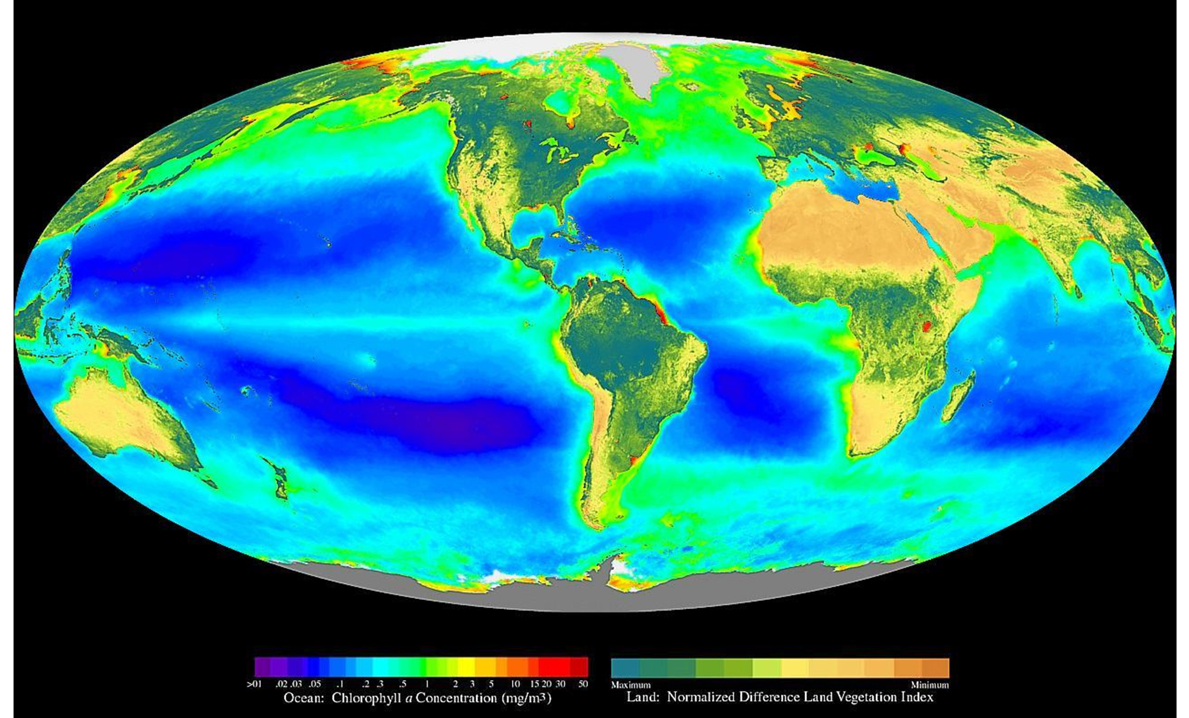
Photosynthesis
Metabolic processes require energy
To get energy, organisms consume others
Stored energy in food traced back to photosynthesis
8.1 Figure 1: This world map shows Earth's distribution of photosynthetic activity determined by chlorophyll a (one of the green pigments required for photosynthesis) concentration. On land, chlorophyll is evident from terrestrial plants, and within oceanic zones, chlorophyll comes from phytoplankton.
SeaWiFS Project, Goddard Space Flight Center and ORBIMAGE on Wikimedia Commons. "Photosynthetic world map."

Slide 4
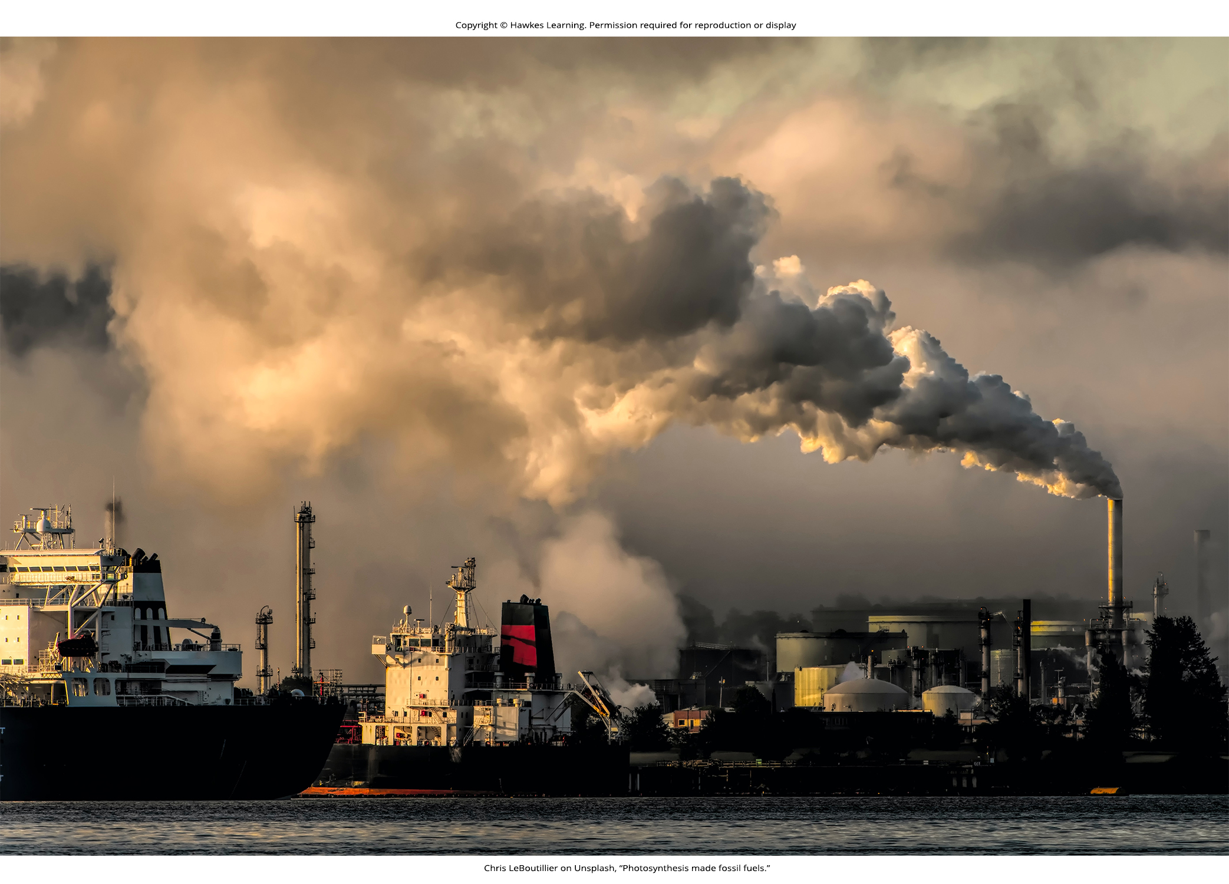
Overview of Photosynthesis₁
Essential to all life on Earth
Only process that can capture energy from sunlight and convert it to chemical compounds (carbohydrates) that every organism uses to power metabolism
Source of oxygen
Captures energy from sunlight to energize electrons, whose energy is stored in covalent bonds of sugar molecules
8.1 Figure 2: The energy stored by photosynthesis millions of years ago powers much of our industry today.
Chris LeBoutillier on Unsplash. "Photosynthesis made fossil fuels."

Slide 5
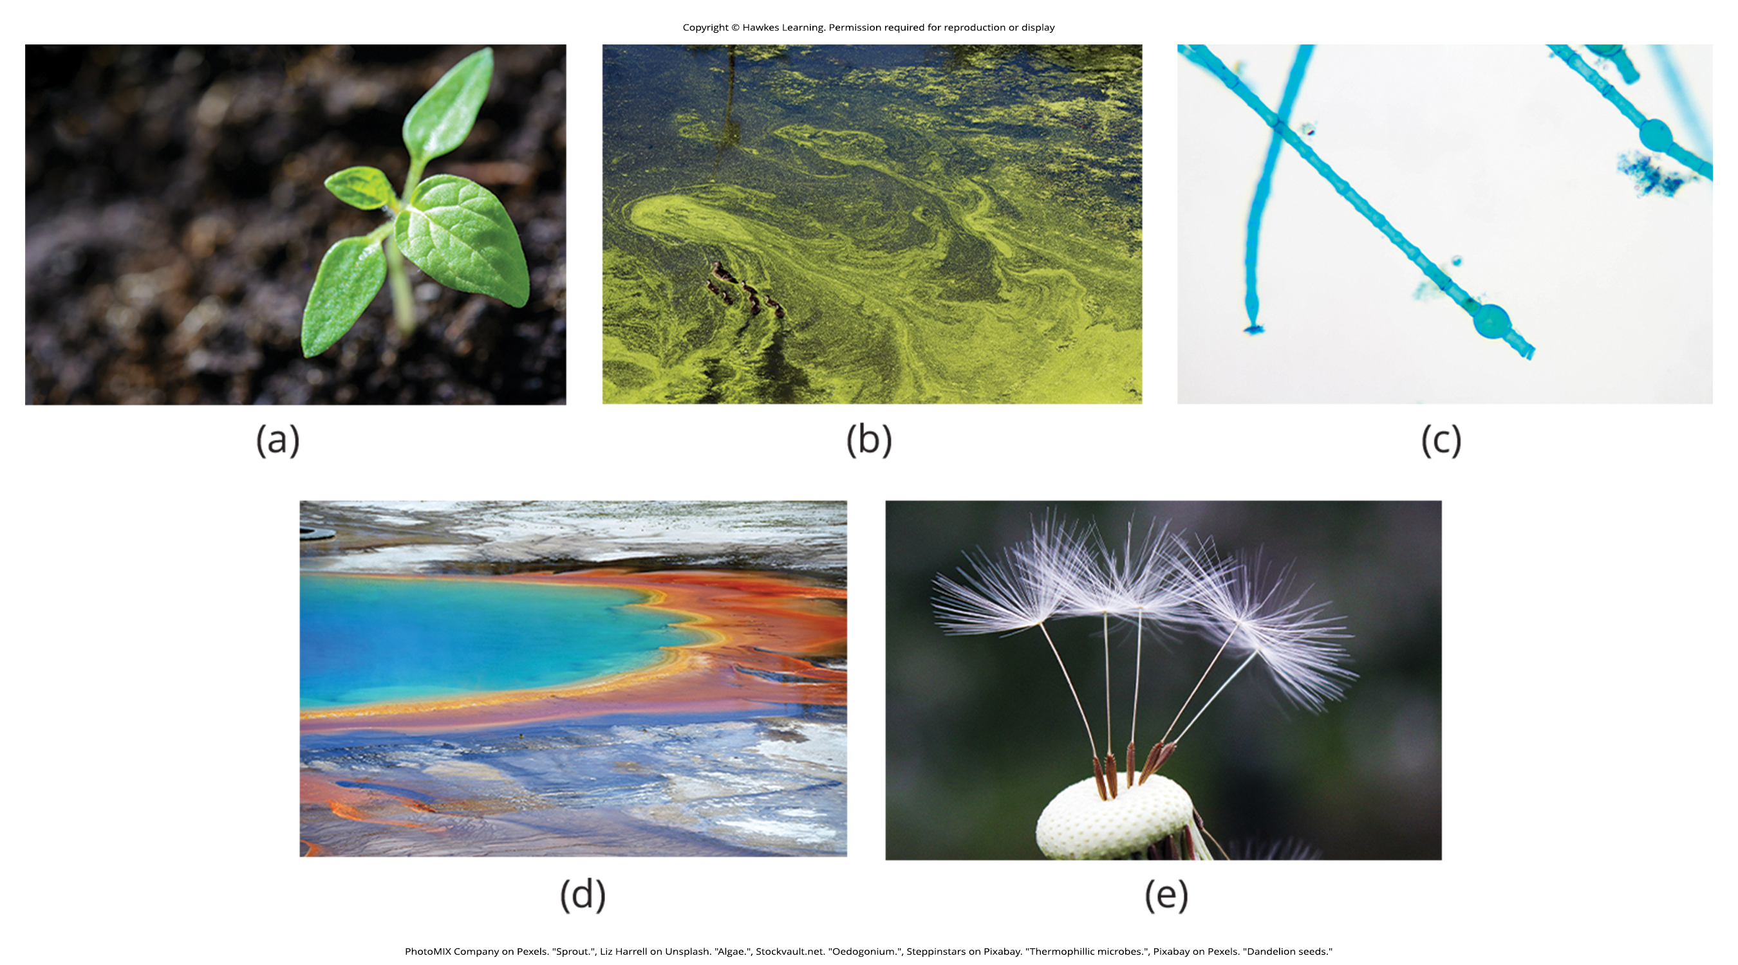
Overview of Photosynthesis₂
Plants, algae, and cyanobacteria capable of performing photosynthesis
Called photoautotrophs: organisms capable of producing their own organic compounds from sunlight
Heterotrophs: organisms that consume organic substances or other organisms for food (e.g., animals, fungi, and most other bacteria)
Chemoautotrophs: organisms that can build organic molecules using energy derived from inorganic chemicals instead of sunlight (example: only a special group of bacteria)
8.1 Figure 3: Pictured are photoautotrophs, including (a) plants, (b) algae, (c) Oedogonium blue-green algae, (d) thermophilic microbes and (e) dandelions.
PhotoMIX Company on Pexels. "Sprout."
Liz Harrell on Unsplash. "Algae."
Stockvault.net. "Oedogonium."
Steppinstars on Pixabay. "Thermophillic microbes."
Pixabay on Pexels. "Dandelion seeds."

Slide 6
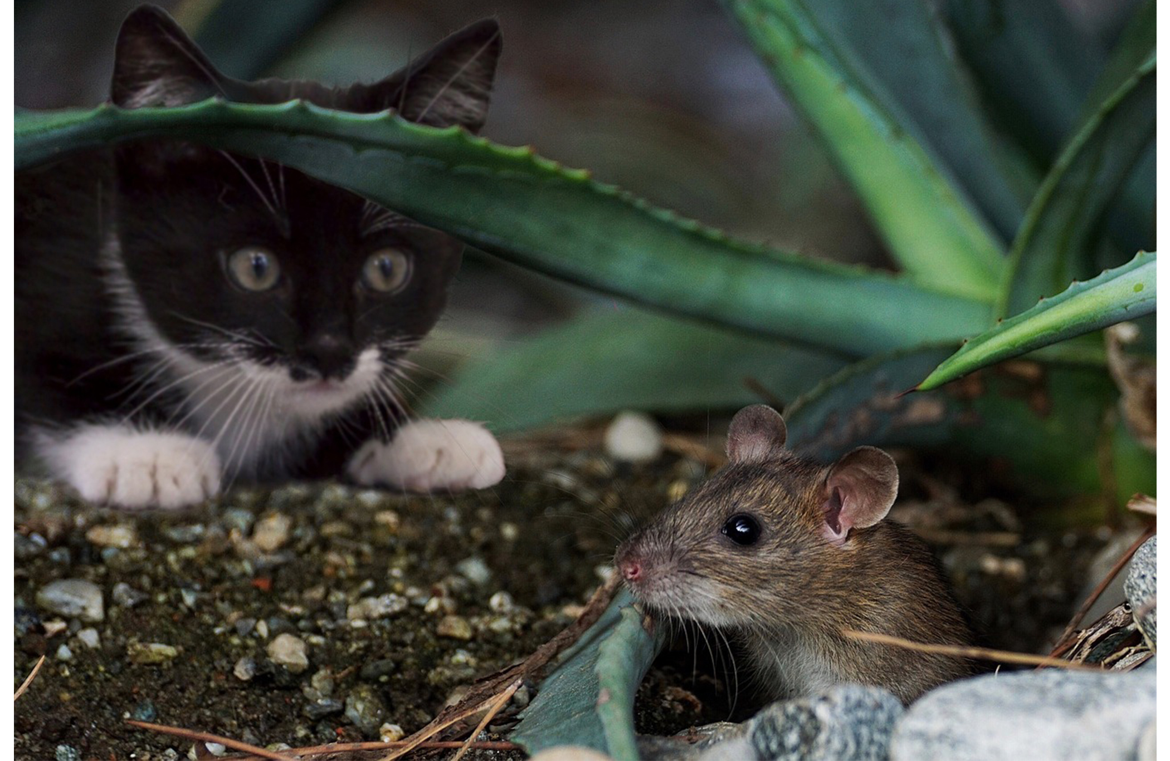
Overview of Photosynthesis₃
Photosynthesis vital because it can store energy from solar radiation (photo-) by transforming that energy into carbon-carbon bonds of carbohydrate molecules (-synthesis)
Becomes the energy source heterotrophs use through consumption of photoautotrophs to power synthesis of ATP via respiration
Powers 99% of Earth's ecosystems
8.1 Figure 4: The energy stored in carbohydrate molecules from photosynthesis passes through the food chain. The predator (the cat) that eats this mouse receives a portion of the energy that originated in the photosynthetic vegetation that the mouse consumed.
Susanne Jutzeler on Pixabay. "Cat and mouse."

Slide 7
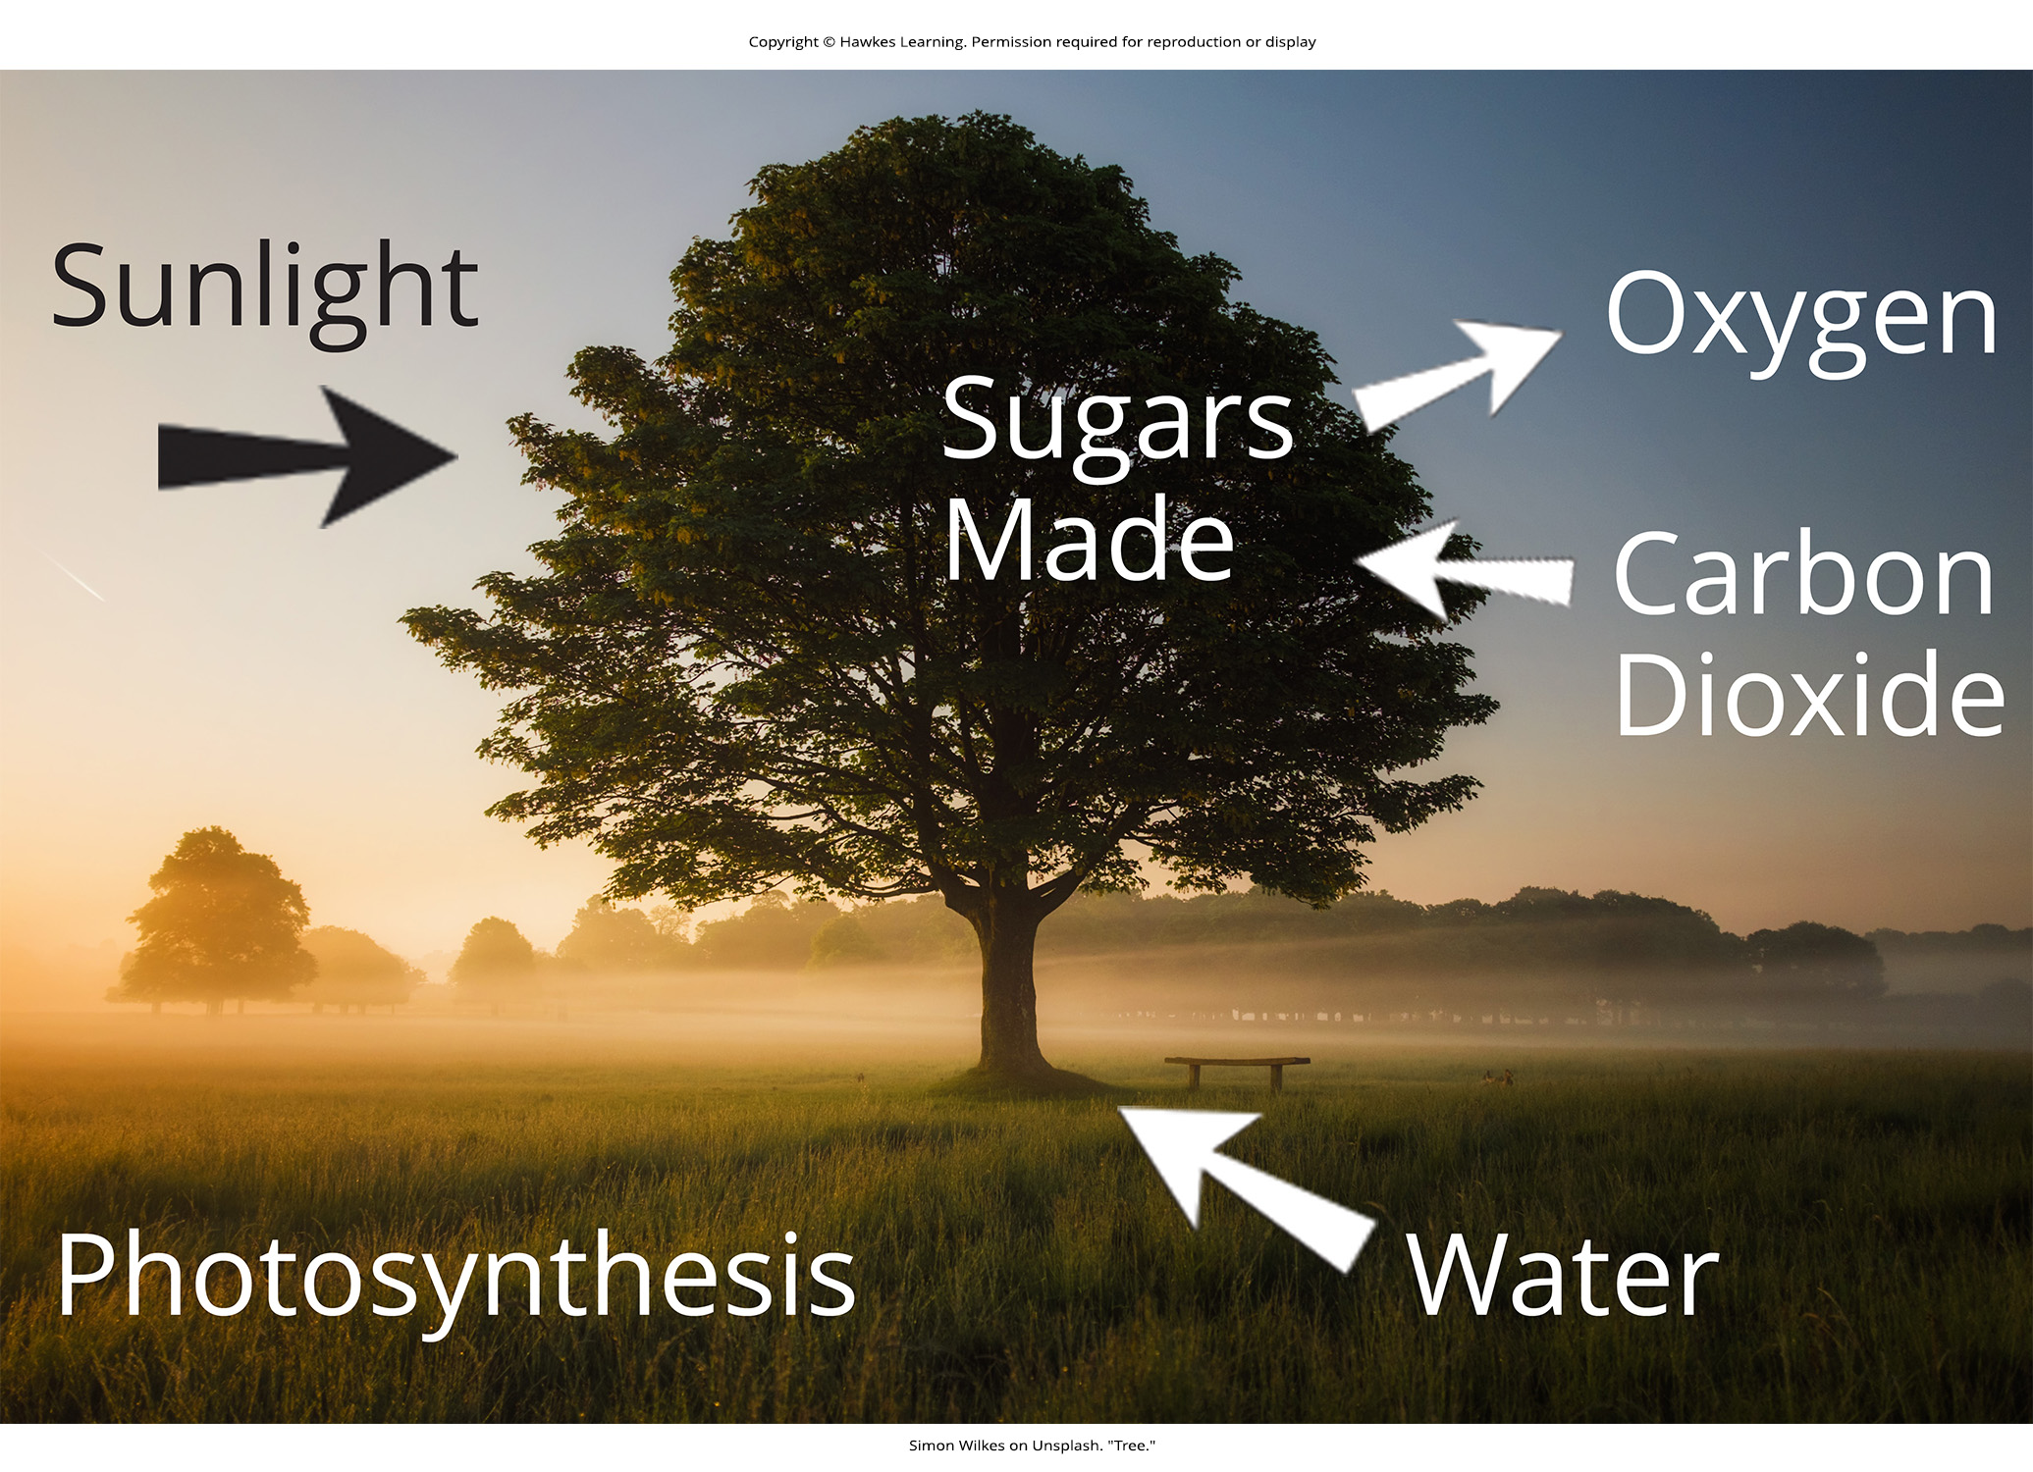
Main Structures and Summary
Multistep process requiring these substrates:
Specific wavelengths of visible light
Carbon dioxide (CO₂)
Water
Produces oxygen and a 3-carbon sugar called glyceraldehyde-3-phosphate (G3P)
G3P converts into higher-energy carbohydrates (like glucose or sucrose)
8.1 Figure 5
Simon Wilkes on Unsplash. "Tree."

Slide 8
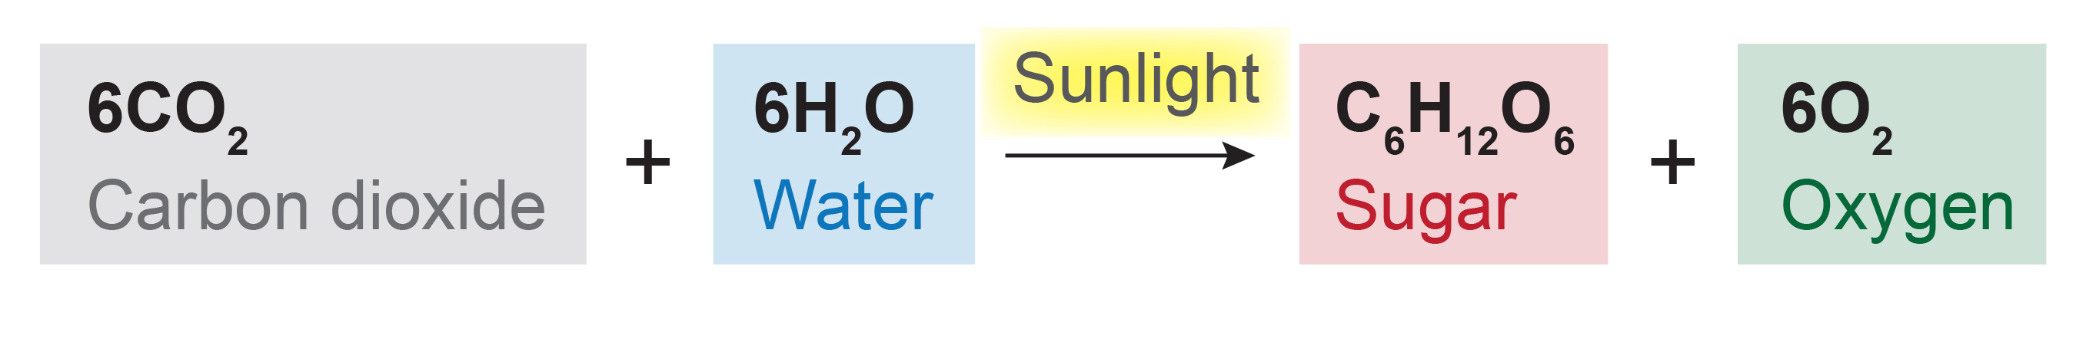
8.1 Figure 6
ZooFari on Wikimedia Commons. "Photosynthesis equation."
Notes:
The overall equation for photosynthesis is deceptively simple. In reality, the process takes place in many steps involving intermediate reactants and products. For example, the sugar (glucose) ultimately produced by photosynthesis is made from two 3-carbon G3Ps that are synthesized as intermediate products of earlier steps in photosynthesis.

Slide 9
Basic Photosynthetic Structures₁
Takes place in one of the several layers of leaves
Mesophyll: middle layer of chlorophyll-rich cells in a leaf
Stomata: opening that regulates gas exchange and water evaporation between leaves and the environment
Where gas exchange between carbon dioxide and oxygen occurs
Located on underside of leaf, which helps minimize water loss due to high temperatures on upper surface of leaf
Each one flanked by two guard cells that regulate opening of stomata in response to osmotic changes

Slide 10
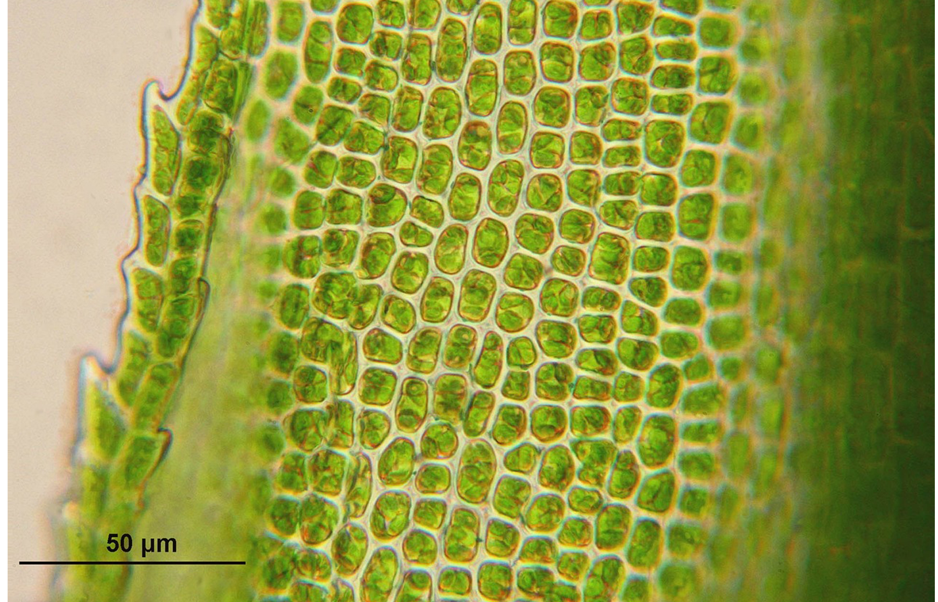
Basic Photosynthetic Structures₂
Chloroplast: membrane-bound organelle that contains chlorophyll and in which photosynthesis takes place
Exist mostly in the mesophyll
Have double membrane
Contain thylakoids
8.1 Figure 7: Mesophyll cells contain chloroplasts.
WikimediaImages on Pixabay. "Mesophyll cells."

Slide 11
Basic Photosynthetic Structures₃
Thylakoids: disc-shaped, membrane-bound structure inside chloroplast where light-dependent reactions of photosynthesis take place
Thylakoid lumen: liquid-filled space bound by a thylakoid membrane
Granum: stack of thylakoid membranes
Stroma: liquid-filled space around the granum
Pigment: molecule that absorbs certain light wavelengths and reflects others
Responsible for initial interaction between light and plant material

Slide 12
The Endosymbiotic Theory
Prevailing theory explaining how chloroplasts evolved in plant cells
Free-living cyanobacteria (photosynthetic bacteria) were engulfed by other cells and performed photosynthesis for the other cells
Also explains mitochondria
Evidence:
Reproduce independently
Contain their own DNA
Encased in double membranes

Slide 13
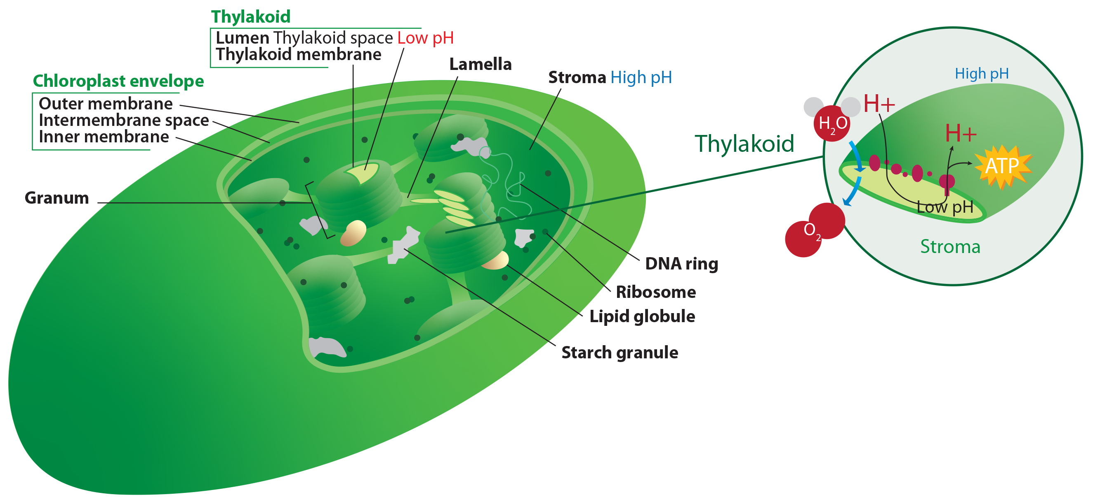
8.1 Figure 8
Kelvinsong on Wikimedia Commons. "Chloroplast diagram."
Notes:
Figure 8: Photosynthesis takes place in chloroplasts, which are photosynthetic organelles that have an outer and inner membrane. Stacks of thylakoids called grana form a third membrane layer.

Slide 14
The Two Parts of Photosynthesis
Two sequential stages:
Light-dependent reactions: first stage of photosynthesis where certain wavelengths of visible light are absorbed to form ATP and NADPH
Use energy carriers to temporarily store energy
Energy carriers return to light-dependent reaction to obtain more energy once it is released
Light-independent reactions: second stage of photosynthesis through which carbon dioxide is used to build carbohydrate molecules using energy from ATP and NADPH
Also known as the Calvin cycle
Energy obtained from light-dependent reactions drives assembly of sugar molecules from carbon dioxide
Do not use light directly but need the products from the light-dependent reactions

Slide 15
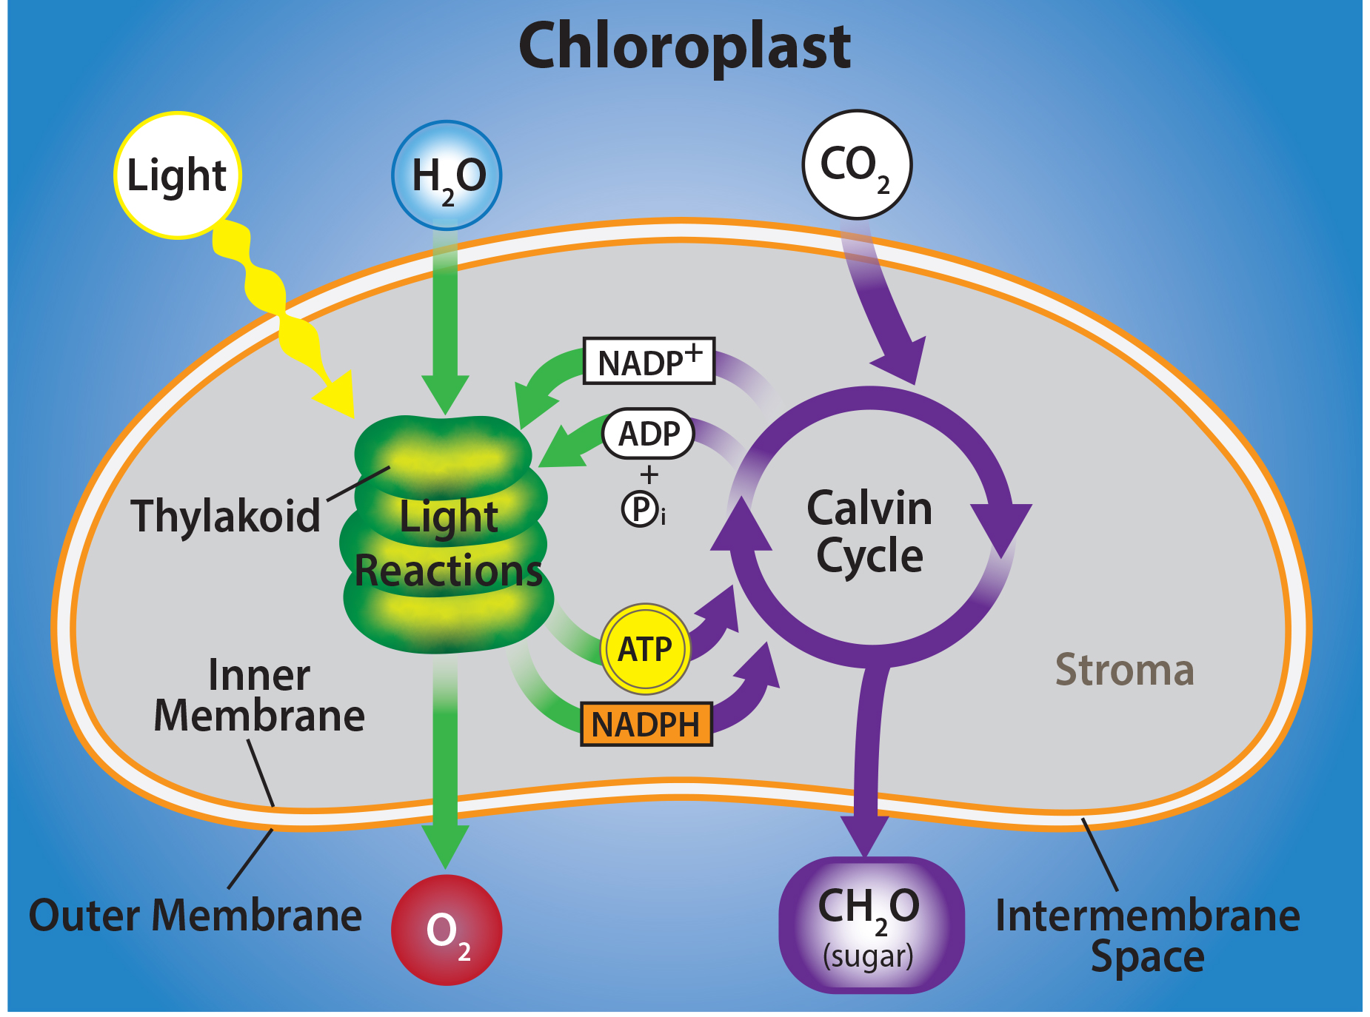
8.1 Figure 9
Rao, A., Ryan, K., Fletcher, S., Hawkins, A. and Tag, A. Texas A&M University. "Light-dependent and light-independent reactions."
Notes:
Figure 9: Photosynthesis takes place in two stages: light-dependent reactions and the Calvin cycle (light-independent reactions). Light-dependent reactions, which take place in the thylakoid membrane, use light energy to make ATP (adenosine triphosphate) and NADPH (nicotinamide adenine dinucleotide phosphate). The Calvin cycle, which takes place in the stroma, uses energy derived from these compounds to make G3P (glycerol-3 phosphate) from CO2.

Slide 16
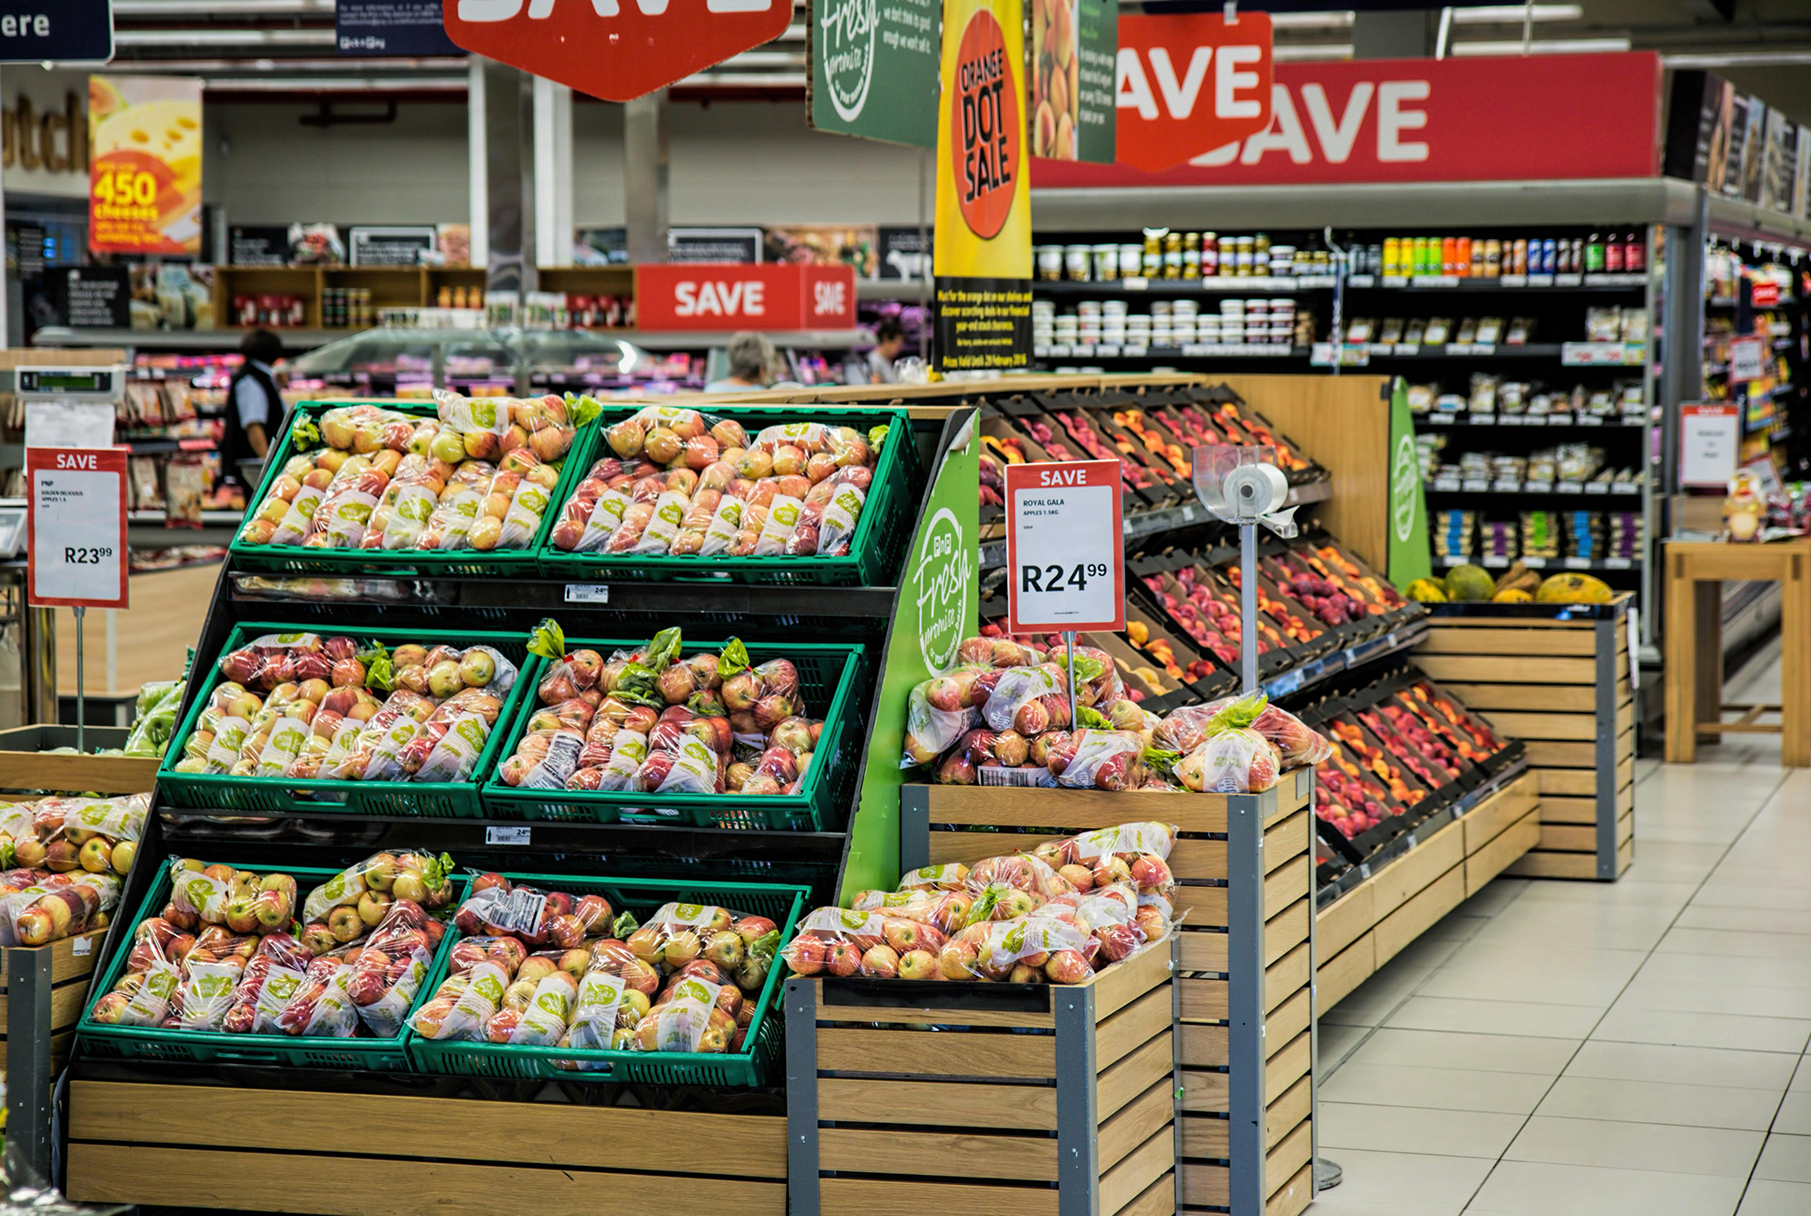
Science and You
All food products ultimately link back to photosynthesis.
Animal products (e.g., meat and dairy) come from livestock fed plant-based foods created by photosynthesis.
Starchy grains (e.g., breads, cereals, pasta) come from seeds of photosynthesis-dependent plants.
Sugar and sweeteners are carbohydrates, which are built directly from photosynthesis.
Non-food items derived from photosynthesis include paper goods, many plastics, and most spices and flavorings.
8.1 Figure 10
Pixabay on Pexels. "Grocery store."
Notes:
This is included as a relevant application for this topic.

Slide 17
Group Activity
As a group, take a walk outside with some blank paper. For the living creatures that you find, discuss specific ways that that creature's energy might trace back to the sun. Draw some of those connections out on your paper using labels and arrows as you discuss. For example, a cat might have these connections:
Cat → Squirrel → Acorn → Oak Tree → Sun

Slide 18
Summary
Photosynthesis harnesses energy from the sun, allowing living things to access vast amounts of energy, which allows them to build new structures and increase biodiversity.
Only photoautotrophs like plants can perform photosynthesis.
They require pigments like chlorophyll to absorb sunlight energy.
Photosynthesis uses carbon dioxide and water to build carbohydrates, releasing oxygen as a byproduct.
Eukaryotes, like plants and algae, have chloroplasts where photosynthesis takes place.
In prokaryotes, like cyanobacteria, photosynthesis occurs within folded membranes, extensions of the plasma membrane, and in the cytoplasm.

Slide 19


End of Hawkes Learning PowerPoint

