Slide 1
Lesson 8.2
The Light-Dependent Reactions of Photosynthesis

Slide 2
Objectives
Describe how and where photosynthesis takes place within a plant.
Describe short and long wavelengths of light.
Explain how plants absorb energy from sunlight.

Slide 3

The Light-Dependent Reactions of Photosynthesis
Light, a form of kinetic energy, can travel, change form, and be harnessed to do work.
In photosynthesis, light energy is converted into chemical energy, which photoautotrophs use to build basic carbohydrates.
Autotrophs use a few specific wavelengths of sunlight.
8.2 Figure 1
Micah Boerma on Pexels. "Sunrise."

Slide 4
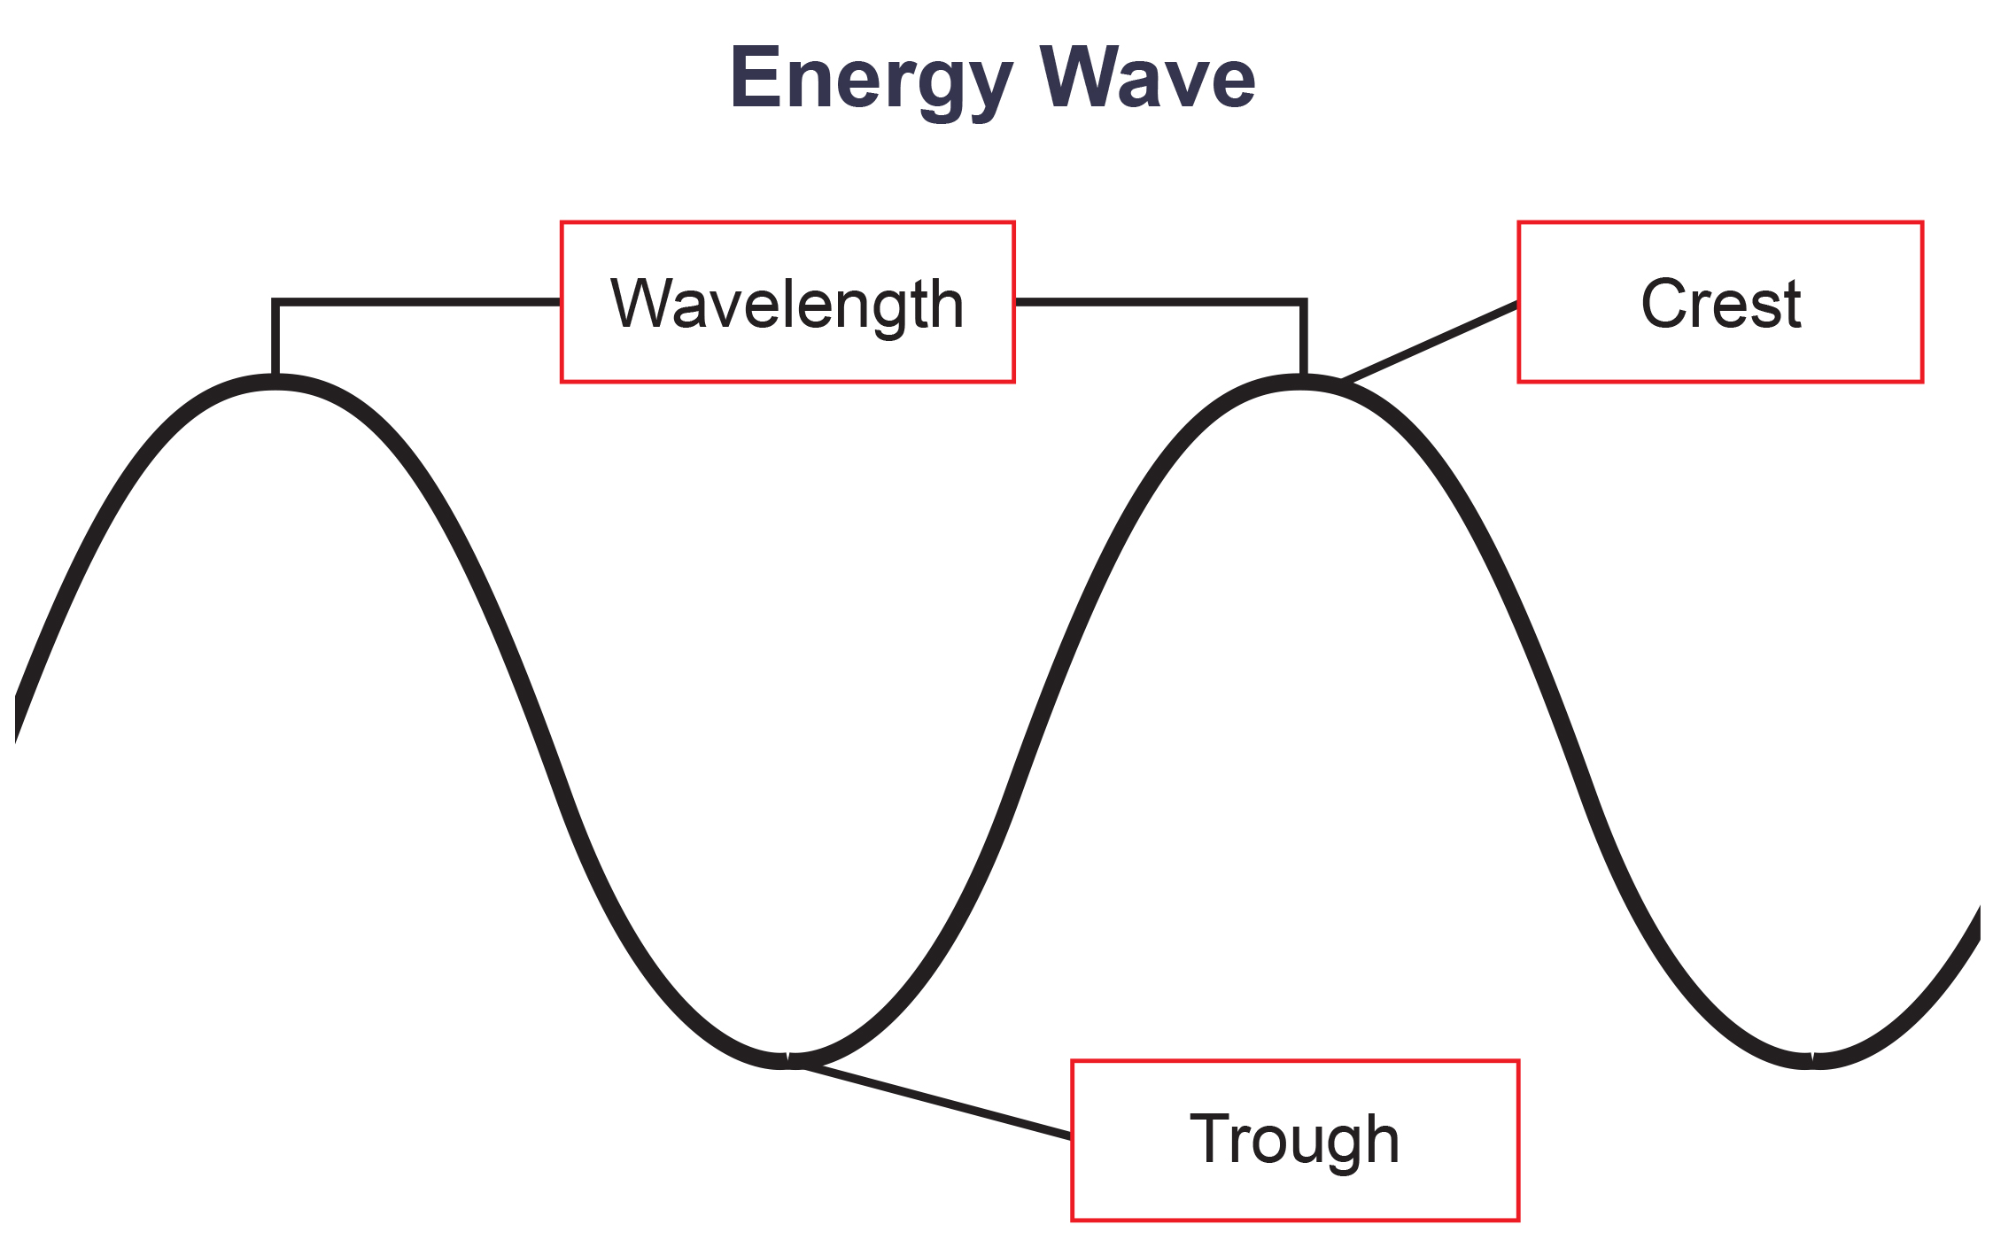
What Is Light Energy?₁
Sun emits a wide spectrum of electromagnetic radiation (or solar energy)
Visible light is small fraction that humans can see
Solar energy travels as waves
Wavelength: distance between consecutive crest points of a wave
Shorter wavelengths more powerful than longer ones
8.2 Figure 2: The wavelength of a single wave is the distance between two consecutive points of similar position (two crests or two troughs) along the wave.
CNX OpenStax on Wikimedia Commons. "Energy wave." Modified.

Slide 5
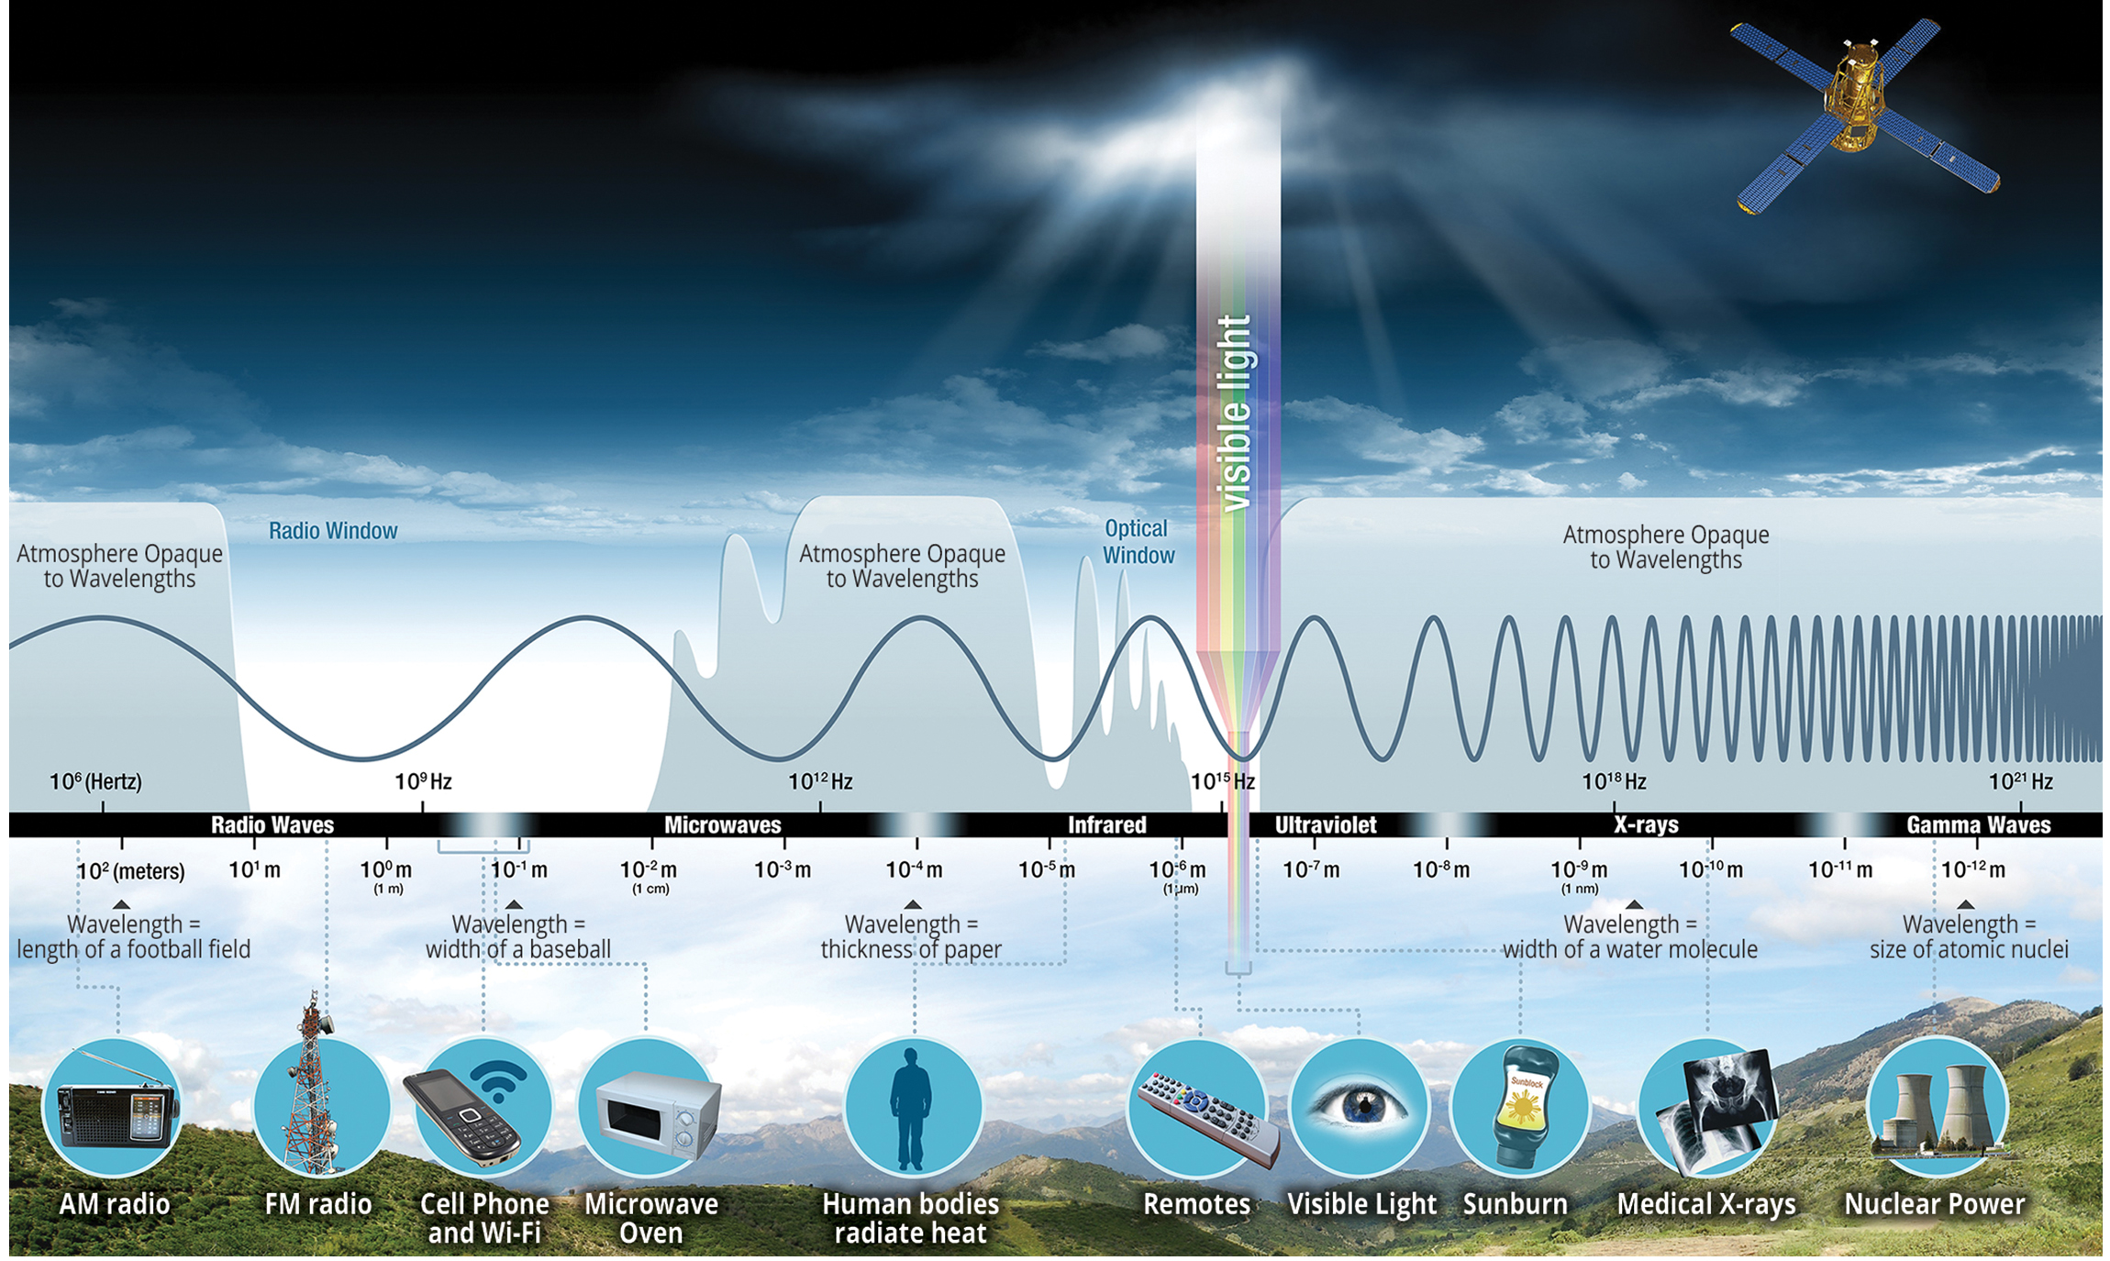
8.2 Figure 3
NASA on Wikimedia Commons. "Electromagnetic spectrum illustration."
Notes:
Figure 3: The sun emits energy in the form of electromagnetic radiation. This radiation exists at different wavelengths, each with its own characteristic energy. All electromagnetic radiation, including visible light, is characterized by its wavelength.

Slide 6
What Is Light Energy?₂
Electromagnetic spectrum: range of all possible frequencies of radiation
Difference between wavelengths is amount of energy carried by them
Wavelength and frequency
Longer the wavelength, lower the frequency, less energy
Short, tight waves carry most energy
Higher-energy waves (e.g., UV and X-rays) can penetrate tissues and damage cells and DNA

Slide 7
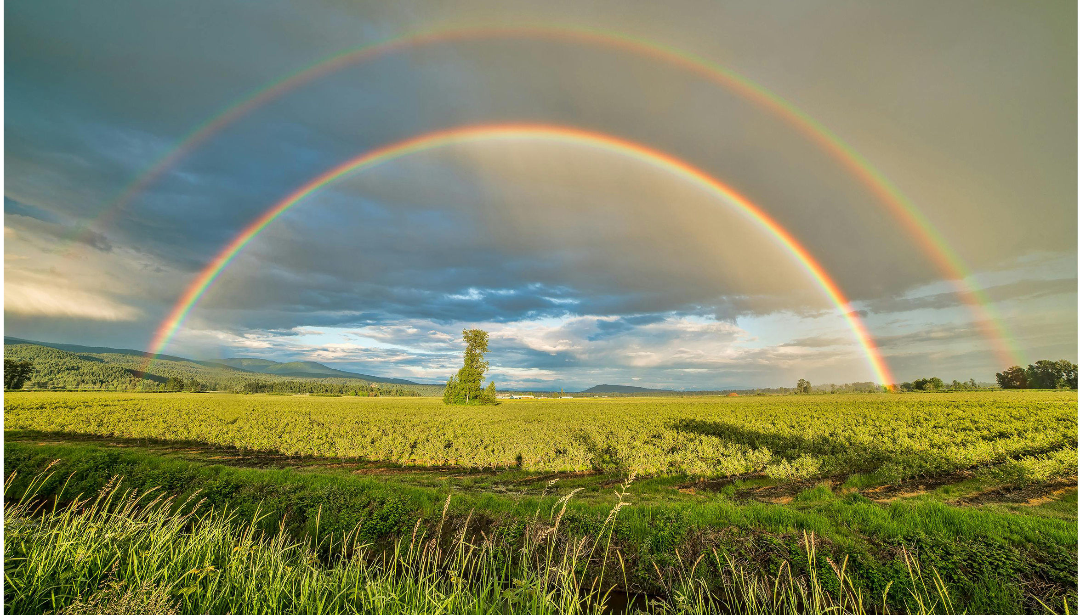
Absorption of Light
Pigments in chloroplasts absorb specific wavelengths of visible light to initiate photosynthesis.
Wavelengths outside the visible range have too little (infrared) or too much (ultraviolet) energy to be useful.
Humans can only see, and plants can only absorb, light between 700 nm (red light) and 400 nm (violet light).
This range is also called photosynthetically active radiation.
White light is a mixture of all visible wavelengths that can be separated into a rainbow by prisms.
8.2 Figure 4: Under certain atmospheric conditions, sunlight reflects through water droplets in the atmosphere and splits into white light's constituent colors. This phenomenon is called a rainbow, and it illustrates the visible light spectrum.
James Wheeler on Pexels. "Rainbow."

Slide 8
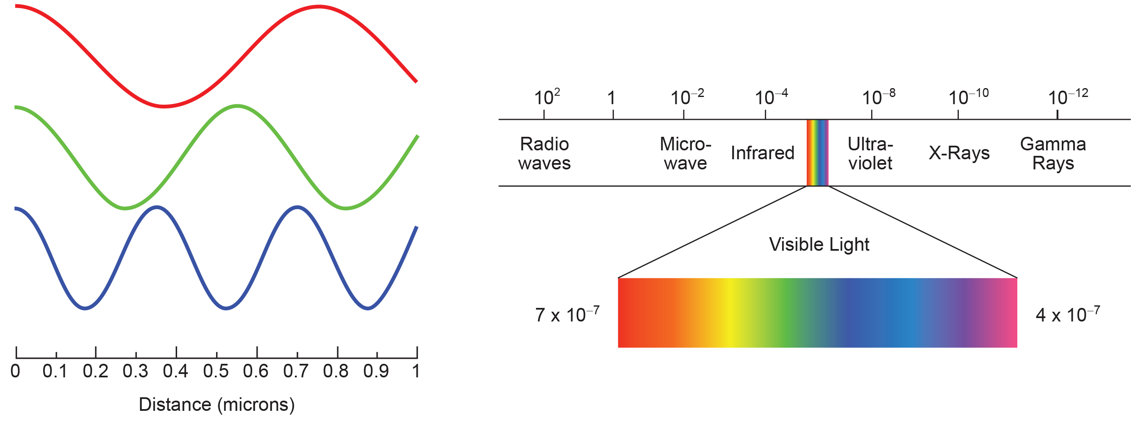
8.2 Figure 5
Maxhurtz on Wikimedia Commons. "Visible light frequencies."
William Anderson on Wikimedia Commons. "Electromagnetic spectrum."
Notes:
Figure 5: The colors of visible light do not carry the same amount of energy. Violet has the shortest wavelength and, therefore, carries the most energy, whereas red has the longest wavelength and carries the least amount of energy.

Slide 9
Understanding Pigments₁
Different pigments only absorb specific visible wavelengths
Reflect or transmit wavelengths they can’t absorb
Appear as mixture of reflected or transmitted light colors

Slide 10
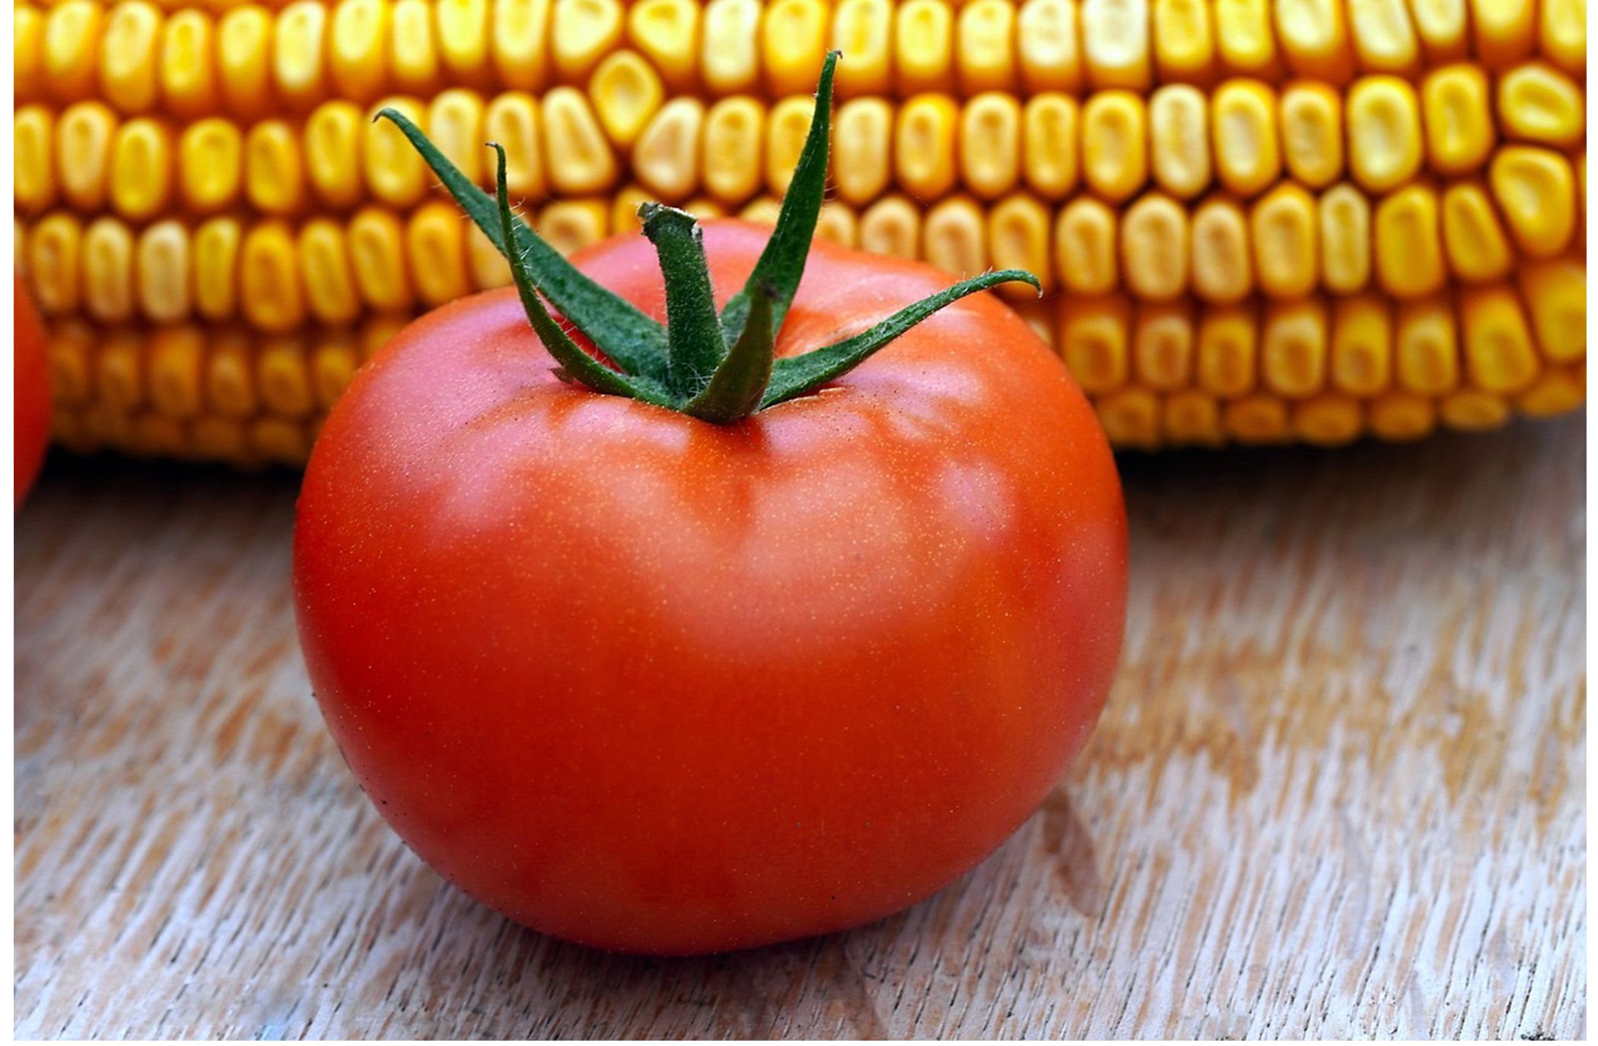
Understanding Pigments₂
Major photosynthetic pigments are chlorophylls (a, b, c, d, and bacteriochlorophyll) and carotenoids
Each has multiple pigments
Chlorophyll a: form that absorbs violet-blue and red light; has bluish-green color; performs photochemistry by getting excited and losing electron to ETC
Chlorophyll b: accessory pigment that absorbs blue and red-orange light; has yellowish-green tint
Carotenoids: photosynthetic pigments (yellow-orange-red) that function to dispose excess energy; reside in thylakoid membrane
8.2 Figure 6: The colorful carotenoid pigments are very notable in fruits, such as tomatoes, which contain lycopene, and corn, which contains zeaxanthin.
Matthias Böckel on Pixabay. "Tomato and corn."

Slide 11
Understanding Pigments₃
Absorption spectrum: range of wavelengths of electromagnetic radiation absorbed by a given substance
Each pigment has distinct peaks and troughs, showing specific pattern of absorption.
Chlorophyll a absorbs blue and red but not green. This is why chlorophyll appears green.
Carotenoids (like β-carotene) absorb blue and reflect yellow, red, and orange.

Slide 12
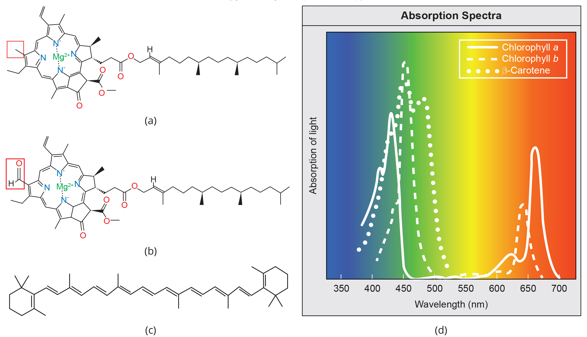
8.2 Figure 7
Rao, A., Ryan, K., Tag, A., Fletcher, S. and Hawkins, A. Department of Biology, Texas A&M University. "Chlorophyll structure and absorption."
Notes:
Figure 7: (a) Chlorophyll a, (b) chlorophyll b, and (c) β-carotene are hydrophobic (nonpolar) organic pigments found in the thylakoid membrane. Chlorophyll a and b, which are identical except for the addition of an oxygen (O) and hydrogen (H) atom in chlorophyll b, as indicated in the red box on the left, are responsible for the green color of leaves. β-carotene is responsible for the orange color in carrots. (d) Each pigment has a unique absorbance spectrum, as indicated by the patterned lines.

Slide 13
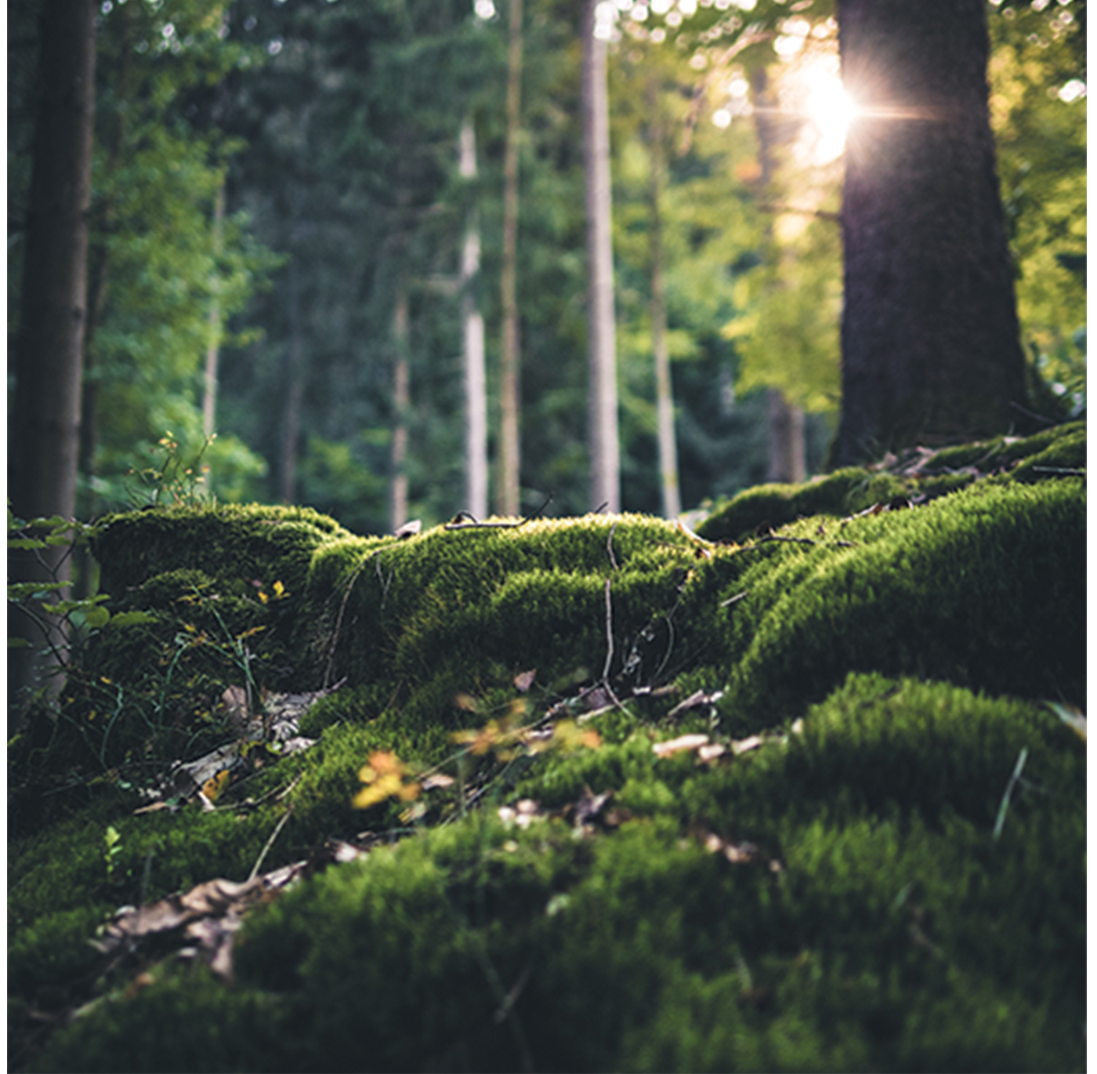
Understanding Pigments₄
Many organisms have mixture of pigments, allowing them to absorb energy from wider range of wavelengths
Not all organisms have full access to sunlight (e.g., underwater, forest floor)
Can determine types of pigments present by generating absorption spectra or using chromatography
Spectrophotometer: instrument that can measure transmitted light and compute the absorption
Chromatography: separating pigments by dissolving them in liquid then observing how they separate when they climb up a solid
8.2 Figure 8: Plants that commonly grow in the shade have adapted to low levels of light by changing the relative concentrations of their chlorophyll pigments.
Fabian Wiktor on Pexels. "Forest and moss."

Slide 14
How Light-Dependent Reactions Work₁
Function: to convert solar energy into chemical energy in the form of NADPH and ATP
Chemical energy supports light-independent reactions and fuels assembly of sugar molecules
Photosystem: group of proteins, chlorophyll, and other pigments that are used in light-dependent reactions to absorb light energy and convert it to chemical energy
Chloroplasts have two photosystems (PSII and PSI) embedded in thylakoid membranes
Photosystem II: integral protein and pigment complex that transports electrons from water to the ETC; oxygen is the product
Photosystem I: integral pigment and protein complex that uses light energy to transport electrons from plastocyanin to NADP⁺

Slide 15
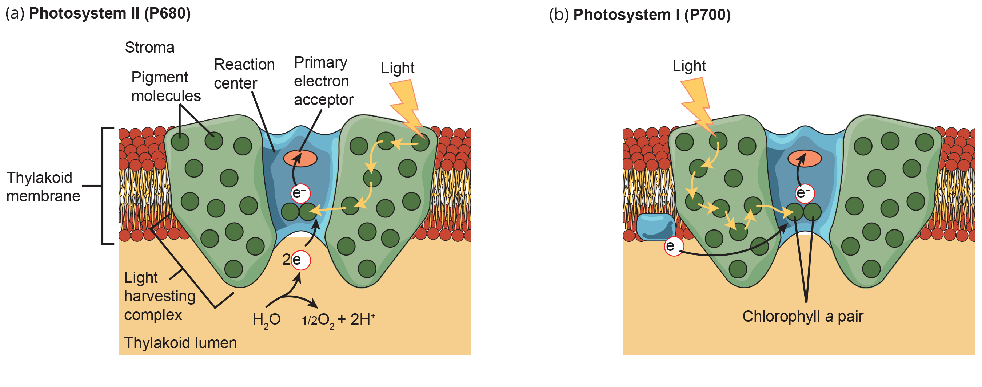
8.2 Figure 9
CNX OpenStax on Wikimedia Commons. "Photosystem II and I." Modified.
Notes:
Figure 9: A photosystem consists of a light-harvesting complex and a reaction center. Pigments in the light-harvesting complex pass light energy to two special chlorophyll a molecules in the reaction center. The light excites an electron from the chlorophyll a pair, which passes to the primary electron acceptor. The excited electron must then be replaced. (a) In photosystem II, the electron comes from the splitting of water, which releases oxygen as a waste product. (b) In photosystem I, the electron comes from the chloroplast electron transport chain.

Slide 16
How Light-Dependent Reactions Work₂
Both photosystems have same basic structure: antenna proteins surround the reaction center where photochemistry takes place
Antenna proteins: pigment molecule that directly absorbs light and transfers energy absorbed to other pigment molecules
Reaction center: complex of chlorophyll molecules and other organic molecules that is assembled around special pair of chlorophyll molecules and a primary electron acceptor; capable of undergoing oxidation and reduction
Each photosystem serviced by light-harvesting complex
Light-harvesting complex: complex that passes energy from sunlight to the reaction center; consists of antenna proteins that contain a mixture of 300 to 400 chlorophyll a and b molecules and carotenoids
Absorption of a photon (distinct quantity of light) by any of the chlorophylls pushes molecule into an excited state

Slide 17
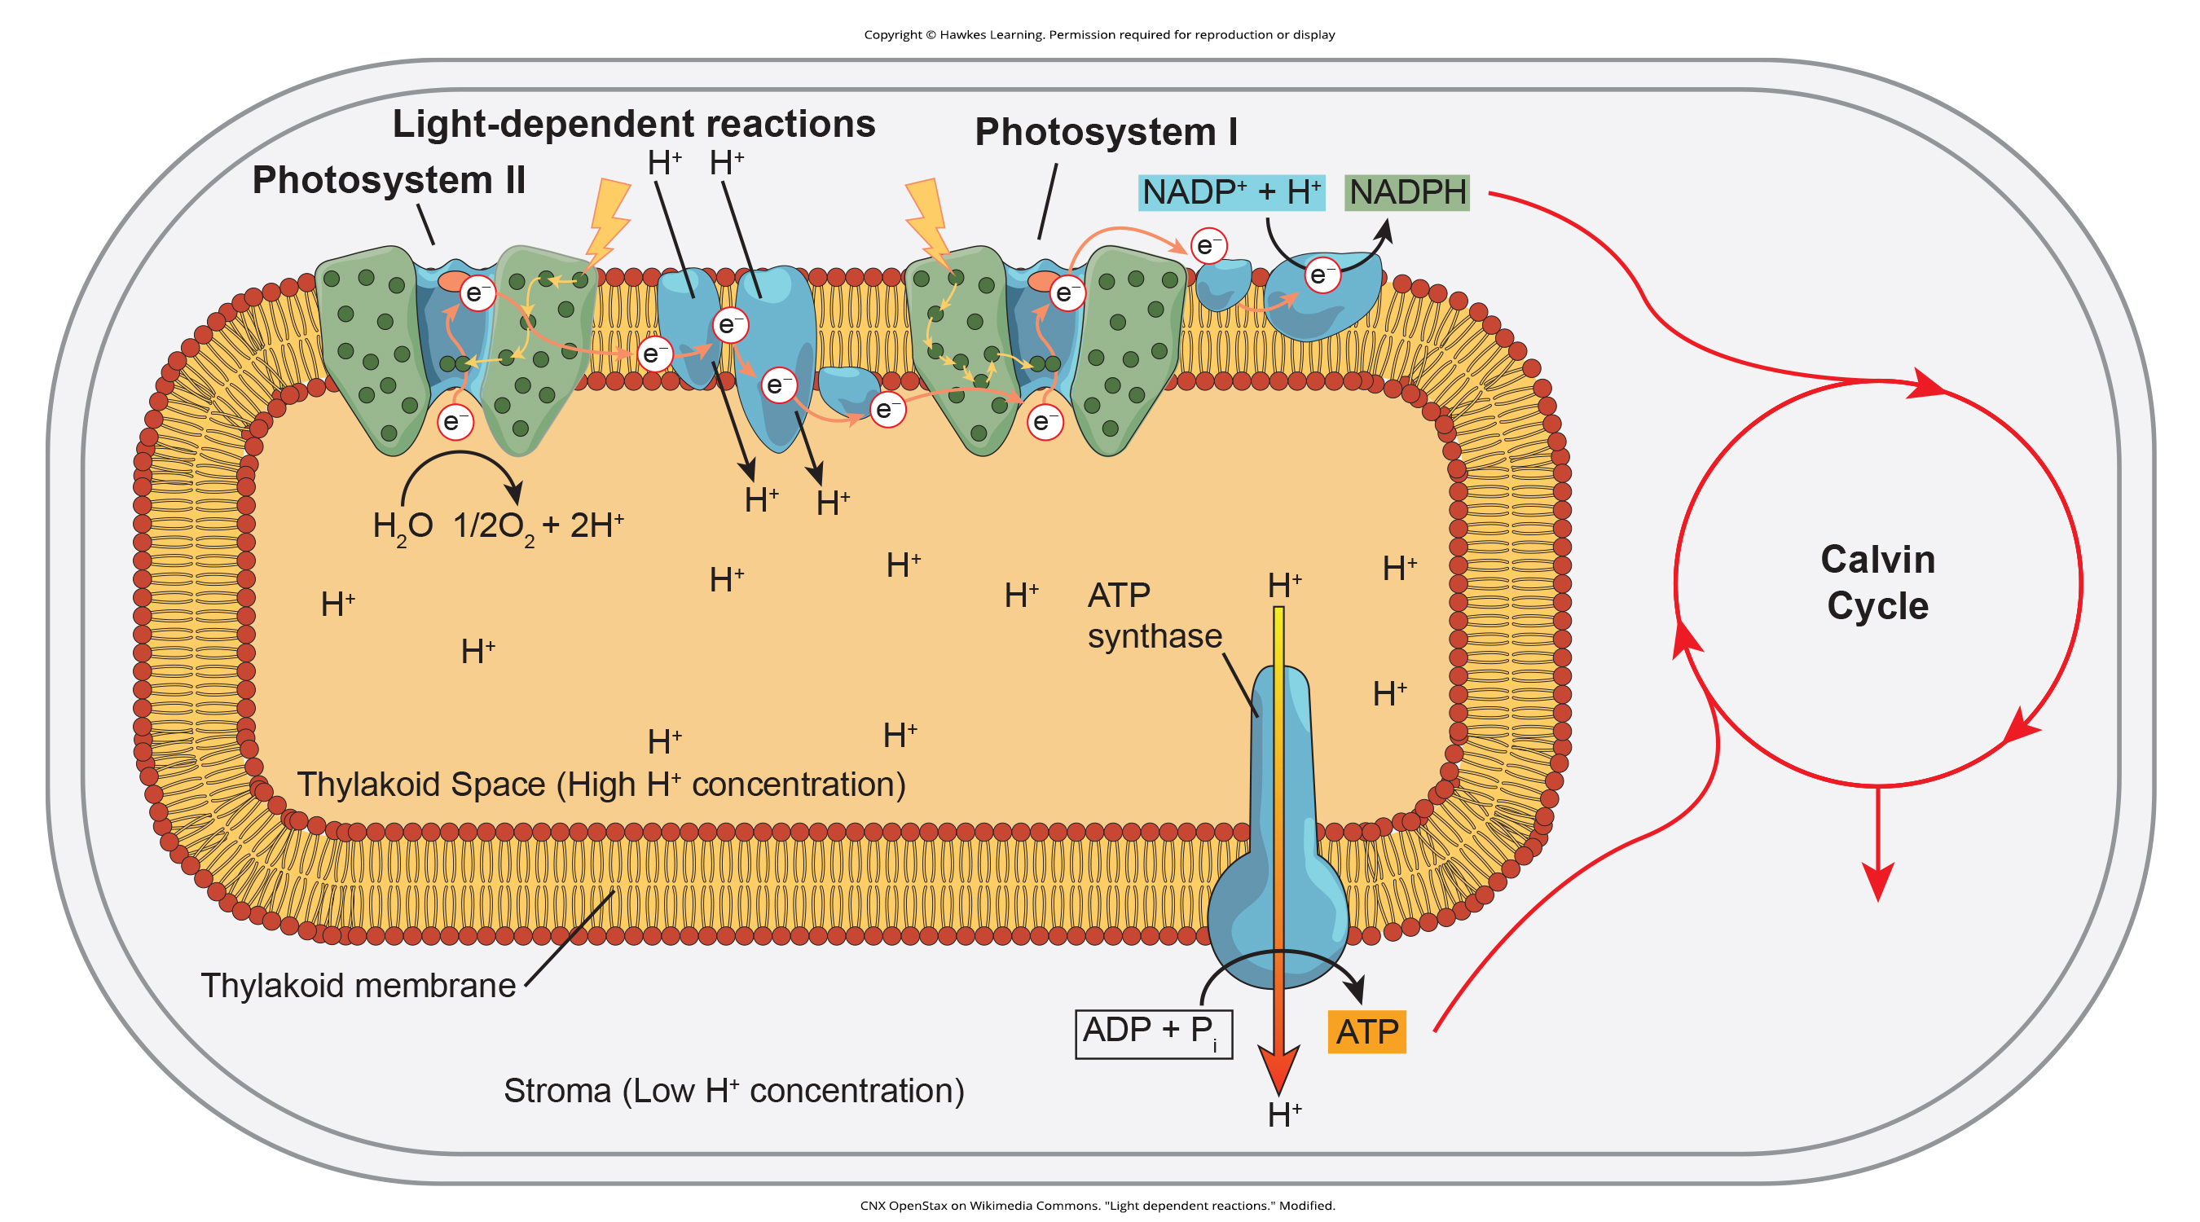
8.2 Figure 10
CNX OpenStax on Wikimedia Commons. "Light dependent reactions." Modified.
Notes:
Figure 10: In the photosystem II (PSII) reaction center, energy from sunlight is used to extract electrons from water. The electrons travel through the chloroplast electron transport chain to photosystem I (PSI), which reduces NADP+ to NADPH. The electron transport chain moves protons across the thylakoid membrane into the lumen. At the same time, the splitting of water adds protons to the lumen, and the reduction of NADPH removes protons from the stroma. The net result is a low pH in the thylakoid lumen and a high pH in the stroma. ATP synthase uses this electrochemical gradient to make ATP.

Slide 18
How Light-Dependent Reactions Work₃
Reaction center contains 2 chlorophyll a molecules that can photoact
Photoact: ejection of an electron from a reaction center using the energy of an absorbed photon
During this step, light energy converts to excited electron
All next steps involve getting that electron to NADPH for delivery to Calvin cycle
PSII and PSI are two major components of photosynthetic ETC, which includes cytochrome complex
Cytochrome complex: group of reversibly oxidizable and reducible proteins that forms part of ETC between PSII and PSI
Transfers electrons from carrier molecule plastoquinone (Pq) to the protein plastocyanin (Pc), which allows transfer of protons across thylakoid membrane and transfer of electrons from PSII to PSI

Slide 19
Reflection Question
Consider how trees near your home visibly change from summer to autumn. Briefly describe those changes. Based on what you've learned so far, what chemical changes might be happening inside the leaves?
Notes:
The reflection question is included here to use as a talking point or for a think-pair-share activity.

Slide 20
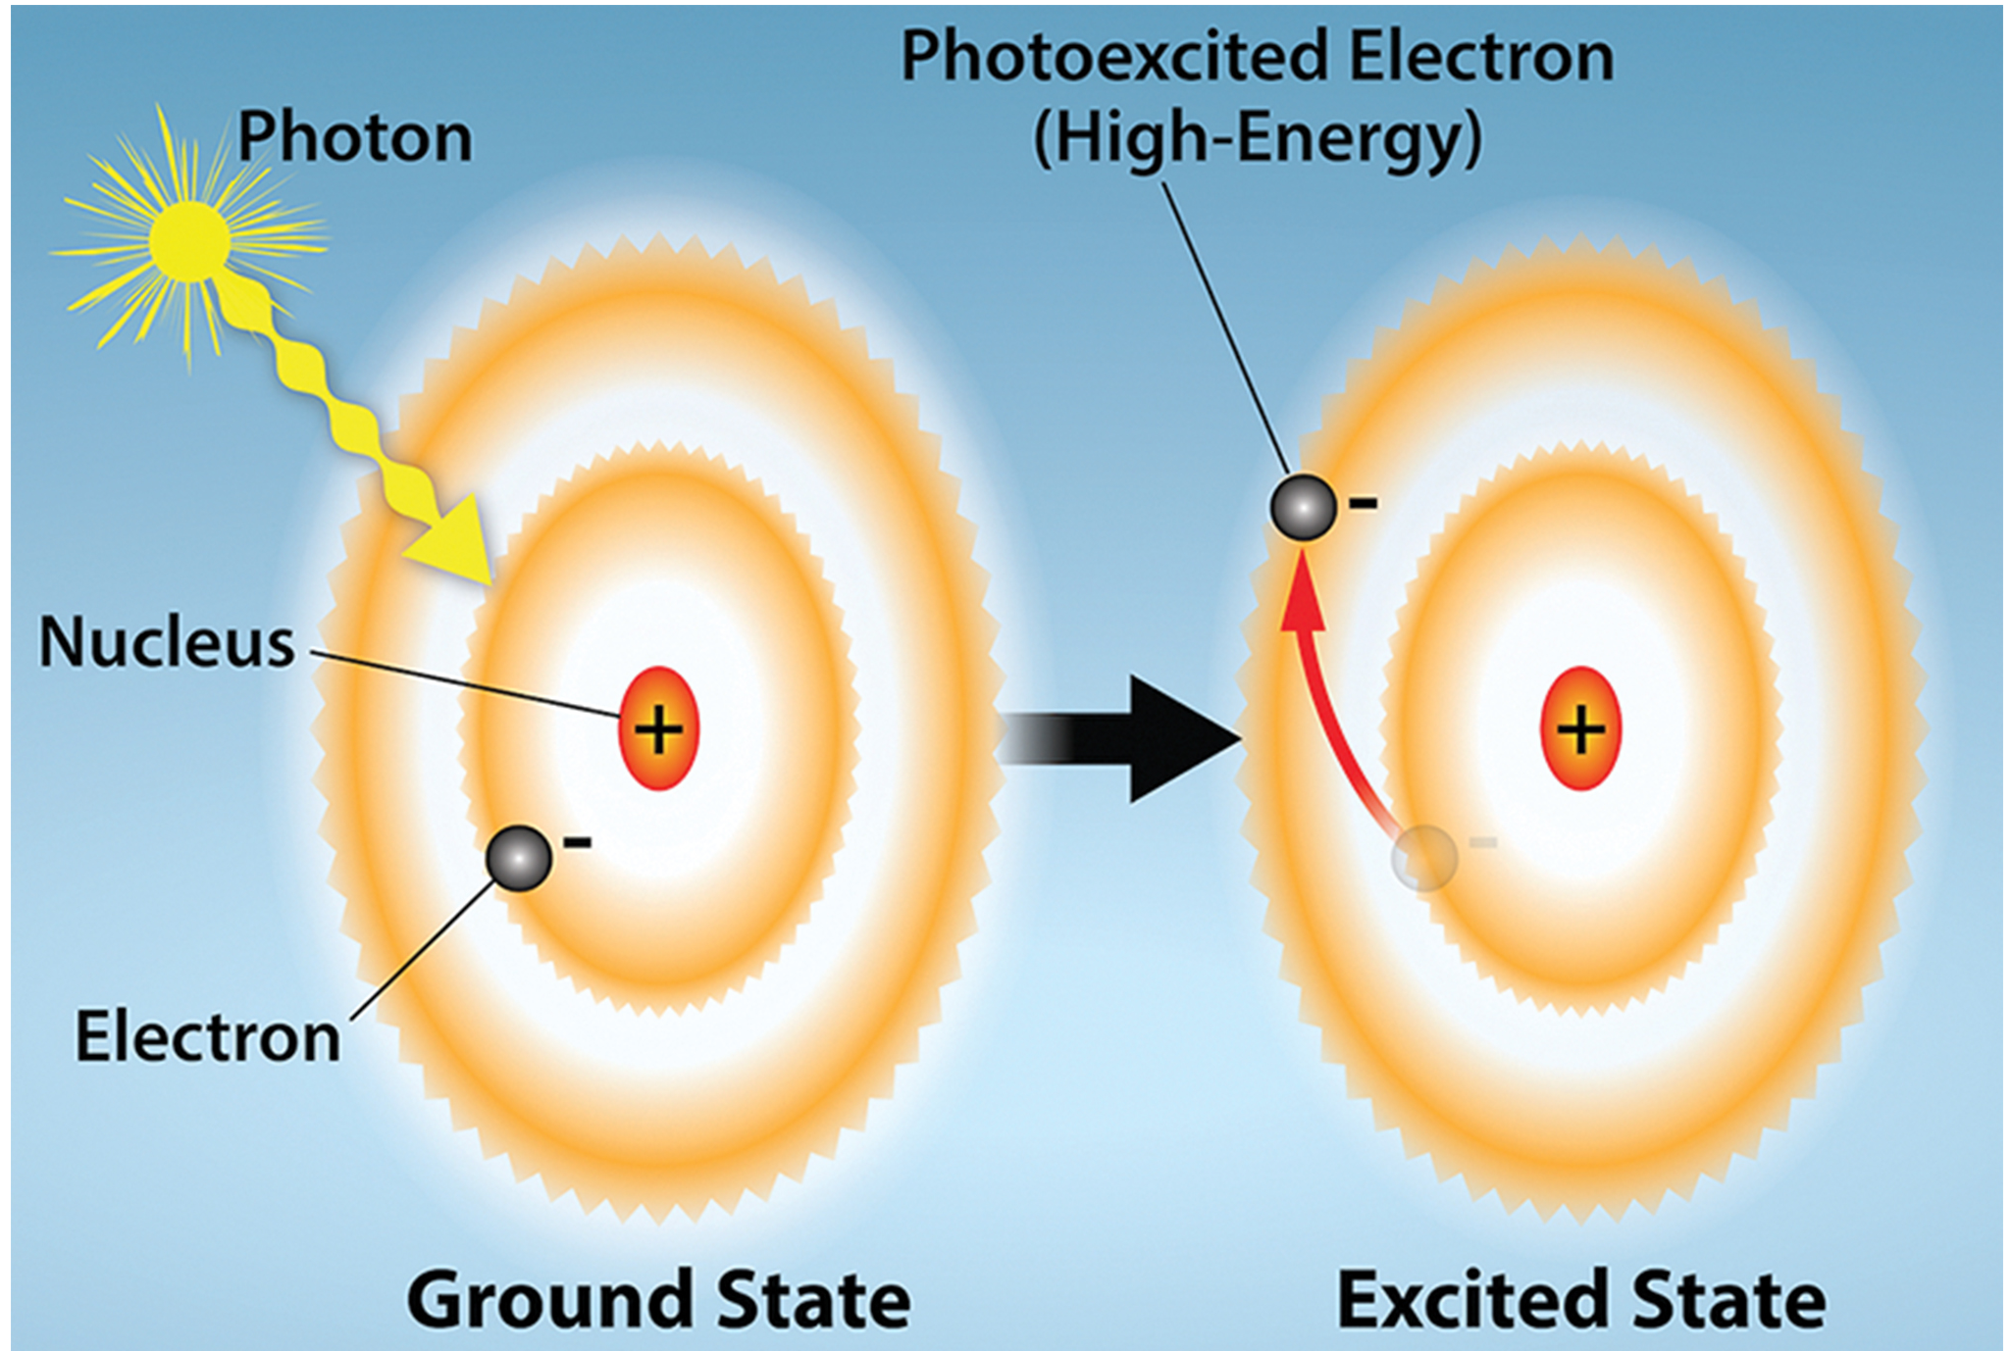
8.2 Figure 11
Rao, A. and Ryan, K. Department of Biology, Texas A&M University. "Excited electron."
Notes:
Figure 11: Light energy can excite electrons. When a photon of light energy interacts with an electron, the electron may absorb the energy and jump from its lowest energy ground state to an excited state.

Slide 21
How Light-Dependent Reactions Work₄
P680 delivers high-energy electrons to the primary electron acceptor and through the ETC (Pq to cytochrome complex to Pc) to PSI.
P680: reaction center of PSII
Primary electron acceptor: pigment or other organic molecule in the reaction center that accepts an energized electron from the reaction center
In P680, a low-energy electron is extracted from water (i.e., water is split), and PSII is re-reduced after every photoact.
10% of the oxygen produced is used by the mitochondria for cellular respiration (the production of ATP through oxidative phosphorylation). The remainder is released to the atmosphere.

Slide 22
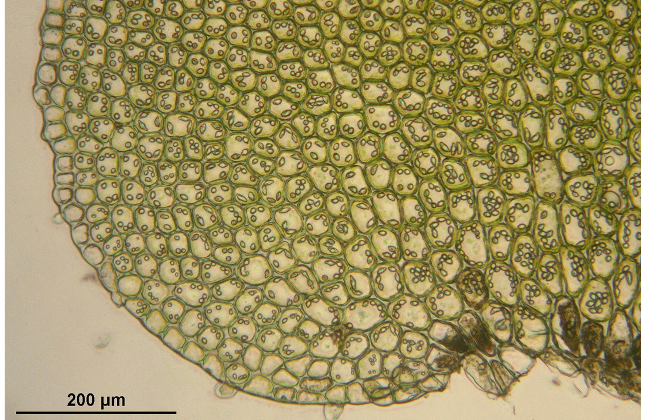
How Light-Dependent Reactions Work₅
Electrons lose energy as they move through proteins between PSII and PSI.
This energy is used to move hydrogen ions from the stromal side to the thylakoid lumen, where they will then be used to synthesize ATP.
Electrons must be re-energized in PSI; another photon is absorbed, and the energy is relayed to P700.
P700: reaction center of PSI
PSI captures the energy to reduce NADP⁺ into NADPH, so NADPH is roughly equivalent to ATP.
8.2 Figure 12: This light micrograph of a leaf shows the plant cells and the chloroplasts they contain.
WikimediaImages on Pixabay. "Cells with chloroplasts."

Slide 23
Generating an Energy Carrier: ATP
Buildup of hydrogen ions in thylakoid lumen creates concentration gradient
Passive diffusion (from high concentration in the thylakoid lumen to low concentration in the stroma) is harnessed to create ATP
Similar to ETC in cellular respiration
To release energy, ions go through protein channel ATP synthase
Allows ATP synthase to attach third phosphate group to ATP, forming molecule of ATP
Called chemiosmosis because ions move from high concentration to low through semipermeable structure of thylakoid

Slide 24
Summary
Pigments like chlorophyll in the antenna complexes absorb sunlight energy in the form of photons
Photons strike antenna pigments of PSII to initiate photosynthesis
Energy travels to reaction center that has chlorophyll a and then goes to ETC, which pumps hydrogen ions into thylakoid
Builds up a high concentration of hydrogen ions, which flow through ATP synthase during chemiosmosis to form ATP
ATP used to form sugar molecules in second stage of photosynthesis
PSI absorbs second photon, which forms NADPH (an energy and reducing carrier for light-independent reactions)

Slide 25


End of Hawkes Learning PowerPoint

