Slide 1
Lesson 8.3
The Calvin Cycle and Glucose Synthesis

Slide 2
Objectives
Define carbon fixation.
Describe the Calvin cycle.
Explain how photosynthesis works in the energy cycle of all living organisms.

Slide 3
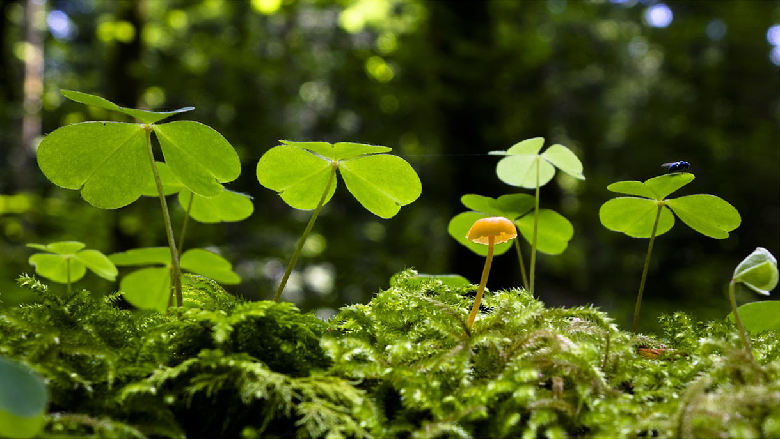
The Calvin Cycle and Glucose Synthesis
Powered by chemical energy stored in ATP and NADPH from the light-dependent reactions
Stored temporarily, need light-independent reactions to store long term
ATP and NADPH converted to carbohydrates and CO₂ (the waste product of respiration in microbes, fungi, plants, animals)
8.3 Figure 1: This mushroom releases carbon dioxide when it carries out aerobic respiration, and so does this plant! Plants both consume carbon dioxide via photosynthesis and release carbon dioxide via aerobic respiration. However, plants generally consume more than they release.
adege on Pixabay. "Mushroom and plant."

Slide 4
The Calvin Cycle
CO₂ enters through stomata until it reaches mesophyll cells, then diffuses into the stroma of the chloroplast (site of light-independent reactions)
Also called Calvin cycle, Calvin-Benson cycle, dark reaction
Calvin cycle: light-independent reactions of photosynthesis that convert carbon dioxide from the atmosphere into carbohydrates using the energy and reducing power of ATP and NADPH
Consists of 3 main stages:
Fixation
Reduction
Regeneration

Slide 5
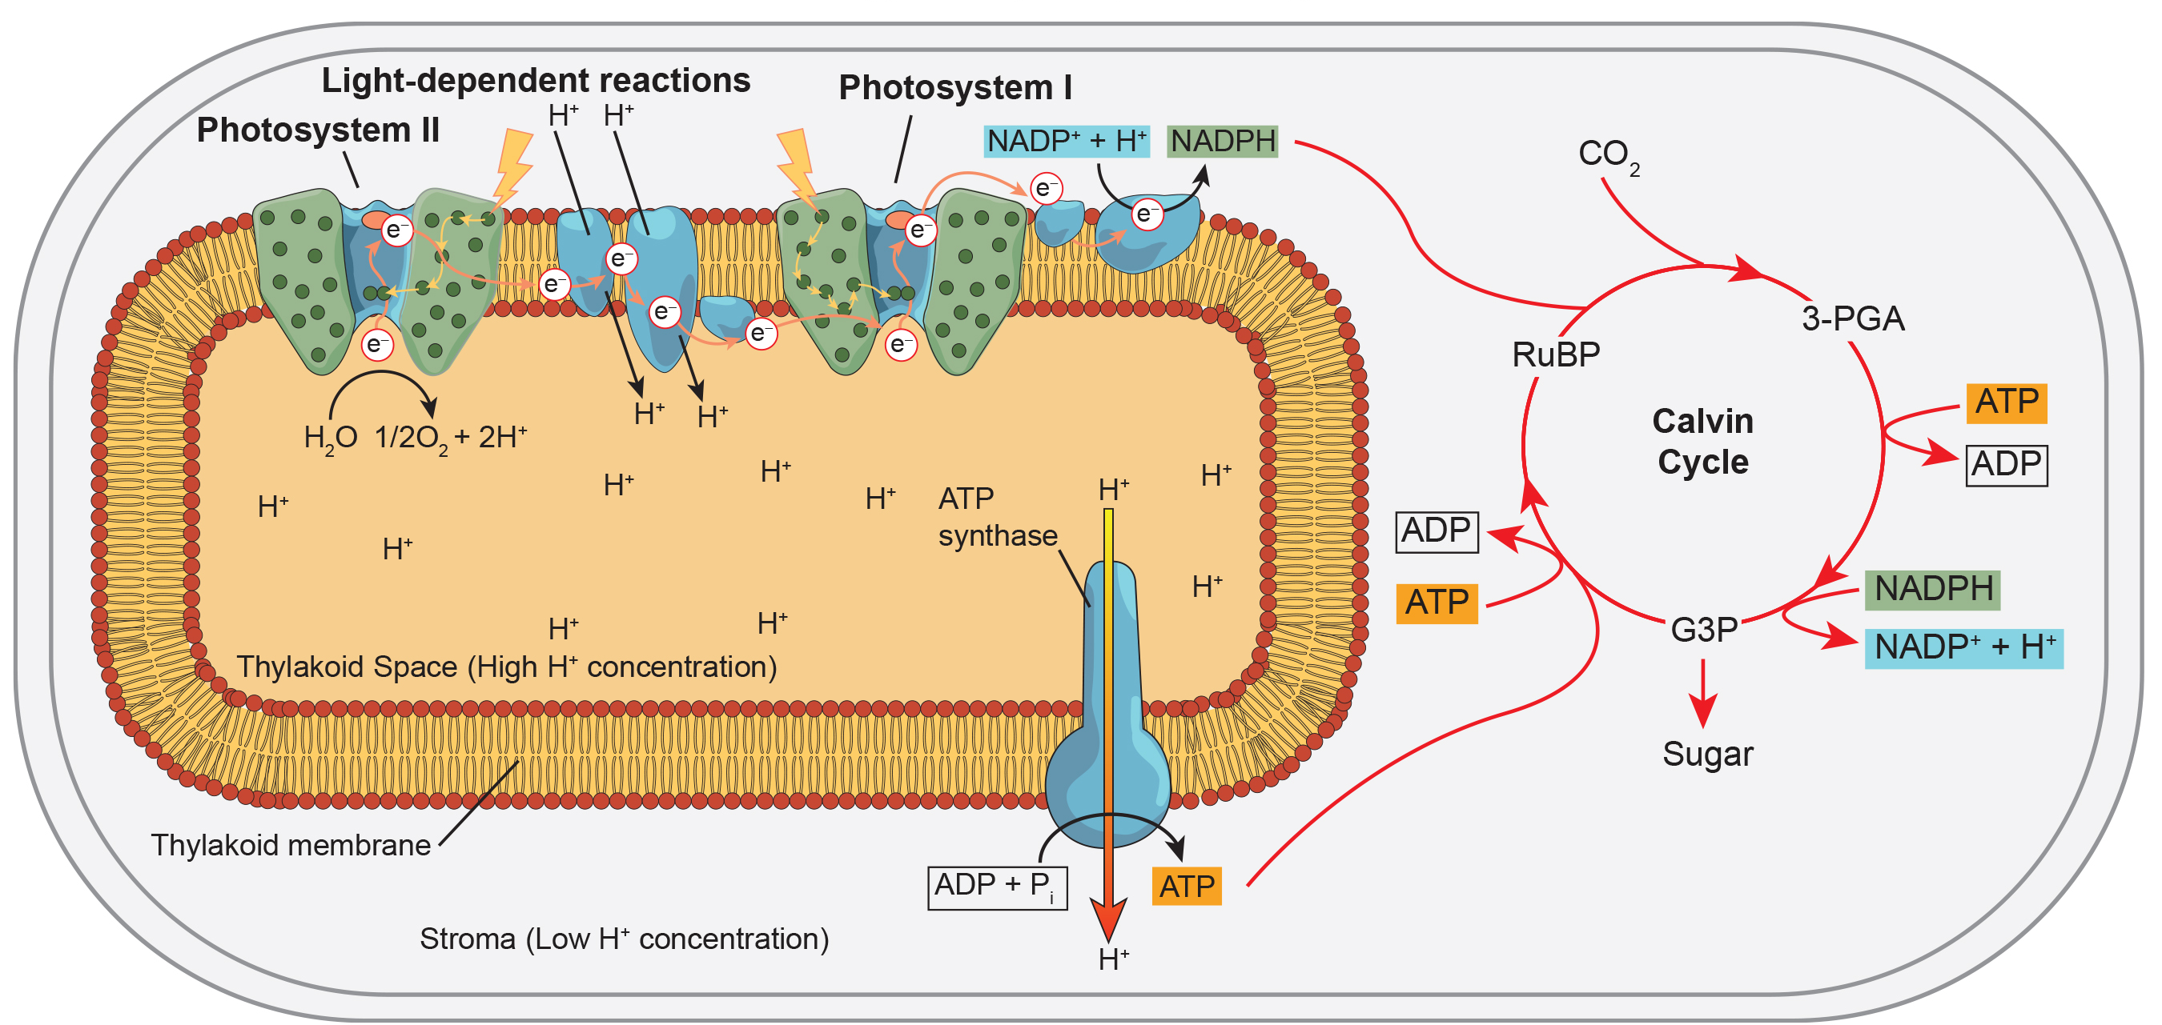
8.3 Figure 2
CNX OpenStax on Wikimedia Commons. "Light dependent reactions." Modified.
Notes:
Figure 2: Light reactions harness energy from the sun to produce chemical bonds, ATP, and NADPH. These energy-carrying molecules are made in the stroma (the liquid-filled space that surrounds the thylakoids), where carbon fixation (the process through which inorganic carbon from carbon dioxide is converted to organic molecules) takes place.

Slide 6
Stage 1: Fixation₁
In stroma, these components initiate light-independent reactions:
CO₂
Ribulose-1,5-bisphosphate carboxylase/oxygenase (RuBisCO)
Three molecules of ribulose bisphosphate (RuBP)

Slide 7
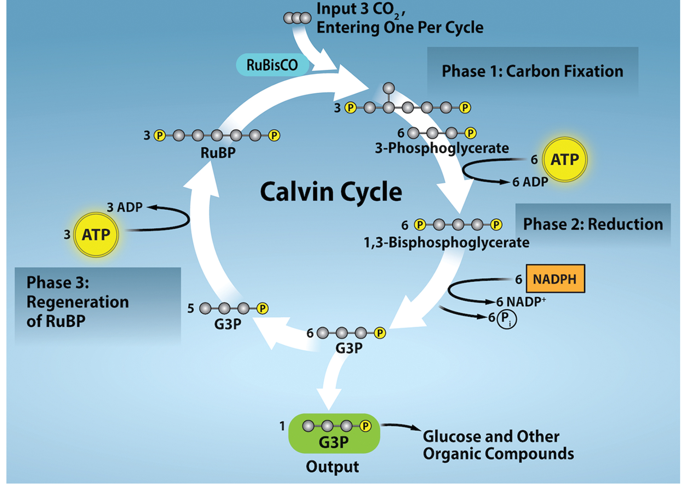
8.3 Figure 3
Rao, A., Ryan, K., Tag, A., Fletcher, S. and Hawkins, A. Department of Biology, Texas A&M University. "Calvin cycle."
Notes:
Figure 3: The Calvin cycle has three stages. In stage 1, the enzyme RuBisCO incorporates carbon dioxide into an organic molecule, 3-PGA (3-phosphoglyceric acid). In stage 2, the organic molecule is reduced, using electrons supplied by NADPH. In stage 3, RuBP, the molecule that starts the cycle, is regenerated so that the cycle can continue. Only one carbon dioxide molecule is incorporated at a time, so the cycle must be completed three times to produce a single 3-carbon G3P molecule and six times to produce a 6-carbon glucose molecule.

Slide 8
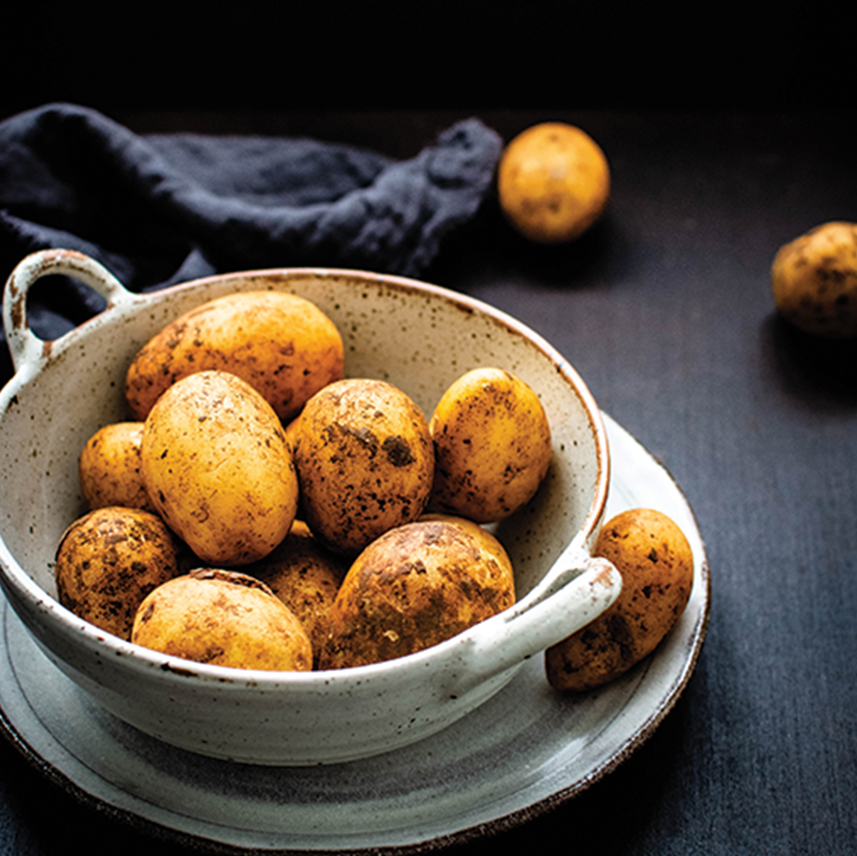
Stage 1: Fixation₂
RuBisCO catalyzes reaction between CO₂ and RuBP
Produces 2 molecules of 3-phosphoglyceric acid (3-PGA) per CO₂ molecule
PGA has 3 carbons and 1 phosphate
1 RuBP + 1 CO₂ = 2 3-PGA
Carbon fixation: process of converting inorganic CO₂ gas into organic compounds
3 C from 3CO₂ + 15 C from 3RuBP = 18 C in 6 3-PGA
8.3 Figure 4: Potatoes are examples of stored plant energy in the form of starch. Photosynthesis creates glucose, and those glucose molecules are snapped together into long starch polymers.
Monika Grabkowska on Unsplash. "Potatoes."

Slide 9
Stage 2: Reduction₁
6 molecules of 3-PGA converts to 6 molecules of glyceraldehyde 3-phosphate (G3P)
Reduction reaction where 3-PGA gains electrons
Reduction: gain of electron(s) by an atom or molecule
Requires 6 molecules of ATP and NADPH

Slide 10
Stage 2: Reduction₂
Each 3-PGA receives 1 phosphate group from ATP
Produces 1,3-bisphosphoglycerate (molecule with 2 phosphate groups)
Forms ATP as byproduct
Reduction occurs as each 1,3-bisphosphoglycerate gains 2 electrons from NADPH and loses 1 phosphate group
Producing G3P as output
NADP⁺ and phosphate as byproducts
ADP and NADP⁺ return to light-dependent reactions to be reused and re-energized

Slide 11
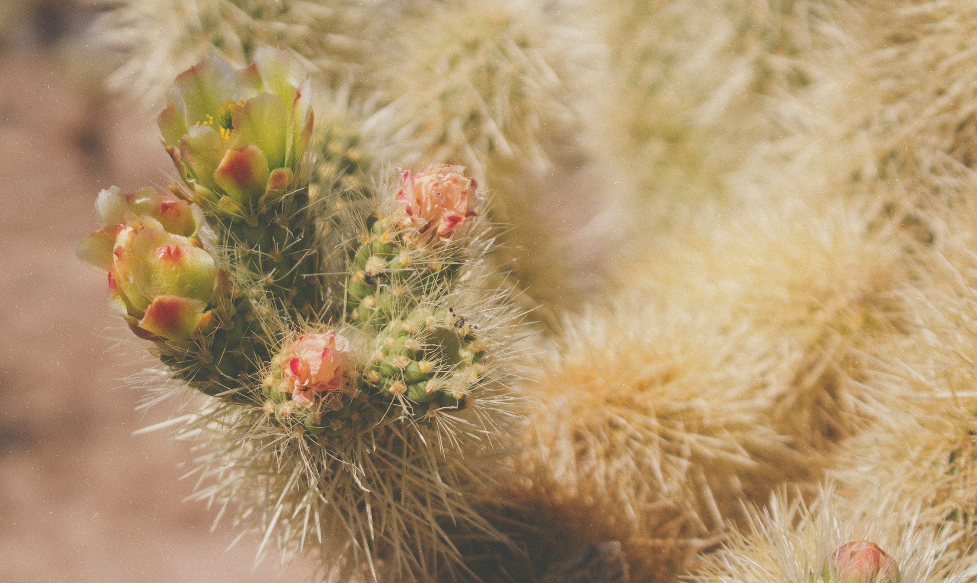
Stage 3: Regeneration
Only one G3P molecule leaves to make glucose
Takes 3 turns to fix enough net carbon to export 1 G3P
Produces 6 G3Ps; one is exported and 5 remain and used to regenerate RuBP
3 more ATP used in these reactions
8.3 Figure 5: The harsh conditions of the desert have led plants, like these cacti, to evolve variations of the light-independent reactions of photosynthesis. These variations increase the efficiency of water usage, helping to conserve water and energy.
jewad alnabi on Unsplash. "Cactus."

Slide 12
Evolution of Photosynthesis
The earliest process had one photosystem and did not use NADPH or produce oxygen.
Still made ATP
The modern process has two photosystems and makes both ATP and NADPH.
Plants must conserve and use every drop of water to survive.
Stomata open to uptake CO₂, but water escapes
Adaptations to prevent loss of water:
Capture and store CO₂ for later use
Example: Cacti open stomata at night to uptake CO₂ and use temporary carbon fixation process to store it until daytime, then use captured CO₂ with the products of light-dependent reactions to produce sugars

Slide 13
Think It Through₁
Identify one way that a cactus manages stomata differently than most plants. Identify one way that photosynthesis, as performed by a cactus, differs from most plants.
Notes:
Originally an On Your Own. This is included here to use as a talking point or for a think-pair-share activity.

Slide 14
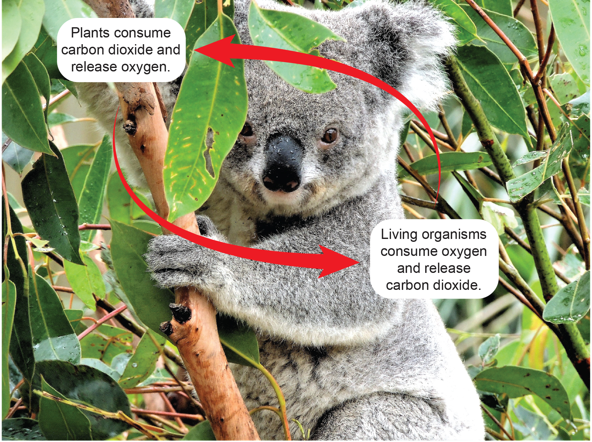
Energy Flow₁
All living things access energy by breaking down carbohydrates and other carbon-rich organic molecules.
They can either make their own food or eat another organism.
They use cellular respiration to break down food, release needed energy, and produce CO₂ waste.
8.3 Figure 6
Geoff Williamson on Pexels. "Koala."

Slide 15
Think It Through₂
Consider a closed, sunny ecosystem consisting of a koala and a tree. Describe the flow of energy through this ecosystem. Then, compare that flow of energy with the movement of carbon.
Notes:
Originally an On Your Own. This is included here to use as a talking point or for a think-pair-share activity.

Slide 16
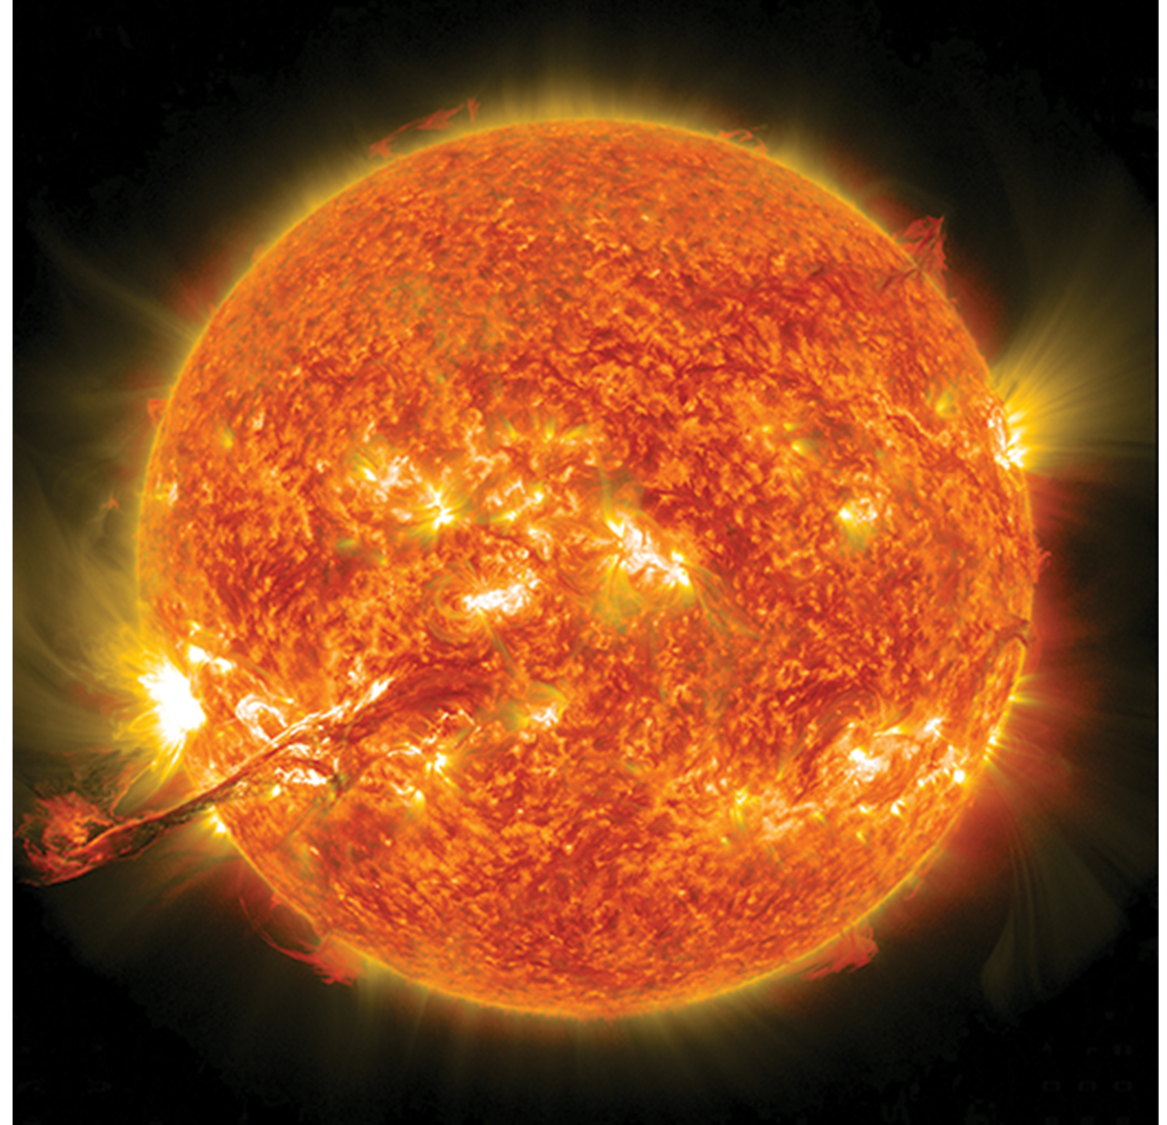
Energy Flow₂
Everything is conserved and recycled infinitely.
The byproducts CO₂ (in cellular respiration) and oxygen (in photosynthesis) move on to other reactions.
Photosynthesis and aerobic cellular respiration are in biological, cyclical harmony to allow access to energy that originates from the sun.
8.3 Figure 7
NASA on Unsplash. "Solar flares."

Slide 17
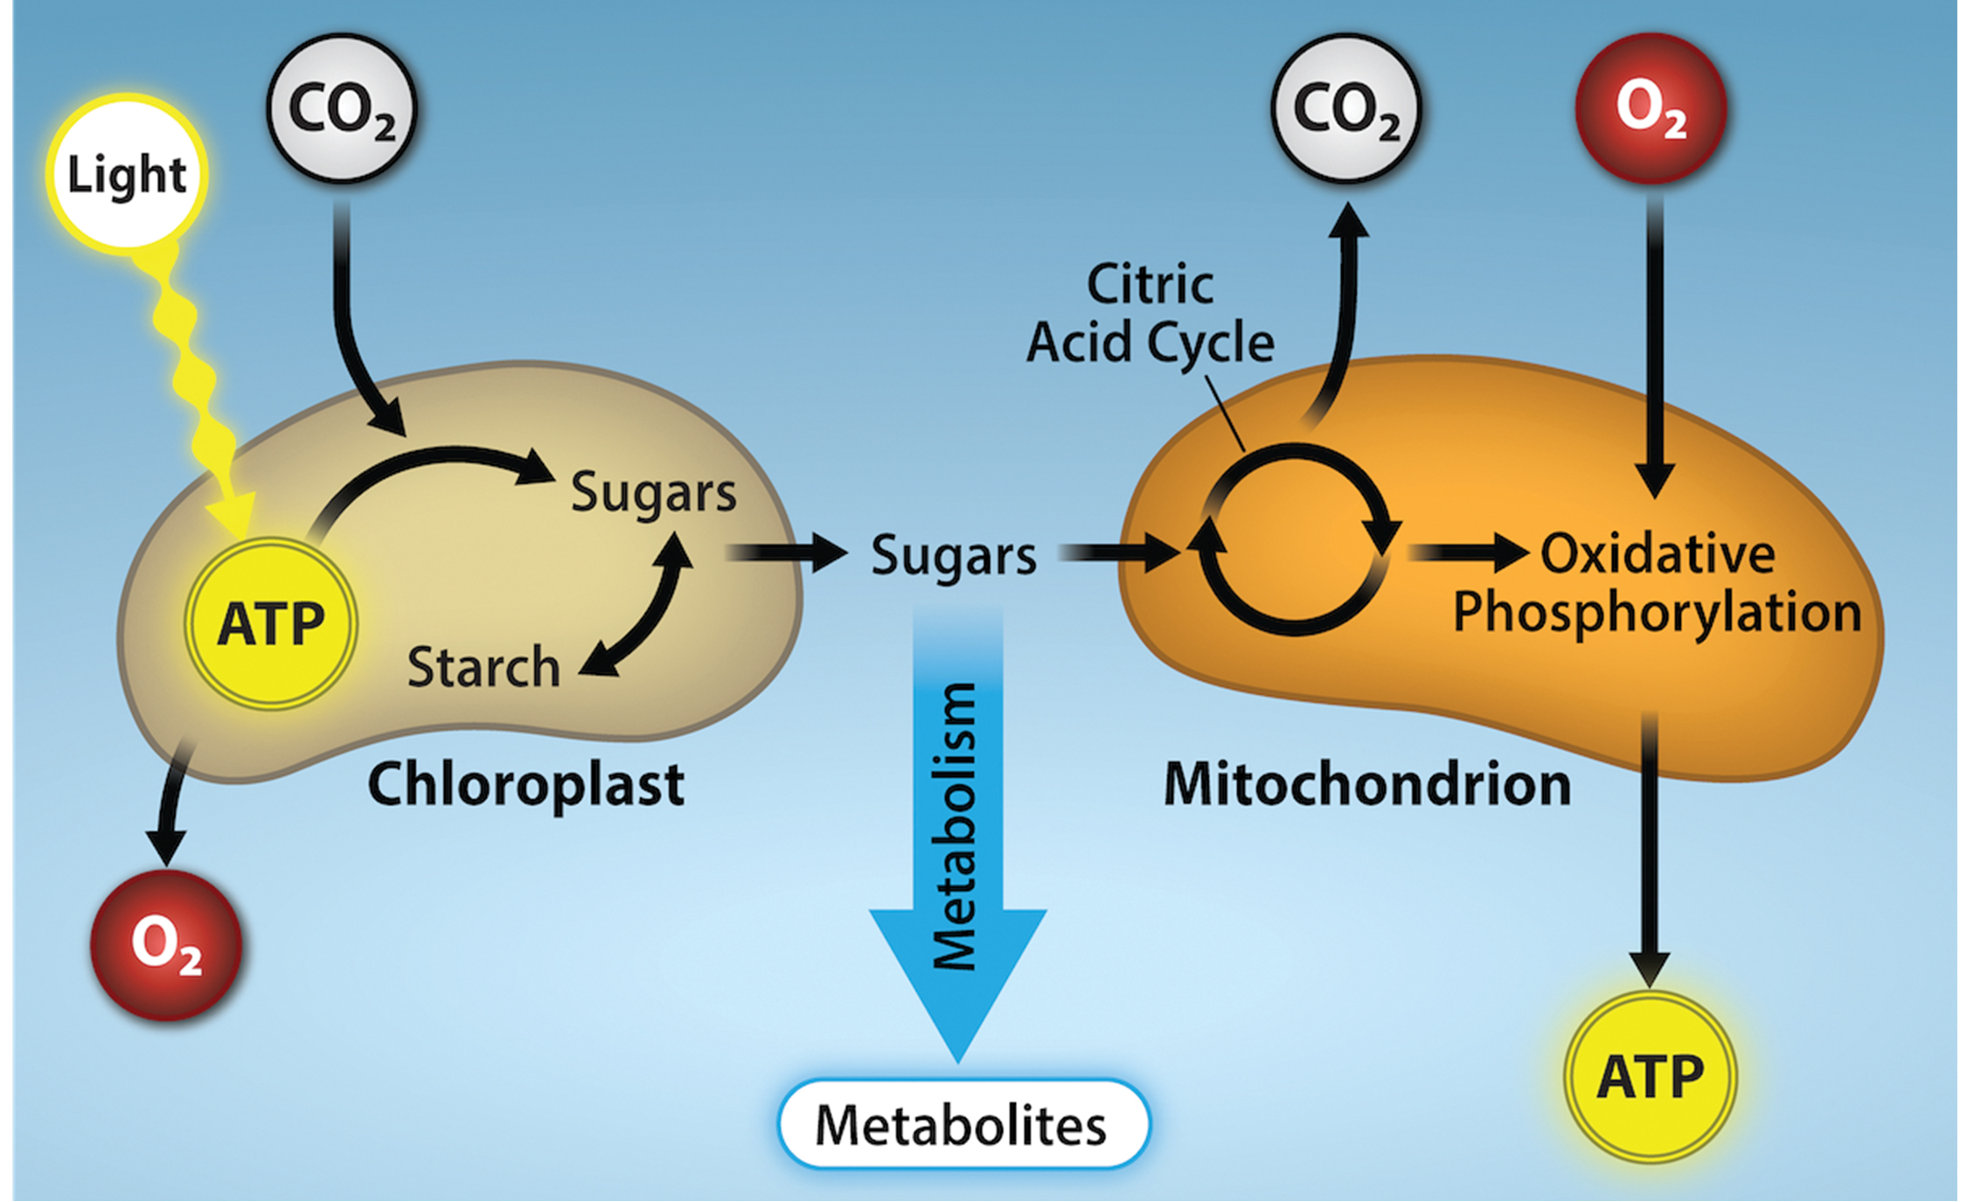
8.3 Figure 8
Rao, A., Ryan, and Tag, A. Department of Biology, Texas A&M University. "Photosynthesis and respiration photosynthesis."
Notes:
Figure 8: This diagram illustrates the connection between photosynthesis and cellular respiration. Photosynthesis in chloroplasts is the process by which light energy is converted to chemical energy and stored in sugars. Initially, the light energy is converted into chemical energy during ATP synthesis in a process that gives off oxygen. The energy in ATP is then used to reduce CO2 to simple sugars. In contrast, cellular respiration is the process in which the chemical energy stored in sugars is converted into ATP, a source of chemical energy that can be used by the rest of the cell. In the process of converting the energy stored in the sugars to ATP, CO2 is released and oxygen is consumed.

Slide 18
Summary
The light-independent reactions (Calvin cycle) use the energy carriers ATP and NADPH to take in CO₂ from the atmosphere.
The enzyme RuBisCO catalyzes a reaction of CO₂ and RuBP.
After 3 cycles, one 3-carbon molecule (G3P) leaves to become part of a carbohydrate molecule.
The remaining G3P molecules regenerate RuBP to continue the cycle.
Photosynthesis and cellular respiration form an energy cycle.
Plants have both chloroplasts (site of photosynthesis) and mitochondria (site of respiration).

Slide 19


End of Hawkes Learning PowerPoint

