Slide 1
Lesson 9.1
Signaling Molecules and Cellular Receptors

Slide 2
Objectives
Compare internal receptors with cell-surface receptors.
Describe four types of signaling mechanisms found in multicellular organisms.
Recognize the relationship between a ligand's structure and its mechanism of action.

Slide 3

Cell Communication
Communication between cells (intercellular signaling) and within cells (intracellular signaling) is vital.
Cells respond to external stimuli and coordinate functions.
Even single-celled organisms communicate to coordinate behaviors.
May create biofilms
9.1 Figure 1: If you and your friend lose each other in a crowd, but have cell phones, you're more likely to find each other. Cell phone networks use various methods of encoding and signaling. Similarly, cells must communicate using specific signals and receptors to ensure that messages are clear.
CHUTTERSNAP on Unsplash. "Crowd."

Slide 4
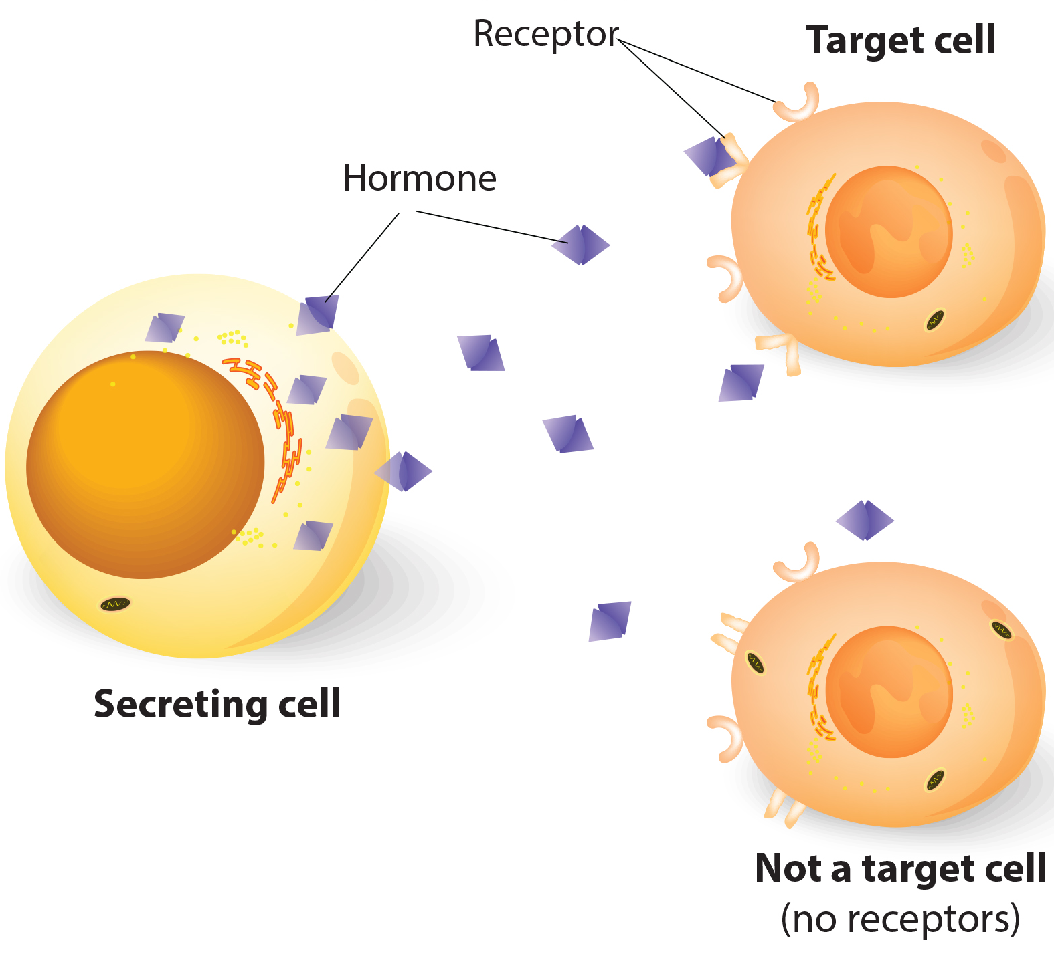
Signaling Molecules and Cellular Receptors
Two types of cellular communication:
Intercellular signaling: communication between cells
Intracellular signaling: communication within a cell
Signaling cells release small molecules called ligands that act as signaling molecules
Ligands bind to specific receptor proteins on target cells.
9.1 Figure 2

Slide 5
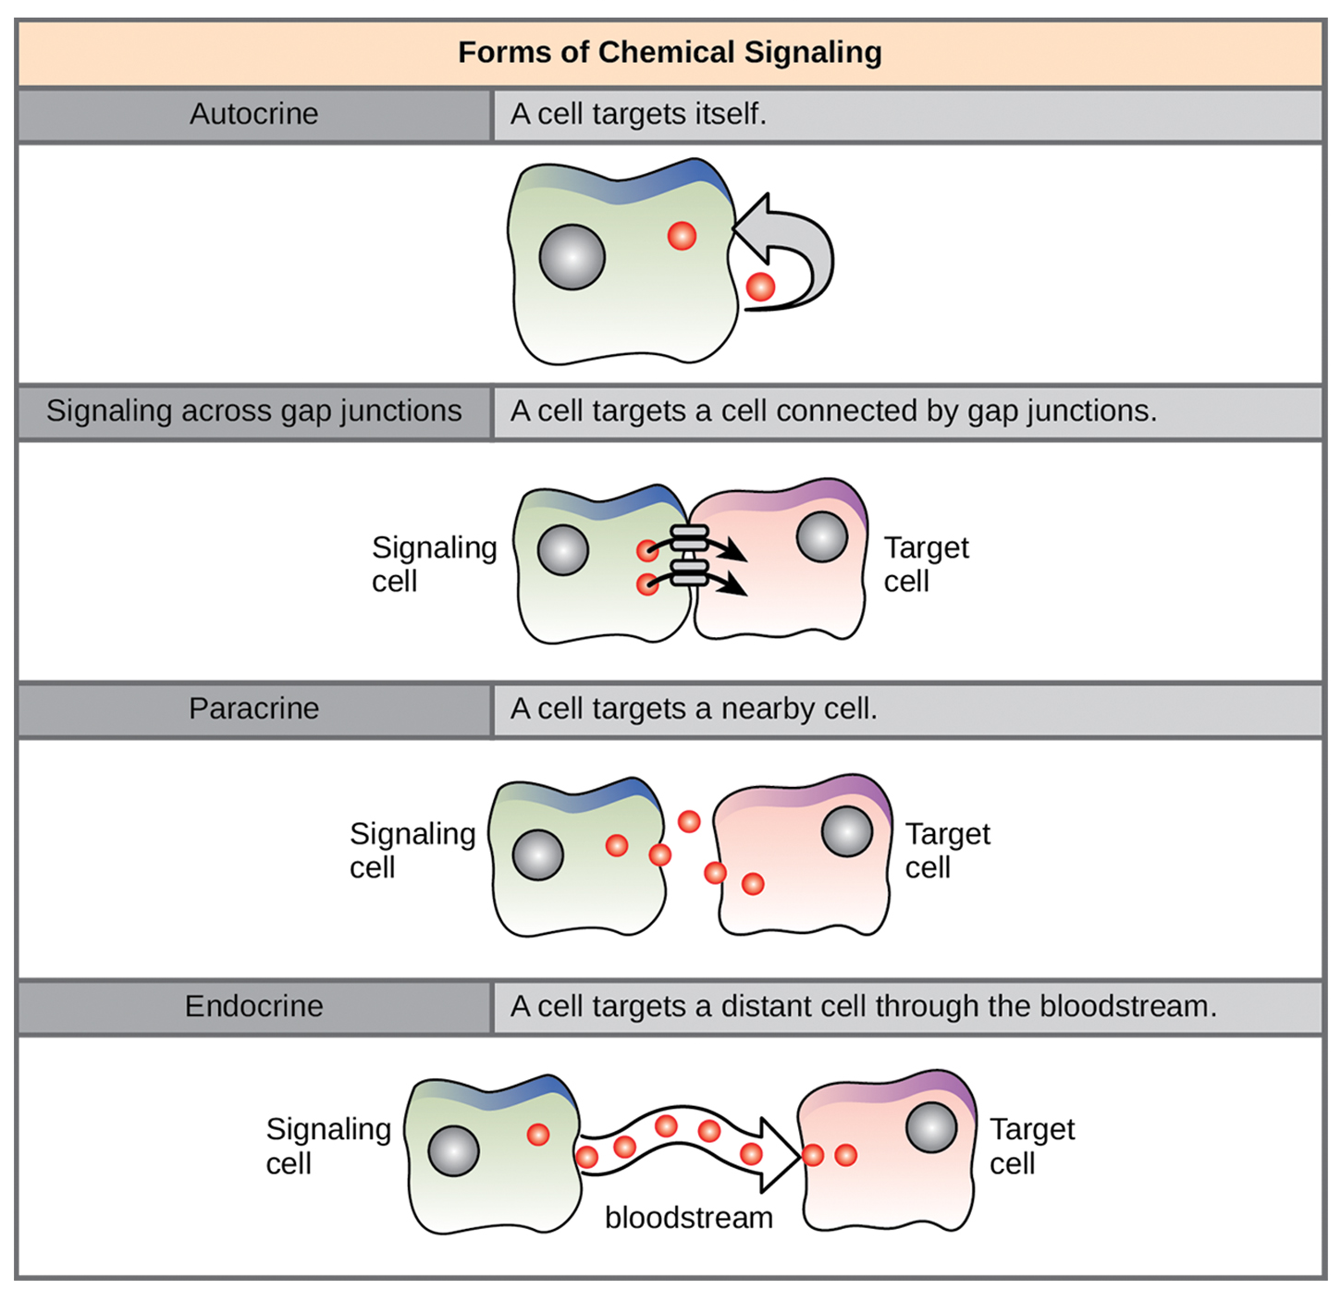
Forms of Signaling
Four categories of chemical signaling in multicellular organisms.
Paracrine signaling
Endocrine signaling
Autocrine signaling
Direct signaling across gap junctions
The main differentiating factor is the distance the signal travels to reach target cell.
Not all cells are affected by the same signals.
9.1 Figure 3
CNX OpenStax on Wikimedia Commons. "Chemical signaling."

Slide 6
Paracrine Signaling₁
Paracrine Signals: signals that act locally between nearby cells by diffusing through extracellular matrix
Ligands rapidly degraded to localize the response.
Removing the signal reestablishes the concentration gradient for the signal.

Slide 7
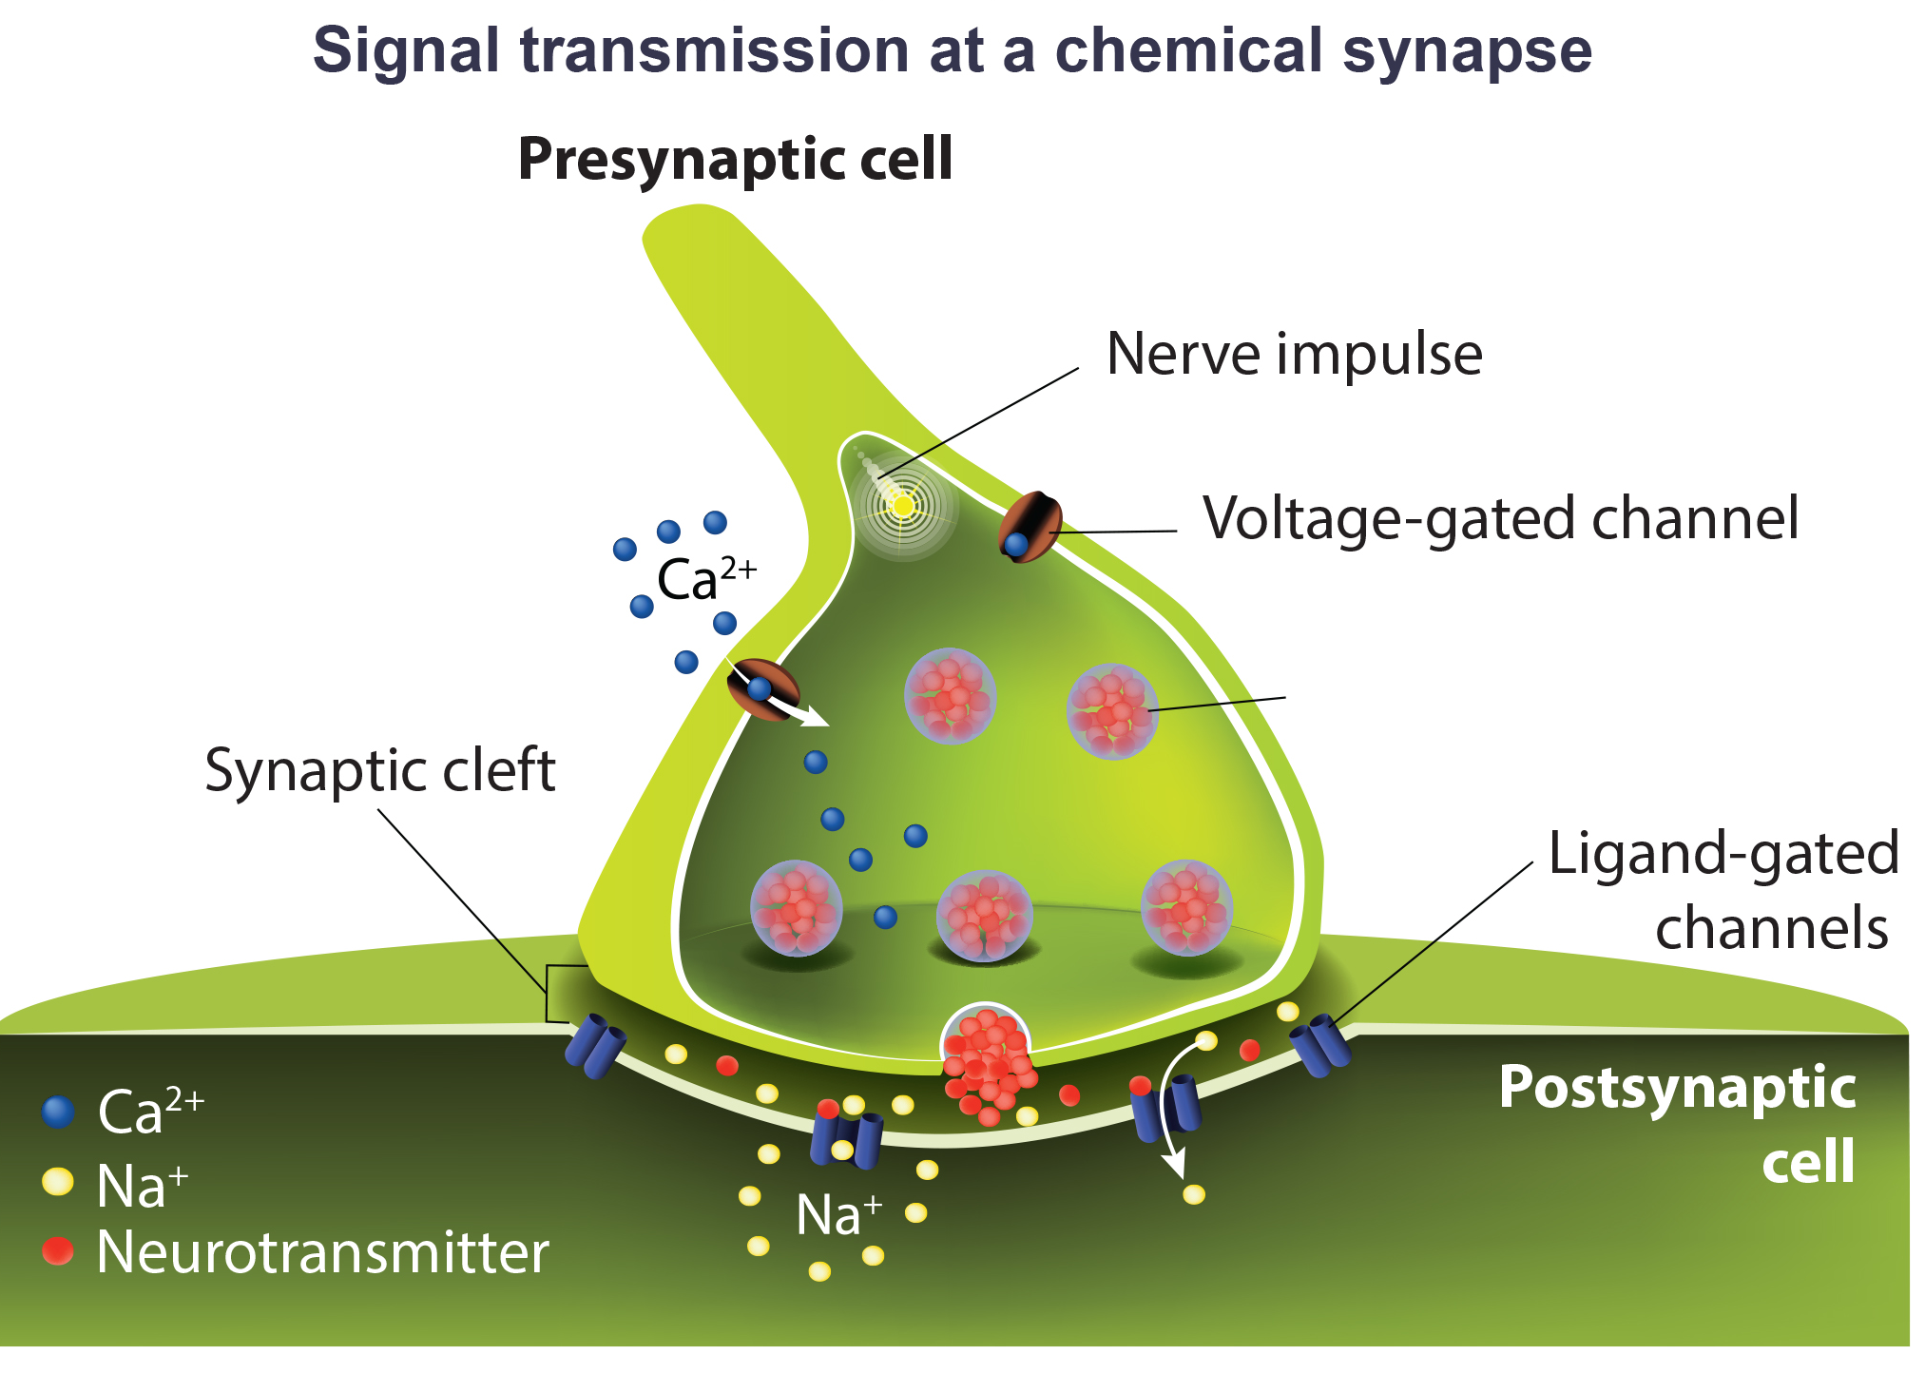
Paracrine Signaling₂
Nerve cell signaling is an example of paracrine signaling.
The junction between nerve cells is a synapse.
A synaptic signal is a chemical signal that travels between nerve cells.
The signal is carried out by neurotransmitters (chemical ligands) diffusing across the chemical synapse and changes the electrochemical potential in the next nerve cell, creating an electrical impulse.
9.1 Figure 4

Slide 8
Endocrine Signaling
Endocrine signals: signals from distant cells that originate form endocrine cells
Many are located in endocrine glands (secrete signals into the blood) such as the thyroid gland, hypothalamus, and pituitary gland.
Chemical signals known as hormones produce a slow response, but long-lasting effect.
Due to the large distance, hormones are in low concentration when they reach their target.

Slide 9
Autocrine Signaling
Autocrine signals: signal that is sent and received by the same or similar nearby cells
Regulates cell differentiation into different tissues during development, pain sensation, inflammatory responses, and even programmed cell death

Slide 10
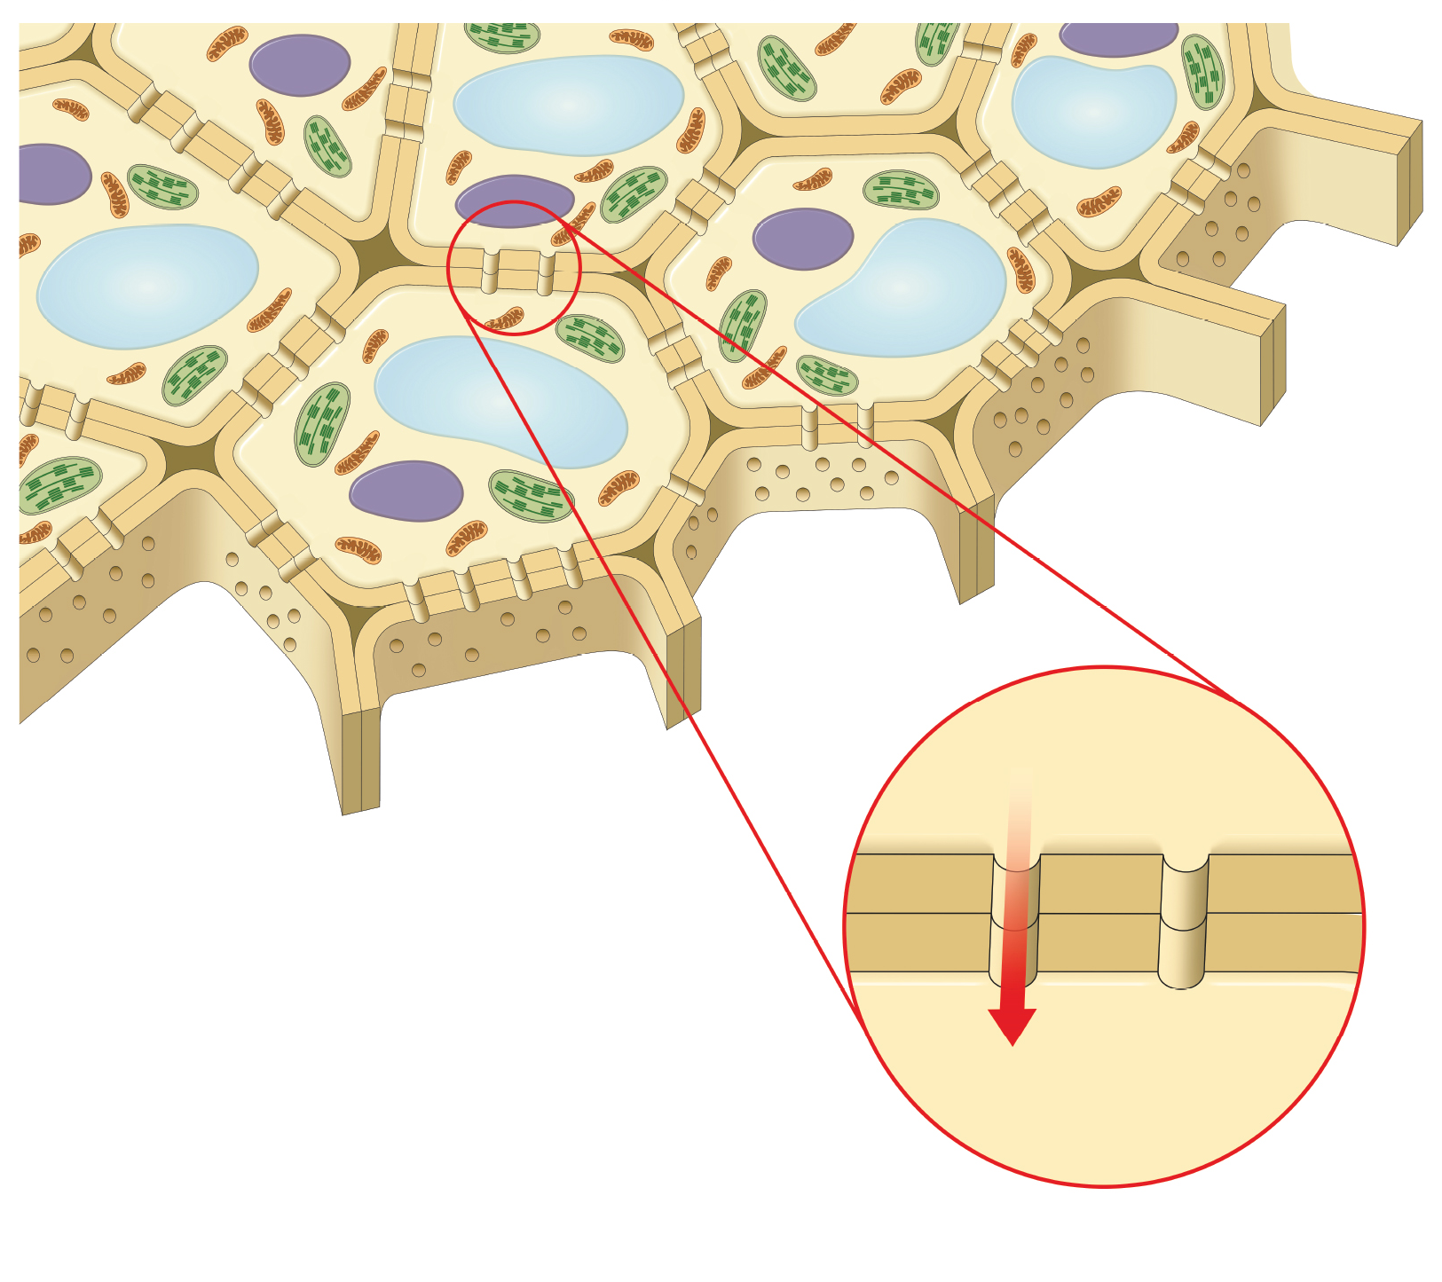
Direct Signaling Across Gap Junctions
Intercellular mediators: small molecules that diffuse directly between neighboring cells through gap junction channels to transmit a signal
Allows a group of cells to coordinate a response to a single signal
Plants use plasmodesmata channels for signaling network.
9.1 Figure 5: Plasmodesmata between adjacent plant cells allow for the continuous transfer of signaling molecules.

Slide 11
Types of Receptors
Receptors are protein molecules in the target cell, or on its surface, that bind ligands. They are either:
Internal receptors
Cell-surface receptors

Slide 12
Types of Receptors: Internal Receptors
Internal receptors are located in the cytoplasm and respond to hydrophobic ligands that cross plasma membrane.
Once the ligand is in the cell it often interacts with proteins that regulate mRNA synthesis to mediate gene expression.
Binding causes a conformational change in the receptor that exposes a DNA-binding site.
Ligand-receptor complex moves into the nucleus where it binds to a regulatory region in the DNA.

Slide 13
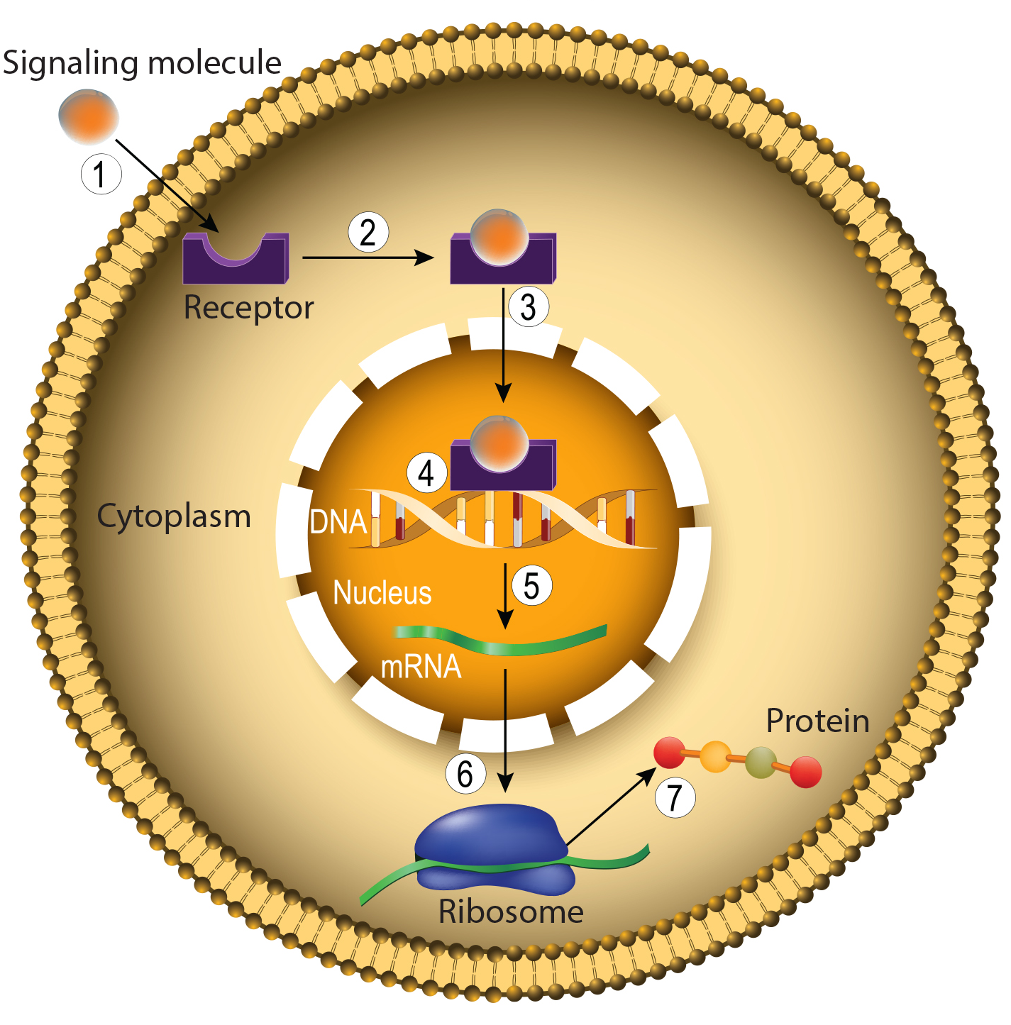
Cell-Surface Receptors
Cell-surface receptors, or transmembrane proteins, are cell surface, membrane-anchored proteins that bind external ligands and transduce signals
Are specific to individual cell types
Has an extracellular domain, transmembrane domain, and intracellular domain
Receptor malfunctions can lead to diseases like hypertension, asthma, heart disease, and cancer.
9.1 Figure 6

Slide 14
Evolution Connection
How Viruses Recognize a Host
Viruses lack metabolic machinery and rely on host cells for reproduction.
Viruses recognize and bind to specific cell-surface receptors on their host cells to gain entry.
Differences in cell-surface receptors between species contribute to viral host specificity.
Rapid viral replication with random errors can lead to mutations allowing viruses to bind new host receptors and jump species barriers.
Close human-animal contact increases opportunities for viruses to evolve the ability to infect humans, becoming emerging viral threats that require monitoring.

Slide 15
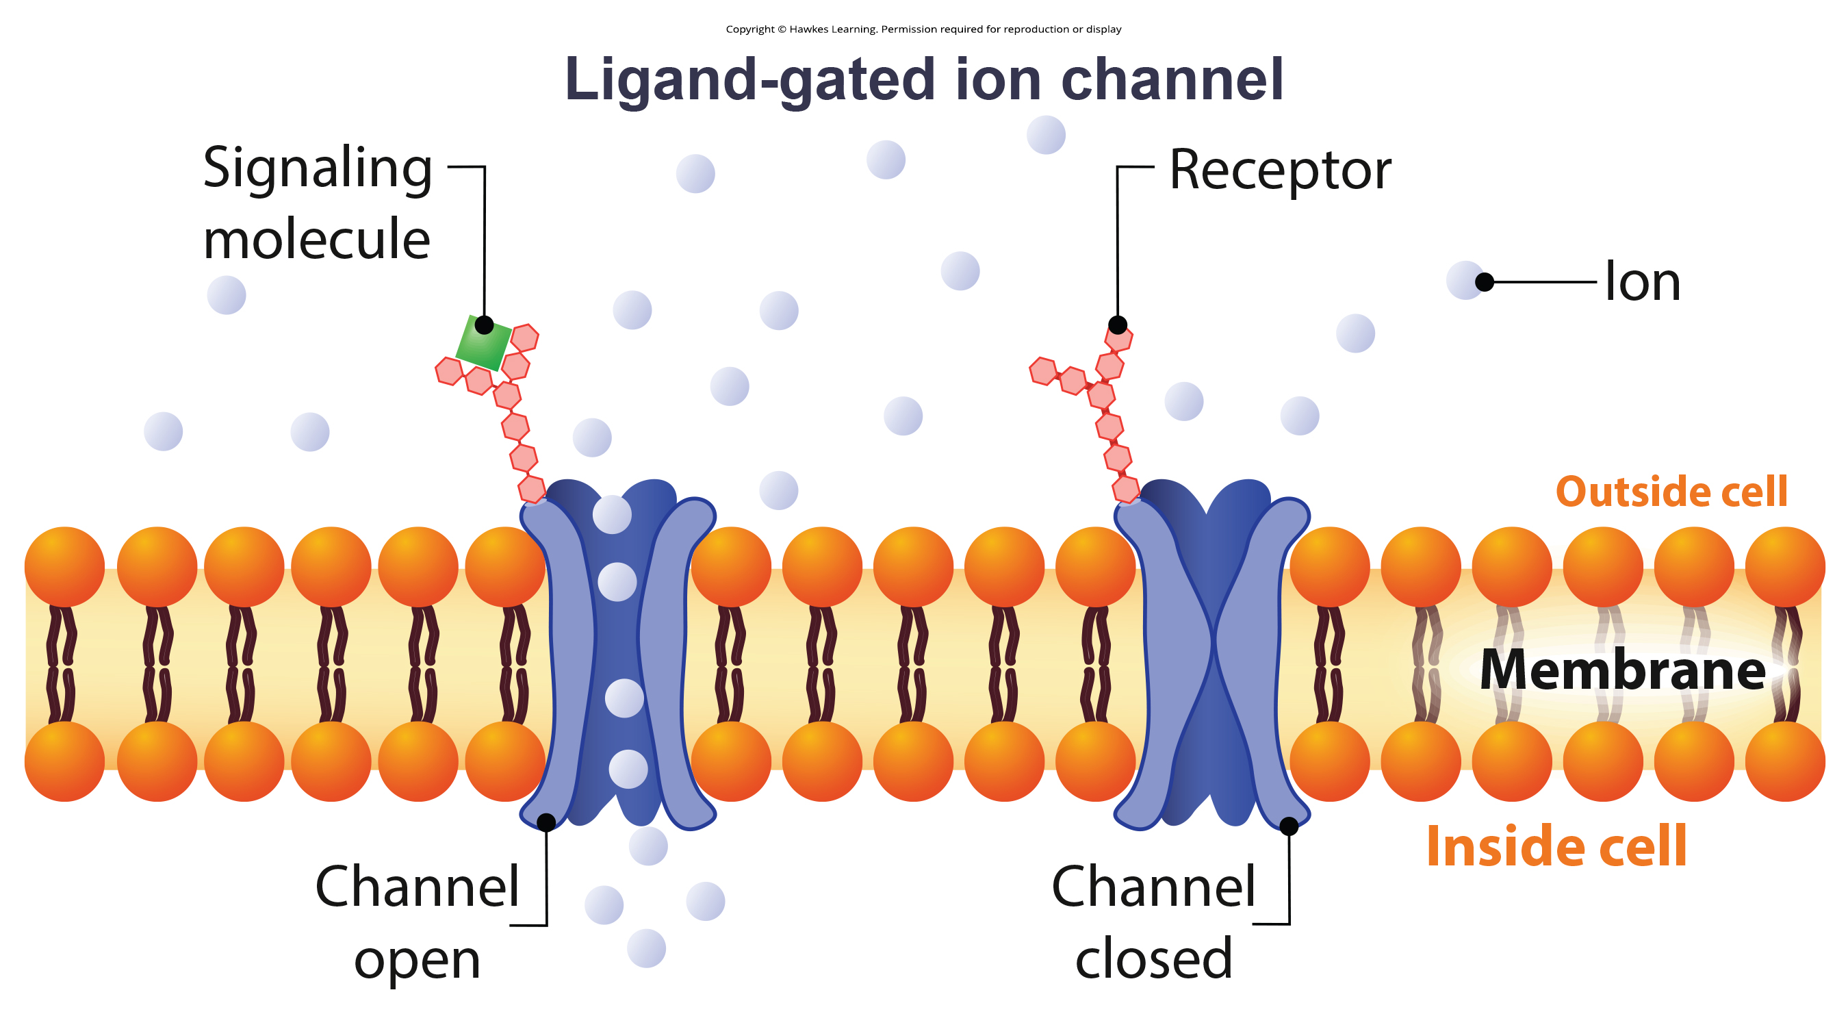
Ion Channel-Linked Receptors
Ion channel-linked receptors: cell-surface receptor that forms a plasma membrane channel, which opens (conformational change) when a ligand binds to the extracellular domain
Channel is hydrophilic allowing water or ions to pass through.
9.1 Figure 7

Slide 16
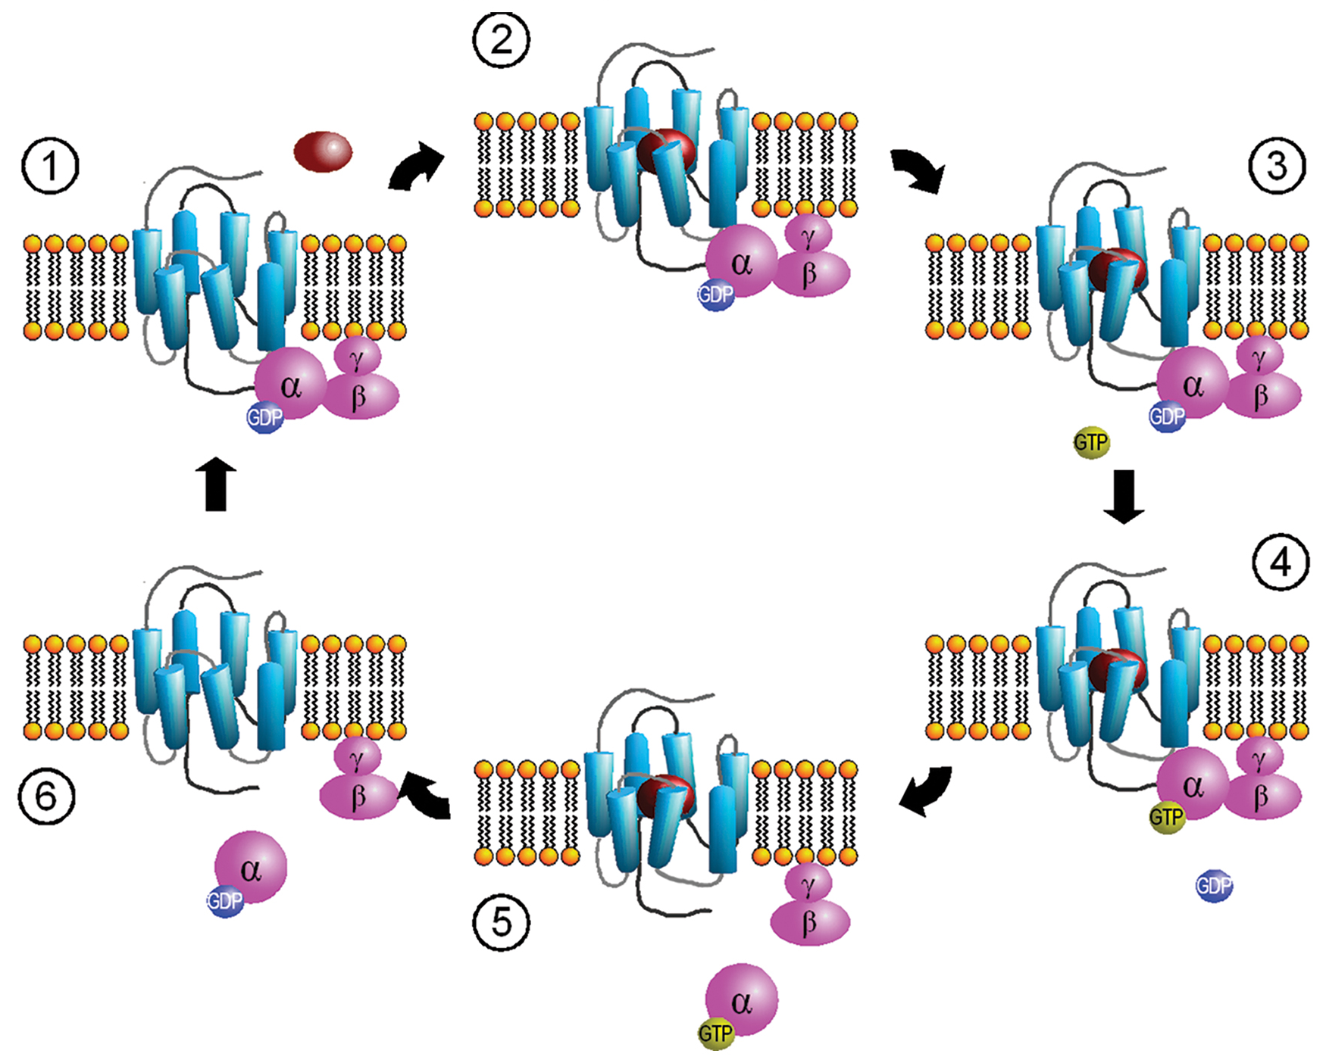
G Protein-Coupled Receptors₁
G Protein-Coupled Receptors (GPCRs): bind to a ligand and activate a G membrane protein.
Binding activates G proteins by exchanging GDP for GTP
G protein splits into α and βγ subunits
Then interacts with an ion channel or enzyme
9.1 Figure 8: When a signaling molecule binds to a G protein-coupled receptor in the plasma membrane, a GDP molecule associated with the α subunit is exchanged for GTP. The β and γ subunits dissociate from the α subunit, and a cellular response is triggered either by the α subunit or the dissociated βγ pair. Hydrolysis of GTP to GDP terminates the signal.
Sven Jähnichen on Wikimedia Commons. "Activation cycle of G-proteins."

Slide 17
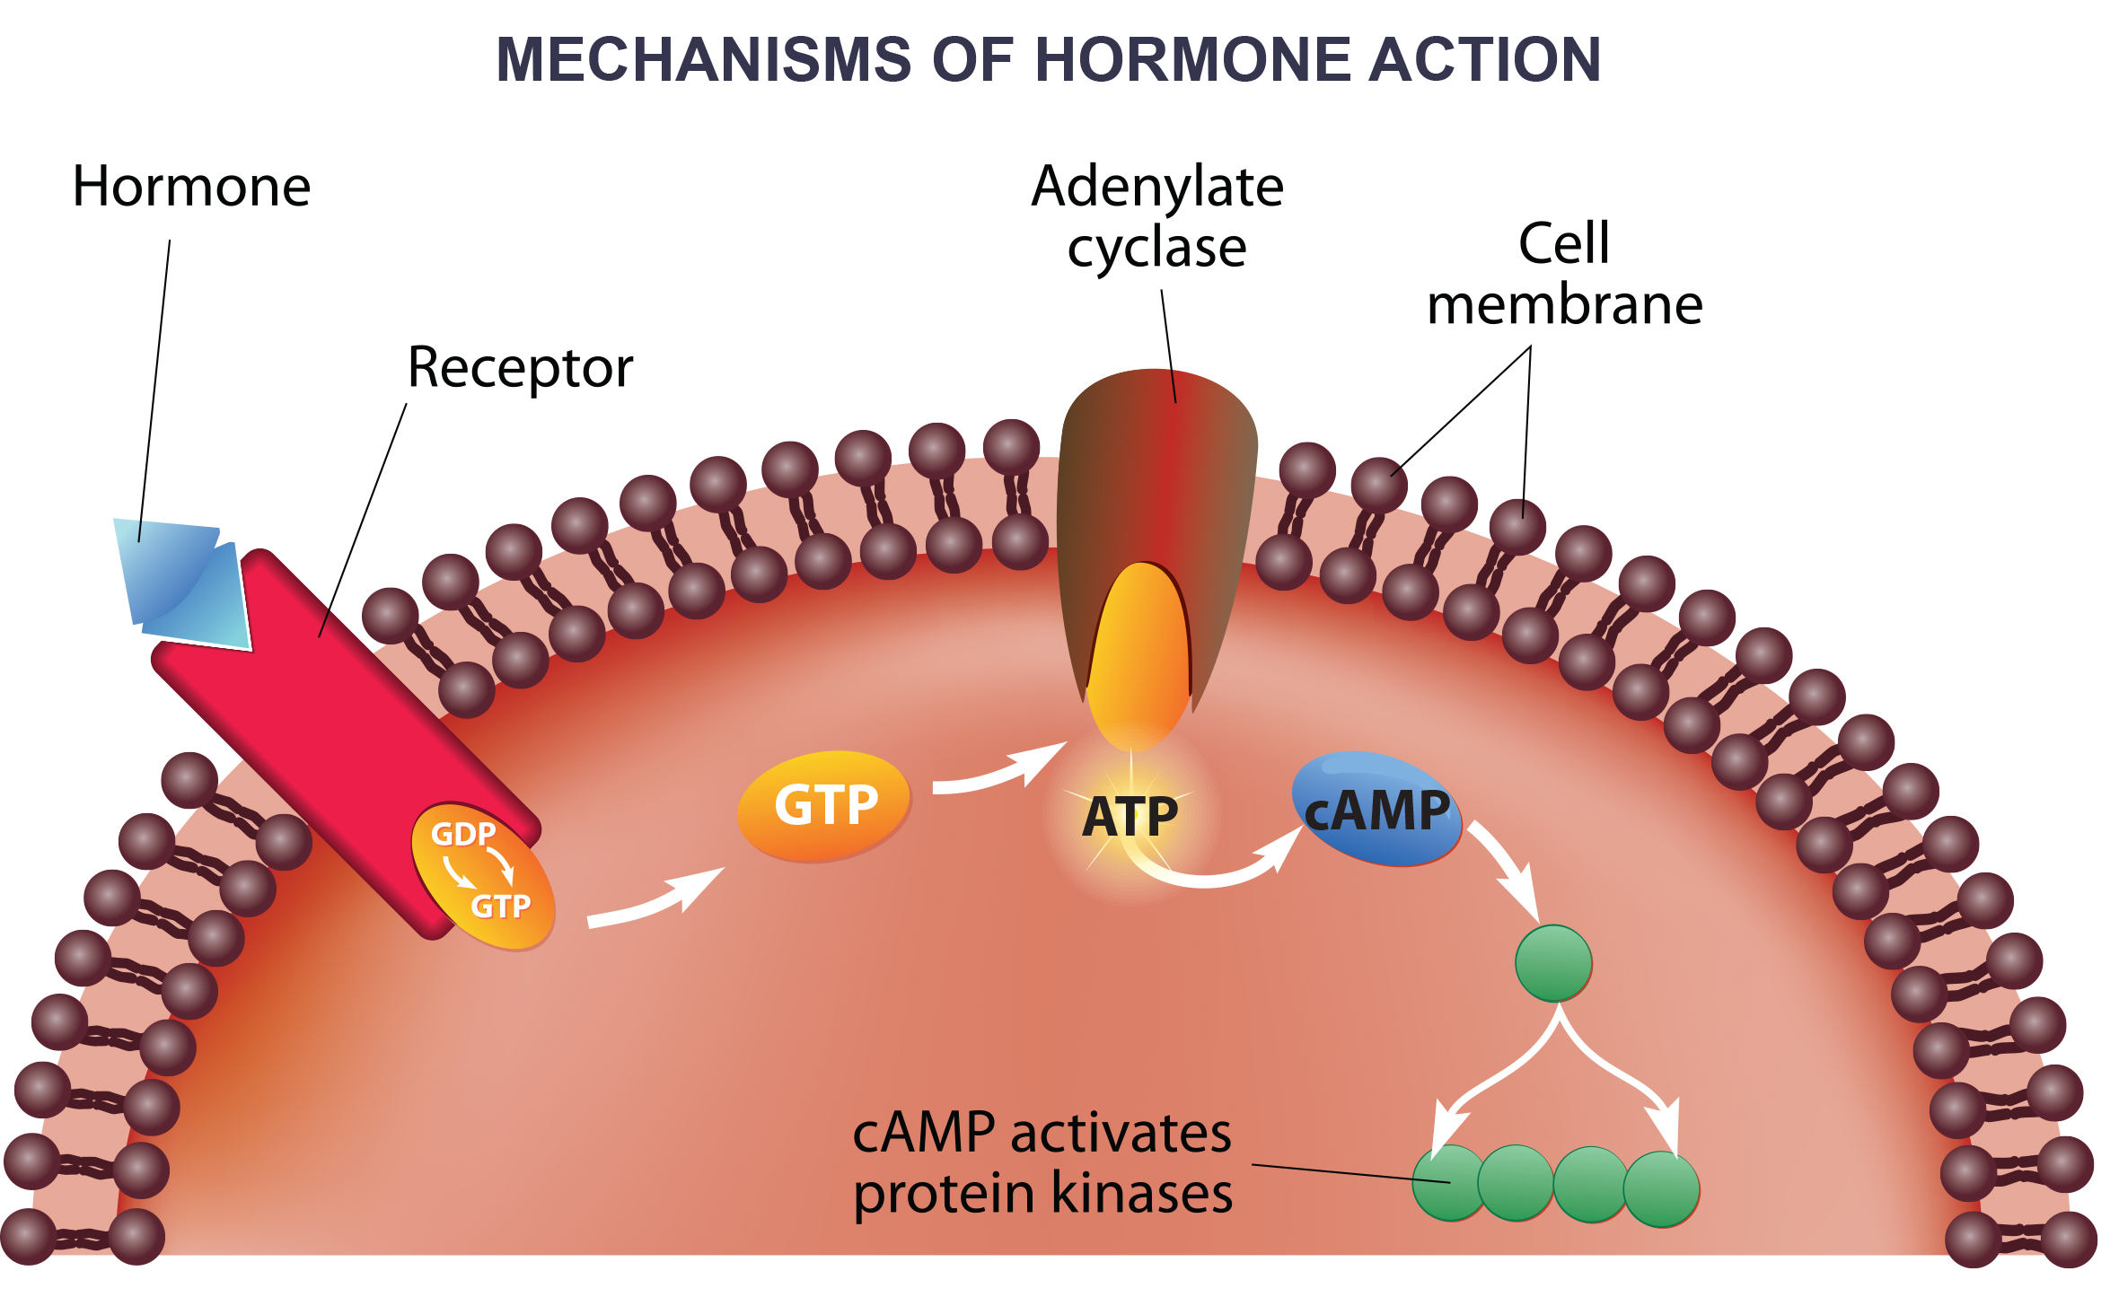
9.1 Figure 9
Notes:
Some hormones utilize G protein-coupled receptors. Note that the hormone must bind to the receptor before any effect is achieved. Both GTP and ATP are the energy molecules used. Adenylate cyclase is an enzyme that yields cyclic AMP (cAMP, a so-called "secondary messenger") that, in turn, activates other molecules in the cell, eventually eliciting a cellular response.

Slide 18
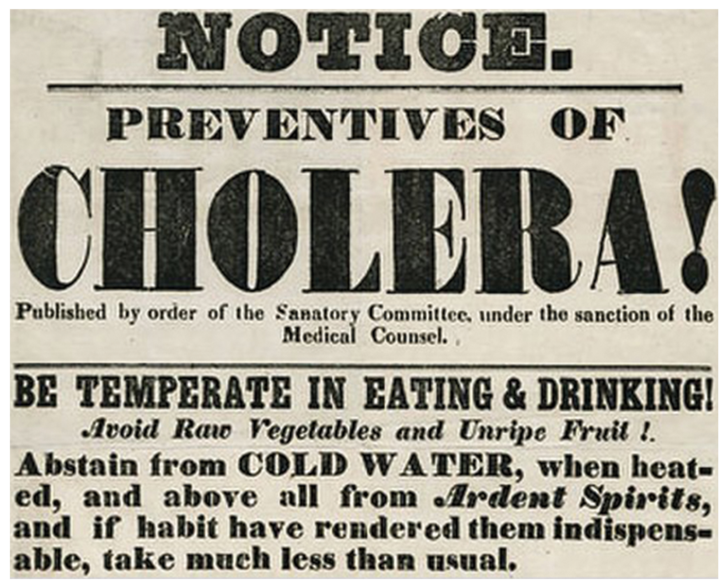
G Protein-Coupled Receptors₂
Bacterial toxins disrupting GPCRs can cause illnesses like cholera, pertussis, and botulism.
In cholera, Vibrio cholerae's choleragen toxin binds and enters intestinal cells.
Choleragen modifies a G protein, causing constitutive chloride channel activation, leading to severe diarrhea and dehydration.
9.1 Figure 10
New York Historical Society on Wikimedia Commons. "Cholera newspaper."

Slide 19
Science and You₁
G protein-coupled receptors (GPCRs) are very common in animals, including humans.
Humans have over 300 different kinds of GPCRs in the nose alone, which detect aromas.
These olfactory receptors help distinguish between different scents like chocolate, coffee, and cinnamon.
Dogs have twice as many olfactory GPCRs as humans, allowing for a better sense of smell.
Mice have an even greater assortment, with over 1,000 different kinds of GPCRs in their noses.
Notes:
This is included as a relevant application for this topic.

Slide 20
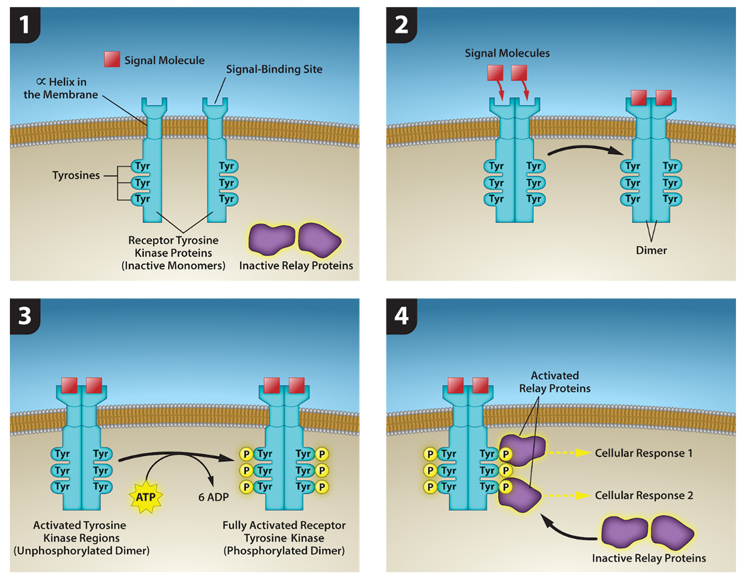
Enzyme-Linked Receptors
Enzyme-linked receptors: cell-surface receptor with intracellular domains that are associated with membrane-bound enzymes
Tyrosine kinase receptors dimerize, autophosphorylate upon activation, and propagate a signal via phosphorylated tyrosine residues.
9.1 Figure 11
Rao, A., Ryan, K., Tag, A., Fletcher, S. and Hawkins, A. Department of Biology, Texas A&M University. "Receptor tyrosine kinase."

Slide 21
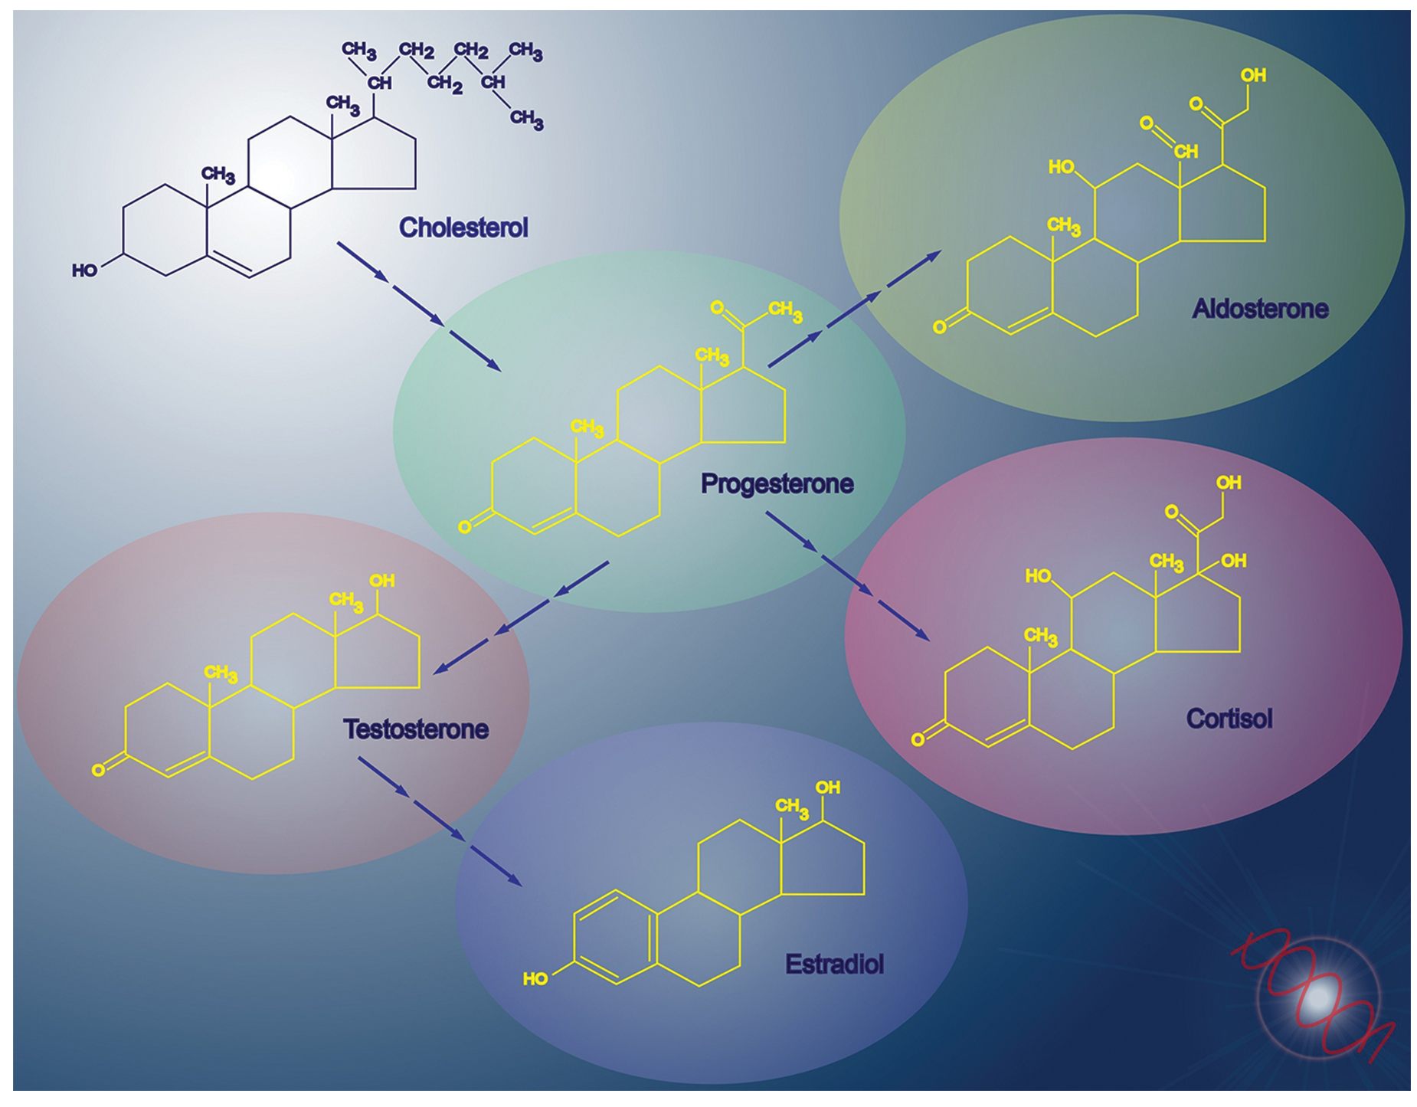
Signaling Molecules₁
Small Hydrophobic Ligands
Can diffuse across membranes to bind to internal receptors.
Examples: Steroid hormones (estradiol and testosterone), cholesterol, and thyroid hormones
Require carrier proteins for transport in the blood
9.1 Figure 12

Slide 22
Signaling Molecules₂
Water-Soluble Ligands
Polar molecules that bind to cell-surface receptors
Include small molecules, peptides, and proteins
Cannot pass through the membrane unaided

Slide 23
Signaling Molecules₃
Other Ligands
Gaseous ligands like nitric oxide (NO) can diffuse across membranes
NO induces smooth muscle relaxation, acts as vasodilator
Viagra targets this NO vasodilation pathway

Slide 24
Science and You₂
Cells naturally produce adenosine, which builds up during the day to create "sleep pressure" at night.
Adenosine enters brain cells via receptors, promoting feelings of sleepiness.
Caffeine competes with adenosine to bind to these receptors, reducing sleep pressure.
Caffeine has a half-life of 5-6 hours, so consumption later in the day can disrupt sleep.
Moderate caffeine intake earlier in the day avoids interference with adenosine receptors at bedtime.
Notes:
This is included as a relevant application for this topic.

Slide 25
Summary
Cells communicate via intercellular and intracellular signaling.
Four signaling categories: paracrine, endocrine, autocrine, and direct signaling across gap junctions
Internal receptors bind ligands that cross the membrane and affect gene expression.
Cell-surface receptors transduce external signals via ion channel-linked receptors, G protein-coupled receptors, and enzyme-linked receptors.
Hydrophobic ligands bind to internal receptor and hydrophilic ligands bind to cell-surface receptors.

Slide 26


End of Hawkes Learning PowerPoint

