Slide 1
Lesson 9.2
Signal Transduction

Slide 2
Objectives
Evaluate the role of second messengers in signal transmission.
Explain how the binding of a ligand initiates signal transduction throughout a cell.
Recognize the role of phosphorylation in the transmission of intracellular signals.

Slide 3
Signal Transduction
Signal transduction: propagation of a signal through the cytoplasm due to a ligand binding to a cell-surface receptor
Ligand binding causes a conformational change in a receptor propagating the signal into the cell and activating the intracellular domain or its associated proteins.
In some cases, ligand binding causes two receptors to bind to each other to form a dimer, or dimerization of the receptor, allowing intracellular domains to activate each other.

Slide 4
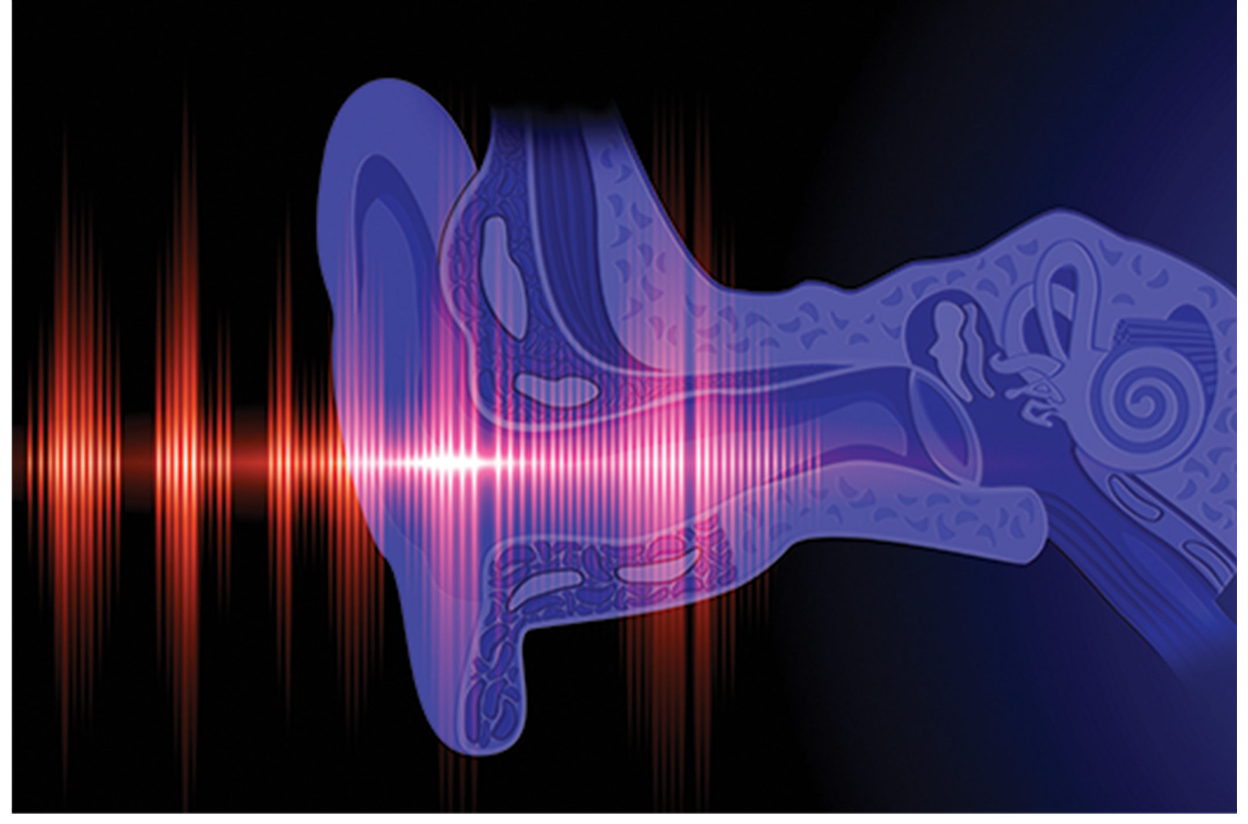
Binding Initiates a Signaling Pathway
After ligand binding to a cell-surface receptor, the activation of intercellular components sets off a signaling pathway, or cascade.
Involves second messengers and activated proteins interacting in a chain reaction.
Events in the cascade occur in order and can be classified as either upstream or downstream of any specific point.
9.2 Figure 1

Slide 5
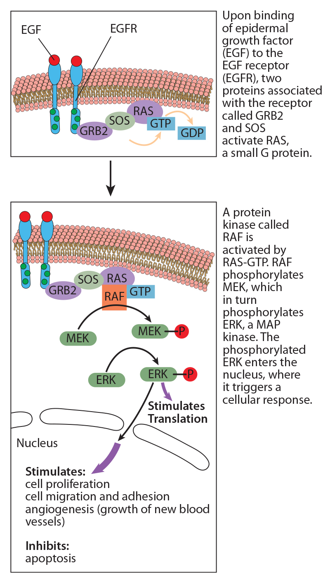
Signaling Pathway Complexity and Signal Amplification
9.2 Figure 2
Signaling pathways are complex and branching, with the same ligand often initiating different signals in different cell types.
The epidermal growth factor (EGF) signaling pathway activates a kinase cascade leading to cell growth and division.
Signal integration: signals from two or more cell-surface receptors merge to activate the same response in the cell
Enzymatic cascades can amplify an initial signal.
CNX OpenStax on Wikimedia Commons. "EFGR."

Slide 6
Think It Through
Consider the signaling pathway shown in Figure 2. Normally, the GTP attached to RAS is ultimately broken down to GDP by an enzyme called a GTPase. What would happen to the pathway if the activity of this GTPase were inhibited?
9.2 Figure 2
CNX OpenStax on Wikimedia Commons. "EFGR."
Notes:
Originally an On Your Own. This is included here to use as a talking point or for a think-pair-share activity.

Slide 7
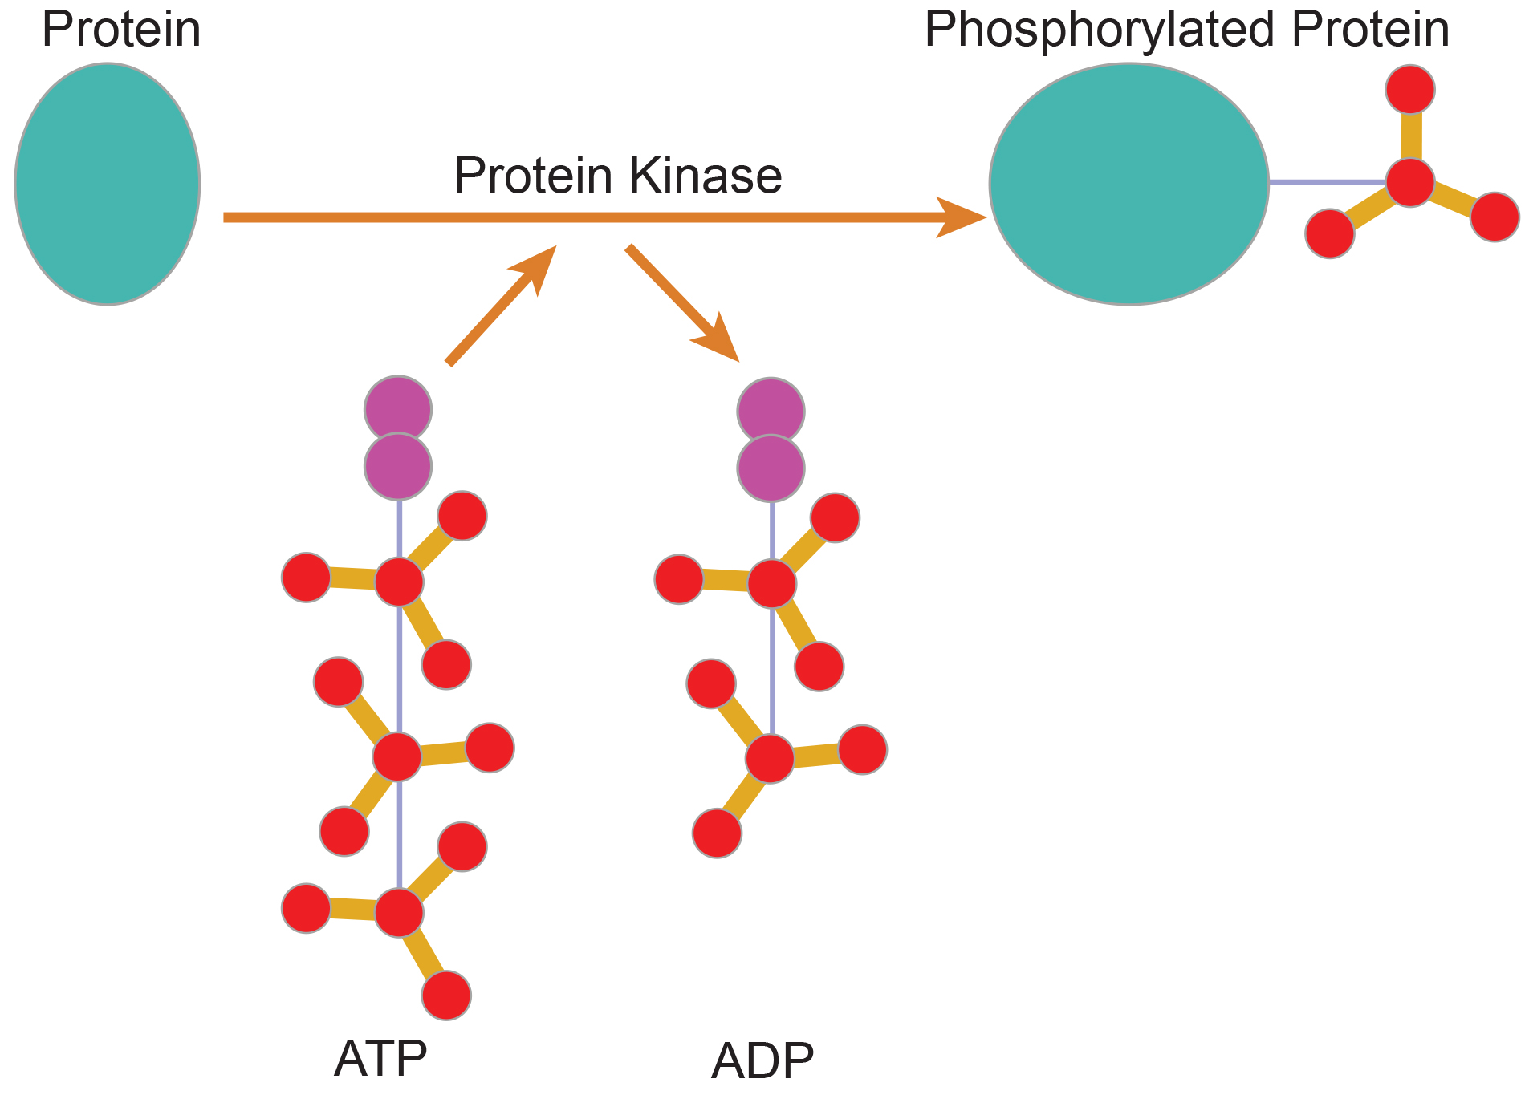
Methods of Intracellular Signaling
Enzyme modifications induce signaling pathways.
Phosphorylation, the addition of a phosphate group by kinases (phosphorylating enzymes) is common modification.
  Phosphate group is often donated by ATP or GTP.
Phosphatases reverse phosphorylation by kinases.
9.2 Figure 3
NIGMS on Wikimedia Commons. "Protein kinase."

Slide 8
Second Messengers₁
Second messengers are small molecules that propagate a signal after being initiated.
Calcium is in the extracellular space or stored in vesicles and is released into cytoplasm after signalling.
  Triggers responses like insulin release or muscle contraction

Slide 9
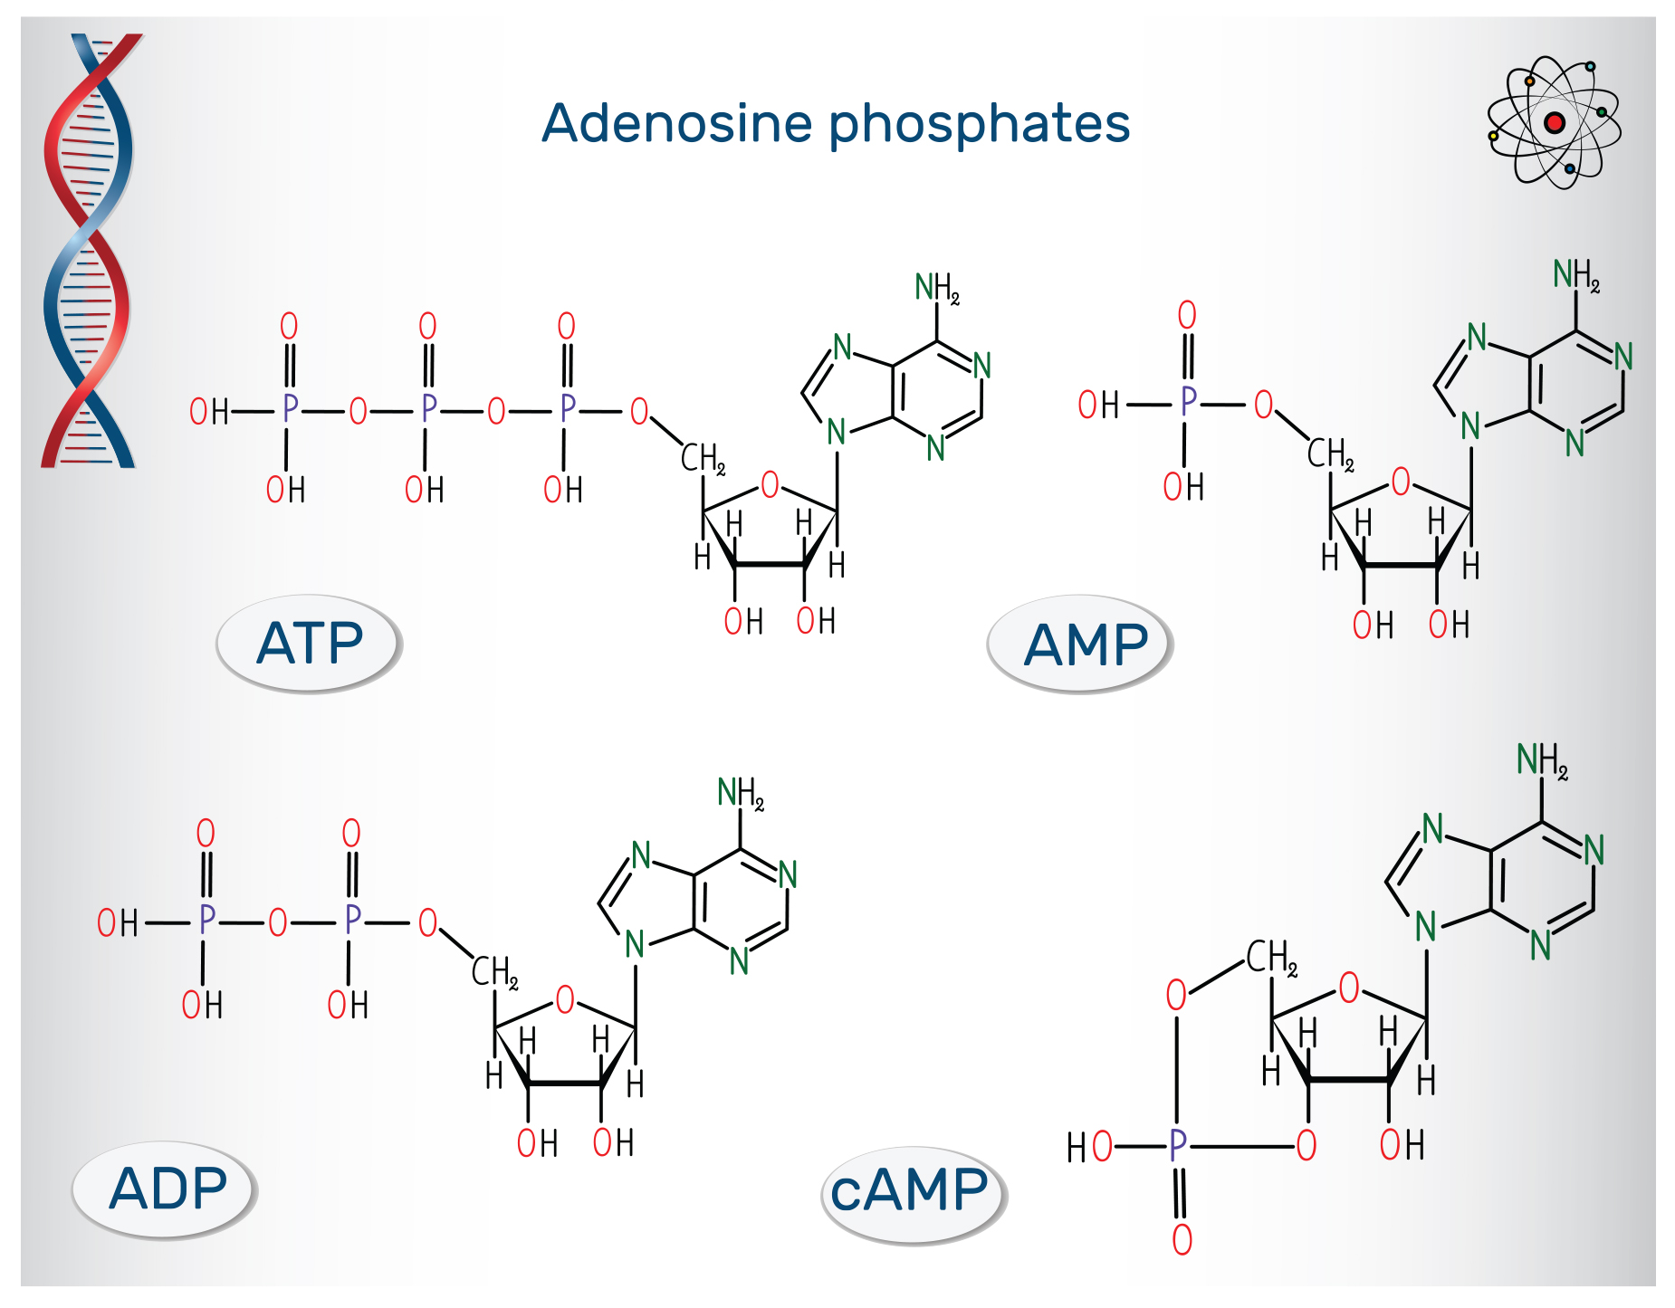
Second Messengers₂
Cyclic AMP (cAMP) is a secondary messenger derived from ATP.
Activates cAMP-dependent protein kinase A (PKA) which phosphorylates and activates target proteins, regulating metabolism.
9.2 Figure 4

Slide 10
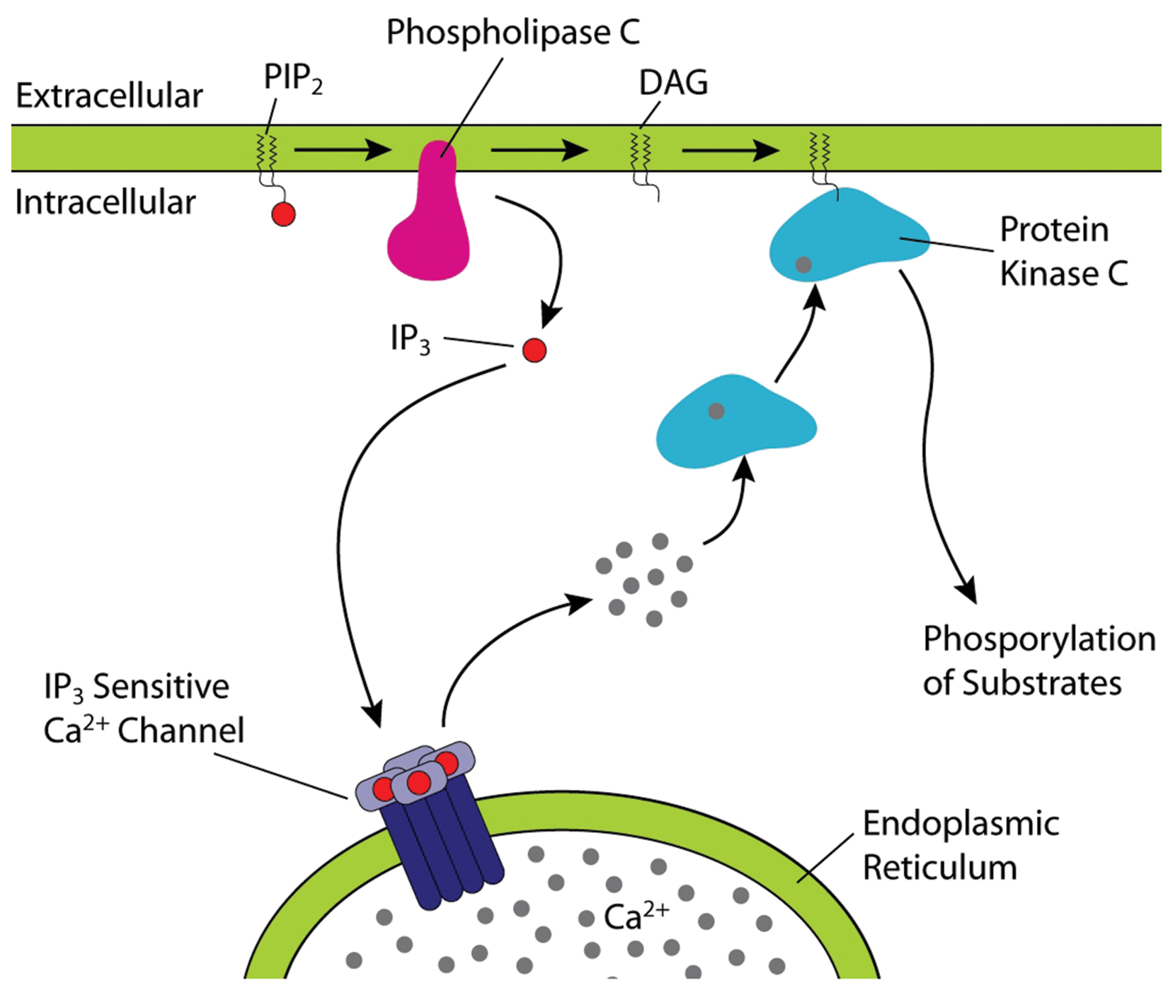
Second Messengers₃
Inositol phospholipids, like phosphatidylinositol (PI), are lipids in the plasma membrane that are converted to second messengers.
The enzyme phospholipase C cleaves PIP₂ into diacylglycerol (DAG) and inositol triphosphate (IP3) second messengers.
DAG activates protein kinase C (PKC), while IP₃ releases calcium from ER stores to propagate the signal.
9.2 Figure 5
Eak435s on Wikimedia Commons. "Phospholipase C."

Slide 11
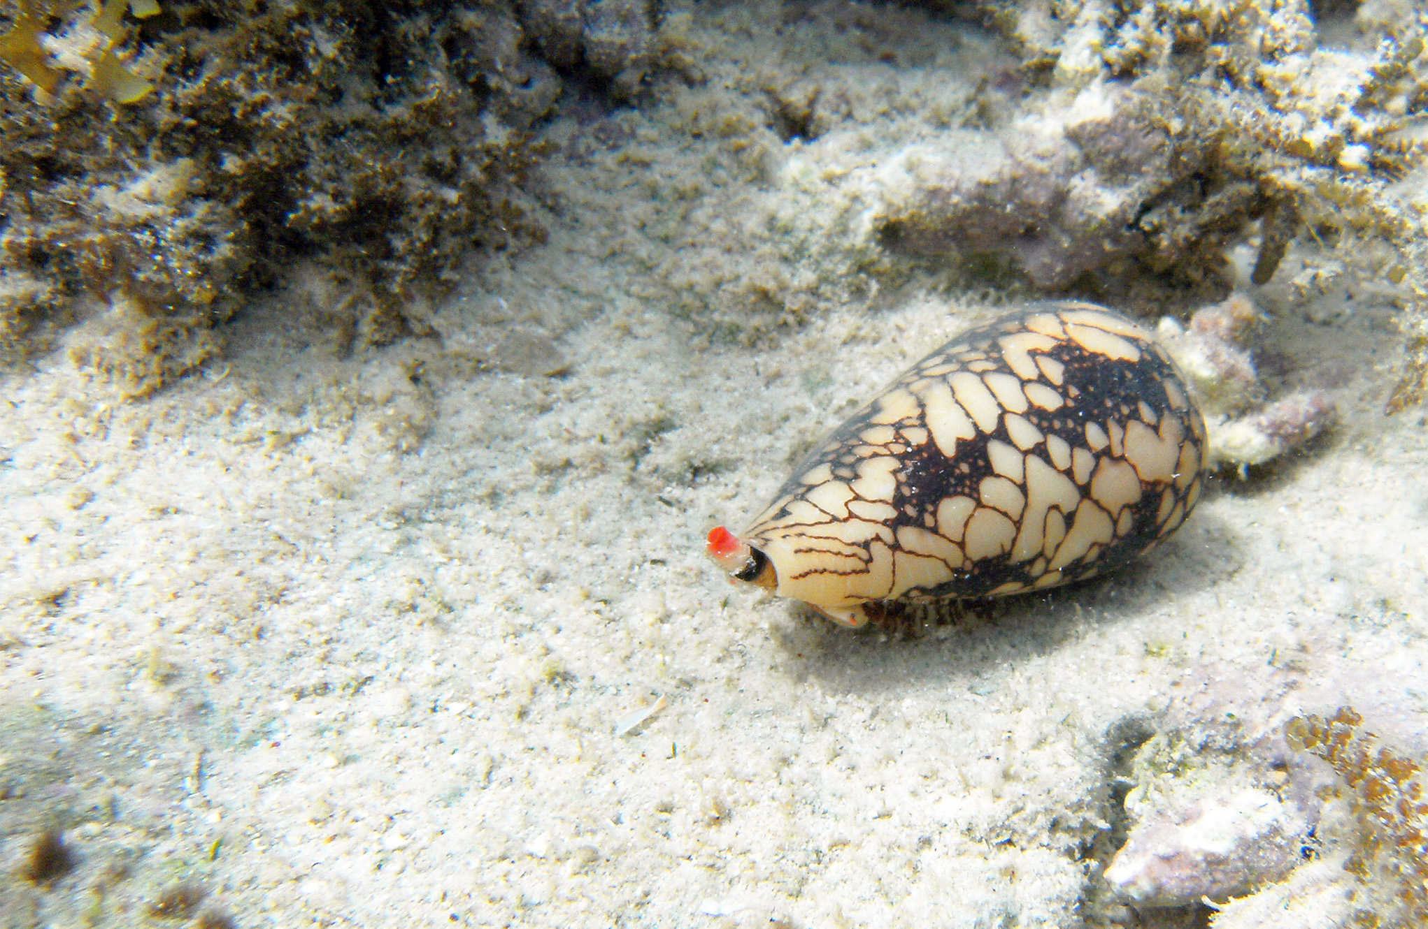
Science and You
Cone snails are venomous ocean snails that can sting humans when handled.
Their venom paralyzes prey by clogging calcium ion channels in nerve endings, preventing muscle contraction.
Cone snail venom can paralyze humans and derivatives are used as medicinal nerve blockers.
9.2 Figure 6
Notes:
This is included as a relevant application for this topic.

Slide 12
Summary
Ligand binding to the receptor allows for signal transduction through the cell.
The chain of events that conveys the signal through the cell is called a signaling pathway or cascade.
Signaling pathways are often complex due to the interplay among different proteins.
Kinases phosphorylate molecules, adding phosphate groups and changing their shapes and activities.
Second messengers like calcium ions, cAMP, DAG, and IP₃ transmit signals within cells.

Slide 13


End of Hawkes Learning PowerPoint

