Slide 1
Lesson 9.3
Cellular Response

Slide 2
Objectives
Describe how signaling pathways direct protein expression, cellular metabolism, and cell growth.
Identify the functions of protein kinases in signal transduction pathways.
Recognize the role of apoptosis in the development and maintenance of a healthy organism.

Slide 3
Cellular Response
Inside the cell, ligands bind to their internal receptors, allowing them to directly affect the cell's DNA and protein production.
Plasma membrane receptor pathways elicit varied responses based on cell type and environmental conditions.

Slide 4
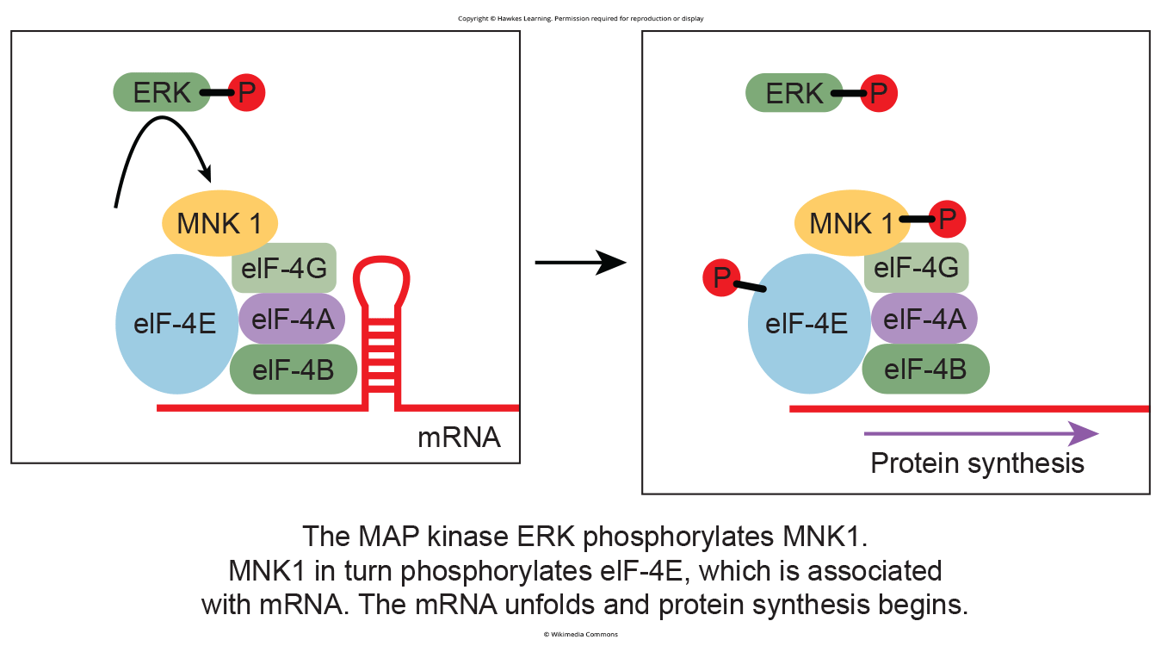
Gene Expression₁
Some signal transduction pathways regulate RNA transcription or mRNA translation.
An example is the MAPK/ERK pathway transmits signals from receptors through a chain of proteins to the nuclear DNA and can also regulated protein translation.
Epidermal growth factor (EGF) binding can activate this chain.
9.3 Figure 1
CNX OpenStax on Wikimedia Commons. "ERK." Modified.

Slide 5
Gene Expression₂
Some pathways activate responses by deactivating inhibitors (molecules that bind to a protein and prevents or reduces its functioning).
Iκ-B binds to transcription factor NF- κB inhibiting it from entering the nucleus to influence gene expression.
Phosphorylation of Iκ -B by PKC (protein kinase) releases NF- κB, allowing it to initiate transcription.

Slide 6
Increase in Cellular Metabolism
Signaling pathways can modulate cellular metabolic processes.
In muscle cells, adrenaline triggers increased glucose metabolism to create energy during the "fight-or-flight" reflex.
Adrenaline binds to β-adrenergic receptors in muscle cells resulting in raised cyclic AMP (cAMP) levels which activate protein kinase A (PKA).
PKA activates glycogen phosphorylase kinase (GPK) which then activates glycogen phosphorylase (GP).
Glycogen phosphorylase breaks down glycogen (polymer) into glucose (monomers).
Phosphorylation of glycogen synthase (GS) inhibits it from converting glycogen into glucose.

Slide 7
Cell Growth
Cell signaling pathways are crucial for regulating cell division and growth.
Growth factors bind to receptor tyrosine kinases (RTKs) on the cell surface, activating signaling cascades.
Activated RTKs initiate pathways involving a G protein called RAS which activates a MAP kinase, leading to the expression of proteins that promote cell division.

Slide 8
Science and You₁
Career: Cancer Biologist
Cancer stems from oncogene (genes that have the potential to cause cancer) mutations disrupting signaling proteins, causing uncontrolled cell division.
30% of cancers have RAS mutations driving uncontrolled growth, tumor formation, and metastasis.
The HER2 cell-receptor is overexpressed in 20% of human breast cancers.
The drug Herceptin causes the immune system to remove HER2 receptors and boosting patient's survival in conjunction with chemotherapy.
Notes:
This is included as a relevant application for this topic.

Slide 9
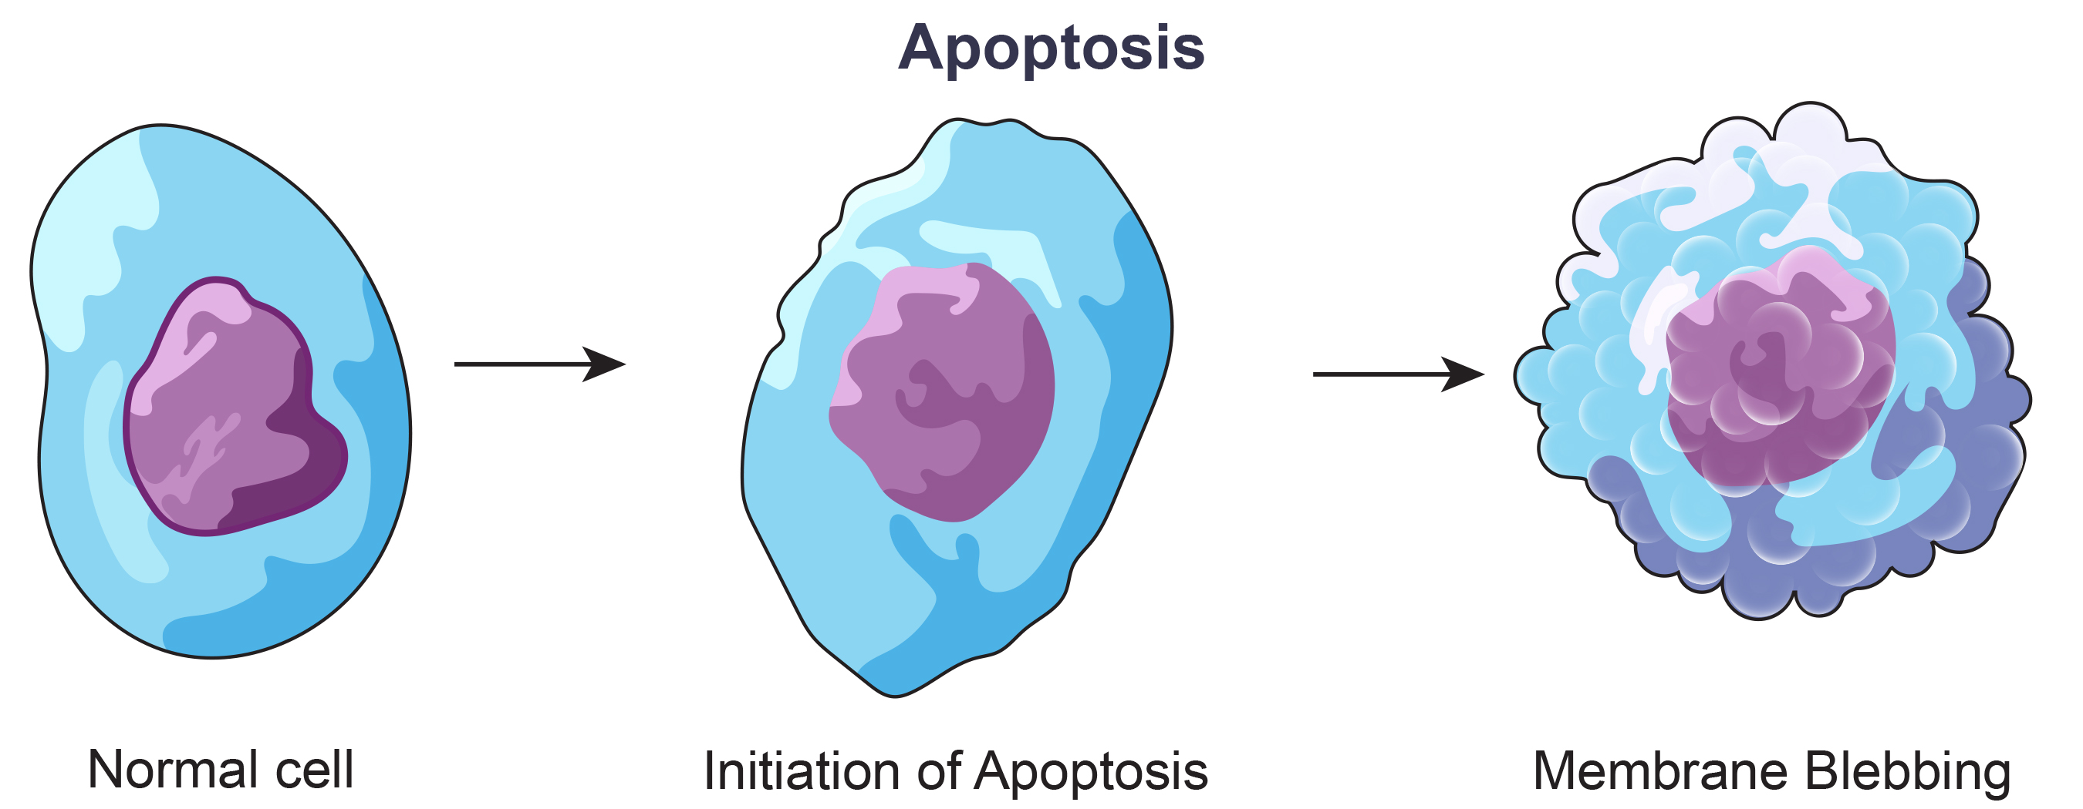
Cell Death₁
Apoptosis is controlled cell death triggered by internal or external cues.
Prevents the release of damaging molecule from inside the cell
Separate from necrosis which is uncontrolled death
Initiated when internal checkpoints find cell abnormalities
Also initiated when the cell disengages from the extracellular matrix and cell signaling signals apoptosis.
9.3 Figure 2

Slide 10
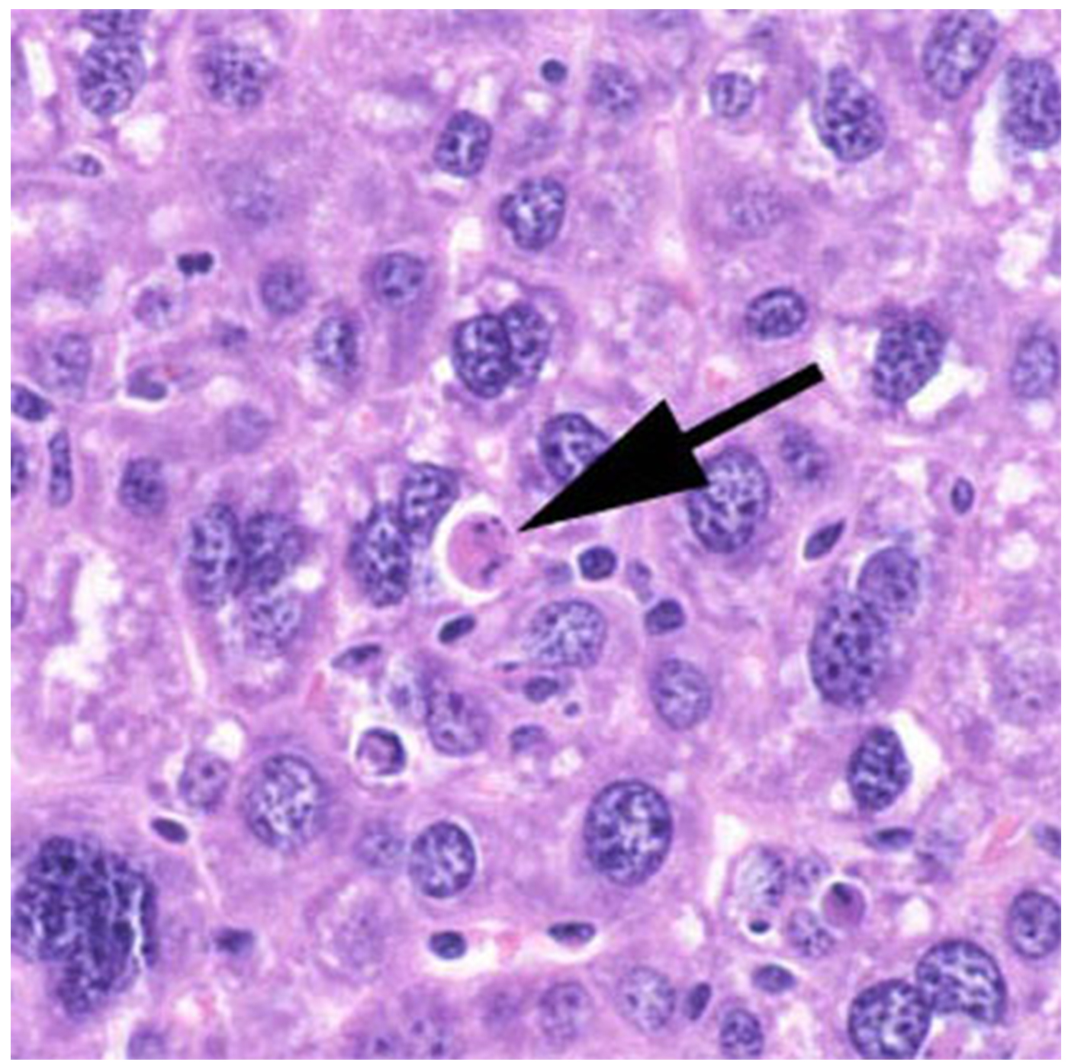
Cell Death₂
The cell uses enzymes and free radicals to destroy the internal contents.
During apoptosis the cytoskeleton breaks up causing the membrane to bulge outwards, called membrane blebbing.
Eventually, bulges break away from the membrane forming bubble-like structures called apoptotic blebs.
9.3 Figure 3: Mouse cell undergoing apoptosis.
Laboratory of Experimental Pathology, Division of Intramural Research, NIEHS (NIH) on Wikimedia Commons. "Apoptosis."

Slide 11
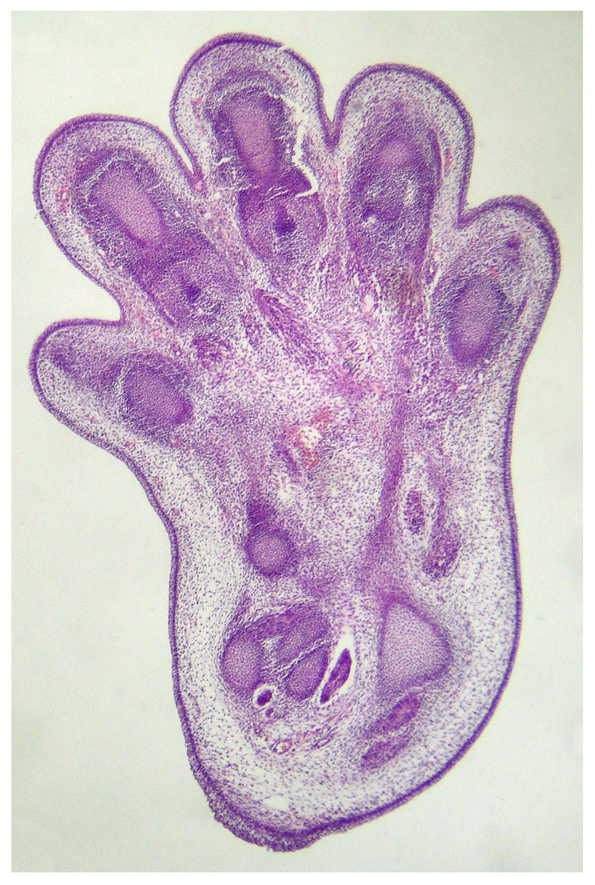
Cell Death₃
T-cells are immune cells that bind to foreign macromolecules, targeting them for destruction.
T-cells "read" cell surface proteins to determine if a cell is "self" or not, if T-cells target "self" cells for destruction, the T-cell itself initiates apoptosis.
This screening prevents autoimmunity by eliminating self-reactive T cells.
Apoptosis is also essential for normal embryological development.
In vertebrates, apoptosis separates digits by removing unneeded cells.
9.3 Figure 4: Histological section of a food of a mouse embryo, showing cells that will be eliminated by apoptosis.
CC-BY-2.5 on Wikimedia Commons. "Embryonic mouse foot."

Slide 12
Science and You₂
T-cell screening occurs in the thymus gland during early vertebrate development.
In autoimmune diseases, such as Type 1 diabetes, rheumatoid arthritis, multiple sclerosis, and lupus, T-cells mistakenly attack self-cells despite having undergone screening.
Treatments aim to prevent cell damage while preserving crucial immune functions of T-cells.
T-cells cannot be suppressed overall as they are crucial for normal immune functions, such as fighting bacteria and toxins.
Notes:
This is included as a relevant application for this topic.

Slide 13
Termination of the Signal Cascade
Proper signal termination is crucial, preventing aberrant (atypical) signaling seen in tumor cells.
Ligand degradation or removal stops signaling by removing access to the receptor.
Carrier proteins protect hydrophobic hormones like estrogen and testosterone from degradation and make them soluble in the bloodstream.
Signaling cascades are reversed by enzymes that undo cellular modifications.
Phosphatases remove the phosphate group from proteins, known as dephosphorylation.
For example, phosphodiesterase degrades cAMP into AMP through dephosphorylation.

Slide 14
Summary
Initiation of signaling pathways is a response to external stimuli, leading to outcomes like protein synthesis, metabolic changes, cell growth, or cell death.
Many pathways influence gene expression by activating enzymes that interact with transcription factors or modify proteins to change their cellular location.
Signaling allows cells to respond to energy demands by storing or utilizing glucose and glycogen.
External growth factor signals stimulate cell growth, while uncontrolled growth from mutations in signaling pathways leads to cancer.
Programmed cell death (apoptosis) recycles cells' components and prevents the release of harmful molecules.
Pathway termination mechanisms like degradation and dephosphorylation ensuring appropriate signal timing and intensity.

Slide 15


End of Hawkes Learning PowerPoint

