Slide 1
Lesson 9.4
Signaling in Single-Celled Organisms

Slide 2
Objectives
Describe how single-celled yeasts use cell signaling to communicate with one another.
Relate the role of quorum sensing to the ability of some bacteria to form biofilms.
Compare and contrast the signaling in bacteria and yeast.

Slide 3
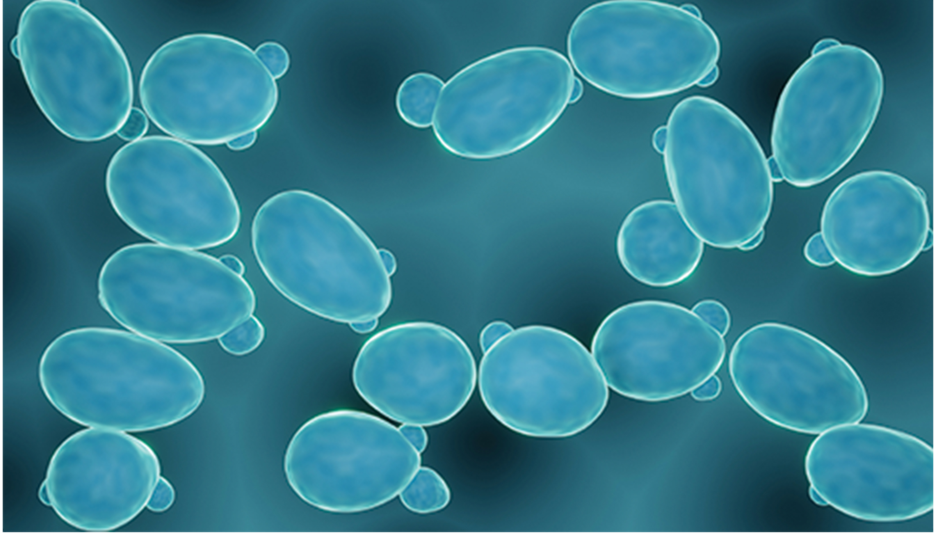
Signaling in Single-Celled Organisms
Intracellular signaling allows bacteria to respond to environmental cues, such as nutrient levels.
Single-celled organisms use signaling molecules for intercellular communication.
9.4 Figure 1: An artistic image of budding cells of the yeast Saccharomyces cerevisiae.

Slide 4
Signaling in Yeasts
Yeasts are single-celled eukaryotes with signaling processes similar to multicellular organisms.
They can reproduce asexually by budding or sexually by combining haploid cells.
Different mating strains exist, and cells secrete a signaling molecule known as a mating factor to initiate mating.
Mating factors binds to cell-surface receptors, triggering a signaling cascade.
This cascade involves protein kinases and GTP-binding proteins.

Slide 5
Think It Through₁
What is the advantage to a yeast strain that can reproduce both asexually (by budding) and sexually?
Notes:
Originally an On Your Own. This is included here to use as a talking point or for a think-pair-share activity.

Slide 6
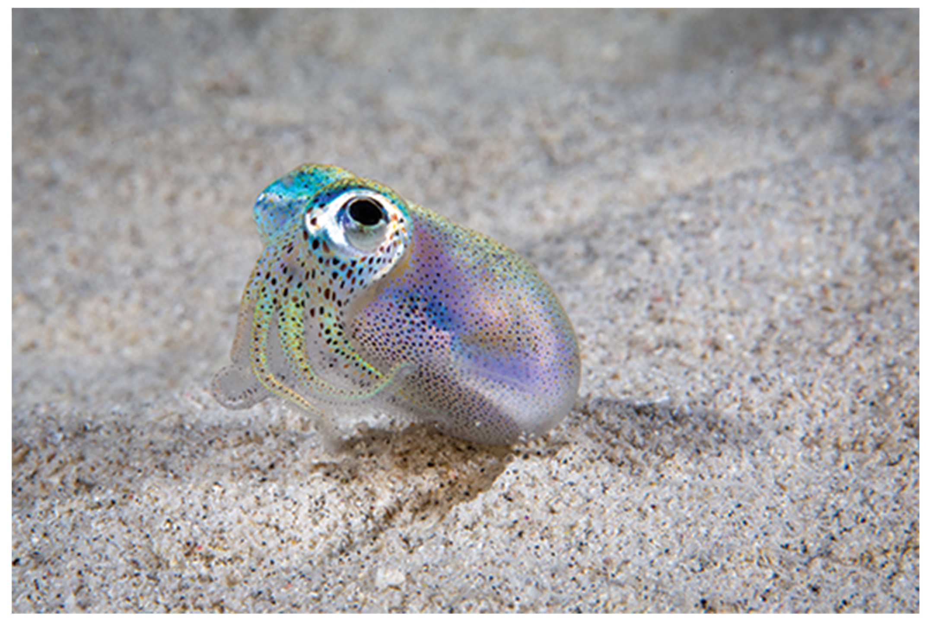
Signaling in Bacteria₁
Vibrio fischeri exhibit quorum sensing within the Hawaiian bobtail squid.
  Squid acquires the bacteria which produce bioluminescent at certain bacterial population density.
Quorum sensing is cell density-dependent bacterial signaling.
  Requires a minimum bacteria number for signaling.
9.4 Figure 2

Slide 7
Signaling in Bacteria₂
Quorum sensing uses autoinducers as signaling molecules between bacteria.
Autoinducers can be small hydrophobic molecules like acyl-homoserine lactone (AHL) or larger peptides.
They bind to transcription factors, altering gene expression in a positive feedback loop (self-amplifying cycle).
Bacteria using quorum sensing can form biofilms (bacterial colonies with a sticky extracellular matrix) that coordinate toxin release.
They can adhere to surfaces like medical implants, causing antibiotic-resistant infections.
  Extracellular matrix can block antibiotics from reaching cells.

Slide 8
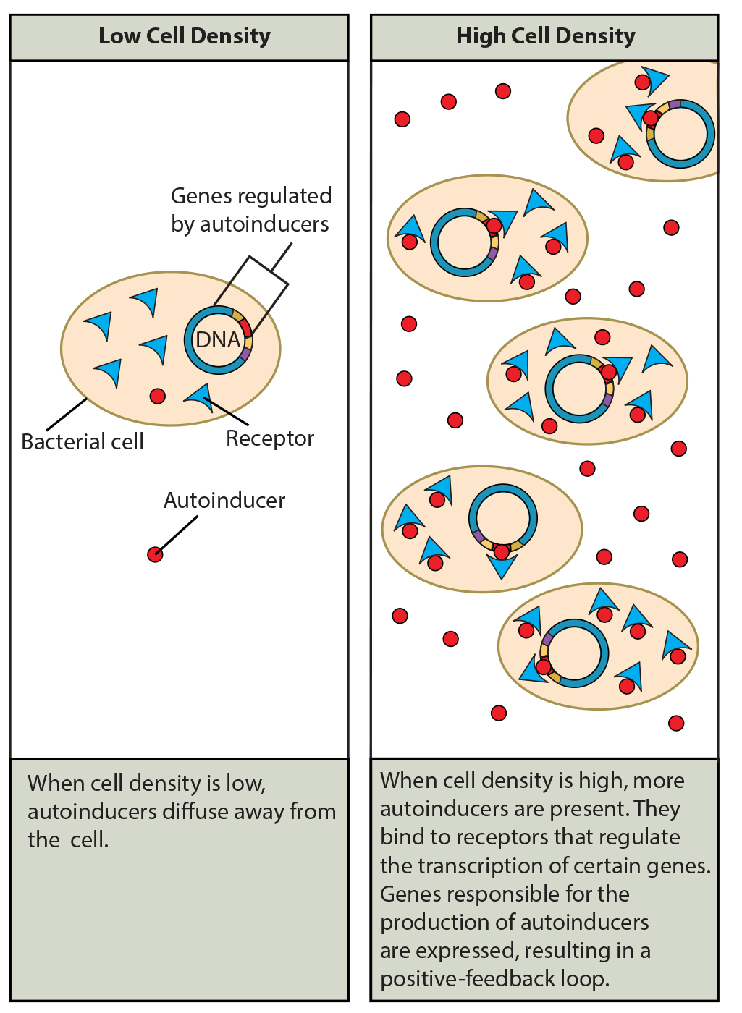
9.4 Figure 3
CNX OpenStax on Wikimedia Commons. "Cell density." Modified.
Notes:
Autoinducers are small molecules or proteins produced by bacteria that regulate gene expression.

Slide 9
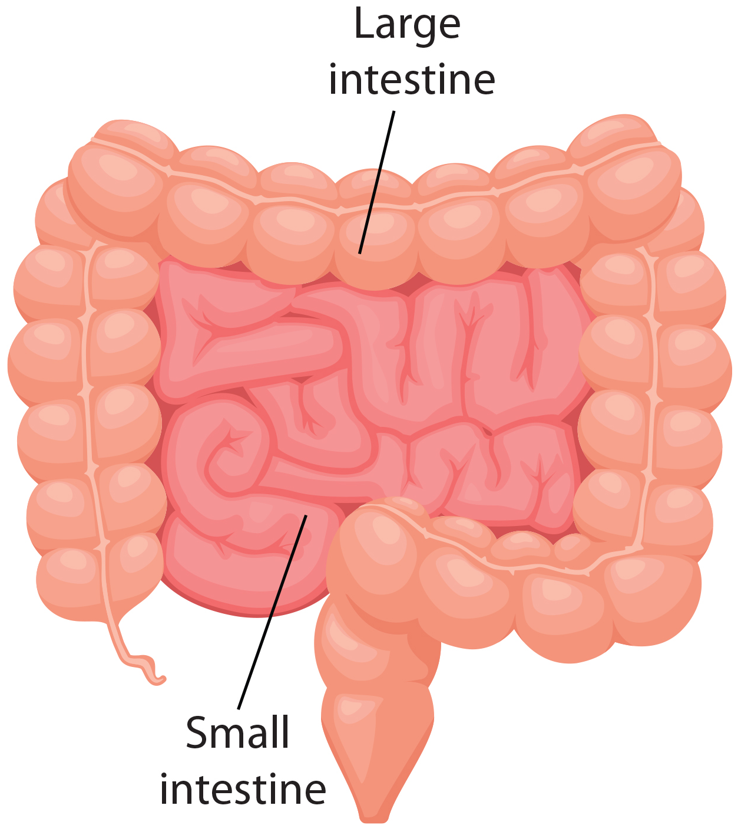
Science and You
Inside your intestines (especially the large intestine) are trillions of bacteria, yeasts, and other microorganisms, which collectively are called the normal gut flora.
They form a layer—a biofilm—along the inside of the large intestine.
These cells use signaling to communicate not only with each other but also with immune system cells, which are located throughout the gut.
Your gut flora influence your overall health.
9.4 Figure 4: The intestines are responsible for the breakdown of food, absorbing nutrients, and creating solid waste in the body.
Notes:
This is included as a relevant application for this topic.

Slide 10
Signaling in Bacteria₃
Research on the details of quorum sensing has led to advances in growing bacteria for industrial purposes.
It may be possible to exploit bacterial signaling pathways to control bacterial growth.
This could replace or supplement ineffective antibiotics.

Slide 11
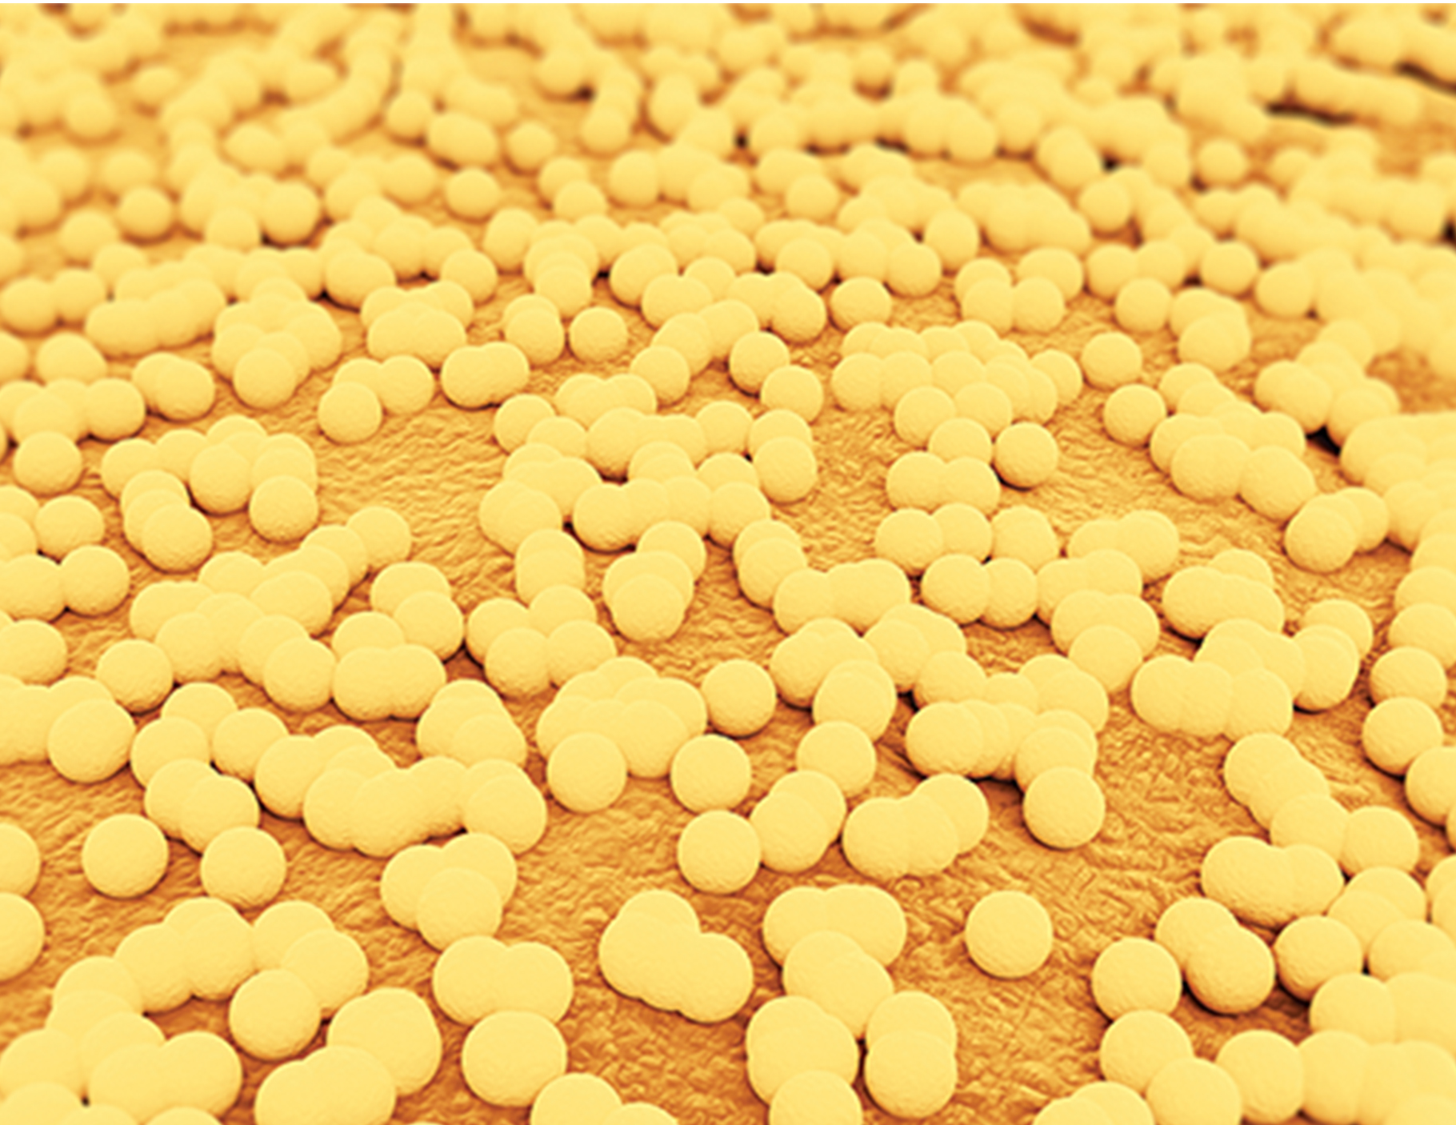
Think It Through₂
In what way does biofilm formation benefit S. aureus?
9.4 Figure 5: Cell-cell communication enables Staphylococcus aureus bacteria, seen here via scanning electron microscopy, to work together to form a biofilm inside a hospital patient's catheter. S. aureus is a main cause of hospital-acquired infections.
Notes:
Originally an On Your Own. This is included here to use as a talking point or for a think-pair-share activity.

Slide 12
Cellular Communication in Yeasts
Early single-celled prokaryotes had limited interaction and signaling.
Cellular communication evolved over 2 billion years for multicellular organisms.
Yeasts are single-celled eukaryotes with complex signaling systems, like humans.
Of the 130 kinase types in yeast, 97 belong to the 55 subfamilies of kinases that are found in other eukaryotic organisms.
Yeasts are ideal for studying signaling cascades due to their simplicity and similarities to humans.

Slide 13
Summary
Yeasts and multicellular organisms have similar signaling mechanisms.
Yeasts use cell-surface receptors and signaling cascades to communicate information on mating with other yeast cells.
Signaling molecule is called mating factor.
Bacterial signaling is called quorum sensing.
Bacteria secrete signaling molecules called autoinducers that are either small, hydrophobic molecules or peptide-based signals.
The hydrophobic autoinducers, such as AHL, bind transcription factors and directly affect gene expression.
The peptide-based molecules bind kinases and initiate signaling cascades in the cells.

Slide 14


End of Hawkes Learning PowerPoint

