Slide 1
Section 1.1
Functions and How We Represent Them

Slide 2
Definition: Relation, Domain, and Range
Given two sets A and B, a relation R from A to B is a set of ordered pairs of the form (a,b), where a ∈ A and b ∈ B. (An ordered pair is just what it sounds like—a pair of elements written in such a way that it is obvious which is the first element and which is the second.)

Slide 3
Definition: Relation, Domain, and Range (cont.)
Given any particular relation R from A to B, the set of all the first elements (the first coordinates) of the ordered pairs is called the domain of R, and the set of all second elements (the second coordinates) is called the range of R. Using set-builder notation, we can write
and

Slide 4
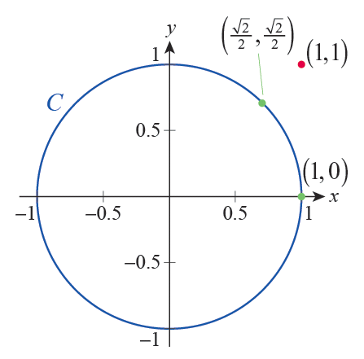
Example 1: Finding the Domain and Range of a Relation
a. For real numbers x and y, suppose they are in relation C (i.e., (x,y)∈C) if they satisfy the equation x² + y² = 1. For example, (1, 0)∈C, but (1, 1)∉C. Figure 1 shows the graph of the equation defining C. (Can you see why we called the relation C?)
Figure 1

Slide 5
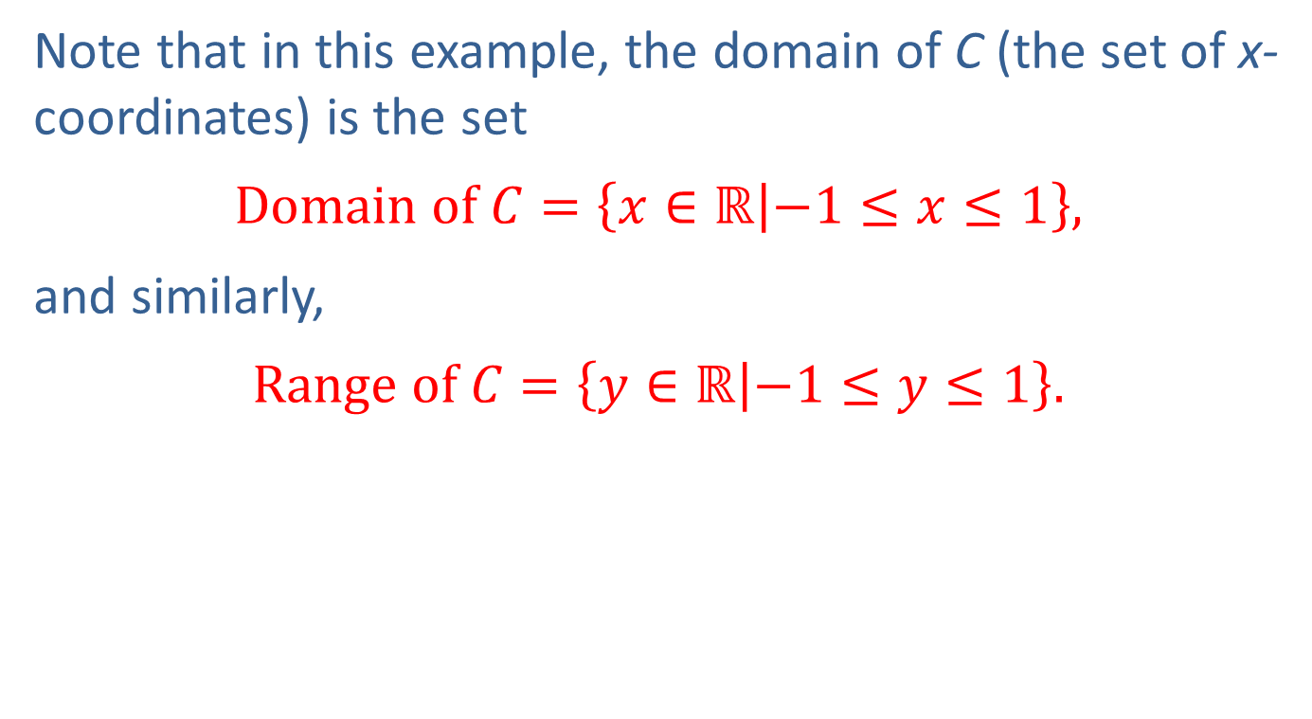
Example 1: Finding the Domain and Range of a Relation (cont.)
Note that in this example, the domain of C (the set of x­coordinates) is the set
$$Domain of C=\left\{x∈ℝ | −1≤x≤1\right\},$$
and similarly,
$$Range of C=\left\{y∈ℝ | −1≤y≤1\right\}.$$

Slide 6
Example 1: Finding the Domain and Range of a Relation (cont.)
b. The following set of ordered pairs is a relation from ℝ to ℝ.
Examining the first and second coordinates of the ordered pairs, respectively, we see that
while

Slide 7
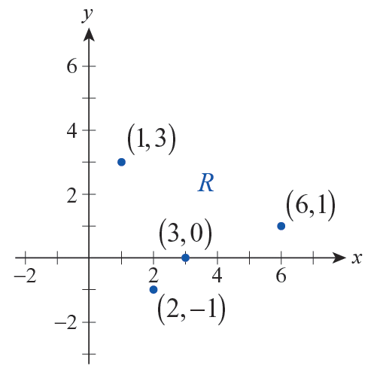
Example 1: Finding the Domain and Range of a Relation (cont.)
Notice that just as we did in part a., we can represent this relation in the Cartesian coordinate system (see Figure 2). Also note that relations do not necessarily have any immediate mathematical meaning such as the one in part a. For example, part c. shows a relation “defined by a picture.”
Figure 2

Slide 8
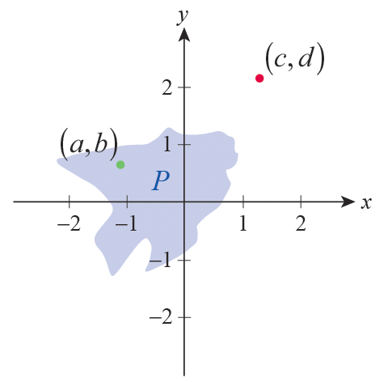
Example 1: Finding the Domain and Range of a Relation (cont.)
c. Figure 3 can be used to define relation P. Note that two real numbers x and y are in relation P if the point (x,y) falls in the shaded area or its boundary. For example, as shown by the illustration, but
Figure 3

Slide 9
Example 1: Finding the Domain and Range of a Relation (cont.)
d. Suppose that the student population on a particular college campus speaks a total of five languages: English, Chinese, German, Japanese, and Spanish. If we represent the above set of languages by {E, C, G, J, S}, the following relation L from the set of students to the set of languages arises quite naturally.

Slide 10
Example 1: Finding the Domain and Range of a Relation (cont.)
Notice that the domain of L is the set of students at the college, while the range is the set of the five given languages. Supposing that Chihiro speaks English and Japanese, but not Spanish, we can express this in symbols by writing

Slide 11
Definition: Functions and Function Notation
A function f from a set A to a set B is a relation from A to B with the additional property that each element a ∈ A is related to exactly one element b ∈ B. Instead of writing we typically use function notation and write b = f(a). In other words, given a ∈ A, f(a) is the unique element of B associated with a.

Slide 12
Definition: Functions and Function Notation (cont.)
The notation f(a) is read “f of a,” and when A and B are sets of numbers, f(a) is often referred to as the value of f at a. The notation f : A → B is used to indicate that f is a function (not just a relation) from the set A to the set B.

Slide 13
Caution
Don’t be misled by the parentheses in the function notation to think that f(a) might represent the product of f and a! While parentheses do often indicate multiplication, they are also used in defining functions.

Slide 14
The Language of Functions
The notation f : A → B automatically indicates that the domain of f is A. In this context, the set B is called the codomain of f . As with relations, the range of f is the set of elements of B that are “used” by f. Using function notation, we can quickly note that the range of f is thus the set

Slide 15
The Language of Functions (cont.)
If a is a symbol representing an arbitrary element of the domain of f, then a is called an independent variable. And, as above, if b is used to represent an arbitrary element of the range of f, then b is called a dependent variable.

Slide 16
Example 2: Determining Whether a Relation Is a Function
Indicate which of the relations from Example 1 are functions, and for those functions make the distinction between the codomain and the range.
Solution
a. The way in which y depends on x in part a. of Example 1 does not demonstrate functional dependence. Consider, for example, the fact that both of the pairs (0, 1) and (0, −1) are in the relation C, and thus 0 is related to both 1 and −1.

Slide 17
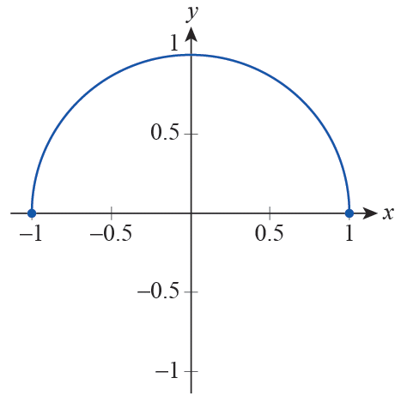
Example 2: Determining Whether a Relation Is a Function (cont.)
However, if we express y from the equation by considering only the positive square root as ,
then the above difficulty is eliminated. Indeed, we obtained a function whose graph is the upper semicircle of radius 1, centered at the origin (see Figure 4).

Slide 18

Example 2: Determining Whether a Relation Is a Function (cont.)
Notice that we can still consider $\left\{x∈\text{ℝ} | −1≤x≤1\right\}$ to be the domain of our function; however, the set of elements “used” by f, the range of f, is the following smaller set.
$$\left\{y∈\text{ℝ} | 0≤y≤1\right\}$$

Slide 19
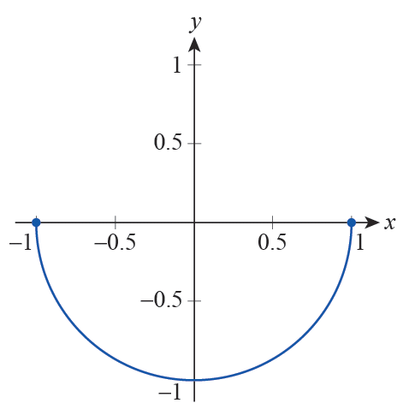
Example 2: Determining Whether a Relation Is a Function (cont.)
Finally, let us also note that in the case of we obtain a different function whose graph is the lower semicircle (see Figure 5).

Slide 20
Example 2: Determining Whether a Relation Is a Function (cont.)
b. The relation defined in part b. of the previous example is a function. It is easy to check by inspection that each domain element is related to exactly one value.
The codomain of R is ℝ while the range of R is {−1, 0, 1, 3}.

Slide 21
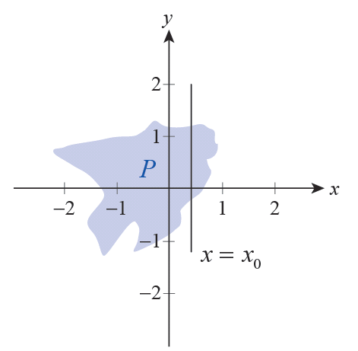
Example 2: Determining Whether a Relation Is a Function (cont.)
c. Examining the graph of the relation given in part c. of Example 1, it is easily concluded that this relation is not a function. Indeed, picking an appropriate x­-value x = x₀ and drawing a vertical line through it, we see that the y‑coordinate of any point falling on the line segment in the interior of the shading is related to x₀ (see Figure 6), thus leaving us with a multitude choices for y₀.
Figure 6

Slide 22
Example 2: Determining Whether a Relation Is a Function (cont.)
d. With regards to relation L given in part d. of Example 1, since there are students on campus (such as Chihiro) who speak more than one language, the relation L is not a function either.

Slide 23
Example 3: Identifying the Dependent and Independent Variables of a Function Defined by an Equation
As we have seen in the preceding examples, we can define a relation or even a function by writing an equation in two variables and considering the set of ordered pairs satisfying our equation. Find the function defined by the given equation, and note the dependent and independent variables.

Slide 24
Example 3: Identifying the Dependent and Independent Variables of a Function Defined by an Equation (cont.)
Solution
a. Moving the terms containing y to the left side, we obtain

Slide 25
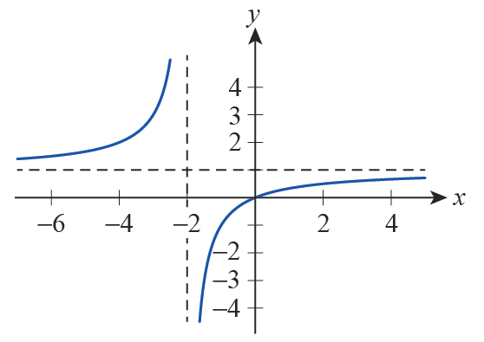
Example 3: Identifying the Dependent and Independent Variables of a Function Defined by an Equation (cont.)
We see that y is completely and unambiguously determined by x, so this is clearly a functional relationship with y being the dependent and x the independent variable. We often put it this way: y is a function of x.

Slide 26
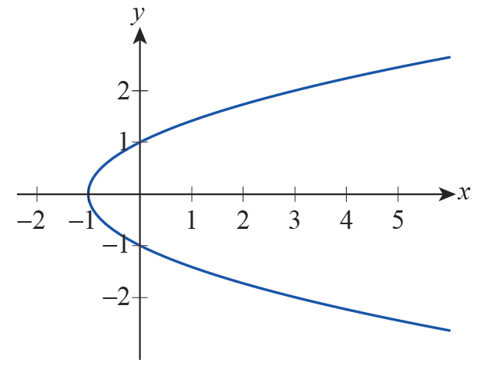
Example 3: Identifying the Dependent and Independent Variables of a Function Defined by an Equation (cont.)
b. Trying to express y as in part a. leads to the ambiguity
However, we can express x as a function of y in this case: x = y² − 1 defines x as a function of y; that is, y is the independent variable, and x is the dependent variable.

Slide 27
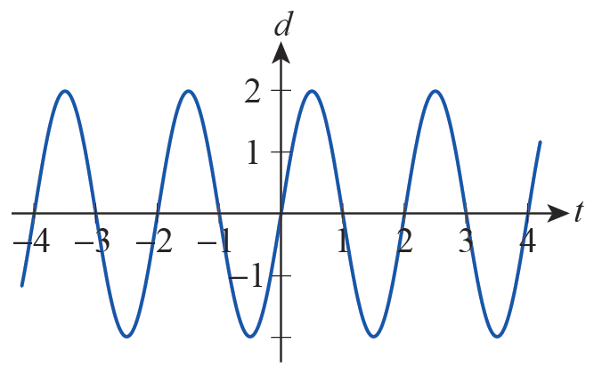
Example 3: Identifying the Dependent and Independent Variables of a Function Defined by an Equation (cont.)
c. We divide both sides of the equation by t for t ≠ 0 and obtain
with d being the dependent, and t the independent variable.
(Note that if you ever studied simple harmonic motion, you undoubtedly worked with functions similar to this one.)

Slide 28
The Language of Functions
In some situations, a function is given to us by means of a formula with no information regarding the domain. In such cases, by convention, the implied domain is the largest collection of points for which the formula returns a real number.

Slide 29
Example 4: Finding the Implied Domain and the Range of a Function
Find the implied domain for each of the following functions, and also determine the range in each case.

Slide 30
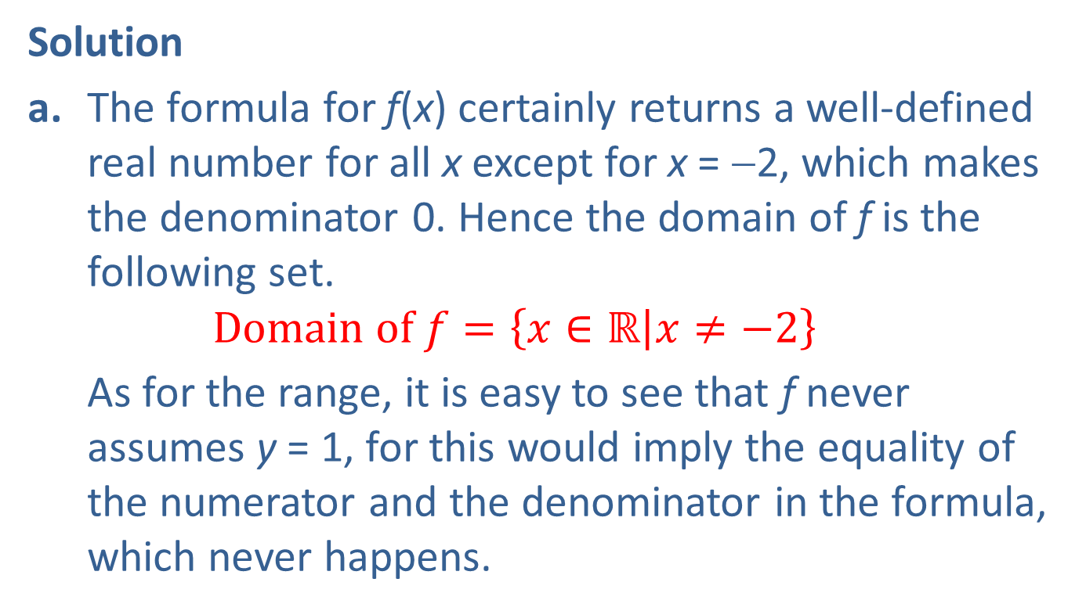
Example 4: Finding the Implied Domain and the Range of a Function (cont.)
Solution
a. The formula for f(x) certainly returns a well‑defined real number for all x except for x = −2, which makes the denominator 0. Hence the domain of f is the following set.
$$Domain of f=\left\{x∈\text{ℝ} | x≠−2\right\}$$
As for the range, it is easy to see that f never assumes y = 1, for this would imply the equality of the numerator and the denominator in the formula, which never happens.

Slide 31
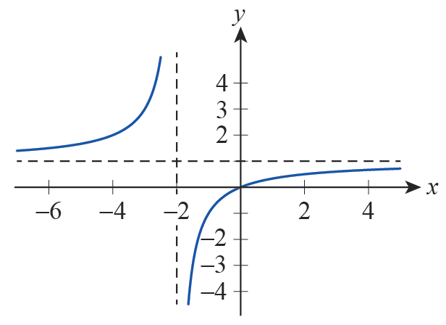

Example 4: Finding the Implied Domain and the Range of a Function (cont.)
In fact, being a rational function with the horizontal asymptote of y = 1, and having “opposing behavior” on the two sides of its vertical asymptote x = −2, we see that f assumes every real value except y = 1 (see Figure 10). Thus, the range of f is as follows.
$$Range of f=\left\{y∈\text{ℝ} | y≠−1\right\}$$

Slide 32
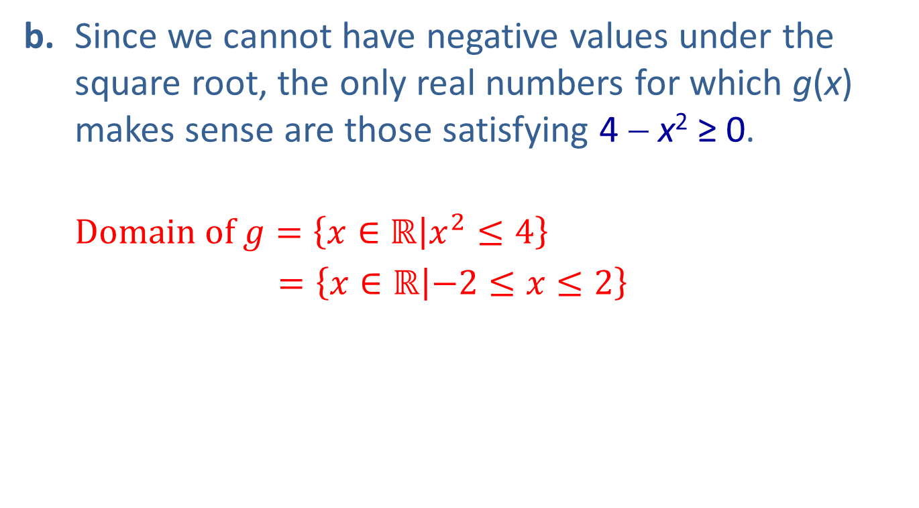
Example 4: Finding the Implied Domain and the Range of a Function (cont.)
b. Since we cannot have negative values under the square root, the only real numbers for which g(x) makes sense are those satisfying 4 − x² ≥ 0.
$$\text{D}\text{omain} \text{of} g=\left\{x∈\text{ℝ} | x^{2}≤4\right\}$$
$=\left\{x∈\text{ℝ} | −2≤x≤2\right\}$

Slide 33
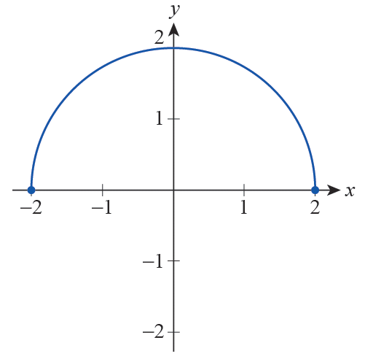
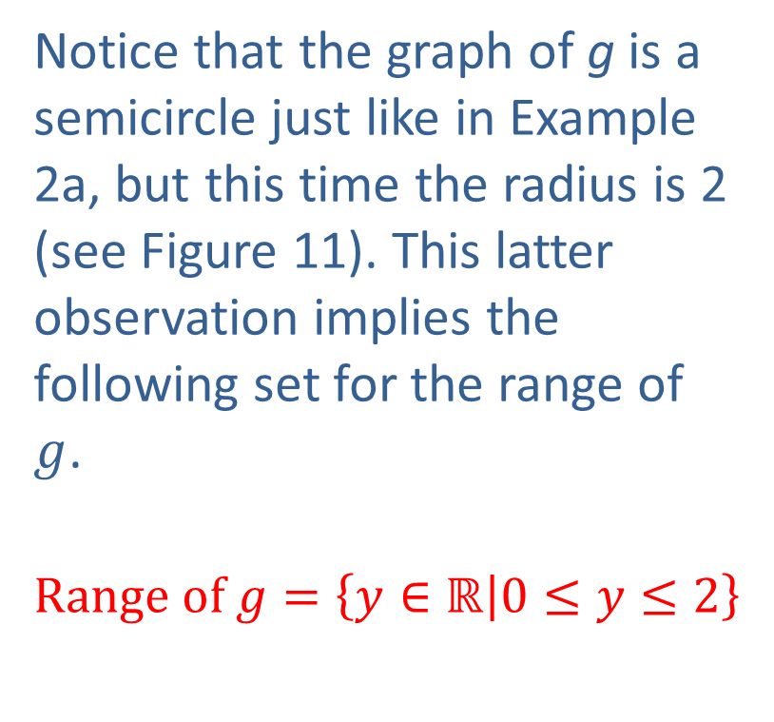
Example 4: Finding the Implied Domain and the Range of a Function (cont.)
Notice that the graph of g is a semicircle just like in Example 2a, but this time the radius is 2 (see Figure 11). This latter observation implies the following set for the range of $g$.
$$Range of g=\left\{y∈\text{ℝ} | 0≤y≤2\right\}$$

Slide 34
Ways of Describing Functions
The four most common ways to describe functional relationships are mathematical formulas, tables of data, graphs, and verbal descriptions.
In a formula such as A(r) = π r ², the variable r is sometimes referred to as the argument of the function, and it is instructive to realize that the exact symbol used for the argument is irrelevant. That is, A(s) = πs ², A(radius) = π (radius)², and A(□) = π □ ² all describe exactly the same function A.

Slide 35
Example 5: Writing Formulas as Functions
Find the following formulas and rewrite them so as to explicitly express the functional relationship between the variables. Identify the argument in each case.
a. The area of an equilateral triangle
b. The stopping distance required by a car traveling at speed v from the moment the brakes are applied
c. The volume of a circular cylinder

Slide 36
Example 5: Writing Formulas as Functions (cont.)
Solution
a. The area of an equilateral triangle of side length s is
(using the fact that the height h of an
equilateral triangle is
This formula can be rewritten as a
functional relationship with s being the argument explicitly showing how the area of an equilateral triangle depends on its side length.

Slide 37
Example 5: Writing Formulas as Functions (cont.)
b. The stopping distance d required by a car traveling at speed v when the brakes are applied is estimated by the formula where μ is the coefficient of friction between the tires and the pavement, and g is the gravity constant. Since μ can also be considered a constant (at least in the short term, when conditions are nearly unchanging) we see that stopping distance depends on initial speed only.

Slide 38
Example 5: Writing Formulas as Functions (cont.)
This can be expressed by the function
with v being the argument of function d. (Note the quadratic dependence of d on v! It certainly pays to observe all speed limit signs and warnings.)

Slide 39
Example 5: Writing Formulas as Functions (cont.)
c. The volume of a circular cylinder is calculated by V = π r²h, where r is the radius of the base, and h stands for the height of the cylinder. Note that the volume here is a function of two independent quantities. We can express this functional relationship as follows.
Both r and h are considered arguments here, and thus V(r, h) is our first example of a function of two variables.

Slide 40
Technology Note: Evaluating and Graphing a Function
Functions and function notation are immensely important not just as mathematical concepts but also in the way we use technology as a mathematical aid. Graphing calculators and computer algebra systems (CAS) all have methods for defining functions and then making use of them.

Slide 41
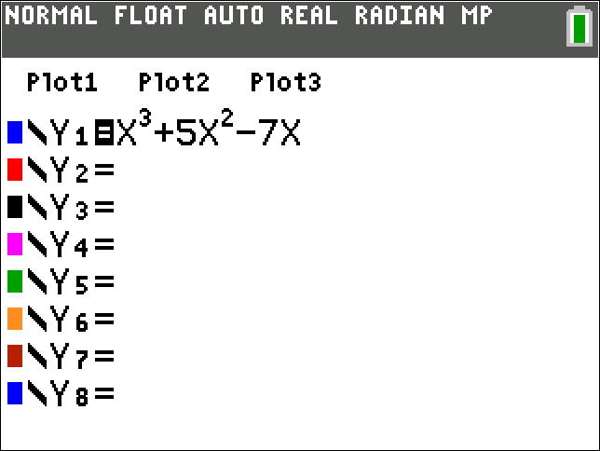
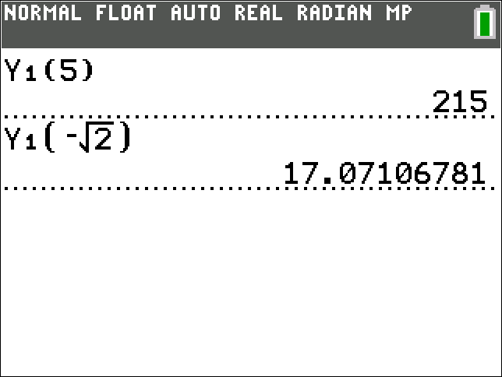
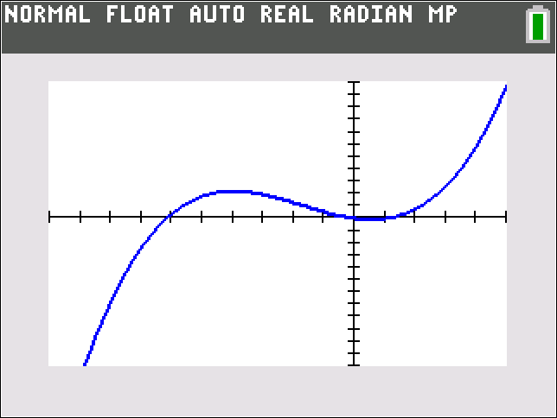

Technology Note: Evaluating and Graphing a Function (cont.)
Figure 12 shows how the function f(x) = x³ + 5x² − 7x is defined using a graphing calculator and how the function is then evaluated at several points and graphed for x∈[−10, 5].
Figure 12

Slide 42
Technology Note: Evaluating and Graphing a Function (cont.)
Figure 13 on the next slide shows how the same function f(x) = x³ + 5x² − 7x is defined in Mathematica, evaluated, and then graphed over the specified region.

Slide 43
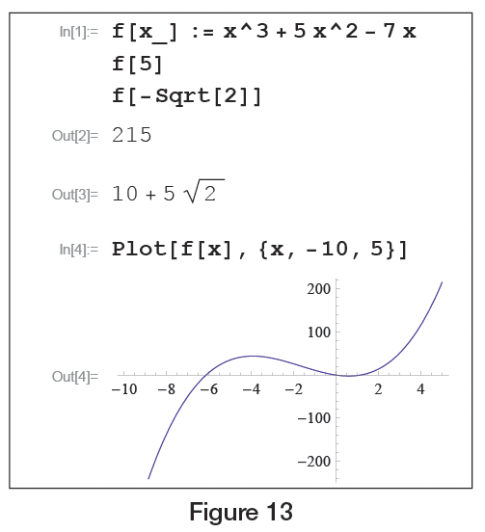
Technology Note: Evaluating and Graphing a Function (cont.)
Figure 13

Slide 44
Ways of Describing Functions
US Population As Measured by the Census Bureau
Year | Population
1950 | 151,325,798
1960 | 179,323,175
1970 | 203,211,926
1980 | 226,545,805
1990 | 248,709,873
2000 | 281,421,906
2010 | 308,745,538
2020 | 331,449,281
Tables of data almost always implicitly describe a function. Table 1 only defines eight values for the function P(t), and it is very often the case that we need to be able to extend the knowledge presented in a table to other values of the independent variable.
Source: www.census.gov
Table 1

Slide 45
Ways of Describing Functions (cont.)
For example, we might want estimates of the US population for every year between 1950 and 2020, or we might desire a projected population for the year 2050. The acts of estimating values of a function based on given data are called interpolation and extrapolation, and are perhaps best introduced with a picture.

Slide 46
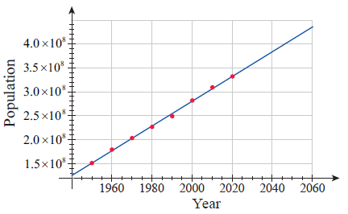
Ways of Describing Functions (cont.)
Figure 14 contains a plot of the eight data points from Table 1, along with a line that seems to approximate the general behavior of the points well.
Figure 14 Graph of US Population Data, 1950–2020

Slide 47
Ways of Describing Functions (cont.)
To interpolate a value from a table or graph means to arrive at an estimate for the value of the implied function between two known data points, while to extrapolate means to guess at a value beyond the given points. In our example, we might interpolate a value for P(1985) to be close to 240 million (2.4 × 10⁸ in scientific notation) and extrapolate a value for P(2050) to be approximately 410 million. However, this census data example is also a good illustration of the limitations of tables and graphs. Figure 15 contains the plot of an expanded version of the US Census table, along with a curve that approximates the behavior.

Slide 48
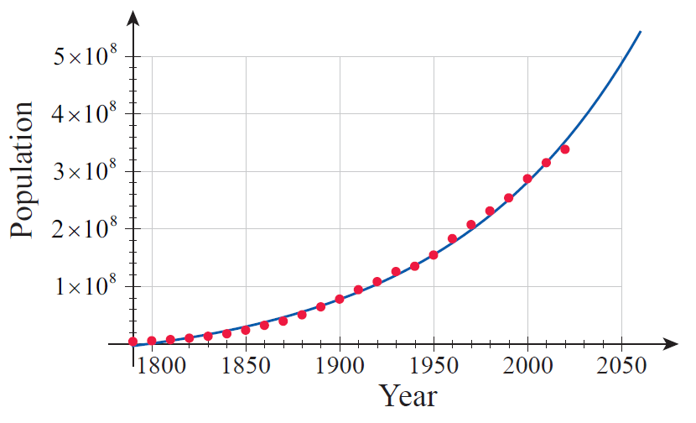
Ways of Describing Functions (cont.)
Figure 15 Graph of US Population Data, 1790-2020

Slide 49
Technology Note: Curve Fitting
You may be wondering how the blue line and blue curve in Figures 14 and 15 were drawn and whether they can be improved upon. There is no definitive answer to the second question, as curve fitting (the act of constructing a curve that closely approximates given data) depends upon making some assumptions about the mathematical nature of the data, and it is often the case that different but equally defensible assumptions can be made.

Slide 50
Technology Note: Curve Fitting (cont.)
In this case, it was assumed that the eight data points in Figure 14 lay approximately along a straight line (that is, that P(t) = a + bt for some choice of a and b) and that the expanded data set in Figure 15 could be approximated by an exponential curve (specifically, that P(t) = a + b^{t} for some a and b).

Slide 51
Technology Note: Curve Fitting (cont.)
The answer to the first question above (the how question) is that the parameters a and b were chosen in each case so that the sum of the squares of the differences between the given data and the fitted curve was as small as possible. This method, called the least‑squares method of curve fitting, will be fully explored later in this text, but for the moment we will focus on the results rather than the method.

Slide 52
Technology Note: Curve Fitting (cont.)
Many software packages (such as Mathematica, Maple, and spreadsheet programs such as Microsoft Excel) and graphing calculators are capable of calculating a least‑squares fit. Using the command Fit from Mathematica, we arrive at the linear function
(whose graph is the blue line in Figure 14)

Slide 53
Technology Note: Curve Fitting (cont.)
and the exponential function
(whose graph is the blue curve in Figure 15).

Slide 54
Ways of Describing Functions
Recall that, mathematically, the graph of a function f that maps real numbers to real numbers is the collection of all points of the form (x, f(x)), where x takes on all the values in the domain of f. In some cases, such as the seismogram of Figure 16, information is presented to us first in the form of a picture, and we then find it useful to infer a functional
relationship from the picture.

Slide 55
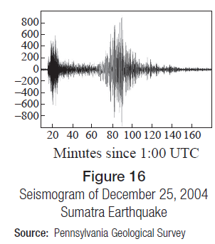
Ways of Describing Functions (cont.)
In other cases, a function is presented in the form of a table or formula, and we find it useful to construct the graph of the given data and possibly even (as in the US population example) to “fill in” the parts of the implied function that might
be missing.

Slide 56
Ways of Describing Functions (cont.)
Consider the act of filing correspondence in a filing cabinet according to the last name of the sender. This act represents a function, which for convenience we might name F for File. Thus, for example, a letter from James Childress would be filed in the F(Childress) = C folder, and one from Deanna Jones would be filed in the F(Jones) = J folder.

Slide 57
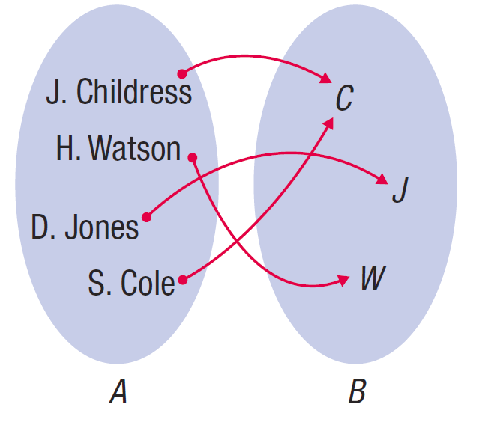
Ways of Describing Functions (cont.)
Figure 17 is an arrow diagram illustrating how F relates the domain set A of correspondents to the codomain set B of file folders.
Note that this act F does indeed satisfy all the requirements to be a function.
Figure 17
Arrow Diagram of Filing Function F

Slide 58
Example 6: Describing Functions Verbally
We will give examples of functions that are easily described verbally, the likes of which you meet on a daily basis, perhaps without even thinking of them as functions.

Slide 59
Example 6: Describing Functions Verbally (cont.)
a. In California, license plates of passenger vehicles follow the pattern of a number followed by three letters and then by three digits, such as, “4ZNR915.” Since every registered car has a unique license plate with no duplications allowed, we can think of this as a functional relation between the set of registered California passenger cars as the domain and the set of strings following the above pattern as the codomain.

Slide 60
Example 6: Describing Functions Verbally (cont.)
b. When a class of calculus students walks into a classroom and sits down, the students (perhaps unknowingly) define a function with its domain being the students themselves and the codomain being the chairs in the room. Since (at least in the ideal case) each student is able to sit and do so on no more than one chair at a time, we see that this is indeed a functional relationship between the two sets.

Slide 61
Example 6: Describing Functions Verbally (cont.)
Note that coming back to class two days later and sitting down in a slightly different order amounts to no more than redefining the function. Also, since every chair may not always be used, there is a clear distinction here between codomain and range.

Slide 62
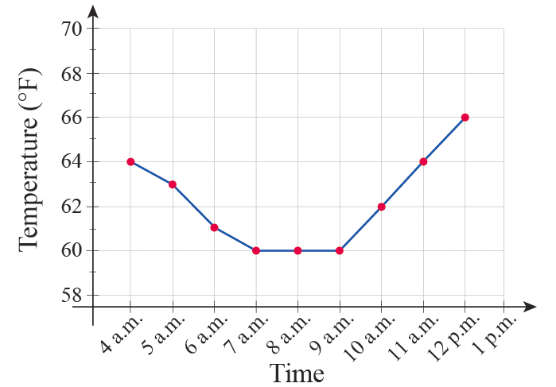
Example 6: Describing Functions Verbally (cont.)
c. The temperature on a given day in Shreveport, Louisiana, is a function of time, with its values being numbers from the Fahrenheit temperature scale. This is a function we can graph on a particular day, as shown in Figure 18.
Figure 18

Slide 63
The Power of Graphs
Given a graph of a relation, how do we determine whether it represents a functional relationship? For graphs in ℝ², there is a simple test to apply.

Slide 64
Theorem: The Vertical Line Test
Given a graph of a relation in the Cartesian plane, the graph represents a function if no vertical line passes through the graph more than once. If even one vertical line intersects the graph in two or more points, the relation fails to be a function.

Slide 65
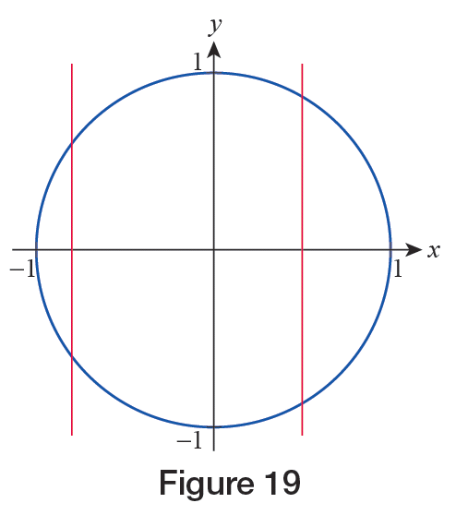
Example 7: Applying the Vertical Line Test
Below, we provide examples of the use of the vertical line test.
a. The unit circle centered at the origin does not define y as a function of x, since there are plenty of vertical lines intersecting the graph more than once (see Figure 19).
Figure 19

Slide 66
Example 7: Applying the Vertical Line Test (cont.)
In fact, as we have seen in Example 2a, the equation of the unit circle x² + y² = 1 defines both functions each having a semicircle for its graph, and thus both satisfying the vertical line test.

Slide 67
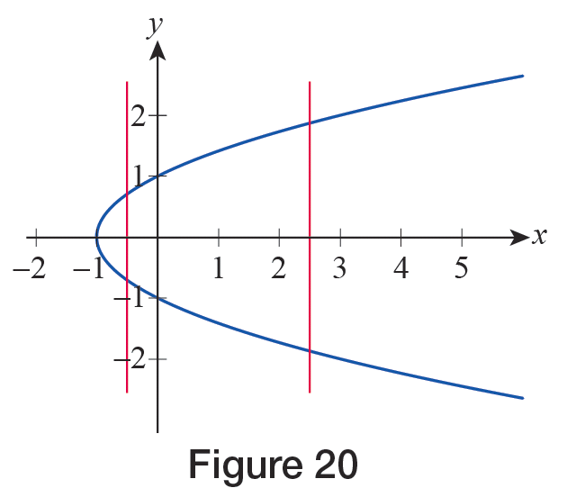
Example 7: Applying the Vertical Line Test (cont.)
b. An easy application of the vertical line test on the graph of y² = x + 1 shows that y is not a function of x (see Figure 20).
Figure 20

Slide 68
Example 7: Applying the Vertical Line Test (cont.)
We note, however, that again both functions
are defined by the original equation. Furthermore, as we noted in Example 3b, our equation does actually define x as a function of y. (Note that because of the change in roles between the variables, from the perspective of the dependent variable x, “vertical lines” are the ones that appear horizontal in the traditional xy‑coordinate system. With this interpretation, the “vertical line test” still applies to x as a function of y!)

Slide 69
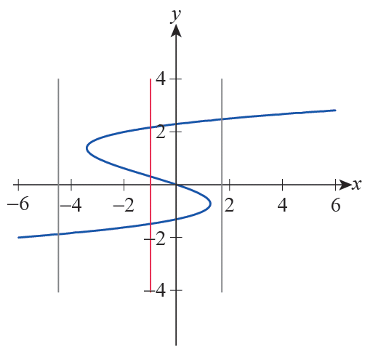
Example 7: Applying the Vertical Line Test (cont.)
c. The graph in Figure 21 is not a function either. Note that while a lot of vertical lines intersect the graph only once, it is enough to find one that doesn’t.
Figure 21

Slide 70
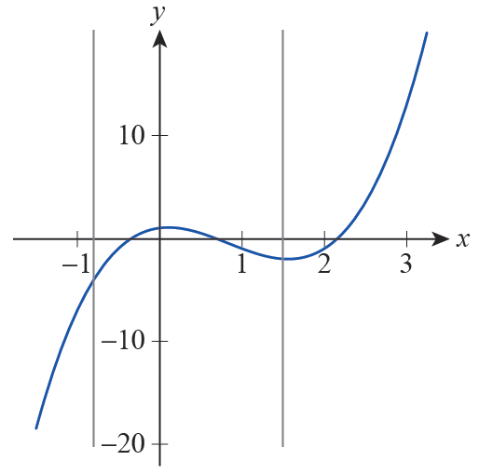
Example 7: Applying the Vertical Line Test (cont.)
d. Finally, we mention that the graphs of all functions
you worked with in your precalculus course (such as polynomials, rational and trigonometric functions, etc.) do pass the vertical line test. As an example, the function
shown in Figure 22, intersects every vertical line exactly once.
Figure 22

Slide 71
Definition: Increasing/Decreasing
A real‑valued function f is said to be increasing on an interval I if whenever x₁ and x₂ are in I,
Similarly, f is said to be decreasing on I if whenever x₁ and x₂ are in I,

Slide 72
Definition: Increasing/Decreasing (cont.)
In either case, f is said to be monotone on I, and if the inequality that compares the function values is strict, the function is said to be strictly increasing or decreasing on I.

Slide 73
Example 8: Identifying Intervals of Monotonicity
Determine the open intervals of monotonicity (intervals where the function is increasing or decreasing) for the following functions.

Slide 74
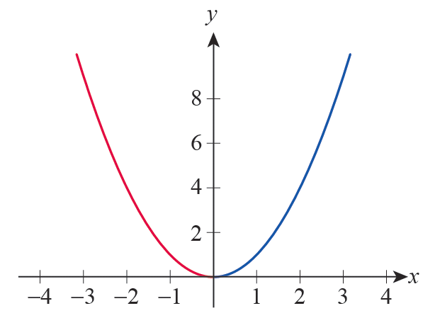
Example 8: Identifying Intervals of Monotonicity (cont.)
Solution
a. The graph of f(x) = x² is a prototypical parabola, opening upward, centered at the origin (see Figure 23).
Figure 23 f(x) = x²

Slide 75
Example 8: Identifying Intervals of Monotonicity (cont.)
It is clear that f is decreasing on the interval (−∞, 0) while it is increasing on (0, ∞). Visually, this means that the graph is “falling” as we scan it from left to right along the negative x‑axis, while it is “rising” for positive x‑values.

Slide 76
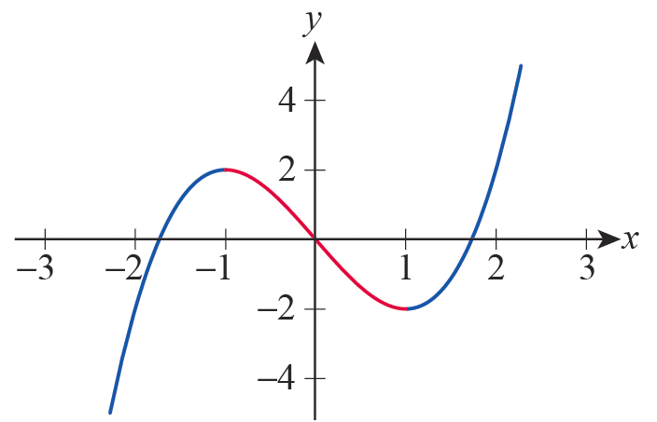
Example 8: Identifying Intervals of Monotonicity (cont.)
b. Examining the graph of g(x) = x³ − 3x in Figure 24, we see g is increasing on (−∞, −1) and (1, ∞) while it is decreasing “in between” these half lines, that is, on the interval (−1, 1).
Figure 24 g(x) = x³ – 3x

Slide 77
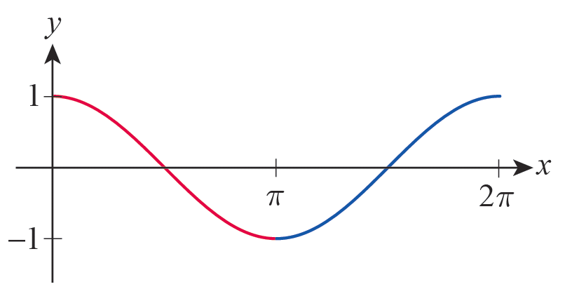
Example 8: Identifying Intervals of Monotonicity (cont.)
From the graph of h(x) = cos x, we conclude that h is decreasing on the interval (0,π)and increasing on (π, 2π) (see Figure 25). More than that, because of 2π-periodicity, cos x is decreasing on all intervals of the form (2kπ, (2k+1)π) for an arbitrary integer k, while it is increasing on all intervals ((2k−1)π, 2kπ).
Figure 25 h(x) = cos x

Slide 78
Definition: Even and Odd Functions
The two most elementary kinds of symmetry are termed even and odd.
If a real‑valued function f has the property that f(− x) = f(x) for all x in its domain, f is said to be an even function. Its graph will display symmetry with respect to the y‑axis, as shown in Figure 26.
If a real‑valued function f has the property that
f(−x) = − f(x) for all x in its domain, f is said to be an odd function. Its graph will display symmetry with respect to the origin, as shown in Figure 27.

Slide 79
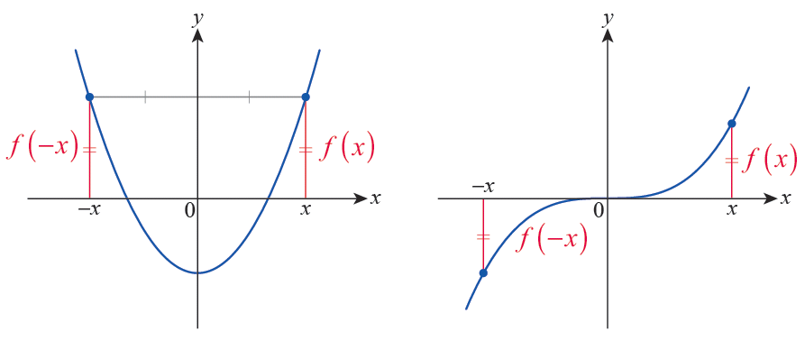
Definition: Even and Odd Functions (cont.)
Figure 26 An Even Function
Figure 27 An Odd Function

Slide 80
Definition: Symmetry of Equations
An equation in x and y is symmetric with respect to
1. the y‑axis if replacing x with −x results in an equivalent equation;
2. the x‑axis if replacing y with −y results in an equivalent equation;
3. the origin if replacing x with −x and y with −y results in an equivalent equation.

Slide 81
Example 9: Identifying Types of Symmetry in Graphs of Relations
Discuss the symmetry of the following functions and equations.

Slide 82
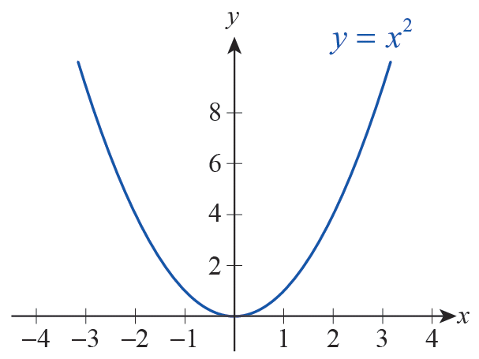
Example 9: Identifying Types of Symmetry in Graphs of Relations (cont.)
Solution
a. Since (−x)² = x², we see that replacing x by −x yields an equivalent equation, so the graph must be symmetric with respect to the y‑axis. Note that we
can rewrite this equation as y = x², and so its graph is the graph of the function f(x) = x². This graph, the prototypical parabola, indeed displays symmetry with respect to the y‑axis (See Figure 28).
Figure 28

Slide 83
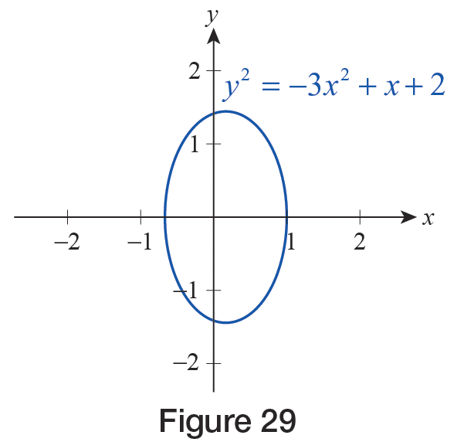
Example 9: Identifying Types of Symmetry in Graphs of Relations (cont.)
b. If we replace y with −y, we obtain an equivalent equation, since (−y)² = y². The same is not true of x, since replacing it by −x turns the right‑hand side of the equation into −x + 2. Hence we conclude that the graph of this equation is symmetric with respect to the x‑axis, but not the y‑axis (see Figure 29).
Figure 29

Slide 84
Example 9: Identifying Types of Symmetry in Graphs of Relations (cont.)
c. If we simultaneously replace x with −x and y with −y in this equation, we obtain
and this latter equation is seen to be equivalent to the original, so we conclude that its graph is symmetric with respect to the origin.

Slide 85
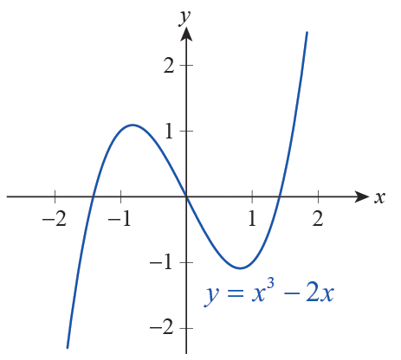
Example 9: Identifying Types of Symmetry in Graphs of Relations (cont.)
Finally, note that this graph is the same as that of the function g(x) = x³ − 2x (see Figure 30).
Figure 30

Slide 86
Example 9: Identifying Types of Symmetry in Graphs of Relations (cont.)
d. This example is more easily done algebraically instead of graphically. By substituting −x for x we obtain

Slide 87
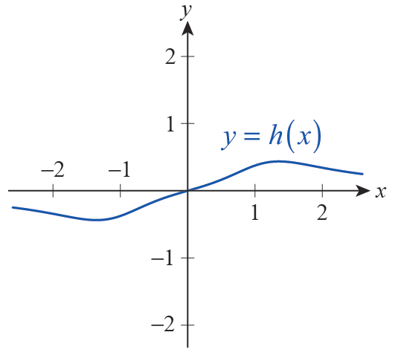
Example 9: Identifying Types of Symmetry in Graphs of Relations (cont.)
and conclude that h is an odd function; thus its graph is symmetric with respect to the origin (see Figure 31).
Figure 31

Slide 88
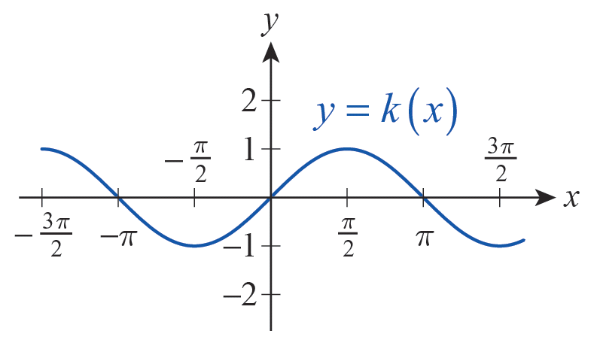
Example 9: Identifying Types of Symmetry in Graphs of Relations (cont.)
e. The trigonometric function k(x) = sin x is odd, since sin(−x) = −sin x, and so its graph displays symmetry with respect to the origin (see Figure 32).
Finally, we also note
that g(x) = cos x is even, for we know cos(−x) = cos x to be true for all x. These facts are also clearly seen by visually examining these basic trigonometric graphs.
Figure 32

