Slide 1
Section 1.2
Common Functions

Slide 2
Definition: Polynomial Functions
A polynomial function f of one variable, say the variable x, is any function that can be written in the form
where each a_{i} is a constant and n is a nonnegative integer. Each a_{i} is called the coefficient of its associated term a_{i} x^{i}. The highest power of the variable is called the degree of the polynomial, and the coefficient of the term containing that highest power is called the leading coefficient of the polynomial.

Slide 3
Algebraic Functions
Polynomial functions of degree 1 are called first‑degree polynomials, and their graphs are straight lines.
A polynomial of the form f(x) = a₀ is a constant polynomial, and its graph is also a line (a horizontal line running through a₀ on the y‑axis). The degree of a constant polynomial is 0, unless a₀ happens to be 0 (in which case the polynomial has no nonzero terms and is said to have no degree). Since their graphs are lines, first‑degree and constant polynomials are together termed linear functions.

Slide 4
Algebraic Functions (Cont.)
Second‑degree polynomials have the form and their graphs are parabolas. Such functions also go by the name of quadratic functions. Similarly, third‑degree polynomials are also known as cubic functions, and fourth‑degree polynomials as quartic functions.

Slide 5
Example 1: Describing Graphs of Polynomial Functions
Graph the following polynomial functions, and briefly discuss their most notable characteristics.

Slide 6
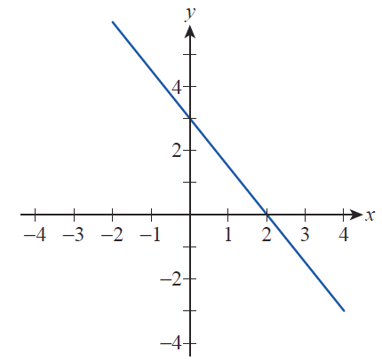
Example 1: Describing Graphs of Polynomial Functions (cont.)
Solution
a. The function f (x) is easily recognized as a first‑degree function. The slope, which is also the leading coefficient, is negative, meaning that the graph “falls” as we scan it from left to right (see Figure 1).

Slide 7
Example 1: Describing Graphs of Polynomial Functions (cont.)
The graph confirms the y-intercept being 3, while the x‑intercept can quickly be found to be 2 by solving the equation Finally, notice that the range of this function is all of ℝ, as is the case for all linear functions, unless they are constant.

Slide 8
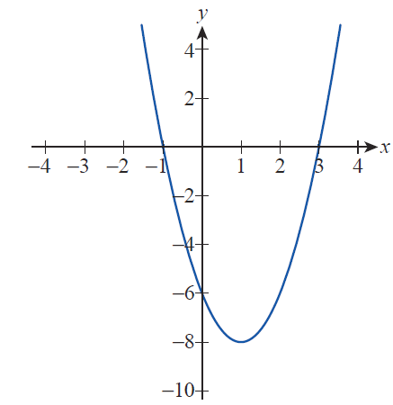
Example 1: Describing Graphs of Polynomial Functions (cont.)
b. The function g(x) is a quadratic polynomial with a positive leading coefficient of 2. This means that the graph is an upward‑opening parabola (see Figure 2). The y‑intercept of −6 is easily found by substituting
x = 0 in the formula.

Slide 9

Example 1: Describing Graphs of Polynomial Functions (cont.)
Note that the constant term turns out to be the y‑intercept, which is no accident and happens with all polynomials, since substituting x = 0 will eliminate all terms but the constant.
The x‑intercepts, on the other hand, are the two solutions of 2x² − 4x − 6 = 0, namely, −1 and 3. Finally, we note that since the vertex of the parabola is at (1, −8) the range of g is the set
$$\left\{y∈ℝ|y≥−8\right\}.$$

Slide 10
Example 1: Describing Graphs of Polynomial Functions (cont.)
c. The function h(x), being a product of three linear polynomials, is certainly cubic, which is readily seen upon expanding and obtaining the standard form of
As before, the y‑intercept is the constant term, −3, and we see from the factored form of h(x) that the x‑intercepts are −2, −1, and 3 (these values being the zeros of the polynomial).

Slide 11
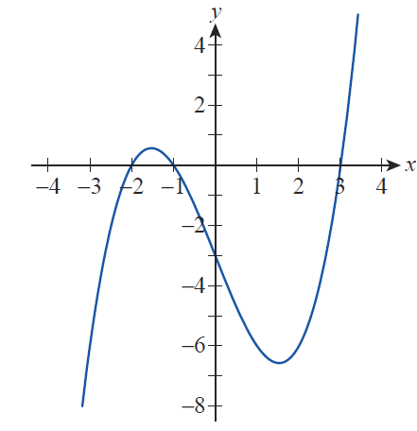
Example 1: Describing Graphs of Polynomial Functions (cont.)
Finally, notice that, unlike the parabola, this graph “falls” to the left and “rises” to the right, as is the case with all polynomials of odd degree and positive leading coefficient, so the range of h(x) is the entire set of ℝ (see Figure 3).

Slide 12
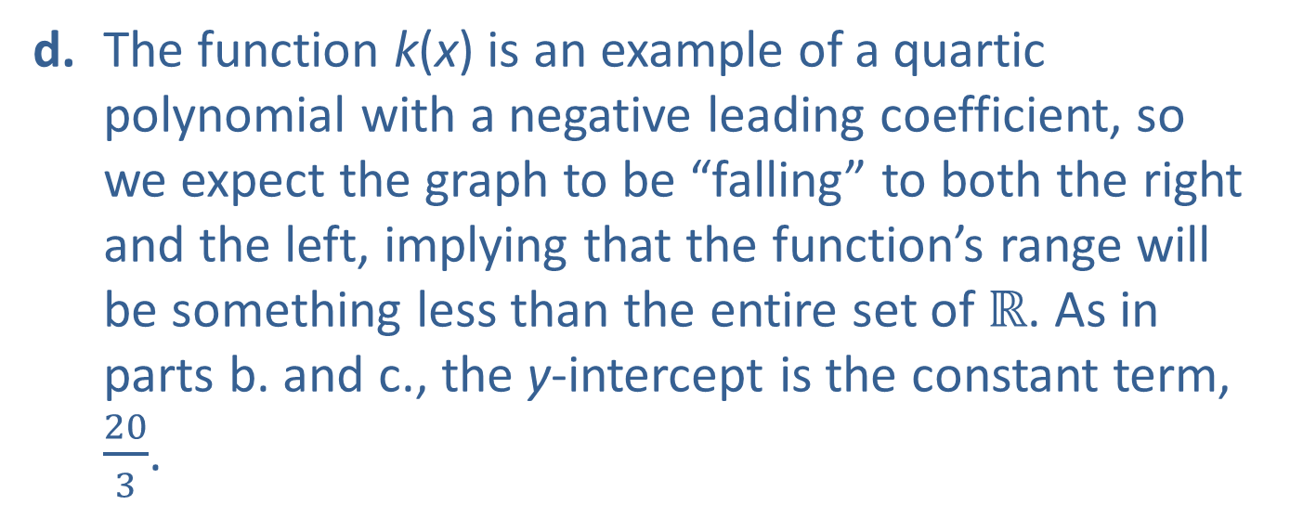
Example 1: Describing Graphs of Polynomial Functions (cont.)
d. The function k(x) is an example of a quartic polynomial with a negative leading coefficient, so we expect the graph to be “falling” to both the right and the left, implying that the function’s range will be something less than the entire set of ℝ. As in parts b. and c., the y‑intercept is the constant term, $\frac{20}{3}$.

Slide 13
Example 1: Describing Graphs of Polynomial Functions (cont.)
To find x‑intercepts, we can use, say, the Rational Zero Theorem along with long or synthetic division to obtain the fully factored form and conclude that the x‑intercepts are ±2, 1, and 5.

Slide 14
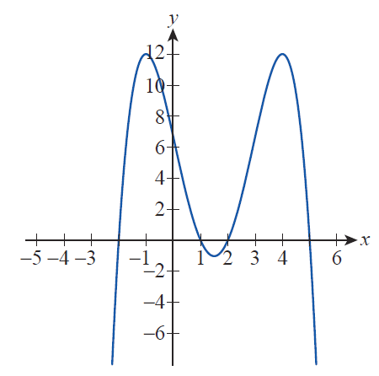

Example 1: Describing Graphs of Polynomial Functions (cont.)
From the graph shown in Figure 4, we also see the range to be the set
$$\left\{y∈ℝ|y≤12\right\}.$$

Slide 15
Example 2: Applying Position and Velocity Functions
A diver jumps from a 24‑foot-high diving board so that her position above the water at any given time during the jump is represented by the function
where p is measured in feet (ft), and t in seconds (s). Her velocity as a function of time is given by How much later and with what velocity does the diver hit the water?

Slide 16
Example 2: Applying Position and Velocity Functions (cont.)
Solution
First of all, since the position function p(t) returns the altitude of the diver above the water surface for any specified t‑value, we note that even though the diver may not move along a linear path, the position function only applies to one dimension. The same is true of velocity, whereas v(t) returns the instantaneous velocity of the diver at any given time t.

Slide 17
Example 2: Applying Position and Velocity Functions (cont.)
Also notice how the constant acceleration caused by gravity, the initial upward jumping speed of
and the height of the platform, 24 ft, are “hidden” in the formula for p(t)! Indeed, we see from the formula for v(t) that the velocity decreases by
with every passing second; thus, there is a negative acceleration of Substituting t = 0 into the formula for v(t) yields the initial velocity
while the height of the platform is the initial position

Slide 18
Example 2: Applying Position and Velocity Functions (cont.)
To find out when the diver hits the water, we turn to the position function and note that at the moment of impact, the position over the water becomes 0, so we solve the quadratic equation −16t² + 8t + 24 = 0. The solutions are t = 1.5 and t = −1. We can safely discard the latter, since time cannot be negative, so we conclude that the diver hits the water 1.5 seconds after leaving the diving board.

Slide 19
Example 2: Applying Position and Velocity Functions (cont.)
As for the velocity of impact, we turn to the velocity function v(t). When t = 1.5, the velocity of impact is obtained by evaluating Note that the negative sign indicates that the direction of motion at the time of impact is downward.

Slide 20
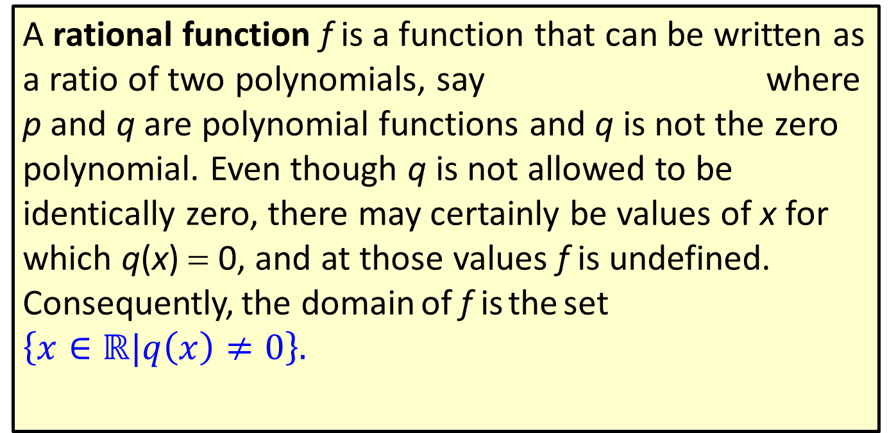
Definition: Rational Functions
A rational function f is a function that can be written as a ratio of two polynomials, say where p and q are polynomial functions and q is not the zero polynomial. Even though q is not allowed to be identically zero, there may certainly be values of x for which q(x) = 0, and at those values f is undefined. Consequently, the domain of f is the set
$$\left\{x∈ℝ|q\left(x\right)≠0\right\}.$$

Slide 21
Example 3: Graphing Rational Functions
Sketch the graphs of the following rational functions, noting all intercepts and asymptotes.

Slide 22
Example 3: Graphing Rational Functions (cont.)
Solution
a. First of all, note that the domain of f is all real numbers except for 1, and that after canceling the common factor of x − 1, the function reduces to f(x) = x + 1. This holds whenever x ≠ 1 and thus the graph of f is simply that of y = x + 1 with one point missing from it, since f is not defined at x = 1.

Slide 23
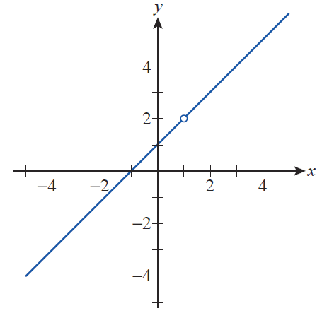
Example 3: Graphing Rational Functions (cont.)
We denote this with an open circle at the point on the graph corresponding to x = 1 (see Figure 5). Note the x‑and y‑intercepts of −1 and 1, respectively; there are no asymptotes.

Slide 24
Example 3: Graphing Rational Functions (cont.)
Since the numerator cannot be factored over the real numbers, we find two vertical asymptotes with equations x = −5 and x = 3. Also, since the numerator and denominator have the same degree and the ratio of the leading coefficients is 1, the line y = 1 is the horizontal asymptote. Since the numerator is never 0, there are no x‑intercepts, while the y‑intercept is the value of the function at 0:

Slide 25
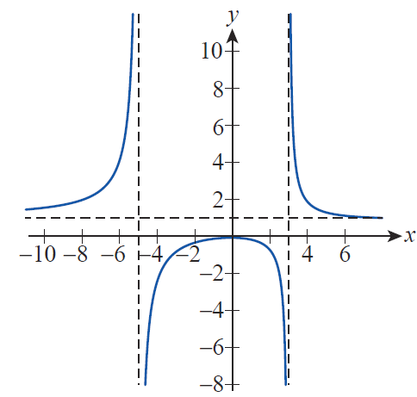
Example 3: Graphing Rational Functions (cont.)

Slide 26
Example 3: Graphing Rational Functions (cont.)
c. Since x = 1 makes the denominator 0, and the numerator is not factorable over the real numbers, h(x) has the vertical asymptote x = 1 (in stark contrast with f (x) discussed in part a.). Furthermore, since the degree of the denominator is less than that of the numerator, there is no horizontal asymptote. However, since the difference in degrees is just one, we anticipate an oblique (or slant) asymptote, which is revealed by dividing x − 1 into x² + 1 by long or synthetic division.

Slide 27
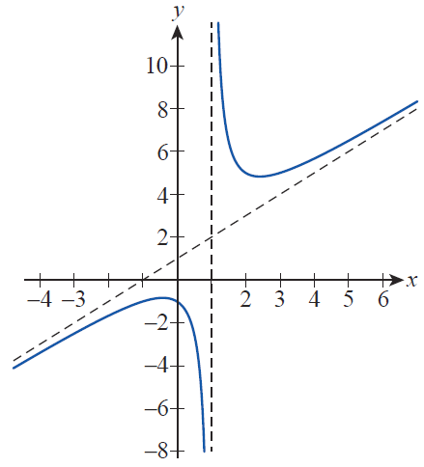
Example 3: Graphing Rational Functions (cont.)
Thus we have obtained that the line y = x + 1 is a slant asymptote for h. As far as intercepts, there are no x‑intercepts since the numerator is never 0, but the function value h(0) = −1 yields the y‑intercept of −1 (see Figure 7).

Slide 28
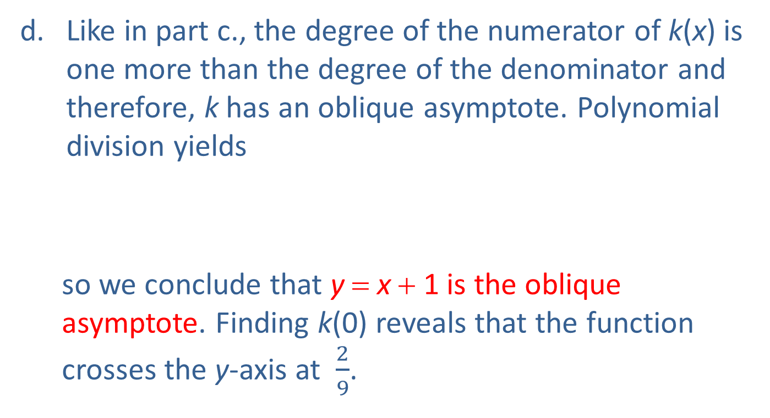
Example 3: Graphing Rational Functions (cont.)
Like in part c., the degree of the numerator of k(x) is one more than the degree of the denominator and therefore, k has an oblique asymptote. Polynomial division yields
so we conclude that y = x + 1 is the oblique asymptote. Finding k(0) reveals that the function crosses the y-axis at $\frac{2}{9}$.

Slide 29
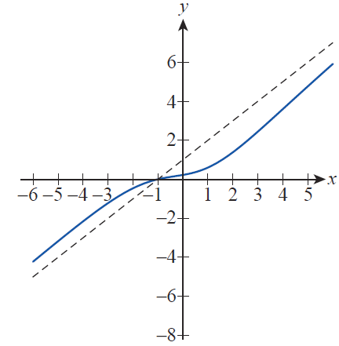
Example 3: Graphing Rational Functions (cont.)
To find x‑intercepts, we need the zeros of the numerator polynomial. One of the potential rational zeros is −1, which actually is a zero, and thus the numerator factors as
so −1 is the only x‑intercept (see Figure 8).

Slide 30
Definition: Power Functions
A power function in the variable x is a function of the form where a ≠ 0. Note that if a is a positive integer, such a function is an example of a single‑term polynomial. If a has the form where n is a positive integer, such a function is a root function (and also written is called the n^{th} root of x). If a = −1, the function is the reciprocal function and is an example of a rational function.

Slide 31
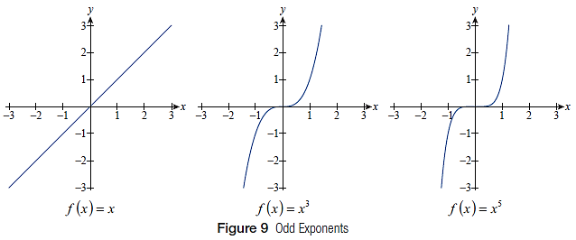
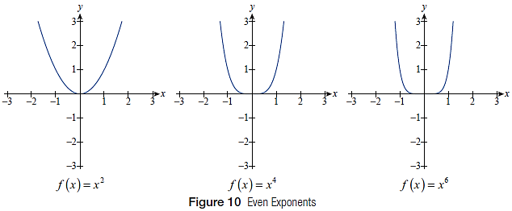
Definition: Power Functions (cont.)

Slide 32
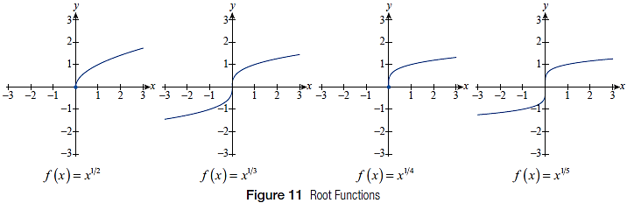
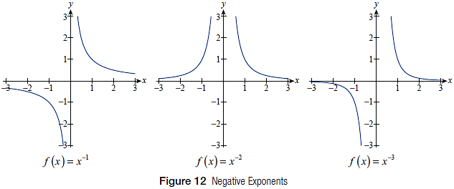
Definition: Power Functions (cont.)

Slide 33
Definition: Algebraic Functions
A function f is in the class of algebraic functions if it can be constructed, starting with polynomials, in a finite number of steps using only the algebraic operations of addition, subtraction, multiplication, division, and the taking of roots.

Slide 34
Example 4: Constructing Algebraic Functions from Polynomials
We provide a few examples of algebraic functions and one way each can be constructed.
a. Consider the algebraic function
It can be constructed in a finite number of steps as shown below. For example, using the notation f(x) = x², we recognize F(x) as
Note that this is not the only way to think about constructing F. Can you think of an alternate one?

Slide 35
Example 4: Constructing Algebraic Functions from Polynomials (cont.)
b. Starting with the “easy” polynomials g(x) = x, and h(x) = 5, we can construct

Slide 36
Example 4: Constructing Algebraic Functions from Polynomials (cont.)
c. Starting with the polynomials
and we can construct the algebraic function

Slide 37
Definition: Transcendental Functions
A function f is in the class of transcendental functions if it is not algebraic. Such a function cannot be constructed with a finite number of applications of algebraic operations and in this sense transcends elementary algebra.

Slide 38
Definition: Trigonometric Functions
The three fundamental trigonometric functions are sine, cosine, and tangent (abbreviated as sin, cos, and tan). Their reciprocals are named, respectively, cosecant, secant, and cotangent (abbreviated as csc, sec, and cot).

Slide 39
Transcendental Functions
Recall that, unlike any of the functions seen thus far, trigonometric functions are periodic; that is, the complete graph of each one consists of an infinite repetition of one basic shape. Also recall that the argument of a trigonometric function represents an angle measure and that, unless specifically indicated otherwise, angles are assumed to be measured in radians (not degrees). Figure 13 illustrates the graphs of the sine, cosine, and tangent functions.

Slide 40
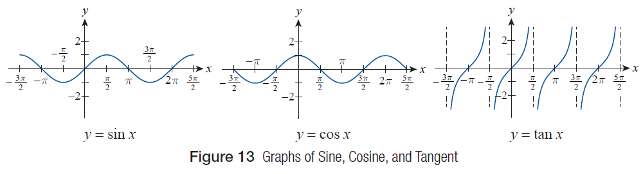
Transcendental Functions (cont.)

Slide 41
Example 5: Simplifying Trigonometric Expressions
When working with trigonometric functions in calculus, it often surprises students that equivalent answers to particular problems may appear to be completely different. This phenomenon is related to the inherent features of trigonometric functions and to the ways they are related to each other. To illustrate, let us simplify the following trigonometric expressions.

Slide 42
Example 5: Simplifying Trigonometric Expressions (cont.)
Solution
a. We start by noting that sin x and cos x are 2π ‑periodic, so sin(x − 4π) simply equals sin x for all x. Furthermore sec x, being the reciprocal of cos x, is an even function, so sec(−x) = sec x. Thus we obtain the following.

Slide 43
Example 5: Simplifying Trigonometric Expressions (cont.)
b. As above, we begin by making use of the observation that since tan t is π-periodic,
and so we can rewrite the given expression as follows.
Note that here we took advantage of the identity
which can easily be checked.

Slide 44
Example 5: Simplifying Trigonometric Expressions (cont.)
We begin by recalling the following identity.
This is easiest to check by nothing that since the cosine function is even, we have

Slide 45
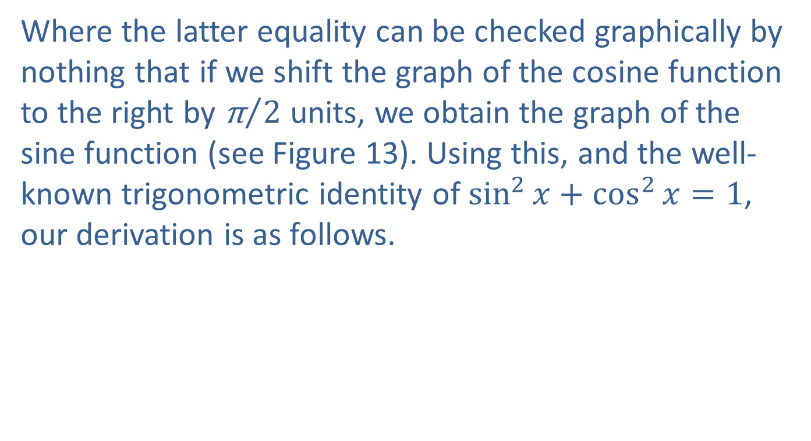
Example 5: Simplifying Trigonometric Expressions (cont.)
Where the latter equality can be checked graphically by nothing that if we shift the graph of the cosine function to the right by ${\text{π}}/2$ units, we obtain the graph of the sine function (see Figure 13). Using this, and the well-known trigonometric identity of $\sin^{2}{x+\cos^{2}{x=1}}$, our derivation is as follows.

Slide 46
Example 5: Simplifying Trigonometric Expressions (cont.)

Slide 47
Example 5: Simplifying Trigonometric Expressions (cont.)
If not explicitly stated, it is understood that equivalences are only valid where the two expressions are both defined. In this case, since and
neither expression is defined when α is a multiple of π (that is, for 𝛼 = kπ, where k is any integer). In addition, the original expression is not
defined when (that is, for

Slide 48
Example 6: Using Trigonometric Models
The following examples illustrate how trigonometric functions can be used to model well‑known real‑life phenomena.
a. If an object attached to a spring is pulled down A inches from equilibrium, the resulting oscillating motion is called simple harmonic motion. The position function of such a motion can be either
or depending on whether the object is in its downward position or at equilibrium when t = 0.

Slide 49
Example 6: Using Trigonometric Models (cont.)
Here ω is a constant that is related to the characteristics of the spring, and A is the amplitude. Notice how the periodicity of the position functions reflects the oscillating nature of the motion.

Slide 50
Example 6: Using Trigonometric Models (cont.)
b. The change in temperature at a particular location on Earth is referred to by meteorologists as diurnal temperature variation. Simply put, the surface receives its heat influx from the sun, through what is called solar radiation, but the surface also constantly loses heat as a result of its own so‑called terrestrial radiation. During daytime hours, solar radiation is stronger, causing Earth to warm up. At night, however, there is a drop in temperature as a result of terrestrial radiation, a process that lasts until about one hour after sunrise, at which time the cycle starts again.

Slide 51
Example 6: Using Trigonometric Models (cont.)
Because of the near‑periodic nature of these events, it is reasonable to conjecture that trigonometric functions play a role in the modeling of diurnal temperature variation. British meteorologist Sir David Brunt (1886–1965) gave the following mathematical model for the heat influx F into the ground at the equinoxes.

Slide 52
Example 6: Using Trigonometric Models (cont.)
where F₀ is a constant, ω is the Earth’s angular velocity, and t stands for time, with t = 0 at noon. Notice that the first line in the model represents daytime hours, while the second line corresponds to nighttime, characterized by constant heat loss. Also notice the periodicity of the model.

Slide 53
Example 6: Using Trigonometric Models (cont.)
Finally, observe that the above model consists of two separate “rules,” each applying to daytime or nighttime hours, respectively. These so‑called piecewise-defined functions will be discussed in more detail at the end of this section.

Slide 54
Definition: Exponential Functions
Given a fixed positive real number a not equal to 1,
is the exponential function with base a.

Slide 55
Transcendental Functions
Populations in nature, as mentioned previously, are known to grow following an exponential pattern if there are no restrictions such as predators and limits in food supply or space. This means the population size P is an exponential function of time, such as
where P₀ is the initial population size corresponding to t = 0. This simple model can be used, in the short term and with certain restrictions, to study a wide variety of population growth problems, as illustrated by the following example.

Slide 56
Example 7: Using an Exponential Function to
Model Population Growth
Suppose that 1000 rabbits are released on an uninhabited island that provides practically unlimited food supply, at least for the first few months. If the population doubles every month, how many rabbits are on the island two and a half months after their initial release?

Slide 57
Example 7: Using an Exponential Function to
Model Population Growth (cont.)
Solution
Knowing the initial size of the population, we start out with the population function
where a is a yet‑unknown base that we will try to determine from the given data.

Slide 58
Example 7: Using an Exponential Function to
Model Population Growth (cont.)
Note that
so our function nicely captures the fact that the initial population size is 1000 rabbits. Since we know that the population doubles after the first month, we can write
so a = 2 and thus

Slide 59
Example 7: Using an Exponential Function to
Model Population Growth (cont.)
We can now use a calculator to determine that
We conclude that there are approximately 5657 rabbits on the island two and a half months after their initial release.

Slide 60
Definition: Logarithmic Functions
Given a fixed positive real number a not equal to 1,
is the logarithmic function with base a. The logarithmic function with base 10 often appears simply as log x, and the logarithmic function with base e usually appears as ln x (the “ln” stands for “natural logarithm”).

Slide 61
Piecewise-Defined Functions
Consider the function f defined by
To evaluate this function for a given x, the first step is to determine which rule to apply, that is, whether x is less than 0 or not.

Slide 62
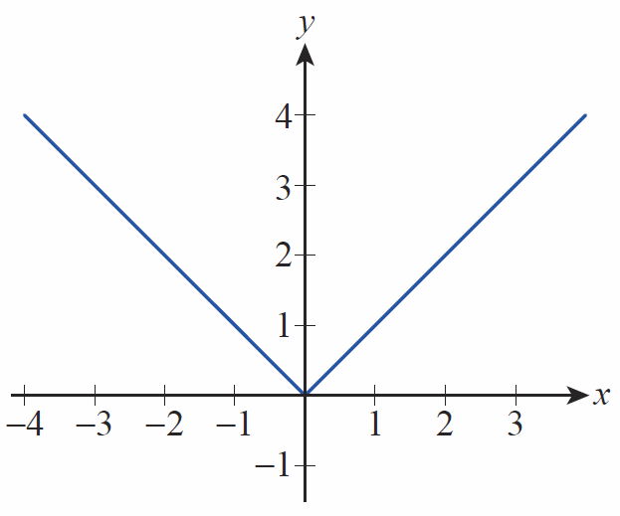
Piecewise-Defined Functions (cont.)
The graph of f simply consists of two pieces, one for x < 0 and the other for x ≥ 0; both pieces are very basic linear functions, and the graph appears in Figure 16.
Figure 16
Absolute Value Function

Slide 63
Piecewise-Defined Functions (cont.)
Although we have used f as a simple example of a function defined in pieces, you have probably seen it before under the name of the absolute value function. In this guise, the function can be defined as f(x) = |x|; note that the piecewise defined rule is nothing more than the definition of absolute value.

Slide 64
Example 8: Graphing and Evaluating a
Piecewise-Defined Function
Sketch the graph of the following piecewise defined function f(x) and find the values
and

Slide 65
Example 8: Graphing and Evaluating a
Piecewise-Defined Function (cont.)
Solution
This graph is “patched” together from three pieces, as follows. Notice that f is the squaring function for negative x‑values, so the first piece of the graph is simply the left‑hand branch of the prototypical parabola. For x‑values between 0 and 2, the graph is a segment of the straight line y = 3x + 1, followed by the graph of (which is also a half parabola) for all x‑values greater than 2.

Slide 66
Example 8: Graphing and Evaluating a
Piecewise-Defined Function (cont.)
To find the value of f(−2), we determine that the first of the three rules applies since −2 is negative.
Next, we use the second rule to find the following.

Slide 67
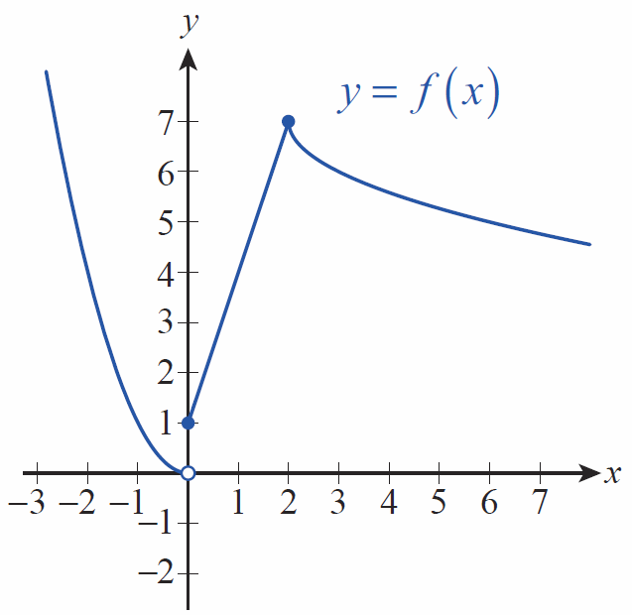
Example 8: Graphing and Evaluating a
Piecewise-Defined Function (cont.)
Note that this means that the y‑axis as a vertical line meets the graph at (0, 1) and misses it at the origin, because (0, 0) is not a point on the graph. This is indicated by the open and closed circles in the Figure 17.
Figure 17

Slide 68
Example 8: Graphing and Evaluating a
Piecewise-Defined Function (cont.)
For x = 1 the second rule applies, so finding f(1) is straightforward.
We see that the second rule applies only to x‑values strictly less than 2, so we use the third rule to evaluate f at x = 2.

Slide 69
Example 8: Graphing and Evaluating a
Piecewise-Defined Function (cont.)
Notice, however, that if we had used the second rule with x = 2, we would have obtained the same function value! Graphically, this is reflected in the fact that the two “pieces” of the graph meet at the point in other words, the graph doesn’t “break” like it does at
x = 0.
To find the last function value, we use the third rule.

Slide 70
Technology Note: Evaluating and Graphing a Piecewise-Defined Function
Computer algebra systems such as Mathematica usually have built‑in commands or syntax for defining and working with piecewise-defined functions. In Mathematica, that command is (nicely enough) Piecewise. Figure 18 shows its use. Note that, in general, graphing technology will not automatically denote “holes” in graphs with open circles.

Slide 71
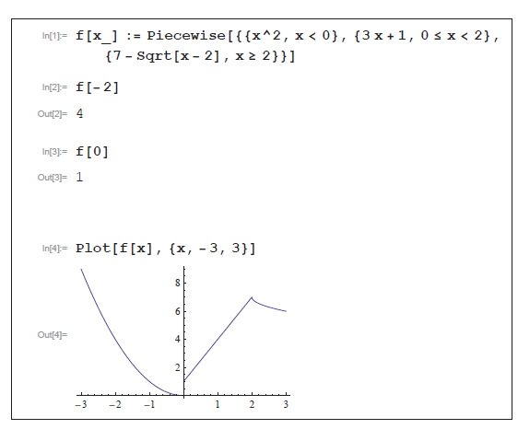
Technology Note: Evaluating and Graphing a Piecewise-Defined Function (cont.)
Figure 18

