Slide 1
Section 1.3
Transforming and Combining Functions

Slide 2
Theorem: Horizontal Shifting
Let f(x) be a function whose graph is known, and let h be a fixed real number. If we replace x in the definition of f by x − h, we obtain a new function g(x) = f(x − h). The graph of g is the same shape as the graph of f, but shifted to the right by h units if h > 0 and shifted to the left by units if h < 0.

Slide 3
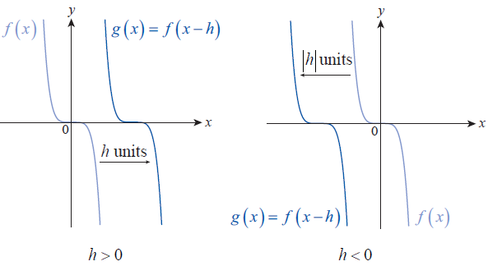
Theorem: Horizontal Shifting (cont.)
Figure 1 Horizontal Shifting

Slide 4
Caution
A word of caution is in order here. It is easy to forget that the minus sign in the expression x − h is critical. It may help to remember a few specific examples:
Replacing x with x − 5 shifts the graph 5 units to the right, since 5 is positive. Replacing x with x + 5 shifts the graph 5 units to the left, since we have actually
replaced x with x − (− 5) . With practice, knowing the effect that replacing x with x − h has on the graph of a function will become natural.

Slide 5
Example 1: Shifting Graphs of Functions Horizontally
Sketch the graphs of the following functions.

Slide 6
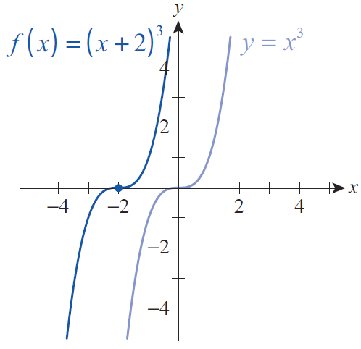
Example 1: Shifting Graphs of Functions Horizontally (cont.)
Solution
a. The shape of (x + 2)³ is the same as the shape of x³, since one expression is obtained from the other by replacing x by x + 2. We simply draw the basic cubic shape (the shape of y = x³), then shift it to the left by 2 units (see Figure 2). Note, for example, that (−2,0) is one point on the graph of f.
Figure 2

Slide 7
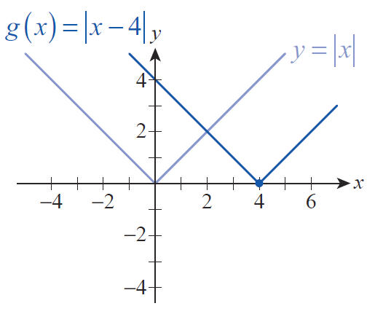
Example 1: Shifting Graphs of Functions Horizontally (cont.)
b. The basic function being shifted is |x|. The graph of g(x) = |x − 4| has the same shape as the graph of the absolute value function, but shifted to the right by 4 units (see Figure 3). Note, for example, that (4,0) lies on the graph of g.
Figure 3

Slide 8
Theorem: Vertical Shifting
Let f(x) be a function whose graph is known, and let k be a fixed real number. The graph of the function g(x) = f(x) + k is the same shape as the graph of f, but shifted upward by k units if k > 0 and shifted downward by |k| units if k < 0.

Slide 9
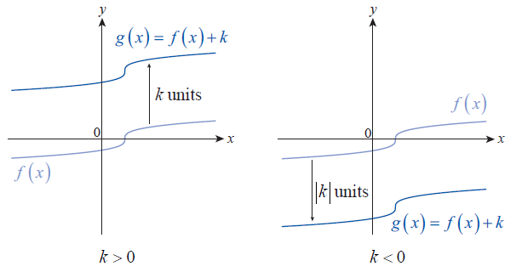
Theorem: Vertical Shifting (cont.)
Figure 4 Vertical Shifting

Slide 10
Example 2: Shifting Graphs of Functions Vertically
Sketch the graphs of the following functions.

Slide 11
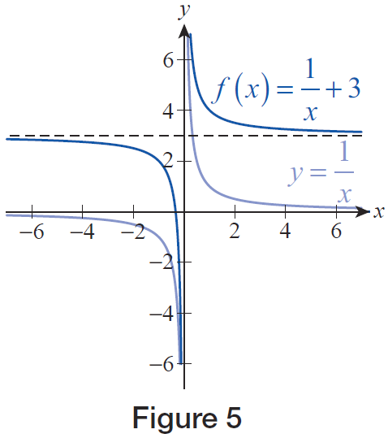
Example 2: Shifting Graphs of Functions Vertically (cont.)
Solution
The graph of f(x) = (1/x) + 3 is the graph of y = 1/x shifted up by 3 units (see Figure 5). Note that this doesn’t affect the domain: the domain of f is (−∞, 0) ∪ (0, ∞), the same as the domain of y = 1/x. However, the range is affected. The range of f is
(−∞, 3)∪(3, ∞).
Figure 5

Slide 12
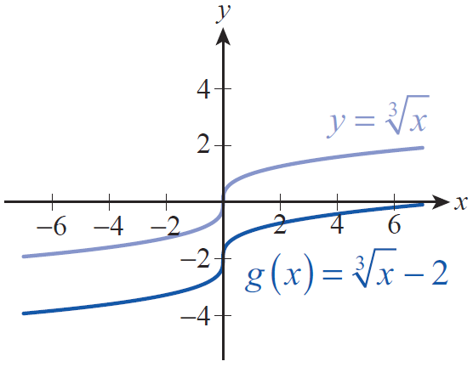
Example 2: Shifting Graphs of Functions Vertically (cont.)
b. The basic function being shifted is To graph
we shift the
graph of down by 2 units (see Figure 6).
Figure 6

Slide 13
Theorem: Reflecting with Respect to the Axes
Let f(x) be a function whose graph is known.
1. The graph of the function is the reflection of the graph of f with respect to the x‑axis.
2. The graph of the function is the reflection of the graph of f with respect to the y‑axis.

Slide 14
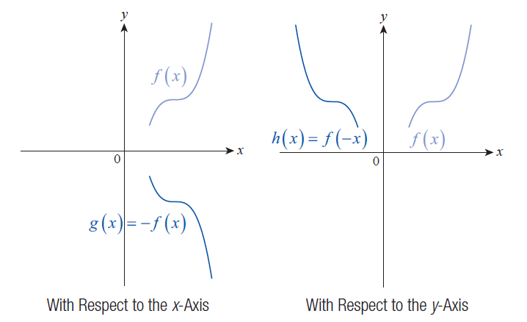
Theorem: Reflecting with Respect to the Axes (cont.)
Figure 7 Reflecting with Respect to the Axes

Slide 15
Example 3: Reflecting Graphs of Functions with Respect to the Axes
Sketch the graphs of the following functions.

Slide 16
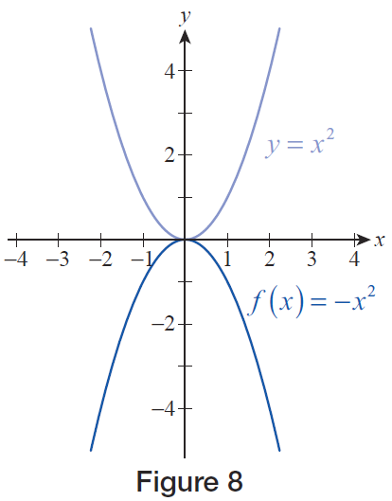
Example 3: Reflecting Graphs of Functions with Respect to the Axes (cont.)
Solution
a. To graph f(x) = −x², begin with the graph of the basic parabola y = x². The entire function is multiplied by −1, so reflect the graph over the x‑axis, resulting in the original shape turned upside down (see Figure 8). Note that the domain is still the entire real line, but the range of f is the interval (−∞,0].
Figure 8

Slide 17
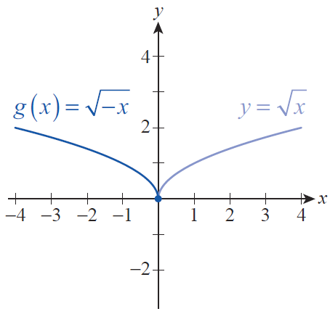
Example 3: Reflecting Graphs of Functions with Respect to the Axes (cont.)
b. To graph we reflect the graph
with respect to the y‑axis because x has been replaced by −x (see Figure 9). Note that this changes the domain, but not the range. The domain of g is the interval (−∞,0] and the range is [0,∞).
Figure 9

Slide 18
Theorem: Vertical Stretching and Compressing
Let f(x) be a function whose graph is known, and let a be a positive real number.
1. The graph of the function g(x) = af (x) is stretched vertically compared to the graph of f if a > 1.
2. The graph of the function g(x) = af (x) is compressed vertically compared to the graph of f if 0 < a < 1.

Slide 19
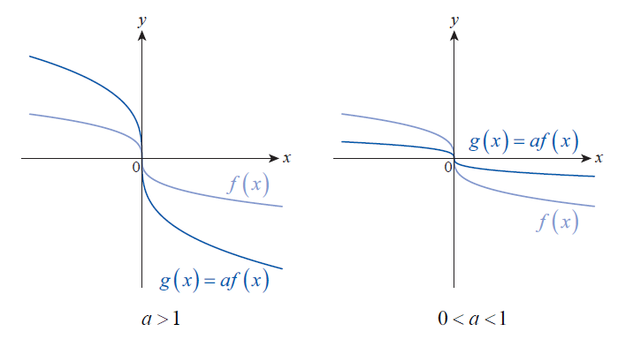
Theorem: Vertical Stretching and Compressing (cont.)
Figure 10 Vertical Stretching and Compressing

Slide 20
Example 4: Stretching and Compressing Graphs of Functions Vertically
Sketch the graphs of the following functions.

Slide 21
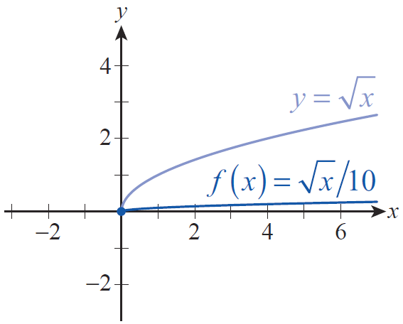
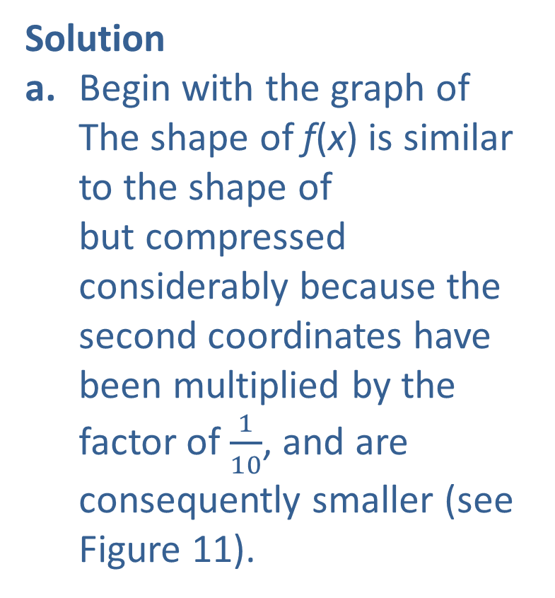
Example 4: Stretching and Compressing Graphs of Functions Vertically (cont.)
Solution
a. Begin with the graph of The shape of f(x) is similar to the shape of but compressed considerably because the second coordinates have been multiplied by the factor of $\frac{1}{10}$, and are consequently smaller (see Figure 11).
Figure 11

Slide 22
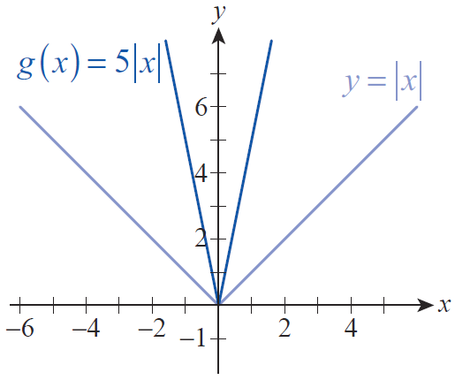
Example 4: Stretching and Compressing Graphs of Functions Vertically (cont.)
b. Begin with the graph of the absolute value function. In contrast to part a., the graph of g(x) = 5|x| is stretched compared to y = |x| (see Figure 12). Every second coordinate has been multiplied by a factor of 5, and is consequently larger.
Figure 12

Slide 23
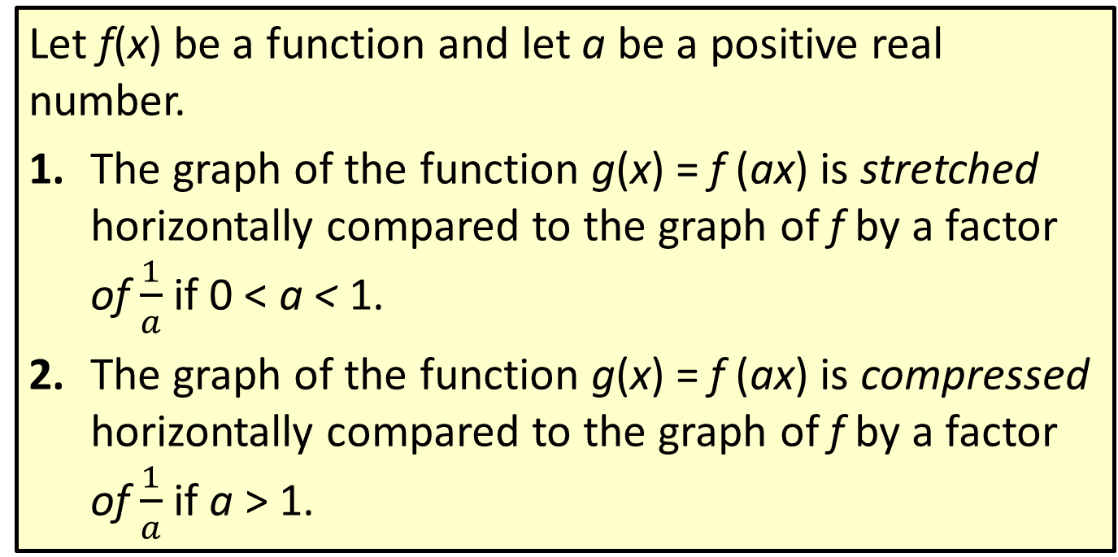
Theorem: Horizontal Stretching and Compressing
Let f(x) be a function and let a be a positive real number.
1. The graph of the function g(x) = f (ax) is stretched horizontally compared to the graph of f by a factor of $\frac{1}{a}$ if 0 < a < 1.
2. The graph of the function g(x) = f (ax) is compressed horizontally compared to the graph of f by a factor of $\frac{1}{a}$ if a > 1.

Slide 24
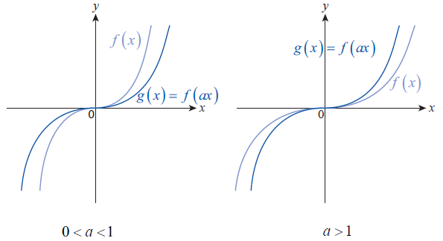
Theorem: Horizontal Stretching and Compressing (cont.)
Figure 13 Horizontal Stretching and Compressing

Slide 25
Procedure: Order of Transformations
If a function g has been obtained from a simpler function f through a number of transformations, g can be analyzed by looking for the transformations in this order.
Step 1: Horizontal shifting
Step 2: Horizontal and vertical stretching and compressing
Step 3: Reflecting with respect to the axes
Step 4: Vertical shifting

Slide 26
Example 5: Graphing a Function Using a Sequence of Function Transformations
Sketch the graph of the function
Solution
The basic function that f is similar to is Now we follow the order of transformations.
Step 1: If we replace x by x + 2 (shifting the graph 2 units to the left), we obtain the function which is closer to what we want.

Slide 27
Example 5: Graphing a Function Using a Sequence of Function Transformations (cont.)
Step 2: There does not appear to be any stretching or compressing transformation.
Step 3: If we now replace x by −x, we have
which is the same as f. This reflects the graph
of with respect to the y‑axis.
Step 4: Since we already found f, we know there is no vertical shift.

Slide 28
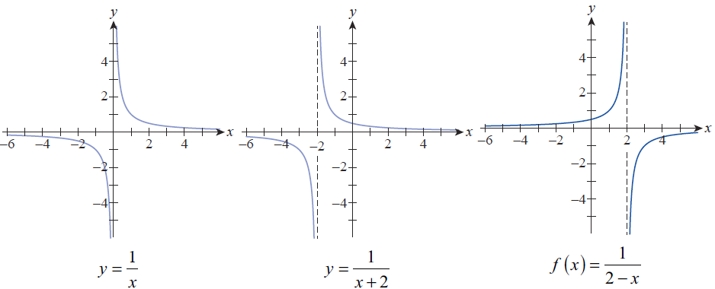
Example 5: Graphing a Function Using a Sequence of Function Transformations (cont.)
The entire sequence of transformations is shown in Figure 15, ending with the graph of f .
Figure 15

Slide 29
Example 5: Graphing a Function Using a Sequence of Function Transformations (cont.)
Note: An alternate approach to graphing
is to rewrite the function in the form
In this form, the graph of f is the graph of shifted 2 units to the right, and then reflected with respect to the x‑axis. The result is the same, as you should verify.

Slide 30
Definition: Adding, Subtracting, Multiplying, and Dividing Functions
Let f and g be two functions. The sum f + g, difference f − g, product fg, and quotient f/g are four new functions defined as follows.

Slide 31
Definition: Adding, Subtracting, Multiplying, and Dividing Functions (cont.)
The domain of each of these new functions consists of the common elements of the individual domains of f and g, with the added condition that for the quotient function we have to omit those elements for which

Slide 32
Example 6: Subtracting and Dividing Functions
Given that and find
and
Solution
By the definition of the difference and quotient of functions, we obtain the following values.

Slide 33
Example 7: Adding and Multiplying Functions
Given the two functions and
find and
Solution
By the definition of the sum and product of functions, we obtain the following formulas.

Slide 34
Example 7: Adding and Multiplying Functions (cont.)
Note that the domain of f is the entire real line, while the domain of g is
Since the domain of two functions combined arithmetically is the intersection of the individual domains, f + g and fg both have the domain

Slide 35
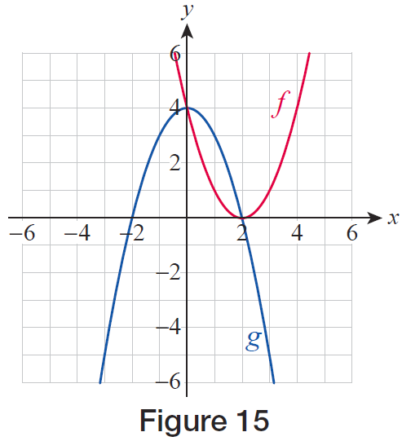
Example 8: Finding the Domain of a Quotient Function
Based on the graphs of f and g in Figure 15, determine the domain of f/g and evaluate (f/g)(1).
Solution
From Figure 16, we can see that the domain of both f and g individually is the set of all real numbers, To find the domain of we need to check where
Figure 16

Slide 36
Example 8: Finding the Domain of a Quotient Function (cont.)
Based on the graph, this occurs when x = −2 and x = 2, so the domain of is as follows.
Also based upon the graphs, it appears that
and so

Slide 37
Definition: Composing Functions
Let f and g be two functions. The composition of f and g, denoted f ∘ g, is the function defined by (The function f ∘ g is read “ f composed with g” or “f of g,” and f ∘ g is also referred to as a composite function.)
The domain of f ∘ g consists of all x in the domain of g for which is in the domain of f.
∘

Slide 38
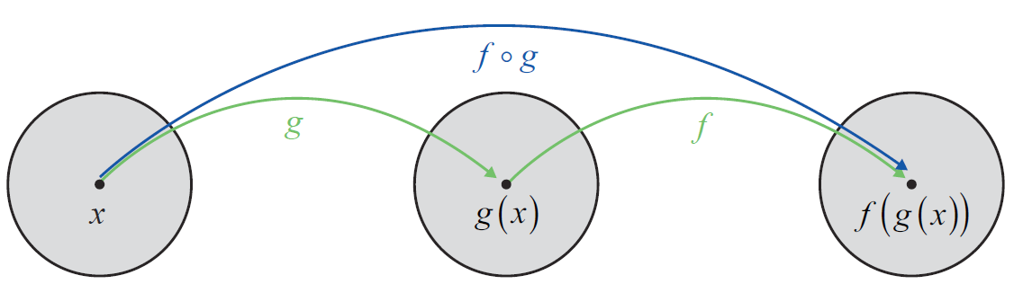
Composing and Decomposing Functions
The diagram in Figure 17 is a sort of schematic of the composition of two functions. The circles represent sets, with the leftmost circle being the domain of the function g. The arrows indicate the element that x is associated with by the various functions.
Figure 17 Composition of f and g

Slide 39
Caution
Note that the order of f and g is important. In general, we can expect the function f ∘ g to be different from the function g ∘ f. That is, the composition of two functions, unlike the sum and product of two functions, is not commutative.

Slide 40
Example 9: Composing Functions
Given and find the following.
Solution
a. Since the first step is to calculate
Then, apply f to the result:
∘
∘
∘
∘

Slide 41
Example 9: Composing Functions (cont.)
b. To find the formula for f ∘ g, we simply apply the definition of composition and then simplify.
Note that once we have found a formula for f ∘ g, we have an alternative way of answering the first question:
∘
∘

Slide 42
Example 10: Finding Formulas and Domains for Composite Functions
Let and Find formulas and state the domains for the following functions.
Solution
The answer may seem to indicate that the domain of f ∘ g is all real numbers, but this is incorrect. The domain of f ∘ g is actually the interval [0,∞), because only nonnegative numbers can be plugged into g.
∘
∘
∘

Slide 43
Example 10: Finding Formulas and Domains for Composite Functions (cont.)
The domain of g ∘ f consists of all x for which or In interval form, the domain is
∘

Slide 44
Example 11: Decomposing a Composite Function
Decompose the function into a composition of a. two functions and b. three functions.
Solution

Slide 45
Example 11: Decomposing a Composite Function (cont.)

Slide 46
Interlude: Recursive Graphics
Recursion, in general, refers to using the output of a function as its input and repeating the process a certain number of times. In other words, recursion refers to the composition of a function with itself, possibly many times. Recursion has many varied uses, one of which is a branch of mathematical art.

Slide 47
Interlude: Recursive Graphics (cont.)
Some special nomenclature and notation have evolved to describe recursion. If f is a function, f ²(x) is used in this context to stand for or (not Similarly, f ³(x) stands for or and so on. The functions are called iterates of f, with f ^{n} being the n^{th} iterate of f.
∘
∘
∘

Slide 48
Interlude: Recursive Graphics (cont.)
Some of the most famous recursively generated mathematical art is based on functions whose inputs and outputs are complex numbers. Recall that every complex number can be expressed in the form a + bi, where a and b are real numbers and i is the imaginary unit.
A one‑dimensional coordinate system, such as the real number line, is insufficient to graph complex numbers, but complex numbers are easily graphed in a two‑dimensional coordinate system.

Slide 49
Interlude: Recursive Graphics (cont.)
To graph the number a + bi, we treat it as the ordered pair (a,b) and plot the point (a,b) in the Cartesian plane, where the horizontal axis represents pure real numbers and the vertical axis represents pure imaginary numbers.

Slide 50
Interlude: Recursive Graphics (cont.)
Benoit Mandelbrot used the function where both z and c are variables representing complex numbers, to generate the image known as the Mandelbrot set in 1979. The basic idea is to evaluate the sequence of iterates
for various complex numbers c and determine if the sequence of complex numbers stays close to the origin or not. Those complex numbers that result in so‑called “bounded” sequences are colored white. We have used similar ideas to generate our own recursive art.

Slide 51
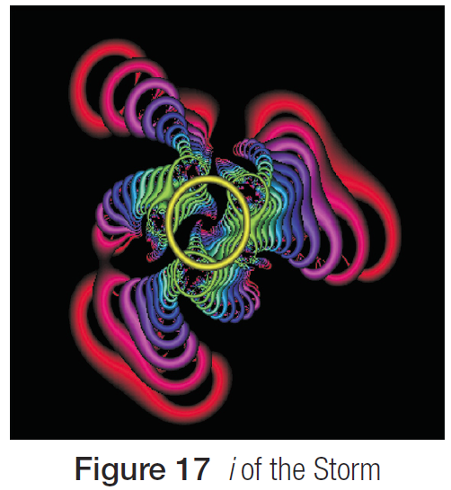
Interlude: Recursive Graphics (cont.)
The image “i of the storm” reproduced in Figure 18 is based on the function
where again z is a variable that will be replaced with complex numbers.
Figure 18 i of the Storm

