Slide 1
Section 1.4
Inverse Functions

Slide 2
Inverse Functions
In much of mathematics, the act of “undoing” one or more mathematical operations plays a critical role. The “undoing” process is often a matter of finding and applying the inverse of a function.
Recall that a relation is just a set of ordered pairs. The inverse of a given relation is the set of these ordered pairs with the first and second coordinates exchanged.

Slide 3
Definition: Inverse of a Relation
Let R be a relation. The inverse of R, denoted R⁻¹, is the set
Note that this automatically implies the following:

Slide 4
Example 1: Finding the Inverse of a Relation and Its Domain and Range
Determine the inverse of each of the following relations. Then graph each relation and its inverse, and determine the domain and range of both.
Solution

Slide 5
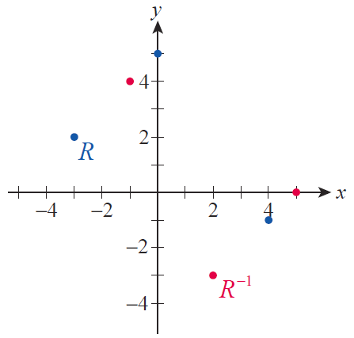
Example 1: Finding the Inverse of a Relation and Its Domain and Range (cont.)
In Figure 1, R is in blue and its inverse is in red. The relation R consists of three
ordered pairs, and its inverse is simply these three ordered pairs with the coordinates
exchanged. Note that the domain of R is the range of R⁻¹, and vice versa.
Figure 1

Slide 6
Example 1: Finding the Inverse of a Relation and Its Domain and Range (cont.)
Domain of R = ℝ
Range of R⁻¹ = ℝ

Slide 7
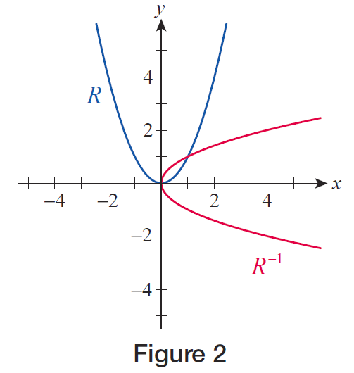
Example 1: Finding the Inverse of a Relation and Its Domain and Range (cont.)
In this problem, R is described by the given equation in x and y. The inverse relation is the set of ordered pairs in R with the coordinates exchanged, so we can describe the inverse relation just by exchanging x and y in the equation. The graphs of R and R⁻¹ are shown in Figure 2.
Figure 2

Slide 8
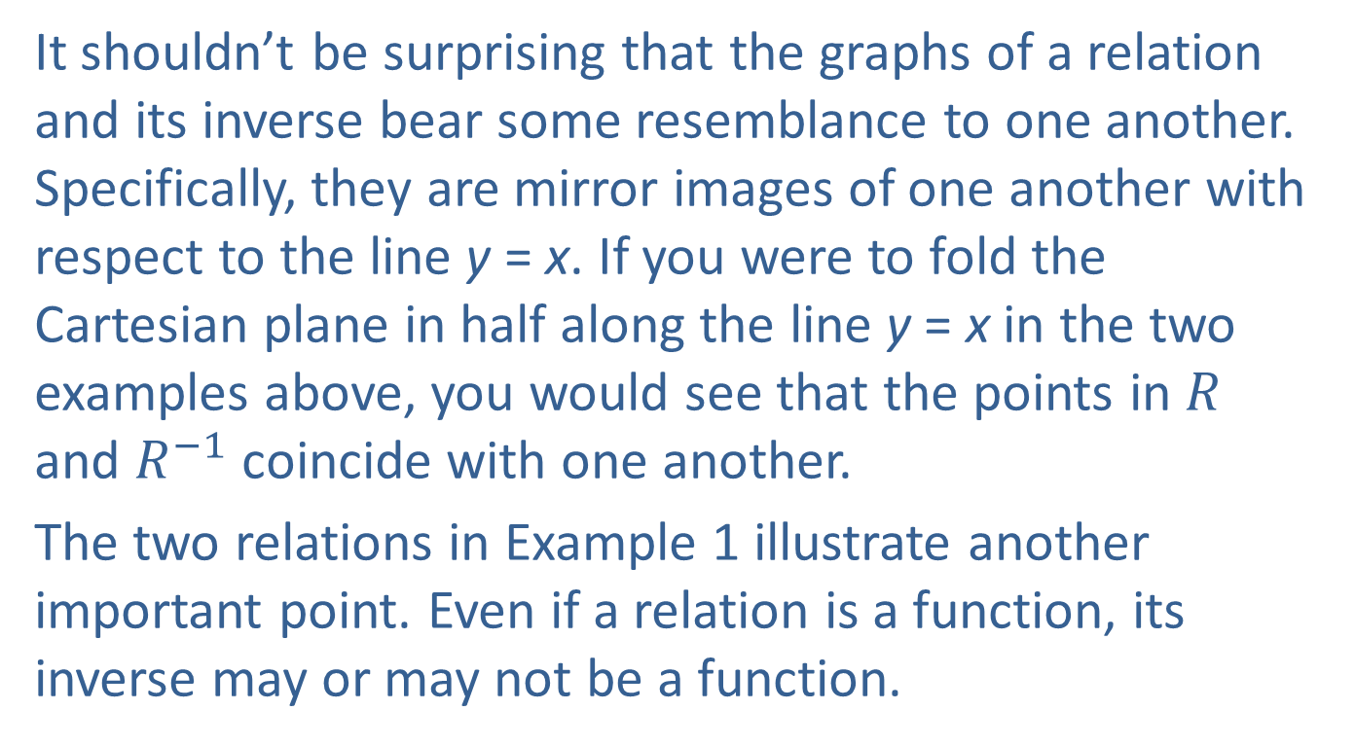
Inverse Relations and Inverse Functions
It shouldn’t be surprising that the graphs of a relation and its inverse bear some resemblance to one another. Specifically, they are mirror images of one another with respect to the line y = x. If you were to fold the Cartesian plane in half along the line y = x in the two examples above, you would see that the points in $R$ and $R^{−1}$ coincide with one another.
The two relations in Example 1 illustrate another important point. Even if a relation is a function, its inverse may or may not be a function.

Slide 9
Inverse Notation
The inverse of a function f is denoted by f ⁻¹ .
Caution
We are faced with another example of reuse of notation: does not stand for when f is a function! We use an exponent of −1 to indicate the reciprocal of a number or an algebraic expression, but when applied to a function or a relation it stands for the inverse relation.

Slide 10
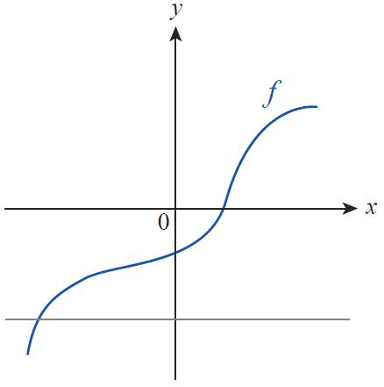
Theorem: The Horizontal Line Test
Let f be a function. We say that the graph of f passes the horizontal line test if every horizontal line in the plane intersects the graph no more than once. The inverse of f is a function only if f passes the horizontal line test.
Horizontal Line Test

Slide 11
Definition: One-to-One Functions
A function f is one-to-one if for every pair of distinct elements x₁ and x₂ in the domain of f , we have f(x₁) ≠ f(x₂). This means that every element of the range of f is paired with exactly one element of the domain of f .

Slide 12
Example 2: Applying the Horizontal Line Test
Determine if the following functions have inverse functions.
a.
b.

Slide 13
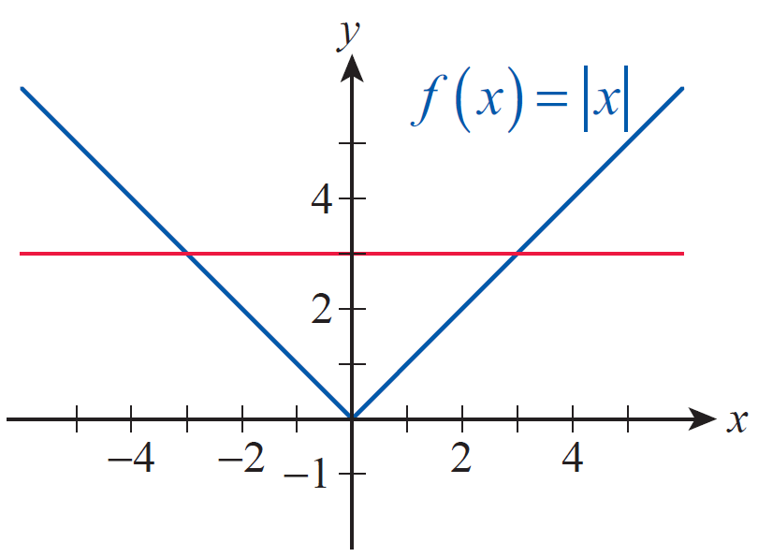
Example 2: Applying the Horizontal Line Test (cont.)
Solution
The function f does not have an inverse function, a fact easily demonstrated by showing that its graph does not pass the horizontal line test. (see Figure 4).
Figure 4

Slide 14
Example 2: Applying the Horizontal Line Test (cont.)
An algebraic proof that f does not have an inverse function is the following: even though −3 ≠ 3, we have f(−3) = f(3). There are an infinite number of pairs of numbers that show f is not one‑to‑one, but one such pair is all it takes to show that f does not have an inverse function.

Slide 15
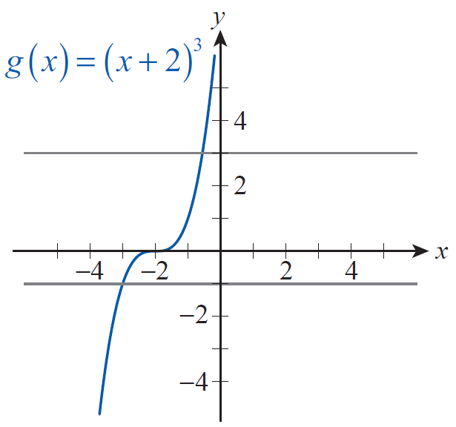
Example 2: Applying the Horizontal Line Test (cont.)
b. The graph of g is the standard cubic shape shifted horizontally 2 units to the left. We can see that this graph passes the horizontal line test, so g has an inverse function (see Figure 5).
Figure 5

Slide 16
Example 2: Applying the Horizontal Line Test (cont.)
But again, it is good practice to prove this algebraically. Note how each line in the following argument implies the next line.
This argument shows that any two distinct elements of the domain of g lead to different values when plugged into g, so g is one‑to‑one and hence has an inverse function.

Slide 17
Procedure: Finding the Inverse of a Function
Let f be a one‑to‑one function, and assume that f is defined by a formula. To find a formula for perform the following steps.
Step 1: Replace in the definition of f with the variable y. The result is an equation in x and y that is solved for y at this point.
Step 2: Interchange x and y in the equation.
Step 3: Solve the new equation for y.

Slide 18
Procedure: Finding the Inverse of a Function (cont.)
Step 4: Replace the y in the resulting equation with

Slide 19
Example 3: Finding the Inverse of a Function
Find the inverse of each of the following functions.
a.
b.

Slide 20
Example 3: Finding the Inverse of a Function (cont.)
Solution
a. We can find the inverse of this function either by the algorithm or by undoing the actions of f in reverse order. The function f subtracts 1 from x, cubes the result, and adds 2; its inverse will first subtract 2, take the cube root of the result, and then add 1.

Slide 21
Example 3: Finding the Inverse of a Function (cont.)
b.

Slide 22
Example 3: Finding the Inverse of a Function (cont.)

Slide 23
Theorem: Properties of Inverse Functions
for all x in the domain of f
for all x in the domain of

Slide 24
Definition: Logarithmic Functions
Let a be a fixed positive real number not equal to 1. The logarithmic function with base a is defined to be the inverse of the exponential function with base a and is denoted In symbols,
In equation form, the definition of logarithm implies that

Slide 25
Definition: Logarithmic Functions(cont.)
Note that a is the base in both equations; it serves as either the base of the exponential function or the base of the logarithmic function.

Slide 26
Logarithms as Inverse Functions
Recall that the graphs of a function and its inverse are reflections of one another with respect to the line y = x. Since exponential functions come in two forms (0 < a < 1 and a > 1), logarithmic functions fall into two similar categories. In each of the graphs in Figure 7, the red curve is the graph of an exponential function representative of its class, and the blue curve is the corresponding logarithmic function.

Slide 27
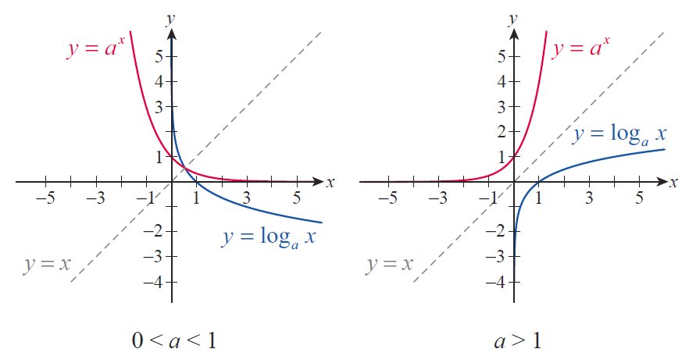
Logarithms as Inverse Functions (cont.)
Figure 7 The Two Classes of Logarithmic Functions

Slide 28
Logarithms as Inverse Functions (cont.)
Note that the domain of each of the logarithmic functions in Figure 7 is indeed (0, ∞), and that the range in each case is (−∞, ∞). Also note that the y-axis is a vertical asymptote for both, and that neither has a horizontal asymptote.

Slide 29
Example 4: Graphing Logarithmic Functions
Sketch the graphs of the following functions.
Solution
a. Begin by graphing which is the basis for the graph of f. We know several points on the graph exactly; for instance, (1, 0) and (3, 1) are on the graph of

Slide 30
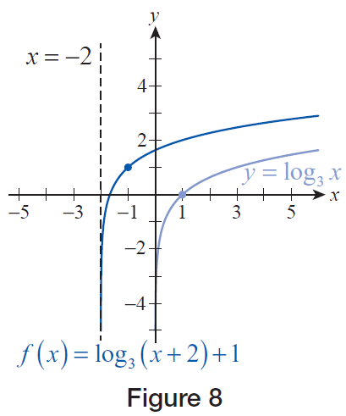
Example 4: Graphing Logarithmic Functions (cont.)
Since x has been replaced by x + 2, we shift this graph 2 units to the left. To find the graph of f, we then shift the result 1 unit up. Note that the vertical asymptote has also shifted to the left. (see Figure 8).
Figure 8

Slide 31
Example 4: Graphing Logarithmic Functions (cont.)
b. Again, we start with the basic shape of the graph, and then worry about the transformations. The basic shape of the graph of g is the same as the shape of . As above, some points on are easily determined, such as

Slide 32
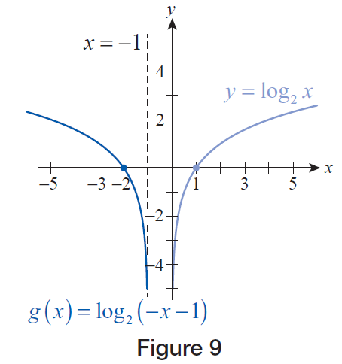
Example 4: Graphing Logarithmic Functions (cont.)
To obtain g from log₂ x, the variable x is replaced with x − 1, which shifts the graph 1 unit to the right, and then x is replaced by −x, which reflects the graph with respect to the y‑axis (see Figure 9).
Figure 9

Slide 33
Example 4: Graphing Logarithmic Functions (cont.)
c. We begin with the graph of This is a decreasing function, as the base is between 0 and 1. Note that are two points on the graph of

Slide 34
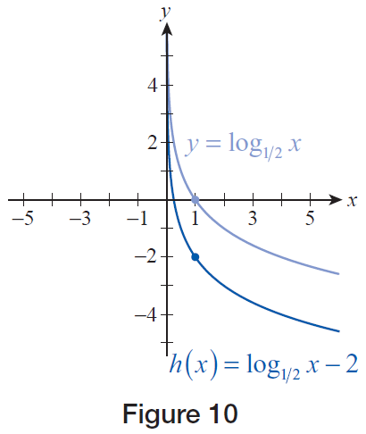
Example 4: Graphing Logarithmic Functions (cont.)
If we then shift the graph 2 units down, we obtain the graph of the function h (see Figure 10).
Figure 10

Slide 35
Logarithms as Inverse Functions (cont.)
Note that the points (1,0) and (a,1) are always on the graph of for any allowable base a. This is a consequence of the definition of logarithms.
because
because
More generally, we can use the fact that the functions and are inverses of one another to write the following equations.
and

Slide 36
Definition: Common and Natural Logarithms
The function is called the common logarithm and is usually written as
The function is called the natural logarithm and is usually written as

Slide 37
Theorem: Properties of Logarithms and Exponents
In each of the following statements a is assumed to be a positive real number not equal to 1. For the properties of logarithms, x and y represent positive real numbers and r is an arbitrary real number. For the properties of exponents, x and y represent arbitrary real numbers.

Slide 38
Theorem: Properties of Logarithms and Exponents (cont.)

Slide 39
Proof
We will start with the right-hand side of the statement and convert the expressions to exponential form. To do this, let The equivalent exponential form of these two equations is
Since we are interested in the product xy, note that

Slide 40
Proof (cont.)
The statement can be converted to logarithmic form, giving us
If we now refer back to the original definition of m and n, we have achieved our goal:

Slide 41
Example 5: Expanding Logarithmic Expressions
Use the properties of logarithms to expand the following expressions as much as possible (that is, decompose the expressions into sums or differences of the simplest possible terms).
a.
b.

Slide 42
Example 5: Expanding Logarithmic Expressions (cont.)
Solution
a.

Slide 43
Example 5: Expanding Logarithmic Expressions (cont.)
Note that the base is immaterial: a can represent
any legitimate logarithmic base.
b. Recall that if the base is not explicitly written, it is assumed to be 10. This is a convenient base when dealing with scientific notation. Note that we can use a calculator to approximate log 2.7.

Slide 44
Example 6: Condensing Logarithmic Expressions
Use the properties of logarithms to condense the following expressions as much as possible (that is, rewrite the expressions as a sum or difference of as few logarithms as possible).

Slide 45
Example 6: Condensing Logarithmic Expressions (cont.)
Solution
a. Note that before a sum or difference of log terms can be combined, they have to have the same coefficient. This is usually straightforward to arrange since the coefficient can be moved up into the exponent.

Slide 46
Example 6: Condensing Logarithmic Expressions (cont.)
Note also that the order in which the properties are applied can vary, though all solutions lead to the same final answer.

Slide 47
Example 6: Condensing Logarithmic Expressions (cont.)
b. Again, we begin by rewriting each term so that its coefficient is 1 or −1; the sums or differences that result can then be combined.

Slide 48
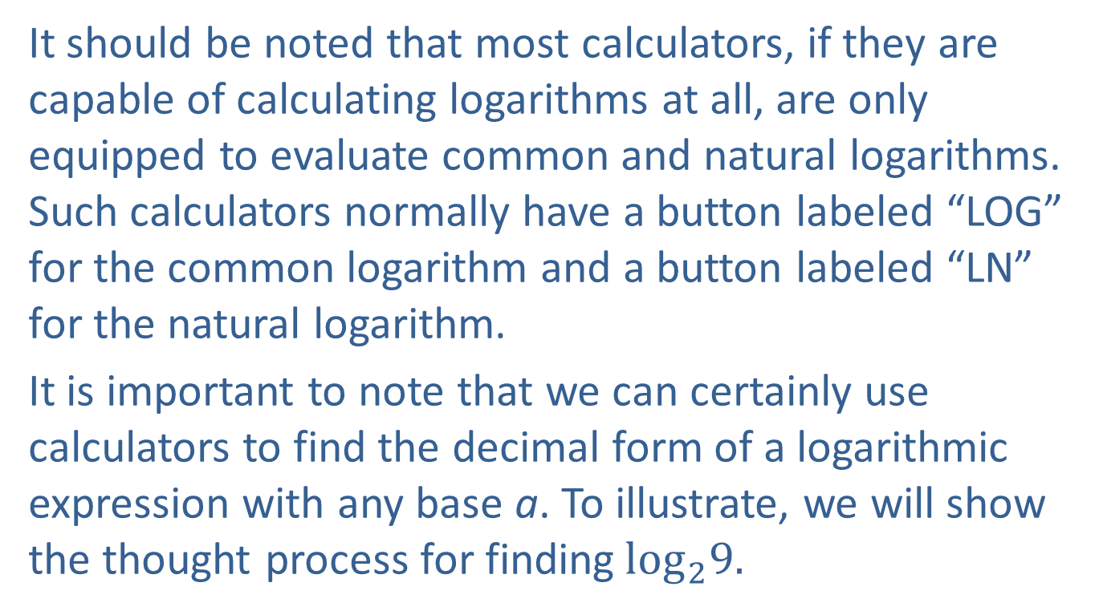
Logarithms as Inverse Functions (cont.)
It should be noted that most calculators, if they are capable of calculating logarithms at all, are only equipped to evaluate common and natural logarithms. Such calculators normally have a button labeled “LOG” for the common logarithm and a button labeled “LN” for the natural logarithm.
It is important to note that we can certainly use calculators to find the decimal form of a logarithmic expression with any base a. To illustrate, we will show the thought process for finding$\log_{2}9.$

Slide 49
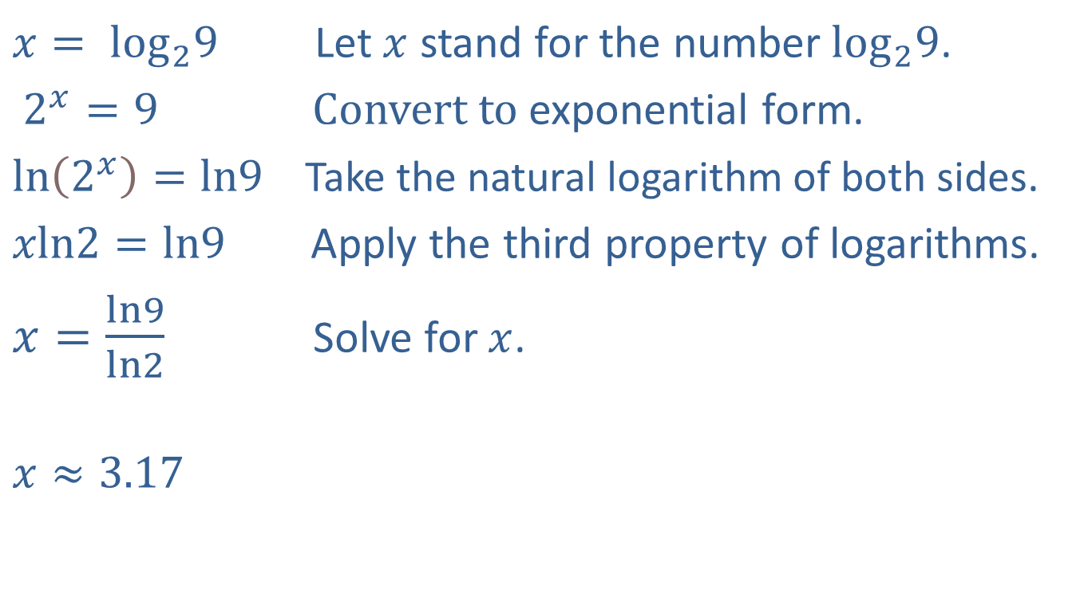
Logarithms as Inverse Functions (cont.)
$x=\log_{2}9$ Let $x$ stand for the number$\log_{2}9$.
$2^{x}=9$ Convert to exponential form.
$\ln\left(2^{x}\right)=ln9$ Take the natural logarithm of both sides.
$xln2=ln9$ Apply the third property of logarithms.
$x=\frac{ln9}{ln2}$ Solve for $x$.
$$x≈3.17$$

Slide 50
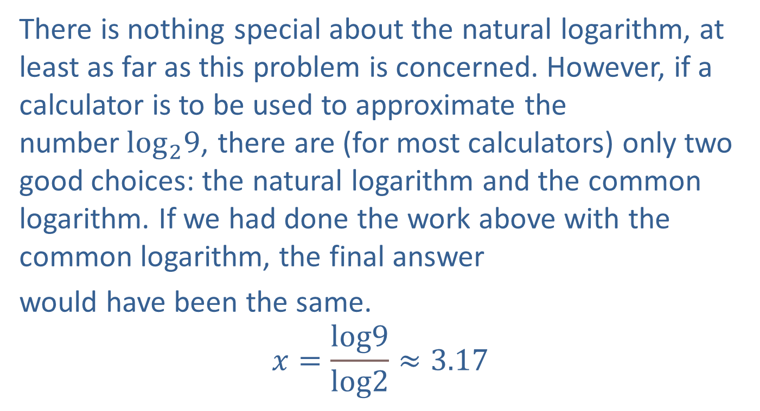
Logarithms as Inverse Functions (cont.)
There is nothing special about the natural logarithm, at least as far as this problem is concerned. However, if a calculator is to be used to approximate the number$\log_{2}9$, there are (for most calculators) only two good choices: the natural logarithm and the common logarithm. If we had done the work above with the common logarithm, the final answer
would have been the same.
$$x=\frac{log9}{log2}≈3.17$$

Slide 51
Logarithms as Inverse Functions (cont.)
More generally, a logarithm with base b can be converted to a logarithm with base a through the same reasoning, as summarized in below slide.

Slide 52
Theorem: Change of Base Formula
Let a and b be positive real numbers, neither of them equal to 1, and let x be a positive real number. Then

Slide 53
Inverse Trigonometric Functions
Recall, however, that a function will have an inverse only if it is one-to-one. Recall also that this means that the graph of the function must pass the horizontal line test; this is something the trigonometric functions fail to do. Fortunately, there is a way out. By restricting the domain of a trigonometric function wisely, we can make it one-to-one and thus invertible.

Slide 54
Definition: Arcsine
Given arcsine is defined by either of the following.
In words, arcsin y is the angle whose sine is y. Since the (restricted) domain of sine is and its range is the domain of arcsine is and its range is

Slide 55
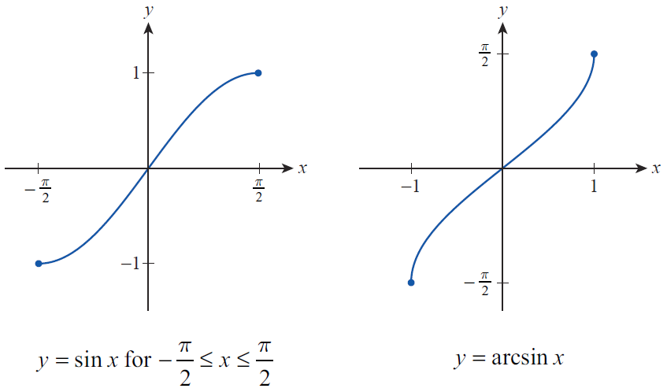
Inverse Trigonometric Functions (cont.)
Figure 12

Slide 56
Example 7: Deriving the Arccosine Function
With the derivation of arcsine as a guide, construct a definition of arccosine and plot the resulting function.
Solution
As with sine, we first need to restrict the domain of cosine to an interval over which cosine is one‑to‑one. Picture the graph of cosine in your mind. Most people would probably say that the natural choice for the restricted domain is the interval and this is indeed the convention. This is all we need in order to make our definition.

Slide 57
Example 7: Deriving the Arccosine Function (cont.)
Given arccosine (with its two notations) is defined by
To graph the arccosine function, we simply reflect the restricted graph of cosine with respect to the line y = x. Since the (restricted) domain of cosine is and the range is we know that the domain of arccosine will be and its range will be This knowledge serves as a good way to double‑check our graph of arccosine.

Slide 58
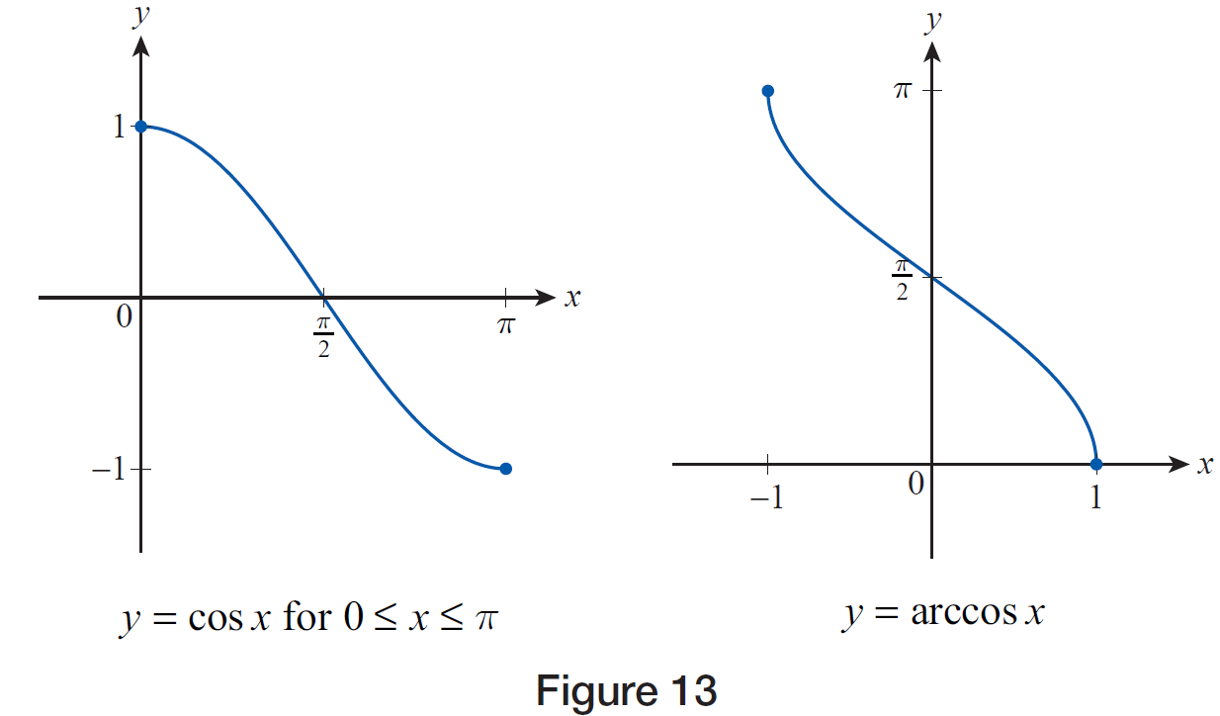
Example 7: Deriving the Arccosine Function (cont.)
Figure 13

Slide 59
Inverse Trigonometric Functions (cont.)
Arctangent is the third commonly encountered inverse trigonometric function, and its definition and graph are arrived at in a similar manner. Figure 14 illustrates the graph of the tangent function restricted to the interval (−π/2, π/2) along with the graph of arctangent. Note the horizontal asymptotes in the graph of arctangent, corresponding to the vertical asymptotes in the graph of tangent.

Slide 60
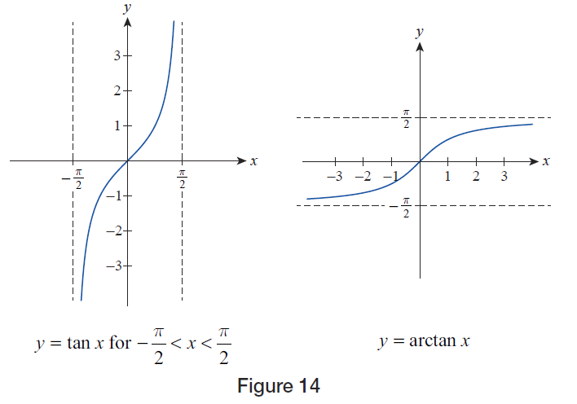
Inverse Trigonometric Functions (cont.)
Figure 14

Slide 61
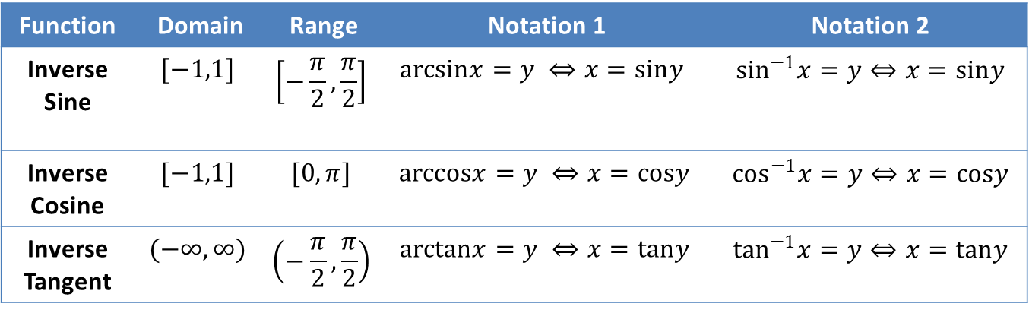
Definition: Arcsine, Arccosine, and Arctangent
Function | Domain | Range | Notation 1 | Notation 2
Inverse Sine | $$[−1,1]$$ | $$\left[−\frac{π}{2},\frac{π}{2}\right]$$ | $$arcsinx=y ⇔x=siny$$ | $\sin^{−1}x=y⇔x=siny$
Inverse Cosine | $$[−1,1]$$ | $$[0,π]$$ | $$arccosx=y ⇔x=cosy$$ | $\cos^{−1}x=y⇔x=cosy$
Inverse Tangent | $$(−∞,∞)$$ | $$\left(−\frac{π}{2},\frac{π}{2}\right)$$ | $$arctanx=y ⇔x=tany$$ | $\tan^{−1}x=y⇔x=tany$

Slide 62
Example 8: Evaluating Compositions of Trigonometric and Inverse Trigonometric Functions
Evaluate the following expressions, if possible.
a.
b.

Slide 63
Example 8: Evaluating Compositions of Trigonometric and Inverse Trigonometric Functions (cont.)
Solution
a. The potential error in this problem is to assume that since arcsin and sin are inverse functions of one another. But lies outside the range of arcsin, which is so we know this can’t be the answer. The key is to evaluate the expressions individually: as follows.

Slide 64
Example 8: Evaluating Compositions of Trigonometric and Inverse Trigonometric Functions (cont.)
b. The number −0.2 lies in the domain of arccosine, and all real numbers lie in the domain of cosine, so all the parts of the expression make sense and we are safe in stating If we wanted to explore the expression a bit further, we could note that, from the graph of arccosine, is some positive
number, and further that must be
greater than since is negative. This is indeed the case: a calculator tells us that is approximately 1.8.

Slide 65
Example 9: Evaluating Compositions of Trigonometric and Inverse Trigonometric Functions
Evaluate the following expressions.
Solution
a. Remember that the range of arcsin is and in particular that will lie between and 0 (the graph tells us that arcsin of a negative number is negative).

Slide 66
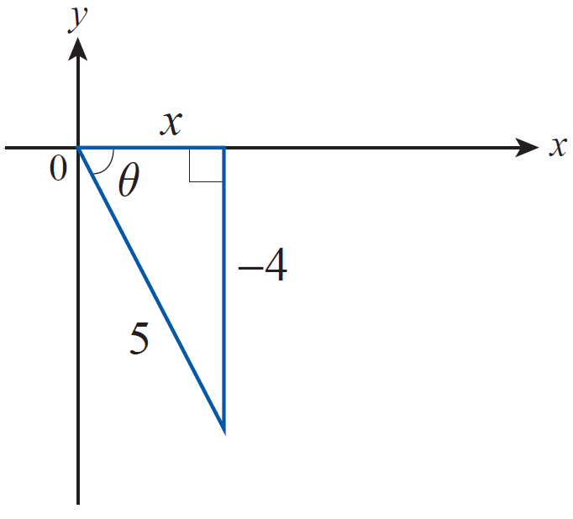
Example 9: Evaluating Compositions of Trigonometric and Inverse Trigonometric Functions (cont.)
If we let then and we can sketch the triangle shown in Figure 15 to illustrate the relationship between θ and the given numbers.
Figure 15

Slide 67
Example 9: Evaluating Compositions of Trigonometric and Inverse Trigonometric Functions (cont.)
The Pythagorean Theorem allows us to calculate x.
Now we can see that so

Slide 68
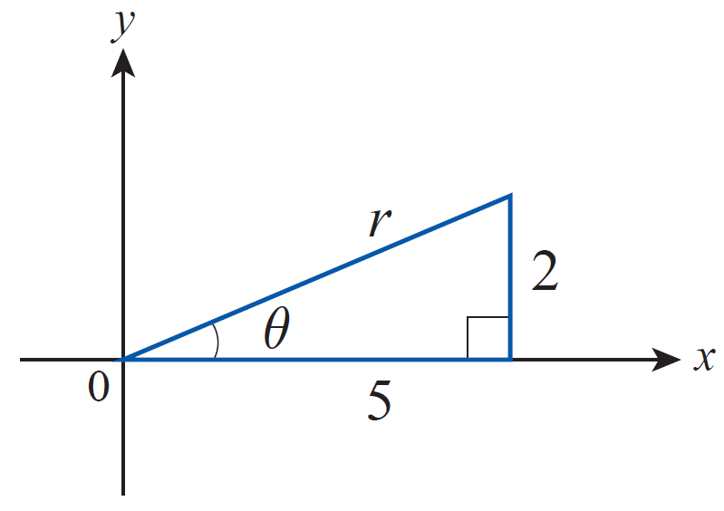
Example 9: Evaluating Compositions of Trigonometric and Inverse Trigonometric Functions (cont.)
b. We can employ the same method and let θ = arctan 0.4. This leads to
and then to the sketch, as seen in Figure 16.
Figure 16
The Pythagorean Theorem gives us and so

Slide 69
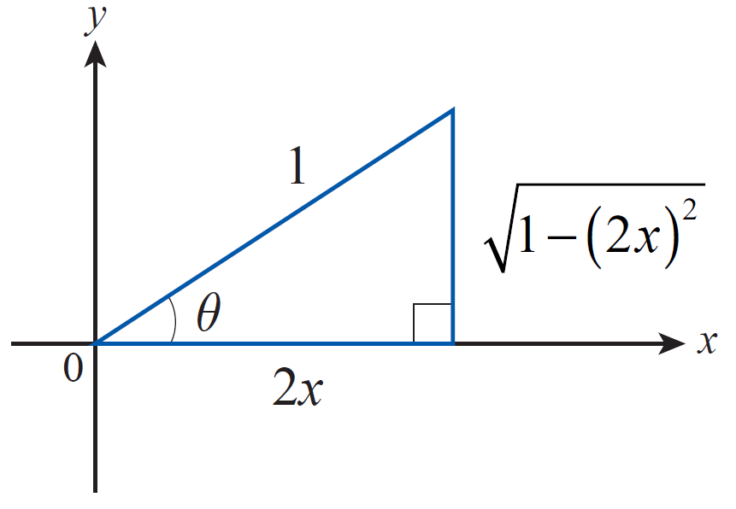
Example 10: Expressing a Composition of Trigonometric and Inverse
Trigonometric Functions as an Algebraic Function
Express as an algebraic function of x,
assuming
Solution
Let Then cos θ = 2x and we are led to consider a sketch like Figure 17.
Figure 17

Slide 70
Example 10: Expressing a Composition of Trigonometric and Inverse
Trigonometric Functions as an Algebraic Function (cont.)
In the sketch, we have chosen the simplest lengths for the adjacent side and the hypotenuse that make
cos θ = 2x, though any positive multiples of these lengths would also work. And as always, Once the lengths of two sides of the right triangle have been determined, the Pythagorean Theorem provides the length of the third side. Now we can refer to the sketch to see that

