Slide 1
Section 1.5
Calculus, Calculators, and Computer Algebra Systems

Slide 2
Graphs via Calculators and Computers
One of the most basic features is the ability to choose the display or viewing window when graphing a function. When graphing functions from ℝ to ℝ, this is simply the choice of the minimum and maximum values for the horizontal and vertical axes. For the purposes of illustration, we will refer to these values as xMin, xMax, yMin, and yMax (on some calculators, these are the exact labels for these quantities).

Slide 3
Graphs via Calculators and Computers (cont.)
The display window is then a rectangle in the plane bounded by these values, [xMin, xMax] by [yMin, yMax], and their choice determines the portion of the function being graphed. It is important to note that this choice effectively gives the user the ability to zoom in (or out) on a a particular part of a graph.

Slide 4
Example 1: Graphing a Function in Different Viewing Windows
Graph the function in the following viewing windows using a graphing calculator.

Slide 5
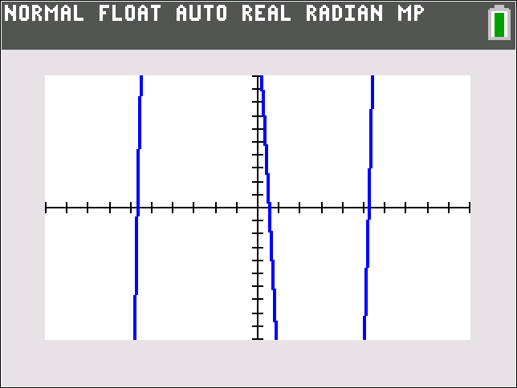
Example 1: Graphing a Function in Different Viewing Windows (cont.)
Solution
a. We set xMin = −10, xMax = 10, yMin = −10, and yMax = 10. The resulting graph is displayed in Figure 1. Note that it appears to be cut off at the top and bottom, indicating that the graph continues vertically beyond the viewing window.
Figure 1
f(x) = x³ − 30x + 15
on [−10, 10] by [−10, 10]

Slide 6
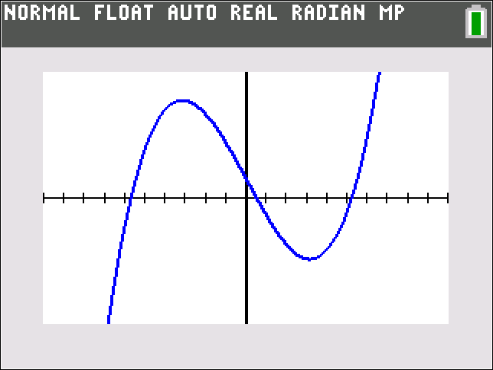
Example 1: Graphing a Function in Different Viewing Windows (cont.)
b. For this viewing window we just need to change the range of y‑values to be from yMin = −100 to yMax = 100. Figure 2 shows the graph in this new viewing window. This is a more complete picture of the graph of f(x), revealing the significant parts of the graph.
Figure 2
f(x) = x³ − 30x + 15
on [−10, 10] by [−100, 100]

Slide 7
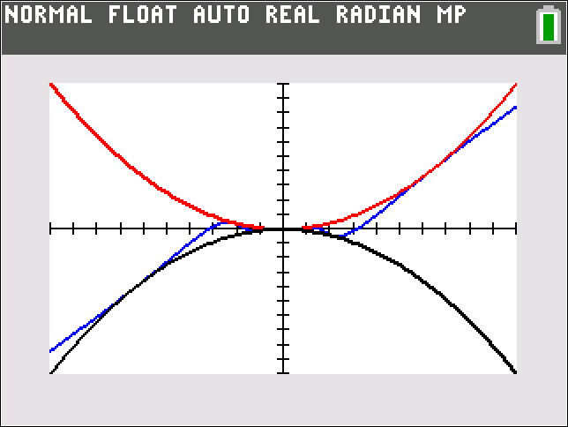
Example 2: Zooming In on a Graph of a Function
We will illustrate the graph of the function
showing the graph at different magnifications or viewing windows.
The first observation we wish to make is that since
cannot take any values above 1 or below −1, the graph of f(x) cannot go above x² or below −x², as illustrated in Figure 3.
Figure 3a
Graphs of x², f(x), and −x²
on [−1, 1] by [−1, 1]

Slide 8
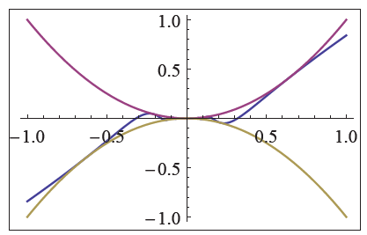
Example 2: Zooming In on a Graph of a Function (cont.)
Figure 3b Graphs of x², f(x), and −x²

Slide 9
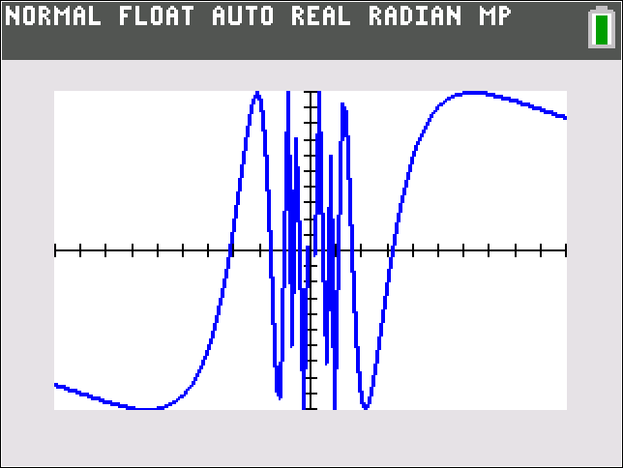
Example 2: Zooming In on a Graph of a Function (cont.)
In order to better understand the graph of f(x), let us take a closer look at g(x) = sin(1/x). As you might recall from your experience with precalculus, g(x) oscillates between −1 and +1 (like any well‑mannered sine function would), but it does so in a surprising way (see Figure 4): it makes infinitely many oscillations near 0 on both sides of the y‑axis.
Figure 4a
g(x) = sin(1/x)
on [−1, 1] by [−1, 1]

Slide 10
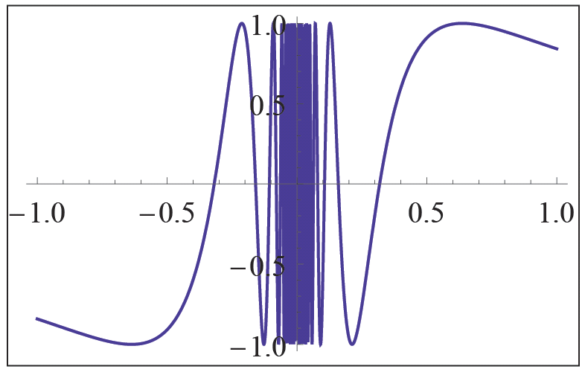
Example 2: Zooming In on a Graph of a Function (cont.)
Figure 4b
g(x) = sin(1/x)

Slide 11
Example 2: Zooming In on a Graph of a Function (cont.)
This is most easily checked by noting that g(x) = sin(1/x) = 0 for x = 1/(nπ), n = ±1, ±2, …. In other words, g(x) = 0 for infinitely many values of x that approach 0 as n grows large. In a similar fashion, one can show that g(x) = 1 and g(x) = −1 infinitely many times on both sides of 0.

Slide 12
Example 2: Zooming In on a Graph of a Function (cont.)
The effect of multiplying g(x) by x² is that
will still oscillate in a similar fashion, but now between x² and −x² (again, you might recall “damped trigonometric graphs” from your prior studies). The oscillation of f(x) is not very clear in Figure 3 but is well illustrated if we ask our technology to “zoom in” or, equivalently, choose a “smaller” viewing window, as shown in Figure 5.

Slide 13
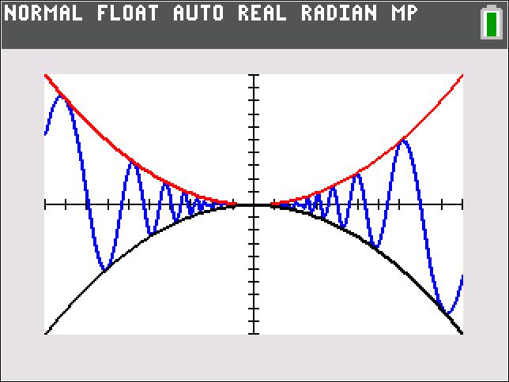
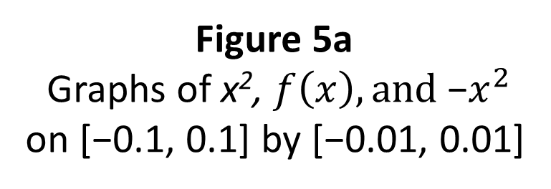
Example 2: Zooming In on a Graph of a Function (cont.)
Figure 5a
Graphs of x², $f\left(x\right), and \text{−}x^{2}$
on [−0.1, 0.1] by [−0.01, 0.01]

Slide 14
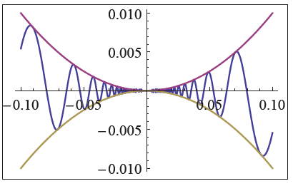
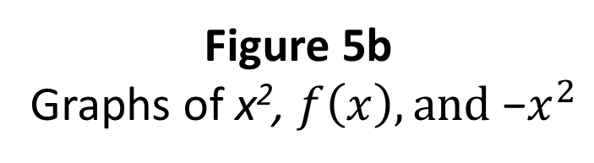
Example 2: Zooming In on a Graph of a Function (cont.)
Figure 5b
Graphs of x², $f\left(x\right), and \text{−}x^{2}$

Slide 15
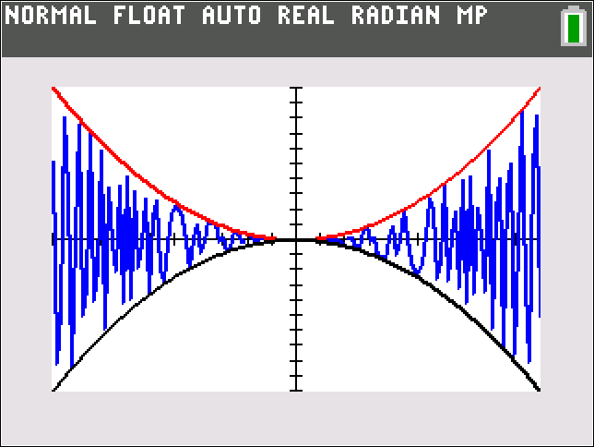
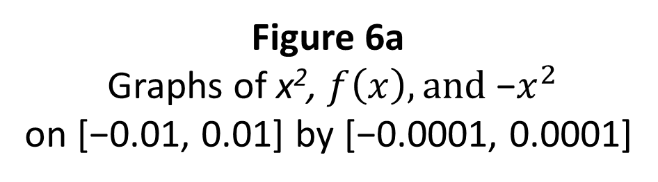
Example 2: Zooming In on a Graph of a Function (cont.)
In order to get a better sense of the infinitude of oscillations, we can zoom in even further, as shown in Figure 6.
Figure 6a
Graphs of x², $f\left(x\right), and \text{−}x^{2}$
on [−0.01, 0.01] by [−0.0001, 0.0001]

Slide 16
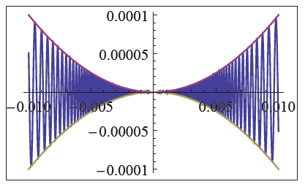
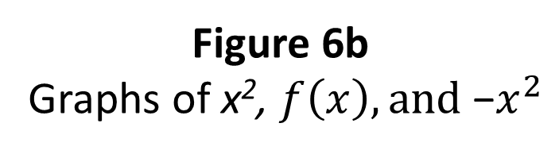
Example 2: Zooming In on a Graph of a Function (cont.)
Figure 6b
Graphs of x², $f\left(x\right), and \text{−}x^{2}$

Slide 17
Example 2: Zooming In on a Graph of a Function (cont.)
Finally, we wish to note that f(x) is not defined for x = 0; that is, there is no function value for x = 0, which is not clear from the graphs we received. Graphing technology, however, is still an extremely useful tool, if we stay aware of its limitations.

Slide 18
Technology Note: Graphing Vertical Asymptotes
With guidance by the user, the graphs generated by calculators and software can usually be much improved in the cases where the default algorithm leads to misleading (or even wildly inaccurate) pictures.
Software such as Mathematica allows the user precise control. Figure 8 illustrate the use of options in Plot that direct Mathematica to skip over values of x for which cos x equals 0 and to indicate those “exclusions” with dashed lines, a notation we commonly use for asymptotes.

Slide 19
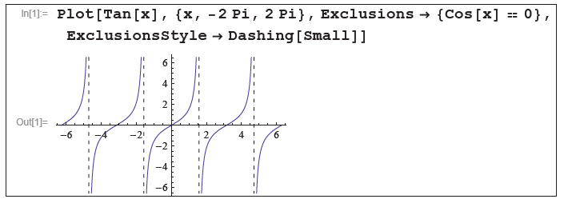
Technology Note: Graphing Vertical Asymptotes (cont.)
Figure 8

Slide 20
Example 3: Using Mathematica to Dynamically Zoom In and Out on a Graph of a Function
The graph of sin 25x oscillates with a high-enough frequency to warrant caution when using a graphing tool. The following screenshots show the use of the Manipulate command in Mathematica. If you have access to this software package, type in and execute the command as shown and then use the slider to dynamically zoom in and out of the picture. What we are actually doing is dynamically changing the horizontal extent of the viewing window from a minimum of [−0.1, 0.1] to a maximum of [−10, 10].

Slide 21
Example 3: Using Mathematica to Dynamically Zoom In and Out on a Graph of a Function (cont.)
We have also instructed Mathematica to increase the number of sampled points (with the PlotPoints option) in order to capture the oscillatory behavior more accurately.

Slide 22
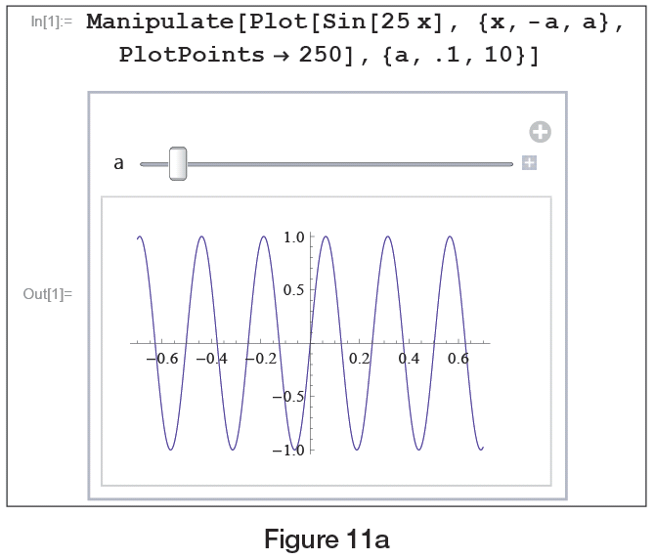
Example 3: Using Mathematica to Dynamically Zoom In and Out on a Graph of a Function (cont.)
Figure 10a

Slide 23
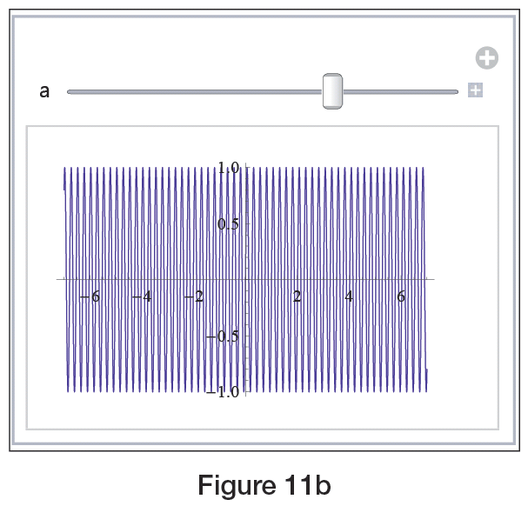
Example 3: Using Mathematica to Dynamically Zoom In and Out on a Graph of a Function (cont.)
Figure 10b

Slide 24
Animations and Models
In Example 3, the variable a is referred to as a parameter, a quantity that we want to allow to vary in order to gain insight into some particular behavior. In the usage above, changing a equates to changing the viewing window, but parameters can appear in many different ways. Example 4 illustrates the use of two parameters, one controlling the size of the viewing window and the other appearing in the definition of the function itself.

Slide 25
Example 4: Using Mathematica to Dynamically Adjust the Graph of a Function for Different Values of a Parameter
Graph the function
Solution
The function f(x) exhibits different characteristics depending on both the value of the parameter c and whether we are interested in the behavior close to 0 or on a larger scale. The screenshots in Figure 11 show just a few of the possible choices for c and for the viewing window. Note that the width of the viewing window can vary from [0, 0.1] to [0, 20] and that c can take on values between 1 and 100.

Slide 26
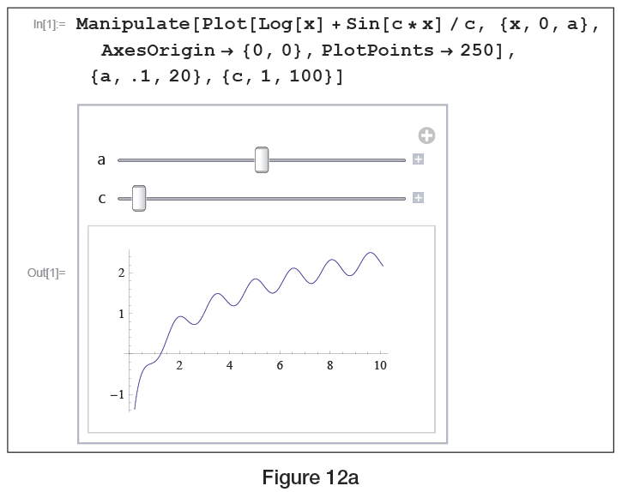
Example 4: Using Mathematica to Dynamically Adjust the Graph of a Function for Different Values of a Parameter (cont.)
Figure 11a

Slide 27
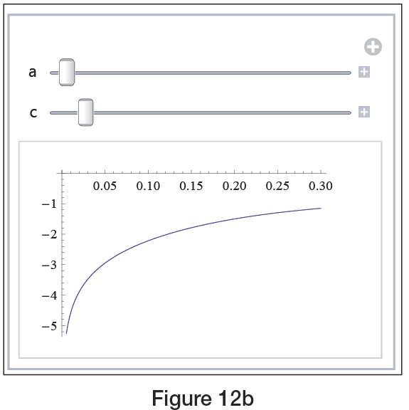
Example 4: Using Mathematica to Dynamically Adjust the Graph of a Function for Different Values of a Parameter (cont.)
Figure 11b

Slide 28
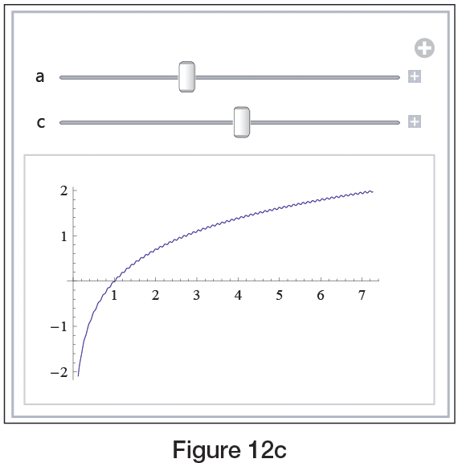
Example 4: Using Mathematica to Dynamically Adjust the Graph of a Function for Different Values of a Parameter (cont.)
Figure 11c

Slide 29
Procedure: Constructing a Mathematical Model
The process of constructing a mathematical model is one you are familiar with—you have worked with many models already, though they may not have been labeled as such. In general, the steps in making a model of a real‑world phenomenon are as follows.
Step 1: Identify the measurable or observable quantities and label them as variables.
Step 2: Find mathematical relationships between the variables, making simplifying assumptions about the phenomenon if necessary.

Slide 30
Procedure: Constructing a Mathematical Model (cont.)
Step 3: Draw mathematical conclusions from the equations, functions, or other mathematical relationships found (this usually amounts to solving equations or performing mathematical operations).
Step 4: Interpret the mathematical conclusions in terms of the real‑world phenomenon, and test the descriptive/predictive power of the model against reality. Adjust and improve the model if necessary.

Slide 31
Example 5: Using Mathematica to Animate a Mathematical Model with Variable Parameters
Build a mathematical model to predict an automobile’s total stopping distance d (i.e., the total distance traveled from the moment the driver decides to stop until the car comes to a complete stop) as a function of its initial speed v. Then construct a graph with animation that is dependent on road conditions and the driver’s response time.

Slide 32
Example 5: Using Mathematica to Animate a Mathematical Model with Variable Parameters (cont.)
Solution
First, we identify time, speed, and distance as the most important measurable quantities for the purposes of our model. Next, observe that the actual stopping distance will consist of two parts: the distance the car travels after the driver decides to stop but before the brakes start to work, that is, the “response distance,” and the actual “braking distance” (the distance traveled while braking). Labeling these by d₁ and d₂, respectively, yields

Slide 33
Example 5: Using Mathematica to Animate a Mathematical Model with Variable Parameters (cont.)
where d is the total stopping distance. Next, we will let v stand for the speed of the car before braking, M for the total mass of the car and passengers, and μ for the coefficient of friction between the tires and the pavement.
We will make the simplifying assumptions that the brakes come on instantly and operate with constant force. The road surface is assumed to be uniform and level. Finally, we ignore air resistance and heat loss. Note that d₁ can be calculated as

Slide 34
Example 5: Using Mathematica to Animate a Mathematical Model with Variable Parameters (cont.)
where t is the time the driver requires to respond. In order to find d₂ note that the car’s kinetic energy (the energy stemming from its forward motion) is dissipated during braking, all the way down to 0. Since the braking force F_{b} arises as a result of friction between the tires and the pavement, we have
where g is the gravity constant.

Slide 35
Example 5: Using Mathematica to Animate a Mathematical Model with Variable Parameters (cont.)
By the law of conservation of energy, the total work done by F_{b} must equal the car’s initial kinetic energy of so
from which we obtain

Slide 36
Example 5: Using Mathematica to Animate a Mathematical Model with Variable Parameters (cont.)
Thus, our mathematical model for the total stopping distance becomes
Since experimental data show the value of t to be approximately 0.75 seconds for the average driver, and μ = 0.9 is realistic on dry pavement, we can complete our model by writing

Slide 37
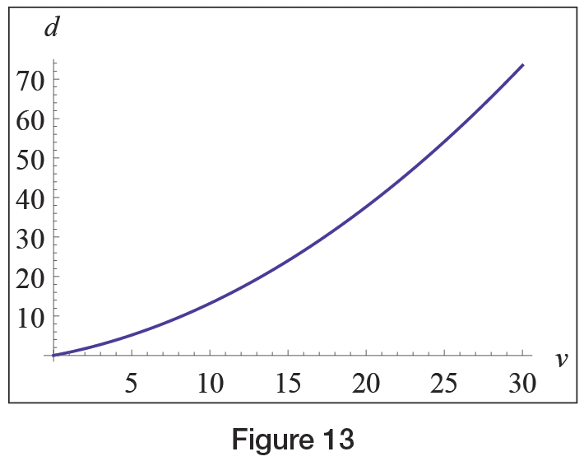
Example 5: Using Mathematica to Animate a Mathematical Model with Variable Parameters (cont.)
In Figure 12, v is assumed to be in meters per second (note that 30 m/s corresponds to 67.1 mph and that g ≈ 9.81 m/s² in the metric system). Observe the quadratic functional dependence, which definitely warns us to observe speed limit signs!
Figure 12

Slide 38
Example 5: Using Mathematica to Animate a Mathematical Model with Variable Parameters (cont.)
The flexibility of our model is demonstrated by the fact that we can treat the driver’s response time t and the friction coefficient μ as parameters, corresponding to the facts that no two drivers are equal and road conditions often change. Exploiting the capabilities of Mathematica’s Manipulate command, we can easily create animations of the previous graph that are dependent on said parameters.

Slide 39
Example 5: Using Mathematica to Animate a Mathematical Model with Variable Parameters (cont.)
Notice from the following graphs that while a slower driver response does result in increased stopping distance as predicted by our model, the real drama happens on a slippery road surface. For small μ ‑values, stopping distance can easily more than double even if the driver has a really short reaction time!

Slide 40
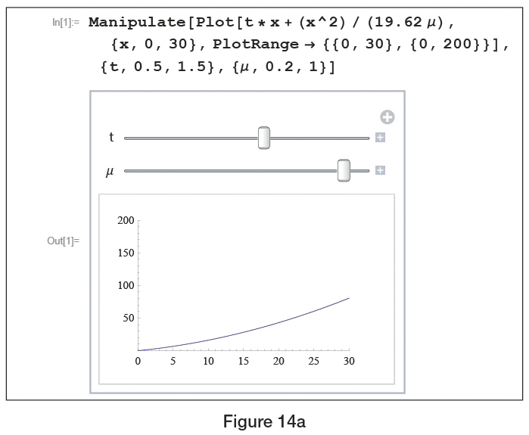
Example 5: Using Mathematica to Animate a Mathematical Model with Variable Parameters (cont.)
Figure 13a

Slide 41
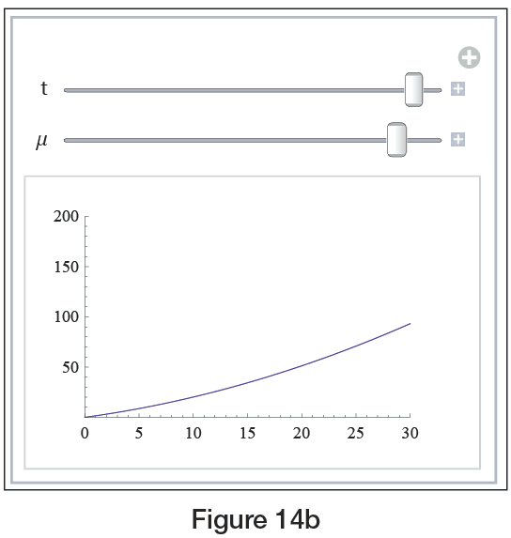
Example 5: Using Mathematica to Animate a Mathematical Model with Variable Parameters (cont.)
Figure 13b

Slide 42
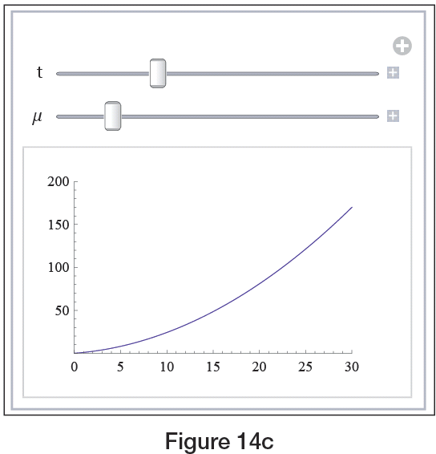
Example 5: Using Mathematica to Animate a Mathematical Model with Variable Parameters (cont.)
Figure 13c

Slide 43
Least-Squares Curve Fitting
In some cases, especially where the relevant measurable quantities consist only of collected data, the “simplifying assumptions” in the modeling process may be nothing more complicated than something like “assume the data lie along a straight line” or “assume the data exhibit exponential behavior.” In such cases, an empirical model may be all that is desired; such a model is based only on the data—no underlying physical principles are used.

Slide 44
Least-Squares Curve Fitting (cont.)
As mentioned briefly in Section 1.1, least‑squares curve fitting is a useful technique for constructing a function (of a predetermined form) that best approximates a given collection of data points. To illustrate the technique, suppose we wish to fit a line to the n data points (x₁, y₁), (x₂, y₂), …, (x_{n}, y_{n}). Every line in the plane has the form y = mx + b for some slope m and y‑intercept b, so the task is to determine the best choices for m and b.

Slide 45
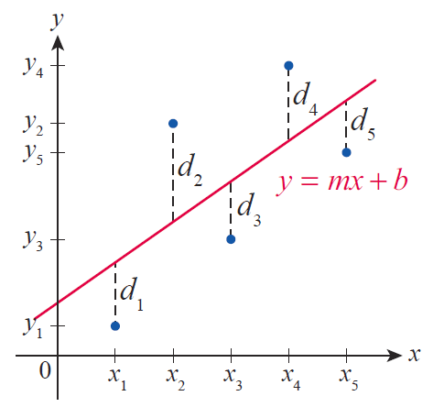
Least-Squares Curve Fitting (cont.)
If we let d_{i} = y_{i} – (mx_{i} + b), then each d_{i} represents the vertical difference between the i^{th} data point and the line y = mx + b (see Figure 14). The least‑squares method gets its name from the objective of choosing m and b so that is minimized.
Figure 14

Slide 46
Least-Squares Curve Fitting (cont.)
As we will see later, calculus allows us to fairly easily determine the following formulas for m and b.

Slide 47
Least-Squares Curve Fitting (cont.)
(Recall that the notation stands for the sum
These are exactly the formulas that graphing calculators and computer software programs use when determining the line of best fit for a given data set.

Slide 48
Example 6: Finding the Best-Fitting Line for a Data Set
Continuing along the lines of Example 5, suppose that Table 1 contains driver response distances (denoted by d in this example) as a function of initial speed v. Use the least‑squares method to find the best‑fitting line for the data, and give an interpretation for the slope of the line.
Table 1
v (km/h) | 40 | 48 | 56 | 64 | 72 | 82 | 88 | 96 | 104 | 112 | 120
d (m) | 8.5 | 10.0 | 11.9 | 13.4 | 15.2 | 16.8 | 18.6 | 20.1 | 21.9 | 23.5 | 25.3

Slide 49
Example 6: Finding the Best-Fitting Line for a Data Set (cont.)
Solution
Note that for the purpose of using our formulas, the numbers in the left column are the values of x_{i}, while the right column provides the y_{i}‑values. However, using Mathematica’s Fit command (see Figure 15) or a graphing calculator (see Figure 16), we can obtain the equation of the best-fitting line much quicker.

Slide 50
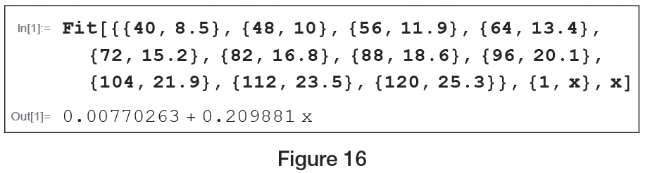
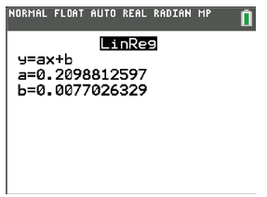
Example 6: Finding the Best-Fitting Line for a Data Set (cont.)
Figure 15
Figure 16

Slide 51
Example 6: Finding the Best-Fitting Line for a Data Set (cont.)
Since the constant term is close to 0, ignoring it we obtain
and thus the slope of the best‑fitting line is
which is the driver’s response time. In order to express t in seconds, we note that since 1 m/s = 3.6 km/h , if v̄ is the speed expressed in meters per second, we have v̄ = v/3.6, and thus t (in seconds) can be obtained as

Slide 52
Example 6: Finding the Best-Fitting Line for a Data Set (cont.)
In other words, the slope of the best-fitting line indicates that based upon this particular data set, the average driver response time is approximately 0.76 seconds.

