Slide 1
Section 10.3
The Integral Test

Slide 2
The Integral Test
Consider the series It passes the n^{th}-Term
Divergence Test (1/n² → 0 as n → ∞), but this only tells us that the series may converge. Remember that this condition is necessary but not sufficient to prove convergence. The series is neither geometric nor telescoping, so we don’t have a convenient formula to use for the partial sums. No theorem that we learned in the previous section seems to help, but a depiction of the series as in Figure 1 at least gives us a way to compare it to something we are familiar with.

Slide 3
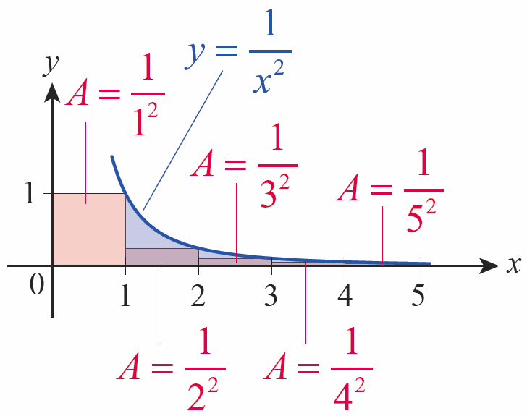
The Integral Test (cont.)
In Figure 1, the n^{th} rectangle has a width of 1 and a height of 1/n², so its area is equal to the n^{th}
term of the series
If we define f(x) = 1/x², we can write
Figure 1 Area Depiction of

Slide 4
The Integral Test (cont.)
Expressed this way, the series takes the form of a very coarse Riemann sum (coarse because the width of each subinterval is 1, a relatively large ∆x). And since f is a decreasing function, the Riemann sum is an underestimate of the area between the graph of f and the positive x-axis—that is clear from Figure 1, since each rectangle lies under the graph of f. In fact, treating the first term separately, we note that

Slide 5
The Integral Test (cont.)
Recall from Section 7.7 that an integral of the form
is called an improper integral of type I, and its value is defined as a limit, if the limit exists—in Example 1 of that section we saw that

Slide 6
The Integral Test (cont.)
We can often compare a series, or at least all the terms of a series past some point N, to an integral just as we did above. When we can, the behavior of the series and the integral coincide—they either both converge or both diverge. The formal statement of this fact is called the Integral Test.

Slide 7
Theorem: The Integral Test
Assume that is a decreasing sequence of positive terms and a_{n} = f(n), where f(x) is a continuous, positive, and decreasing function for all x greater than or equal to some natural number N. Then the series
and the improper integral both
converge or both diverge.

Slide 8
Proof
For simplicity of presentation, we will prove the theorem for N = 1; the proof is similar for all other values of N.
The fact that both the sequence and the function f are positive means that the sequence of partial sums
is an increasing sequence and that
increases as b → ∞. So by the Bounded Monotonic Sequence Theorem, we can show converges by showing it is bounded above.

Slide 9
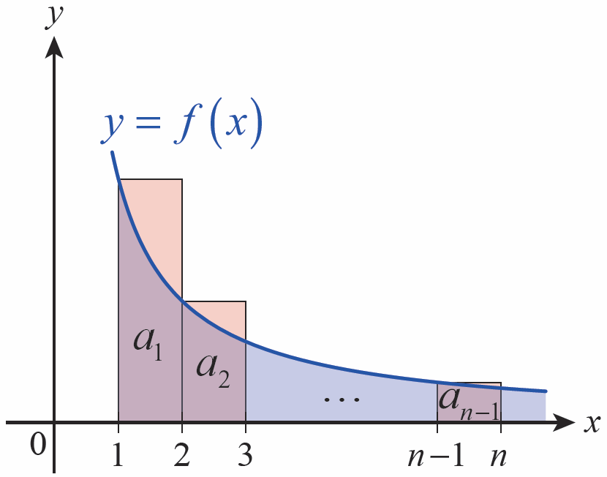
Proof (cont.)
The decreasing nature of both and f allows us to relate the partial sums to the integrals, as follows. If we
construct a Riemann sum for
the integral
using left endpoints of the subintervals [1, 2],…,[n − 1, n] (as shown in Figure 2), then
Figure 2

Slide 10
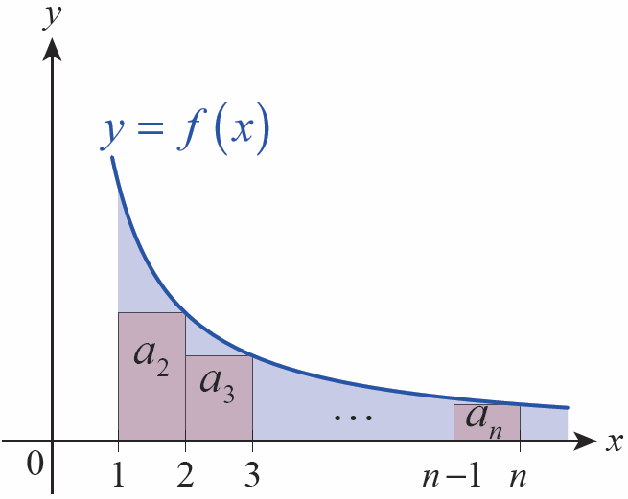
Proof (cont.)
But if we construct a Riemann sum for the same integral using right endpoints for our sample points (as in Figure 3) then
which, if we add the first term of the series to both sides, gives us
Figure 3

Slide 11
Proof (cont.)
So if converges, we know that
and hence converges as well (and its sum is less
than

Slide 12
Proof (cont.)
If diverges, then diverges too, since
(By the same reasoning, convergence of implies
convergence of and divergence of
implies divergence of

Slide 13
Caution
Although a series and integral meeting the conditions of the Integral Test will either both converge or both diverge, it should not be inferred, in the case of convergence, that they converge to the same value. For
example, and both converge, but
the series converges to a value of while the integral converges to a value of 1.

Slide 14
Example 1: Using the Integral Test to Prove a Series Diverges
Use the Integral Test to prove the divergence of the harmonic series.
Solution
In the last section, we showed that by
showing there is a subsequence of partial sums that grows unbounded. But we can now use the Integral Test to more directly show divergence.

Slide 15
Example 1: Using the Integral Test to Prove a Series Diverges (cont.)
Since is a sequence of positive but decreasing terms, and since
also diverges.

Slide 16
The Integral Test (cont.)
The convergent series and the divergent
series are two examples of a p‑series, which is
any series of the form with p a fixed real
number. Example 2 resolves the question of their convergence in full generality.

Slide 17
Example 2: Finding the Values of p for Which a p-Series Converges
Determine for which values of p a p-series converges.
Solution
We already know that the harmonic series, p = 1, diverges. If p = 0, and if p < 0,
so also diverges by the
n^{th}-Term Divergence Test for p ≤ 0.

Slide 18
Example 2: Finding the Values of p for Which a p-Series Converges (cont.)
For 0 < p < 1 and p > 1, is a sequence of positive but decreasing terms and we can apply the Integral Test. We first note that

Slide 19
Example 2: Finding the Values of p for Which a p-Series Converges (cont.)
If p > 1, −p + 1 < 0 so
and the integral and series converge (remember though that the Integral Test doesn’t tell us the sum of the series).

Slide 20
Example 2: Finding the Values of p for Which a p-Series Converges (cont.)
If 0 < p < 1, −p + 1 > 0, and b^{−p +1} increases without bound as b → ∞. That is,
and the integral diverges. In summary, a p-series converges if p > 1 and diverges if p ≤ 1.

Slide 21
Series and Remainder Estimates
Suppose we have been able to use the Integral Test to
show that converges. Since the Integral Test only
provides an upper bound for the sequence of partial sums it doesn’t tell us the actual sum
of the series. But we can use the reasoning behind the proof of the Integral Test to come up with an estimate for the sum that is as precise as we desire.

Slide 22
Series and Remainder Estimates (cont.)
To do so, we introduce the idea of the series remainder r_{n} = s − s_{n}. Referring to Figure 4, we see that
and, referring to Figure 5,
where, as before, f is a continuous, positive, and decreasing function with a_{n} = f(n).

Slide 23
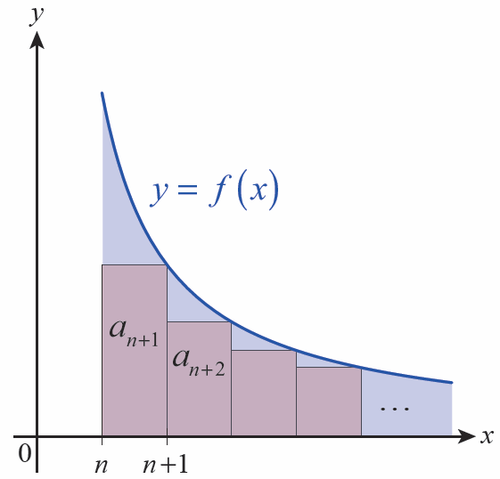
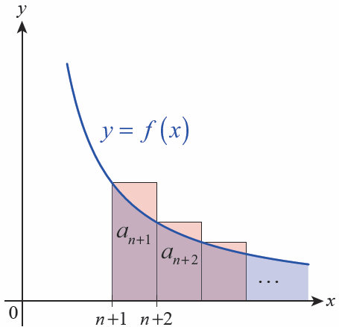
Series and Remainder Estimates (cont.)
Figure 4
Figure 5

Slide 24
Series and Remainder Estimates (cont.)
This gives us a lower and upper bound on the remainder r_{n} and, if we rewrite it in terms of s and the n^{th} partial sum s_{n}, a lower and upper bound on the actual sum of the series.
For reference, we state these two results as a theorem.

Slide 25
Theorem: Series and Remainder Estimates
Assume that is a convergent series and a_{n} = f(n),
where f(x) is a continuous, positive, and decreasing function. Then the sum s, the n^{th} partial sum s_{n}, and the n^{th} remainder r_{n} satisfy the inequalities
and

Slide 26
Example 3: Finding Lower and Upper Bounds for the Sum of a Series
Let
a. Rounded to two decimal places, the 10th partial sum s₁₀ is 1.55; based on this, find lower and upper bounds for s.
b. With what accuracy do we know s if we instead use s₁₀₀₀ ≈ 1.643935?

Slide 27
Example 3: Finding Lower and Upper Bounds for the Sum of a Series (cont.)
Solution
Since
we can make the following estimates.
a.

Slide 28
Example 3: Finding Lower and Upper Bounds for the Sum of a Series (cont.)
b.
Since s lies within an interval of width 1 × 10⁻⁶, we could approximate s by the average of the two values, 1.6449345, and know that the approximation is accurate to within (The exact value of s is .)

Slide 29
Series and Remainder Estimates (cont.)
Although the harmonic series diverges, we can still use an integral comparison to gain an appreciation for how slowly the sum grows. As we saw in proving the Integral
Test, the relationship is valid for any
series of positive but decreasing terms.

Slide 30
Example 4: Finding a Lower Bound for a Partial Sum
Find a lower bound for the sum of the first 1 million terms of the harmonic series.
Solution
Using with n = 1,000,001 gives us

Slide 31
Example 4: Finding a Lower Bound for a Partial Sum (cont.)
In fact, after a significant amount of computation, a computer algebra system can tell us that s_{1,000,000} ≈ 14.393, so the lower bound given by the integral is a very quick and reasonable indication of the rate at which a divergent series of positive decreasing terms grows.

