Slide 1
Section 10.8
Taylor and Maclaurin Series

Slide 2
Taylor and Maclaurin Series
Assume we can represent a given function f as a power series for all x within a convergence radius R about a fixed real number a:
We then determine what the coefficients c_{n} must be, given this assumption. First, by letting x = a, we see immediately that f(a) = c₀.

Slide 3
Taylor and Maclaurin Series (cont.)
Next, since we can differentiate a power series (within its radius of convergence) term by term, we note that
and substituting x = a into this equation tells us that
f ’(a) = c₁. We proceed to differentiate and substitute x = a repeatedly, to obtain

Slide 4
Taylor and Maclaurin Series (cont.)
and, in general,
.
.
.

Slide 5
Taylor and Maclaurin Series (cont.)
Solving for each c_{n}, and using the conventions that and 0! = 1, we have discovered that
Remember that this all hinges upon the key assumption that f can be represented as a power series about a—we will soon revisit this assumption to answer the question of when this is possible. But for now, we have motivated the following definition.

Slide 6
Definition: Taylor Series and Maclaurin Series
Given a function f with derivatives of all orders throughout an open interval containing a, the power series
is called the Taylor series generated by f about a.

Slide 7
Definition: Taylor Series and Maclaurin Series (cont.)
The Taylor series generated by f about 0 is also known as the Maclaurin series generated by f .

Slide 8
Taylor and Maclaurin Series (cont.)
Note that the definition above formally describes Taylor and Maclaurin series as series—there is no claim (yet) that the Taylor series associated with a given function f actually converges to that function on any interval.

Slide 9
Example 1: Finding the Taylor Series Expansion of a Function and Where It Converges
Find the Taylor series expansion of f(x) = 1/x about a = 3, and determine where, if anywhere, the Taylor series converges to f.
Solution
We determine the coefficients c_{n} of the series as follows:

Slide 10
Example 1: Finding the Taylor Series Expansion of a Function and Where It Converges (cont.)
and, in general, and

Slide 11
Example 1: Finding the Taylor Series Expansion of a Function and Where It Converges (cont.)
So the Taylor series generated by f about a = 3 is
Since the series was generated by f(x) = 1/x we are certainly justified in hoping that it actually equals 1/x somewhere.

Slide 12
Example 1: Finding the Taylor Series Expansion of a Function and Where It Converges (cont.)
That hope may be in vain, as we will see in Example 5, but in this case we can easily determine exactly where the series converges to the function because it is of a form we understand well. It is a geometric series with ratio −(x − 3)/3 and it converges when or 0 < x < 6. And, for those values of x,

Slide 13
Taylor and Maclaurin Series (cont.)
If we were to discard all the terms of the Taylor series of Example 1 with degree greater than n, we would wind up with a polynomial of degree n that approximates 1/x on the interval (0, 6). Specifically, the first four such polynomial approximations from Example 1 are as follows.

Slide 14
Taylor and Maclaurin Series (cont.)

Slide 15
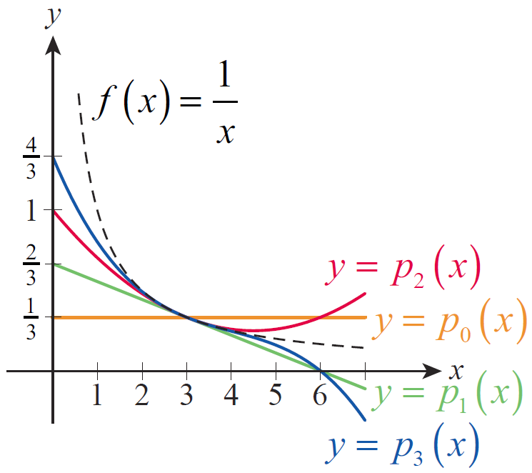
Taylor and Maclaurin Series (cont.)
These polynomials are shown in Figure 1. They are called Taylor polynomials and they generalize the idea of approximating a function with its linearization, p₁(x) .
Figure 1 Taylor Polynomials

Slide 16
Definition: Taylor Polynomial of Order n
Given a function f with derivatives up through order N throughout an open interval containing a, the polynomial

Slide 17
Definition: Taylor Polynomial of Order n (cont.)
is called the Taylor polynomial of order n generated by f about a. If a = 0, the Taylor polynomial is also known as the Maclaurin polynomial.

Slide 18
Example 2: Finding the Maclaurin Polynomials
Generated by a Function
Find the Maclaurin polynomials generated by f(x) = sinx.
Solution
The derivatives of f exhibit a nice cyclical pattern, and we leave it to the reader to verify that

Slide 19
Example 2: Finding the Maclaurin Polynomials
Generated by a Function (cont.)
So the Maclaurin series generated by f is

Slide 20
Example 2: Finding the Maclaurin Polynomials
Generated by a Function (cont.)
Since all the terms with an even exponent are absent, we can describe the family of Maclaurin polynomials with the formulas
and

Slide 21
Example 2: Finding the Maclaurin Polynomials
Generated by a Function (cont.)
As a consequence, the Maclaurin polynomials of order 2n + 1 and order 2n + 2 are the same and both have degree 2n + 1. For instance, the Maclaurin polynomials of order 5 and order 6 are
and both have degree 5.

Slide 22
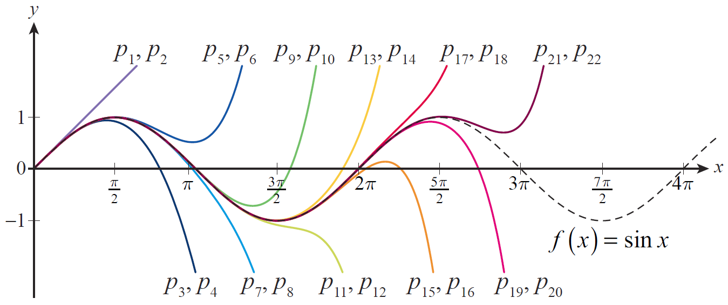
Example 2: Finding the Maclaurin Polynomials
Generated by a Function (cont.)
Figure 2 is an illustration of how the Maclaurin polynomials of increasing order approximate f(x) = sin x. Keep in mind, however, that we still have the task of determining where this Maclaurin series actually converges to its generating function.
Figure 2 Maclaurin Polynomial Approximations of Sine

Slide 23
Remainder Estimates and Convergence for Taylor Series
We are now ready to tackle the question of when (and where) Taylor series converge to their generating functions, and we do so with a theorem that generalizes the Mean Value Theorem.

Slide 24
Theorem: Taylor’s Theorem
If f and its derivatives up through f^{(n)} are all continuous on the closed interval [a, b] and if f^{(n+1)} exists on the open interval (a, b), then there is a number such that

Slide 25
Remainder Estimates and Convergence for Taylor Series (cont.)
In applying Taylor’s Theorem, we typically desire an approximation for the value f(x) based on the known value of f and its first n derivatives at some fixed point a, so we replace b in the theorem with x and express the result as a formula.

Slide 26
Theorem: Taylor’s Formula
If f has derivatives of all orders throughout an open interval I containing a, then for each natural number n and for each x ∈ I,

Slide 27
Formula: Taylor’s Formula (cont.)
where c is some number between a and x. Defining p_{n}(x) and r_{n}(x) as above, we can write where p_{n} is a polynomial of degree at most n and r_{n} is called the remainder (or error) of order n.

Slide 28
Remainder Estimates and Convergence for Taylor Series (cont.)
So given a function f meeting the conditions of Taylor’s formula, we now note that the Taylor polynomials p_{n} converge to f for all x in the open interval I if as n → ∞ for each x. If this is the case, we write
and say that the Taylor series generated by f converges to f on I. We are often able to show that on I by knowing something about the behavior of the derivatives of f throughout I.

Slide 29
Example 3: Finding the Maclaurin Series Generated by a Function and Where It Converges
Find the Maclaurin series generated by f(x) = e^{x} and determine where it converges to f.
Solution
The function f has derivatives of all orders on the entire real line, and f^{(n)}(0) = 1 for every n, so the formal Maclaurin series generated by f(x) = e^{x} is

Slide 30
Example 3: Finding the Maclaurin Series Generated by a Function and Where It Converges (cont.)
The only remaining step is to determine for which values of x this series converges to f. We do so by splitting the real number line into three cases. In two of them, we make use of the fact that
for every real number x.

Slide 31

Example 3: Finding the Maclaurin Series Generated by a Function and Where It Converges (cont.)
This is true because the series is absolutely
convergent for any x (by the Ratio Test) and hence convergent (absolute convergence implies convergence), so the terms $xn$/n! must converge to 0.

Slide 32
Example 3: Finding the Maclaurin Series Generated by a Function and Where It Converges (cont.)
(1) If x < 0, Taylor’s formula tells us that the remainder r_{n}(x) of order n is
for some x < c < 0. And since
and hence as well.

Slide 33
Example 3: Finding the Maclaurin Series Generated by a Function and Where It Converges (cont.)
(2) If x = 0, r_{n}(x) = 0 for every n ≥ 1, so
(3) If x > 0, Taylor’s formula again tells us that
this time for some 0 < c < x. But since f is an increasing function, we know e^{c} < e^{x} so

Slide 34
Example 3: Finding the Maclaurin Series Generated by a Function and Where It Converges (cont.)
Since for every real number x,
everywhere.

Slide 35
Remainder Estimates and Convergence for Taylor Series (cont.)
We often make use of the fact that in showing Taylor series convergence.

Slide 36
Example 4: Finding Values of x for Which a Maclaurin
Series Converges to Its Generating Function
For which values of x does
Solution
In Example 2, we constructed the formal Maclaurin series above for f(x) = sinx. And since for all n and all possible values of c, the remainder of order n satisfies
and hence as well.

Slide 37
Example 4: Finding Values of x for Which a Maclaurin
Series Converges to Its Generating Function (cont.)
So the Maclaurin series generated by sin x is another example of a series that converges to its generating function for all x.

Slide 38
Remainder Estimates and Convergence for Taylor Series (cont.)
So far, we have determined that e^{x} and sin x converge to their respective Maclaurin series (that is, Taylor series about a = 0) for all x. and Example 1 demonstrated that 1/x converges to its Taylor series about a = 3 on the interval 0 < x < 6 (and by checking the endpoints 0 and 6 individually, its easy to see that they cannot be included in the interval of convergence). The next example demonstrates that not all Taylor series are so well behaved.

Slide 39
Example 5: Exploring a Maclaurin Series That Converges to the Desired Function at Only One Point
Let f be defined by
It is easy to see that f has derivatives of all orders for every x ≠ 0, and with a bit of work we can show that f^{(n)}(0) = 0 for every n. First, by the definition of the derivative,

Slide 40
Example 5: Exploring a Maclaurin Series That Converges to the Desired Function at Only One Point (cont.)
This limit is of indeterminate form 0/0 and we could apply L’Hôpital’s Rule to it directly—unfortunately, as you can verify, this leads to a limit that’s harder to analyze. But we can transform the limit into one of indeterminate form and make progress.

Slide 41
Example 5: Exploring a Maclaurin Series That Converges to the Desired Function at Only One Point (cont.)
We use the same principle to show that higher derivatives of f evaluated at 0 are also 0. For instance,
and two applications of the same trick result in
By induction, and through repeated application of L’Hôpital’s Rule, we obtain f^{(n)}(0) = 0 for every n.

Slide 42
Example 5: Exploring a Maclaurin Series That Converges to the Desired Function at Only One Point (cont.)
So the Maclaurin series generated by f is the series
or 0. But clearly for every x ≠ 0. So the
Maclaurin series for this particular function converges to it at one and only one point—not a very useful expansion at all.

Slide 43
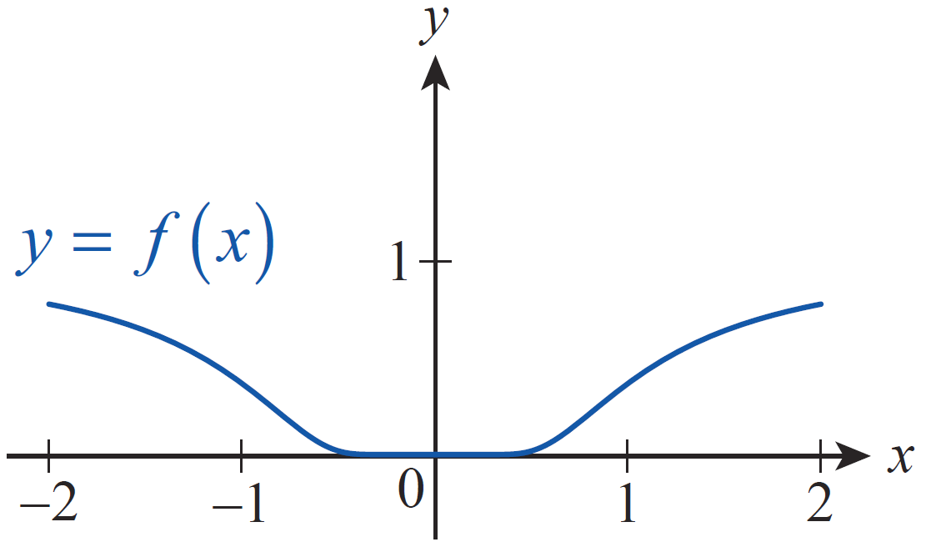
Example 5: Exploring a Maclaurin Series That Converges to the Desired Function at Only One Point (cont.)
What goes wrong in this example? Actually, nothing at all—Taylor’s Theorem is not contradicted by this function. Figure 3 shows that f is extremely flat near 0,
but not exactly flat. For any x ≠ 0, f^{(n)}(x) will eventually begin to diverge rapidly from 0 as n → ∞, resulting in
Figure 3

Slide 44
Example 6: Finding the Maclaurin Series Expansion of Cosine
Find the Maclaurin series expansion of cos x.
Solution
Since for all x (see Example 4), we
know we can differentiate it term by term. So
for all x.

Slide 45
Example 7: Using a Known Maclaurin Series to Find the
Maclaurin Series Expansion of a Related Function
Find the Maclaurin series expansion of
Solution
We could construct the series expansion directly, but it is far quicker to simply use the known series expansion of e^{x} (which from Example 3 we know converges for all x) and substitute −x² for x.

Slide 46
Example 8: Approximating a Nonelementary Definite Integral
Approximate to within 0.001.
Solution
The integral is an example of a nonelementary integral, so we cannot evaluate it using an antiderivative of But we can make use of the series expansion we just found in Example 7. Since the series converges for all x, we can integrate it term by term without hesitation.

Slide 47
Example 8: Approximating a Nonelementary Definite Integral (cont.)

Slide 48
Example 8: Approximating a Nonelementary Definite Integral (cont.)
The absolute value of the next term in the series would be so by the Alternating Series Test we know the approximation 0.7475 is correct to within 0.001.

Slide 49
Example 9: Finding a Taylor Series Expansion of the Natural Logarithm
Find the Taylor series expansion of lnx about a = 1.
Solution
We leave it as an exercise to find the Taylor series expansion directly, and instead demonstrate how several facts we already know can be combined as follows.

Slide 50
Example 9: Finding a Taylor Series Expansion of the Natural Logarithm (cont.)
Note that the expansion we just found remains valid for |x − 1|< 1. Note also that the interval of convergence now includes the endpoint x = 2 but not the endpoint x = 0.

Slide 51
Example 9: Finding a Taylor Series Expansion of the Natural Logarithm (cont.)
The expansion may appear in several slightly different forms. For instance, if (−1)^{n+1} is factored out of each numerator and the series reindexed to begin with 1, it can be written as

Slide 52
Example 10: Using Known Maclaurin and Taylor Series Expansions to Find Series Expansions of Related Functions
Find a. the Maclaurin series expansion of x sinx and
b. the Taylor series expansion of x lnx about a = 1.
Solution
a. Since our series expansion of sinx is valid for all x (see Example 4), we can simply multiply it by x (which is, trivially, the Maclaurin series of x).

Slide 53
Example 10: Using Known Maclaurin and Taylor Series Expansions to Find Series Expansions of Related Functions (cont.)
b. To quickly find the series expansion of x lnx about a = 1, we want to use the result of Example 9 along with the series expansion of x about a = 1, which is x = 1 + 1(x − 1).

Slide 54
Example 10: Using Known Maclaurin and Taylor Series Expansions to Find Series Expansions of Related Functions (cont.)

Slide 55
Remainder Estimates and Convergence for
Taylor Series (cont.)
Function | Taylor Series | Convergence Condition
e^{x}
sinx
Table 1

Slide 56
Remainder Estimates and Convergence for
Taylor Series (cont.)
Function | Taylor Series | Convergence Condition
cosx
lnx
Table 1 (cont.)

