Slide 1
Section 10.9
Further Applications of Series

Slide 2
Applications Using Series
We have already determined that the Taylor series expansion
is valid for all x ∈ ℝ. One way to extend this exponential function to the complex numbers is to use its series expansion as the basis for the definition of e^{iθ}, as follows.

Slide 3
Applications Using Series (cont.)

Slide 4
Applications Using Series (cont.)
The equation e^{iθ} = cosθ + i sinθ is called Euler’s formula, which allows us to relate the constants e, i, and π with the equation e^{iπ} = cosπ + i sinπ = −1, or
e^{iπ} + 1 = 0. It also allows us to now define the value of e^{z} for any complex number z = x + iy, as follows.

Slide 5
Example 1: Using Euler’s Formula
Express e^{iπ /4} and e^{1−3iπ} in the form x + iy.
Solution

Slide 6
Applications Using Series (cont.)
We have previously found and used linear approximations such as which is valid for x ≈ 0. The Taylor series for about x = 0, where m represents any fixed constant, is called the binomial series expansion of it is a generalization of formulas like with many uses, and we are now ready to derive it.

Slide 7
Applications Using Series (cont.)

Slide 8
Applications Using Series (cont.)
In general,
We can now extend the meaning of the binomial coefficient by defining, for any real number m and nonnegative integer n,

Slide 9
Applications Using Series (cont.)
and,
(note that if m is a natural number, this new definition
of reduces to
Given this extended meaning for the binomial coefficient, we can define the following type of series.

Slide 10
Definition: Binomial Series
For any real number m and −1 < x < 1, the series
is called a binomial series.

Slide 11
Applications Using Series (cont.)
By the Ratio Test, it is easy to see that the binomial series converges for |x| < 1. This does not prove that it converges to (1 + x)^{m}, but that is indeed the question of whether the series converges at the endpoints of the convergence interval depends on m. For example, if
−1 < m ≤ 0, the series converges at x = 1; and if m ≥ 0, it converges at both x = −1 and x = 1.

Slide 12
Applications Using Series (cont.)
Note also that the series is finite (and hence convergent for all x) if m is a natural number, since in this case all the binomial coefficients past some point are equal to 0. In other words, when m is a natural number, the binomial series expansion simply reduces to the Binomial Theorem.

Slide 13
Example 2: Using the Binomial Series to Find Series Expansions of Functions
Use the binomial series to find the series expansions of a. and b. about x = 0.
Solution
a. This confirms the power series expansion of 1/(1 − x) we have previously found.

Slide 14
Example 2: Using the Binomial Series to Find Series Expansions of Functions (cont.)
We know this converges for |x| < 1, and by examining the series with the specific values x = −1 and x = 1, it’s easy to see it diverges at both endpoints.

Slide 15
Example 2: Using the Binomial Series to Find Series Expansions of Functions (cont.)
b.

Slide 16
Example 2: Using the Binomial Series to Find Series Expansions of Functions (cont.)
The series converges for |x²| < 1, so the radius of convergence is again 1. In this case, however, the Alternating Series Test tells us that the series also converges at both x = −1 and x = 1.

Slide 17
Example 3: Using the Binomial Series to Expand an Equation
If a particle of mass m is moving with velocity v, the total relativistic energy of the particle is
where c is the speed of light in a vacuum. We can use the binomial series to expand this as follows.

Slide 18
Example 3: Using the Binomial Series to Expand an Equation (cont.)

Slide 19
Example 3: Using the Binomial Series to Expand an Equation (cont.)
The term mc² is called the particle’s rest-mass energy, and the remainder of the series is called the particle’s kinetic energy E_{k}. When a particle is moving with a velocity v much smaller than c (the so-called classical case), v²/c² and all its positive powers are very close to 0 and

Slide 20
Applications Using Series (cont.)
When a closed-form solution to a differential equation is difficult (or impossible) to find, a polynomial approximation may be attainable by beginning with the assumption that the solution has a power series representation.

Slide 21
Example 4: Finding a Power Series Solution to a Differential Equation
Find a power series solution of the equation y′′ − x²y = 0.
Solution
We begin by assuming the solution y can be written in the form

Slide 22
Example 4: Finding a Power Series Solution to a Differential Equation (cont.)
Then
and
So

Slide 23
Example 4: Finding a Power Series Solution to a Differential Equation (cont.)
To satisfy the equation y′′ − x²y = 0, it must be the case that each coefficient of x in the expression above is 0, so
c₂ = 0, c₃ = 0, and for n ≥ 2.

Slide 24
Example 4: Finding a Power Series Solution to a Differential Equation (cont.)
If the differential equation is associated with other information, such as initial conditions like y(0) = a and y′ (0) = b, then we would know that a = y(0) = c₀ and b = y′ (0) = c₁ and it would make sense to express all the coefficients in terms of a and b.
c₀ = a, c₁ = b, c₂ = 0, c₃ = 0 and for n ≥ 2

Slide 25
Example 4: Finding a Power Series Solution to a Differential Equation (cont.)
This would allow us to express the solution y as a sum of two series.

Slide 26
Example 4: Finding a Power Series Solution to a Differential Equation (cont.)
Both of the series converge absolutely for all x, as can be verified by the Ratio Test. In many applications, a polynomial approximation of the solution would be sufficient, so the above two series would be truncated at the desired degree of accuracy.

Slide 27
Fourier Series
As we have seen, a Taylor series expansion of a function represents a limit of polynomials of increasing degree. As such, the polynomials are better able to approximate the original function as the order of the Taylor polynomials increases. But there is no escaping the fact that for any fixed Taylor
Polynomial p_{n}. That is, polynomials grow unbounded in magnitude as x gets further and further from 0, which is not the kind of behavior exhibited by a periodic function.

Slide 28
Fourier Series (cont.)
As a consequence, there is no hope that any fixed Taylor polynomial generated by a periodic function could approximate that function well outside of a bounded interval.

Slide 29
Fourier Series (cont.)
On the other hand, sine and cosine are familiar functions that are easy to manipulate and that exhibit exactly the kind of periodicity that might be needed. For this reason, the French mathematician Jean-Baptiste Joseph Fourier (1768–1830) used them as the basis for solving differential equations describing the flow of heat in physical objects.

Slide 30
Fourier Series (cont.)
The decomposition of functions into sums (possibly infinite sums) of sines and cosines has come to be a part of what is now called Fourier analysis, a branch of mathematics that deals with problems in electrical engineering, acoustics, vibration analysis, optics, signal and image processing, and quantum mechanics, in addition to the original heat flow problems. We introduce the subject here with an outline of the theory of Fourier series.

Slide 31
Fourier Series (cont.)
Suppose f is a periodic function and we hope to express it as a sum of sines and cosines of differing frequencies over the interval [−π, π]. Specifically, we want to find coefficients {a_{k}} and {b_{k}} such that

Slide 32
Fourier Series (cont.)
We do so by multiplying the above equation through by a particular cos px or sin px, and integrating the resulting expressions from −π to π, making use of the following facts.
p, q ∈ℤ
p, q ∈ℤ

Slide 33
Fourier Series (cont.)
For instance, multiplying through by cos(0 ⋅ x), which is the constant function 1, and integrating results in
since all the other integrals on the right hand side are equal to 0. After multiplying through by cos x and sin x, respectively, and integrating we obtain

Slide 34
Fourier Series (cont.)
In general, if k is a positive integer, then
which, when we solve for the coefficients, gives us the following definition.

Slide 35
Definition: Fourier Coefficients and Fourier Series
Given a function f that is integrable on the interval [−π, π ], we define its Fourier coefficients with the formulas

Slide 36
Definition: Fourier Coefficients and Fourier Series (cont.)
and the corresponding Fourier series for f by

Slide 37
Fourier Series (cont.)
We will not explore in this text the question of when the Fourier series for a given function converges to the original function. This question actually leads into a rich
area of mathematical research known as harmonic analysis; for our purposes, it will suffice to simply determine the Fourier coefficients for various common functions.

Slide 38
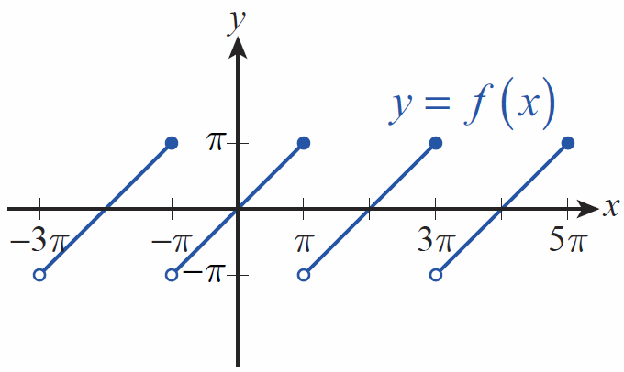
Example 5: Approximating a Sawtooth Function with Its Fourier Series
In electrical engineering applications, the sawtooth function defined by
arises frequently; its graph appears in Figure 1.
Figure 1 Sawtooth Function

Slide 39
Example 5: Approximating a Sawtooth Function with Its Fourier Series (cont.)
This function poses both mathematical and practical difficulties because of its points of discontinuity. Fortunately, it can be approximated as accurately as desired with the first few terms of its Fourier series, and any such approximation has derivatives of all orders. In Exercise 43, you will be asked to verify the following equations for the Fourier coefficients.

Slide 40
Example 5: Approximating a Sawtooth Function with Its Fourier Series (cont.)

Slide 41
Example 5: Approximating a Sawtooth Function with Its Fourier Series (cont.)
If we let g(x) be the truncated Fourier series then

Slide 42
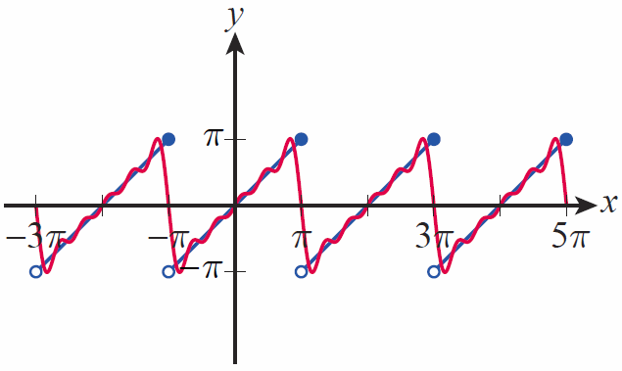
Example 5: Approximating a Sawtooth Function with Its Fourier Series (cont.)
A graph of g appears with the graph of f in Figure 2.
Figure 2
Sawtooth Function f and Fourier Approximation g

Slide 43
Summary of Common Taylor Series
Series expansions of some familiar functions are used so frequently that it’s useful to compile a list of them for reference. We have already determined many of the expansions that appear in the following table—the remainder are left as exercises.

Slide 44
Summary of Common Taylor Series (cont.)
Function | Taylor Series | Convergence Condition
e^{x}
Sin x

Slide 45
Summary of Common Taylor Series (cont.)
Function | Taylor Series | Convergence Condition
cos x
lnx

Slide 46
Summary of Common Taylor Series (cont.)
Function | Taylor Series | Convergence Condition
tan⁻¹x
 |  | Varies with m, but at least |x| < 1

