Slide 1
Section 11.2
Vectors and Vector Algebra

Slide 2
Vectors and Vector Algebra
Many quantities are defined primarily by their size. For example, length, area, mass, price, and temperature are fully determined by a single number; such numbers, representing only magnitude, are called scalars. Other quantities, however, cannot be adequately described by a number alone. Force and velocity, for instance, possess both a magnitude and a direction, and a complete description of these quantities must include both.

Slide 3
Vectors and Vector Algebra (cont.)
Such directed magnitudes are called vectors. In this section, we will study the terminology and algebraic operations of vectors, with the immediate goal of using them to describe curves and surfaces in space.

Slide 4
Vector Terminology and Notation
In this text, we will work with vectors in the setting of ℝ² and ℝ³, but the study of vectors in general constitutes an enormous area of mathematics, and vectors are easily generalized into spaces of any dimension. In two- and three-dimensional space, vectors are often depicted as directed line segments (informally, “arrows”). Such a directed line segment begins at an initial point P and ends at a terminal point Q, and the notation is used to refer to the vector.

Slide 5
Vector Terminology and Notation (cont.)
A subtle but very important point, though, is that a vector is characterized entirely by its direction and magnitude, not by its initial and terminal points. That is, for a specific pair of points P and Q, is only one way of depicting the vector it represents. We will use boldface letters to denote vectors in general, and an expression such as means that u is a vector whose length and direction is the same as that of the directed line segment (when writing by hand, the notation instead of u is common).

Slide 6
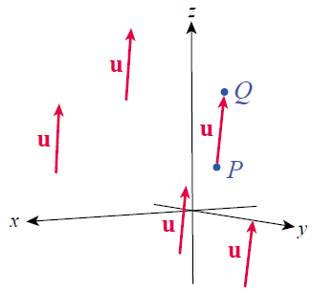
Vector Terminology and Notation (cont.)
Figure 1 illustrates five different
ways of depicting the one vector
u—each of the five arrows is
simply a translation of the
directed line segment from
the point P to the point Q.
Figure 1
Five Depictions of the Vector u

Slide 7
Vector Terminology and Notation (cont.)
Since vectors are characterized entirely by length and direction, we say that two vectors u and v with the same length and the same direction are equal (no matter where they might actually be depicted, if they are graphed) and we write u = v. The length of a vector, also called its magnitude or norm, is denoted or —we will soon see that the distance formula allows us to easily find the lengths of vectors in ℝ² and ℝ³. And in keeping with our prior use of the word, the length of a vector is always nonnegative.

Slide 8
Vector Terminology and Notation (cont.)
The only vector with a length of 0 is the zero vector, denoted 0. We write and note that for every vector

Slide 9
Vector Terminology and Notation (cont.)
For the purposes of calculus, we often need an algebraic way of describing specific vectors in ℝ² and ℝ³, a way that lends itself to such operations as integration and differentiation. The component form of a vector satisfies that need. If a vector u is depicted with the origin as its initial point, the vector is said to be in standard position. If we are working within the context of the plane ℝ², then the terminal point corresponds to an ordered pair (u₁, u₂) and the component form of u is

Slide 10
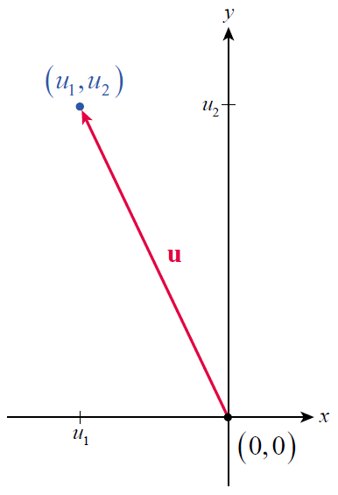
Vector Terminology and Notation (cont.)
Figure 2 is an illustration of
the vector
in standard position in the
plane.
Figure 2 Vector u in ℝ²

Slide 11
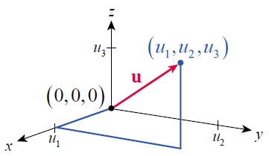
Vector Terminology and Notation (cont.)
Similarly, if the context is ℝ³, the terminal point corresponds to an ordered triple (u₁,u₂ ,u₃ ) and the component form of u is
Figure 3 shows such a vector u in ℝ³,
again in standard position.
Figure 3 Vector u in ℝ³

Slide 12
Vector Terminology and Notation (cont.)
More generally, if a given vector is shown with its initial point somewhere other than the origin, the component form of a vector still represents the distances traveled, parallel to the coordinate axes, from the initial point to the terminal point.

Slide 13
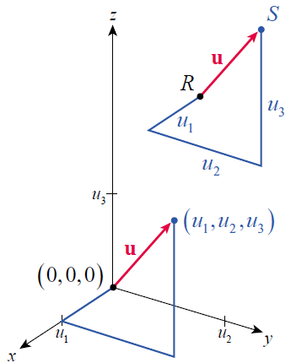
Vector Terminology and Notation (cont.)
Figure 4 shows two depictions of the vector one in standard position and the other with initial point R and terminal point S. But the length of u is unchanged, and the distance formula tells us that
Figure 4

Slide 14
Example 1: Finding the Component Form and Length of a Vector
Find a. the component form and b. the length of the vector u in ℝ³ with initial point (−1, 3, 2) and terminal point (0, 1, −5).
Solution
a. The first component of u is the difference between the x-coordinates of the initial and terminal points, or 0 − (−1) = 1; note that the order of subtraction matters, since we are looking for the signed distance we must travel in the x-direction to take us from the initial point to the terminal point.

Slide 15
Example 1: Finding the Component Form and Length of a Vector (cont.)
In similar fashion, the second component of u is the difference in the y-coordinates, 1 − 3 = −2, and the third component is the difference in the z-coordinates,
−5 −(−2) = −3. So

Slide 16
Example 1: Finding the Component Form and Length of a Vector (cont.)
b.

Slide 17
Vector Terminology and Notation (cont.)
We have previously solved many problems involving velocity, but to this point we have only been concerned with the velocity of an object moving forward and backward along a line. Even when considering a thrown object, we have sought merely to determine its vertical velocity, without regard to any horizontal motion it may or may not have. We are now in a position to consider the total velocity of an object.

Slide 18
Example 2: Using Vectors with Horizontal and Vertical Velocity
A ball is shot by a slingshot into the air with an initial velocity that has a vertical component of 64 ft/s and a horizontal component of 10 ft/s. Determine a. its velocity at time t, b. the magnitude of its velocity at the highest point of its arc, and c. the magnitude of its velocity just at the moment it hits the ground. (Ignore air resistance, and assume the initial height of the ball is 0.)

Slide 19
Example 2: Using Vectors with Horizontal and Vertical Velocity (cont.)
Solution
We can consider the context of this problem to be ℝ², with the positive y-axis pointing straight up and the positive x-axis pointing in the direction of the horizontal motion of the ball. So, if we denote the vertical and horizontal components of the velocity by and respectively, we seek the velocity vector

Slide 20
Example 2: Using Vectors with Horizontal and Vertical Velocity (cont.)
a. Recall that, in general, the vertical velocity at time t of an object with initial vertical velocity is where g is the acceleration due to gravity. The initial vertical velocity is given in terms of feet and seconds, so we use and
hence The ball has an initial horizontal velocity of and this remains constant during the flight of the ball, so (we ignore any slight decrease in velocity that air resistance might cause during the short flight). This gives us the total velocity vector.

Slide 21
Example 2: Using Vectors with Horizontal and Vertical Velocity (cont.)
b. We find the time when the ball reaches its highest point just as we have in the past: it is that time when namely t = 2. But the ball still has nonzero horizontal velocity at time t = 2, and the magnitude of the total velocity at that time is

Slide 22
Example 2: Using Vectors with Horizontal and Vertical Velocity (cont.)
c. We have solved enough problems involving objects moving under the influence of gravity alone to know that if it takes 2 seconds for the ball to reach its apex, it will take another 2 seconds for it to return to the ground (we are making the assumption that the ball’s initial height is 0). But we can confirm that fact and gain a useful expression for the ball’s position at time t by applying the knowledge that position is the antiderivative of velocity.

Slide 23
Example 2: Using Vectors with Horizontal and Vertical Velocity (cont.)
Taking the components one at a time, the ball’s horizontal position (relative to its initial position, which we can take to be the origin), is (note that our assumption about the ball’s initial position leads to a constant of integration of 0). Similarly, the ball’s vertical position is (again, the constant of integration is 0). And as we suspected, implies t = 0 and t = 4.

Slide 24
Example 2: Using Vectors with Horizontal and Vertical Velocity (cont.)
Finally, we compute the magnitude of the ball’s velocity just as it hits the ground, as follows.

Slide 25
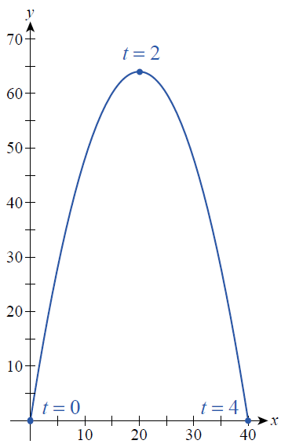
Example 2: Using Vectors with Horizontal and Vertical Velocity (cont.)
Making use of what we have discovered about the ball’s horizontal and vertical position at time t, the graph of the parametrically defined path x = 10t and over the interval appears in Figure 5.
Figure 5 Flight of the Ball

Slide 26
Vector Algebra
Consider a kayaker paddling in a straight line on a perfectly calm, still lake. In the absence of any other motion, we can describe her velocity as a vector v, where |v| is her still-water speed and the direction of v is her direction of travel. If she were to begin paddling faster and double her speed, her direction would be unchanged but her speed would be twice as much. We represent her new velocity vector as 2v, an example of scalar multiplication—the product of a scalar and a vector. Note that the magnitude of 2v is two times the magnitude of v; that is,

Slide 27
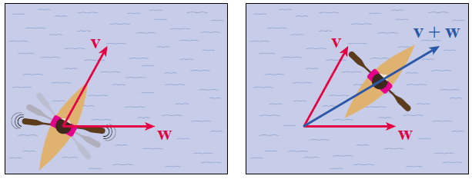
Vector Algebra (cont.)
Now imagine the same kayaker paddling on a river with her original velocity v. If the water in the river is flowing with velocity w, we represent her overall velocity with the vector sum v + w, a new vector whose magnitude and direction are a combination of the magnitudes and directions of the individual vectors (see Figure 6). This is an example of vector
addition.
Figure 6 Vector Addition

Slide 28
Vector Algebra (cont.)
As just one specific example, if she were to paddle upriver at a pace exactly matching the water’s flow rate, then v and w would cancel each other out and we would write v + w = 0, or v = −w. In this case, v is the additive inverse of the vector w, which is equivalent to the product of the scalar −1 and the vector w.

Slide 29
Vector Algebra (cont.)
Scalar multiplication and vector addition are the two basic components of vector algebra, the properties of which we will summarize in a later theorem. But before we list the algebraic properties, we introduce ways in which vector sums and scalar multiples of vectors can be represented graphically.

Slide 30
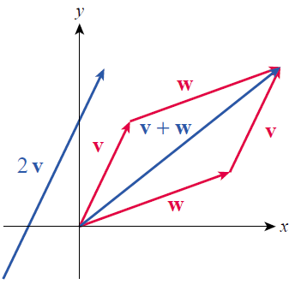
Vector Algebra (cont.)
Figure 7 depicts two vectors v and w in red and then illustrates two new vectors 2v and v + w, shown in blue. One typical way of graphically constructing a sum like v + w is to place v somewhere in space, draw w so that its initial point coincides with the terminal point of v, and then draw the resultant vector v + w from the initial point of v to the terminal point of w.
Figure 7 Vector Algebra

Slide 31
Vector Algebra (cont.)
Alternatively, w can be drawn first and v second—the fact that the resultant vector is the same is an illustration of the Parallelogram Law of vector addition, also known as the Commutative Property.

Slide 32
Vector Algebra (cont.)
In terms of vector components, multiplication by a scalar a corresponds to multiplying each component of a vector by a, and addition of two vectors corresponds to adding the respective components of the vectors. So, in ℝ³,
and

Slide 33
Theorem: Properties of Scalar Multiplication and Vector Addition
Assume u, v, and w represent vectors, while a and b represent scalars. Then the following properties hold.
Scalar Multiplication Properties | Vector Addition Properties
 | u + v = v + u
 | u + 0 = u
1 u = u, 0 u = 0, and a 0 = 0

Slide 34
Vector Algebra (cont.)
These properties are all readily verified using the component definitions of scalar multiplication and vector addition, and you will do so in Exercises 91 and 92.

Slide 35
Example 3: Performing Vector Algebra Using Vector Components
Let and Find the following.
a. 2u + v b. v − u c.
Solution
a.

Slide 36
Example 3: Performing Vector Algebra Using Vector Components (cont.)
b.
c.
(Note that this is indeed equal to

Slide 37
Example 4: Graphing Vector Sums and Scalar Multiples of Vectors
Given the two vectors and in ℝ², depict −2v and u − v graphically.
Solution
In terms of components,

Slide 38
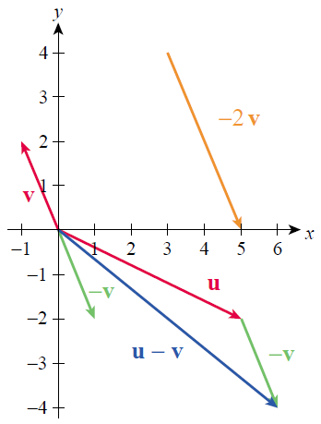
Example 4: Graphing Vector Sums and Scalar Multiples of Vectors (cont.)
Figure 8 is a depiction of u,
v, −v, −2 v, and u − v. Note that
Figure 8

Slide 39
Vector Algebra (cont.)
We can use vector operations to easily describe points that lie between two given points. For instance, given the two points (a₁, a₂ , a₃ ) and (b₁, b₂ , b₃ ) in ℝ³, the vector
is the directed line segment from (a₁, a₂ , a₃ ) to (b₁, b₂ , b₃). If we place the initial point of at its terminal point will lie halfway between (a₁, a₂ , a₃ ) and (b₁, b₂ , b₃ ).

Slide 40
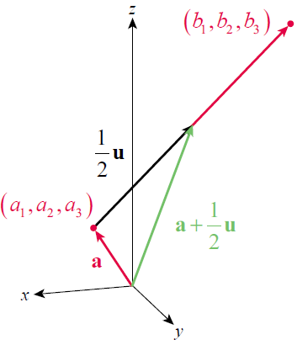
Vector Algebra (cont.)
If we draw the vector in standard position, the vector relationship shown in Figure 9 is the result. We can describe other points along the line segment in similar fashion,
as illustrated in Example 5.
Figure 9

Slide 41
Example 5: Using Vector Algebra to Find Coordinates of Points
Given and determine the coordinates of the point
a. halfway between P and Q.
b. one quarter of the way from P to Q.

Slide 42
Example 5: Using Vector Algebra to Find Coordinates of Points (cont.)
Solution
a. Using the reasoning illustrated in Figure 9, the point halfway between P and Q is the terminal point (in standard position) of the vector
that is, the point

Slide 43
Example 5: Using Vector Algebra to Find Coordinates of Points (cont.)
Note that if we define vectors and
then we have just calculated
or

Slide 44
Example 5: Using Vector Algebra to Find Coordinates of Points (cont.)
b. Similarly, the point one quarter of the way from P to Q corresponds to the terminal point of the vector
or The vector is
and the point is

Slide 45
Vector Algebra (cont.)
A vector of length 1 is called a unit vector. The two unit vectors and in ℝ², and the three unit vectors and in ℝ³ are useful in describing other vectors, and are called the standard basis vectors (see Figure 10). For instance, note that an arbitrary vector in ℝ³ can be written as a linear combination of the standard basis vectors.

Slide 46
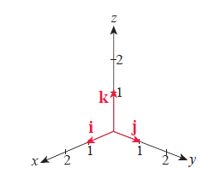
Vector Algebra (cont.)
Figure 10 Standard Basis Vectors
I,j and k in Standard Position

Slide 47
Vector Algebra (cont.)
In other applications, it is convenient to work with a unit vector that has the same direction as a given vector v, and the product of v with the reciprocal of its length (assuming its length is nonzero) gives us such a unit vector. The process of multiplying a nonzero vector by the reciprocal of its length is called normalization, and the result is referred to as a normalized vector.

Slide 48
Example 6: Using Standard Basis and Unit Vectors
Let
a. Express u as a linear combination of the standard basis vectors of ℝ³.
b. Express u as a product of its magnitude and a vector pointing in the same direction.
Solution
a. u = 3i − 2j + 4k
b.

Slide 49
Example 6: Using Standard Basis and Unit Vectors (cont.)
The vector is a unit vector pointing
in the same direction as u, and we can write

Slide 50
Vector Algebra (cont.)
In our next example, we make use of trigonometry to decompose vectors into appropriate components.

Slide 51
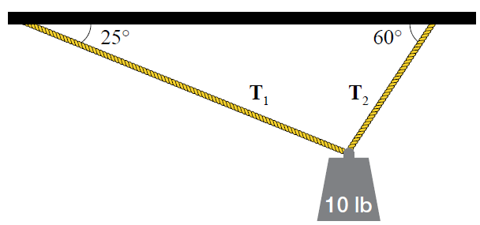
Example 7: Determining Tension Force Vectors Using Trigonometry
A ten‑pound weight (a force) is suspended from two ropes, as shown in Figure 11. The ropes are of different lengths, so the tensions (also forces) in the ropes are unequal. Given the measured angles shown in the figure, determine the tension vectors.
Figure 11 Suspended Weight

Slide 52
Example 7: Determining Tension Force Vectors Using Trigonometry (cont.)
Solution
First, an important note of caution. Diagrams like Figure 11 are often used to illustrate such problems, but the diagram can be very misleading if interpreted incorrectly. The magnitudes of the two tensions typically don’t correspond to the lengths of the ropes in the diagram. But we can still use the picture as the basis for what physicists and engineers call a force diagram, which will allow us to determine

Slide 53
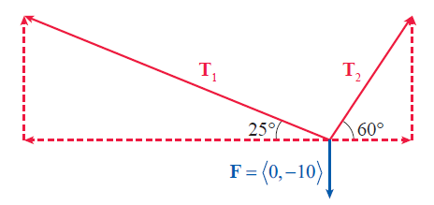
Example 7: Determining Tension Force Vectors Using Trigonometry (cont.)
In Figure 12, the ten-pound weight is shown as the vector and the components of the two tension vectors can be determined using trigonometry.
Figure 12 Force Diagram

Slide 54
Example 7: Determining Tension Force Vectors Using Trigonometry (cont.)
Because the weight is stationary in space, the three forces acting on it must have a vector sum of zero. That is, or

Slide 55
Example 7: Determining Tension Force Vectors Using Trigonometry (cont.)
Equating the components individually leads to the following system of equations.
In Exercise 83, you will solve this system for and and show that

Slide 56
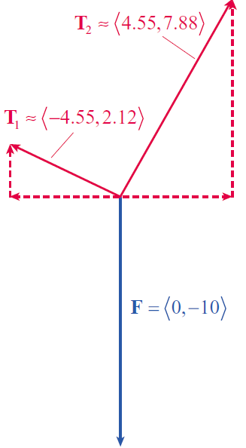
Example 7: Determining Tension Force Vectors Using Trigonometry (cont.)
Figure 13 contains an accurate depiction of the three forces in this problem, with the lengths of the vectors in the diagram corresponding to their relative magnitudes.
Figure 13 Accurate Vector Diagram

