Slide 1
Section 11.3
The Dot Product

Slide 2
The Dot Product and Its Properties
The dot product takes its name from the notation typically used for the operation, but it also goes by the names scalar product (because the result is a scalar) and inner product (in contrast to an operation called outer product seen in other areas of mathematics). We will be concerned with the dot product of pairs of vectors in ℝ² and ℝ³, but the definition below can
be extended to many other spaces.

Slide 3
Definition: Dot Product
Given two vectors the dot product u ⋅ v of the two vectors is the scalar defined by
A similar formula defines the dot product of two vectors in ℝ².

Slide 4
Example 1: Evaluating Dot Products
Evaluate each of the following dot products.
Solution

Slide 5
Example 1: Evaluating Dot Products (cont.)

Slide 6
Theorem: Properties of the Dot Product
Assume u, v, and w represent vectors and that a represents a scalar. Then the following properties hold.

Slide 7
The Dot Product and Its Properties (cont.)
Another property, however, is not so immediately clear. The following theorem shows how the dot product can be used to quickly determine the angle between any two vectors in ℝ² or ℝ³. Its proof makes use of the Law of Cosines and several of the properties above.

Slide 8
Theorem: Dot Product and the Angle between Two Vectors
If two nonzero vectors u and v are depicted so that their initial points coincide, and if θ represents the smaller of the two angles formed by u and v (so that 0 ≤ θ ≤ π ), then

Slide 9
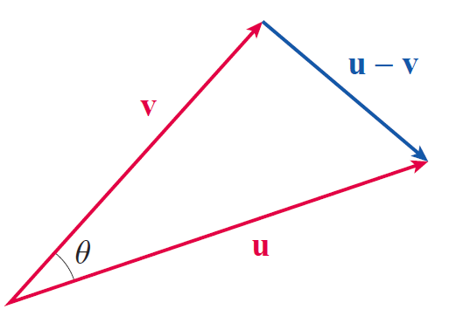
Proof
Given u and v placed so that their initial points coincide, construct u − v as shown in Figure 1. Then, by the Law of Cosines,
Figure 1

Slide 10
Proof (cont.)
The proof of the fact that this equation is true even in the two extreme cases θ = 0 and θ = π is left as Exercise 28.
Since the dot product of a vector with itself is the square of the norm of the vector, we can also write

Slide 11
Proof (cont.)
Equating these two different ways of expressing and canceling like terms, we obtain
which, once we divide both sides by −2, is the desired result.

Slide 12
Example 2: Finding the Angle between Two Vectors
Find the angle between the vectors and
Solution
We begin by determining that
and then
Therefore, or approximately 100.3°.

Slide 13
Applications of the Dot Product
By definition, the angle θ in the formula lies in the interval [0, π ]. Since for all nonzero vectors u and v, the sign of u ⋅ v will thus always be the same as the sign of cosθ. Specifically, we note the following.

Slide 14
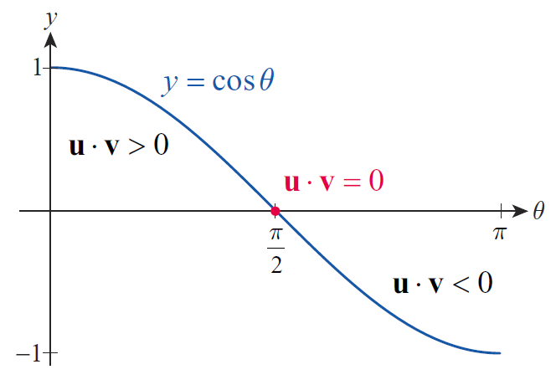
Applications of the Dot Product (cont.)
Vectors for which are called orthogonal or perpendicular, and the zero vector 0 is considered to be orthogonal to every vector.
Figure 2

Slide 15
Definition: Orthogonal Vectors
Two vectors u and v are orthogonal, or perpendicular, if u ⋅ v = 0.

Slide 16
Applications of the Dot Product (cont.)
Another synonym for orthogonal is normal, often used when discussing lines or planes. For example, a vector u is said to be normal to a given plane if u ⋅ v = 0 for every vector v in the plane. Note, however, that this usage of the word “normal” has nothing in common with the notions of normalization or normalized vector, which were defined in Section 11.2.

Slide 17
Example 3: Finding an Unknown Component of Orthogonal Vectors
Determine k so that the vectors and are orthogonal.
Solution
The two vectors are orthogonal if and only if 6 − 3k = 0, that is, when k = 2.

Slide 18
Example 4: Describing a Set of Orthogonal Vectors
Describe the set of all vectors orthogonal to j.
Solution
We seek all vectors such that in other words, the solution set of the equation Since this reduces to b = 0, all vectors of the form are orthogonal to j. When graphed in standard position, these are all the vectors that lie in the xz-plane.

Slide 19
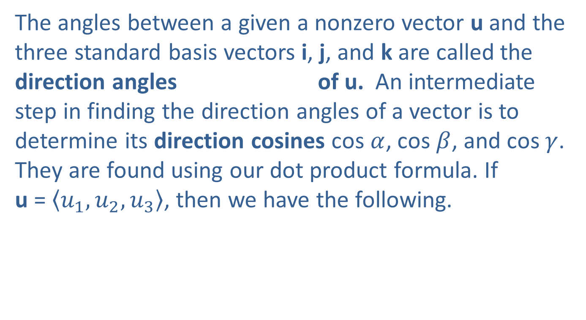
Applications of the Dot Product (cont.)
The angles between a given a nonzero vector u and the three standard basis vectors i, j, and k are called the direction angles of u. An intermediate step in finding the direction angles of a vector is to determine its direction cosines cos $α$, cos $β$, and cos $γ$. They are found using our dot product formula. If u = $\left\langle u_{1},u_{2},u_{3}\right\rangle$, then we have the following.

Slide 20
Example 5: Finding the Direction Angles of a Vector
Find the direction angles of the vector
Solution

Slide 21
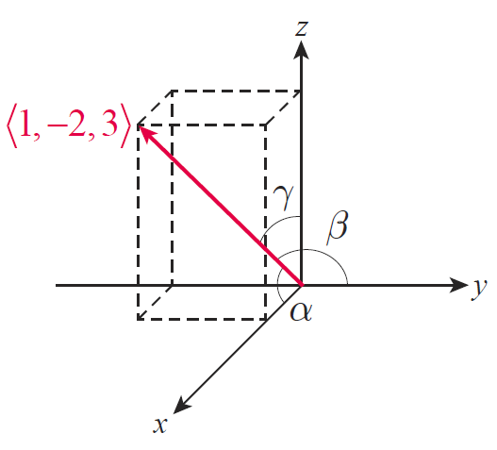
Example 5: Finding the Direction Angles of a Vector (cont.)
Hence, the direction angles are as follows.
These angles and the vector are shown in Figure 3.
Figure 3

Slide 22
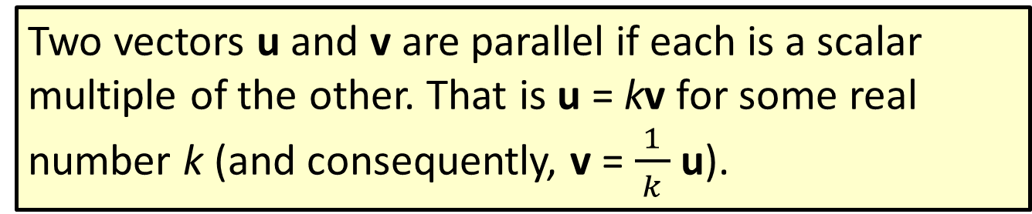
Definition: Parallel Vectors
Two vectors u and v are parallel if each is a scalar multiple of the other. That is u = kv for some real number k (and consequently, v = $\frac{1}{ k }$u).

Slide 23
Applications of the Dot Product (cont.)
Geometrically, two vectors are parallel if either they point in the same direction or exact opposite directions.
In many vector applications, a key step involves writing one vector u as a sum of two vectors, one of which is parallel to another vector v and the other of which is orthogonal to v. We call the first vector the projection of u onto v and give it the name proj_{v}u. Once we determine proj_{v}u, it is easy to determine the second (orthogonal) vector.

Slide 24
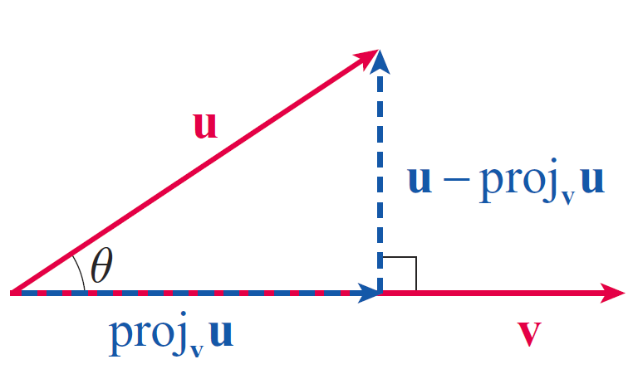
Applications of the Dot Product (cont.)
Figure 4 is an illustration of vectors u and v and the decomposition of u into such a sum in the case where From trigonometry, we know that and the dot product formula also tells us that
Figure 4
Projection of u onto v

Slide 25
Applications of the Dot Product (cont.)
so,
To construct the vector proj_{v}u, we multiply the magnitude |proj_{v}u| by a unit vector pointing in the same direction as v.

Slide 26
Applications of the Dot Product (cont.)
The same formula also applies if but in this case u ⋅ v is negative and hence proj_{v}u points in the opposite direction of v.
Notice that the derivation above makes no mention of the dimensionality of the space—it is valid in both ℝ² and ℝ³.

Slide 27
Example 6: Decomposing a Vector into a Sum of Orthogonal Vectors
Let Express u as a sum of two vectors, one parallel to v and one perpendicular to v (see Figure 5).
Solution
The projection of u onto v is the first vector we seek (the one parallel to v), and since and

Slide 28
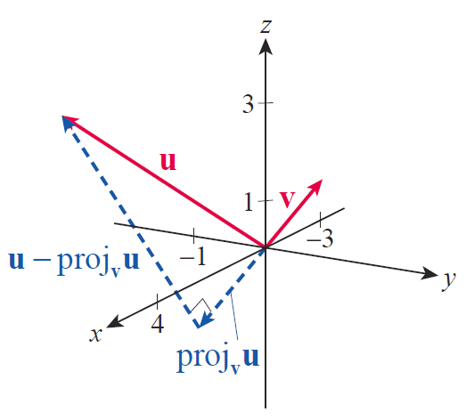
Example 6: Decomposing a Vector into a Sum of Orthogonal Vectors (cont.)
By the construction of proj_{v}u, u − proj_{v}u is guaranteed to be perpendicular to v.
As verification, note that
Figure 5

Slide 29
Applications of the Dot Product (cont.)
Physics and engineering problems often require finding the component of one vector that lies in the direction of another vector, especially in applications involving force and work. In Section 6.5, we learned that the work W performed in applying a force F over a distance d is given by W= Fd. But this equation assumes that F is applied in the direction of motion (along which d is measured). More generally, if the force applied is represented by the vector F and the direction of motion by the vector D, then the amount of work W done is equal to the portion of the force applied in the direction of D multiplied by the length of D: W =|proj_{D}F||D|. This leads to the following equation.

Slide 30
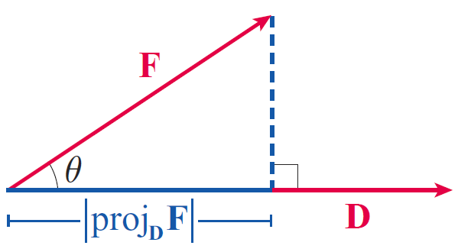
Applications of the Dot Product (cont.)
Figure 6 illustrates how work is related to a representative force vector and direction vector. Note that by our dot product formula,
a formula often seen in physics texts.
Figure 6
Projection of F onto D

Slide 31
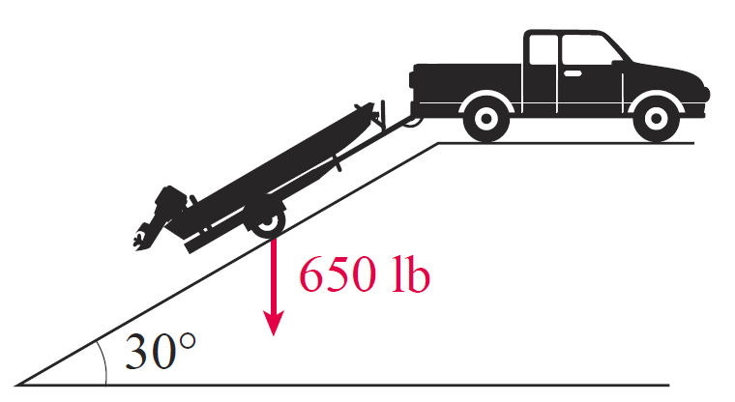
Example 7: Using a Projection of a Vector to Calculate Force
A boat and trailer, which together weigh 650 pounds, are to be pulled up a boat ramp that has an incline of 30°. What force is required to merely prevent the boat and trailer from rolling down the ramp?
Figure 7

Slide 32
Example 7: Using a Projection of a Vector to Calculate Force (cont.)
Solution
To gain some insight into this problem, note that the force that would be required to hold the boat and trailer up off the ground is 650 pounds. But the ramp supports a portion of the weight all by itself—we only need to supply the force needed to counteract the component of the weight that lies in the direction of the ramp.

Slide 33
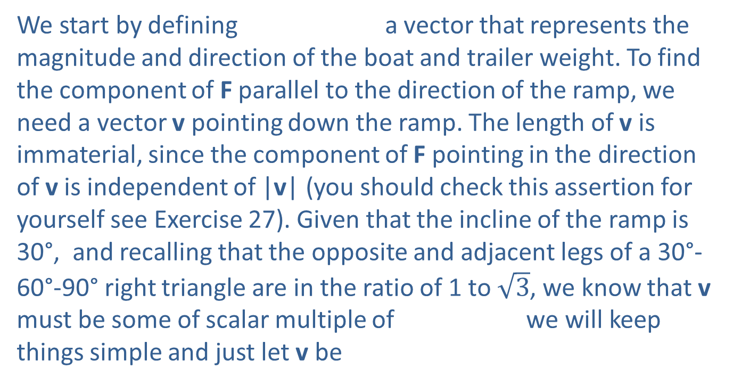
Example 7: Using a Projection of a Vector to Calculate Force (cont.)
We start by defining a vector that represents the magnitude and direction of the boat and trailer weight. To find the component of F parallel to the direction of the ramp, we need a vector v pointing down the ramp. The length of v is immaterial, since the component of F pointing in the direction of v is independent of |v| (you should check this assertion for yourself see Exercise 27). Given that the incline of the ramp is 30°, and recalling that the opposite and adjacent legs of a 30°-60°-90° right triangle are in the ratio of 1 to $\sqrt{3}$, we know that v must be some of scalar multiple of we will keep things simple and just let v be

Slide 34
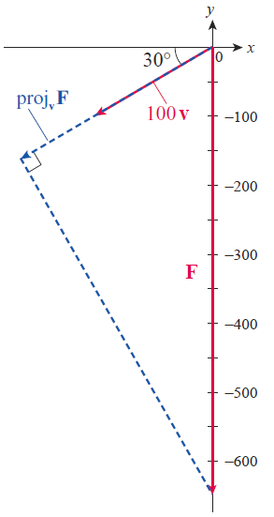
Example 7: Using a Projection of a Vector to Calculate Force (cont.)
Figure 8 is an illustration of F and a positive scalar multiple of v (the vector v as we have defined it is too short to show up in the diagram so we have graphed 100 v).
Figure 8
Projection of Weight onto the Ramp

Slide 35
Example 7: Using a Projection of a Vector to Calculate Force (cont.)
We now compute the magnitude of the projection of F in the direction of v.
This is the answer to our question: we must supply 325 pounds of force to keep the boat and trailer from rolling down the ramp—any force greater than 325 pounds will pull the boat and trailer up the ramp. Note that in this problem, we only care about |proj_{v}F|, the magnitude of the component of F in the direction of v, not the actual vector proj_{v}F.

Slide 36
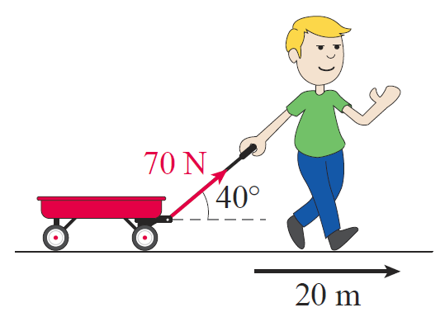
Example 8: Using Vectors to Find the Work Done in Pulling a Wagon
A child pulls a wagon along a sidewalk, exerting a force of 70 newtons on the handle of the wagon. The handle of the wagon is at an angle of 40° to the horizontal. If he pulls the wagon a distance of 20 meters, how much work has been done?
Figure 9

Slide 37
Example 8: Using Vectors to Find the Work Done in Pulling a Wagon (cont.)
Solution
We start by defining the force and distance vectors.
The calculation of the work done is now straightforward.

