Slide 1
Section 11.4
The Cross Product

Slide 2
The Cross Product and Its Properties
The cross product of two vectors u and v is written as notation which explains its common name. However, the cross product also goes by several other names including vector product, a name reflecting the fact that is a vector. This is in contrast to which is a scalar. The magnitude of on the other hand, has much in common with one of the properties of If, as in Section 11.3, we let θ denote the angle between u and v when the two vectors are depicted with the same initial point, then

Slide 3
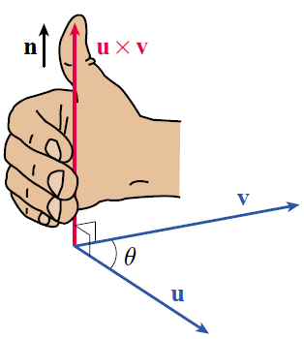
The Cross Product and Its Properties (cont.)
We construct the vector by multiplying its magnitude by a unit vector n that is perpendicular to both u and v, with n chosen so that if you curl the fingers of your right hand from the direction of u to the direction of v, n points in the direction of your thumb. That is, the three vectors u, v, and n (in that order) follow the right-hand rule.
Figure 1
Constructing u × v

Slide 4
Definition: Cross Product
Given two nonparallel and nonzero vectors u and v, the cross product of u and v is the vector
with n a unit vector chosen perpendicular to both u and v according to the right-hand rule. If u and v are parallel, or if either is the zero vector, then

Slide 5
The Cross Product and Its Properties (cont.)
This definition immediately points out one of the differences between the cross product and the dot product: by its nature, when the vector u × v cannot lie in the same plane as u and v and hence the cross product only makes sense in ℝ³. Specifically, it is a function that takes two vectors in ℝ³ and returns a third vector in ℝ³.

Slide 6
The Cross Product and Its Properties (cont.)
Another property follows quickly from the definition above. Two nonzero, nonparallel vectors u and v with the same initial point define a unique plane, and there are exactly two unit vectors perpendicular to that plane: the vector n as defined above, and the vector −n. Your thumb points in the direction of n if you curl your fingers from the direction of u to the direction of v, and points in the direction of −n if you curl your fingers from the direction of v to the direction of u. That is,

Slide 7
Example 1: Evaluating Cross Products
Simplify each of the following cross products.
a. b. c. d.
Solution
a. The vectors i and k are orthogonal, so sinθ = 1. They are also unit vectors, so All that remains is to visualize a right hand with fingers curling from i to k, and noting that the thumb points in the direction of −j. So

Slide 8
Example 1: Evaluating Cross Products (cont.)
b. The thumb of a right hand with fingers curling from i to −k points in the direction of j. Every other factor is 1, as in part a., so

Slide 9
Example 1: Evaluating Cross Products (cont.)
c. The two vectors i and are again orthogonal so sinθ = 1, but Determining n also requires a bit more effort than the first two problems. Since n must be orthogonal to i, it lies in the yz-plane. The vector j + k also lies in the yz-plane, so n must be a scalar multiple of

Slide 10
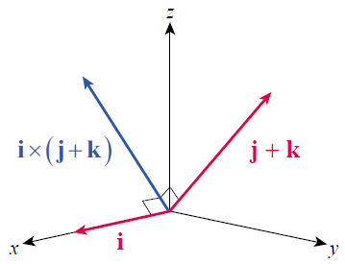
Example 1: Evaluating Cross Products (cont.)
(Note how the right‑hand rule
is satisfied by the vectors in
Figure 2.) For n to have
magnitude 1, we let
This gives us the following result.
Figure 2 i × (j + k)

Slide 11
Example 1: Evaluating Cross Products (cont.)

Slide 12
The Cross Product and Its Properties (cont.)
Note that i × j = k, so which combined with part c. of Example 1 indicates that i × (j + k) = (i × j)+ (i × k). A similar argument shows that
and
whenever u, v, and w are replaced with i, j, and k, in any order.

Slide 13
The Cross Product and Its Properties (cont.)
Also, by the reasoning of part d.,
for scalars a and b whenever u and v are each replaced by i, j, or k.
As Example 1 already shows, the formula can be tedious to apply in all but the simplest cases. Fortunately, we can use the distributive properties above and the facts that and restricting their use to i, j, and k, to establish a much more easily applied formula.

Slide 14
Theorem: The Cross Product Determinant Formula
Given and

Slide 15
Proof
Writing u = u₁ i + u₂ j + u₃ k and v = v₁ i + v₂ j + v₃ k, and making use of the properties we noted previously,

Slide 16
Proof (cont.)
The matrix determinant notation seen in the statement of this theorem is used merely as a convenient reminder of the formula.

Slide 17
Example 2: Using the Cross Product Determinant Formula

Slide 18
Theorem: Properties of the Cross Product
Assume u, v, and w represent vectors in ℝ³ and that a and b represent scalars. Then the following properties hold.

Slide 19
Applications of the Cross Product
We say that a vector or a line that is perpendicular to a given plane is normal to the plane, and we will see in the next section how normal vectors play a role in characterizing planes. The cross product, by its nature, allows us to quickly construct normal vectors.

Slide 20
Example 3: Constructing a Vector Normal to a Plane Defined by Three Points
Construct a vector normal to the plane containing the three points and
Solution
If we define and then u and v have the same initial point and lie in the plane containing P, Q, and R.

Slide 21
Example 3: Constructing a Vector Normal to a Plane Defined by Three Points (cont.)
Further, we now know that these three points determine a unique plane, because u and v are not parallel (neither is a scalar multiple of the other)—if the two vectors were parallel, the three points P, Q, and R would be collinear and there would be an infinite number of planes containing them.

Slide 22
Example 3: Constructing a Vector Normal to a Plane Defined by Three Points (cont.)
The vector is perpendicular to both u and v, so it is also normal to the plane containing u and v. We now apply the cross product determinant formula, as follows.

Slide 23
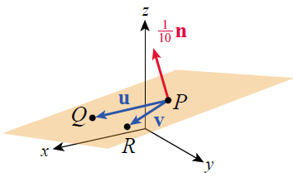
Example 3: Constructing a Vector Normal to a Plane Defined by Three Points (cont.)
Any nonzero multiple of n will also be normal to the plane, and Figure 3 is an illustration of the three points P, Q, and R, the two vectors u and v drawn with initial point P, and one-tenth of the vector n also drawn with initial point P. Incidentally, the fact that serves as an alternative proof that u and v are not parallel.
Figure 3

Slide 24
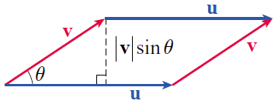
Applications of the Cross Product (cont.)
Two nonzero, nonparallel vectors u and v in ℝ³ can also be used to define a parallelogram, if the vectors are arranged as shown in Figure 4. Since the area of such a parallelogram is the magnitude of u × v provides a convenient way to calculate the area.
Figure 4 Area of a Parallelogram

Slide 25
Theorem: Cross Product Formula for Area of a Parallelogram
Given two nonzero, nonparallel vectors u and v in ℝ³, positioned to form a parallelogram as in Figure 4, the area A of the parallelogram can be calculated as follows.

Slide 26
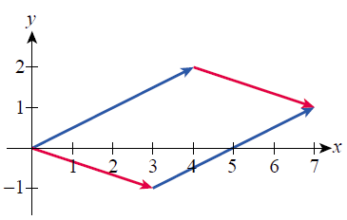
Example 4: Using the Cross Product Formula for Area of a Parallelogram
The two vectors are used to construct the parallelogram shown in Figure 5. Find its area.
Solution
Although the parallelogram is constructed of vectors from ℝ², we can also define the parallelogram with the three-dimensional vectors and
Figure 5

Slide 27
Example 4: Using the Cross Product Formula for Area of a Parallelogram (cont.)
In fact, we must do so if we want to use the cross product formula to find the parallelogram’s area.
The area of the parallelogram equals or 10 square units.

Slide 28
Example 5: Using a Cross Product to Find the Area of a Triangle
Find the area of the triangle whose vertices are the origin and the points and
Solution
The area of the triangle OAB, illustrated in Figure 6, is half of the area of the parallelogram formed by the vectors and

Slide 29
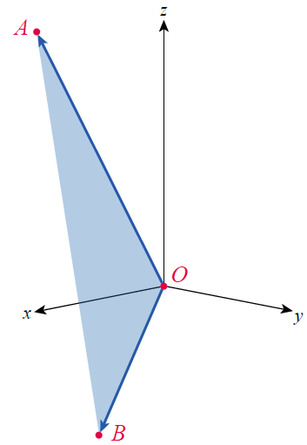
Example 5: Using a Cross Product to Find the Area of a Triangle (cont.)
The area of the triangle is
square units.
Figure 6

Slide 30
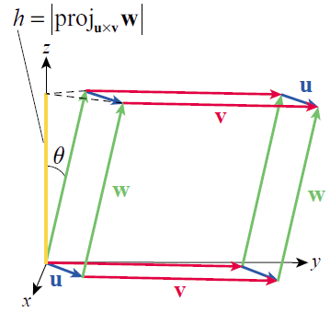
Applications of the Cross Product (cont.)
Just as two vectors can be used to define a parallelogram, three vectors in space can be used to define a parallelepiped. Figure 7 illustrates how four copies each of three vectors u, v, and w define its edges. Once constructed, the cross product and dot product together provide an elegant way to calculate the volume of such a parallelepiped.
Figure 7 Volume of a Parallelepiped

Slide 31
Applications of the Cross Product (cont.)
We already know that the area of the parallelogram defined by u and v is and we also know that in general the volume of an object with fixed cross-sectional area A and height h is Ah (for review, see Section 6.1). Referring to Figure 7, we see that h is equal to the absolute value of the component of w in the direction of u × v.

Slide 32
Applications of the Cross Product (cont.)
Note that we use instead of cosθ in case This gives us the following formula for the volume V of the parallelepiped.
The expression is called the triple scalar product of u, v, and w. Since the cross product is not commutative (that is, the order of the vectors is critical.

Slide 33
Applications of the Cross Product (cont.)
However, one of the properties proved in the exercises shows that the cross and dot product can be interchanged, since Further,
the following determinant formula makes it relatively easy to compute

Slide 34
Theorem: Triple Scalar Product Formula for Volume of a Parallelepiped
Given three nonzero, nonparallel vectors u, v, and w in ℝ³, positioned to form a parallelepiped as in Figure 7, the volume V of the parallelepiped can be calculated
as follows.
Note that the last expression in the above formula denotes the absolute value of a determinant.

Slide 35
Example 6: Using the Triple Scalar Product Formula for Volume of a Parallelepiped
Find the volume of the parallelepiped defined by the vectors and
Solution
The volume of the parallelepiped follows from the fact that
and hence cubic units.

Slide 36
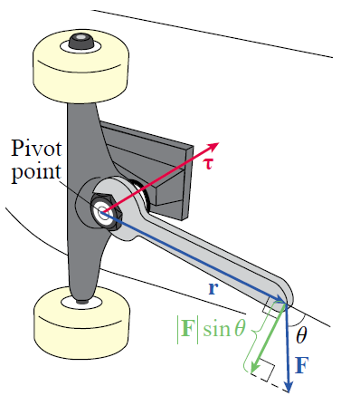
Applications of the Cross Product (cont.)
We will conclude this section with one more use of the cross product frequently seen in physics and engineering applications. The magnitude of the torque (tau), relative to the pivot point, produced by a force F applied to the end of a lever arm r is equal to the product of the length of r and the component of F perpendicular to r. That is, referring to Figure 8,
Figure 8

Slide 37
Applications of the Cross Product (cont.)
This reflects the fact that the magnitude of the torque depends on both the length of the lever and how much of the force is applied in a useful direction—in the extreme cases of and no torque is generated by the force F, no matter how great its magnitude.

Slide 38
Applications of the Cross Product (cont.)
In the context of screws and bolts, a force F applied with generates a torque “into” the page. That is, tightening a bolt (turning a wrench clockwise) creates a torque vector τ that drives the bolt into an object. Loosening, or turning the wrench counterclockwise, corresponds to applying a force with and backs the bolt out of the object.

Slide 39
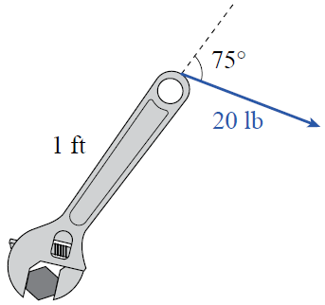
Example 7: Using a Cross Product to Find the Torque Generated by a Wrench
A bolt is tightened by a wrench supplying 20 pounds of force at an angle of (see Figure 9). The length of the wrench is 1 foot. How much torque is applied to the bolt at the pivot point?
Solution
Note that the direction of the torque vector is into the page.
Figure 9

