Slide 1
Section 11.5
Describing Lines and Planes

Slide 2
Lines in Space
The position vector of a point P is a vector in standard position having P as its terminal point—we use position vectors to describe a point’s location. In both ℝ² and ℝ³, we can construct position vectors describing all the points of a line, given some basic information about that line as in the example below.

Slide 3
Example 1: Constructing Position Vectors to Describe a Line
Construct position vectors describing the points making up the line L passing through A(4, 2, −1) and B(1, 2, 3).
Solution
The position vector describes one point of L, namely the point A. As in Example 5 of Section 11.2,

Slide 4
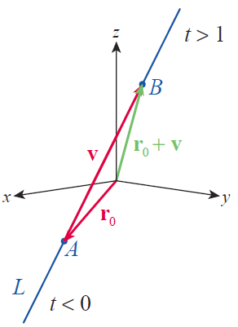
Example 1: Constructing Position Vectors to Describe a Line (cont.)
we can add the vector to r₀ to construct a position vector whose terminal point is B; Figure 1 illustrates the fact that
Figure 1
Vector Description of a Line

Slide 5
Example 1: Constructing Position Vectors to Describe a Line (cont.)
And as in that previous example, we can describe any other point between A and B with a position vector of the form r₀ + tv, for some 0 ≤ t ≤ 1. But by merely allowing t to take on all possible real values, we describe all the points that can be reached by starting at A and traveling in the direction of v by some scalar multiple (including negative scalar multiples). So the position vector
is a function of t that describes all the points of the line L as t takes on all real values.

Slide 6
Definition: Vector Form and Parametric Form of a Line
The vector form for the line L containing the point and parallel to the direction vector
is
Note that if we let denote the components of r(t), then the equations
x = x₀ + at, y = y₀ + bt, and z = z₀ + ct
are parametric equations (in the parameter t) describing the line L.

Slide 7
Example 2: Finding the Vector Form and Parametric Equations of a Line
Find both the vector form and the parametric equations of the line parallel to the direction vector 3i − j + 2k and passing through the point (−7, 2, 5).
Solution
The line passing through the given point and parallel to 3i − j + 2k can be described in vector form as follows.
The parametric equations are
x = −7 + 3t, y = 2 − t, and z = 5 + 2t.

Slide 8
Lines in Space (cont.)
As we saw in Chapter 9, Parametrizations are not unique. For instance, the parametrizations
x = −1 + 3t, y = −t, and z = 9 + 2t (different initial point)
and
x = −7 + 3t³, y = 2 − t³, and z = 5 + 2t³ (different tracing rate)
both describe the same line as the parametrization in Example 2.

Slide 9
Example 3: Finding the Points of Intersection of a Line with the Coordinate Planes
Determine the points of intersection of the line with the three coordinate planes.
Solution
This is the line from Example 1—you may want to refer to Figure 1 as we work through this problem.

Slide 10
Example 3: Finding the Points of Intersection of a Line with the Coordinate Planes (cont.)
The yz-plane corresponds to the equation x = 0, and we find the point of intersection of the line with the plane x = 0 by determining the value of the parameter for which the x‑component of r(t) is 0.
For this value of t, y = 2 and Note that y = 2 for any value of t. So the point of intersection between the line and the yz‑plane is the point

Slide 11
Example 3: Finding the Points of Intersection of a Line with the Coordinate Planes (cont.)
The line intersects the xy-plane when z = 0, and the z‑component of r(t) is 0 when For this value of t, and y = 2, so the point of intersection between the line and the xy‑plane is the point
Since y = 2 always, the line never intersects the xz­-plane.

Slide 12
Example 4: Finding the Point of Intersection of Two Lines
Determine the point of intersection of each of the following pairs of lines, if possible.

Slide 13
Example 4: Finding the Point of Intersection of Two Lines (cont.)
Solution
If the two lines r(u) and s(v) intersect, there must be values of u and v for which r(u) = s(v). In other words, for those values of u and v, it must be the case that
Solving the first two (by elimination, substitution,
or a matrix method) yields u = 1 and v = −1,

Slide 14
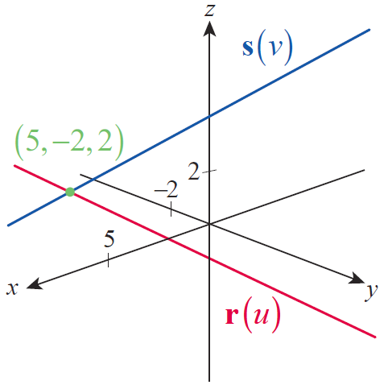
Example 4: Finding the Point of Intersection of Two Lines (cont.)
and these values also satisfy the third equation.
So the two lines intersect at the point (5, −2, 2) shown in Figure 2.
Figure 2
Intersecting Lines

Slide 15
Example 4: Finding the Point of Intersection of Two Lines (cont.)
b. Proceeding in the same manner, the solution of the first two of the three equations
is u = 0 and v = 1. But these values don’t satisfy the third equation, so it is impossible to find a point of intersection of these two lines. Moreover, the lines are not parallel since their direction vectors are not scalar multiples of one another.

Slide 16
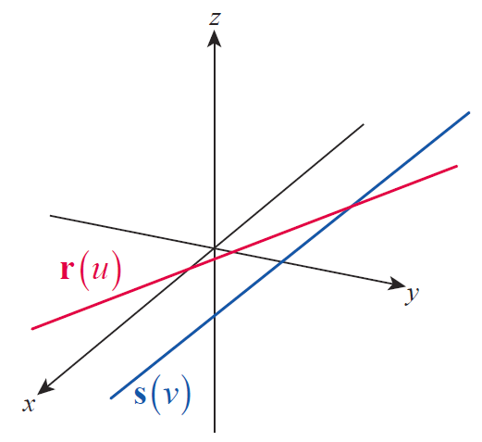
Example 4: Finding the Point of Intersection of Two Lines (cont.)
Nonparallel lines with no point of intersection are called skew lines. Skew lines, while not parallel to each other, do have the property that they lie in two planes that are parallel to each other.
Figure 3 Skew Lines

Slide 17
Definition: Equation for a Plane with a Known Normal Vector
If the vector is normal to a given plane, and if the point lies in the plane, then any point (x, y, z) in the plane must satisfy the vector equation
In scalar form, this becomes the linear equation

Slide 18
Example 5: Finding Equations for a Plane Given a Point and a Normal Vector
Find a vector equation and a scalar equation for the plane containing the point (−3, 1, 5) and having as a normal vector.
Solution
The vector equation for the plane is
After carrying out the scalar product operation and simplifying, we have the scalar equation

Slide 19
Example 6: Describing a Plane as a Two-Parameter Set of Points
Describe the plane 2x − 4y + z = −5 as a two-parameter set of points in ℝ³.
Solution
By solving the equation 2x − 4y + z = −5 for any one of the three variables, we can describe the plane as a set of points in terms of the other two variables. For instance,
is one description of all the ordered triples making up the plane.
ℝ
ℝ

Slide 20
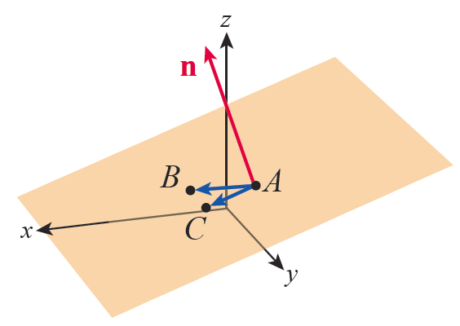
Example 7: Finding an Equation for a Plane Given Three Points
Find an equation for the plane containing the three points A(−1, 2, 2), B(2, −1, 1), and C(2, 2, 1).
Solution
To use the formulation above, we need a vector n normal to the plane; we can construct such a vector by taking the cross product of two vectors u and v in the plane.
Figure 4 Plane Containing A, B, C

Slide 21
Example 7: Finding an Equation for a Plane Given Three Points (cont.)
To that end, let
Then,
and, using the fact that A is a point in the plane, a vector equation for the plane is

Slide 22
Example 7: Finding an Equation for a Plane Given Three Points (cont.)
or, as linear equation, 3x + 9z = 15. Using either of the other two points B and C would have resulted in an equivalent answer.

Slide 23
Planes
If a line is not parallel to a plane, it must intersect it at some point. The next example illustrates how that point can be determined.

Slide 24
Example 8: Finding the Point of Intersection of a Line and a Plane
Find the point of intersection between the line
and the plane 4x − y + 2z = 5.
Solution
Each point on the line has the form (2 − 3t, 1 + 4t, −3 − t) for some t ∈ ℝ, and we seek the value of t for which such a point also satisfies 4x − y + 2z = 5. So, we solve the following equation for t.

Slide 25
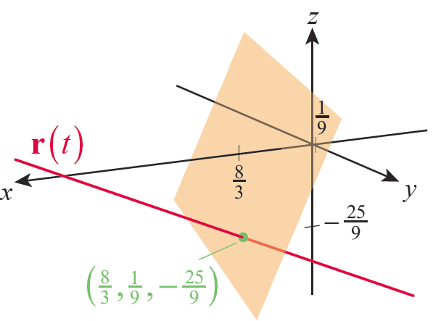
Example 8: Finding the Point of Intersection of a Line and a Plane (cont.)
The point of intersection occurs when and
Therefore is the point of intersection and it is shown in Figure 5.
Figure 5

Slide 26
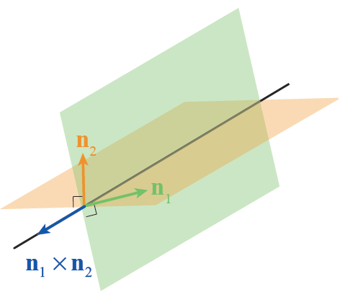
Example 9: Finding Parametric Equations for a Line of Intersection of Two Planes
Find parametric equations for the line formed by the intersection of the two planes x − 2y + 4z = 7 and 2x − y + 3z = 0.
Solution
The line of intersection of two planes lies in each plane, so it is orthogonal to a vector that is orthogonal to either plane (see Figure 6).
Figure 6
Line of Intersection of Two Planes

Slide 27
Example 9: Finding Parametric Equations for a Line of Intersection of Two Planes (cont.)
We can use this fact to quickly find a direction vector for the line we seek. From the given equations for the planes, we know that is normal to the first plane and is normal to the second plane. So, the vector
will serve as a direction vector for the line.

Slide 28
Example 9: Finding Parametric Equations for a Line of Intersection of Two Planes (cont.)
To complete the characterization of the line of intersection, we need a point on the line. Any such point will suffice, so we can choose to use the point where it intersects the xy-plane—that is, where z = 0 (if the line doesn’t intersect the xy-plane, that will become apparent in the next step). Setting z = 0 in the two plane equations and solving for x and y yields the point

Slide 29
Example 9: Finding Parametric Equations for a Line of Intersection of Two Planes (cont.)
So the vector form of the line of intersection is
and the parametric equations describing this line are

Slide 30
Example 10: Finding the Shortest Distance between a Point and a Plane
Find the shortest distance between the point A(3, 1, −2) and the plane 2x − 3y + 6z = 2.
Solution
We are looking for the distance d between A and the point on the plane closest to A. If B is any point on the plane, then d is equal to the length of the projection of onto a vector orthogonal to the plane.

Slide 31
Example 10: Finding the Shortest Distance between a Point and a Plane (cont.)
From the equation 2x − 3y + 6z = 2, we know that the vector is normal to the plane and we can say that
All that remains is to find a convenient point B and carry out the computation. By inspection, the point (1, 0, 0) is an easily found point on 2x − 3y + 6z = 2, and this gives us

Slide 32
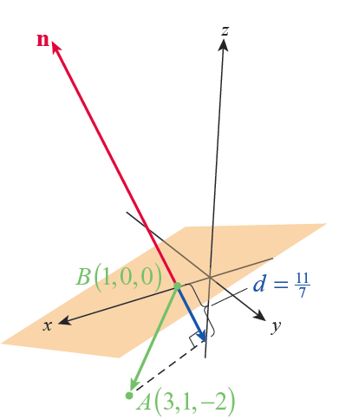
Example 10: Finding the Shortest Distance between a Point and a Plane (cont.)
Figure 7

Slide 33
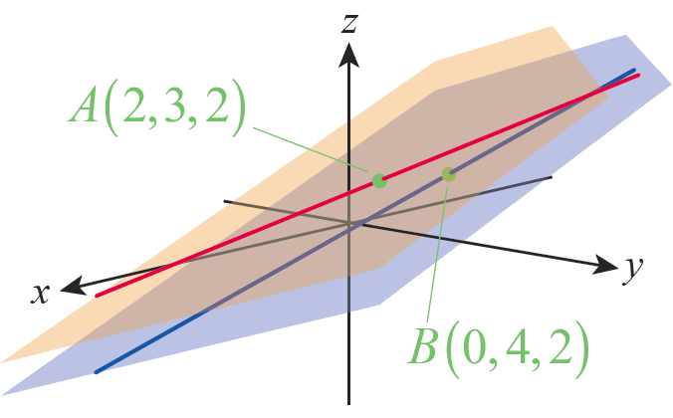
Example 11: Finding the Shortest Distance between Two Skew Lines
Find the shortest distance d between the skew lines
Solution
We determined in Example 4b that the lines are skew, so we know that they lie in two parallel planes.
Figure 8

Slide 34
Example 11: Finding the Shortest Distance between Two Skew Lines (cont.)
If we can determine those planes, the shortest distance between the lines will be the same as the distance between the planes. A variation of our work in Example 10 will let us find that distance.

Slide 35
Example 11: Finding the Shortest Distance between Two Skew Lines (cont.)
Since and the direction vector for the line r(u) is and the direction vector for the line s(v) is Any vector n normal to the two parallel planes must be orthogonal to both p and q, so we can define

Slide 36
Example 11: Finding the Shortest Distance between Two Skew Lines (cont.)
The point A(2, 3, 2) lies in the plane containing the line r(u) and the point B(0, 4, 2) lies in the plane containing the line s(v). So, the length of the projection of the vector onto n is the distance d between the two planes.

