Slide 1
Section 12.1
Vector-Valued Functions

Slide 2
Vector Functions and Space Curves
The parametric equations introduced in Chapter 9 expanded the notion of curves in the plane, and the vector and parametric forms of lines in Section 11.5 began to illustrate the connection between parametric equations and vectors. Generalizing these ideas, we say that a vector-valued (or simply vector) function on a domain D is a function that assigns a vector to each element of D. For our current purposes, the domain D can be taken to be an interval I of real numbers, and the vectors assigned to each t ∈ I are position vectors in ℝ³ (recall that a position vector is one whose initial point is the origin).

Slide 3
Vector Functions and Space Curves (cont.)
If f, g, and h are all real-valued (or scalar) functions defined on I, then
is such a vector-valued function, and f, g, and h, are its component functions. The equations
are parametric equations describing the same points in space as the vector function r(t).

Slide 4
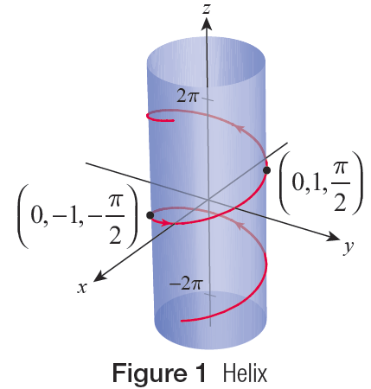
Example 1: Understanding the Parameters of a Vector Function
The vector function
describes the helix shown in red in
Figure 1. Note that x² + y² = 1, where x = cos t and y = sin t, so the points of the helix all reside on the cylinder of radius 1 shown in blue.
Figure 1 Helix

Slide 5
Example 1: Understanding the Parameters of a Vector Function (cont.)
The third parametric equation, z = t, tells us that the position vector r(t) travels “up” the helix (in the direction of the positive z‑axis) as t increases. We often indicate the direction of increasing values of the parameter with arrows, as shown. If the third component of r(t) were instead −t, the orientation of the helix would be downward and the arrows on the helix would be reversed.

Slide 6
Definition: Limits of Vector Functions
Let be a vector function and L a fixed vector. We say that r has limit L as t approaches a, and write if for every number ε > 0 there is
a number δ > 0 such that

Slide 7
Vector Functions and Space Curves (cont.)
As with scalar functions, this definition means that the vector r(t) approaches the fixed vector L as t gets closer to the fixed number a. If then
and this, in turn, is equivalent to each of the three summands under the radical approaching 0 as t → a.

Slide 8
Vector Functions and Space Curves (cont.)
That is,
and hence
This fact allows us to use all the familiar tools of calculus to determine limits of vector functions component by component.

Slide 9
Example 2: Finding the Limit of a Vector Function
Given find
Solution

Slide 10
Definition: Continuity of Vector Functions
A vector-valued function r(t) is continuous at t = a if
The function is said to be continuous on
the interval I if it is continuous at each point of I.

Slide 11
Vector Functions and Space Curves (cont.)
In parallel with the definition of limit, a vector function is continuous at a given point a if and only if each of its component functions is continuous at a. We use this fact as the motivation for the following definition, given our intuitive sense that a curve represents a continuous collection of points.

Slide 12
Definition: Space Curves
Given functions f, g, and h, each continuous on an interval I, the set C of points traced out by the vector function is said to be a space curve (or simply a curve) in ℝ³. The curve C is also defined by the parametric equations
x = f (t), y = g(t), and z = h(t) for t ∈ I.

Slide 13
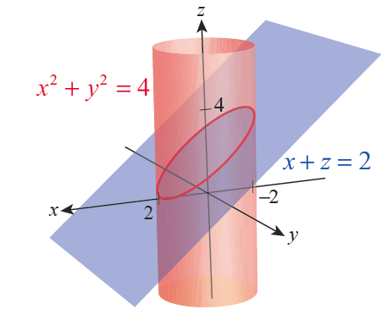
Example 3: Describing a Space Curve in
Terms of a Vector Function
The intersection of the cylinder x² + y² = 4 and the plane x + z = 2 is shown in Figure 2. Describe this curve in terms of a vector function r(t).
Solution
In order to introduce a
parameter t, we can use the
fact that the circle x² + y² = 4
in the xy-plane corresponds
to the parametric equations
x = 2 cos t and y = 2 sin t,
0 ≤ t ≤ 2π.
Figure 2

Slide 14
Example 3: Describing a Space Curve in
Terms of a Vector Function (cont.)
These equations also describe the cylinder x² + y² = 4 in ℝ³, since there is no restriction on z. Now, we can make the substitution z = 2 − x = 2 − 2 cos t to describe the values of z on the plane x + z = 2 restricted to points also on the cylinder. Thus, the function
describes the space curve defined by the intersection of the two surfaces.

Slide 15
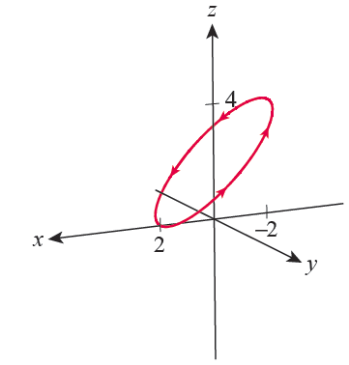
Example 3: Describing a Space Curve in
Terms of a Vector Function (cont.)
The curve is traced out in the direction indicated in Figure 3.
Figure 3

Slide 16
Differentiation and Integration of Space Curves
Our definition of the derivative of a vector function
is the same as the derivative of a scalar function.

Slide 17
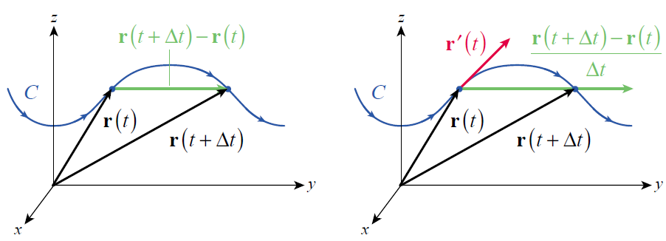
Differentiation and Integration of Space Curves (cont.)
The geometric meaning of this limit is also familiar. Figure 4 depicts a curve C defined by r and two vectors, r(t) and r(t + Δt), for a fixed t and one particular value of Δt.
Figure 4

Slide 18
Differentiation and Integration of Space Curves (cont.)
The numerator of the difference quotient,
r (t + Δt) − r (t), is referred to as a secant vector, and dividing r (t + Δt) − r (t) by Δt produces either a vector pointing either in the same direction as r (t + Δt) − r (t) if Δt is positive or in the opposite direction if Δt is negative. In either case, if Δt is small enough, the result is a vector approximately parallel to the line tangent to the curve C, provided the tangent line exists.

Slide 19
Differentiation and Integration of Space Curves (cont.)
Further, the difference quotient vector has the same orientation as C, in the sense that it points in the direction of increasing t. The approximation becomes exact as Δt → 0, assuming r′(t) ≠ 0, so we call r′(t) the tangent vector to C in this case.

Slide 20
Differentiation and Integration of Space Curves (cont.)
As with limits, differentiation of
can be determined component by component.

Slide 21
Differentiation and Integration of Space Curves (cont.)
This follows from the fact that

Slide 22
Example 4: Finding the Derivative of a Vector Function
Given find
Solution
We have over the same interval 1 ≤ t ≤ 3.

Slide 23
Definition: Differentiability and Smoothness of Space Curves
A vector function is differentiable at t₀ if f, g, and h are each differentiable at t₀. The curve C defined by r is smooth at t₀ if r′ is a continuous function at t₀ and This is equivalent to f ′, g ′, and h ′ all being continuous at t₀ and not simultaneously 0 at t₀.

Slide 24
Example 5: Finding the Vector Form of an
Equation for a Tangent Line
Find the vector form of an equation for the line tangent to the helix traced out by at the
point
Solution
Since the z‑component of r is simply t, the given point on the helix corresponds to the parameter value
(and, as a check, we note that

Slide 25
Example 5: Finding the Vector Form of an
Equation for a Tangent Line (cont.)
The direction vector for the tangent line at this point is
so the tangent line in vector form (as defined in Section 11.5) is
where t is an element of ℝ.

Slide 26
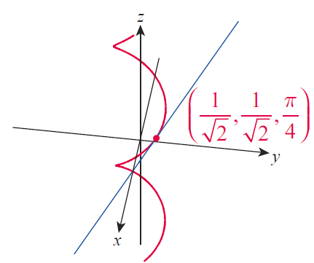

Example 5: Finding the Vector Form of an
Equation for a Tangent Line (cont.)
Figure 5 is an illustration of the helix and, in blue, the tangent line we just found.

Slide 27
Theorem: Differentiation Rules for Vector Functions
Assume that u and v are differentiable vector functions, C is a constant vector, f is a differentiable scalar function, and c is a scalar. Then the following rules apply.
Constant Vector Rule
Scalar Multiple Rules

Slide 28
Theorem: Differentiation Rules for Vector Functions (cont.)
Sum/Difference Rules
Dot Product Rule
Cross Product Rule
Chain Rule

Slide 29
Proof
We will prove the Cross Product Rule and leave the remaining proofs as exercises (Exercises 60–64).
The proof is very similar to the proof of the Product Rule for scalar functions in Section 3.2, with the key step being the addition and subtraction of a term (shown in red below). Along the way, we will also need two facts about limits and vectors which you will prove in Exercises 41 and 42.

Slide 30
Proof (cont.)
Exercise 41
Exercise 42

Slide 31
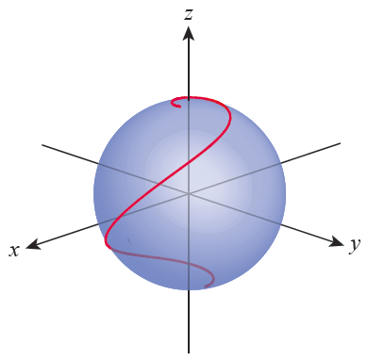
Example 6: Proving a Constant-Magnitude Vector
Function and Its Tangent Are Orthogonal
Assume r(t) is a differentiable vector function of constant magnitude—geometrically, a vector function that traces out a curve on a sphere centered at the origin, as shown in Figure 6.
Show that for all t.
In words, this means r(t) and its
tangent vector r′(t) are always
orthogonal if is constant.
Figure 6
Vector Function of Constant Magnitude

Slide 32
Example 6: Proving a Constant-Magnitude Vector
Function and Its Tangent Are Orthogonal (cont.)
Solution
Recall that so the fact that is constant means
On the other hand, the Dot Product Rule tells us that
and therefore

Slide 33
Definition: Indefinite and Definite Integrals of Vector Functions
Given a vector function the indefinite integral of r with respect to t is the family of all vector functions whose derivative is r, denoted
If R is a particular antiderivative of r, then
where C represents an arbitrary constant vector.

Slide 34
Definition: Indefinite and Definite Integrals of Vector Functions (cont.)
If f, g, and h are all integrable functions over an interval [a, b], then the definite integral of r from a to b
is denoted , and

Slide 35
Definition: Indefinite and Definite Integrals of Vector Functions (cont.)
Using alternate notation,
we have
If R is again a particular antiderivative of r, then

Slide 36
Example 7: Using Integration to Find Velocity and Position Vector Functions
A ball is shot by a slingshot into the air with an initial velocity vector measured in ft/s. Determine its velocity v and its position r as functions of time t. Find the position of the ball at 2 seconds and 4 seconds.
Solution
We begin with the fact that the acceleration of the ball is given by the vector reflecting the fact that the Earth’s gravity is pulling it (and every other object) in the negative z‑direction at a rate of

Slide 37
Example 7: Using Integration to Find Velocity and Position Vector Functions (cont.)
So the ball’s velocity vector is the indefinite integral of a.
Since we are given its velocity at time t = 0,
so

Slide 38
Example 7: Using Integration to Find Velocity and Position Vector Functions (cont.)
If we let r denote the ball’s position vector, then
We can locate the origin of the coordinate system wherever convenient, so we may as well specify that the ball’s position at time t = 0 is the origin, meaning
We previously determined that the ball reaches its maximum height when t = 2 and lands on the ground when t = 4, and its position at these times is given by the following definite integrals of its velocity.

Slide 39
Example 7: Using Integration to Find Velocity and Position Vector Functions (cont.)
In words, the ball has traveled 20 feet horizontally when it reaches its maximum height of 64 feet, and has traveled 40 feet horizontally when it lands.

