Slide 1
Section 12.2
Arc Length and the Unit Tangent Vector

Slide 2
Definition: Arc Length of Space Curves
Suppose a curve C is defined over the interval a ≤ t ≤ b by the position vector or, equivalently, by the parametric equations x = f(t), y = g(t), and z = h(t). Suppose further that f ′, g′, and h′ are all continuous on [a, b], and that C is traced out just once over the interval, except possibly for a finite number of self-intersections.

Slide 3
Definition: Arc Length of Space Curves (cont.)
Then the arc length L of C is given by
Since the above is equivalent
to

Slide 4
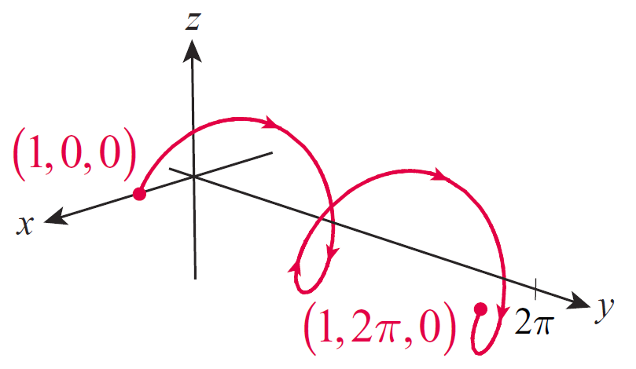
Example 1: Finding the Arc Length of a Space Curve
Find the arc length of the portion of the helix over the interval [0, 4π ].
Solution
The given interval defines two coils of the helix as shown in Figure 1, beginning at the point (1, 0, 0) and ending at the point (1, 2π, 0).
Figure 1

Slide 5
Example 1: Finding the Arc Length of a Space Curve (cont.)
The arc length of this curve is as follows.

Slide 6
Arc Length
We often use t as the symbol for the parameter in defining a curve, since the curves in many applications arise as functions of time. But curves can be reparametrized as convenient, and when studying the pure geometry of a curve, it often makes sense to replace the original parameter with the arc length parameter s. After doing so, we say the curve is parametrized with respect to arc length.

Slide 7
Arc Length (cont.)
The arc length parameter is defined by the arc length formula.
In this formula, we assume that the curve is parametrized in terms of u, and that is a conveniently chosen reference point from which to measure arc length. Then s(t) is the length of the curve between u = t₀ and u = t, and by the Fundamental Theorem of Calculus,

Slide 8
Arc Length (cont.)
Another advantage of the arc length parameter is evident if we are able to write t as a function of s, for then
and the arc length of the curve between two points r(t(a)) and r(t(b)) is thus

Slide 9
Example 2: Parametrizing a Space Curve with Respect to Arc Length
Reparametrize the helix with respect to arc length.
Solution
We first make the cosmetic reparametrization so that we can use t as a variable upper limit of integration. Any point on the helix can be used as a reference point, so we choose u = 0.

Slide 10
Example 2: Parametrizing a Space Curve with Respect to Arc Length (cont.)
This confirms that the arc length of the helix between t = 0 and t = 4π is as we found in Example 1. Solving for t yields so the parametrization of the curve with respect to arc length is

Slide 11
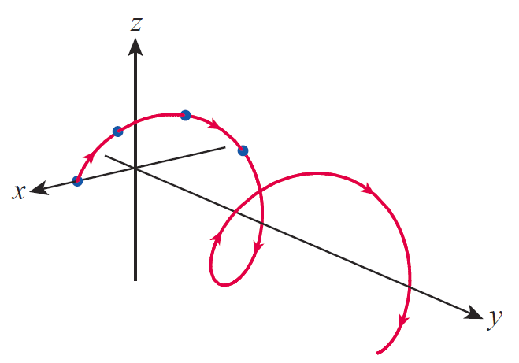
Example 2: Parametrizing a Space Curve with Respect to Arc Length (cont.)
This tells us, for instance, that the points
mark off locations that are 1 unit from each other traveling along the helix (see Figure 2).
Figure 2

Slide 12
Definition: Unit Tangent Vector
The unit tangent vector T(t) of a smooth curve r(t) is
Note that if s is the arc length parameter
for the curve, then
So, at any given point, the rate of change of a curve with respect to the arc length parameter is the unit tangent vector.

Slide 13
Example 3: Finding the Unit Tangent Vector for a Curve
Find the unit tangent vector for the curve defined by over the interval [0, 2π].
Solution

Slide 14
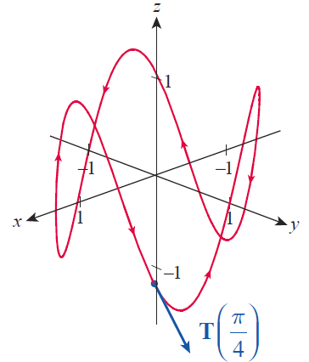
Example 3: Finding the Unit Tangent Vector for a Curve (cont.)
Figure 3 is an illustration of the curve r and
Figure 3

Slide 15
Example 4: Finding the Unit Tangent Vector for a Curve
Find the unit tangent vector for the curve in the plane defined by
Solution
This is an easy task: so The point of this example is simply to illustrate the general fact (proved in Section 12.1) that if |r(t)| is constant, then r and r′ are orthogonal at every point of the curve.

Slide 16
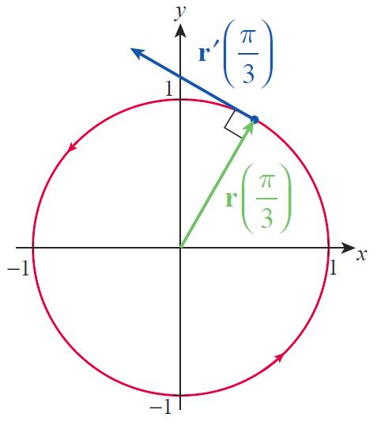
Example 4: Finding the Unit Tangent Vector for a Curve (cont.)
Figure 4 depicts the unit tangent vector at the point
Figure 4

Slide 17
Projectile Motion
If we let r(t) denote the position of such an object at time t, then its velocity and acceleration are, respectively, v = r′(t) and a = r′′ (t). Newton’s Second Law of Motion, F = m a, tells us that the sum of the forces acting on an object is equal to the product of its mass m and its acceleration a; if gravity is the only force present, then F = −mg j, where g is either 9.81 m/s² or 32 ft/s² and j is the unit vector pointing in the positive y‑direction (away from the Earth’s center). That is, −mg j = mr′′(t) or, canceling m from both sides, −g j = r′′ (t).

Slide 18
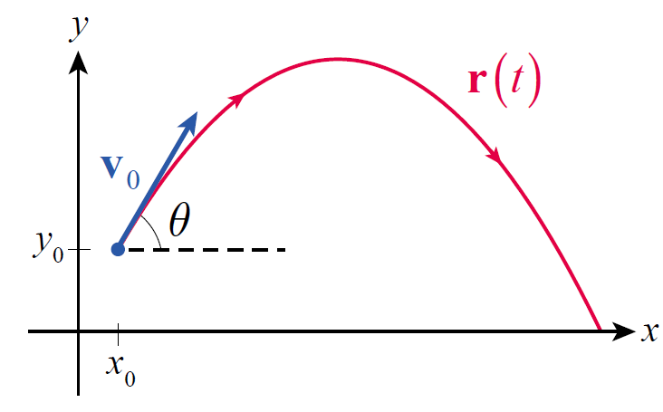
Projectile Motion (cont.)
If we set up our coordinate system so that the object moves in the xy-plane, as illustrated in Figure 5, and if the object has initial velocity v₀ and initial position r₀, then we determine r(t) by solving the following initial value problem.
Figure 5 Projectile Motion

Slide 19
Projectile Motion (cont.)
Integrating once and making use of the initial velocity results in the velocity vector
and integrating a second time and using the initial position gives us

Slide 20
Projectile Motion (cont.)
Often, it is more natural to express the initial velocity of a projectile in terms of its magnitude (or speed) v₀ and the angle θ shown in Figure 5, in which case
Figure 5 Projectile Motion

Slide 21
Projectile Motion (cont.)
If we also express r₀ in component form as then
The parametric equations corresponding to this vector function are as follows.

Slide 22
Example 5: Finding the Maximum Height of a Projectile
Given the vector function
for a projectile’s motion, find formulas for its maximum height and the time at which it reaches that height.
Solution
A projectile reaches its maximum height when the vertical component of its velocity is 0.

Slide 23
Example 5: Finding the Maximum Height of a Projectile (cont.)
Since the formula for the time at which it reaches its maximum height is
At that time, the vertical component of r is

Slide 24
Example 6: Finding the Distance Traveled by a Projectile and Its Speed at Impact
A bullet is shot from a rifle with a muzzle velocity of 170 m/s at a 30° angle of elevation. The bullet leaves the rifle at a height 2 m above the ground. Assuming the surrounding terrain is flat and level, how far does the bullet travel, and with what speed does it hit the ground?

Slide 25
Example 6: Finding the Distance Traveled by a Projectile and Its Speed at Impact (cont.)
Solution
We can determine the time t at which the bullet lands by solving the quadratic equation

Slide 26
Example 6: Finding the Distance Traveled by a Projectile and Its Speed at Impact (cont.)
The second solution for t is the value we seek (the first solution is a time before the rifle is fired), and the horizontal distance x − x₀ the bullet has traveled over that time is as follows.

Slide 27
Example 6: Finding the Distance Traveled by a Projectile and Its Speed at Impact (cont.)
As always, the speed of an object is the absolute value of its velocity, so using the fact that the speed of the bullet when it lands is
or just slightly greater than the speed which it left the rifle.

