Slide 1
Section 12.3
The Unit Normal and Binormal Vectors, Curvature, and Torsion

Slide 2
The Unit Normal and Binormal Vectors
By design, the unit tangent vector T(t) corresponding to a smooth curve r(t) has constant length, so we know that at every t for which exists—that is, T and T′ are orthogonal vectors. For the remainder of this chapter we will be interested only in curves which are not only smooth, but for which T is also smooth, so we can assume T′ is continuous and for all t. Under this assumption, we have the following definitions.

Slide 3
Definition: Unit Normal and Binormal Vectors
The unit normal vector N(t) of a smooth curve r(t) is defined as
and the unit binormal vector B(t) as

Slide 4
The Unit Normal and Binormal Vectors (cont.)
Since T and N are both unit vectors, B is as well, and the three vectors T, N, and B (in that order) form a right-handed orthogonal system of vectors at every point on the curve defined by r. This is called the TNB frame of reference for the curve, or the Frenet-Serret frame (after the French mathematicians Jean Frenet and Joseph Serret who independently developed the idea in the mid-nineteenth century).

Slide 5
Example 1: Finding the Unit Tangent, Normal, and
Binormal Vectors for a Curve
Find the unit tangent, normal, and binormal vectors for the helix defined by the vector function
Solution

Slide 6
Example 1: Finding the Unit Tangent, Normal, and
Binormal Vectors for a Curve (cont.)
We can now use T to determine the unit normal vector N(t).

Slide 7
Example 1: Finding the Unit Tangent, Normal, and
Binormal Vectors for a Curve (cont.)
Further, we can use T and N to find the unit binormal vector B(t).

Slide 8
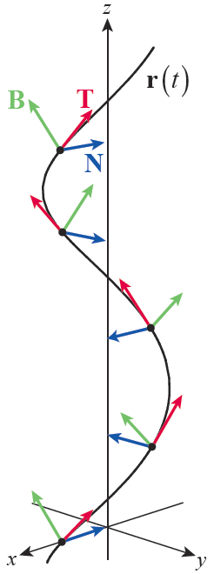

Example 1: Finding the Unit Tangent, Normal, and
Binormal Vectors for a Curve (cont.)
Figure 1 illustrates the helix and the TNB frame at five points on the helix. Note that the T vectors (in red) always point in the direction of the curve, while the N and B vectors (in blue and green, respectively) are both orthogonal to the curve at each point. Note also that the T, N, and B vectors form a right-hand system.

Slide 9
Definition: Osculating, Normal, and Rectifying Planes
Given a vector function r and its associated tangent, normal, and binormal vector functions T, N, and B, the osculating plane at a particular point r(t₀) is the plane containing r(t₀) and the vectors T(t₀) and N(t₀). The name comes from the Latin word osculari, meaning “to kiss,” and indicates that the plane just touches (or kisses) the curve at the point r(t₀). Similarly, the normal plane at the point contains r(t₀) and the vectors N(t₀) and B(t₀), while the rectifying plane contains the vectors B(t₀) and T(t₀).

Slide 10
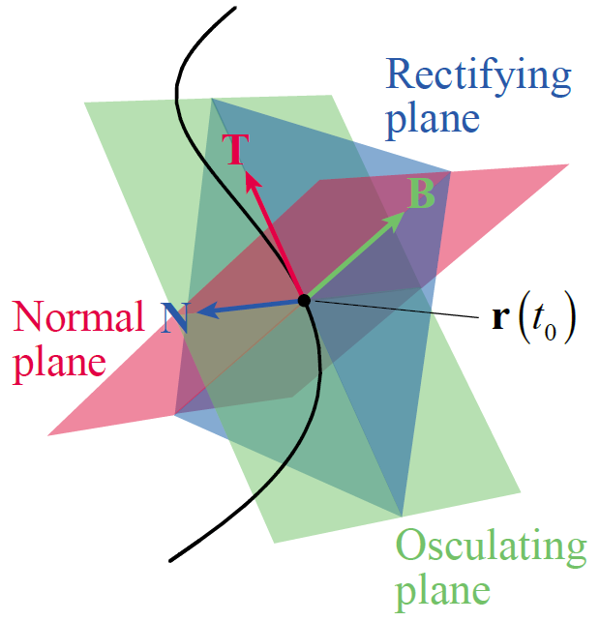
The Unit Normal and Binormal Vectors (cont.)
Figure 2 illustrates the relationships of the osculating, normal, and rectifying planes to the underlying curve. The tangent, normal, and binormal
vectors are again colored red, blue,
and green, respectively. Note that
the osculating plane can be
characterized entirely by the
fact that it contains the point
r(t₀) and is normal to B(t₀), so the
osculating plane has been colored
green in the figure.
Figure 2

Slide 11
The Unit Normal and Binormal Vectors (cont.)
Similarly, the normal plane is normal to T(t₀) and is colored red, while the rectifying plane is normal to N(t₀) and is colored blue.

Slide 12
Example 2: Determining Equations for the Osculating,
Normal, and Rectifying Planes of a Curve
Use the results of Example 1 to determine equations for the osculating, normal, and rectifying planes associated with the helix
Solution
Recall that the equation describes all the points (x, y, z) of a plane containing the particular point (x₀, y₀, z₀), where n is normal to the plane.

Slide 13
Example 2: Determining Equations for the Osculating,
Normal, and Rectifying Planes of a Curve (cont.)
So the osculating, normal, and rectifying planes passing through the point (cos t, sin t, t) are described by the equations.
(Note that in order to simplify the equations, we have used appropriately chosen multiples of B and T for the normal vector n.)

Slide 14
Example 2: Determining Equations for the Osculating,
Normal, and Rectifying Planes of a Curve (cont.)
The equations we have found are equations in the variables x, y, and z and in the parameter t, so they describe the planes of the TNB system at each point r(t) of the helix. For instance, the planes at the specific point where t = π, namely (−1,0, π), are as follows.

Slide 15
Example 3: Finding Parametric Descriptions of a Ribbon and a Tube
Given the helix as the base curve, find a parametric description of a ribbon of width 1 centered on the curve. Then, do the same for a circular tube of diameter 1 centered on the curve.
Solution
At any point r(t) on the helix, the line segment parametrized by is a segment of length 1 centered at r(t) and running in the direction of N(t).

Slide 16
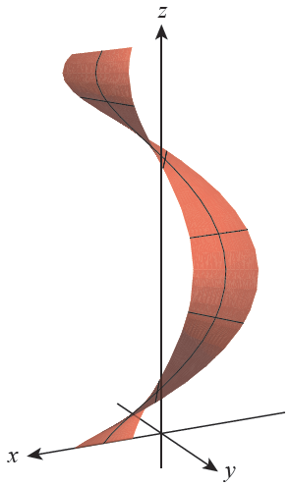
Example 3: Finding Parametric Descriptions of a Ribbon and a Tube (cont.)
So the position vectors with and for some interval I, define all the points over a length of the desired ribbon. For example, Figure 3 illustrates the ribbon over one full twist of the helix.
Figure 3 Ribbon

Slide 17
Example 3: Finding Parametric Descriptions of a Ribbon and a Tube (cont.)
As we know, the position vector defines a circle of diameter 1 centered at the origin of the xy-plane. It does this by tracing out the terminal points of the vectors for
We can describe a tube of diameter 1 centered on the helix r(t), for any fixed t, by constructing a circle centered at r(t) in the NB‑plane (the normal plane). In other words, the vector N plays the role of i and the vector B plays the role of j.

Slide 18
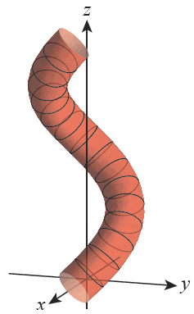
Example 3: Finding Parametric Descriptions of a Ribbon and a Tube (cont.)
So the tubular surface consists of all those points of the form and for some interval I. Figure 4 is an illustration of this surface for
Figure 4 Tube

Slide 19
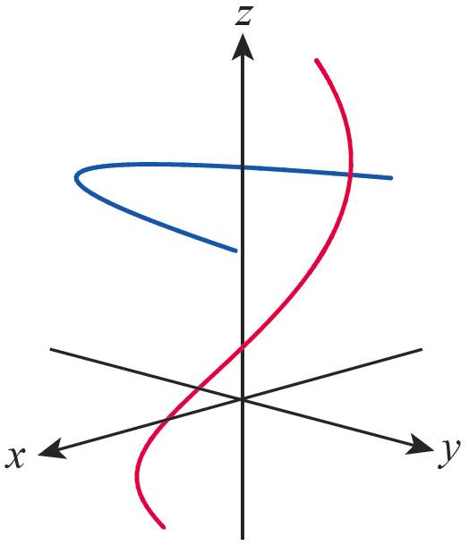
Curvature and Torsion
The three vectors T, N, and B give us one way to describe the behavior of a curve r(t), but they only indirectly tell us something about its relative “twistiness.” The two curves in Figure 6, for instance, are qualitatively different in several ways. The red curve (a portion of a helix) appears to be consistently turning in toward the z-axis and, at the same time, changing in all three coordinate directions.
Figure 6

Slide 20
Curvature and Torsion (cont.)
The blue curve, on the other hand, appears to have segments that are comparatively straight and the curve seems to lie entirely in one plane. Curvature and torsion are scalar quantities that capture these characteristics of a curve.

Slide 21
Definition: Curvature
The curvature κ (kappa) of a curve at any given point is the magnitude of the rate of change of its unit tangent vector T with respect to the arc length parameter s.

Slide 22
Curvature and Torsion (cont.)
Informally, the more T changes for every unit change of arc length, the greater the curvature. In practice, if the unit tangent vector for a curve r(t) is known as a function of some parameter other than arc length, the following variation is convenient.

Slide 23
Example 4: Determining the Curvature of a Line and a Circle
Determine the curvature of a. a line and b. the circle
Solution
a. For any line (in ℝ² or ℝ³), the unit tangent vector T is a constant vector (pointing in the direction of the line), so

Slide 24
Example 4: Determining the Curvature of a Line and a Circle (cont.)
b. and
These lead to , and the curvature is as follows.
Note that a circle of larger radius a thus has smaller curvature κ.

Slide 25
Curvature and Torsion (cont.)
Since κ is a measure of the rate of change of T (with respect to arc length), and since T′ points in the direction of N, it isn’t surprising that κ and N have a connection. Specifically, since

Slide 26
Curvature and Torsion (cont.)
Written in the form
this is one of the Frenet-Serret formulas that relate the derivatives of T, N, and B to the vectors themselves.

Slide 27
Curvature and Torsion (cont.)
To find the corresponding formula for dB/ds, we note first that dB/ds must be orthogonal to B since B has constant length. At the same time,

Slide 28
Curvature and Torsion (cont.)
So dB/ds is also orthogonal to T (and, incidentally, to dN/ds). Since dB/ds is orthogonal to both B and T, it must be a multiple of N, and we define the torsion τ of the curve on that basis.

Slide 29
Definition: Torsion
The torsion τ (tau) of a curve at any given point is defined by the relationship
Taking advantage of one of the properties of the dot product,

Slide 30
Theorem: The Frenet-Serret Formulas
Given a curve r and associated unit tangent, normal, and binormal vectors T, N, and B, we have the following.

Slide 31
Curvature and Torsion (cont.)
Geometrically, the curvature κ tells us the rate at which a curve is bending in the osculating plane (the TN­-plane), while the torsion τ tells us the rate at which the curve is twisting out of the osculating plane. Example 5 illustrates these ideas with the now-familiar helix.

Slide 32
Example 5: Calculating the Curvature and
Torsion Functions of a Helix
Calculate the curvature and torsion functions for the helix
Solution
We could divide by to determine κ, as we did in Example 4, but since our only formula for τ so far requires knowing the arc length parameter, we will use the formulation of curvature. The first step is determining s(t).

Slide 33
Example 5: Calculating the Curvature and
Torsion Functions of a Helix (cont.)
Hence, and, from Example 1, we have the
following tangent, normal, and binormal vectors.

Slide 34
Example 5: Calculating the Curvature and
Torsion Functions of a Helix (cont.)
Now we can proceed to find the curvature κ and torsion τ.

Slide 35
Example 5: Calculating the Curvature and
Torsion Functions of a Helix (cont.)

Slide 36
Curvature and Torsion (cont.)
For practical purposes, it is highly desirable to have a variety of formulas for T, N, B, κ, and τ. One key step in finding other formulas is to note the facts below about r′ and r′′. Since r′ and r′′ often have the physical meaning of velocity and acceleration, respectively, we include the alternate labels v and a. The variable s denotes the arc length parameter, as usual, and all prime notation indicates differentiation with respect
to t.

Slide 37
Curvature and Torsion (cont.)
These formulas are important in their own right, so we make the following definition.

Slide 38
Definition: Tangential and Normal Components of Acceleration
The tangential and normal components of acceleration of an object with position function r(t) are defined, respectively, as
where s denotes the arc length parameter of the curve and κ is its curvature. Thus, we can write a = a_{T} T + a_{N} N, and use the fact that T and N are orthogonal to note

Slide 39
Example 6: Finding the Tangential and Normal
Components of Acceleration of an Object
Find the tangential and normal components of acceleration of an object whose position function is the spiral
Solution
We will need both and so we first find these vectors.

Slide 40
Example 6: Finding the Tangential and Normal
Components of Acceleration of an Object (cont.)
Next,
so

Slide 41
Example 6: Finding the Tangential and Normal
Components of Acceleration of an Object (cont.)
Using the relation to determine a_{N} saves us the step of finding κ, and from above (after simplification) we find

Slide 42
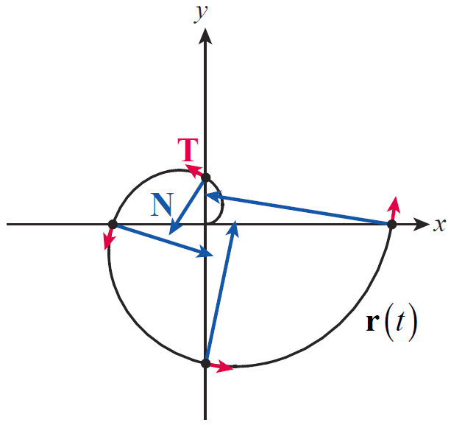
Example 6: Finding the Tangential and Normal
Components of Acceleration of an Object (cont.)
Figure 7 depicts the curve over the interval
with the tangential and normal components of drawn in red and blue, respectively,
at four points. Note that the normal
components are significantly larger
than the tangential components
in magnitude (and grow as t
grows), indicating that most of
the acceleration is directed inward.
Figure 7

Slide 43
Curvature and Torsion (cont.)
Summary of Space Curve Definitions and Formulas
Unit Tangent Vector
Unit Normal Vector
Unit Binormal Vector
Arc Length Parameter
Table 1

Slide 44
Curvature and Torsion (cont.)
Summary of Space Curve Definitions and Formulas (cont.)
Osculating Plane | Spanned by T and N
Normal Plane | Spanned by N and B
Rectifying Plane | Spanned by B and T
Velocity
Acceleration
Table 1 (cont.)

Slide 45
Curvature and Torsion (cont.)
Summary of Space Curve Definitions and Formulas (cont.)
Tangential Component
Normal Component
Third Derivative
Table 1 (cont.)

Slide 46
Curvature and Torsion (cont.)
Summary of Space Curve Definitions and Formulas (cont.)
Curvature
Torsion
Frenet-Serret Formulas
Table 1 (cont.)

