Slide 1
Section 13.1
Functions of Several Variables

Slide 2
Real-Valued Functions of Two Variables
We begin with functions that map ℝ² into ℝ as these functions can (at least in principle) be easily described geometrically and will serve to introduce all of the relevant ideas. The new material in this chapter is primarily a shift in how we think about and work with multivariable functions. For example, we will view the surface area formula A = 2π rh + 2π r² as defining a function A in the variables r and h and the quadric surface 9x² + 4y² − z = 0 as defining a function z in the variables x and y.

Slide 3
Definition: Real-Valued Functions of Two Variables
A real-valued function f of two (real) variables is a function that returns a real number denoted f(x, y), for each ordered pair (x, y) in a domain D ⊆ ℝ². The range of f is the set of real numbers If the domain of f is not explicitly stated, it is assumed to be all ordered pairs (x, y) for which f(x, y) is a well-defined real number. In the equation form z = f(x, y), x and y are referred to as the independent variables and z as the dependent variable.

Slide 4
Example 1: Finding the Domain and Range of a Function of Two Variables
Determine the domain and range of each of the given functions, and evaluate each at the point (1, 2).

Slide 5
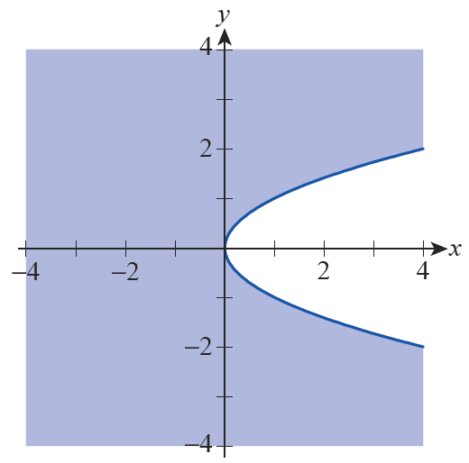
Example 1: Finding the Domain and Range of a Function of Two Variables (cont.)
Solution
In order for f(x, y)
to be a
real number, we need
y² − x ≥ 0. This inequality
then defines the domain
of f,
which is depicted as the
shaded region in Figure 1.
Figure 1

Slide 6
Example 1: Finding the Domain and Range of a Function of Two Variables (cont.)
All nonnegative real numbers are possible outputs of f, so the range of f is the interval [0, ∞). And since
(1,2) ∈ D, f can be evaluated at the ordered pair and

Slide 7
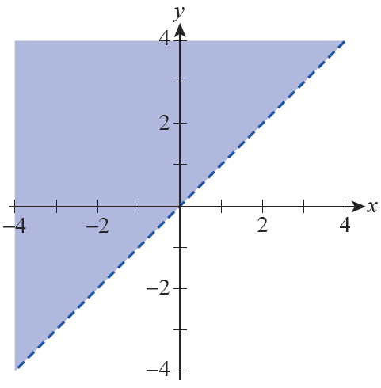
Example 1: Finding the Domain and Range of a Function of Two Variables (cont.)
b. For g(x, y) to be a real
number, we require
y − x > 0, so the domain
of g consists of the part
of the xy-plane above
the line y = x,
as
shown in Figure 2—we
use a dashed line to
indicate that the line y = x
is not included in the domain.
Figure 2

Slide 8
Example 1: Finding the Domain and Range of a Function of Two Variables (cont.)
Every real number can be written in the form ln(y − x) for some x and some y in the domain, so the range of g is ℝ. Finally,

Slide 9
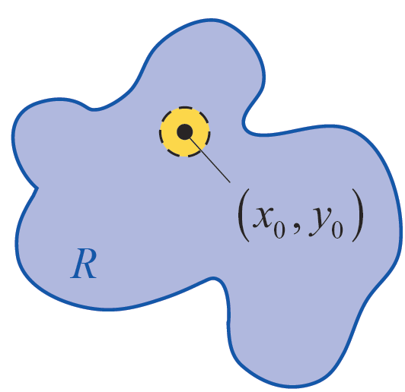
Definition: Interior Points, Boundary Points, and Open and Closed Regions
Let R be a region of the Cartesian
plane ℝ². A point is
said to be an interior point of R
if, for some ε > 0, all points
within a distance of ε from
are also elements of R—that is,
where
Interior Point

Slide 10
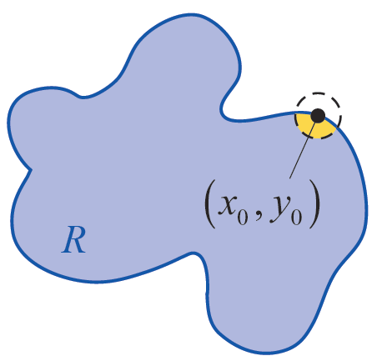
Definition: Interior Points, Boundary Points, and Open and Closed Regions (cont.)
(a set of the form is
called an open disk of radius ε ).
A point is said to be a
boundary point of R if, for every
ε > 0, contains both
points that lie in R and points
that lie outside R—note that
can be a boundary point
of R without being an element
of R itself.
Boundary Point
Figure 3

Slide 11
Definition: Interior Points, Boundary Points, and Open and Closed Regions (cont.)
A region R is open if every point in R is an interior point, while R is closed if it contains all of its boundary points. Figure 3 illustrates a typical interior point and boundary point of a region.
Interior Point
Figure 3
Boundary Point

Slide 12
Real-Valued Functions of Two Variables (cont.)
Similarly, we extend the idea of a bounded interval to a bounded region with the following definition.

Slide 13
Definition: Bounded and Unbounded Regions
Let R be a region of the Cartesian plane ℝ². R is said to be bounded if, for some d > 0, that is, every point of R is within d units of the origin. A region for which no such d exists is unbounded.

Slide 14
Example 2: Identifying Bounded and Unbounded Regions
The domain found in part a. of Example 1 is closed, as it contains all of its boundary points—namely, the points of the curve y² − x = 0.
On the other hand, the domain of Example 1 part b. is open.

Slide 15
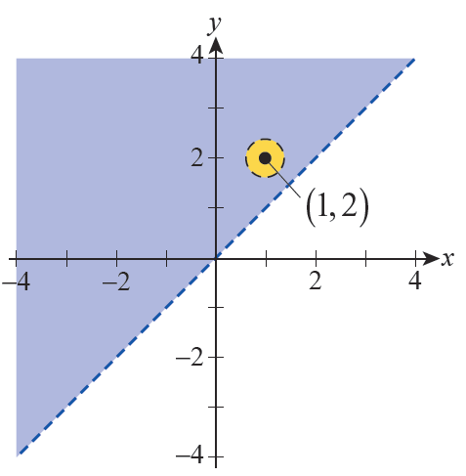
Example 2: Identifying Bounded and Unbounded Regions (cont.)
Any point in the
domain lies some positive
distance d away from the
line y = x, so
as depicted in Figure 4 for
the point (1, 2). The boundary
of the domain
is the line y = x, which in this
case is not a part of the domain.
Figure 4

Slide 16
Example 2: Identifying Bounded and Unbounded Regions (cont.)
Both of the domains of Example 1 are unbounded, as they contain points arbitrarily far away from the origin. In contrast, any set provides a simple example of a bounded region, as by definition it consists only of points within some fixed distance of the origin.

Slide 17
Graphs and Contour Maps
Given a function f(x, y) that maps its domain D into ℝ, we frequently desire a way to visualize its features. The two most common methods of doing so are the subject of the next definition.

Slide 18
Definition: Graphs and Contour Maps of Functions of Two Variables
The set of ordered triples in ℝ³ is called the graph of the function f : D → ℝ—equivalently, the graph of f is the set of all points
(x, y, z) solving the equation z = f (x, y). The set of points in D for which f(x, y) = c, for some fixed constant c, is called a contour (or level curve) of f, and a collection of such contours is called a contour map.

Slide 19
Graphs and Contour Maps (cont.)
Graphing a two-variable function f(x, y) in ℝ³ is the natural analog of graphing a single-variable function f(x) in ℝ². Surfaces in ℝ³ can serve as examples of graphs of two-variable functions, though we may have to restrict our attention to a portion of the surface in order to represent it as a function.

Slide 20
Example 3: Writing an Equation of a Surface as a Function of x and y
Write the half of the sphere x² + y² + z² = 9 above the xy-plane as a function of x and y.
Solution
Solving the equation x² + y² + z² = 9 for z, we must choose whether to use the negative or positive root. The positive root corresponds to the hemisphere above the xy-plane, so we define

Slide 21
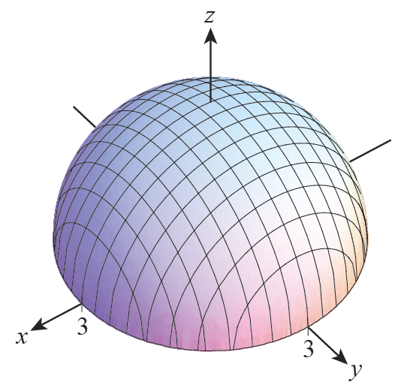
Example 3: Writing an Equation of a Surface as a Function of x and y (cont.)
The graph of f is shown in
Figure 5; note that the domain
of f is the region
in the xy-plane.
Figure 5

Slide 22
Example 4: Examining a Quadric Surface and Its Contour Map
The quadric equation 9x² + 4y² − z = 0 defines a surface called an elliptic paraboloid, and its graph appears in Figure 6. The equation also defines z as a function of x and y, namely

Slide 23
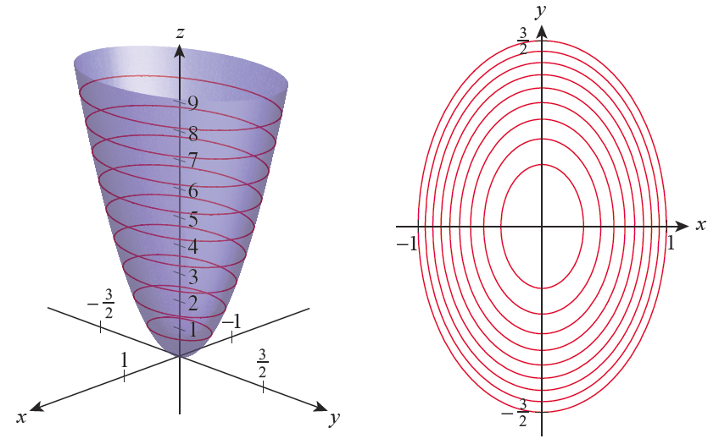
Example 4: Examining a Quadric Surface and Its Contour Map (cont.)
Figure 6 Elliptic Paraboloid
Figure 7 Contour Map

Slide 24
Example 4: Examining a Quadric Surface and Its Contour Map (cont.)
For this particular function, a contour map, such as shown in Figure 7, is also very instructive. The nine specific contours in Figure 7 correspond to the nine traces in Figure 6, which are all depictions of intersections of the surface with planes parallel to the xy-plane. Specifically, the nine contours and traces correspond to the equations

Slide 25
Example 4: Examining a Quadric Surface and Its Contour Map (cont.)
The classification of this quadric surface as an elliptic paraboloid reflects the fact that each contour in the
xy-plane is an ellipse, namely 9x² + 4y² = c for some constant c.

Slide 26
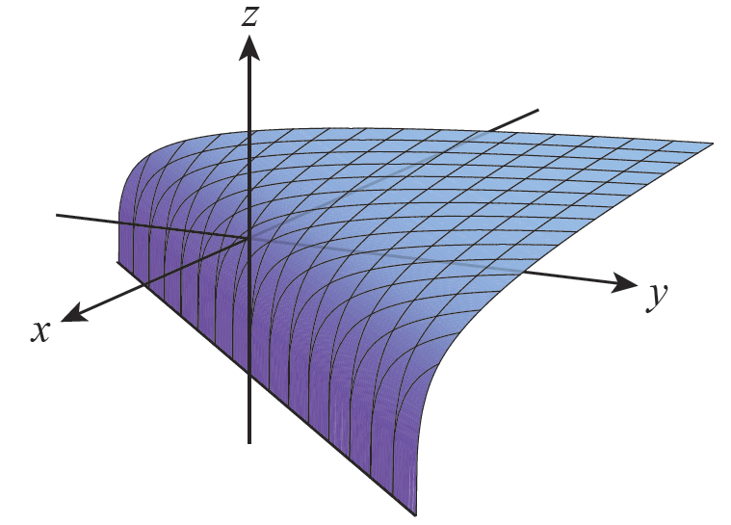
Example 5: Examining a Surface and Its Contour Map
The surface defined by the
function is
shown in Figure 8. As we
determined in Example 1,
the domain of g is the region
Figure 8

Slide 27
Example 5: Examining a Surface and Its Contour Map (cont.)
Although the illustration of the surface may not convey the fact that the range of g is the entire set of real numbers, note that as we consider points (x, y) in the domain closer and closer to the boundary line y = x, and as we consider points (x, y) for which y − x gets larger and larger. We will later return to the matter of limits of multivariable functions.

Slide 28
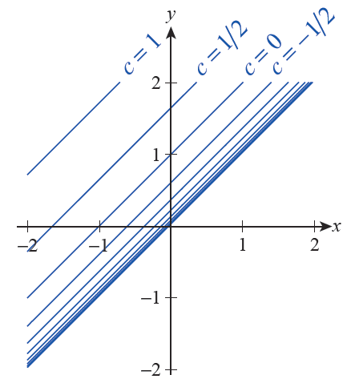
Example 5: Examining a Surface and Its Contour Map (cont.)
Since g(x, y) is constant along
lines of slope 1, every contour
map of the function will look
something like Figure 9, which
shows level curves for values
of c from −5 to 1 in increments
of Note how the contour
lines “bunch up” as c → −∞.
Figure 9
Contour Map of g(x, y)

Slide 29
Graphs and Contour Maps (cont.)
Just as a curve in ℝ² may represent a function x = f(y), a surface in ℝ³ may represent a function of two variables other than x and y.

Slide 30
Example 6: Writing an Equation of a Surface as a Function of Two Variables Other than x and y
Express the planar surface x + 2y + 3z = 2 as a function of two variables other than the pair x and y.
Solution
Expressing the surface as a function of y and z is very easily done.

Slide 31
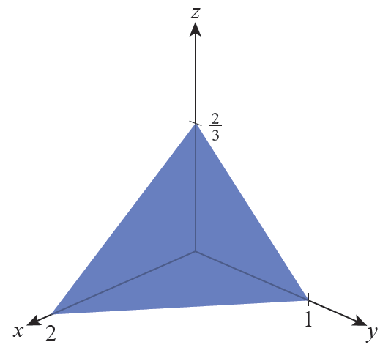
Example 6: Writing an Equation of a Surface as a Function of Two Variables Other than x and y (cont.)
Expressing the surface as a function of x and z is almost as easy.
The graph of either function is the
plane shown in Figure 10 (only the
portion in the first octant is shown).
In graphing f, the value of the function
is used as the x-component; and in
graphing g, the value of the function
corresponds to the y-component.
Figure 10

Slide 32
Technology Note: Creating Graphs of Surfaces and Contour Maps
Computer algebra systems, such as Mathematica, are very useful in constructing both graphs and contour maps; most of them have built‑in commands to generate such images. For instance, the command to plot the function from Example 5 in Mathematica is Plot3D and its basic use is shown in Figure 11.

Slide 33
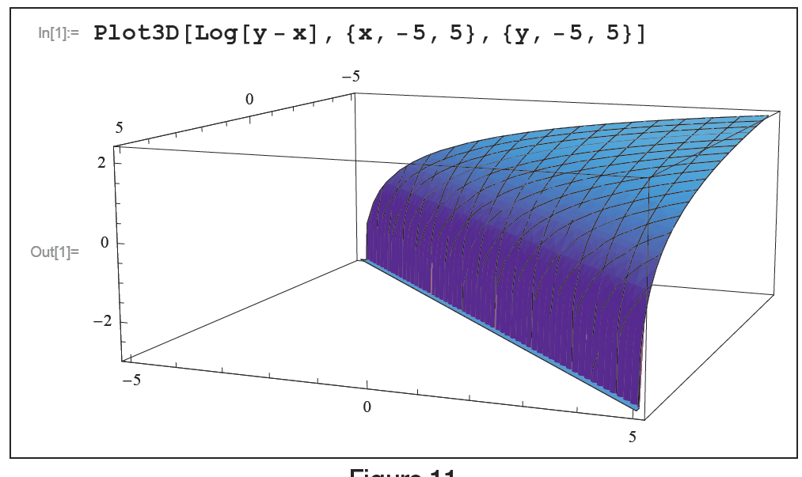
Technology Note: Creating Graphs of Surfaces and Contour Maps (cont.)
Figure 11

Slide 34
Technology Note: Creating Graphs of Surfaces and Contour Maps (cont.)
Contour maps can be constructed with the ContourPlot command, as shown in Figure 12, where we plot the nine specific contours of the elliptic paraboloid from Example 4. Both commands have many options allowing the user to refine the image as desired, which is what was done in order to create Figures 8 and 7, respectively.

Slide 35
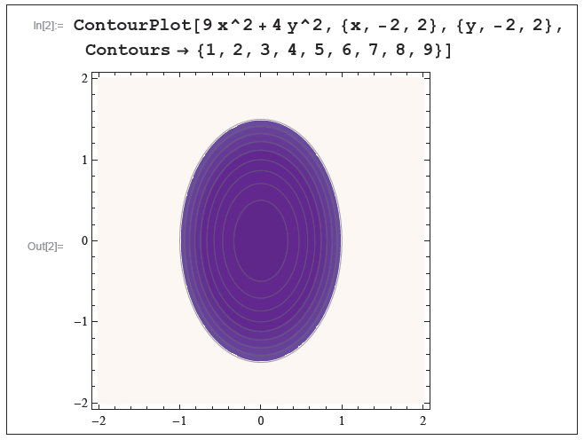
Technology Note: Creating Graphs of Surfaces and Contour Maps (cont.)
Figure 12

Slide 36
Graphs and Contour Maps (cont.)
Contour maps also appear in nonmathematical settings. Examples include topographical maps (Figure 13) and maps of lines of constant temperature (isotherms) (Figure 14) or constant pressure (isobars) in weather reports.

Slide 37
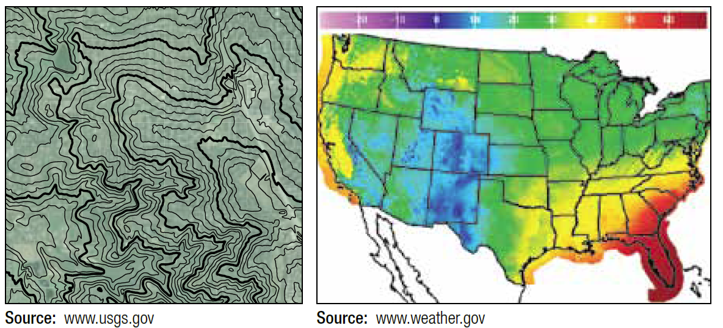
Graphs and Contour Maps (cont.)
Figure 13
Figure 14

Slide 38
Functions of Three or More Variables
As the number of variables in the definition of a function increases, our ability to represent the function with pictures deteriorates. For a function f(x, y, z) of three variables, the analog of a level curve (or contour) is a level surface—that is, the collection of points in ℝ³ for which f(x, y, z) = c for some constant c. In principle, we can readily show any level surface of f(x, y, z) but a complete depiction would consist of all level surfaces at once, and such an image would almost certainly be impossible to interpret.

Slide 39
Functions of Three or More Variables (cont.)
Even worse, an illustration of the graph of a function f(x, y, z), which consists of all 4-tuples of the form (x, y, z, f(x, y, z)), would require an ability to draw in ℝ⁴.
Nevertheless, the basic principles of working with functions of three or more variables are the same—it is only our ability to illustrate the principles with pictures that is hampered. We begin with the following definitions, soon to be used when we discuss limits and derivatives of multivariable functions.

Slide 40
Definition: Real-Valued Functions of n Variables
A real-valued function f of n (real) variables
is a function that returns a real number denoted for each ordered n-tuple in a domain D ⊆ ℝ^{n}. The range of f is the set of real numbers

Slide 41
Definition: Real-Valued Functions of n Variables (cont.)
Important: In order to simplify notation, it is common to denote an ordered n-tuple as simply x; context tells us whether x refers to a single real variable, that is, x ∈ ℝ, or whether
and refers to an element of ℝ^{n}. Note the correlation with the notation used for position vectors: the point
corresponds to the terminal point of the position vector

Slide 42
Definition: Real-Valued Functions of n Variables (cont.)
In practice, we typically use notation like f(x, y) and
f(x, y, z) for functions whose domains are subsets of ℝ² or ℝ³, and the notation f(x), where
when discussing a generic function f: ℝ^{n} → ℝ with n as an unspecified positive integer.

Slide 43
Definition: Interior Points, Boundary Points, Open and Closed Regions, and Boundedness in ℝ^{n}
Let R be a region (i.e., a subset) of ℝ^{n}. A point
is said to be an interior point of R if, for some ε > 0, all points within a distance of ε from p are also elements of R—that is, where
and |p − q| denotes the Euclidean distance between p and q,
ℝ^{n}

Slide 44
Definition: Interior Points, Boundary Points, Open and Closed Regions, and Boundedness in ℝ^{n} (cont.)
(a set of the form is called an n-dimensional open ball of radius ε ). A point p is said to be a boundary point of R if, for every ε > 0, contains both points that lie in R and points that lie outside R. The region R is said to be open if every point in R is an interior point, and R is said to be closed if it contains all of its boundary points.

Slide 45
Definition: Interior Points, Boundary Points, Open and Closed Regions, and Boundedness in ℝ^{n} (cont.)
Finally, R is said to be bounded if, for some d > 0, that is, every point of R is within d units of the origin of ℝ^{n}. If no such d exists, R is unbounded.

Slide 46
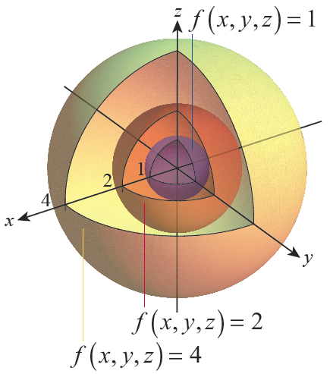
Example 7: Visualizing the Level Surfaces of a Function of Three Variables
The function
returns the distance between
each ordered triple (x, y, z) and
the origin. Thus, its level
surfaces consist of all the
nested spheres centered at
the origin. Figure 15 shows,
in a cut-out diagram, level
surfaces of the function
corresponding to the three
level values 1, 2, and 4.
Figure 15

