Slide 1
Section 13.2
Limits and Continuity of Multivariable Functions

Slide 2
Limits of Multivariable Functions, and Their
Evaluation
Informally, we say that L is the limit of a function f at a particular point if, as the argument of f approaches the point, the value of f approaches L. The only difference in the expanded definition below is a necessary adjustment to acknowledge the multidimensional nature of the domain of f .

Slide 3
Definition: Limit of a Real-Valued Function of n Variables
Let f be a function mapping its domain D ⊆ ℝ^{n} into ℝ, and let be a point in either D or the boundary of D. We say that the limit of f as x approaches c is L, and write
if for every real number ε > 0 there is a number δ > 0 such that whenever x ∈ D and

Slide 4
Definition: Limit of a Real-Valued Function of n Variables (cont.)
Recall that the notation denotes the Euclidean distance between two points x and c in ℝ^{n}, so if
then

Slide 5
Limits of Multivariable Functions, and Their
Evaluation (cont.)
Just as with the original definition of limit, the above definition contains some subtle points worth highlighting. First, it is important to note that f isn’t necessarily defined at the point c, since the domain of f may not contain all of its boundary points. But by stipulation, if c is not in the domain D of f, c is an element of the boundary of D and thus there are elements of D arbitrarily close to c—that is sufficient for us to discuss the limit of f at c.

Slide 6
Limits of Multivariable Functions, and Their
Evaluation (cont.)
Second, and in contrast to the one-variable case, there are many paths along which we can imagine a variable x approaching the fixed point c in ℝ^{n}, when n ≥ 2. As we will see in the following examples, this latitude leads to both interesting results and the opportunity to use some new reasoning techniques.

Slide 7
Example 1: Determining Whether a Limit Exists for a Function of Two Variables
Determine whether the function
has a limit at the point (0,0). (Note that f is not defined at (0,0).)

Slide 8
Example 1: Determining Whether a Limit Exists for a Function of Two Variables (cont.)
Solution
We want to determine
if it exists, but we can quickly decide no such limit is possible if we consider just two specific paths by which the variable point (x,y) can approach (0,0).

Slide 9
Example 1: Determining Whether a Limit Exists for a Function of Two Variables (cont.)
The first path is along the x-axis, where y = 0.
But if we approach (0,0) along the y-axis, where x = 0, we see

Slide 10
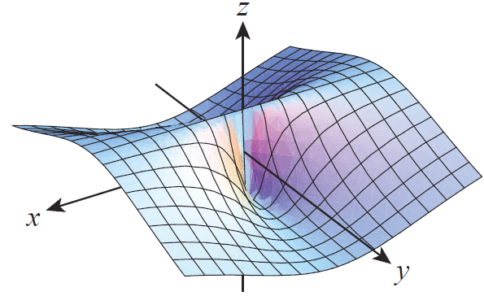
Example 1: Determining Whether a Limit Exists for a Function of Two Variables (cont.)
These two facts alone are sufficient to tell us that the limit at (0,0) does not exist, since limits are unique—the limit cannot depend on how the points approach (0,0). Figure 1 is a graph of the function f(x,y), and reflects the fact that f has a
constant value of 1 along the
x-axis and a constant value of
−1 along the y-axis.
Figure 1

Slide 11
Limits of Multivariable Functions, and Their
Evaluation (cont.)
Whenever it can be shown that a function f (x, y) has two different limiting values as (x, y) approaches (x₀, y₀)
along two different paths, we know that
does not exist. To prove that a limit does exist, and to actually evaluate that limit, we can employ extensions of the limit laws.

Slide 12
Theorem: Extended Limit Laws
Let f and g be two real-valued functions of n variables such that both and exist, where c ∈ ℝ^{n}
is a fixed point. Let k be a fixed real number. Then the following laws hold.
Sum/Difference Law
Constant Multiple Law

Slide 13
Theorem: Extended Limit Laws (cont.)
Product Law
Quotient Law
Rational Power Law
(a and b nonzero integers with no common factor)

Slide 14
Example 2: Finding Limits of Functions of Two Variables
Each of the limits below can be evaluated by employing limit laws and the sort of algebraic manipulation.

Slide 15
Example 2: Finding Limits of Functions of Two Variables (cont.)
Note that canceling the common factor of x − y is legitimate since the factor is 0 only when x = y, and the line x = y is not in the domain of the function.

Slide 16
Example 2: Finding Limits of Functions of Two Variables (cont.)

Slide 17
Example 2: Finding Limits of Functions of Two Variables (cont.)
Note that, again, the common factor is nonzero on the domain of the function, which consists of all points for which x + 3 ≠ y.

Slide 18
Example 3: Finding a Limit of a Function of Two Variables
Find if the limit exists.
Solution
As with each of the previous examples, the numerator and denominator of the function both go to 0 as (x, y) approaches (0, 0), which does not allow us to immediately evaluate the limit (if it exists). On the other hand, we cannot immediately conclude that the limit does not exist, as we did in Example 1, since

Slide 19
Example 3: Finding a Limit of a Function of Two Variables (cont.)
Remember that this does not tell us that the limit of the function at (0,0) is 0, since the limit along some other approach may be different, but it does tell us that if the limit does exist, it must be 0.
So suppose we wish to demonstrate that, given ε > 0, we can find a δ > 0 so that

Slide 20
Example 3: Finding a Limit of a Function of Two Variables (cont.)
Then since x² ≤ x² + y² and y² ≤ x² + y²,
The condition means that
so if we let
and hence

Slide 21
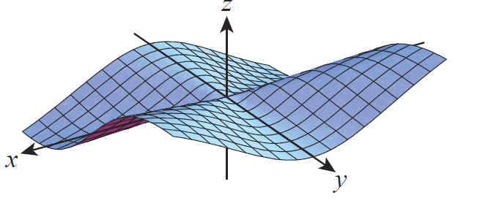
Example 3: Finding a Limit of a Function of Two Variables (cont.)
A graph of the function is shown in Figure 2.
Figure 2

Slide 22
Continuity of Multivariable Functions
Continuity of a function of n variables at a point requires that the limit exist at that point and that the limit value is the same as the function value.

Slide 23
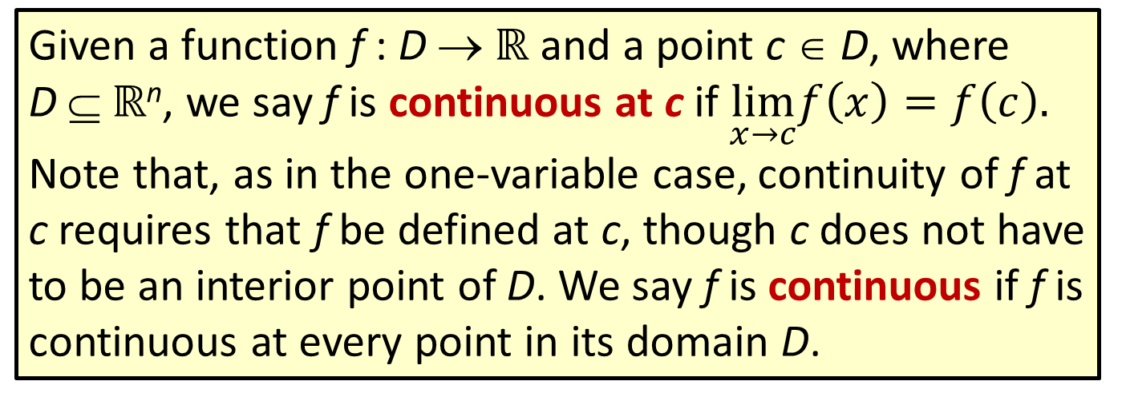
Definition: Continuity of a Multivariable Function at a Point
Given a function f : D → ℝ and a point c ∈ D, where
D ⊆ ℝ^{n}, we say f is continuous at c if $\lim_{x→c}f\left(x\right)=f\left(c\right).$
Note that, as in the one-variable case, continuity of f at c requires that f be defined at c, though c does not have to be an interior point of D. We say f is continuous if f is continuous at every point in its domain D.

Slide 24
Continuity of Multivariable Functions (cont.)
Also as in the single-variable case, the extended limit laws mean that the basic algebraic combinations of continuous functions are all continuous, a fact we state briefly below.

Slide 25
Properties of Continuous Functions
Sums, differences, constant multiples, products, quotients, and rational powers of continuous functions are continuous at all points where they are mutually defined.

Slide 26
Continuity of Multivariable Functions (cont.)
In particular, this means that polynomial and rational functions of n variables are continuous at all points of their domain.

Slide 27
Example 4: Determining Where Multivariable Functions Are Continuous
Determine where each of the following functions is continuous.

Slide 28
Example 4: Determining Where Multivariable Functions Are Continuous (cont.)
Solution
a. Since f is a rational function (of three variables), it is continuous everywhere it is defined, and the only points not in the domain of f are those for which
x² + y² + z² = 9. In words, f is continuous on all of ℝ³ except for the points on the sphere of radius 3 centered at the origin.

Slide 29
Example 4: Determining Where Multivariable Functions Are Continuous (cont.)
b. The function g is a sum of a polynomial function and a rational function, and the rational portion is defined everywhere (1 + x²y⁴ ≠ 0 for all x and y). So g is continuous on all of ℝ².

Slide 30
Example 5: Defining the Continuous Extension of a Function of Two Variables
If possible, extend the definition of the function
in order to make it continuous
everywhere.
Solution
The domain of the rational function f is all of ℝ² except for the origin, and we found in Example 3 that
So if we define f(0,0) to be 0 (and to have the original value otherwise), f is continuous everywhere.

Slide 31
Continuity of Multivariable Functions (cont.)
One last property remains to be extended to the multivariable arena: continuity of composite functions.

Slide 32
Theorem: “A Composition of Continuous Functions Is Continuous”
Assume that f : D → ℝ, where D ⊆ ℝ^{n}, and g: ℝ → ℝ. If f is continuous at c ∈ D and g is continuous at f(c), then g ∘ f is continuous at c.

Slide 33
Example 6: Examining the Continuity of Compositions of Multivariable Functions
a. The function is continuous everywhere, as it is the composition of a polynomial function and an exponential function.

Slide 34
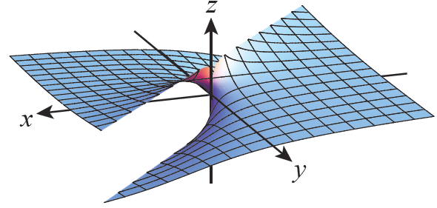
Example 6: Examining the Continuity of Compositions of Multivariable Functions (cont.)
b. The function shown in Figure 3, is the composition of the rational function
and the arctangent function. The function g is continuous for all (x,y) ∈ℝ² except the line x = y, since the rational function is continuous everywhere x ≠ y
and the arctangent
function is continuous
on all of ℝ.
Figure 3

