Slide 1
Section 13.4
The Chain Rule for Multivariable Functions

Slide 2
The Chain Rule for Multivariable Functions
The Chain Rule, makes differentiating the composition of two functions of a single variable relatively easy. Recall that if y = f(u) and u = g(x), and if the derivatives are all defined, then
In this section, we extend the Chain Rule to handle the composition of functions when at least one of them depends on more than one variable.

Slide 3
The Chain Rule and Its Proof
We will build toward a general statement of the Chain Rule by considering first the case of a function y = f(u, v) where both u and v are functions of another variable x, say u = g(x) and v = h(x). Then ultimately, y is a function of the single variable x, a fact which is apparent if we write y = f(g(x), h(x)); in this context, we often call u and v intermediate variables between the independent variable x and the dependent variable y. But the rate of change of y with respect to x has to reflect the fact that y is defined in terms of two functions of x that are independent of one another.

Slide 4
Theorem: The Chain Rule (Case I)
If y = f(u, v) is a differentiable function and if u = g(x) and v = h(x) are both differentiable functions of x, then the composite function y = f(g(x), h(x)), is a differentiable function of x and
Alternatively,

Slide 5
Proof
The method of proof is identical in nature to the proof of the Chain Rule, but our increment-based definition of differentiability allows for a more elegant presentation.
By the definition of differentiability,

Slide 6
Proof (cont.)
at any point where y is differentiable, and ε₁ → 0 and ε₂ → 0 as (Δu,Δv) → (0,0). So the ratio of the increment Δy to the increment Δx is
Both u and v are continuous functions of x since they are differentiable, and hence Δu → 0 and Δy → 0 as Δx → 0. So we can determine dy/dx by letting Δx → 0.

Slide 7
Proof (cont.)

Slide 8
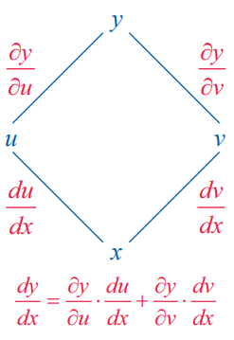
The Chain Rule and Its Proof (cont.)
A tree diagram, such as the one shown in Figure 1, is a convenient way to remember the Chain Rule and determine how to apply it for any given set of independent, intermediate, and dependent variables. To use such a diagram, multiply the derivatives appearing along each path from top to bottom and then add the resulting products.
Figure 1: Tree Diagram
for the Chain Rule (Case I)

Slide 9
Example 1: Using the Chain Rule (Case I)
Given that y = u³v² and u = x² and v = x³ − 1, determine dy/dx.
Solution
Using the Chain Rule, we determine dy/dx as follows:

Slide 10
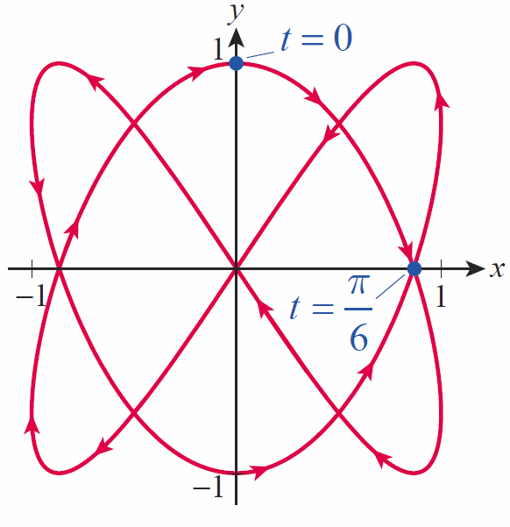

Example 2: Finding the Rate of Change of a Multivariable Function along a Parametric Curve
Determine the rate of change with respect to t of the function f(x, y) = xy along the Lissajous curve described parametrically by x = sin 2t and y = cos 3t. Then calculate at the specific points corresponding to t = 0 and t = π/6 (see Figure 2).
Figure 2
$$x=sin2t and y=cos3t$$

Slide 11
Example 2: Finding the Rate of Change of a Multivariable Function along a Parametric Curve (cont.)
Solution
Using the Chain Rule, we have the following.

Slide 12
Example 2: Finding the Rate of Change of a Multivariable Function along a Parametric Curve (cont.)
If we desired, we could now express as a function of t alone, but the previous formula is sufficient to evaluate at the two points where t = 0 and t = π/6. These two points are, respectively, (0, 1) and

Slide 13
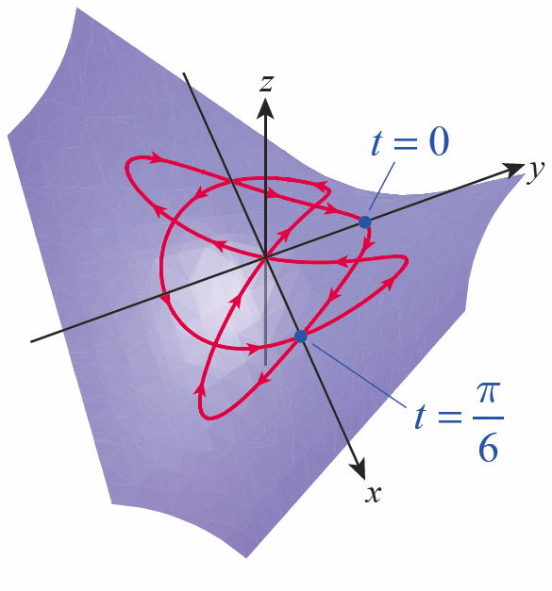

Example 2: Finding the Rate of Change of a Multivariable Function along a Parametric Curve (cont.)
If we consider the surface z = f(x, y), then the two derivatives we just found correspond to the rates of change of a point traveling along the curve shown in Figure 3 at the two locations corresponding to t = 0 and t = π/6. Note how the signs of the derivatives reflect the fact that z is increasing along the curve when t = 0, but decreasing along the curve when t = π/6.
Figure 3
$$z=f\left(x,y\right)=xy$$

Slide 14
Theorem: The Chain Rule (Case II)
If z = f(u, v) is a differentiable function and if u = g(x, y) and v = h(x, y) are both differentiable functions of x and y, then the composite function is a differentiable function of x and y and

Slide 15
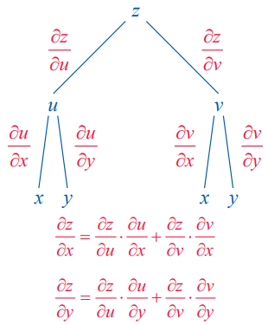
Example 3: Using a Tree Diagram to Apply the Chain Rule (Case II)
If z = e^{u+2v} while u = x³y and v = y² − x, determine ∂z/ ∂x and ∂z/ ∂y.
Solution
A tree diagram is again useful in remembering and applying the Chain Rule, and Figure 4 illustrates the relevant relationships of the variables.
Figure 4

Slide 16
Example 3: Using a Tree Diagram to Apply the Chain Rule (Case II) (cont.)
In this case, to determine the derivative of the top variable with respect to either of the independent variables, multiply the derivatives along each appropriate path and add the resulting products.

Slide 17
Example 3: Using a Tree Diagram to Apply the Chain Rule (Case II) (cont.)
If desired, we could now substitute u = x³y and v = y² − x to express each partial derivative explicitly in terms of x and y.

Slide 18
Theorem: The Chain Rule (General Case)
If is a differentiable function of and if each variable is a differentiable function of then y is a differentiable function of and
for each i = 1, 2, …, m.

Slide 19
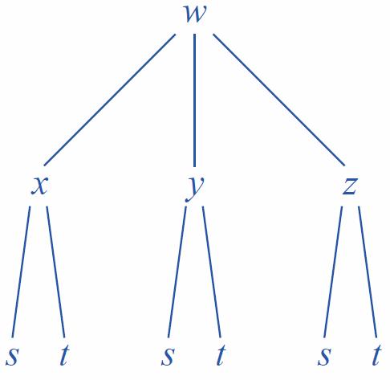
Example 4: Using a Tree Diagram to Apply the Chain Rule
Given that w = 2xy³ + x²z − yz² while x = s − t, y = s² + t², and z = st, determine w_{s} and w_{t} (answers may be left in terms of the intermediate and independent variables).
Solution
The relevant tree diagram appears in Figure 5, and we apply the same procedure as previously.
Figure 5

Slide 20
Example 4: Using a Tree Diagram to Apply the Chain Rule (cont.)
Hence,
and

Slide 21
Example 5: Using the Chain Rule to Find Second-Order Partial Derivatives
Assume has continuous second-order partial derivatives. If x = v² − u² and y = uv, determine z_{uu} and z_{vv}.
Solution
We begin by finding z_{u}.

Slide 22
Example 5: Using the Chain Rule to Find Second-Order Partial Derivatives (cont.)
Without knowing anything further about the function f, z_{u} must be left in terms of z_{x} and z_{y}. However, we do know that z_{x} and z_{y} are also functions of u and v, so we can differentiate with respect to u again to determine z_{uu}, making use of the equality of mixed partial derivatives along the way.

Slide 23
Example 5: Using the Chain Rule to Find Second-Order Partial Derivatives (cont.)

Slide 24
Implicit Differentiation via the Chain Rule
Let F(x, y) = 0 be an equation in x and y (written so that all the terms appear on one side), and assume the equation implicitly defines y as a function of x. Then if F is differentiable, differentiation with respect to x yields

Slide 25
Implicit Differentiation via the Chain Rule (cont.)
Since dx/dx = 1, solving for dy/dx gives us
assuming we are evaluating dy/dx at a point where F_{y} ≠ 0.

Slide 26
Example 6: Using the Chain Rule for Implicit Differentiation
Find dy/dx, given that
Solution
Defining the equation has the form

Slide 27
Implicit Differentiation via the Chain Rule (cont.)
The Implicit Function Theorem, typically proved in an advanced calculus course, outlines conditions under which an equation is guaranteed to define one variable as a differentiable function of the others. In the two-variable case, the theorem states that if F(x, y) is defined and has continuous partial derivatives in a neighborhood of the point (a, b), and if F(a, b) = 0 and F_{y}(a, b) ≠ 0, then the equation F(x, y) = 0 defines y as a function of x near (a, b) and dy/dx = −F_{x} /F_{y}.

Slide 28
Implicit Differentiation via the Chain Rule (cont.)
The three-variable case is similar: if F(x, y, z) is defined and has continuous partial derivatives in a neighborhood of the point (a, b, c), and if F(a, b, c) = 0 and F_{z}(a, b, c) ≠ 0, then the equation F(x, y, z) = 0 defines z as a function of x and y and

Slide 29
Example 7: Finding Partial Derivatives of an Implicit Function
Find z_{x} and z_{y}, given that
Solution
Defining the equation has
the form Now we can find z_{x} and z_{y}.

