Slide 1
Section 13.6
Tangent Planes and Differentials

Slide 2
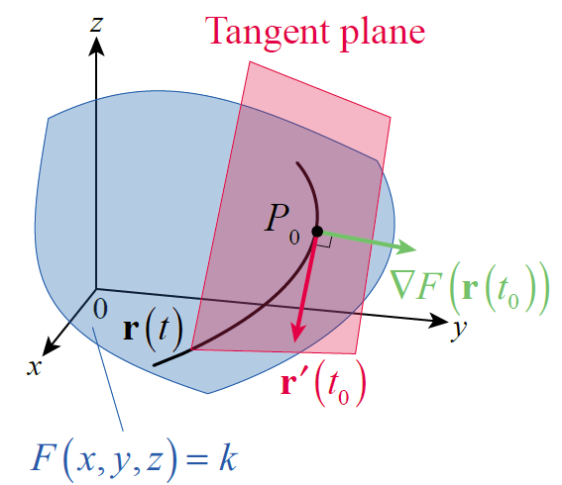
Tangent Planes and Normal Lines
The gradient of a function of two variables always points in a direction normal to the function’s contour curves; the same reasoning applies to functions of any number of variables. For our present
purposes, let F(x, y, z) be a
differentiable function, and
suppose
is a smooth curve on a particular
level surface of F, say
F(x, y, z) = k (see Figure 1).
Figure 1

Slide 3
Tangent Planes and Normal Lines (cont.)
Then, using the Chain Rule and gradient notation, we have the following.
In other words, the vector which we know is tangent to the curve r(t), is orthogonal to ∇F at every point on the surface F(x, y, z) = k.

Slide 4
Tangent Planes and Normal Lines (cont.)
Recall that a plane is completely characterized by one of its points, say (x₀, y₀, z₀), and a normal vector n, as each point (x, y, z) of the plane must then satisfy the equation
Since is normal to the tangent vector at
the point for every smooth curve on the surface, we define the tangent plane to a surface and the normal line to the surface as follows.

Slide 5
Definition: Tangent Plane and Normal Line
Given a differentiable function F(x, y, z), the tangent plane at the point on the level surface
is described by the equation

Slide 6
Definition: Tangent Plane and Normal Line (cont.)
Similarly, since ∇F is normal to the surface
the normal line to the surface at the point
is described by the vector function
and parametrically by the following equations.

Slide 7
Example 1: Determining the Tangent Plane and Normal Line at a Point on a Surface
Determine the tangent plane and normal line at the point (2, 1, 8) of the surface defined by
Solution
If we let then the graph of
is a level surface of F. The first step in answering both questions is to determine the gradient of F.

Slide 8
Example 1: Determining the Tangent Plane and Normal Line at a Point on a Surface (cont.)
In particular, so the equation for the tangent plane at the point (2, 1, 8) is as follows.
Next, the vector equation for the normal line passing through (2, 1, 8) with direction vector is

Slide 9
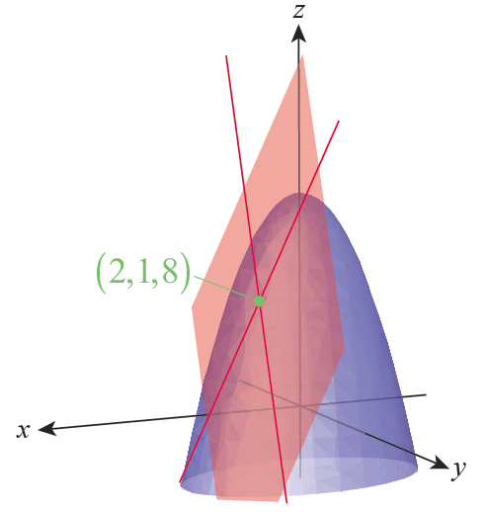
Example 1: Determining the Tangent Plane and Normal Line at a Point on a Surface (cont.)
Figure 2 is an illustration of the
surface F(x, y, z) = 15 and its
tangent plane at the point
(2, 1, 8), with tangent lines
parallel to the xz-plane and
yz-plane shown as well.
Figure 2

Slide 10
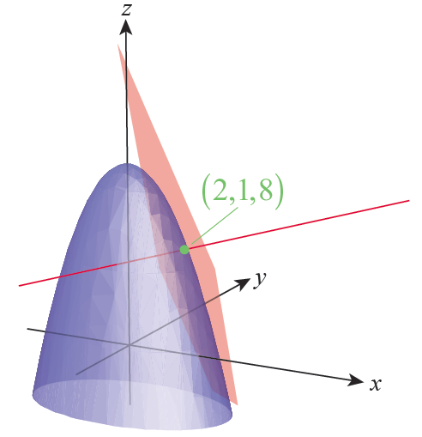
Example 1: Determining the Tangent Plane and Normal Line at a Point on a Surface (cont.)
Figure 3 is the same surface
and tangent plane from a
different perspective with the
normal line through (2, 1, 8)
shown.
Figure 3

Slide 11
Tangent Planes and Normal Lines (cont.)
Sometimes surfaces in ℝ³ are defined as graphs of functions of two variables, such as z = f(x, y). In this case, we can think of the surface as a level surface of the function F(x, y, z) = f(x, y) − z, so
and the tangent plane at a point is described as follows.

Slide 12
Example 2: Determining the Tangent Plane at a Point on a Surface
Determine the tangent plane at the point of the surface
Solution
If we define then
So and the tangent
plane is described by

Slide 13
Tangent Planes and Normal Lines (cont.)
The fact that ∇F is normal to the tangent of any smooth curve on the surface F(x, y, z) = k provides a convenient shortcut in solving certain types of problems.

Slide 14
Example 3: Finding Parametric Equations for a Line Tangent to a Smooth Curve on a Surface
Consider the curve C defined by the intersection of the surfaces and z = 4 − x² − 2y². Find the parametric equations for the line tangent to C at the point (1, 1, 1).
Solution
The direct way of solving this problem would be to find a parametrization r(t) of the curve C, determine r′ at the point (1, 1, 1), and then use the result as a direction vector for the tangent line. But we can shorten the process considerably by skipping the step of parametrizing C.

Slide 15
Example 3: Finding Parametric Equations for a Line Tangent to a Smooth Curve on a Surface (cont.)
If we define and
then C is the intersection of the level surfaces F(x, y, z) = 0 and G(x, y, z) = 4 and the point (1, 1, 1) lies on both surfaces. We know that
∇F(1, 1, 1) is normal to the tangent of C at the point
(1, 1, 1), since C is a curve on the surface F(x, y, z) = 0. Likewise, ∇G(1, 1, 1) is normal to the tangent of C at
(1, 1, 1) since C is a curve on the surface G(x, y, z) = 4. So by the properties of the cross product, the vector
must point in the direction of the desired tangent line.

Slide 16
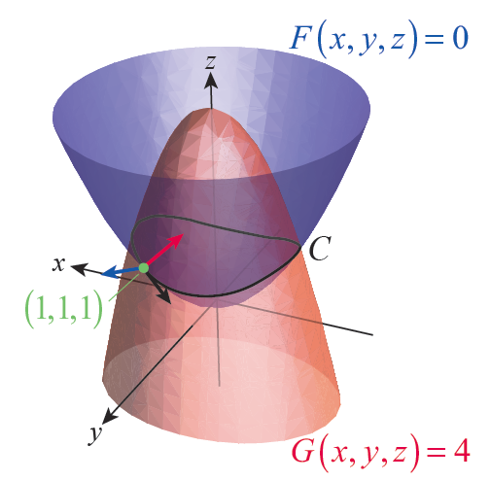
Example 3: Finding Parametric Equations for a Line Tangent to a Smooth Curve on a Surface (cont.)
Figure 4 shows the surface
F(x, y, z) = 0 in blue, the
surface G(x, y, z) = 4 in red,
and three unit vectors
pointing in the directions of
∇F(1, 1, 1), ∇G(1, 1, 1), and
v in red, blue, and black,
respectively.
Figure 4

Slide 17
Example 3: Finding Parametric Equations for a Line Tangent to a Smooth Curve on a Surface (cont.)
These lead to and
Thus, describes the line tangent to C at the point (1, 1, 1), giving us the parametric equations
x = 1 − 10t, y = 1 + 6t, and z = 1 − 4t.

Slide 18
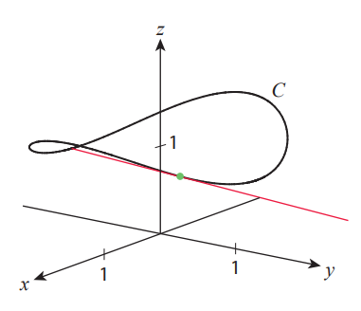
Example 3: Finding Parametric Equations for a Line Tangent to a Smooth Curve on a Surface (cont.)
Figure 5 is an illustration of the curve C with its tangent line at (1, 1, 1).
Figure 5

Slide 19
Definition: Linear Approximations and Total Differentials
Given a function f(x, y) differentiable at the point
(x₀, y₀) its linear approximation (or linearization) at
(x₀, y₀) is the function

Slide 20
Definition: Linear Approximations and Total Differentials (cont.)
The (total) differential df at the point (x₀, y₀) is the change in the linearization of f from the point (x₀, y₀) to the point (x₀ + dx, y₀ + dy), where the differentials dx and dy are independent variables. That is,

Slide 21
Definition: Linear Approximations and Total Differentials (cont.)
Using alternate notation, if z = f(x, y), the differential dz is a function of the differentials dx and dy defined by

Slide 22
Differentials and Linear Approximations
In other words, the linear approximation of the surface z = f(x, y) at the point (x₀, y₀) is obtained by expressing the tangent plane
as a function of x and y.

Slide 23
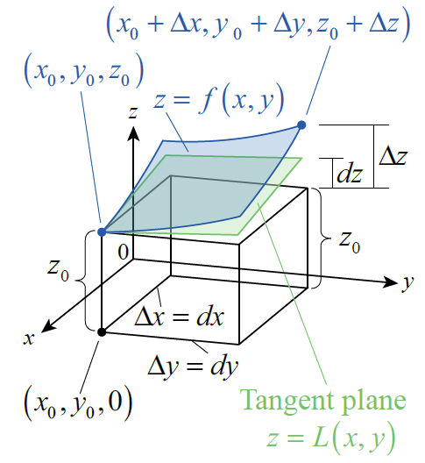
Differentials and Linear Approximations (cont.)
Figure 6 illustrates the
relationship between a
surface z = f(x, y), its
linearization L(x, y), the
increments Δx, Δy, Δz,
and the differentials dx,
dy, and dz.
Figure 6

Slide 24
Example 4: Finding the Differential and Linearization of a Function of Two Variables
Let Find
a. the differential df at an arbitrary point (x, y) and
b. the linearization of f at the point (2, 1).
Solution
Both the differential and linearization depend on the partial derivatives of f, so we begin with them.

Slide 25
Example 4: Finding the Differential and Linearization of a Function of Two Variables (cont.)
b. The linearization of f at the point (2, 1) is the following function.

Slide 26
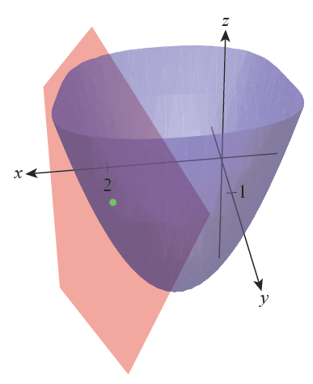
Example 4: Finding the Differential and Linearization of a Function of Two Variables (cont.)
The graph of z = f(x, y), and its linearization (i.e., tangent plane) at the point (2, 1) are shown in Figure 7.
Figure 7

Slide 27
Example 5: Finding an Upper Bound on Relative Error
Consider again the density formula If the mass m of an object is known to within 2% relative error and its volume v to within 5% relative error, find an upper bound on the relative error with which its density is known.
Solution
We begin by finding dρ.

Slide 28
Example 5: Finding an Upper Bound on Relative Error (cont.)
We know that the true mass of the object is approximately m ± dm, and the information we are given tells us that Similarly,
and we seek an upper bound on the relative error
Dividing the differential dρ by ρ, we obtain
so by the Triangle Inequality we have the following.

Slide 29
Example 6: Finding an Upper Bound on Relative Error
Suppose the radius r of a right circular cylindrical oil drum is known to within 4% relative error and its height h to within 1% relative error. Find an upper bound on the relative error with which the drum’s volume V is known.
Solution
Beginning with the volume formula V = πr²h, we obtain

Slide 30
Example 6: Finding an Upper Bound on Relative Error (cont.)
and so,
Note that an error in the measurement of r has twice as much effect in the relative error of V as an error in the measurement of h. For the relative errors given, we can state that

Slide 31
Example 7: Linearizing a Function of Four Variables
Find the linear approximation of the following function at the given point.
Solution
The linearization of f at (−2, 1, 0, 3) is given by the formula

Slide 32
Example 7: Linearizing a Function of Four Variables (cont.)
So we calculate the following values of the function and its four partial derivatives.

Slide 33
Example 7: Linearizing a Function of Four Variables (cont.)
Hence,

