Slide 1
Section 13.7
Extreme Values of Functions of Two Variables

Slide 2
Definition: Absolute (Global) and Relative (Local) Extrema
Given a function f(x, y) defined on a domain D, we say f has an absolute maximum (or global maximum) on D at the point (a, b) if for all and f(a, b) is consequently called the maximum value of f on D.
Similarly, if for all we say f has an absolute minimum (or global minimum) at (a, b), and we call f(a, b) the minimum value of f on D.

Slide 3
Definition: Absolute (Global) and Relative (Local) Extrema (cont.)
The function f has a relative (or local) maximum at (a, b) if for all domain points (x, y) in some open region containing (a, b), with relative (or local) minimum defined similarly but with the inequality reversed.

Slide 4
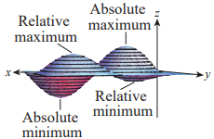
Absolute and Relative Extrema
Figure 1 is an illustration of a surface on a domain D that has exactly one absolute maximum and one absolute minimum. For this relatively well-behaved function, it is clear that at each extreme point the
tangent plane is horizontal—that is, parallel to the xy-plane. This is analogous to the fact that the tangent line, if it exists, is horizontal at an extreme point of a function of one variable.
Figure 1

Slide 5
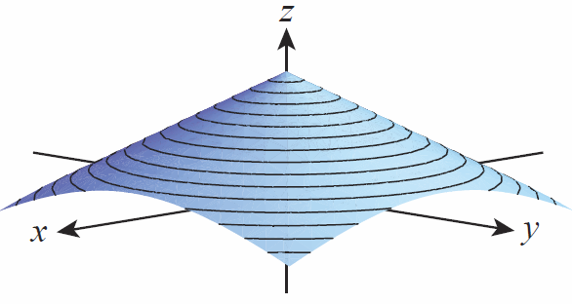
Absolute and Relative Extrema (cont.)
But as in the one-variable case, a function of two variables may have an extremum at a point without a tangent plane, as seen in Figure 2.
Figure 2

Slide 6
Definition: Critical Point
Given a function f(x, y) defined on domain D, an interior point is a critical point of f if or if one or both of f_{x} and f_{y} do not exist at (a, b).

Slide 7
Theorem: Relative Extrema Are Critical Points
If f(x, y) has a relative extremum at an interior point (a, b) of its domain, and if f_{x} and f_{y} both exist at (a, b), then f_{x}(a, b) = 0 = f_{y}(a, b).

Slide 8
Proof
If we define the function of one variable g(x) = f(x, b), then g has a relative extremum at x = a and so by Fermat’s Theorem (the single-variable version of this theorem) we know that Since In similar fashion, defining results in

Slide 9
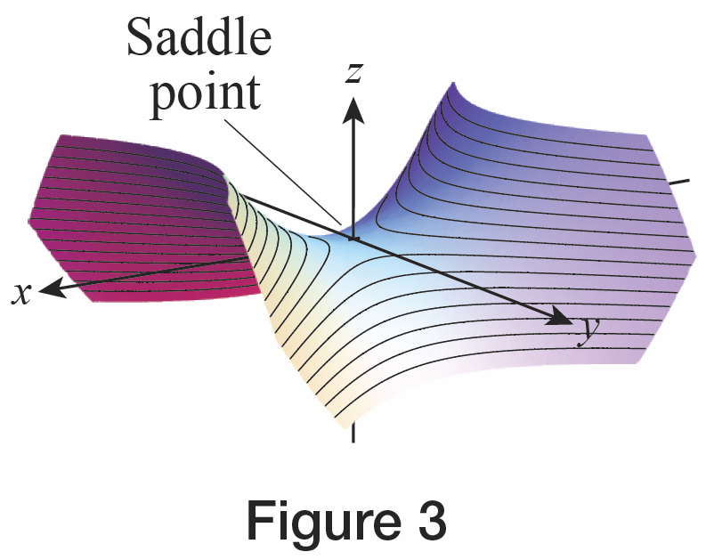
Definition: Saddle Point
A differentiable function f(x, y) has a saddle point at a critical point (a, b) if f takes on values both larger and smaller than f(a, b) in every open neighborhood
of (a, b). That is, if every
open disk centered at (a, b)
contains a point with
and a point
with
Figure 3

Slide 10
Example 1: Finding the Relative Extrema of a Function of Two Variables
Find the relative extrema of the function
Solution
Since f is a polynomial, it is differentiable everywhere and the only critical points will be where both partial derivatives are 0. So we proceed to solve the equations f_{x} = 0 and f_{y} = 0.

Slide 11
Example 1: Finding the Relative Extrema of a Function of Two Variables (cont.)
Hence the only candidate for a relative extremum is but we don’t yet know if f has a local minimum, a local maximum, or a saddle point at However, if we complete the square on the terms comprising f, we find In this form, f takes on its minimum value of −5 at the point so f has a local minimum value of −5 at (In fact, −5 is the global minimum value of f.)

Slide 12
Example 2: Finding the Relative Extrema of a Function of Two Variables
Find the relative extrema of the function
Solution
The partial derivatives are f_{x} = 2x and f_{y} = −2y. They tell us that the only critical point is (0, 0).
Since and f takes on both
larger and smaller values than
f(0,0) at points arbitrarily close
to (0,0) and hence f has a saddle
point at (0,0) (see Figure 3).
Figure 3

Slide 13
Theorem: Second Partial Derivative Test
Assume the second partial derivatives of are continuous on an open disk D centered at and that Then
1. f has a relative minimum at (a, b) if f_{xx} > 0 and
at (a, b);
2. f has a relative maximum at (a, b) if f_{xx} < 0 and
at (a, b);

Slide 14
Theorem: Second Partial Derivative Test (cont.)
3. f has a saddle point at (a, b) if at
(a, b);
4. the test is inconclusive if at (a, b).

Slide 15
Proof Sketch
While a complete proof of the theorem is best left for a class in advanced calculus, the basic idea can be presented here.
The assumption that the second partial derivatives of f are all continuous on D means that the first partial derivatives are differentiable and continuous, which in turn means that f is differentiable and continuous on D.

Slide 16
Proof Sketch (cont.)
And for any choice of sufficiently small positive real numbers h and k, the line segment parametrized by
lies entirely in D. If we define F to be the restriction of f along the line segment with the formula , then by the Chain Rule,

Slide 17
Proof Sketch (cont.)
The differentiability of f_{x} and f_{y} means is differentiable and hence

Slide 18
Proof Sketch (cont.)
We can apply Taylor’s Formula to the function F(t) on the interval [0, 1] to write
where c is some real number in (0, 1).

Slide 19
Proof Sketch (cont.)
Expressing this back in terms of f ,

Slide 20
Proof Sketch (cont.)
Since the change from to is thus

Slide 21
Proof Sketch (cont.)
We are interested in the sign of for all eligible h and k. If the difference is always positive, then f has a relative minimum at (a, b); while if the difference is always negative, then f has a relative maximum at (a, b); and if the difference takes on both positive and negative values, then f has a saddle point at (a, b). So we examine the sign of the function

Slide 22
Proof Sketch (cont.)
If the continuity of the partial derivatives means that and will have the same sign for small enough h and k, and we look specifically at
In the first two cases of the theorem we also know that so by completing the square we can write

Slide 23
Proof Sketch (cont.)
1. If and then
and f has a relative minimum at
2. If and then
and f has a relative maximum at
3. If it can be shown that
takes on both positive and negative values as h and k, vary and hence f has a saddle point at

Slide 24
Proof Sketch (cont.)
4. If no conclusion can be drawn
and the critical point (a, b) must by studied by other means.

Slide 25
Finding Extrema
The quantity called the discriminant or Hessian in this context, can be remembered as the following determinant.

Slide 26
Example 3: Using the Second Partial Derivative Test
Use the Second Derivative Test to classify the critical points of
Solution
Since f is a polynomial function, we know ahead of time that its second partial derivatives are continuous everywhere, so the Second Derivative Test will apply.

Slide 27
Example 3: Using the Second Partial Derivative Test (cont.)
To start, we find the critical points of f by setting the first partial derivatives equal to 0.
The first equation implies x = y, and substituting this into the second equation results in

Slide 28
Example 3: Using the Second Partial Derivative Test (cont.)
Thus, f has two critical points, (0, 0) and (1, 1). To test them, we next determine the second partial derivatives.
Hence,

Slide 29
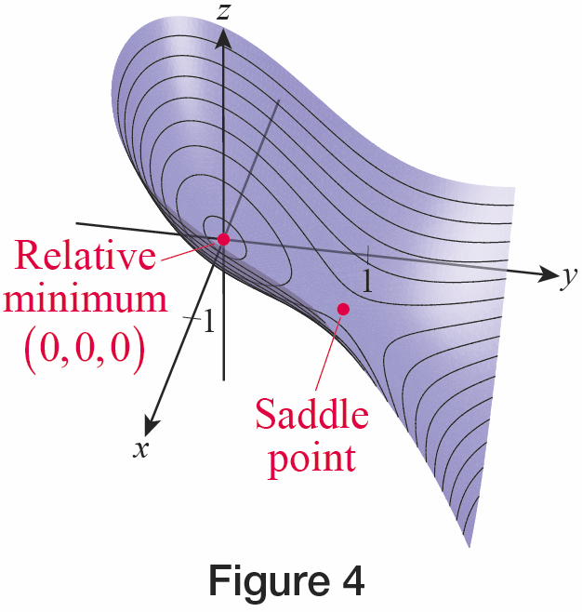
Example 3: Using the Second Partial Derivative Test (cont.)
Since at (0, 0) (as well as at every other point), the Second Partial Derivative Test tells us that f has a relative minimum at (0, 0); note that the relative minimum value at this point is
f(0, 0) = 0. And since the discriminant is negative at (1, 1), we conclude f has a saddle point at (1, 1). A graph of this portion of f, with the two critical points identified, appears in Figure 4.
Figure 4

Slide 30
Example 4: Using the Second Partial Derivative Test
Use the Second Partial Derivative Test to classify the critical points of
Solution
Once again, f is a polynomial so we are assured that the Second Partial Derivative Test will apply and that the only critical points will be those where the first partial derivatives are simultaneously equal to 0.

Slide 31
Example 4: Using the Second Partial Derivative Test (cont.)
Those critical points are where
Both derivatives can be factored by grouping, and doing so will allow us to quickly identify the critical points.

Slide 32
Example 4: Using the Second Partial Derivative Test (cont.)
We will consider the three ways in which and, for each solution, solve the corresponding equation
If y = 0, then and implies x = 2, −1.
If y = 3, then and implies x = 2, −1.
If then and implies

Slide 33
Example 4: Using the Second Partial Derivative Test (cont.)
So the five critical points are (−1, 0), (2,0), (−1, 3), (2, 3), and The next step is to find the second partial derivatives, and again the factored form of each first derivative is handy.

Slide 34
Example 4: Using the Second Partial Derivative Test (cont.)
If we define then
so f has a saddle point at each of these four critical points. For the remaining critical point,
so f has a relative maximum at

Slide 35
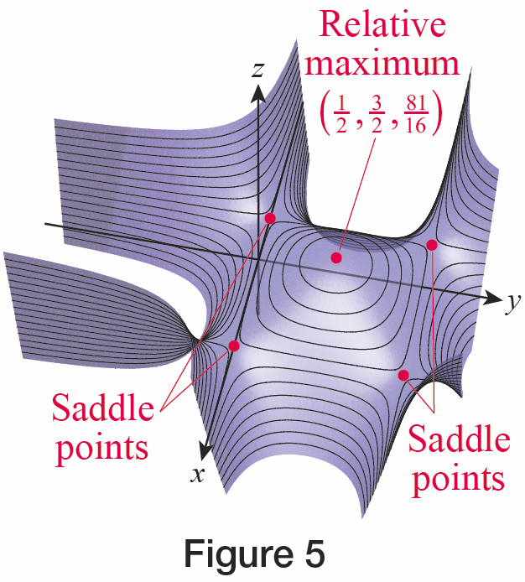
Example 4: Using the Second Partial Derivative Test (cont.)
Its relative maximum value is A graph of f and these five critical points appears in Figure 5.
Figure 5

Slide 36
Technology Note: Finding Second Partial Derivatives and Values
A computer algebra system such as Mathematica can be used to speed up the process of calculating the values of discriminants and second‑order partial derivatives; one way of doing so is shown in Figure 6. The built-in command Evaluate tells Mathematica to compute the expression inside the brackets immediately, which is often necessary when we define new functions in terms of old (in this case, the new functions are derivatives of existing functions).

Slide 37
Technology Note: Finding Second Partial Derivatives and Values (cont.)
Note the composition of the differentiation command D with itself, which is how we find and In Figure 6, the second‑order partial derivative functions have been given the names fxx, fxy, and fyy, and the discriminant function has been given the name disc.

Slide 38
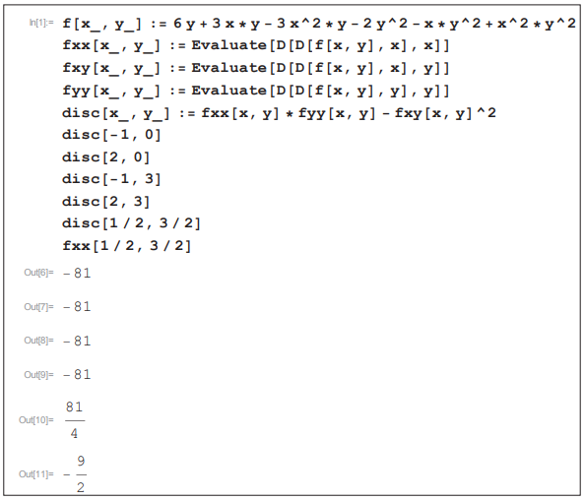
Technology Note: Finding Second Partial Derivatives and Values (cont.)
Figure 6

Slide 39
Theorem: The Extreme Value Theorem for Functions of Two Variables
If f(x, y) is a continuous function defined on a closed and bounded region D ⊆ ℝ², then there exist points and in D where f attains both its absolute maximum value and absolute minimum value (Recall that a region is closed if it contains all its boundary points;
D ⊆ ℝ² is bounded if it is contained in a disk of some radius centered at the origin.)

Slide 40
Procedure: Strategy for Finding Absolute Extrema
To find an absolute extrema of f(x, y) on a closed and bounded region D ⊆ ℝ², perform the following steps.
Step 1: Find and classify the critical points of f on the interior of D. Calculate the value of f at each relative extrema.
Step 2: Find the relative extrema of f on the boundary of D, and calculate the value of f at each such point. (We will see how this can be done in the next two examples.)

Slide 41
Procedure: Strategy for Finding Absolute Extrema (cont.)
Step 3: Compare the values computed in the first two steps. The largest is the absolute maximum value of f on D, and the smallest is the absolute minimum value of f on D.

Slide 42
Example 5: Finding the Absolute Extrema of a Function of Two Variables
Find the absolute extrema of the function on the triangular region
D ⊆ ℝ² with vertices (0, 0), (4, 0), and (0, 4).
Solution
We start by identifying all critical values of f, regardless of where they lie—we will then pick out those that lie in D.

Slide 43
Example 5: Finding the Absolute Extrema of a Function of Two Variables (cont.)
As it turns out, f has a single critical point (2, 1), and it lies in the interior of D. Since and we have everywhere and everywhere, so f has a relative maximum at (2, 1). Its relative maximum value there is f(2,1) = 13.
But we now have to compare the relative maximum value of f in the interior of D with any extreme values of f on the boundary of D, and we do so by considering the three sides of the triangular region one by one.

Slide 44
Example 5: Finding the Absolute Extrema of a Function of Two Variables (cont.)
Along x = 0, 0 ≤ y ≤ 4:
The critical point of this function of y on the interval [0, 4] is y = 1. But we also have to check the endpoints of [0, 4]. So we note that f(0, 0) = 8, f(0, 1) = 9, and f(0, 4) = 0.

Slide 45
Example 5: Finding the Absolute Extrema of a Function of Two Variables (cont.)
Along y = 0, 0 ≤ x ≤ 4:
The critical point of this function of x on the interval [0, 4] is x = 2. But again, we also have to evaluate f at the endpoints (one of which we have already done). So we note that f(2, 0) = 12 and f(4, 0) = 8.
Along x + y = 4, x ≥ 0, y ≥ 0: Using y = 4 − x,

Slide 46
Example 5: Finding the Absolute Extrema of a Function of Two Variables (cont.)
Since we seek the critical point of f on this interval, we differentiate with respect to x, set the result equal to 0, and solve to obtain The corresponding y-value is and we note that
Comparing the values obtained, we now know that the absolute maximum value of f on D is 13 and occurs at (2, 1) and that the absolute minimum value is 0 and occurs at (0, 4).

Slide 47
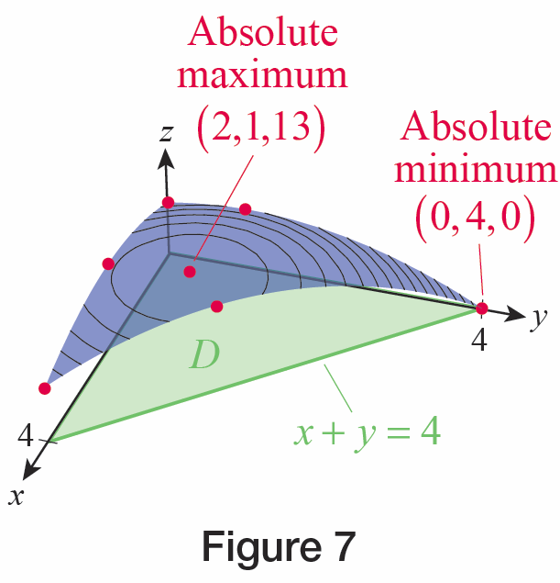
Example 5: Finding the Absolute Extrema of a Function of Two Variables (cont.)
Figure 7 is an illustration of the surface f (in blue)
restricted to the domain D
(in green), with the seven candidates for absolute extrema appearing as red points on the surface.
Figure 7

Slide 48
Example 6: Maximizing the Volume of a Box
A well-known parcel service specifies that packages in one rate category must be boxes whose length plus girth is no greater than 84 inches, where “length” is defined as the length of the longest side and “girth” is the perimeter of the parcel’s cross-section. What dimensions in this rate category maximize the volume of such a box? What is the maximum possible volume?

Slide 49
Example 6: Maximizing the Volume of a Box (cont.)
Solution
If we let x denote the box’s length and y and z the dimensions of the cross‑section, then we want to find the absolute maximum of the function V = xyz under the restriction that x + 2y + 2z = 84 (and x, y, z ≥ 0). Substituting x = 84 − 2y − 2z, we can reduce this to finding the absolute maximum of on the region D in the
yz-plane defined by y ≥ 0, z ≥ 0, and 84 − 2y − 2z ≥ 0 (or y + z ≤ 42).

Slide 50
Example 6: Maximizing the Volume of a Box (cont.)
We proceed as in Example 5, first identifying the critical points of V.

Slide 51
Example 6: Maximizing the Volume of a Box (cont.)
The only remaining critical point satisfies the system 42 − 2y − z = 0 and 42 − y − 2z = 0, giving us y = z. Making this substitution in either V_{y} = 0 or V_{z} = 0 leads to the last critical point (14,14) so we calculate
It can be shown that V(y, z) = 0 on each edge of the boundary D and that V has a relative (and hence absolute) maximum value at the point (14,14).

Slide 52
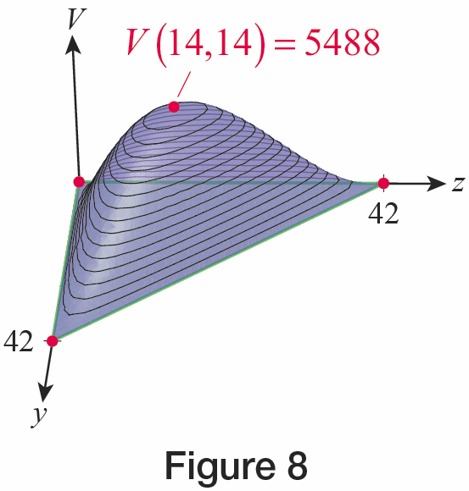
Example 6: Maximizing the Volume of a Box (cont.)
Thus, the dimensions that maximize volume are a length of 28 inches with a square cross-section of width
14 inches, and the maximum possible volume is 5488 cubic inches. Figure 8 shows a graph of the function V over its triangular region of definition.
Figure 8

