Slide 1
Section 13.8
Lagrange Multipliers

Slide 2
The Method of Lagrange Multipliers
The fact that the gradient of a multivariable function is orthogonal to its level curves lies at the heart of the method. To gain an intuitive understanding of why the method works, consider the task of maximizing or minimizing a function f(x, y) under the constraint that g(x, y) = k; in other words, considering only those points (x, y) on the curve g(x, y) = k, find the extreme values of f(x, y). In general, we would not expect the contour lines of f and g to exhibit any common behavior, so f may very well take on different values as we trace out the contour g(x, y) = k.

Slide 3
The Method of Lagrange Multipliers (cont.)
But suppose (x₀, y₀) is a point at which the tangents to the contour lines of f and g coincide. Then, in the direction of the contour, f is neither increasing nor decreasing at the point (x₀, y₀), meaning (x₀, y₀) is a critical point for f and a candidate for an extremum. Since and are both orthogonal to the common tangent line at the point (x₀, y₀), for some constant λ. The real number λ is called a Lagrange multiplier in this context. Before formalizing the above argument, we will demonstrate its application with an example.

Slide 4
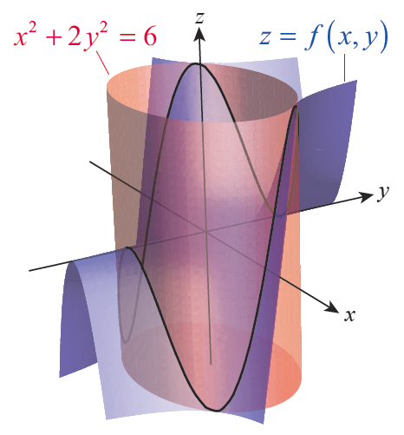
Example 1: Using Lagrange Multipliers to Find Absolute Extreme Values
Find the absolute extreme values of the function f(x, y) = x²y on the curve x² + 2y² = 6.
Solution
The graph of z = f(x, y) is shown as the blue surface in Figure 1, and the graph of x² + 2y² = 6 in red (recall that since z doesn’t appear in the constraint, the graph of x² + 2y² = 6 in ℝ³ is an elliptic cylinder parallel to the z­-axis).
Figure 1

Slide 5
Example 1: Using Lagrange Multipliers to Find Absolute Extreme Values (cont.)
If we define g(x, y) = x² + 2y², then we seek the extreme values of f(x, y) subject to the constraint g(x, y) = 6; that is, we are looking for the high and low points on the intersection of the two surfaces, shown as the black curve in Figure 1.
Figure 1

Slide 6
Example 1: Using Lagrange Multipliers to Find Absolute Extreme Values (cont.)
Using Lagrange’s method, we introduce the variable λ and solve the equation ∇f = λ∇g for x and y. But this equation actually has three variables, and we will need to also consider the constraint g(x, y) = 6 in order to determine x and y. Since and we are led to the following system of equations.

Slide 7
Example 1: Using Lagrange Multipliers to Find Absolute Extreme Values (cont.)
The first equation implies x = 0 or λ = y. Since f takes on both positive and negative values along the curve g(x, y) = 6 and f(0, y) = 0, the solution x = 0 can be discarded. Substituting λ = y into the second equation results in the relation x² = 4y², and substituting this into the third equation gives us y² = 1, or y = ±1. Using the relation x² = 4y² again, we obtain x = ±2. We could also note that λ = ±1, but we don’t actually need explicit values for λ—its purpose was simply to stretch, shrink, and/or reverse ∇g so that the equation ∇f = λ∇g could be satisfied.

Slide 8
Example 1: Using Lagrange Multipliers to Find Absolute Extreme Values (cont.)
The four points (±2, ±1) are the candidates for the extreme values of f on g(x, y) = 6, and we simply compute f at each of them and compare to finish the task.

Slide 9
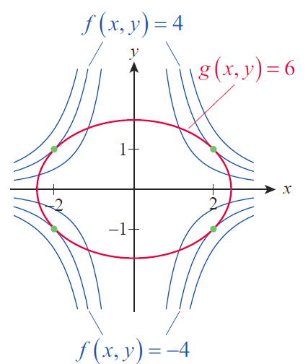
Example 1: Using Lagrange Multipliers to Find Absolute Extreme Values (cont.)
Figure 2 is an illustration of how the contour curves are tangent to the curve g(x, y) = 6 only at (±2, ±1). A total of six contours of f are shown, but only for the contours f(x, y) = 4 and f(x, y) = −4 is it possible to find points where ∇f = λ∇g.
Figure 2

Slide 10
Procedure: The Method of Lagrange Multipliers
If f(x, y, z) and g(x, y, z) are differentiable in an open region containing the level surface g(x, y, z) = k and ∇g ≠ 0 on g(x, y, z) = k, then any relative extrema of f can be found as follows.
Step 1: Simultaneously solve the equations

Slide 11
Procedure: The Method of Lagrange Multipliers (cont.)
Step 2: Evaluate f at the solution points (x, y, z) found in Step 1. To identify the relative minima and relative maxima of f on g(x, y, z) = k, it suffices to compare the value of f at the solution points.

Slide 12
Proof
Suppose f has a relative extremum on the surface g(x, y, z) = k at the point (x₀, y₀, z₀), and that is a smooth curve on the surface containing the point (x₀, y₀, z₀). Let t₀ be the value for which Since f has a relative extremum at (x₀, y₀, z₀),

Slide 13
Proof (cont.)
Geometrically, this means that is orthogonal to which is tangent to the curve r(t). But we also know that ∇g is orthogonal to any level surface of g at any point, so as well. Since this is true for every such smooth curve through (x₀, y₀, z₀), and since the two gradients ∇f and ∇g must be parallel at (x₀, y₀, z₀). That is, for some constant λ.

Slide 14
Example 2: Using the Method of Lagrange Multipliers to Maximize the Volume of a Box
Consider again the problem of maximizing the volume function V = xyz under the constraint that x + 2y + 2z = 84. Solve this problem using Lagrange multipliers.
Solution
If we define we need to solve the system

Slide 15
Example 2: Using the Method of Lagrange Multipliers to Maximize the Volume of a Box (cont.)
This gives us the following four equations.

Slide 16
Example 2: Using the Method of Lagrange Multipliers to Maximize the Volume of a Box (cont.)
Discarding a solution of 0 for any variable (since we know the maximum volume won’t be 0), the second and third equations tell us that y = z. Multiplying the first equation by 2 and substituting the result into the second equation gives us 2y = x. So we can write the fourth equation in terms of y to obtain 6y = 84, or y = 14. Hence, z = 14 as well and x = 28. Since (28, 14, 14) is the only solution of the system for which V ≠ 0, we know that V(28, 14, 14) = 5488 in.³ must be the maximum possible volume.

Slide 17
Example 3: Finding the Location on a Plane Closest to a Point
Find the location on the plane −2x − 6y + 4z = 8 closest to the point (1, −2, 3).
Solution
Although vector techniques can be used to solve this problem, the method of Lagrange multipliers provides a different approach that can be generalized to other types of curves and surfaces.

Slide 18
Example 3: Finding the Location on a Plane Closest to a Point (cont.)
Viewing the problem from this perspective, we seek to minimize the distance between the point (1, −2, 3) and the given plane. We could proceed to work with the distance function which represents the distance between the point (1, −2, 3) and an arbitrary point (x, y, z) on the plane −2x − 6y + 4z = 8 (or anywhere else in ℝ³), but we can make our work easier by instead choosing to minimize the function

Slide 19
Example 3: Finding the Location on a Plane Closest to a Point (cont.)
That is, the point (x, y, z) on the plane that minimizes the square of the distance will be the same point that minimizes the distance. In the language of this section, we are looking for the absolute minimum of f(x, y, z) under the constraint that g(x, y, z) = 8, where

Slide 20
Example 3: Finding the Location on a Plane Closest to a Point (cont.)
So we proceed to solve the following system.
Using the first three equations to express x, y, and z in terms of λ, and substituting the results into the fourth equation, we obtain 28λ + 22 = 8, so We then use this to determine that and z = 2.

Slide 21
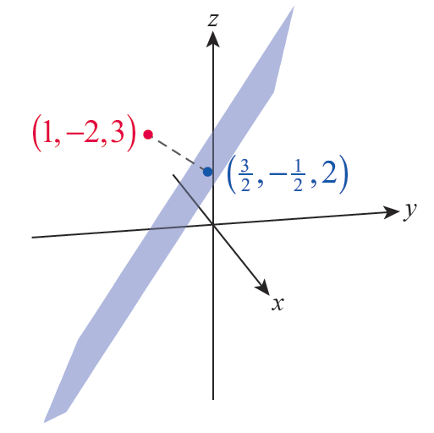
Example 3: Finding the Location on a Plane Closest to a Point (cont.)
Figure 3 is an illustration of the plane, the point (1, −2, 3) in red, and the solution point in blue.
Figure 3

Slide 22
Example 4: Finding the Points on a Curve of Relative Minimum and Maximum Distance from the Origin
In ℝ², find the points of relative minimum and maximum distance between the origin and the curve y² = x³ + 1.
Solution
We can again make our task easier by finding the relative extrema of the function f(x, y) = x² + y², the square of the distance between (x, y) and the origin, rather than the distance function itself. And we restrict the search to those points on the curve g(x, y) = 1, where g(x, y) = y² − x³.

Slide 23
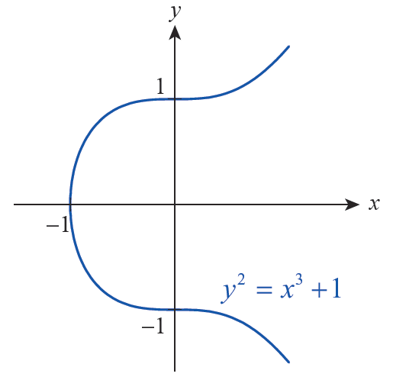
Example 4: Finding the Points on a Curve of Relative Minimum and Maximum Distance from the Origin (cont.)
Figure 4 shows a graph of the curve g(x, y) = 1, and clearly there is no upper bound on the distance between the origin and points on the graph (as x increases, the corresponding y‑values increase in magnitude).
Figure 4

Slide 24
Example 4: Finding the Points on a Curve of Relative Minimum and Maximum Distance from the Origin (cont.)
But near the origin, it appears there should be points of relative extrema of f. We find them by solving the following system.

Slide 25
Example 4: Finding the Points on a Curve of Relative Minimum and Maximum Distance from the Origin (cont.)
From the second equation we know that y(λ − 1) = 0, so y = 0 or λ = 1. We consider these two cases separately as follows.
If y = 0: The third equation becomes x³ = −1 and so x = −1.
If λ = 1: The first equation becomes x(3x + 2) = 0 so x = 0 or
The corresponding y‑values are, respectively, y = ±1 and

Slide 26
Example 4: Finding the Points on a Curve of Relative Minimum and Maximum Distance from the Origin (cont.)
Comparing the values of f at each of these points, we find
Remember that these values are the square of the distance from the points to the origin, but the location of these relative extrema is the same whether we are optimizing the distance or the distance squared.

Slide 27
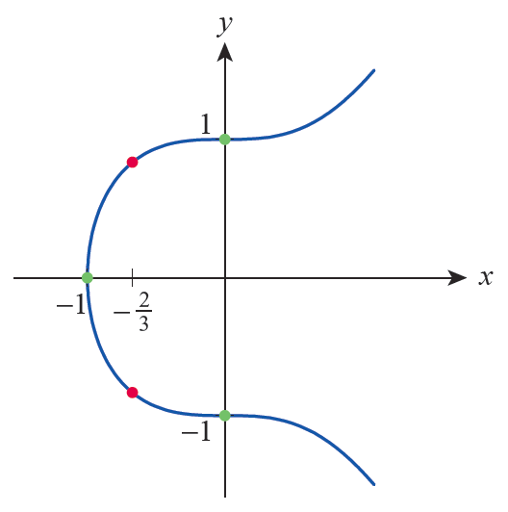
Example 4: Finding the Points on a Curve of Relative Minimum and Maximum Distance from the Origin (cont.)
Figure 5 illustrates the relative extrema we have located, with the relative minima in green and the relative maxima in red.
Figure 5

Slide 28
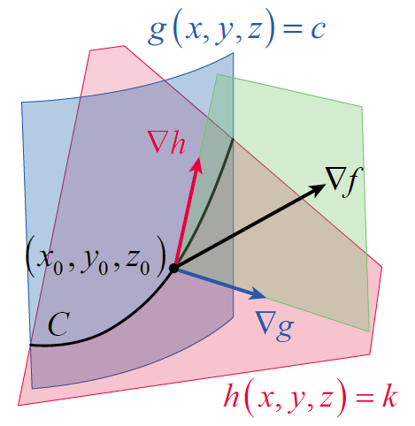
Lagrange Multipliers with Two Constraints
Lagrange’s method extends nicely to optimization problems with two constraints. Suppose we want to find the extreme values of f(x, y, z) under the side conditions that g(x, y, z) = c and h(x, y, z) = k. Assuming that g and h are differentiable and that ∇g and ∇h are not parallel, the points satisfying g(x, y, z) = c and h(x, y, z) = k lie along the intersection C of two surfaces, such as those shown in Figure 6.
Figure 6

Slide 29
Lagrange Multipliers with Two Constraints (cont.)
So we seek the extrema of f(x, y, z) under the constraint that (x, y, z) lies on C.
By the same reasoning as before, we know that if f has an extremum at (x₀, y₀, z₀), then ∇f is orthogonal to C at (x₀, y₀, z₀). We also know that ∇g(x₀, y₀, z₀) is orthogonal to g(x, y, z) = c and ∇h(x₀, y₀, z₀) is orthogonal to h(x, y, z) = k at the point (x₀, y₀, z₀), so ∇f(x₀, y₀, z₀) must lie in the same plane as ∇g(x₀, y₀, z₀) and ∇h(x₀, y₀, z₀).

Slide 30
Lagrange Multipliers with Two Constraints (cont.)
In other words, there must exist two real numbers λ and μ (again called Lagrange multipliers) such that We actually identify x₀ , y₀ , and z₀ by solving the following system of equations.

Slide 31
Example 5: Using the Method of Lagrange Multipliers with Two Constraints
Find the absolute extreme values of f(x, y, z) = x + y + z subject to the constraints x² + 2y² = 6 and 3x + 2y + 4z = 5.
Solution
Defining g(x, y, z) = x² + 2y² and h(x, y, z) = 3x + 2y + 4z, the constraints have the form g(x, y, z) = 6 and h(x, y, z) = 5.

Slide 32
Example 5: Using the Method of Lagrange Multipliers with Two Constraints (cont.)
Noting that and introducing two Lagrange multipliers λ and μ, we are led to the following system of equations.

Slide 33
Example 5: Using the Method of Lagrange Multipliers with Two Constraints (cont.)
The third equation gives us immediately and substituting this into the first and second equations results in and so λ x = λ y. It is easy to verify that λ = 0 is not part of a solution to the system, so we are left with x = y. Using this knowledge in the fourth equation leads to and the corresponding values for z, from the fifth equation, are then

Slide 34
Example 5: Using the Method of Lagrange Multipliers with Two Constraints (cont.)
Evaluating f at the two critical points, we obtain the following.

Slide 35
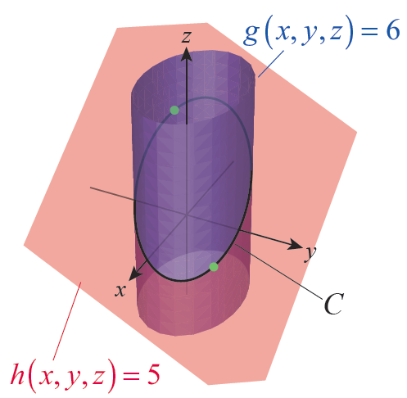
Example 5: Using the Method of Lagrange Multipliers with Two Constraints (cont.)
Figure 7 is an illustration of the two surfaces g(x, y, z) = 6 and h(x, y, z) = 5, their intersection C, and the locations of the absolute extreme values of f on C.
Figure 7

