Slide 1
Section 14.1
Double Integrals

Slide 2
Double Integrals
Chapter 5 introduced integrals of functions of a single variable over bounded intervals of ℝ; in this section, we extend the definition of integration to encompass double integrals over bounded regions of ℝ². Just as the integrals of Chapter 5 had geometric interpretations as signed areas, the double integrals of this chapter can be interpreted as signed volumes. And just as the Fundamental Theorem of Calculus allowed us to evaluate single integrals without taking limits of Riemann sums, we will learn similar techniques that greatly simplify the evaluation of double integrals.

Slide 3
Double Integrals and Riemann Sums
Recall that the formal definition of the integral is based on the limit of Riemann sums of the form
where is a partition of the
interval [a, b], and each is a sample point from the subinterval Each term in the sum represents the area of a rectangle of height and width so the Riemann sum is an approximation of the (signed) area between the graph of f(x) and the x-axis over the interval [a, b].

Slide 4
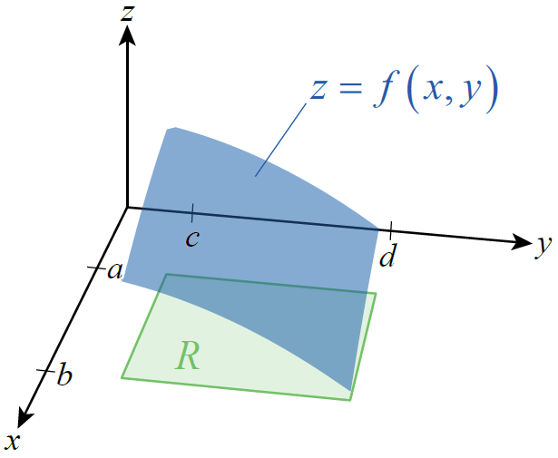
Double Integrals and Riemann Sums (cont.)
To extend this idea to a function f(x, y) defined on a region R ⊆ ℝ², we assume initially that R is a rectangle in the plane defined by a ≤ x ≤ b and c ≤ y ≤ d, which we write as [a, b] × [c, d]; Figure 1 is
an illustration of such a rectangle
and the graph of a surface z = f(x, y).
Figure 1

Slide 5
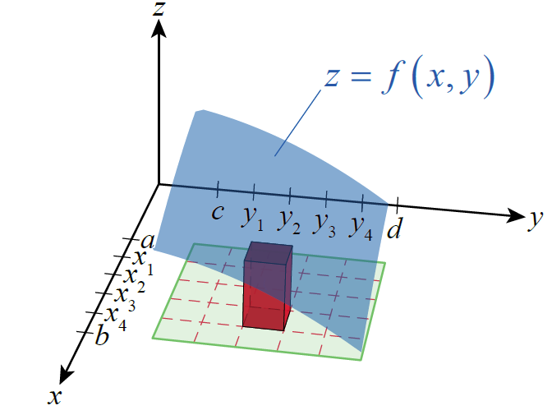
Double Integrals and Riemann Sums (cont.)
We can approximate the volume of the space between z = f(x, y) and the xy-plane over the region R by partitioning R into a grid of
rectangles and summing the
volumes of rectangular columns,
such as the one shown in Figure 2.
Figure 2

Slide 6
Double Integrals and Riemann Sums (cont.)
The height of each column is the value where is a sample point chosen from the subrectangle defined by and and the area of the base is ΔA = Δx_{i} Δy_{j}, where and So the volume of each column is and the sum of the volumes is expressed as

Slide 7
Double Integrals and Riemann Sums (cont.)
where is a partition of [a, b] and is a partition of [c, d]. The double sum above is an example of a Riemann sum of f(x, y) over the region R.

Slide 8
Double Integrals and Riemann Sums (cont.)
In order to refine our approximation of the true volume between z = f(x, y) and the plane over R, it is important that we consider Riemann sums for which goes to zero. We use the word
partition again to refer to the subdivision of R into subrectangles, and if P represents one particular partition, we define the norm of P by

Slide 9
Double Integrals and Riemann Sums (cont.)
If all double Riemann sums of the form above converge to a common value as we consider partitions of smaller and smaller norm, we define the double integral of f over R to be that common value. The formal definition follows.

Slide 10
Definition: Double Integral
Given a function f(x, y) defined on the region we define the double integral of f over R to be the value
provided the limit exists. If the limit exists, we say f is integrable over R, and define the signed volume between the surface z = f(x, y) and the xy‑plane over the region R to be the double integral.

Slide 11
Example 1: Using Riemann Sums to Estimate Volume under a Surface
Given the function and the region R defined by a = 1, and d = 2, the Riemann sum approximations corresponding to n = m = 5, 10, and 20 equal partitions of each interval are as shown in Figure 3.
The exact value of the double integral of f over R is
cubic units, and the difference between each Riemann sum and the exact value is listed below each graph. Each Riemann sum has been calculated (by computer, not by hand!) with the top‑right corner of each subrectangle.

Slide 12
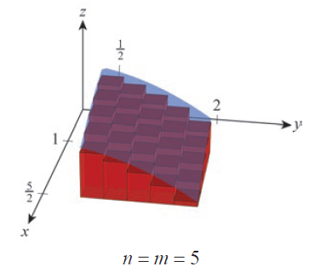
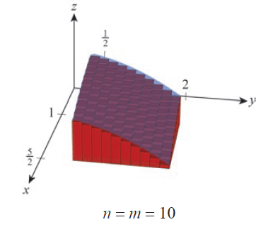
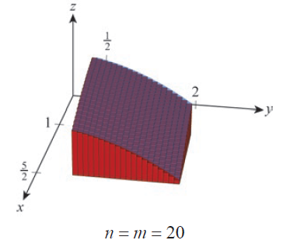
Example 1: Using Riemann Sums to Estimate Volume under a Surface (cont.)
Riemann sum
Difference from exact value = 2.97
Riemann sum
Difference from exact value ≈ 1.460
Riemann sum
Difference from exact value ≈ 0.724
Figure 3

Slide 13
Fubini’s Theorem
Clearly, we would prefer not to have to take limits of double Riemann sums to evaluate double integrals if there is an easier alternative. Further, while the approximations shown in Example 1 may make a fairly convincing argument that the Riemann sums converge to some value, there is nothing in the work presented to indicate that the value is

Slide 14
Fubini’s Theorem (cont.)
Fubini’s Theorem allows us to both avoid limits of Riemann sums and arrive at the exact value of a double integral, at least when we are able to find antiderivatives of the integrand as outlined below. It does so by reducing the task of evaluating a double integral to the task of evaluating two single integrals consecutively.

Slide 15
Fubini’s Theorem (cont.)
The theorem, the proof of which we only outline here, is based on the principle that the volume V of a solid is equal to the integral of its cross‑sectional areas over some interval. We first encountered this principle in Section 6.1 in the form and

Slide 16
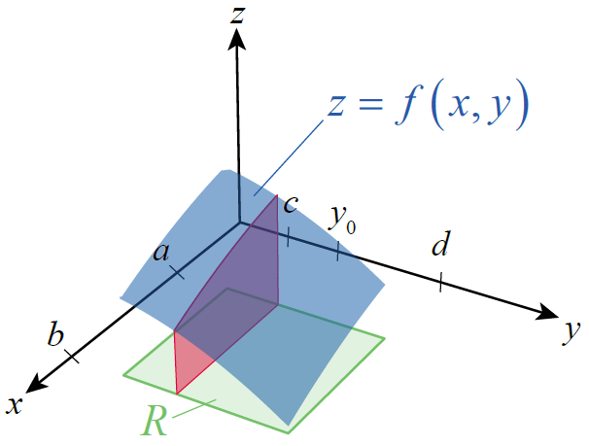
Fubini’s Theorem (cont.)
Consider again the solid bounded by the xy-plane and the surface z = f(x, y) over a region R, but this time with an eye toward its cross‑sectional slices perpendicular to the y-axis—one of them, through
the point y = y₀ , is shown in Figure 4.
Figure 4

Slide 17
Fubini’s Theorem (cont.)
Then the volume of the solid is
But each cross-sectional area A(y) corresponds to the area between a function of x and the xy-plane over the interval [a, b]; for instance,

Slide 18
Fubini’s Theorem (cont.)
Hence,
Such an integral is called an iterated or repeated integral, and Fubini’s Theorem specifies conditions under which its value is equal to the double integral

Slide 19
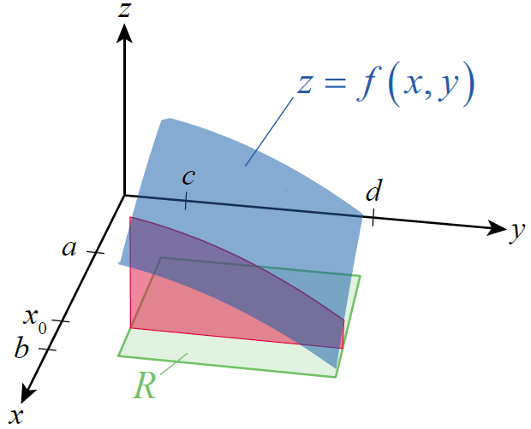
Fubini’s Theorem (cont.)
Before stating the theorem formally,
note that we could just as well
begin with cross‑sectional slices
perpendicular to the x-axis, as
shown in Figure 5, in which case
we arrive at the following result.
Figure 5

Slide 20
Theorem: Fubini’s Theorem
If f(x, y) is continuous on the region then

Slide 21
Example 2: Using Fubini’s Theorem to Evaluate a
Double Integral
Evaluate the double integral where
Solution
As Figure 6 indicates, the function takes on both positive and negative values on the region R (that is, part of the surface lies above the
xy-plane, and part below). This doesn’t affect the procedure for evaluating the double integral, but keep in mind that double integrals represent signed volume, and it is entirely possible for the result to be positive, negative, or zero.

Slide 22
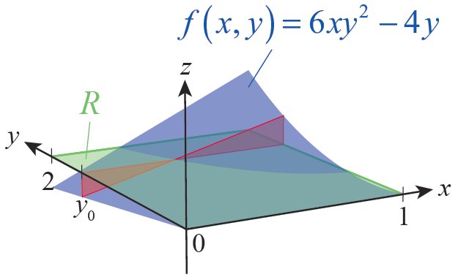
Example 2: Using Fubini’s Theorem to Evaluate a
Double Integral (cont.)
By Fubini’s Theorem,
To evaluate such an iterated integral, we first evaluate the inner integral by finding an antiderivative of the integrand with y held fixed—remember,
the inner integral represents a
cross-sectional area A(y), such
as shown in Figure 6, and y
doesn’t vary until we integrate
A(y) over [0, 2] in the outer integral.
Figure 6

Slide 23
Example 2: Using Fubini’s Theorem to Evaluate a
Double Integral (cont.)
In this respect, the evaluation of iterated integrals is much like partial differentiation, all but one of the variables is held fixed at each stage.

Slide 24
Example 2: Using Fubini’s Theorem to Evaluate a
Double Integral (cont.)
This result means that the volume between the xy-plane and the positive portion of z = 6xy² − 4y has the same magnitude (but opposite sign) as the volume between the xy-plane and the negative portion of the surface. The result is the same if we choose to work with the alternative iterated integral, though the intermediate steps differ.

Slide 25
Example 2: Using Fubini’s Theorem to Evaluate a
Double Integral (cont.)

Slide 26
Example 3: Using Fubini’s Theorem to Evaluate a
Double Integral
Evaluate the double integral where
Solution
By Fubini’s Theorem,

Slide 27
Example 3: Using Fubini’s Theorem to Evaluate a
Double Integral (cont.)
In Exercise 3 you will show that as well.

Slide 28
Double Integrals over General Bounded Regions
Further, Fubini’s Theorem extends to double integrals over these general regions, allowing us to evaluate them by iterated integration. In particular, the double integrals we need to evaluate can usually be expressed in one of the two forms shown below, where g₁(x), g₂(x), h₁(y), and h₂(y) all represent continuous functions defined on a bounded interval.

Slide 29
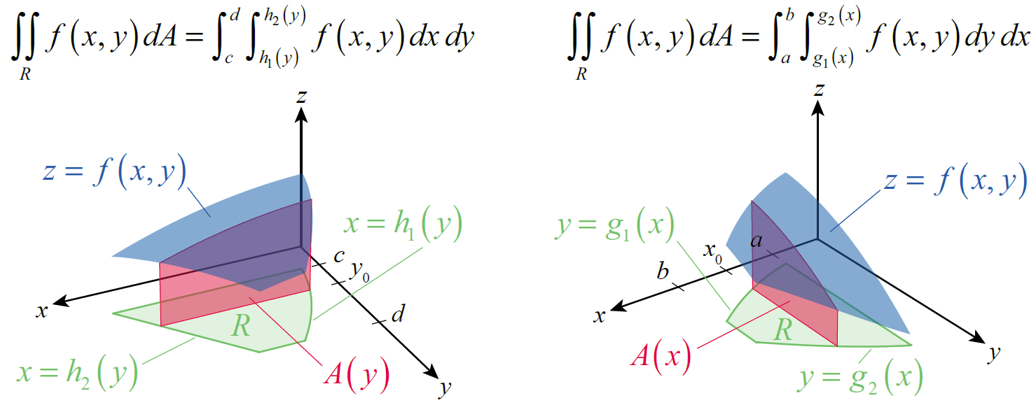
Double Integrals over General Bounded Regions (cont.)
Figure 8
Figure 9

Slide 30
Double Integrals over General Bounded Regions (cont.)
In Figure 8, the region R is defined by the inequalities and c ≤ y ≤ d, so each cross-sectional
area is given by and the volume
of the bounded solid by
The situation shown in Figure 9 is similar, except that each cross-sectional area is a function of x and the order of integration is reversed.

Slide 31
Example 4: Evaluating a Double Integral
Evaluate over the region R bounded between
y = 3x² and y = 2 + x².
Solution
The first step is to sketch the region R, if a sketch is not provided. We use the sketch to decide on the order of integration and to determine the limits of integration.

Slide 32
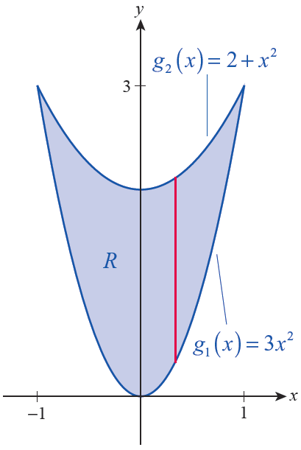
Example 4: Evaluating a Double Integral (cont.)
Figure 10 shows the two parabolas defined
by the boundary equations; note that the
curves intersect at
The shape of R guides us to set up the
iterated integral in the form
because we can easily define cross‑sections
through R (such as the one shown in red)
as line segments with lower bound g₁(x)
and upper bound g₂(x).
Figure 10

Slide 33
Example 4: Evaluating a Double Integral (cont.)
The alternative order of integration would lead to horizontal cross‑sections that are functions of y, and the left-hand and right-hand limits of the line segments would be much more cumbersome to define and use.
Note that, scanning from left to right, R is bounded by the limits x = −1 and x = 1. Putting the pieces together, we have the following.

Slide 34
Example 4: Evaluating a Double Integral (cont.)

Slide 35
Example 5: Evaluating a Double Integral
Evaluate the iterated integral
Solution
Since the iterated integral is already set up, there is nothing to stop us from trying to evaluate it immediately. Unfortunately, as we already know from Section 7.6, (sin x)/x has no simple antiderivative and the inner integral is nonelementary. We are stuck at the outset, unless we find a way to rewrite the problem.

Slide 36
Example 5: Evaluating a Double Integral (cont.)
Although the region R associated with this iterated integral was not explicitly defined for us, the limits of integration define it indirectly. Beginning with the inner integral, the left and right edges of the region are given by x = y and x = 1 (we know these are the left and right edges, as opposed to bottom and top, because they define limits of x). The outer integral defines the bottom and top edges of R as y = 0 and y = 1.

Slide 37
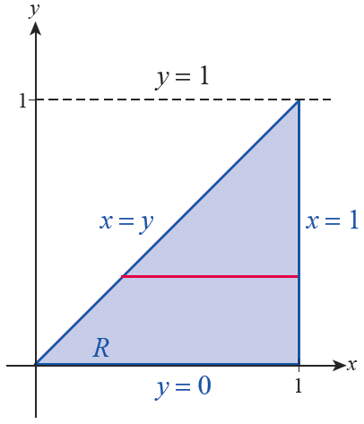
Example 5: Evaluating a Double Integral (cont.)
Graphing these four lines gives us
the region shown in Figure 11,
with the red horizontal line
segment representing a typical
cross-sectional slice defined by
the inner integral.
Figure 11

Slide 38
Example 5: Evaluating a Double Integral (cont.)
In some cases, a double integral may be nonelementary under one order of integration but readily evaluated under the alternative. We can’t change the region R over which we are integrating, but if we use vertical cross‑sections instead of horizontal, we can use Fubini’s Theorem to rewrite the original integral.

Slide 39
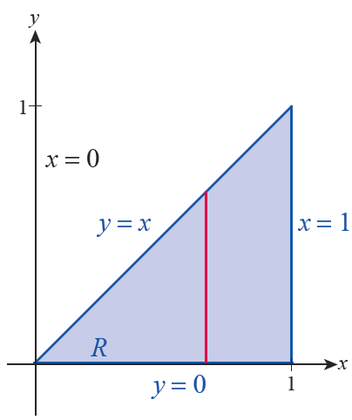
Example 5: Evaluating a Double Integral (cont.)
Figure 12 shows a representative
vertical cross‑section through R; note
that it begins at the lower limit of y = 0
and ends at the upper limit of y = x.
Figure 12

Slide 40
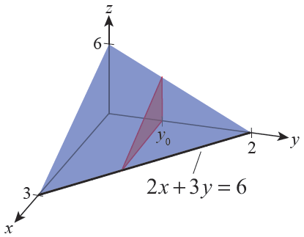
Example 6: Finding the Volume of a Tetrahedron
Find the volume of the tetrahedron bounded on three sides by the coordinate planes and on the fourth side by the plane 2x + 3y + z = 6.
Solution
The four planes bound a solid in the
first octant of ℝ³, as depicted in
Figure 13.
Figure 13

Slide 41
Example 6: Finding the Volume of a Tetrahedron (cont.)
We can determine its volume by integrating the function over a region R in the xy-plane. We determine R by setting z = 0 in the equation 2x + 3y + z = 6, resulting in the line 2x + 3y = 6.
We could use cross‑sections in either direction to evaluate the double integral; using horizontal cross‑sections, as shown in the figure 13, we obtain the following volume.

Slide 42
Example 6: Finding the Volume of a Tetrahedron (cont.)

Slide 43
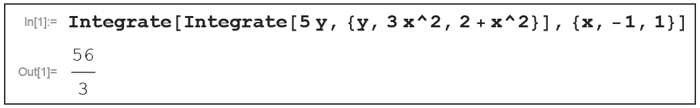
Technology Note: Evaluating a Double Integral
A computer algebra system can be used to evaluate double as well as single integrals. The syntax varies with the software, but the form usually reflects the fact that iterated integration is “an integral of an integral.” For instance, one way to use Mathematica to evaluate the integral of Example 4 is shown in Figure 14.
Figure 14

Slide 44
Theorem: Properties of Double Integrals
Assume that f(x, y) and g(x, y) are continuous, that k is a constant, and that R₁ and R₂ are two regions with at most boundary points in common. Assume also that all the integrals below exist. Then the following properties hold.
Constant Multiple Property
Sum/Difference Property

Slide 45
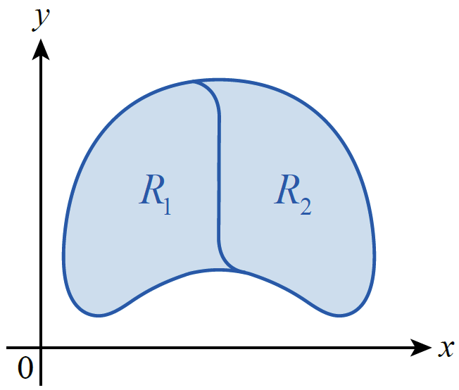
Theorem: Properties of Double Integrals (cont.)
Domination Property
Disjoint Region Property
(see Figure 15)
Figure 15 Disjoint Regions

