Slide 1
Section 14.2
Applications of Double Integrals

Slide 2
Area by Double Integration
In Section 5.5, we illustrated the underlying philosophy of integration with the observation that the area A of a planar region R can be found by integrating together all of the area differential elements dA over R—this informal statement was made precise with the formula

Slide 3
Area by Double Integration (cont.)
In that and later sections, we then expressed dA in terms of a function A′(x) multiplied by a differential dx so that we could integrate over an interval, the only option available to us at the time. Using double integration, the same philosophical idea takes the form

Slide 4
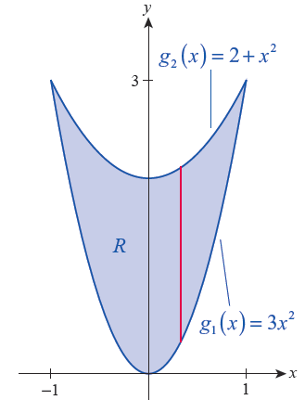
Example 1: Using a Double Integral to Find the Area between Two Parabolas
Find the area of the region R bounded between the parabolas y = 3x² and y = 2 + x².
Solution
We encountered this region in
Example 4 of Section 14.1; but in this
problem, we seek the area of R.
Referring to Figure 1, and using
vertical slices through R, its area is
as follows.
Figure 1

Slide 5
Example 1: Using a Double Integral to Find the Area between Two Parabolas (cont.)

Slide 6
Area by Double Integration (cont.)
Given our work in Section 14.1, could also be
interpreted as the volume of the solid between the xy‑plane and the surface f(x, y) = 1 over the region R—in other words, the volume of a right cylinder of height 1 and base R. Since the volume of such a cylinder is 1 × Area (R), we have the following.

Slide 7
Area by Double Integration (cont.)
Now imagine an empty tank in the shape of a right cylinder with base R and indefinite height, which we proceed to fill with a given volume V of water. Then V = h × Area (R), where h is the ultimate height of the water in the tank. If the surface of the water is now pushed down in some areas, it must rise in other areas in order to maintain constant volume.

Slide 8
Area by Double Integration (cont.)
At any given moment in time, the surface of the water represents the graph of a function f(x, y) and the volume of the solid bounded by the xy-plane and
z = f(x, y) over R is Since the volume of
water never changes, it must be the case that

Slide 9
Area by Double Integration (cont.)
We use this observation to define the average value of f over R to be h, which also makes sense if h is negative (although its interpretation as the height of the water does not have any physical meaning in this case). Formally,
Note the similarity between this definition and that of the average value of a function f(x) over an interval
a, b , namely (Section 5.2).

Slide 10
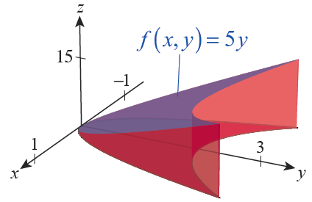
Example 2: Finding the Average Value of a Function over a Region
Find the average value of f(x, y) = 5y over the region R of Example 1.
Figure 2

Slide 11
Example 2: Finding the Average Value of a Function over a Region (cont.)
Solution
In example 4 of Section 14.1, we determined that
and we have just calculated so the average height of the solid bounded between the xy-plane and the graph of z = 5y over R, depicted in Figure 2, is

Slide 12
Definition: First Moments about the Axes, Mass, and Center of Mass of a Planar Object
Given a planar object modeled by the region R in the xy-plane, and whose density is represented by ρ(x, y), its first moments M_{x} and M_{y} about the coordinate axes, its mass M, and its center of mass are as follows, assuming the integrals exist.

Slide 13
Definition: First Moments about the Axes, Mass, and Center of Mass of a Planar Object (cont.)
First moment about the x-axis
First moment about the y-axis
Mass
Center of mass

Slide 14
Example 3: Finding the Center of Mass of a Plate of Varying Density
Find the center of mass of the triangular plate bounded by y = 0, x = 1, and y = x if the density of the plate at the point (x, y) is given by ρ(x, y) = x² + y.
Solution
In order to develop an intuitive sense of how such a plate behaves, note that the density is very low near the origin (in fact, ρ(0, 0) = 0) and increases as x and y increase; however, the plate’s density grows faster as x increases than it does as y increases.

Slide 15
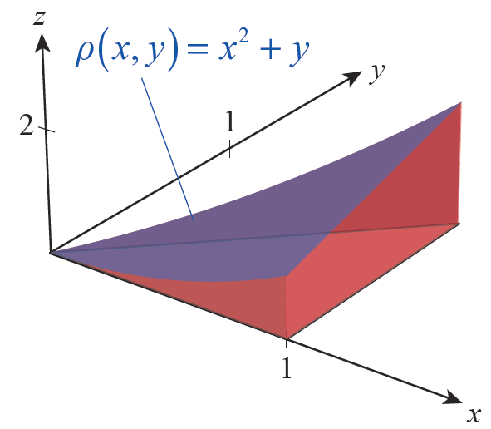
Example 3: Finding the Center of Mass of a Plate of Varying Density (cont.)
One way in which a plate might have a density function ρ(x, y) = x² + y is if its thickness is defined by ρ, as shown in Figure 4. Try to
imagine where such a plate
will balance before we
actually calculate the center
of mass, as follows.
Figure 4

Slide 16
Example 3: Finding the Center of Mass of a Plate of Varying Density (cont.)

Slide 17
Example 3: Finding the Center of Mass of a Plate of Varying Density (cont.)
So we obtain

Slide 18
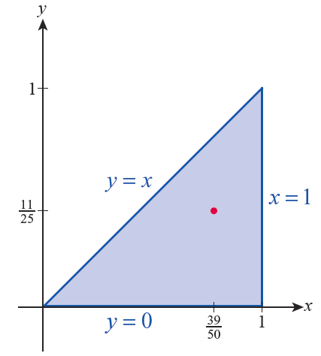
Example 3: Finding the Center of Mass of a Plate of Varying Density (cont.)
The center of mass is shown in Figure 5.
Figure 5

Slide 19
Second Moments
While an object’s first moment reflects the point of balance of its static mass with respect to a given axis, its second moment, also called its moment of inertia, contains information about the kinetic energy the object possesses if it rotates about the axis.

Slide 20
Definition: Second Moments and Radii of Gyration of a Planar Object
Given a planar object modeled by the region R in the xy-plane, and whose density is represented by ρ(x, y), its second moments I_{x} , I_{y} , and I₀ and its corresponding radii of gyration are as follows, assuming the integrals exist.
Second moment about the x-axis

Slide 21
Definition: Second Moments and Radii of Gyration of a Planar Object (cont.)
Second moment about the y-axis
Second moment about the origin
Mass
Radii of gyration

Slide 22
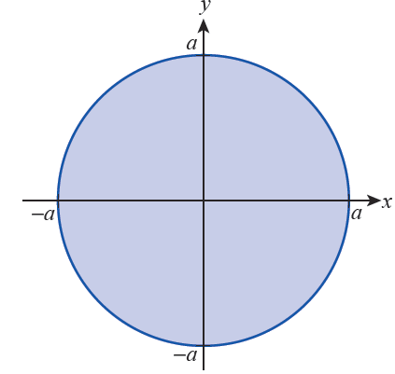
Example 4: Finding Second Moments of a Disk
Determine I_{x} , I_{y} , and I₀ for a disk of radius a and constant density ρ centered at the origin of the xy­plane. Then find its three radii of gyration.
Solution
The disk in question is depicted
in Figure 6, and referring to the
figure we set up the four
integrals that follow.
Figure 6

Slide 23
Example 4: Finding Second Moments of a Disk (cont.)

Slide 24
Example 4: Finding Second Moments of a Disk (cont.)
The techniques of integration learned in Chapter 7 allow us to evaluate I_{x} , as follows.

Slide 25
Example 4: Finding Second Moments of a Disk (cont.)
Similar techniques can be used to evaluate I_{y} , as written, but we obtain the result faster by changing the order of integration (as learned in Section 14.1) and noting that I_{y} = I_{x}.

Slide 26
Example 4: Finding Second Moments of a Disk (cont.)
The third moment of inertia comes quickly.
Without doing any integration, we know the mass of the disk is M = 𝜋a²ρ, so the three radii of gyration are

Slide 27
Example 4: Finding Second Moments of a Disk (cont.)
Remember the physical interpretation of these results: a point with the same mass as the disk, but located
units from the x-axis, would have the same second moment if spun about the x-axis, with a similar meaning for r_{y}, while the same point would have to be located units from the origin for its second moment to be the same as that of the disk about the origin.

Slide 28
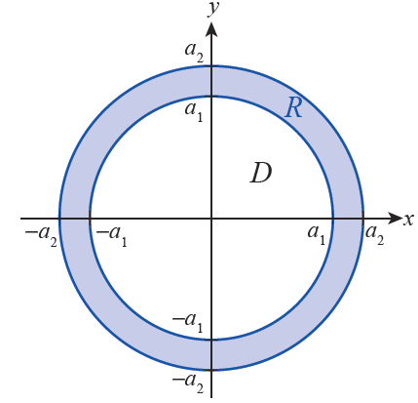
Example 5: Finding the Moment of Inertia about the Origin of an Annulus
Suppose the annulus shown in Figure 7 represents a planar object with total mass M. Determine its moment of inertia about the origin.
Figure 7 An Annulus Centered at the Origin

Slide 29
Example 5: Finding the Moment of Inertia about the Origin of an Annulus (cont.)
Solution
The properties of integrals (double or single) mean that the moments of inertia of pieces of an object can be added in order to find the moment of inertia of the whole; in physics and engineering texts, this is often referred to as the Principle of Superposition. This applies whether we find it useful to decompose an object into overlapping pieces of different masses or, as in this case, to decompose a region into a union of essentially disjoint regions (regions that only intersect at their boundaries, if at all).

Slide 30
Example 5: Finding the Moment of Inertia about the Origin of an Annulus (cont.)
Recall from Example 4 that, for a disk of radius a and constant density ρ, So if we let D represent the solid disk centered at the origin of radius a₁ and R the annulus in question, and if we imagine that the region R ∪ D is a single disk of material with constant density ρ, then

Slide 31
Example 5: Finding the Moment of Inertia about the Origin of an Annulus (cont.)
so

Slide 32
Example 5: Finding the Moment of Inertia about the Origin of an Annulus (cont.)
Physically, the factor represents the mass of the solid disk of radius a₂ minus the mass of the solid disk of radius a₁, so and the moment of inertia of the annular object about the origin is thus

Slide 33
Example 6: Finding Second Moments and Radii of Gyration of a Plate of Constant Density
Given a fixed positive number s, determine I_{x} , I_{y} , and I₀ for the square [0, s] × [0, s] of constant density ρ. Then find its three radii of gyration.
Solution
The three second moments for this object are readily calculated.

Slide 34
Example 6: Finding Second Moments and Radii of Gyration of a Plate of Constant Density (cont.)
Since the mass of the square is M = ρs², this tells us

